Slide 1
First Flight of the EUV Snapshot Imaging Spectrograph (ESIS)
Charles Kankelborg, Jacob Parker, Roy Smart, Hans Courrier
Montana State University
Amy Winebarger, Ken Kobayashi, Laurel Rachmeler
NASA Marshall Space Flight Center

Slide 2
Abstract
The solar atmosphere is highly dynamic and morphologically complex. Solar transient phenomena such as flares, eruptions, and explosive events evolve on time scales too fast to be covered effectively by slit spectrograph rasters. The EUV Snapshot Imaging Spectrograph (ESIS) is a new suborbital rocket-borne slitless spectrograph that collects four simultaneous images (expandable to six), each formed by a grating with its dispersion oriented at a different angle. The purpose of this arrangement is to collect enough data in a single exposure to infer spectral line profiles across a large, 2D field of view. We report on the first flight of ESIS, observing O V (63.0 nm) and Mg X (61.0, 62.5 nm) for about five minutes during solar minimum. Also included in the rocket experiment for its third flight is the Multi-Order Solar EUV Spectrograph (MOSES), the predecessor of ESIS. In its current configuration, MOSES images Ne VII (46.5 nm) in three spectral orders from a single objective grating. We present the combined observations from MOSES and ESIS, covering the solar atmosphere from transition region to corona.

Slide 3
EUV Snapshot Imaging Spectrograph
(ESIS) Rocket
NASA Sounding Rocket mission
Collaboration between MSU (Kankelborg; optics) and MSFC (Winebarger; detectors, electronics)
Launched successfully September 30, 2019
Pointed to disk center (the Sun was very quiet!).
Heritage: MOSES sounding rocket (2006, 2015)
Slitless imaging spectrograph (“overlappograph”, like Skylab S082A, but with multiple channels).
See Amy Winebarger’s talk, directly after this one, on the COOL-AID rocket overlappograph.

Slide 4
ESIS Instrument
Slitless spectrograph with 4 channels (expandable to 6), each with differing dispersion direction.
Spectral resolution: 12 km/s per pixel

Slide 5
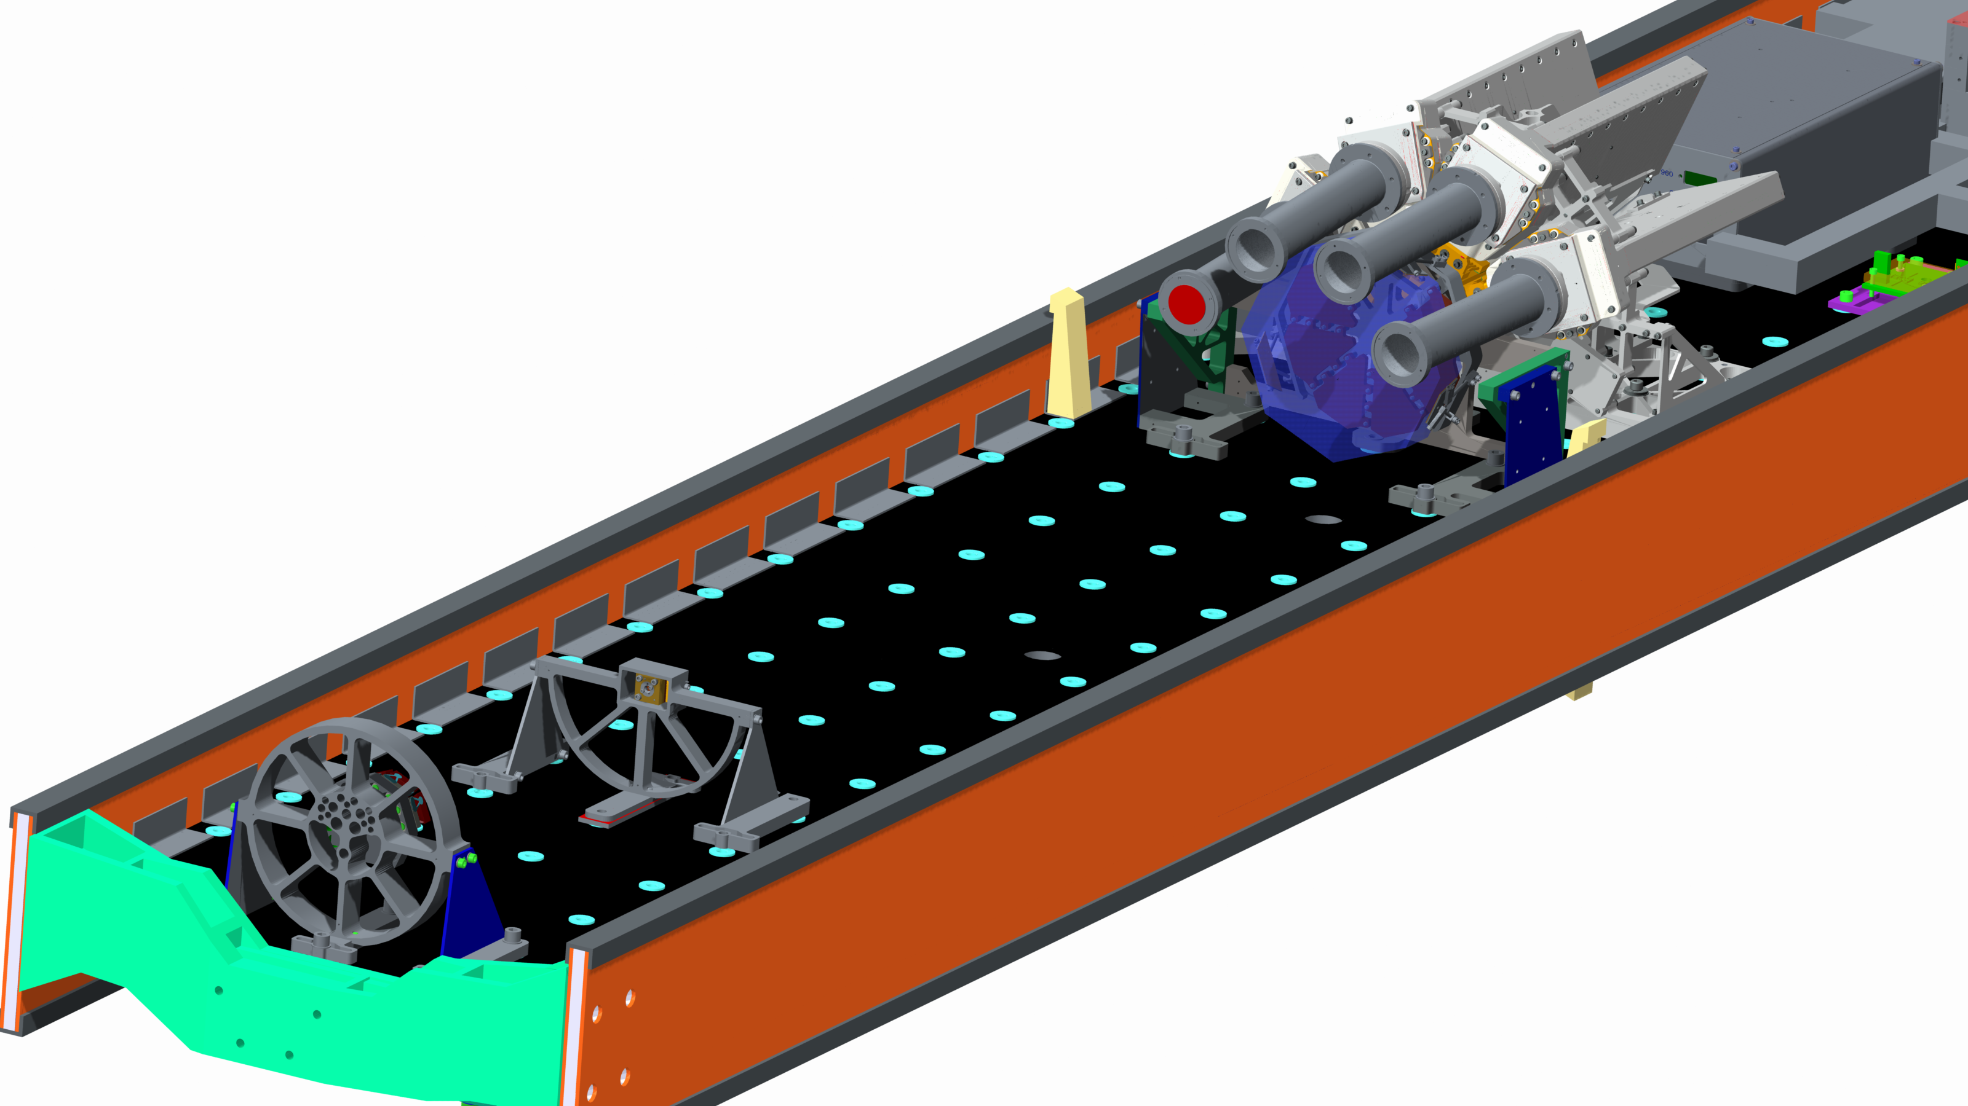
Instrument
5. detectors
4. filters
1. primary
2. field stop
3. grating array

Slide 6
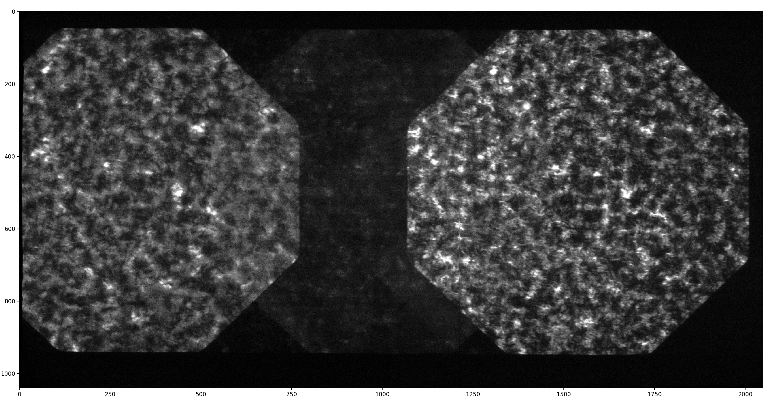
Level 1 Data (Ch 1)
Movie credit: Jacob Parker
11’
FOV
He I
58.43 nm
O III
59.97 nm
Mg X
60.98 nm
Mg X
62.49
O V
62.97 nm

Slide 7
4 ESIS channels
Ch 2
Ch 3
Ch 1
solar north
Ch 4
dispersion

Slide 8
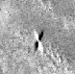

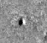
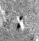
Example Events (O V, Ch 2 – Ch 3)
2
4
Ch2
Ch3
Dispersion (+λ)
Explosive Events
3
1
Blue-Shifted Jet
Failed Mini-Filament Eruption?

Slide 9
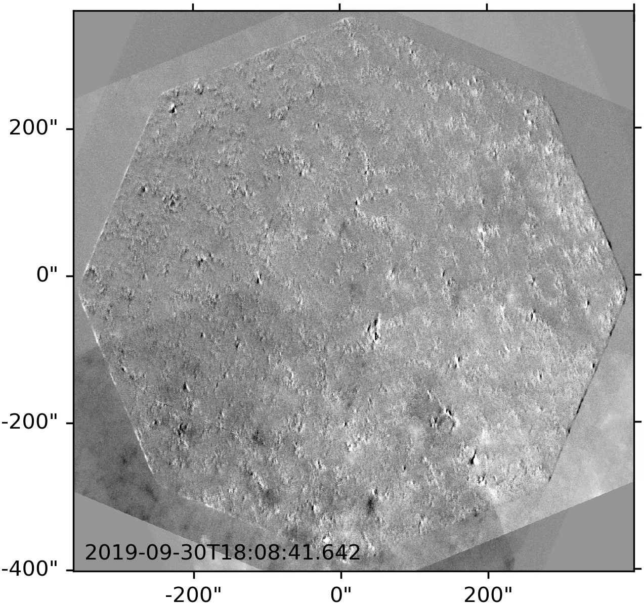
Dozens of events
(O V, Ch 2 – Ch 3)
Movie credit: Jacob Parker
1
Ch2
Ch3
4
2
3
Dispersion (+λ)

Slide 10
Analysis Tasks
Level 1: data reduction, despiking (preliminary product)
Level 2: distortion mapping (in progress)
Level 3: co-aligned frames in solar coordinates (preliminary product)
Forward Model: (x, y, λ) cube → L2 (in progress)
Inversions (preliminary MART algorithm coded; Neural Network in progress)
True
NN Inversion
Residuals
Neural Network inversion of synthetic MOSES data (credit: Roy Smart)

Slide 11
Summary
ESIS had a successful flight.
The images cover an 11’ field of view, at 10 s cadence, without rastering.
We observe in O V, Mg X, O III and He I.
We can measure Doppler shifts and broadenings in explosive events, blue shifted jets, and more complicated dynamic objects.
Data analysis is nontrivial, but we are making good progress.
MOSES (Ne VII, 46.5 nm) also flew on this mission. Shutter failed, no data.
We gratefully acknowledge the support of NASA HTIDS, grant NNX14AK71G. Smart is supported by NASA NESSF, grant 80NSSC17K0524.

Slide 12
MSU Rocket-Related Posters at AGU
Jacob Parker SH31C-3320 “A Preliminary Study of the Data From the ESIS/MOSES III Sounding Rocket Flight and Coordinating Observatories”
Roy Smart SH31C-3321 “A Neural Network-based Data Analysis Technique for the EUV Snapshot Imaging Spectrograph”
Catharine Bunn SH31C-3324 “The Signature of Explosive Events in the FUV Spectrum of the Sun as a Star”

