Slide 1
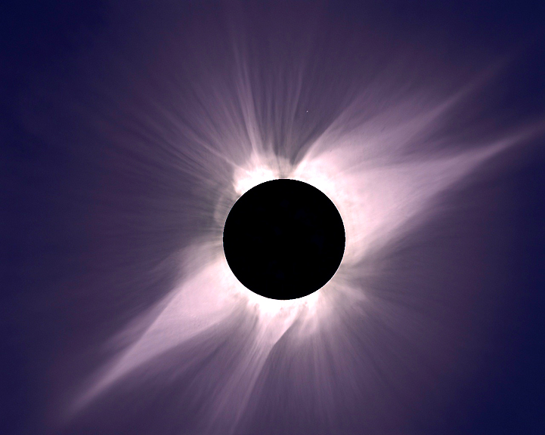

Coronal Hole tracking
David Stauffer
Chris Lowder
Steve Albers, Dennis di Cicco, and Gary Emerson

Slide 2
Motivation
How are coronal holes shaped by magnetic fields?
Are daily hmi-updated synoptic magnetic charts more accurate than the full rotation hmi charts for this purpose?
Can we consistently track how a coronal hole’s boundary evolves over multiple rotations?
How do changes in coronal hole boundaries encompass new flux?

Slide 3
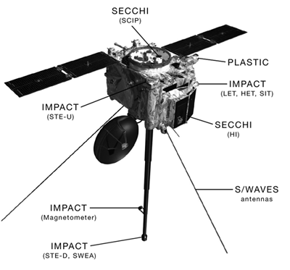
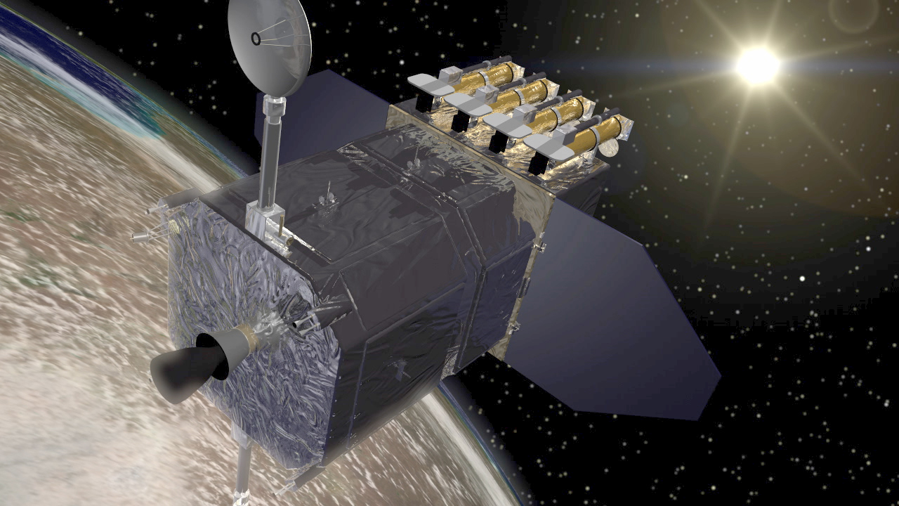
Data Sources
Solar Dynamics Observatory (SDO) – Atmospheric Imaging Assembly (AIA) and Helioseismic and Magnetic Imager (HMI)
STEREO A and B Satellites – Sun Earth Connection Coronal and Heliospheric Investigation (SECCHI)
STEREO
AIA

Slide 4
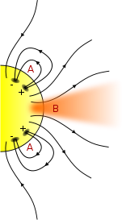
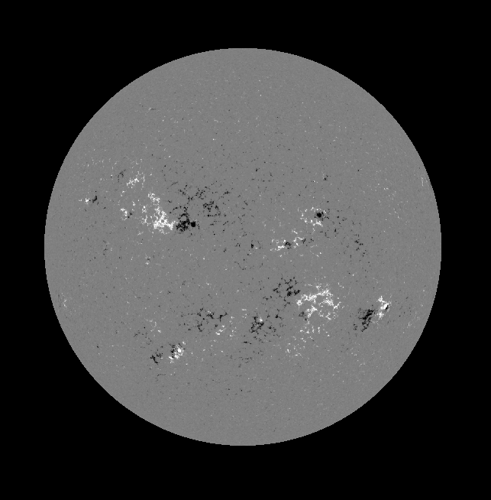
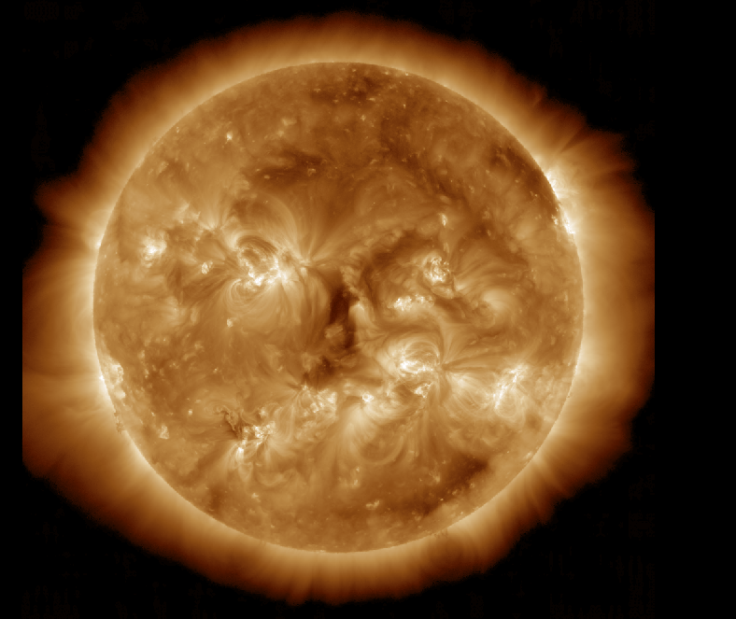
Coronal Holes and Magnetic Field Lines
AIA
HMI
http://en.wikipedia.org/wiki/File:Coronal_Hole_Magnetic_Field_Lines.svg
JHelioviewer, August 5

Slide 5
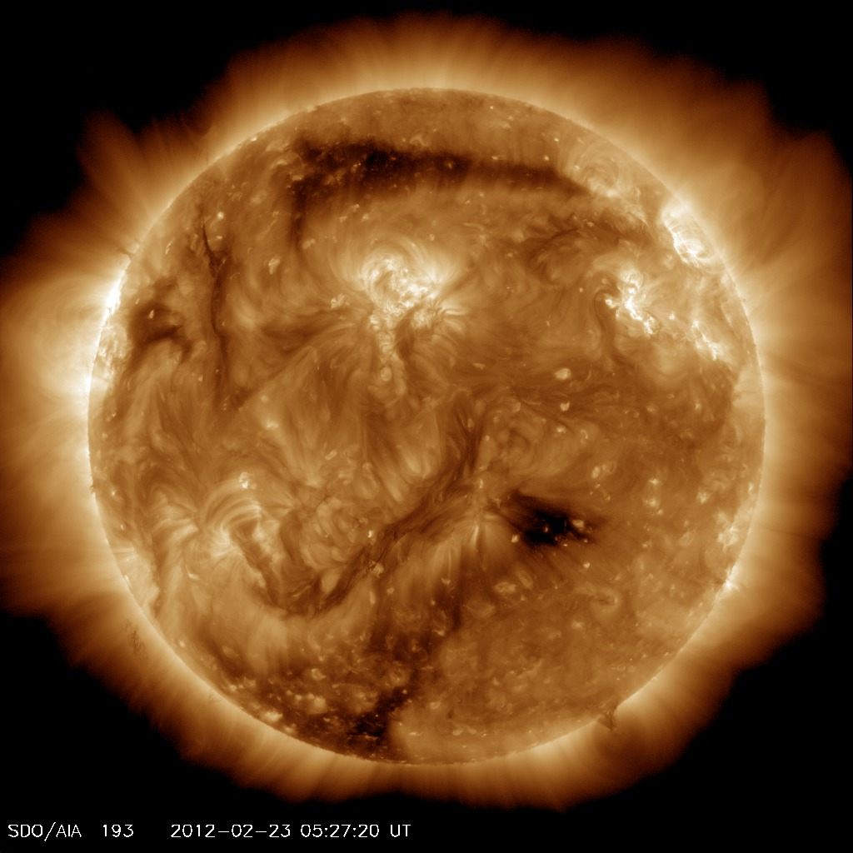
Procedure
Download data
Identify coronal holes (vs. filament channels)
Track specific hole
Measure positive and negative flux through hole from HMI synoptic charts:
  daily and monthly

Slide 6
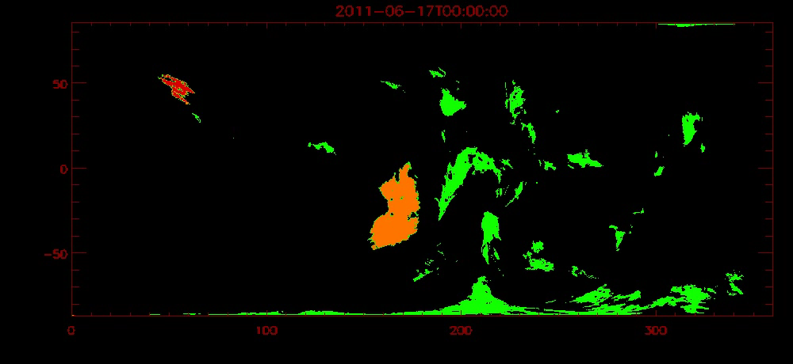
Tracking Coronal Holes
Notes:
Ugliest color scheme ever?

Slide 7
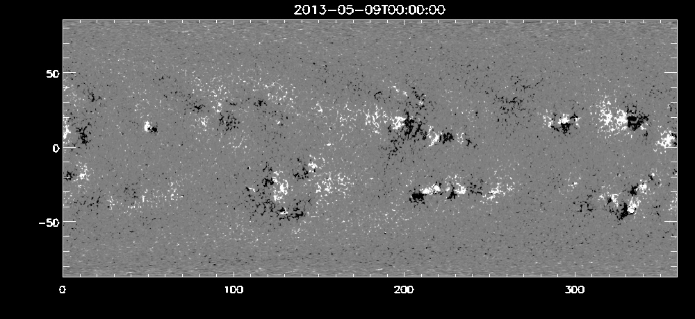
Flux Calculation

Slide 8
Comparison of Daily and Monthly Synoptic Charts

Slide 9
Flux Results – 2013/5/9-2013/6/25

Slide 11
Conclusions
How are coronal holes shaped by magnetic fields?
  No further clarification.
Are daily hmi-updated synoptic magnetic charts more accurate than the full rotation hmi charts for this purpose?
  Yes - alignment with AIA view emphasizes this
Can we consistently track how a coronal hole’s boundary evolves over multiple rotations?
  Mostly – lose image on limbs
How do changes in coronal hole boundaries encompass new flux?
  General increase, plateau and decline

Slide 12
Flux Results – 2011/6/17-2011/8/23

Slide 14
Flux Results – 2011/6/17-2011/7/12

