Slide 1
Filament Chirality over an Entire Cycle Determined with an Automated Detection Module -- a Neat Surprise
Piet Martens and Karthik Pillai – MSU
Anthony Yeates – Durham University
Duncan Mackay – St Andrews
Notes:
Selling your ideas is challenging. First, you must get your listeners to agree with you in principle. Then, you must move them to action. Use the Dale Carnegie Training® Evidence – Action – Benefit formula, and you will deliver a motivational, action-oriented presentation.

Slide 2
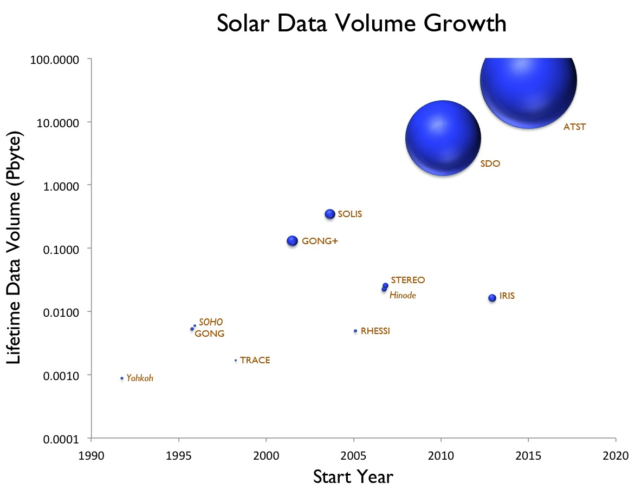
The Peta-byte Challenge
Figure courtesy of Joe Gurman
Note that the ordinate is in logarithmic units.
The radius of the blue balloons is the logarithm of the downlink rate.

Slide 3
SDO Computer Vision Project
Project URL: http://solar.physics.montana.edu/sol_phys/fft/
Paper: Martens et al. Sol. Phys. 2012
Overview: SDO Feature Finding Team (FFT) has produced 16 software modules that detect, analyze, and track solar features and events, most in near real time (“pipeline”)
Why? 1) SDO data stream is overwhelming. 2) Solar Physics will benefit by moving from the analysis of single events to the statistical analysis of sets of events and features.
Who? International team, seven institutions in the US, five in Europe, data center at SAO, PI at MSU.
How? Separate, robust and efficient software modules, standardized interface protocols
Output: FFT delivers metadata: real-time space weather alerts, VOEvent formatted catalogs and annotated images, available on-line via the Heliophysics Events Knowledgebase (HEK) at LMSAL and the Virtual Solar Observatory (VSO)

Slide 4
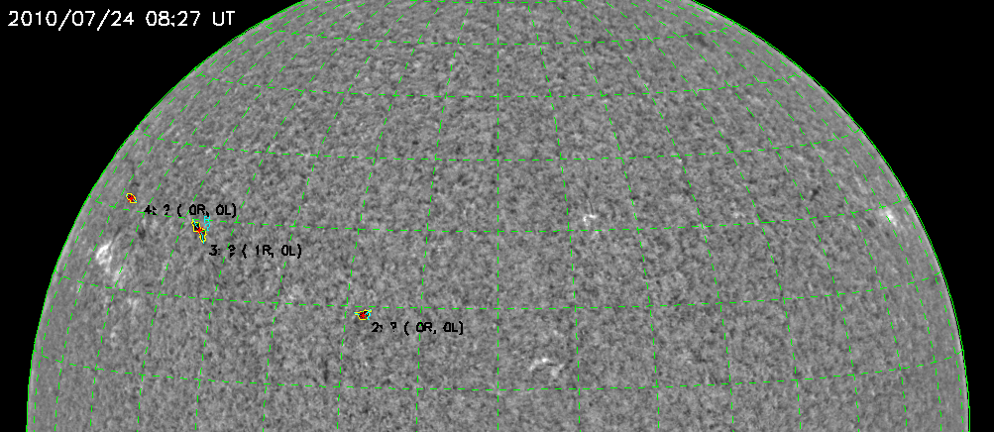
Filament Tracking (Bernasconi)
Automated tracking of the origin, evolution, and disappearance (eruption) of all filaments. Outlines contours, determines chirality, tracks individual filaments, handles mergers and splitting.
)

Slide 5
This Presentation
An overview of the first results from the filament and sigmoid detection modules
A review of the first scientific results obtained by those.
Comparison of these results with recent, also surprising, simulation results by Yeates & Mackay (2012)

Slide 6
Barb Bearing in Filaments
Left-bearing Filament Right-bearing Filament
Spine
Barb
Key Points:
Bearing is independent of start point of spine
Filament Bearing can be determined from Hα image alone; no need for magnetogram

Slide 7
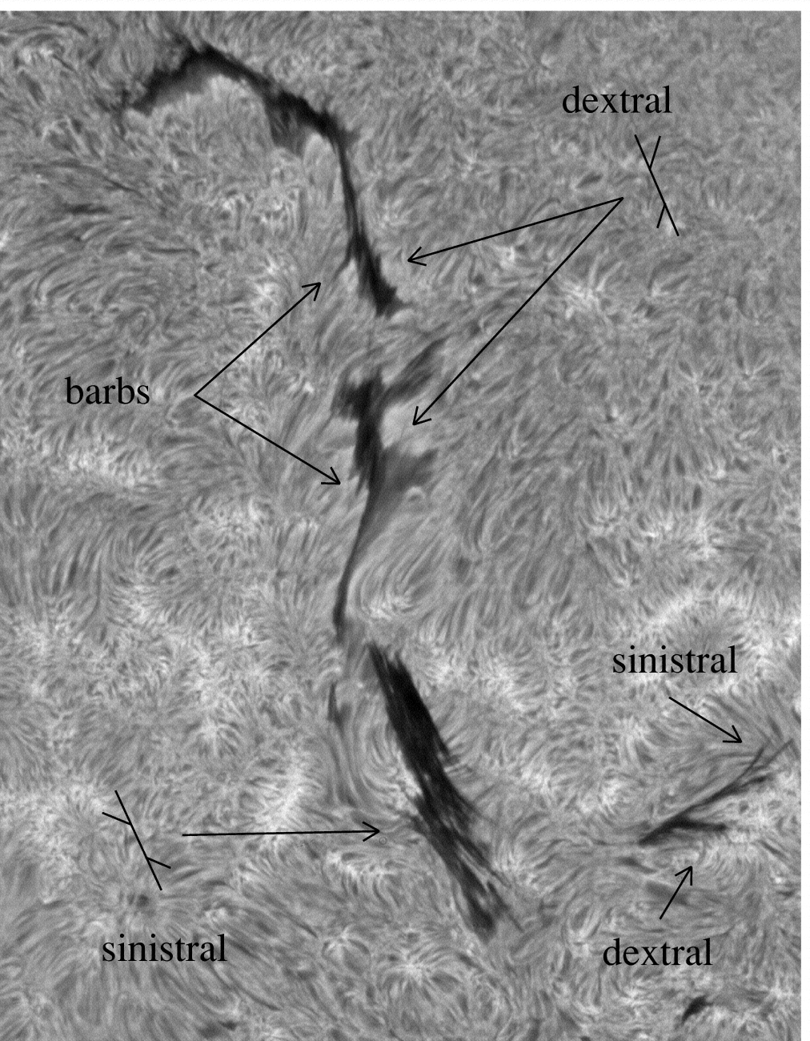
Barb Bearing and Filament Chirality
Bernasconi’s filament detection module determines filament bearing in about 50% of the cases (rest undetermined)
Past observations (Martin et al.) have shown that barb bearing indicates filament chirality: right-bearing = dextral chirality and left-bearing =sinistral.

Slide 8
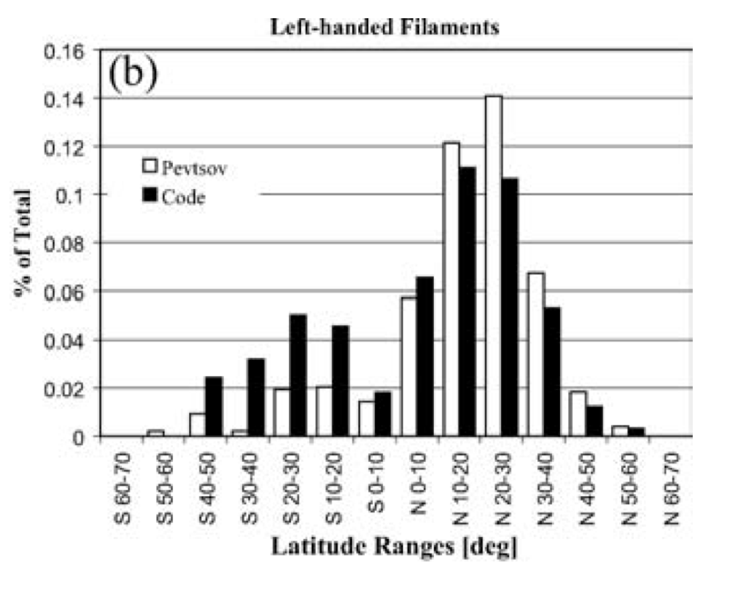
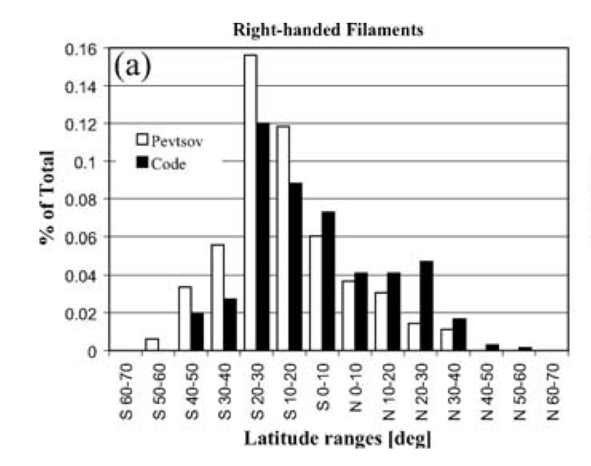
Chirality Results for Early Cycle 23
Manual determination of chirality by Pevtsov et al (2003) for the period July 15, 2000 to June 22, 2002. Result: dextral preference (= left-handed twist) in northern hemisphere and v.v.
Automated detection by Bernasconi
et al (2005) confirmed this result.
Note: Chirality pattern does not change per cycle. Same pattern in Cycle 22 (Martin et al 1994).

Slide 9
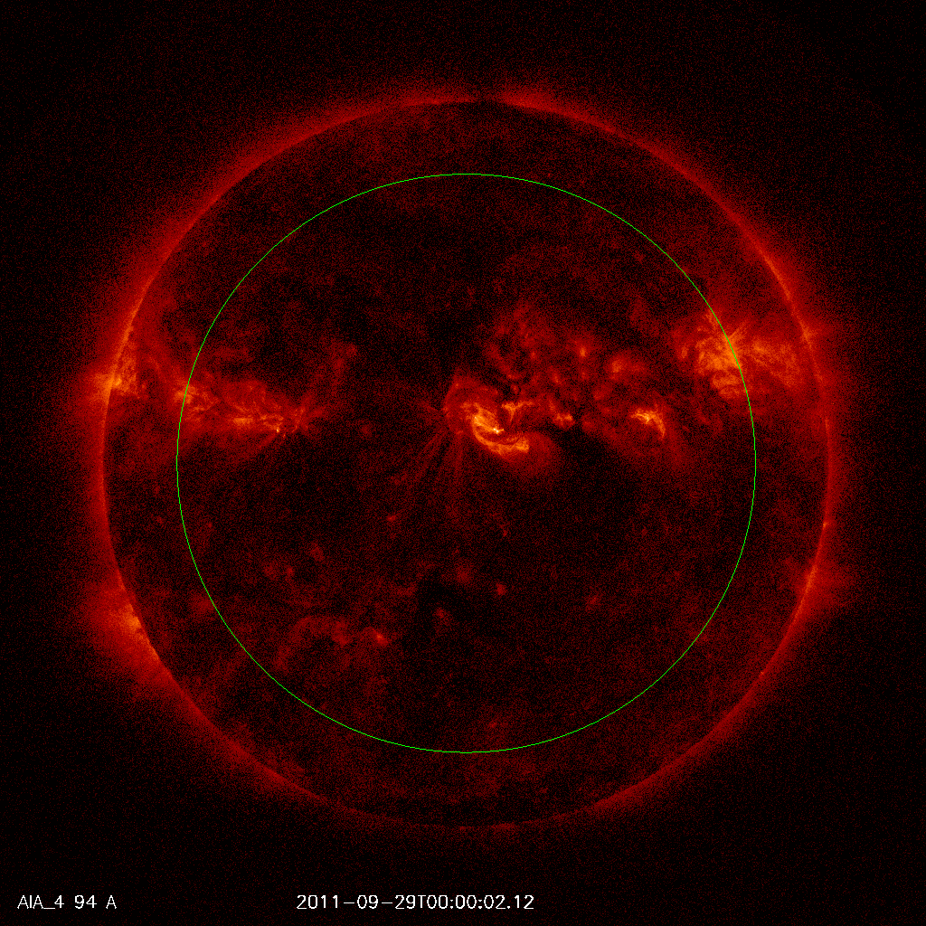
Sigmoid Sniffer (Georgoulis, Raouafi)
Sigmoids detected with the sigmoid sniffer in AIA 94 A. The FFT sigmoid sniffer is set up for both XRT and AIA images.
The sigmoid sniffer also detects the handedness of the sigmoid: “S” or “Z”.
Green circle indicates detection limit.

Slide 10
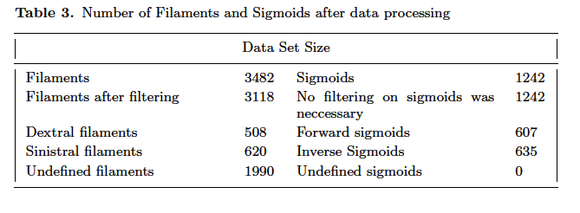
Filament and Sigmoid Measurements
Automated Detection: October 2010 – February 2011
Note: Large number of undefined filaments, which turns out to be typical for solar minimum

Slide 11
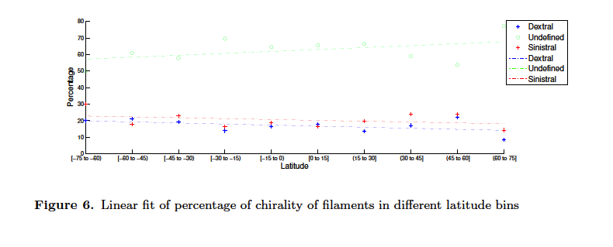
Result: Filament Chirality Rule Disappears

Slide 12
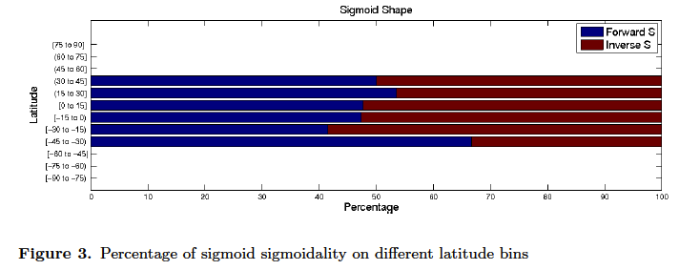
Result: Sigmoid Handedness Rule Disappears

Slide 13
Result: Filament and Sigmoid Helicity Still Correlate
How to reconcile this with observations earlier in the cycle?

Slide 14
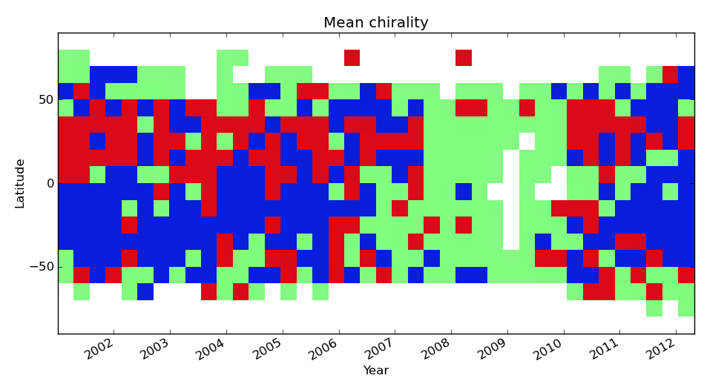
Result: Filament Chirality over Cycle 23
“Mean” chirality per time-latitude box for the entire cycle 23: the pattern changes!
The pattern has not (yet?) been re-established for Cycle 24

Slide 15
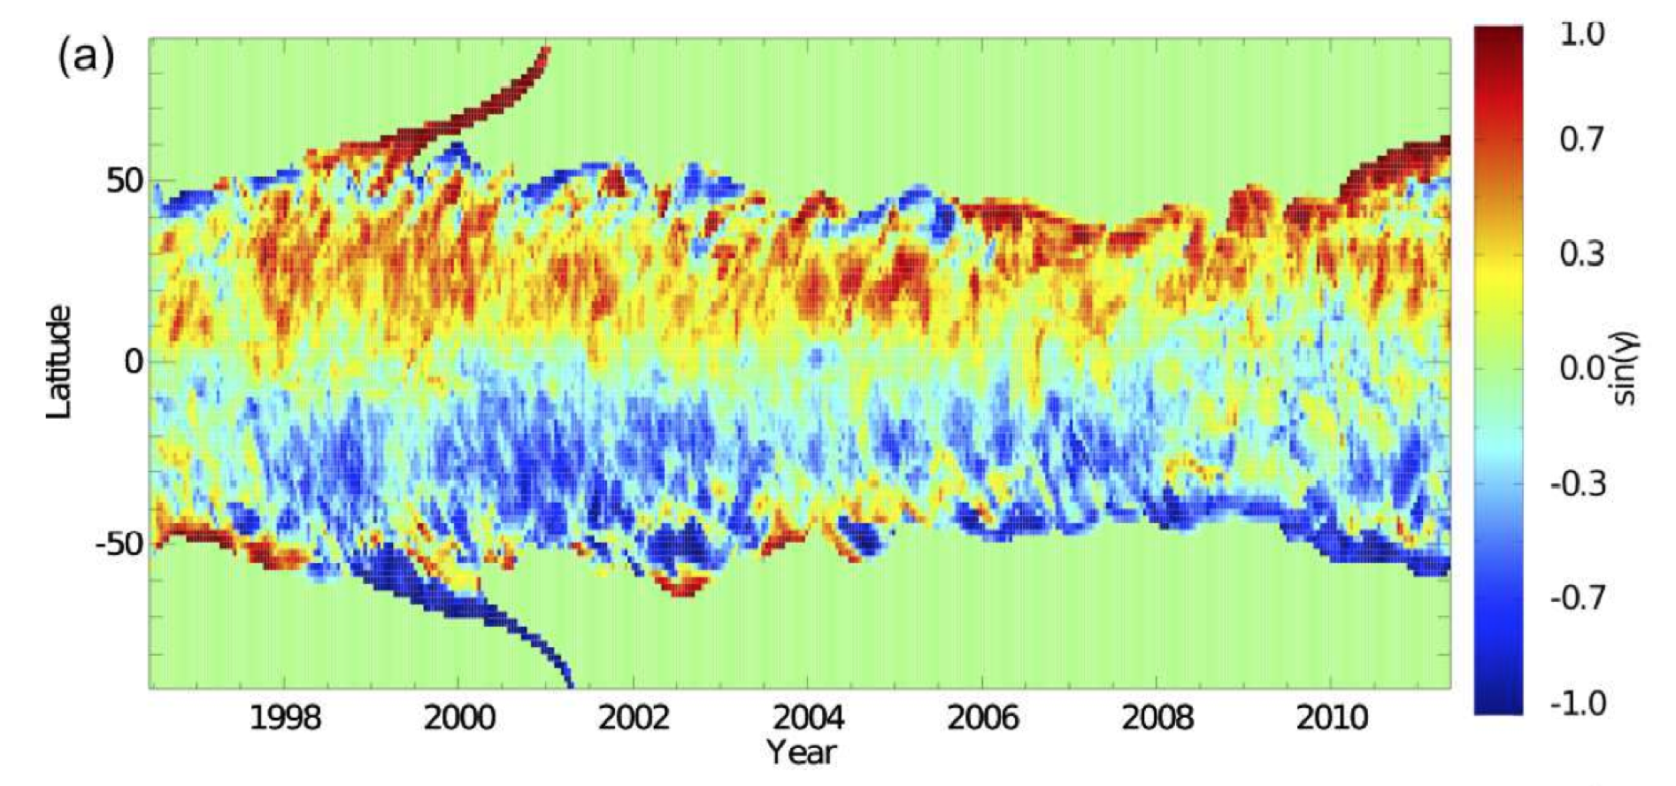
Surface Flux Transport Simulations
Yeates and Mackay (2012), totally independent of these results, find mixed chirality at lower latitudes during the extended solar minimum between cycle 23 and 24, as well as occasional deviations from the chirality pattern during cycle 23. The sign of the skew angle γ represents chirality, red = sinistral, v.v.

Slide 16
Conclusions
The hemispheric filament chirality pattern waxes and wanes over Cycle 23.
The correlation between filament chirality and sigmoid handedness seems preserved.
Simulations by Yeates & Mackay (2012) show similar results, but far from perfect agreement with data. Much more detailed data analysis and simulations are needed.
This type of work (~ 100,000 filaments per cycle) can only be done with automated detection.

