Slide 1
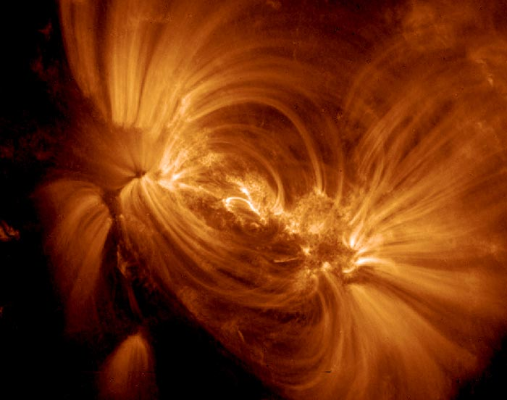
Helicity Condensation: The Origin of Coronal/Heliospheric Structure
S. K. Antiochos, C. R. DeVore, et al NASA/GSFC
Key features of the corona and wind
Laminar loops
Sheared filament channels
Non-steady slow wind
TRACE: Title et al
VAULT: Vourlidas et al
Ulysses: McComas et al

Slide 2
Origins of Coronal/Wind Structure
Magnetic flux sources at photosphere
Driving by photospheric flows, rotation, convection, etc.
Reconnection-dominated evolution in corona
All three observed (Canfield, Pevtsov, Duvall, Rust, Martin…) and expected (Taylor, Berger, …) to produce net helicity in each hemisphere
Helicity is topological measure of field line linkages
Lau and Finn (1990) formulation
NOT a material quantity, such as mass, energy, momentum, etc., but it is preserved under magnetic reconnection
Helicity conservation determines coronal/wind structure/dynamics

Slide 3
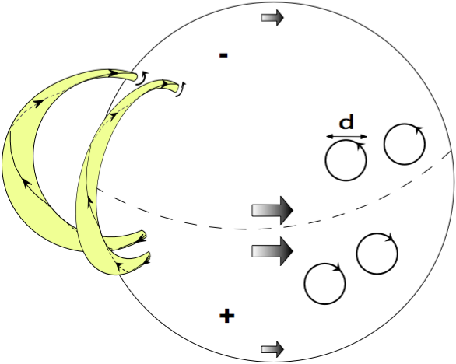
Model for Coronal Helicity Evolution (Antiochos 2013)
Assume helicity injection dominated by supergranular twists
Sense determined by hemispheric rule
Closed loops with same sense of twist merge by reconnection
Opposite sense “bounce” (Linton & Antiochos)
Helicity (shear) condenses onto PIL and CH boundary

Slide 4
Implications of Model
Rate of shear buildup at PIL given by:
v_{L} = v_{p} (d / L₁), where L₁ = √ (L² – H²)
Helicity spectrum:
θ_{λ} ~ λ⁻², except at largest scale L where shear builds up
Physical origin of shear buildup at CH boundary:
H_{T} = Φ_{S} Φ_{L1} + Φ_{S} Φ_{CH}
But coronal hole cannot contribute to helicity; therefore, need canceling helicity:
H_{CH} = - Φ_{S} Φ_{CH}

Slide 5
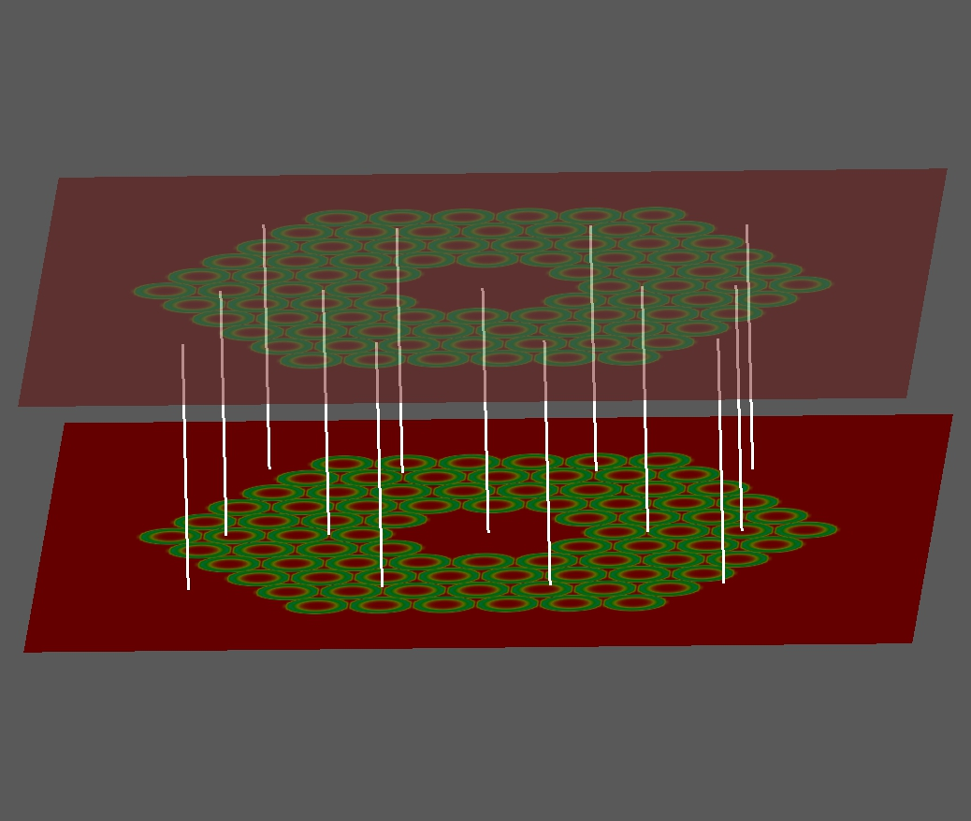
Simulations of Helicity-Condensation
Start with usual uniform field between two photospheric plates, a la Parker
Apply slow twists at plates to simulate supergranular flows
Specify various cases for number and extent of flows
“PIL” and “CH” given by boundaries of flow region
Use ARMS MHD code to calculate evolution
Helicity conserved to good accuracy

Slide 6
Simulations of Helicity-Condensation
Interaction of two twisted coronal loops:
For same twist see reconnection and merger, opposite twist only kink
(from Zhao, DeVore and Antiochos, 2013)

Slide 7
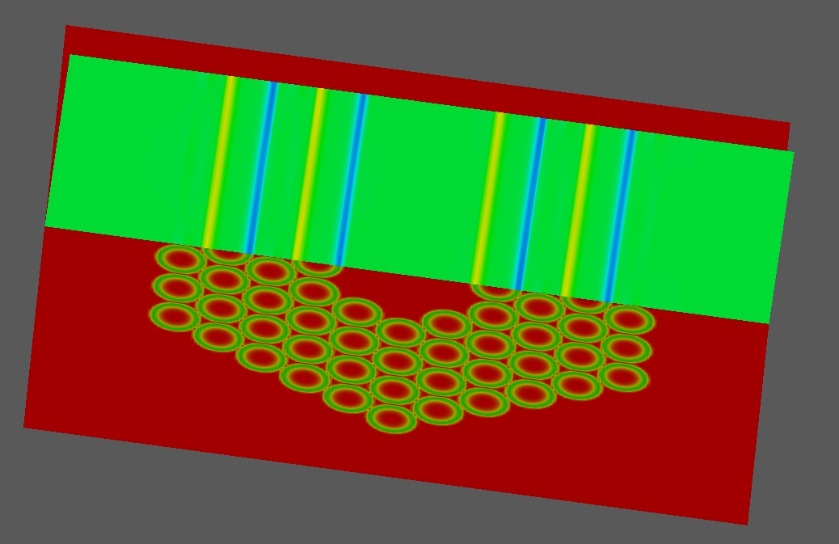
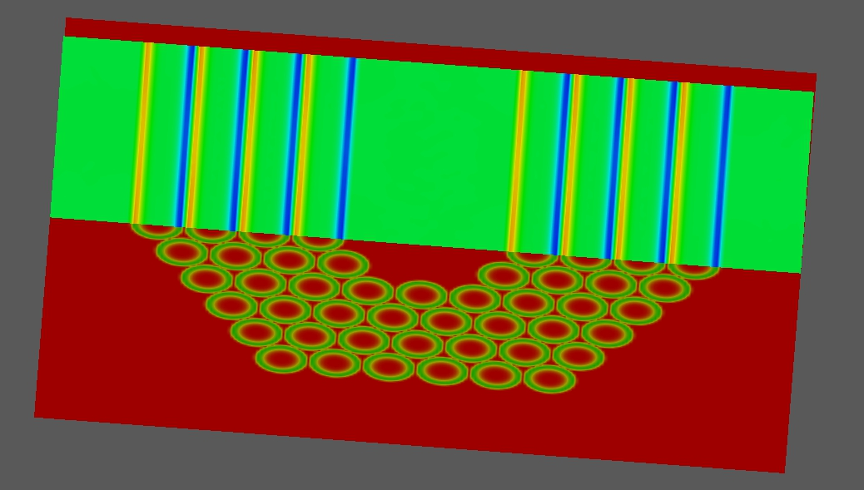
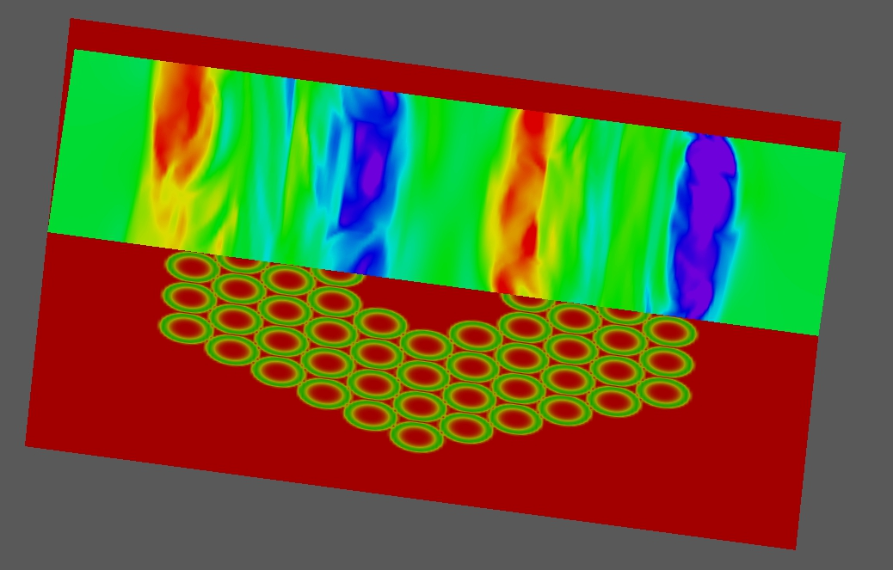
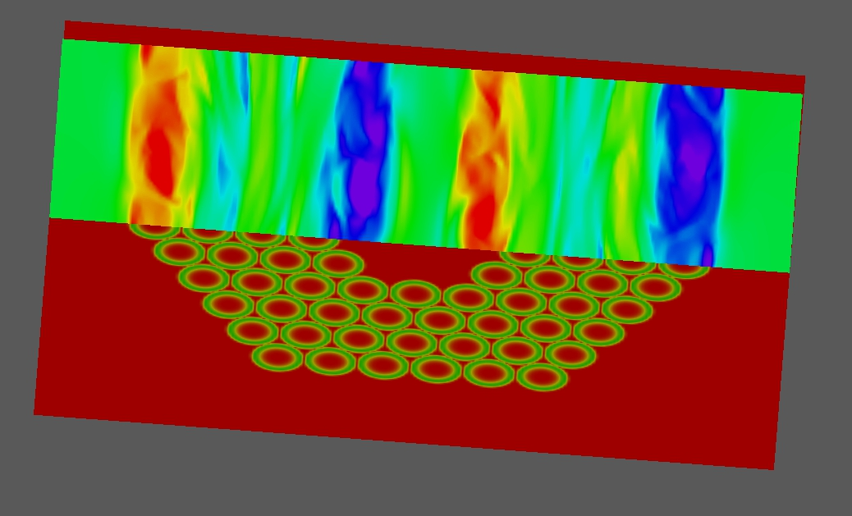
Interaction of 84 twisted coronal loops ~ supergranular pattern
External bdy ~ PIL, internal bdy ~ coronal hole
Twist condenses at both bdys (Knizhnik, DeVore & Antiochos)

Slide 8
Filament Channel Formation
(Mackay, DeVore, & Antiochos 2013)
Magneto-frictional model for global field evolution
Includes diff. rotation, meridional flow, surface diffusion (Van Ballegooijen & Mackay)
Yields wrong chirality for E-W PIL
Added supergranular helicity injection and condensation to model
Yields correct hemispheric rule for sufficiently large injection & condensation
Also yields sheared filament channel rather than highly twisted flux rope

Slide 9
Conclusions
Magnetic helicity (twist injected by photospheric motions) condenses onto boundaries of flux systems (PIL and CH) due to reconnection
Keeps interior (coronal loops) “laminar”
Produces magnetic shear at PIL, with little internal twist
Also produces shear at CH bdy
But quickly ejected by field opening and closing
Explains the variability of slow wind – S-web model (Antiochos et al 2011)

