Slide 1

First Results from the
EUNIS 2013 Sounding Rocket Campaign
A. Daw¹, C. Beck², J. Brosius³, G. Cauzzi⁴, J.P. Haas¹, T. Plummer¹, D. Rabin¹, K. Reardon²
¹NASA Goddard Space Flight Center, ³National Solar Observatory,³Catholic University of America at NASA-GSFC, ⁴INAF-Osservatorio di Arcetri

Slide 2
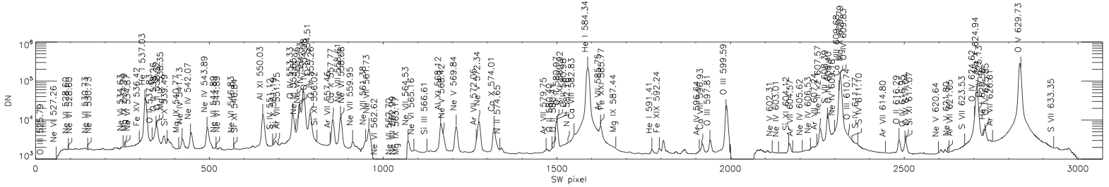
EUNIS-2013
Extreme Ultraviolet Normal Incidence Spectrograph
Successful Mission, 23 April 2013, 17:30 UT from WSMR
Two-channel imaging spectrograph that observes the solar corona and transition region with high resolution and rapid 1.3 s cadence.
Highest resolution observations of the 52-63 nm spectral region of the Sun to date - new channel incorporating toroidal varied line space (TVLS) grating yields λ/Δλ=3000 with high throughput
First flight demonstration of cooled CMOS active pixel sensors
Radiometric calibration using NIST-calibrated AXUV photodiode
Provides ‘under-flight’ calibration for orbital instruments:
SDO/AIA, by using 30-37 nm channel
SoHO/CDS, by using 52-63 nm channel
Hinode/EIS, using DEM from EUNIS wide temperature range

Slide 3
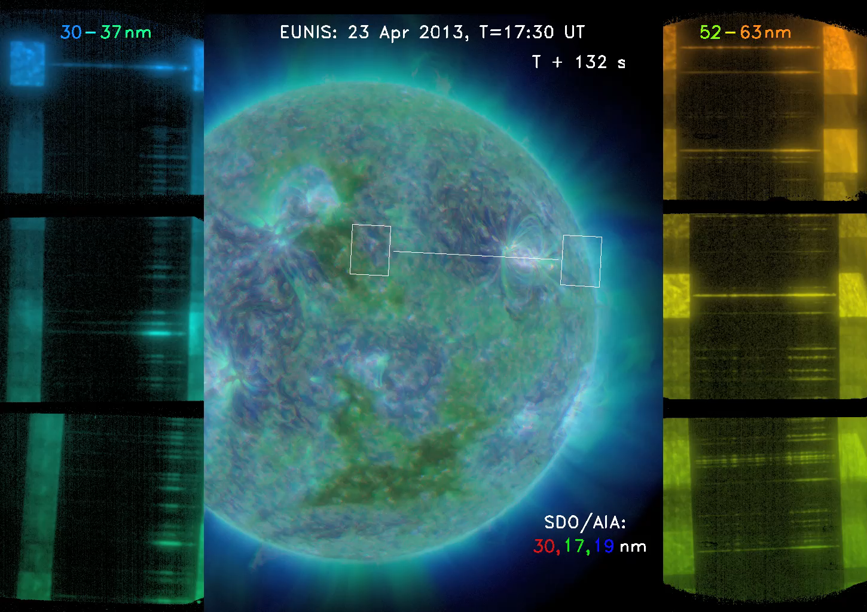
Flight Data / Observation Sequence

Slide 4
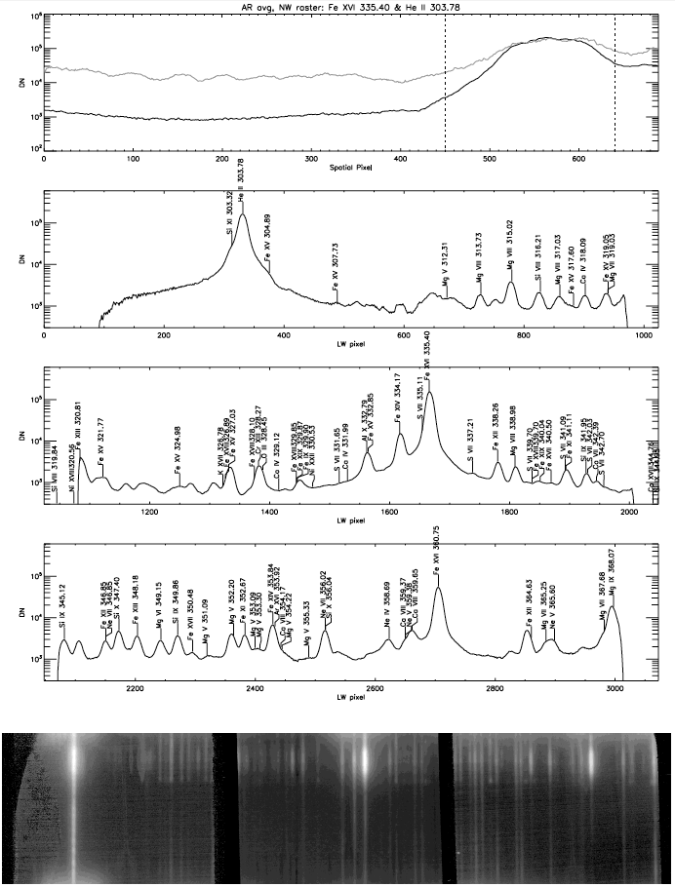
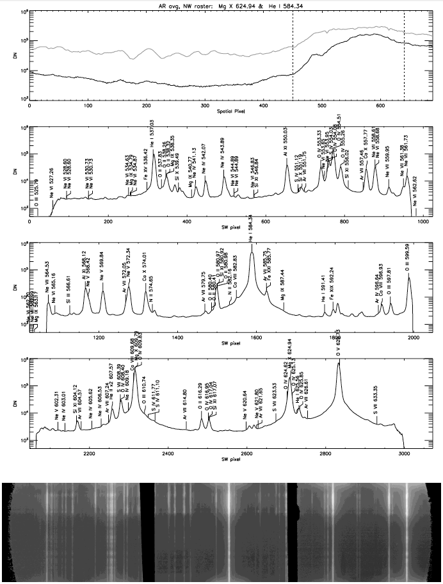
Example Spectrum - NW Active Region

Slide 5
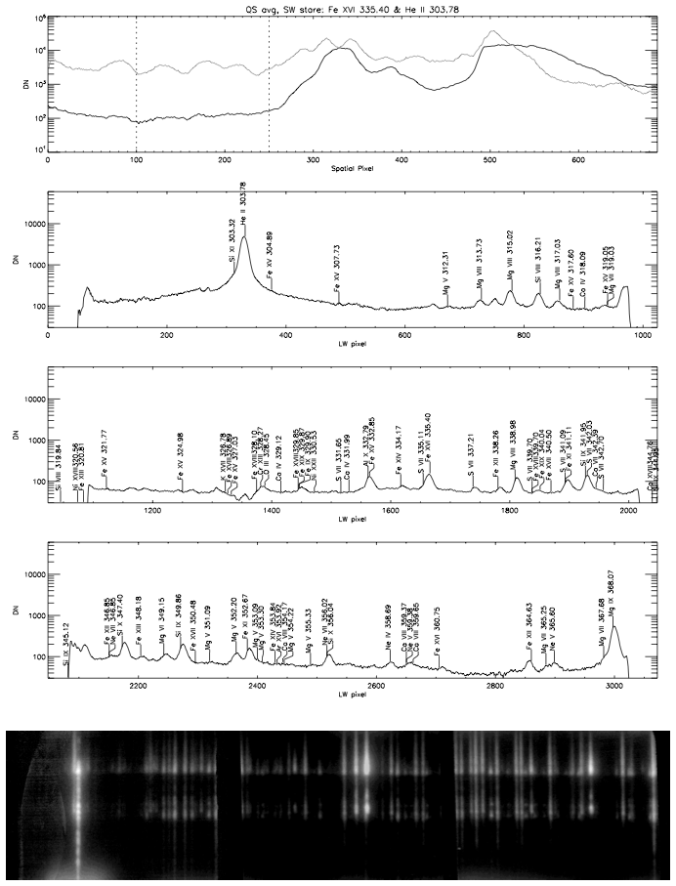
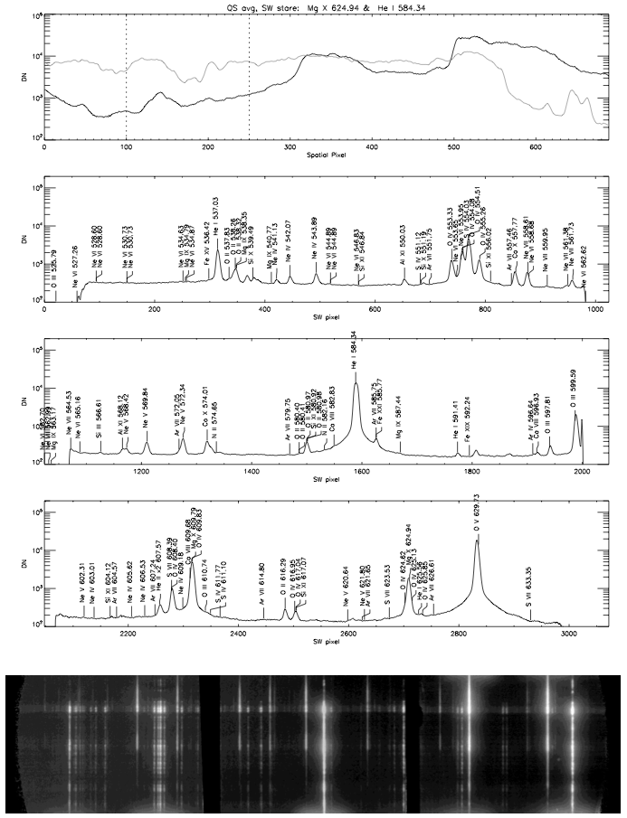
Example Spectrum - SW Quiet Sun

Slide 6
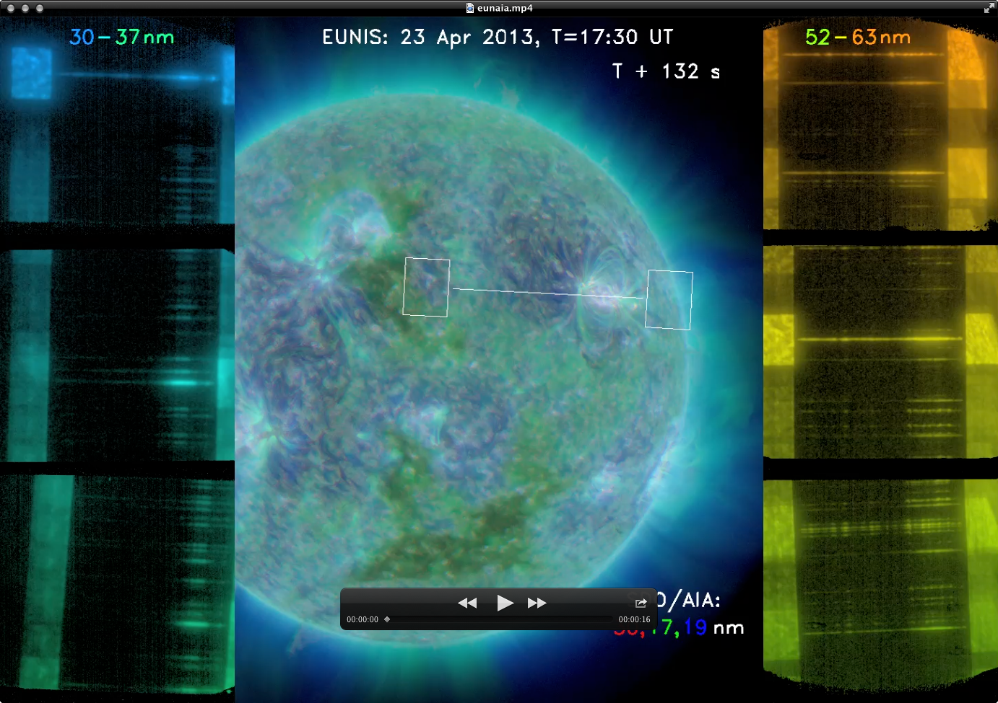
Why call it a ‘Campaign’?

Slide 7
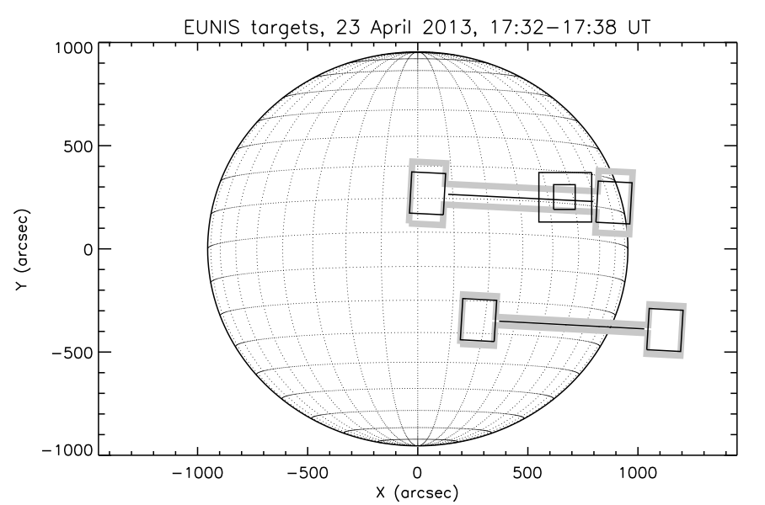
… because three active regions were observed?
11726
11724
11723

Slide 8
Co-Observations … in addition to SDO/AIA & EVE
RHESSI
(and GOES) light curves show activity throughout the day on
23 April 2013, many of them attributed to small flares in 11726.
11726
11724
11723

Slide 9
Co-Observations
EIS
DST / IBIS
CDS

Slide 10
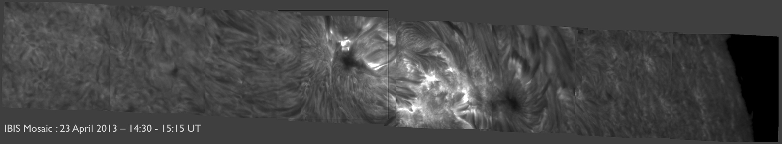
Interferometric Bidimensional Spectropolarimeter (IBIS)
Line scans of:
H-alpha 6563 Å (see pictures for core)
Ca II 8542 Å
He I D3 5876 Å
Na I D1 5896 Å
Above: mosaic taken prior to launch.
Left: H-alpha core during flight.

Slide 11
Calibration of Orbital Instruments
by EUNIS-2013
SoHO/CDS, by direct comparison to EUNIS 52-63 nm channel
SDO/AIA, A304 and A335 allow direct comparison to 30-37 nm channel, and there are othertechniques as well (see below).
Hinode/EIS, using ‘insensitive’ line ratios, and DEM constructed from EUNIS wide temperature range

Slide 12
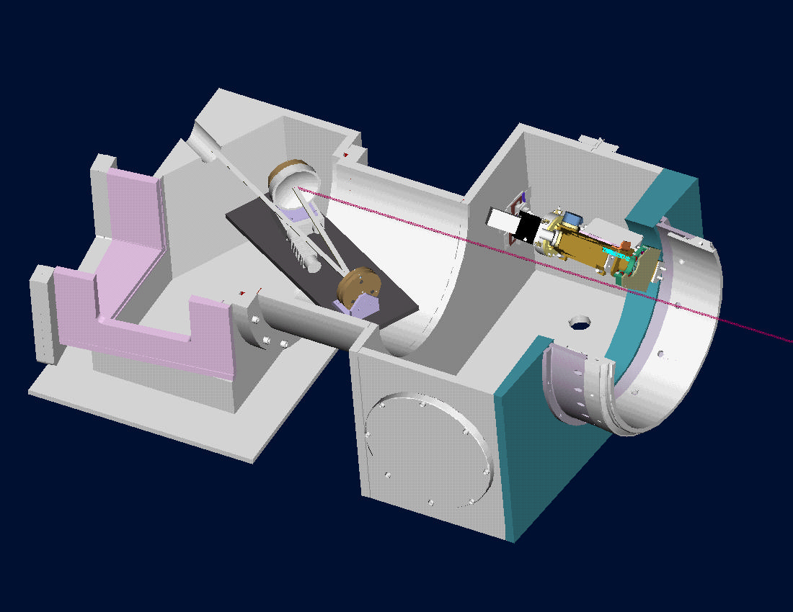
EUNIS Radiometric Calibration
(McPherson 629 Hollow Cathode Lamp)
(AXUV photodiode)
Optical alignment and component/subsystem measurements are performed using the EUNIS calibration chamber shown above.
Absolute radiometric calibration of the spectrographs are performed using a hollow cathode discharge lamp to produce He I 584 Å and He II 304 Å, and a NIST-calibrated AXUV-100G photodiode placed behind the slit. The spectrograph calibration is then combined with reflectivity measurements of the telescope OAPs to provide the absolute radiometric calibration of the instrument.

Slide 13
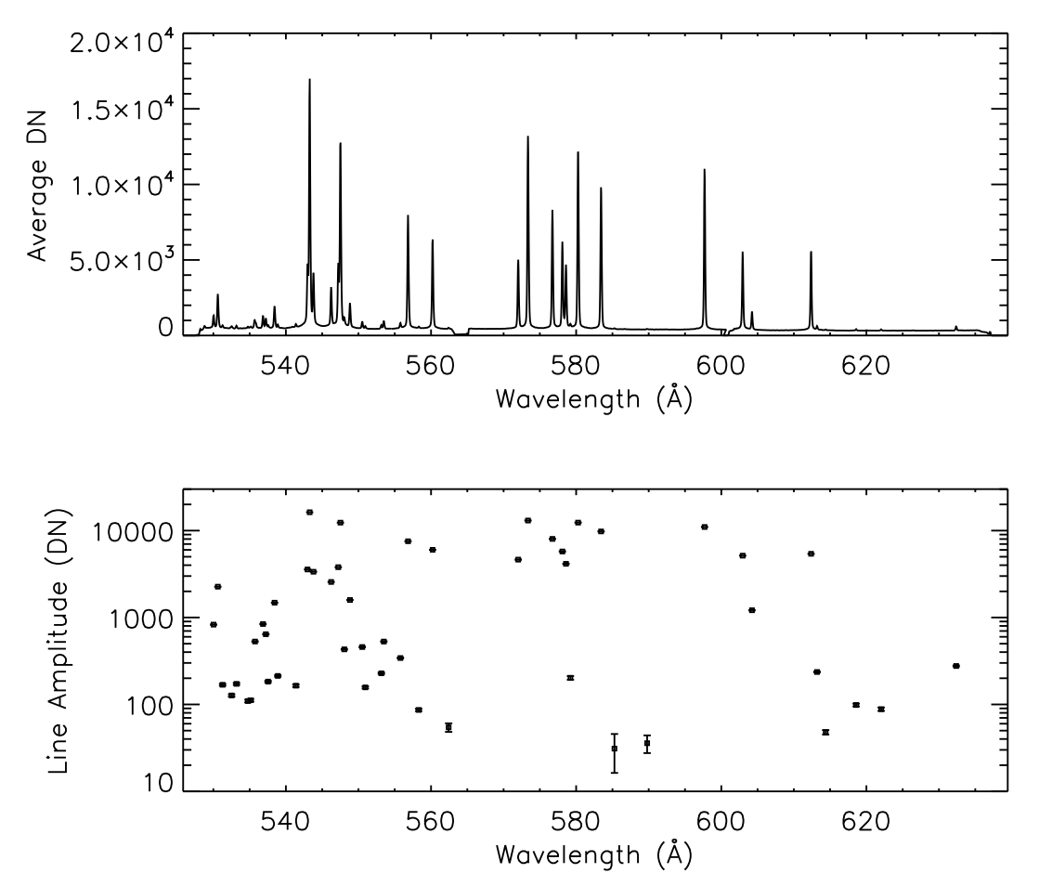
EUNIS Radiometric Calibration
300-370 Å channel:
25 mÅ/pix
G=3600 mm⁻¹
Ir/Si multilayer (aperiodic)
Also calibrated previously at RAL.
527-634 Å channel:
38 mÅ/pix
TVLS with G_{o}= 2340 mm⁻¹
broad-band B₄C/Ir coating
Absolute radiometric calibration from Lab observations of He II 304 Å and He I 584 Å
Spectral responsivity from line pairs with known intensity ratio in Flight and Lab spectra:
30-37 nm:
He I-II, Ne II-III
52-63 nm:
He I, Ne I, III,
Ar II-III, Kr II-III
Each detector assembly is a KBr-coated MCP intensifier fiber-optically coupled to three 1Kx1K active pixel sensors.

Slide 14
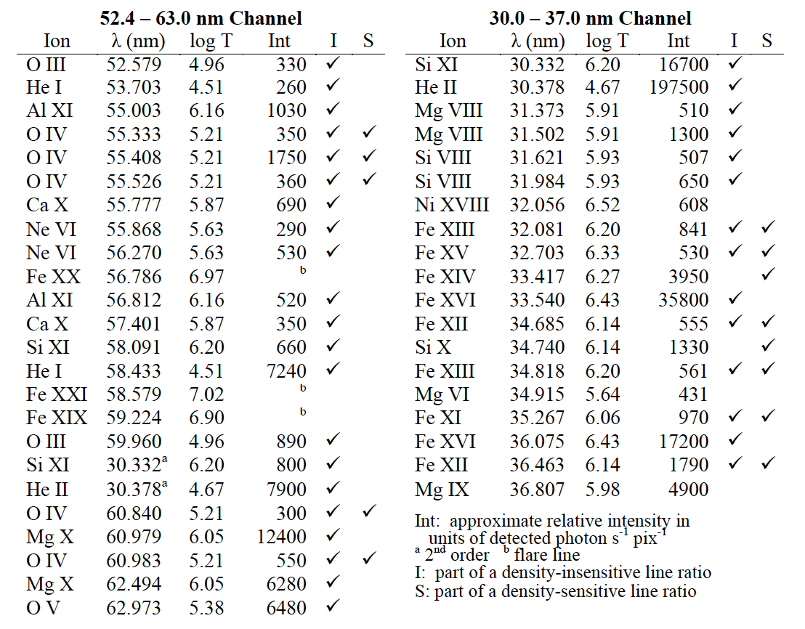
EUNIS covers a wide temperature range: 2x10⁴ to 10⁷ K

Slide 15
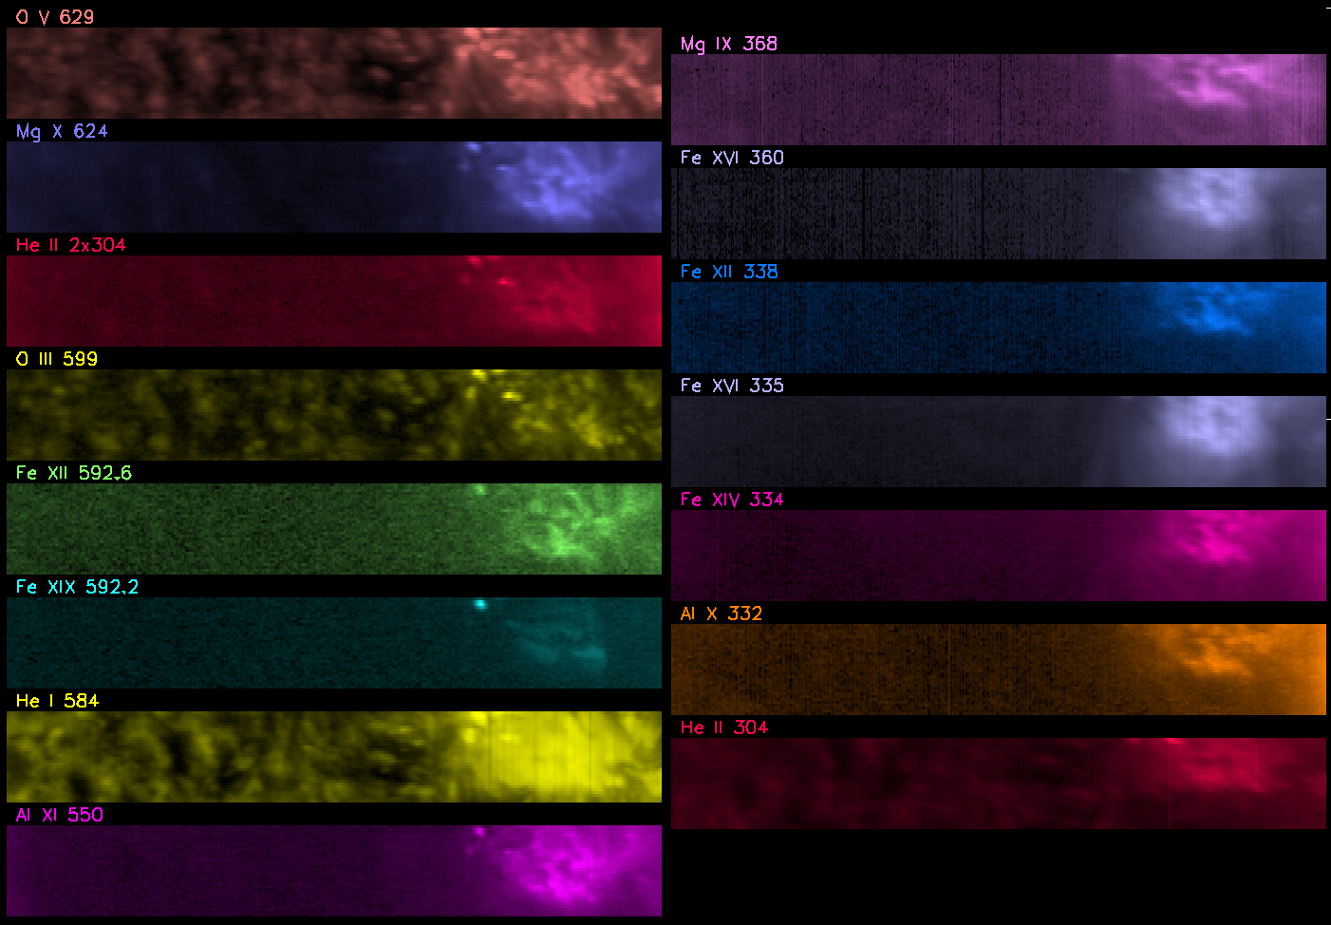
15 Emission Lines from One Scan in the NW

Slide 16
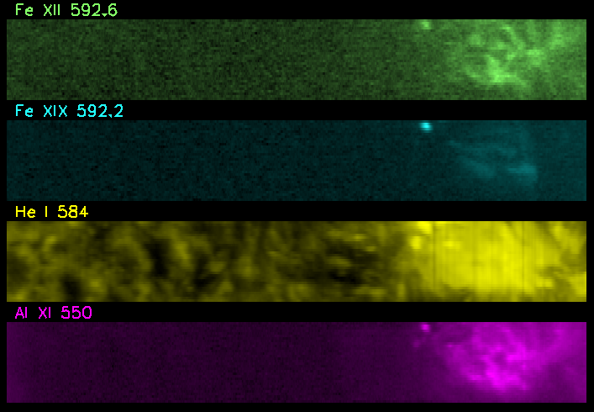
Do the AIA 94 & 131 Å channels see hot stuff?
Yes.

Slide 17
Do the AIA 94 & 131 Å channels see hot stuff?
Yes, but they see cooler stuff too.
EUNIS can resolve the lines.

Slide 18
A Closer Look at the Fe XIX ‘Hot Spot’

Slide 19
How Close?
3 x 0.9” pixels = 2.7”
2.4”/s x 1.3 s = 3.1”

Slide 20
Fe XX is spotted too

Slide 21
Fe XX is spotted too
Hot Stuff
Lots of Cooler Stuff

Slide 22
O IV multiplet at 553-555 Å is clearly resolved (note log scale).

Slide 23
Ratio to O IV 625 is density-sensitive

Slide 24
… the densities …
(This is only one example of many useful line ratios.)

Slide 25
EUNIS-2013 … stay tuned for level 1 data release
EUNIS-2013 Incorporates a new 525–630 nm channel covering a wide temperature range of 0.025 to 10 MK.
Provides the highest resolution observations of this important solar spectral region to date.
Sees Fe XIX and Fe XX emission in flaring (and non-flaring?) ARs *
Co-observed dynamic coronal AR and QS phenomena with DST/IBIS, Hinode/EIS, SoHO/CDS, RHESSI and SDO
Will provide absolute radiometric calibration of EIS, CDS, and AIA
Provides the first flight demonstration of cooled (-20 C) APS/CMOS arrays to achiev read-noise limited performance
* What about elsewhere? Hard to say, but noting the strongest lines of Fe XVIII–Fe XXIII are all in the 90–140 Å band …

Slide 26
EUNIS-2013 … to see more, please stop by poster #10
Future flights of EUNIS can:
Explore the poorly-known 90–140 Å wavelength band, which has never been observed with an imaging spectrograph.
Test theories of coronal heating by quantifying the faint signature of sub-resolution impulsive events, using the brightest of the hot (4–10 MK) emission lines.
Derive accurate and reliable temperature-response curves for the two shortest wavelength bands of the SDO Atmospheric Imaging Assembly
Many thanks for the support of co-observers and folks at WSMR, WFF, GSFC and HQ!
EUNIS is supported by NASA through the Low Cost Access to Space Program in Solar and Heliospheric Physics.

Slide 27
First Results from the EUNIS 2013 Sounding Rocket Campaign
A. Daw¹, C. Beck², J. Brosius³, G. Cauzzi⁴, J.P. Haas¹, T. Plummer¹, D. Rabin¹, K. Reardon²
¹NASA Goddard Space Flight Center, ²National Solar Observatory, ³Catholic University of America at NASA-GSFC, ⁴INAF-Osservatorio di Arcetri
Abstract. The Extreme Ultraviolet Normal Incidence Spectrograph (EUNIS) sounding rocket launched 23 April 2013 at 17:30 UT, as part of a campaign including co-ordinated observations with the Dunn Solar Telescope/IBIS, Hinode/EIS, SoHO/CDS, RHESSI and SDO. EUNIS obtained the highest-resolution observations of the solar spectrum from 52-63 nm observed to date, as well as observations with the previously-flown waveband from 30-37 nm. The broad spectral coverage of the EUV observations includes emission lines of ionization stages from He I to Fe XIX, and thus a wide temperature range of 0.025 to 10 MK. Absolute radiometric calibration of EUNIS provides underflight calibration of CDS, EIS and AIA. Spectra were obtained with a 1.3 s cadence as the 660-arcsec long slit was rastered across two different regions. The observations captured a B-class flare in active region NOAA 11726 as well as active regions 11723, 11724, off-limb, quiet sun and a coronal hole. We discuss first results from anaysis of this rich and extensive data set.

