Slide 1
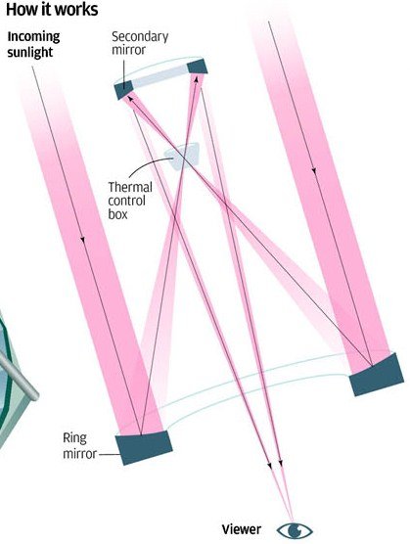
PLANNING THE 8-meter CHINESE GIANT SOLAR TELESCOPE
Jacques Beckers, Zhong Liu, Yuanyong Deng & Haisheng Ji
U. Arizona YNAO NAOC PMO
PARTICIPATING CHINESE INSTITUTES
Yunnan Astronomical Observatory, CAS
National Astronomical Observatories, CAS
Purple Mountain Observatory, CAS
Nanjing University
Nanjing Institute of Astronomical optics
Beijing Normal University
SPD Meeting
Bozeman, MT
July 7-11, 2013

Slide 2
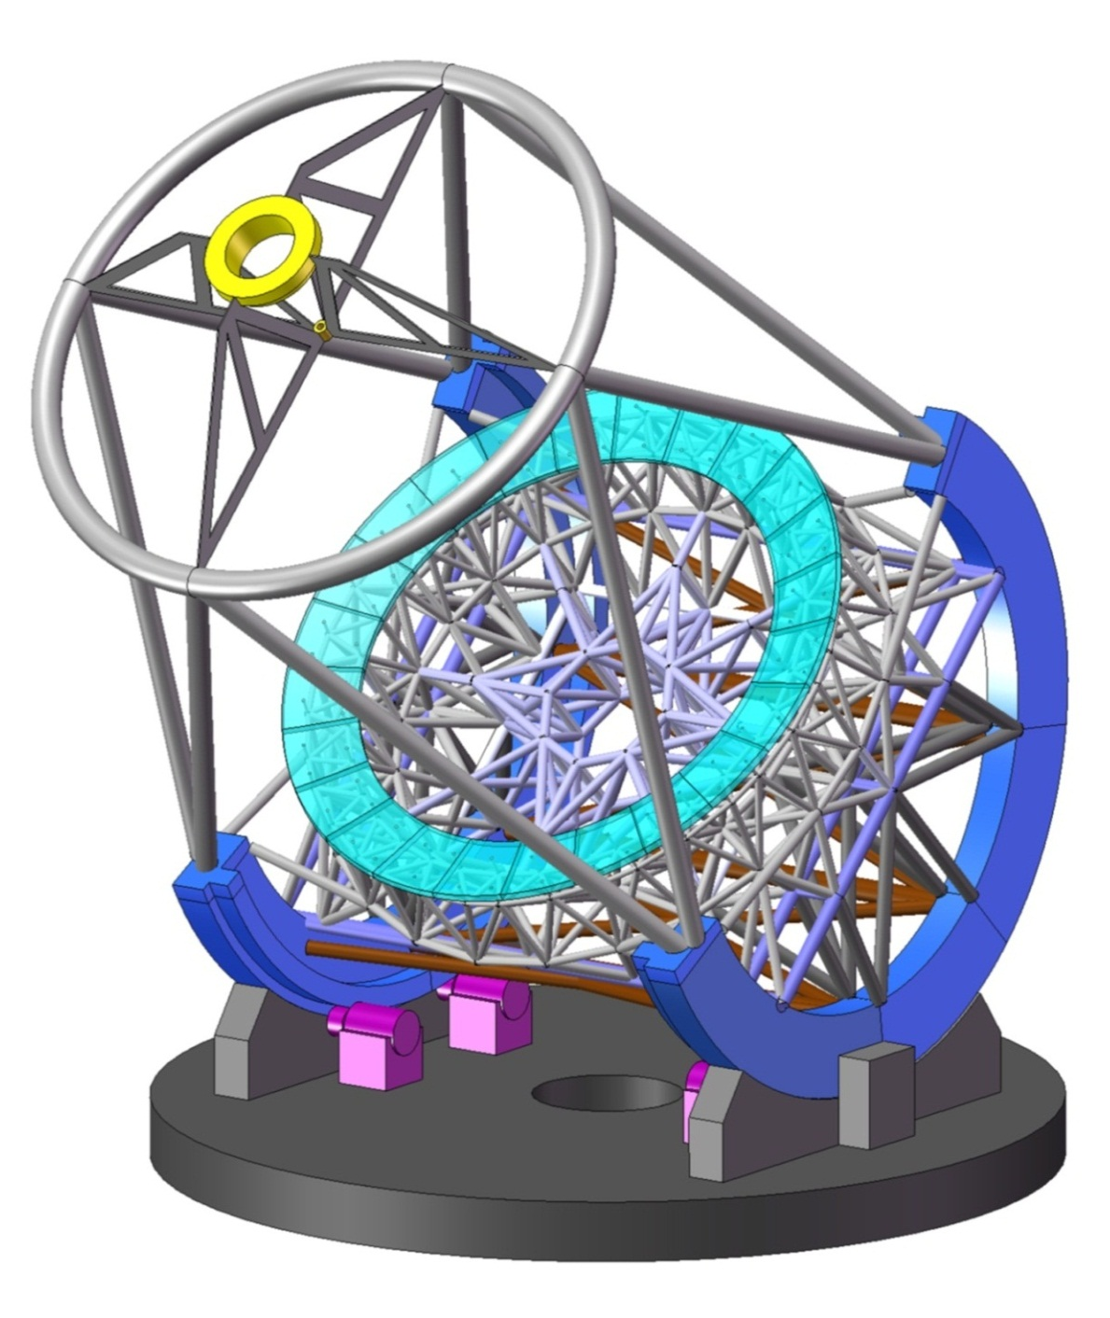
The Original CGST Concept is an 8^{m} Diameter Segmented Ring Solar Telescope with a 1^{m} Ring Width.
It has a ~5^{m} Equivalent
Collecting Diameter
ADVANTAGES SRST ARE:
Covers all Spatial Frequencies
that of an 8^{m} Filled Aperture
Telescope but with Heat
Load of a 5^{m} Aperture
Is Polarization “Neutral”
(or “free”) as Compared to
Off-Axis Telescope like ATST
Large space available at Gregorian Focus for MCAO & Instruments

Slide 3
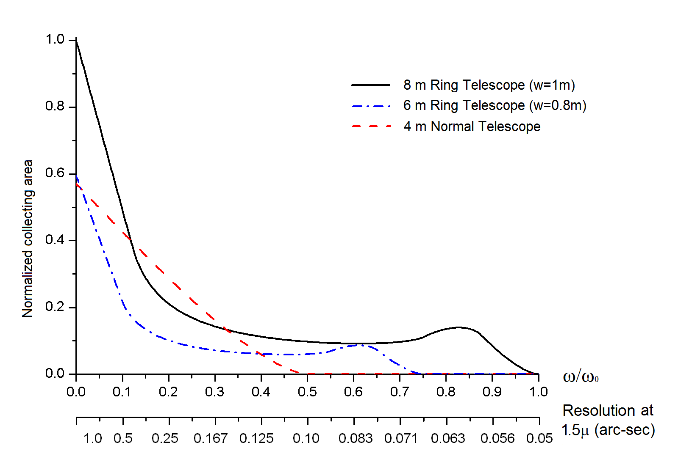
MODULATION TRANSFER
FUNCTIONS OF CGST/SRST
8^{m} CGST
NORMALIZED MTF
4^{m} telescope
6^{m} CGST
NORMALIZED SPATIAL FREQUENCY (Cycles/8-meter)
“NORMALIZED” MTF REFERS TO THE 8^{m} CGST/SRT WITH RING WIDTH OF 1.0^{m}
CGST WILL INCORPORATE MULTI-CONJUGATE ADAPTIVE OPTICS TO COVER
FULL SPATIAL FREQUENCY REGIME OVER LARGE SOLAR AREA (~ 2.5 arcmin)
IN ADDITION IT WILL USE SPECKLE MASKING/TRIPLE CORRELATION IMAGE
RESTORATION TECHNIQUES TO RECOVER AMPLITUDE & PHASE IN FULL
SPATIAL FREQUENCY (u,v) DOMAIN

Slide 4
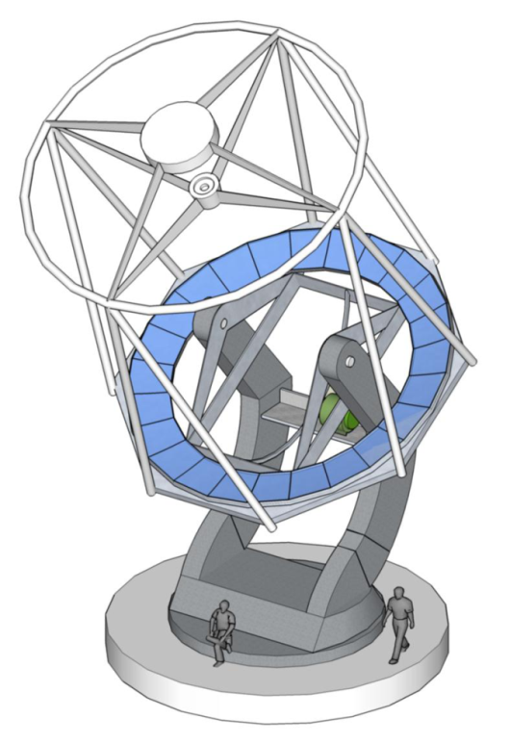
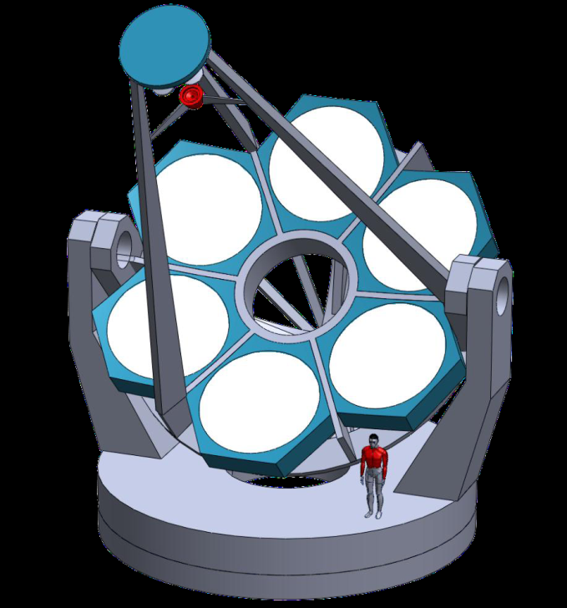
TWO TYPES OF RING TELESCOPES ARE
UNDER CONSIDERATION
Segmented Ring SolarTelescope
(SRST)
Aperture Ring Solar Telescope
(ARST)
N = 6
Alternate design by NIAOT, Nanjing
Similar suggested by JMB at August 2011
Number N of sub-telescopes is to be determined
Maximum edge-to-edge distance is also 8^{m}
Has resolution diameter of full 8^{m} telescope
Collecting diameter depends on N and optics detail
Gregorian configuration
Requires co-alignment and co-phasing of N
telescopes and maybe TBD secondary
Original proposed by Liu Zhong, Yunnan Obs.
Has 24 trapezoidal segments ~ 1^{m} x 1^{m} in size
Outer ring diameter is 8^{m}; inner diameter 6^{m}
Has resolution diameter of full 8^{m} telescope
Has collecting diameter of full 5.3^{m} telescope
Gregorian configuration
Requires co-alignment and co-phasing of 24
segments of primary and maybe TBD secondary

Slide 5
COMPARISON OF
APERTURE RING
SOLAR TELESCOPES
WITH N = 5, 6 AND 7
AND D= 8-meters
α
COMMENTS:
Red MTF curve is for
Segmented Ring Telescope
(2) Six Green and Blue MTF
curves are for Aperture
Ring Solar Telescopes with
β = 0, 0.2α, 0.4α, 0.6α,
0.8α and 1.0α respectively
(3) N = 5 and 7 MTF are much
more isotropic, approaching
that of Segmented RST
(4) Even numbered N ARSTs
are redundant in aperture
location and have a rather
non-isotropic MTF and PSF
(5) All 8-meter ARSTs have a
lower MTF at high spatial
frequencies then the CGST

Slide 6
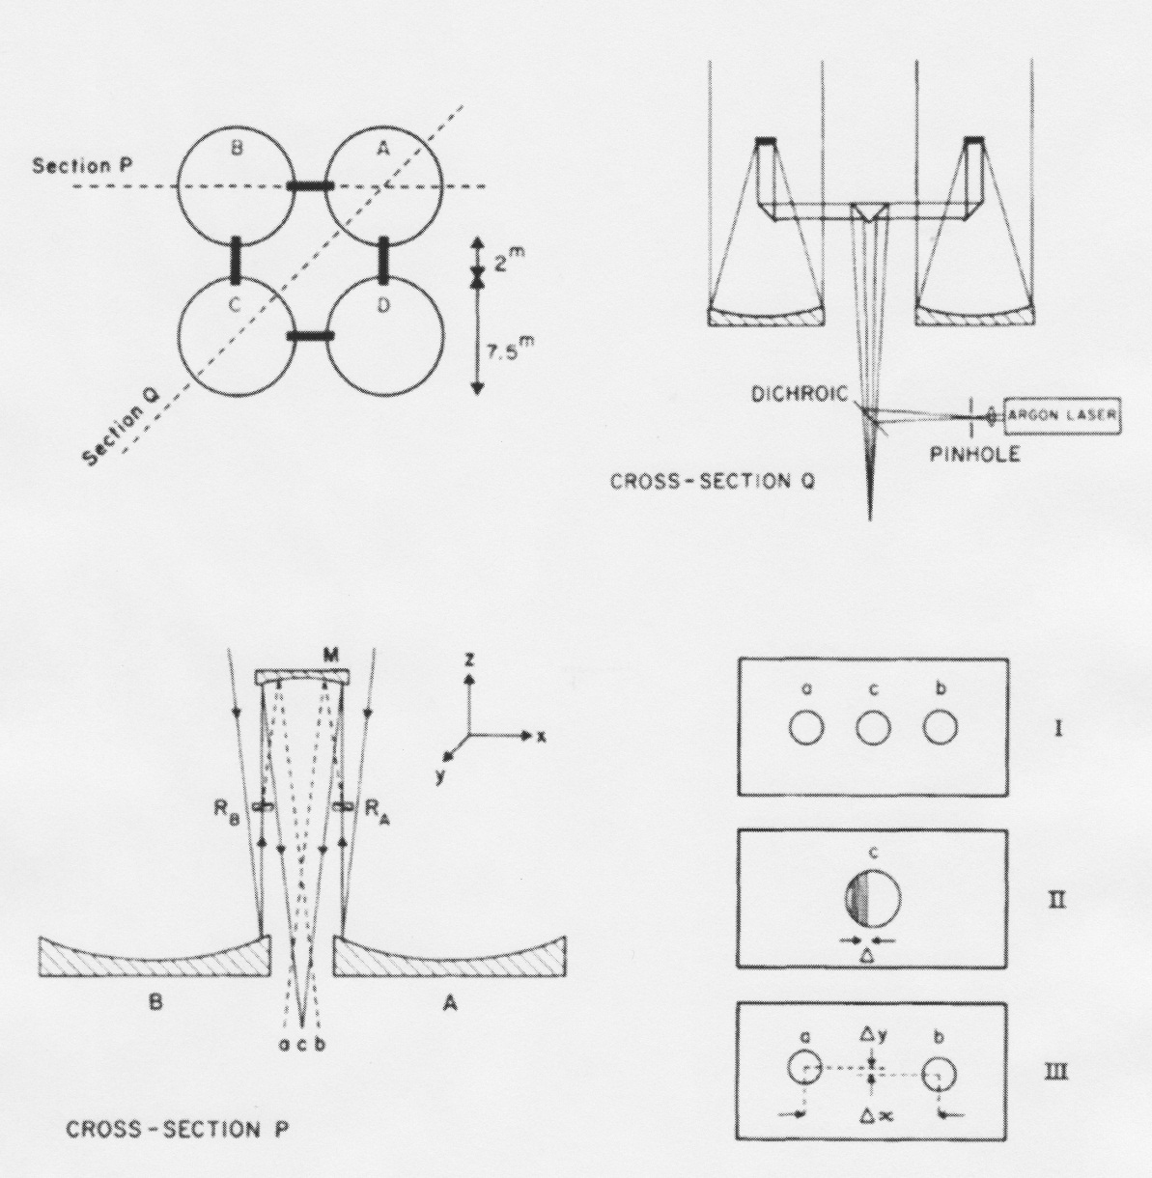
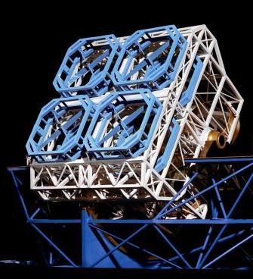
CO-ALIGNMENT-COPHASING OPTICS MIGHT
USE ABANDONED 16m NOAO NATIONAL
NEW TECHNOLOGY TELESCOPE SCHEME
SPIE Proc. 628, 102, 1986

Slide 7
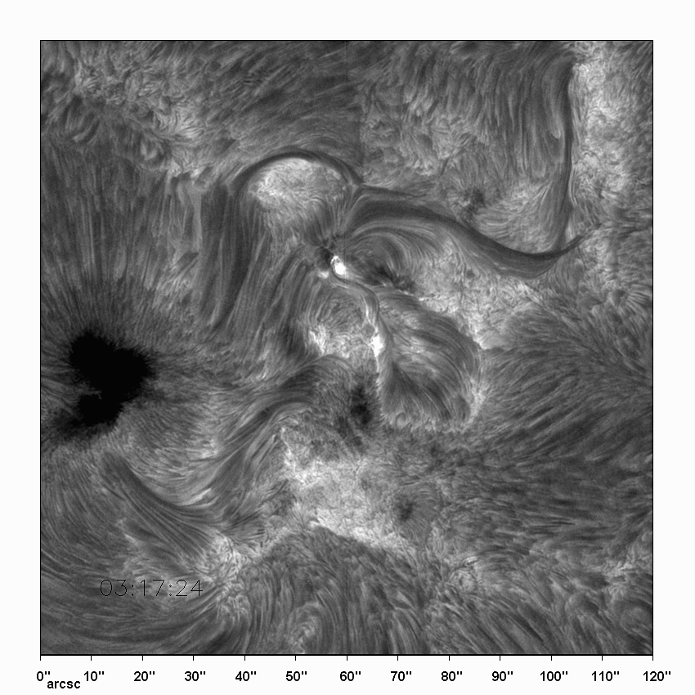
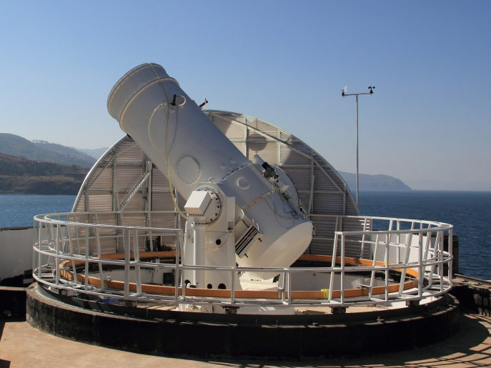
Hα Movie taken with
Yunnan Observatory
1^{m} SolarTelescope
(after image reconstruction)
Yunnan Vacuum telescope
is/will be used to test
Ring Solar Telescope
concept with (MC)AO
& Image Restoration
Algorithms
NOTE: FOV as
suggested for
CGST Imaging and
Spectrometry

Slide 8
SOLAR PHYSICS SCIENCE OBJECTIVES
MAGNETO-HYDRODYNAMICS OF CONVECTION IN SOLAR ATMOSPHERE
MHD theory predicts that spatial resolution of 1/40 arcsec will resolve
all in Quiet Solar Atmosphere (E. Parker, R. Stein, Matthias Rempel), etc.
=> Design 8^{m} CGST and its MCAO & Instruments for NIR (0.8 μm and up)
=> In addition the NIR spectral region has lines with larger Zeeman splitting
and highest H- continuum transparency at 1.8 μm (especially in sunspots)
=> At longer wavelengths the CGST has twice the resolution of the ATST/EST
4^{m} telescope: (150 nm) 430 nm 1.08 μm 1.72 μm 3.45 μm
CGST (8^{m}): 300 nm 860 nm 2.16 μm 3.45 μm 6.90 μm
From MHD Model by
Robert Stein as observed
at diffraction limit
at listed wavelength

Slide 9
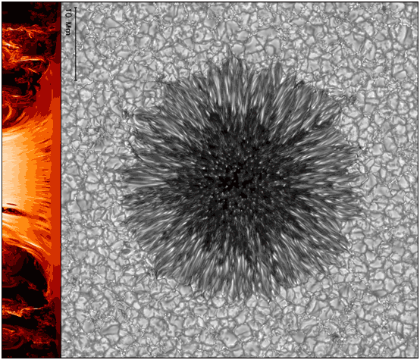
SOLAR PHYSICS SCIENCE OBJECTIVES
MAGNETO-HYDRODYNAMICS OF CONVECTION IN SOLAR ATMOSPHERE
MHD theory predicts that spatial resolution of 1/40 arcsec will resolve
all in Quiet Solar Atmosphere (E. Parker, R. Stein, etc.).
Design 8^{m} CGST and its MCAO & Instruments for NIR (1.0 μm and up)
In addition the NIR spectral region has lines with larger Zeeman splitting
and highest H- continuum transparency at 1.8 μm (especially in sunspots)
At longer wavelengths the CGST has
twice the resolution of a 4^{m} telescope
But theory & models may be wrong and
smaller scale structure may exist.
And current models of Sunspots show
very small structures.
Allow CGST design to be used at
visible wavelengths using Partial
Adaptive Optics, smaller pixels and
Image Reconstruction.
From MHD Model by Matthias Rempel,

Slide 10
ATMOSPHERIC TOMOGRAPHY
IS MORE COMPLICATED WITH
THE RING TELESCOPE

Slide 11
BEAM CROSSECTION
for 3 (out of 6)
Solar “Guide Stars”
Height 12 km
Wavelength
= 1.56 µm
Corrected Area:
SCAO
(20”)
TCAO
(100”)
8-meter
RING
TELESCOPE

Slide 12
CGST RING TELESCOPE
THEREFORE REQUIRES
~3x MORE “GUIDE STARS”
(= sub-areas on Sun)
FOR WAVEFRONT SENSING
THAN FILLED-APERTURE
TELESCOPES

Slide 13
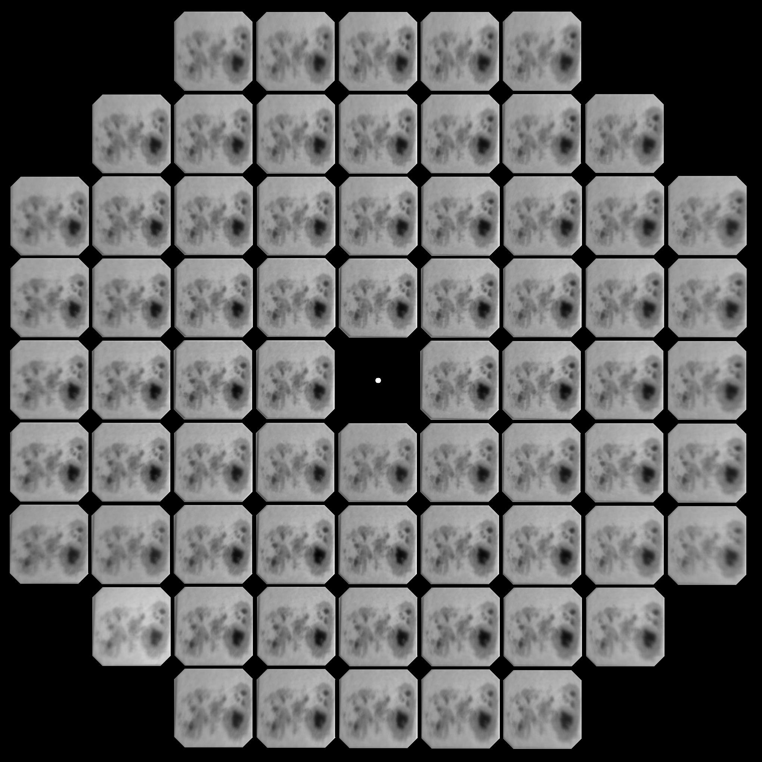
SOLAR SHACK
HARTMANN
WAVEFRONT
SENSOR FOR
ATMOSPHERIC
TOMOGRAPHY
127”
Configuration:
NSO Dunn Solar
Telescope
D = 76.2 cm
Wavelength =
411 nm
Bandwidth = 2.5 nm
CCD: 2078 x 2108
pixel size 13.8 μm
= 0.623 arcsec
FOV=127” x 127”
Exp. Time = 10 ms
725 mm
73 mm

Slide 14
CONCLUSIONS FOR 8-METER APERTURE
CHINESE GIANT SOLAR TELESCOPE DESIGN
Design Telescope for Near-Infrared & Infrared
Wavelengths (0.8 μm – 13 μm)
2. Allow for Future Extension to Visible Wavelengths in
case MHD Models & 4^{m} Telescope Data Demand Better
Resolution
3. Include Multi-Conjugate Adaptive Optics (TCAO?)
4. Use one GMT-Type Adaptive Secondary (672 actuators)
5. Ring Aperture Requires ~3x more “Guide Stars”
6. Consider Low Scattered Light at IR Wavelengths
(Coronagraph) to Allow Coronal Magnetic Field
Observations at High Resolution

Slide 15
WHAT ABOUT
LOCATION ??
WE PREFER SITE IN LAKE ENVIRONMENT OVER MOUNTAIN SITE
Low Ground-Layer/Boundary Seeing in Middle of the Day
(2) => Smaller Zenith Distance for Sun
(3) => Lower Sky Brightness => Better Good Seeing Coronal Sky
=> Lower IR Sky Background
(4) => Less Distant Tropopause &
Shorter Tropopause Path => Larger Isoplanatic Patch
=> Larger Triple MCAO Sky Area
(5) => Smaller Airmass => Weaker Atmospheric Absorption Lines

Slide 16
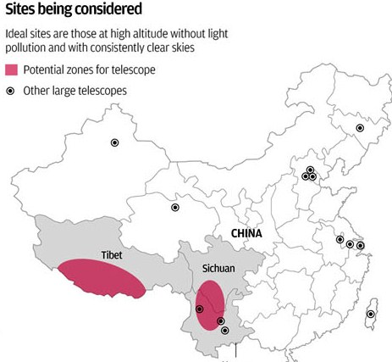
Ο

Slide 17
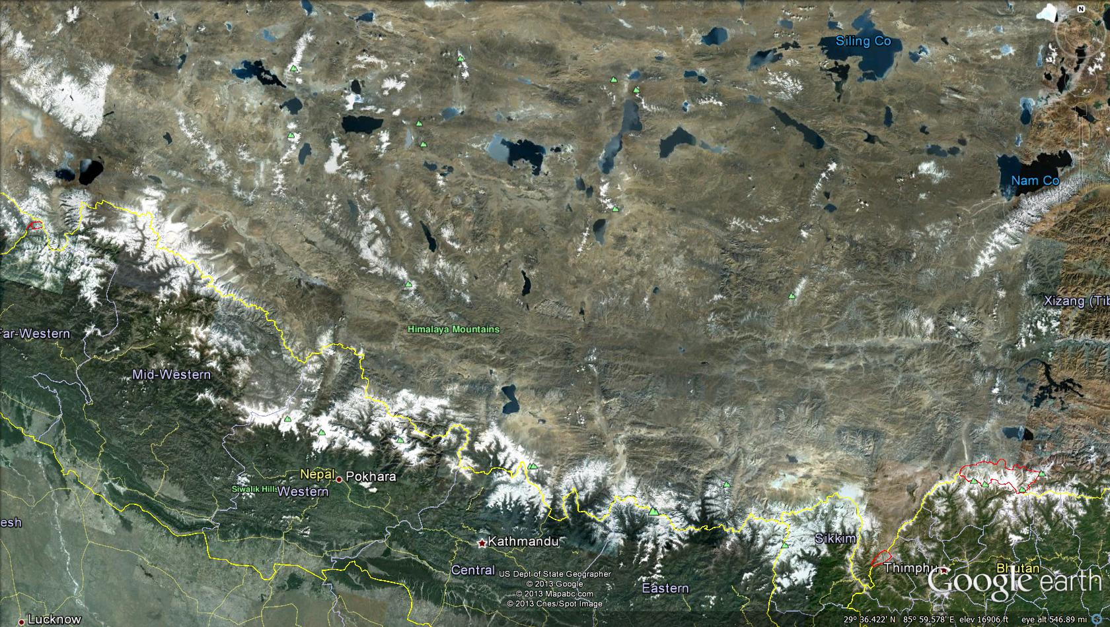
POSSIBLE CGST LOCATION: TRARI NAMTSO LAKE
(N 30^{O}55’ ; E 85^{O}36’ ; 4600^{m} high; dimension 20 x 30 km)
360 km

Slide 18
THANK YOU!

