Slide 1
Connecting Near-Sun CME flux Ropes to the 1-AU Flux Ropes using the Flare-CME Relationship
N. Gopalswamy, H. Xie, S. Yashiro, and S. Akiyama
NASA/GSFC
SPD Meeting July 8 -11, 2013 Bozeman, Montana

Slide 2
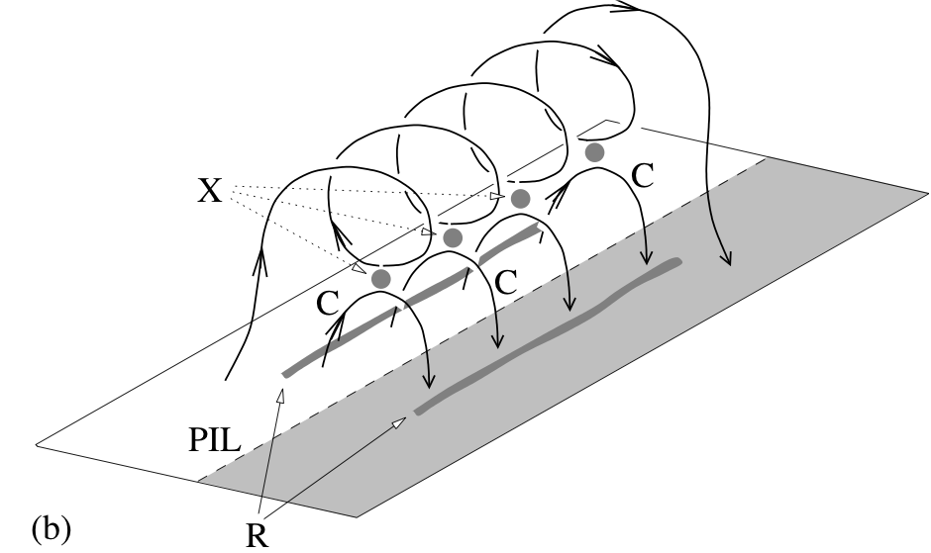
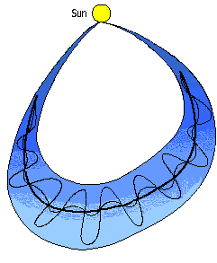
Flare – CME Connection
Flux rope formed during flare
reconnection observed as a
magnetic cloud at 1 AU
Flare reconnection flux
approximated by the
flare ribbon flux
Φ_{P}
≈
Φ_{r}
Φ_{P}
Φ_{r}
Longcope et al. 2007
Longcope & Beveridge, 2007
Qiu et al. 2007
ribbons
Notes:
We modified this picture in two ways

Slide 3
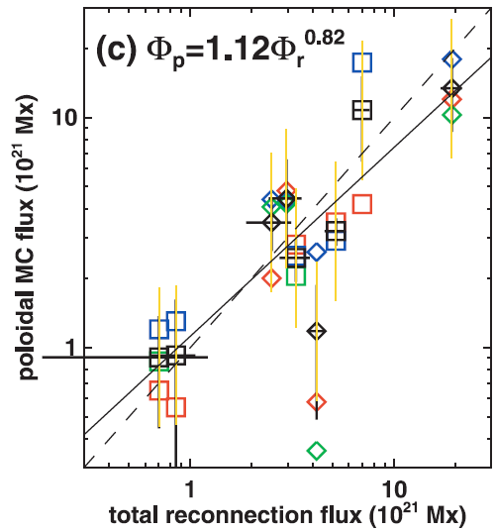
Flare – CME Connection
Qiu et al. 2007
Ф_{p} ~ Ф_{r}
Ф_{r} from flare ribbons & photospheric B
Jump from the chromosphere to the IP medium (1-AU magnetic cloud, MC)
Add coronal observations to this picture
Ф_{p} = Ф_{r}

Slide 4
Using Coronal Data
Use Post Eruption Arcades (PEAs) to get Ф_{r}
Use White-light CME observations to get FR dimensions
Ф_{r} = ½ A_{f} B_{f} where
A_{f} = Area under the EUV arcade after maturity (single frame)
B_{f} = Average photospheric magnetic field under the arcade
7x10²¹ Mx (PEA) vs. 5x10²¹ (Ribbon)

Slide 5
The PEA & Ribbon Methods are Consistent
From the Flux Rope CDAW events - cdaw.gsfc.nasa.gov/meetings/2011_fluxrope
Φ_{p} = 0.95Φ_{r}^{0.84}
Φ_{p} from Force-free fit to 1 –AU data

Slide 6
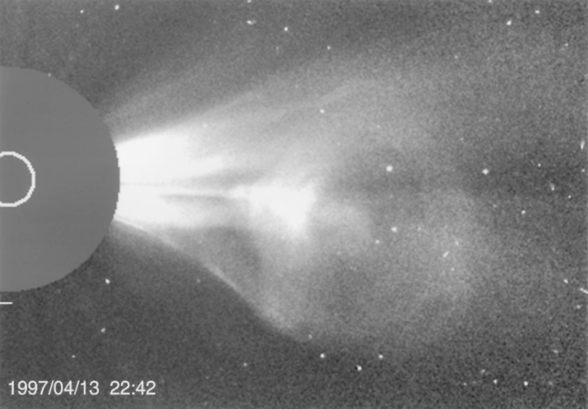
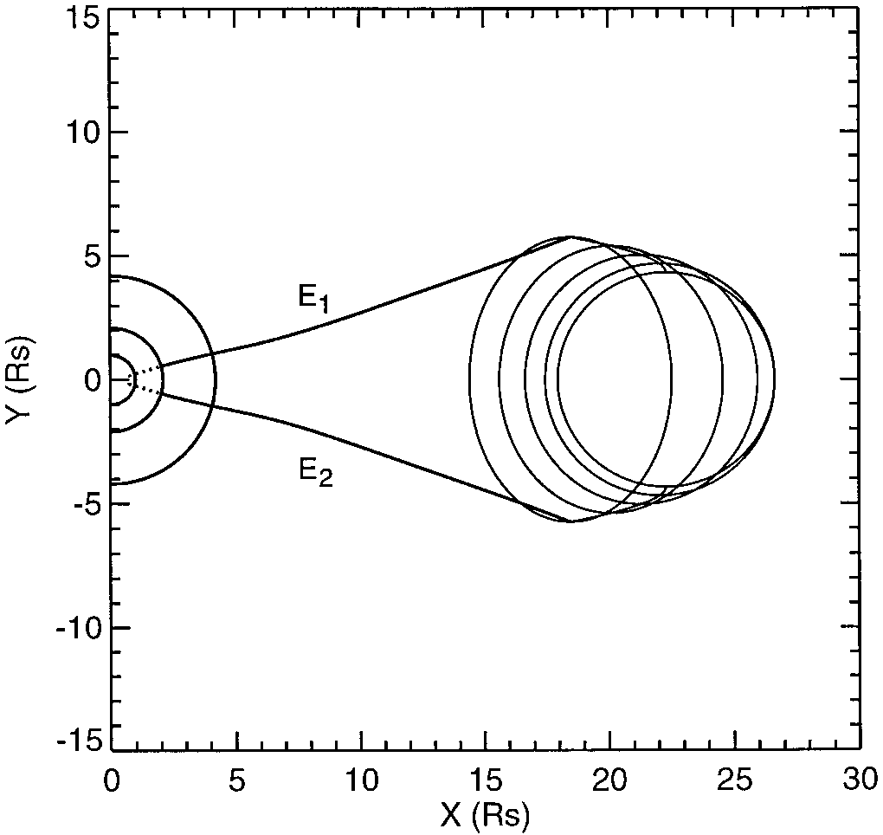
White-Light Flux Ropes
Flux ropes identified and modeled from white-light data
(Chen et al., 1997, Dere et al., 1999, Gibson and Low, 2000, Krall et al., 2001, Krall and St. Cyr, 2006, Thernisien, et al. 2006, Krall, 2007; Xie et al. 2013)
Geometrical properties can be measured (e.g. aspect ratio), which is difficult to obtain from in-situ observations
Chen et al. 1997

Slide 7
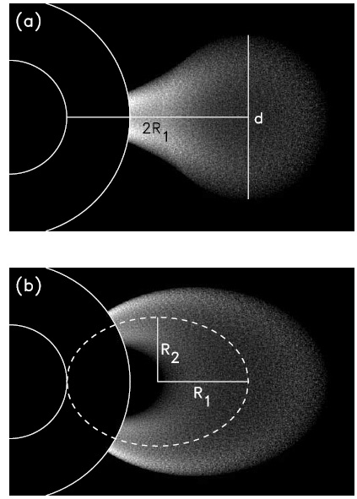
White-Light Flux Rope
Krall & St. Cyr 2006
Characterized by two parameters:
aspect ratio: Λ = 2R₁/d
and
the eccentricity ε = R_{2/}R₁
R_{tip} = 2R₁ + d/2
(d/2)/R_{tip} = 1/(2Λ +1) related to
the flux rope size Ro at 1 AU
(self-similar expansion)
Λ − Flux rope Size in the coronagraph FOV

Slide 8
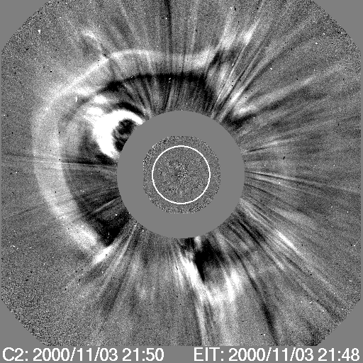
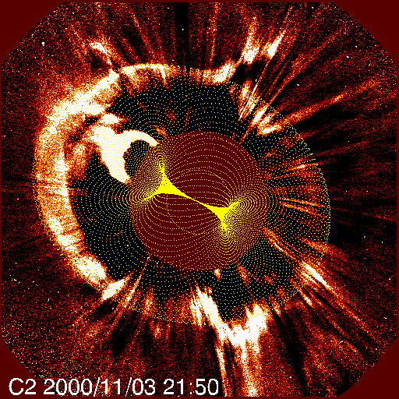
Flux rope fit can also give the Tilt Angle
SOHO/LASCO
Krall & St Cyr Flux rope
N02W02
Low-inclination flux rope

Slide 9
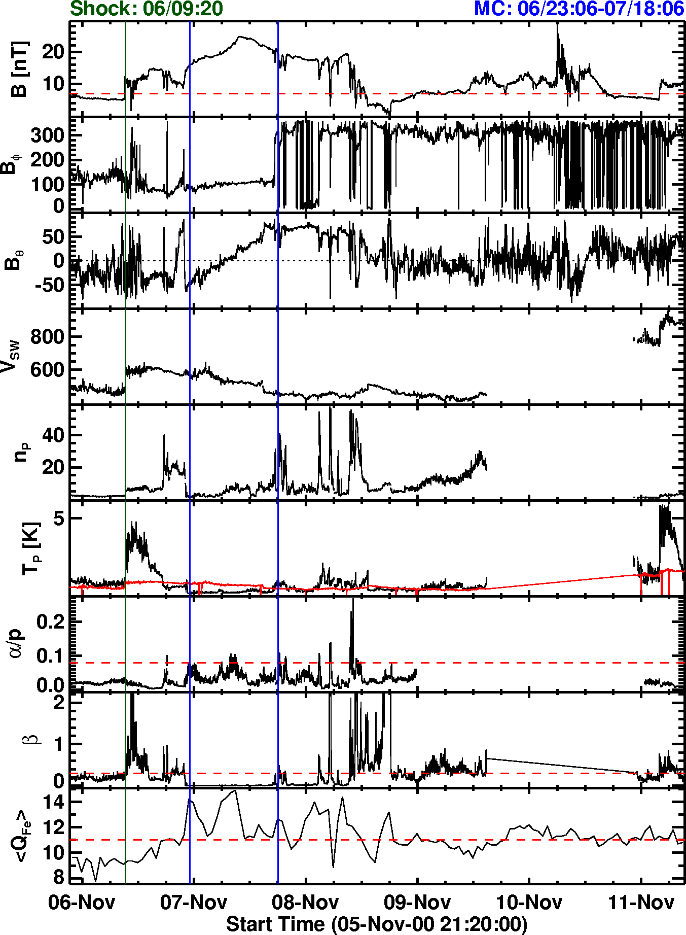
1-AU Flux Rope
Out of the ecliptic component showing
smooth rotation (Flux rope)
Earth
Exp V = 75 km/s
Ro
Bo = 23.9 nT (force-free fit)
Ro = 0.14 AU
Left handed
High Charge State → Flare connection

Slide 10
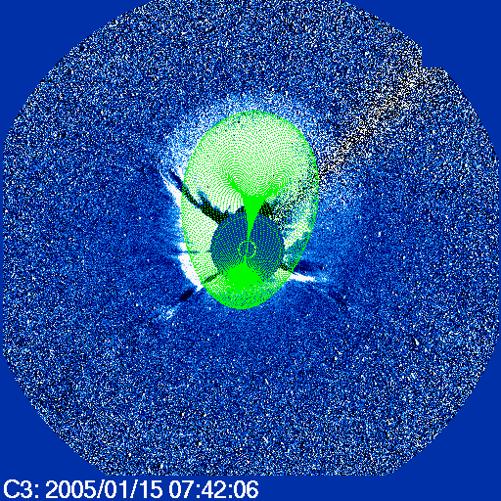
Example: High Inclination FR
Gopalswamy, 2010
Fast CME: 2049 km/s
solar source: N16E04
Flux-rope (green curves)
Λ = 2R₁/d = 1.1, d = 15.8 R_{s}
λ_{ε} = R₂/R₁ =0.9
R_{tip} = 25.3 R_{s}, R₁ = 8.7 R_{s} (R_{tip} = 2R₁+d/2)
Direction: N20W00, Tilt: 83°
Notes:
Gopalswamy, N., Large-Scale Solar Eruptions, in Heliophysical Processes, Edited by N. Gopalswamy, S. Hasan, and A. Ambastha. Astrophysics and Space Science Proceedings, Springer-Verlag Berlin Heidelberg, p. 53, 2010

Slide 11
1 AU Magnetic Field
Flux-rope fitting to 1 AU data (e.g., Lepping et al. 1990) gives
Ф_{t} = 2πJ₁(x₀₁)BoRo²/x₀₁; Ф_{p} = BoRoL/x₀₁
Bo: total field strength at the flux rope axis
L: the flux rope length (~ 1 AU)
Ro: flux rope radius at 1 AU
x₀₁: location of the first zero (=2.4048) of the zeroth order Bessel function: J₀(x₀₁) = 0
Use the Ф_{p} = Ф_{r} relation: ½ A_{f} B_{f} = BoRoL/x₀₁ to get Bo
Bo = ½ A_{f} B_{f} x₀₁/RoL
Ro = 0.5/(2Λ + 1) (self-similar expansion) (L~1 AU)
Bo = A_{f} B_{f} x₀₁(2Λ+1)
B_{t} = BoJ₀(αr) and B_{p} = HBoJ₁(αr) with 0≤r≤Ro and α = x₀₁/Ro; helicity sign H from PEA skew

Slide 12
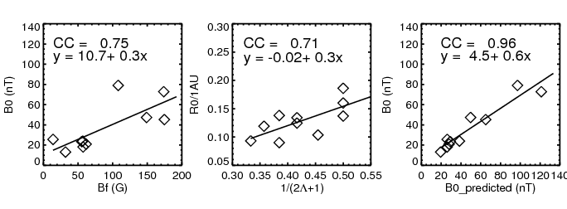
Testing the Scheme
For 10 events, we fit flux ropes to the LASCO images to get Λ
Flux rope fit to 1 AU data to obtain the axial field strength Bo
Bo also obtained from the prediction: Bo = ½ A_{f}B_{f}x₀₁(2Λ+1)
Compare Bo and Bo_predicted.
1 AU Flux rope size shows
correlation with the white-light
flux rope geometry
Ro = 0.5/(2Λ + 1)
1 AU Axial field shows
correlation with the average
flare field
1 AU axial field strength
from observations agrees
with predictions

Slide 13
Summary
Reconnection flux can be obtained from PEA
Flux rope fit to white-light CME can give 1-AU size Ro ~ 0.5/(2Λ + 1) AU (Space Weather)
Axial field of the 1-AU flux rope from flare white-light CME observations:
Bo=A_{f} B_{f} x₀₁(2Λ+1)
and hence the axial and azimuthal fluxes (Space Weather)

