Slide 1
Near Space Total Solar Eclipse
Darci Collins

Slide 2
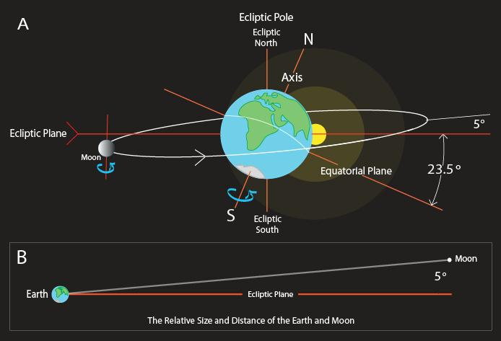
What is an Eclipse?
Notes:
The moon passes between the sun and the earth blocking the sun
A totally solar eclipse can only occur at new moon and has a maximum duration of 7.5 minutes
Node ecliptic - orbit tilted angle 5 degree so that is why we do not see an eclipse every month because
Lunar nodes are orbital nodes of the moon or the points where the moon crosses the ecliptic (so there is an ascending and decending node)
The plane of the lunar orbit precesses in space and hence the lunar nodes precesses around the ecliptic completing a revolution very 18.6 years

Slide 3
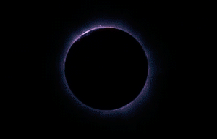
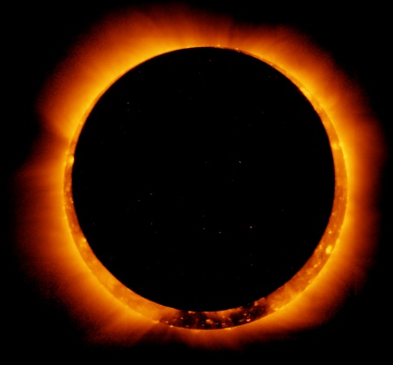
A
B
C
Notes:
So even if the moon is in a node it is often too far away to fully eclipse the sun which results in these various partial eclipses
So during the total solar eclipse no portion of the sun’s photosphere can be seen from the umbral region of the moon’s shadow
Penumbra (moon’s faint outer shadow) an Umbra (moon’s dark inner shadow) so the total solar eclipse is visable from within the umbral shadow and partial from within the penumbra
Last cross country in 1918. Last in continental US 1979.
So very rare and this is a great opportunity

Slide 4
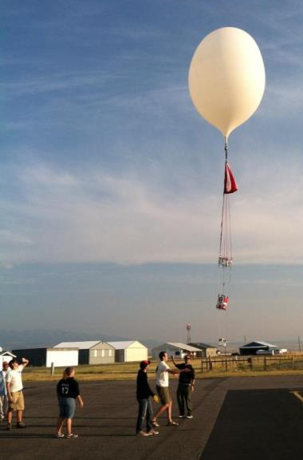
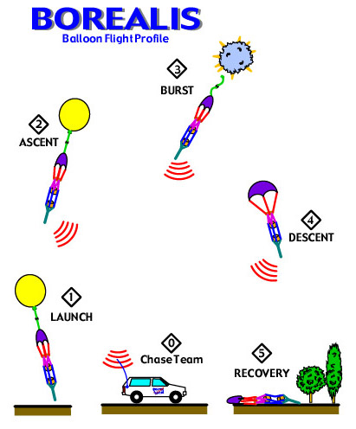
High Altitude Ballooning
Typical high altitude balloon flight
Notes:
In a space- like environment we are able to view the sun
Has been done in Austrilia with a Go-Pro in 2012
For the eclipse ballooning project, over 50 teams from across the US will send student-built payloads to the edge of space on high altitude balloons. These payloads will transmit images from the near space perspective to the NASA website for all to see
Launch the balloon in Rexberg, Idaho on August 21, 2017
Rises approximately 1,000 feet per second
During the total solar eclipse, the balloon should be between 85000- 95000 ft in the air

Slide 5
Previous balloon Launch
Other ballooning missions in the past
Notes:
(still looking to get this video to work possibly just putting link)
What is special about this is not that it is a good picture of the sun but because of the shadow from the moon

Slide 6
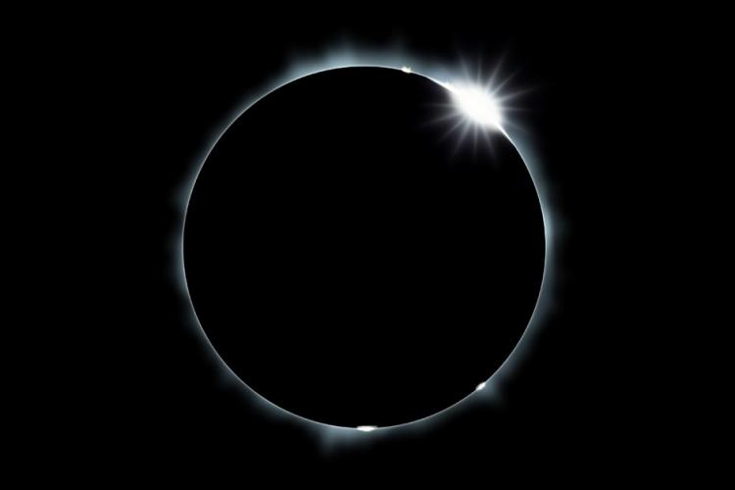
Why are we interested in the total solar eclipse?
Chromosphere/ Corona
Interplanetary Dust
Interested in Near IR
Notes:
In the region we are looking at, we are not focusing on a specific line but rather using this opportunity to see the chromosphere and potential theorized interplanetary dust (cosmic dust btwn planets and dust can obscure light so we can look for the light that is not there)

Slide 7
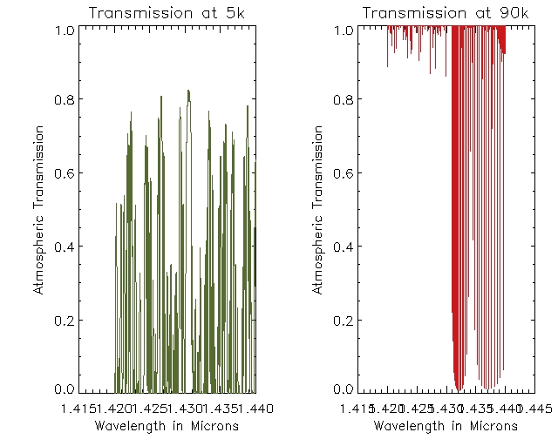

Slide 8
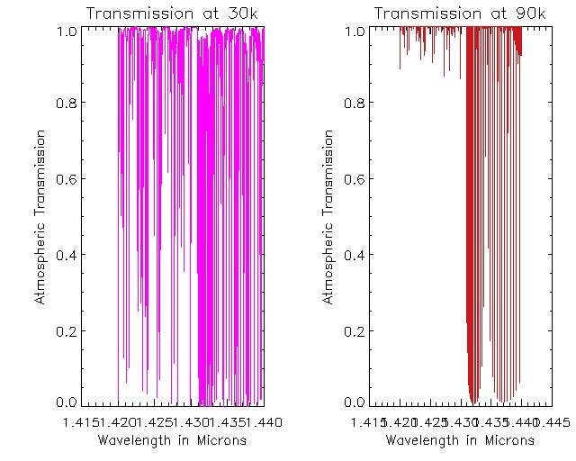

Slide 9
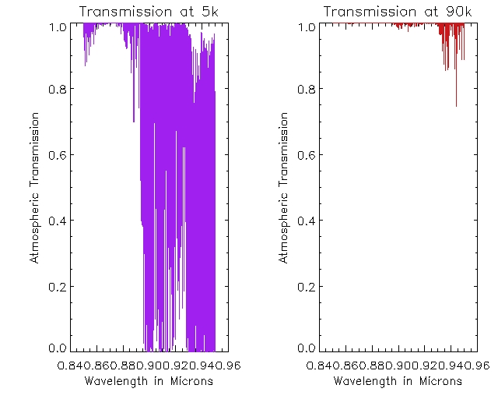
The IR Spectrum
Notes:
IR TRANSMISSION: going to work on the graphs above currently but this is a sample of why the ballooning is so important and useful
-we get past 99% of the atmosphere and can see a lot more than on the ground
-second graph is at 90,000 feet above ground
-first is at 5,000 feet above ground which is approximately the elevation of Rexberg
-So 1.0 is completely transmitted so we can see a lot more the higher we go

Slide 10
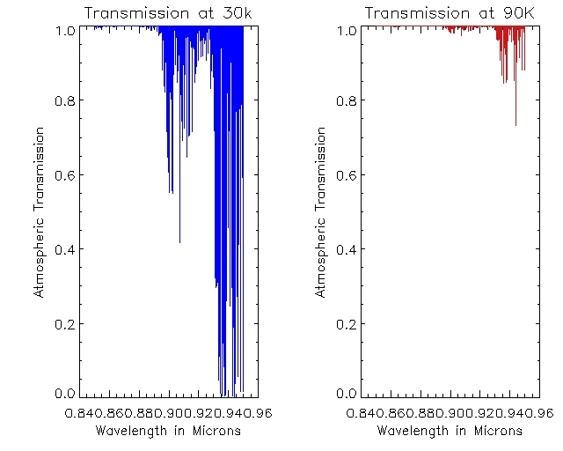
IR
Notes:
This is at 30,000 ft and 90,000 to compare the difference and prove further that the ballooning has advantages
This is about where a plane would be so a lot less IR rays are blocked out from the atmosphere the higher we go- which is why ballooning allows us to get a good amount of transmission without the cost of space travel

Slide 11
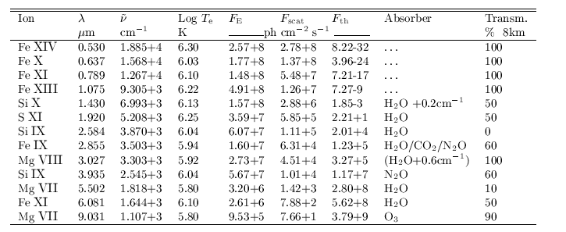
Coronal Magnetic Field
Interested in Si X with a wavelength of 1.430 micrometers
Not feasible for the balloon
Notes:
-SI X is about measuring the magnetic field
Measurements of components of vector magnetic field in the solar corona can yield info critical to our understanding of cornal structure (dynamics and heating)
The well known forbidden coronal emission lines of magnetic dipole character appear to have the highest potential to address outstanding problems in coronal physic espeically those related to the storage and release of magnetic free energy
We cannot directly measure the coronal magnetic field because it isn’t bright enough so during the eclipse currently

Slide 12
Coronal Magnetic Field
Interested in Si X with a wavelength of 1.430 micrometers
Not feasible for the balloon
Notes:
-SI X is about measuring the magnetic field
Measurements of components of vector magnetic field in the solar corona can yield info critical to our understanding of cornal structure (dynamics and heating)
The well known forbidden coronal emission lines of magnetic dipole character appear to have the highest potential to address outstanding problems in coronal physic espeically those related to the storage and release of magnetic free energy
We cannot directly measure the coronal magnetic field because it isn’t bright enough so during the eclipse currently

Slide 13
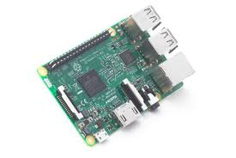
Camera
Raspberry Pi 3 No IR filter camera
The Raspberry Pi is a low cost, credit-card sized computer
It is cost effective and small
Notes:
Features:
Fits on the 6lb payload
Are able to program in Python or Linux on the camera so we can preset exposure time, sharpness, brightness
which is something we have to look into doing still
Only sensitive until about .95 micrometers
8 mg pixel camera

Slide 14
Where will you be?
August 21, 2017

