Slide 1
Light and Fast Terrestrial Gamma Flash Recorder
Jacob Adams

Slide 2
A Terrestrial Gamma-ray Flash (TGF) is a ~millisecond burst of radiation
Produced from lightning strikes
Beamed from within thunderstorm, 10-15 km up in the atmosphere
Accelerated electrons with energies up to tens of MeV (this is disputed)
Short duration on the order of 0.1 to 2 ms
Extraordinarily bright ~10¹⁸ gamma rays
Notes:
Things people argue about: Electron energies (could be from pile-up), where they are produced.
Speech: Terrestrial gamma ray flashes are quick bursts of radiation emitted from thunderstorms. They are caused by accelerated electrons with energies up to tens of MeV. These events only last for a millisecond or so before they are over. These bursts are very bright and produce many gamma rays. In fact, TGF’s are so bright that they saturate gamma ray detectors on satellites 400 miles up.

Slide 3
TGF’s can be harmful
High energy electrons scattered by TGF’s can escape the atmosphere and hit orbiting spacecraft (Dwyer et al., 2008; Briggs et al., 2011)
Radiation is intense enough to create health concern for passengers and crew (Dwyer et al., 2010)
Notes:
Above about 50 km, many of these high-energy electrons (and positrons, for cases of pair production by multi-MeV gammas) escape the atmosphere and follow a magnetic field line through the radiation belts and over to the magnetic conjugate point, where they have been seen to hit orbiting spacecraft (Dwyer et al., 2008; Briggs et al., 2011).
In the avalanche region, TGFs radiation is intense enough to create a health concern for airplane passengers and crew (Dwyer et al., 2010). In fact, new information on the low altitude of TGF production (~12km versus ~ 15km as we thought at the time of that paper) suggests that the worst-case dose could approach 1 Sv, comparable to a lifetime’s natural dose and enough to produce radiation sickness and a significant risk of death.
Low chance of harm. Because they are rare and you would have to be right above the flash
Speech: TGF’s have the potential to be harmful to humans and aircraft. They have been shown to scatter electrons out of the atmosphere where they follow a magnetic field line through the radiation belts. From here they have been detected hitting spacecraft. In addition, if an airplane was flying above or near a thunderstorm and was in the avalanche region of a TGF, the radiation would be strong enough to cause health problems. In a worst case, the radiation dosage could be as much as one Sievert which is equivalent an entire lifetime of radiation. Although, this is unlikely as TGF’s are rather rare and a plane would have to be directly above the electron avalanche to be affected by this much radiation.

Slide 4
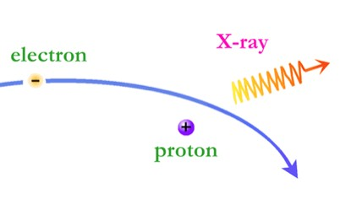
TGF’s are created by high energy electrons
Electrons are accelerated via strong electric field inside a thundercloud. These high energy electrons collide with the air and emit gamma rays through bremsstrahlung interactions. (Kippen, 2012)
Still unsure what causes the initial avalanche of electrons
Bremsstrahlung interaction
Notes:
http://permalink.lanl.gov/object/tr?what=info:lanl-repo/lareport/LA-UR-12-26453
Speech: Current theories on TGF production say that electrons are accelerated by a strong electric field inside of a thundercloud to nearly the speed of light. These electrons interact with the air and sometimes produce gamma rays or x-rays through bremsstrahlung interactions. Bremsstrahlung radiation is the result of an electron being decelerated by an atom. The electron has a certain kinetic energy before being decelerated by an atom, the loss in kinetic energy of the electron is is conserved in the form of a photon. This being said, it is still uncertain what causes the initial avalanche of electrons. The two current theories say that the avalanche is either created by multiple seed electrons coming off of the lightning leaders, or the avalanche is started by one seed as part of the relativistic feedback model displayed above.

Slide 5
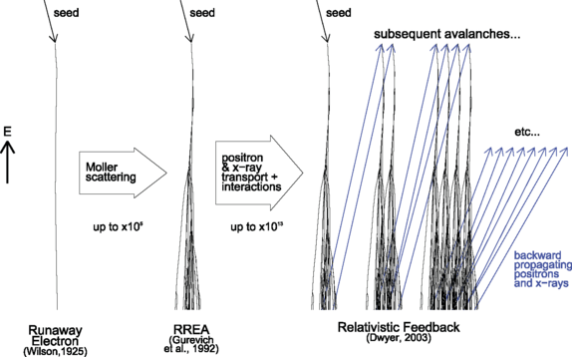

Slide 6
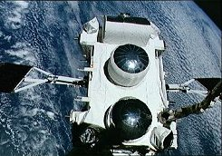
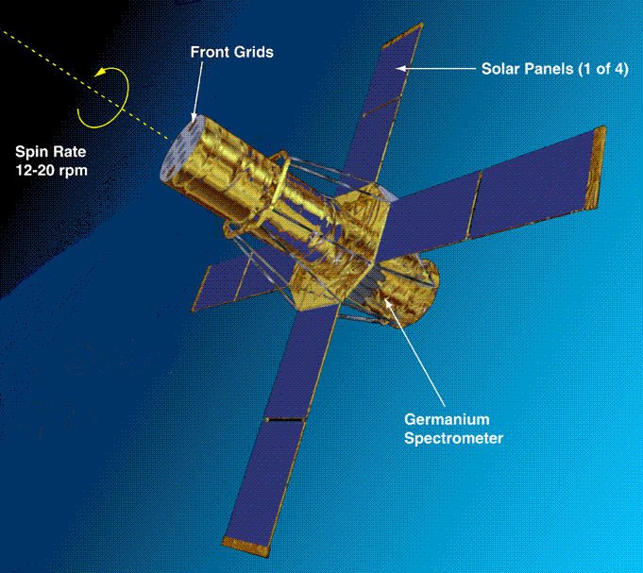
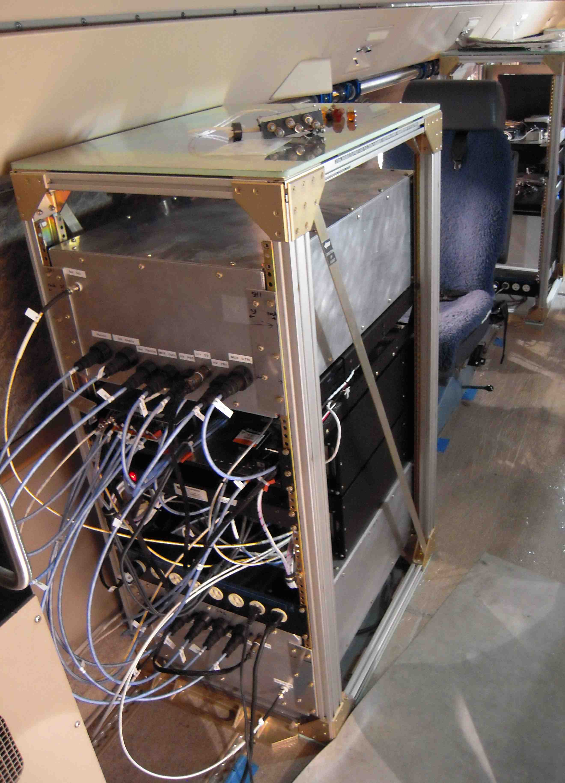
Previous detection of TGF’s
BATSE 1994
First detection
Found association with thunderstorms
RHESSI 2005
Measured many TGF’s,
Energies greater than 20 MeV
Association with Intra Cloud (IC) lightning
Adele 2009-present
Flown on a plane at ~14 km
ADELE passed by 1213 lightning flashes within 10km horizontal distance and saw only one TGF (Smith, 2011)
Notes:
Study of high energy radiation from thunderstorms is only about two decades old
RHESSI is not made to measure TGF’s
ADELE was flown off to the side of thunderstorms, not directly overhead.
Speech: The study of high energy radiation from thunderstorms is only about two decades old. Began with BATSE in 1994 when that satellite measured a few TGF’s and found its correlation to thunderstorms below. RHESSI was another satellite that has measured TGF’s, and has had many detections of the flashes. It measured energies greater than 20 MeV and saw an association with intra cloud lightning. Finally, there has been ADELE which differs from the other two in that it was flown on a plane and not in space. Although ADELE flew by many lightning strikes and only saw one TGF. This is likely due to ADELE flying off to the side of thunderstorms and not right above.

Slide 7
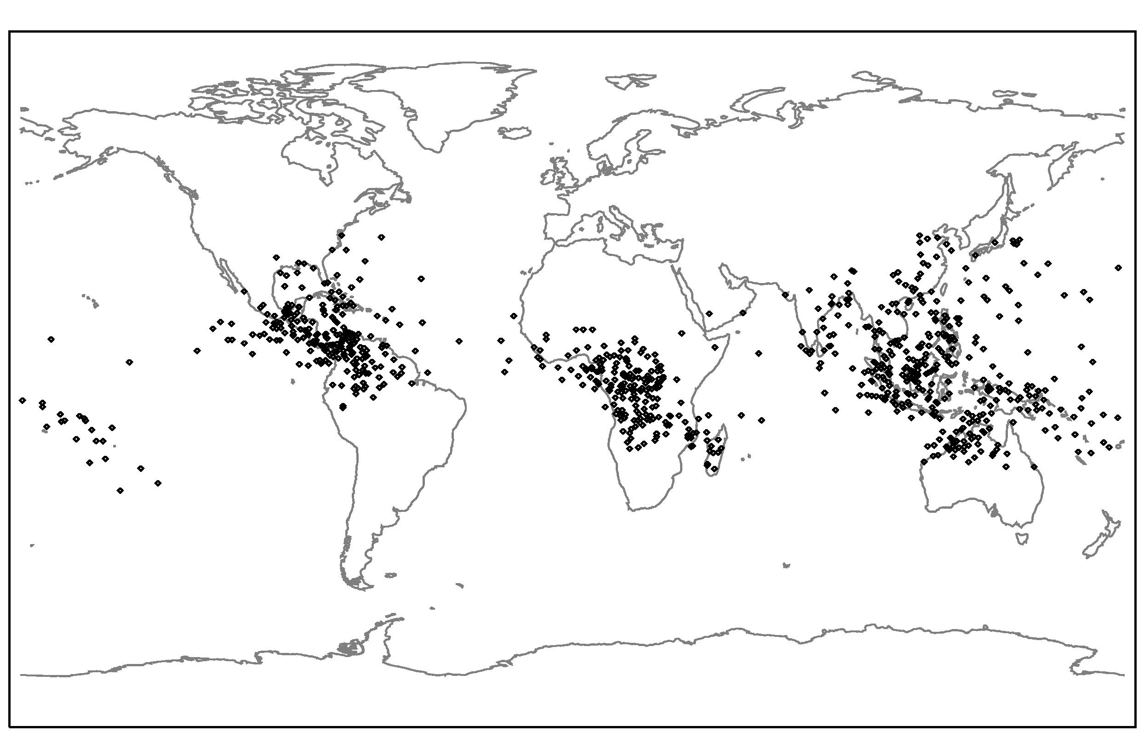
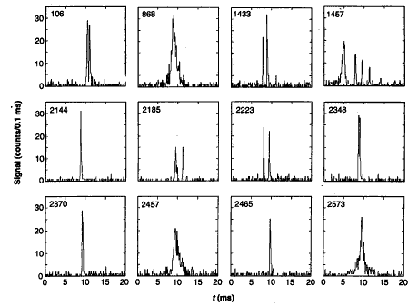
Light and Fast TGF Recorder (LAFTR) aims to answer questions about TGF’s
What is the low intensity end of the luminosity distribution?
What production model is favored by the time substructure?
TGF map from RHESSI satellite data
TGF time profiles from BATSE satellite data (Fishman et al. 1994, Science)
Notes:
Are there TGF’s that produce smaller intensities? Not quite on the order of ~10¹⁸ gamma rays
Are the production of TGF’s from something liked stepped leaders with multiple seeds? Or are they produced by one seed?
Images are from RHESSI, they show that not many TGF’s happen up north… Why?
Graphs show that we are uncertain whether or not
Speech: We know that TGF’s are very bright as measured by satellites such as RHESSI. However, we have not seen the lower end of the spectrum for TGF’s. Maybe there are less intense TGF’s that are not as bright and therefore can not be detected by these satellites. As can be seen by the map of RHESSI satellite data, the TGF’s are focused near the equator. This is in part because lightning is more common in these places, even so there are no TGF’s in the Montana area. This may mean that there are other qualifications for a TGF, and not just a lightning strike. Lastly, LAFTR aims to find out which production model is most likely for TGF’s. It is uncertain whether or not the electron avalanche is caused by a single seed which would cause a near instantaneous burst of radiation similar to this graph(point at a sharp slope). Or maybe, the avalanche is started by multiple seeds in a sort of stepped leader process similar to this graph (point to stepped graph). Other LAFTR will be the first detector of its kind with a fast enough time resolution to see which production model is more likely.

Slide 8
LAFTR has advantages over previous detectors
Get closer to the thunderstorm
Gain signal according to 1/r²
Some atmospheric absorption is eliminated as compared to satellites
Lightweight, micro payload design allows for wide deployment
High time resolution
Notes:
Gain signal according to 1/r^2, atmospheric absorption is eliminated
Measure at least 1000 counts in a millisecond\
Speech: LAFTR will get much closer to the TGF’s than satellites have before. Since the signal drops off at a rate of 1/r² , The signal LAFTR receives will be roughly 1600 times brighter than the signal seen by a satellite. Also, there will be less atmosphere between LAFTR and the original electron avalanche, meaning that less of the gamma rays will be scattered by the air. As compared to detectors flown on aircraft such as ADELE, LAFTR will have a better chance of being in the direct beam radius. This is because the beam radius grows larger the farther away from the original source. Therefore LAFTR flown at 15 km above the avalanche has a 56 times better chance of being in the direct beam radius than a detector that is 2 km above the avalanche. Finally, LAFTR will focus on having a precise time resolution so that we can gain insight into how the TGF was started.

Slide 9
Mechanical design requirements
Withstand forces of up to 2 g’s on takeoff and 10 g’s on parachute deployment
Shield electronic components from noise
Total weight less than 6 lb
Keep payload thermally stable
Notes:
Less than six pounds to satisfy FAA regulations
Smallest volume possible for aerodynamics

Slide 10
Design
Surround individual components in aluminum enclosures to avoid noise
Bolt aluminum enclosures together and place into thin plastic shell
Plastic shell placed into polythene foam box for insulation and shock absorption
Wrapped in aluminum tape to reflect radiation from the sun
Notes:
Wires must be shielded as well
Special mounting hardware for PMT tube since it is delicate
Run vibration tests on hardware to ensure it can handle the forces

Slide 11
Transparent portion is the plastic case, red case represents the power supply, yellow case is the UCSC board, orange case is the MSU board, and the black case is the detector (PMT). Units given in inches
Transparent portion is the foam enclosure, colored box is the plastic case. Units given in inches.

Slide 12
In the meantime
Get PMT detector up and running for testing
Use oscilloscope to generate a function similar to that of an event in order to test the software
Notes:
Many things need be to finalized about the detector. How much power will it draw? Will the voltage divider/D-socket work in a vacuum? What is the best way to support it?
See if the computer science guys code is fast enough for what we need

Slide 13
References
1. D. M. Smith et al. , Science 307, 1085 (2005).
2. D. Smith. (2015). Results and Prospects for Terrestrial Gamma-ray Flashes [PowerPoint slides].
3. M. Kippen. (2012). Terrestrial Gamma-ray Flashes [PowerPoint slides]. Retrieved from http://permalink.lanl.gov/object/tr?what=info:lanl-repo/lareport/LA-UR-12-26453
4. D.M. Smith, J.R. Dwyer, B.J. Hazelton, B.W. Grefenstette, G.F.M. Martinez-McKinney, Z.Y. Zhang, A.W. Lowell, N.A. Kelley, M.E. Splitt, S.M. Lazarus, W. Ulrich, M. Schaal, Z.H. Saleh, E. Cramer, H.K. Rassoul, S.A. Cummer, G. Lu, R.J. Blakeslee, Geophys. Res. Lett. 38(8), L08807 (2011b)

