Slide 1
All Sky Polarimetry with DSLR Cameras
Advisor: Dr. Joseph Shaw
Presenter: Kendra Gillis
Notes:
DSLR = digital single-lens reflex

Slide 2
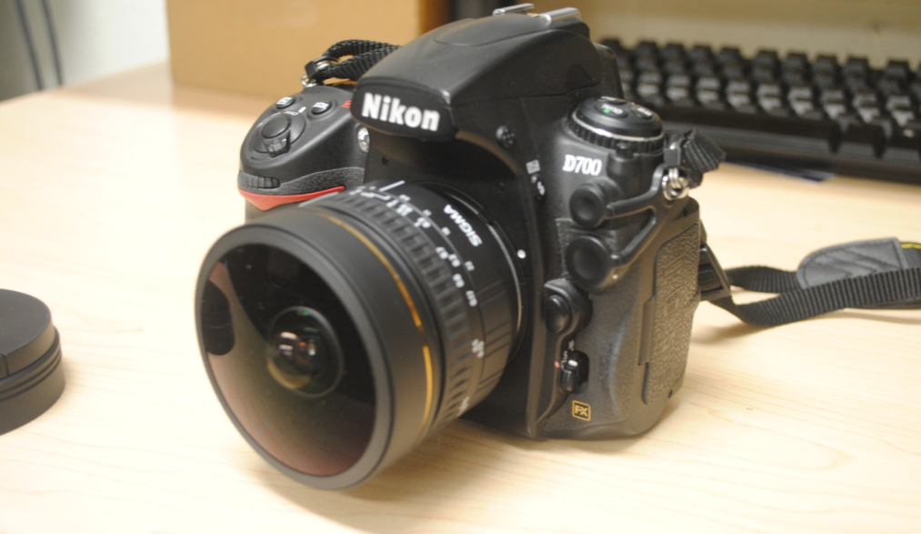
DSLR Camera

Slide 3
The Coming Solar Eclipse
Notes:
Quickly explain that your research is in reference to the coming eclipse (as Logan already pointed out).

Slide 4
Sky Polarization
Notes:
Show what polarization looks like on a normal day
Explain why (Rayleigh scattering)

Slide 5
Sky Polarization
Notes:
Show what polarization looks like on a normal day
Explain why (Rayleigh scattering, dipole scattering)
Remember, most of these arrows go into the screen

Slide 6
Sky Polarization
Notes:
Show what polarization looks like on a normal day
Explain why (Rayleigh scattering)

Slide 7
Sky Polarization
Shaw, Joseph A., et al. "Continuous Outdoor Operation of an All-sky Polarization Imager."
Notes:
Show what polarization looks like on a normal day
Explain why (Rayleigh scattering)

Slide 8
Sky Polarization During the Eclipse
Shaw, Glenn E. “Sky Brightness and Polarization During the 1973 African Eclipse”
Notes:
Measurements have been made, but have been a sweep
There was a-symmetry, unsure where it came from so we want an all-sky imager

Slide 9
Sky Polarization During the Eclipse
Brigitta Sipo ̋cz, et al. “Spatiotemporal change of sky polarization during the total solar eclipse on 29 March 2006 in Turkey: polarization patterns of the eclipsed sky observed by full-sky imaging polarimetry
Notes:
Explain why the polarization is different
Explain multiple scattering
Explain the intense lighting difference

Slide 10
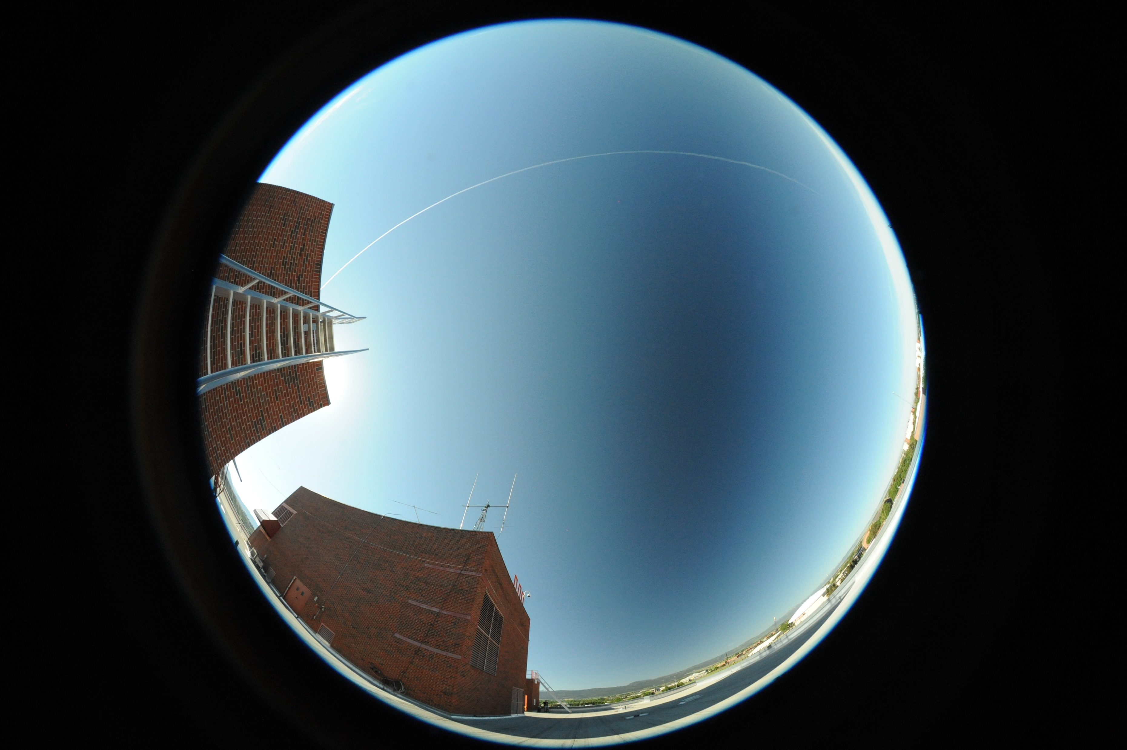
DSLR Camera
Notes:
Contrail

Slide 11
DSLR Camera
Notes:
Polarizing filter had to be put in on the back
We’re unsure how the polarization of light will be affected by the lens

Slide 12
DSLR Camera

Slide 13
Whole set-up
Notes:
In the future, We want three or four cameras, each with a different polarizing lens

Slide 14
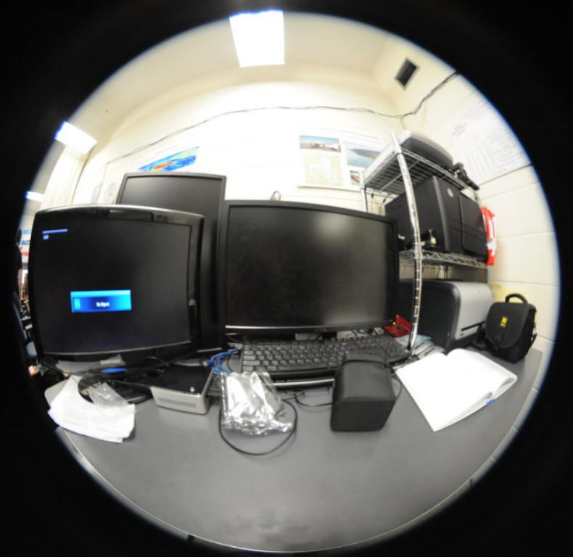
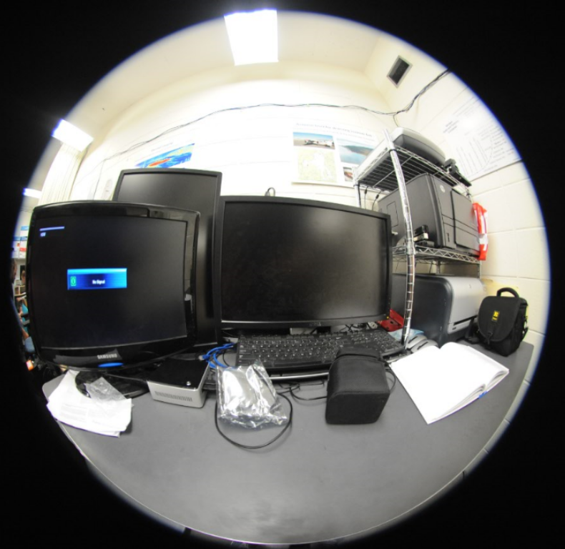
Polarizer Orientation
Notes:
Some may be in house
Don’t know how the fish eye lens will affect polarization
Mention Yoav Schechner!!!
Horizontal then vertical

Slide 15
Changing Sky Brightness
Notes:
Sky brightness will be equivalent to full moon or twilight
Can’t rely on automatic settings

Slide 16
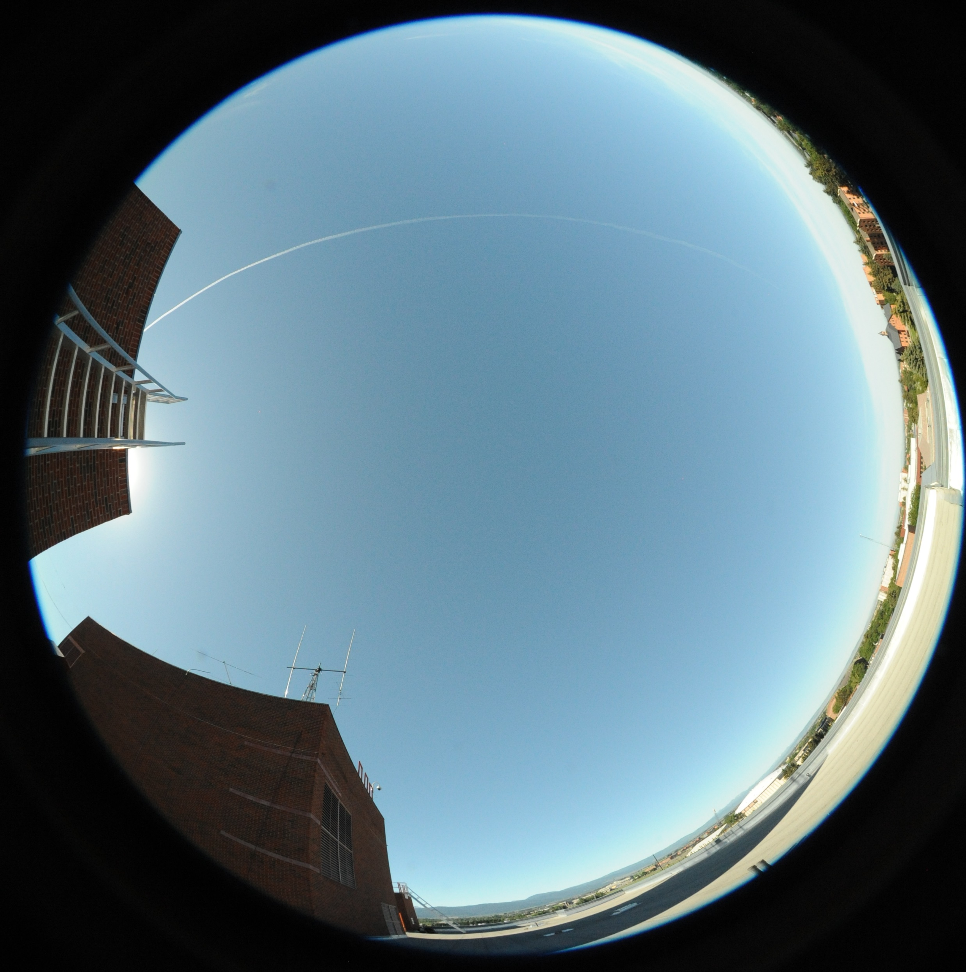
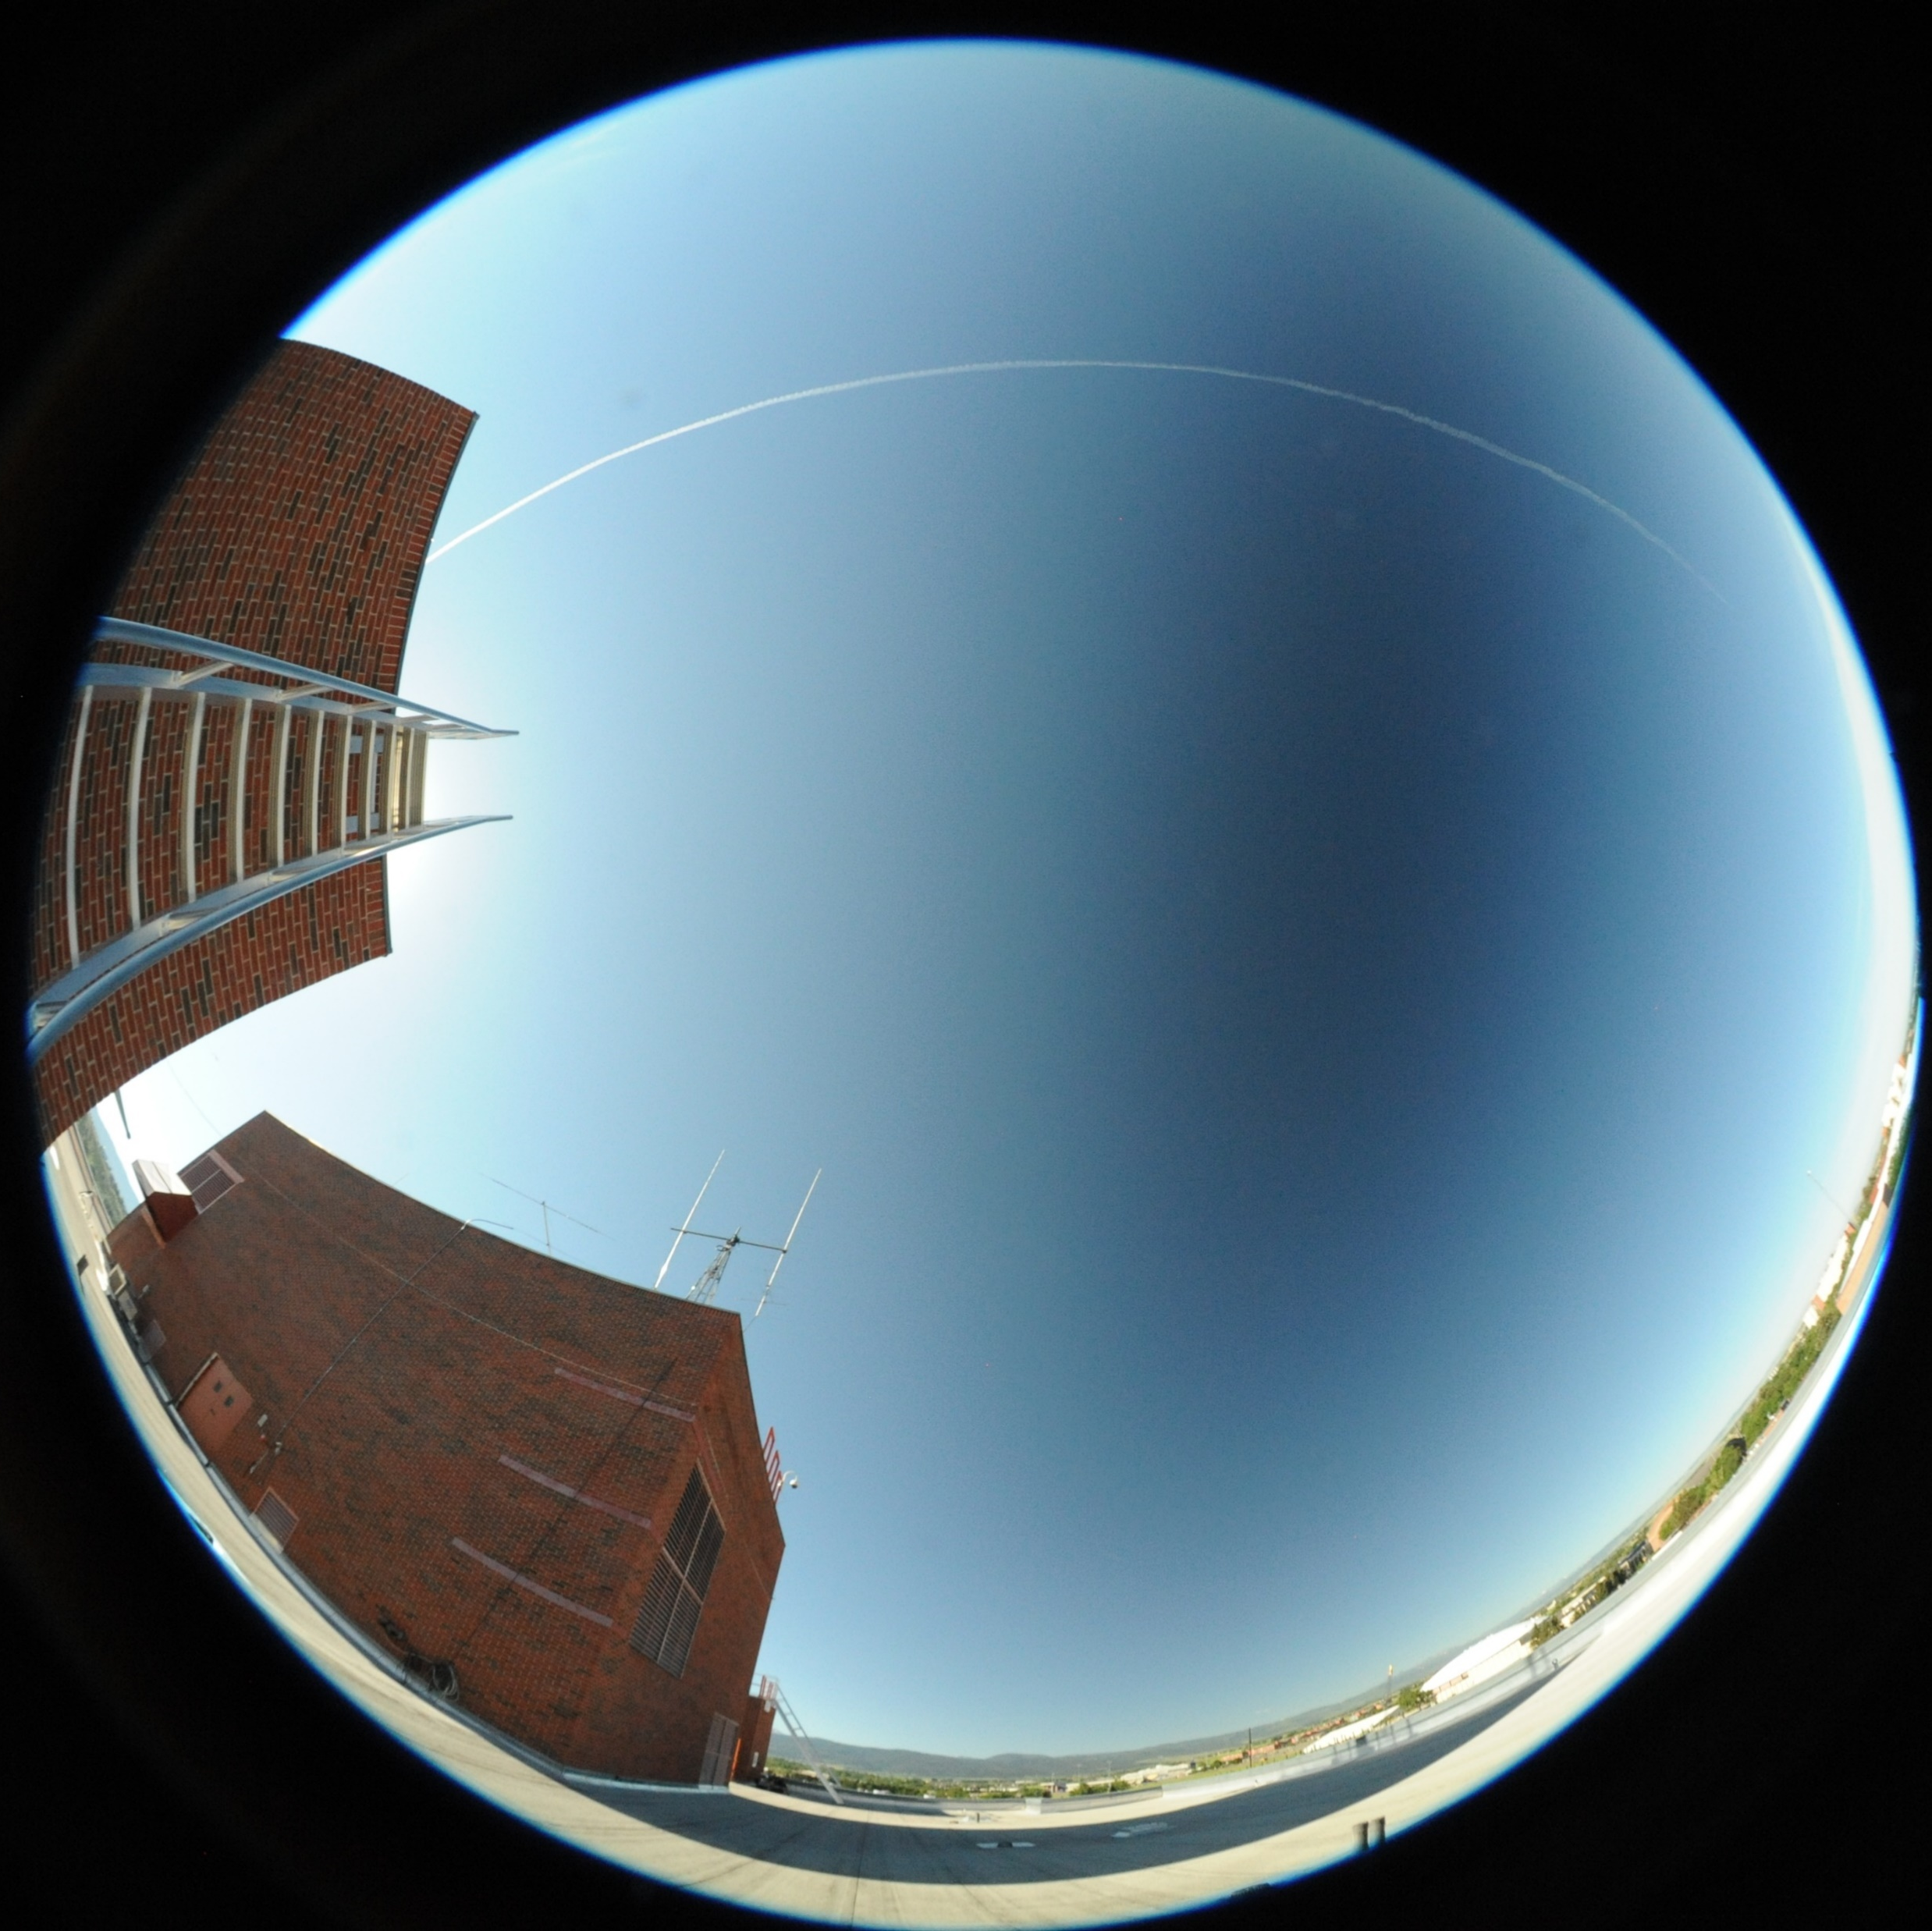
Aligning pictures
Notes:
Because of the slightly different angles the pictures won’t be perfectly aligned
It’s a next step sort of thing

Slide 17
References
Eclipse picture: http://www.timeanddate.com/eclipse/total-solar-eclipse.html
Picture of sky polarization: Shaw, Joseph A., et al. "Continuous Outdoor Operation of an All-sky Polarization Imager." (n.d.): n. pag. Web.
Sweeping eclipse polarization: Shaw, Glenn E. “Sky Brightness and Polarization During the 1973 African Eclipse”
All-sky eclipse polarization: Brigitta Sipo ̋cz, et al. “Spatiotemporal change of sky polarization during the total solar eclipse on 29 March 2006 in Turkey: polarization patterns of the eclipsed sky observed by full-sky imaging polarimetry
Shadow on earth: https://upload.wikimedia.org/wikipedia/commons/4/42/Eclipse_fromISS_2006-03-29.jpg

