Slide 1
Modelling the Effect of Magnetic Field Variation on Solar Flares

Slide 2
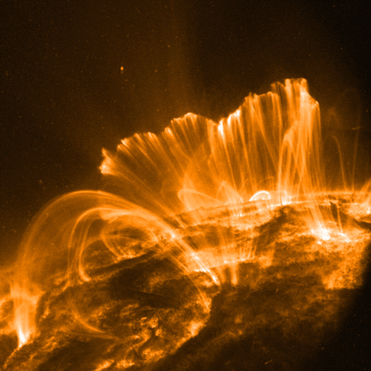
Introduction
Solar flares occur when energy is converted into x-rays ,heat & supersonic fluid motion.
Energy is stored in magnetic filed lines.
Electric field changes connectivity of magnetic field lines and the energy is released.
Field lines retract rapidly.
I’ll be looking at the post reconnection

Slide 3
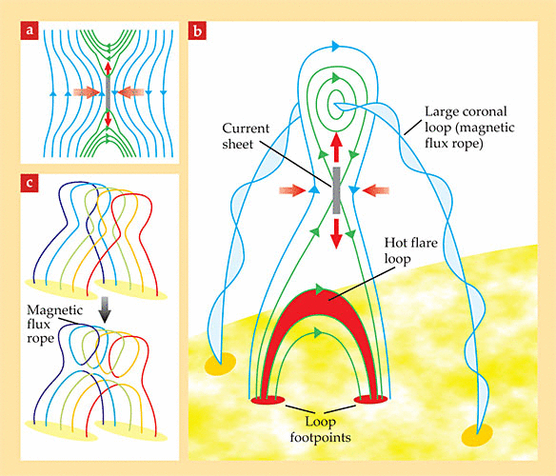
Magnetic Reconnection
Ant-parallel magnetic field lines separated by the current sheet.
Magnetic field lines move towards current sheet.
Now we have magnetic reconnection.

Slide 4
Retraction & Evaporation
Retraction releases energy
Heats Plasma
Density peak due to inward motion (where the tube’s hottest)
Thermal conduction towards the footpoints

Slide 5
Retraction & Evaporation
Increased temperature at the footpoints
Increased pressure at the footpoints
Material then pushed up into the coronal part of the tube. This is the evaporation.
Other tubes are forming above this one
As time progresses we see the cooler loops at the bottom which gives the impression that the loops are rising.

Slide 6
PREFT (Dana Longcope)
Post-Reconnection Evolution of a Flux Tube
Tube made of cells and nodes.
Lagrangian Code
PREFT based on Thin Flux Tube assumptions
PREFT contains the chromosphere

Slide 7
PREFT Equations
The Energy Equation:
The Momentum Equation

Slide 8
PREFT Equations
The Ideal Gas Law
The Continuity Equation

Slide 9
What I’m Looking At
Considering one flux tube
Looking at various shaped chambers to see if they can produce different positions for the evaporation fronts to collide.
We’ll also look into how they look in EUV

Slide 10
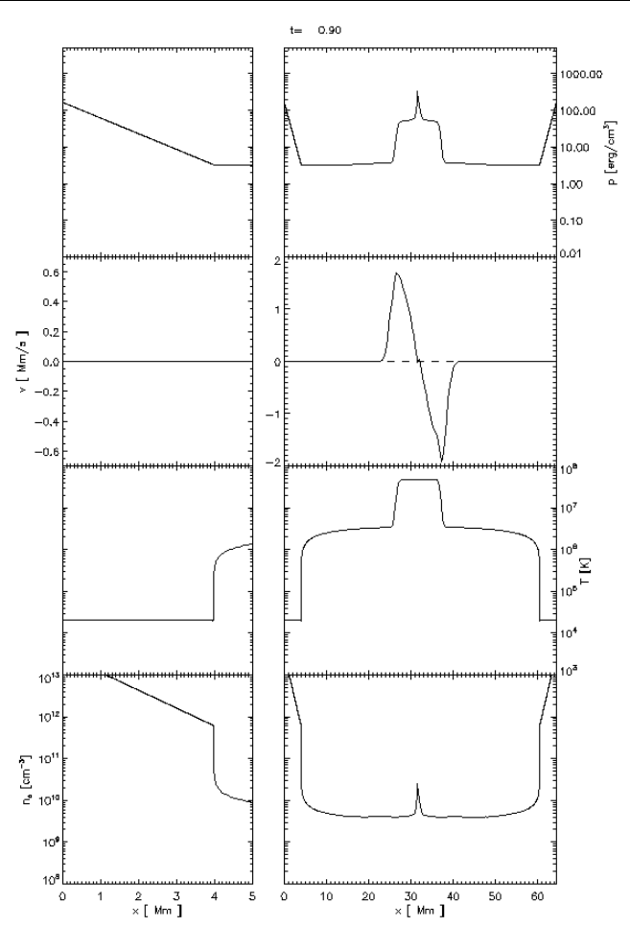
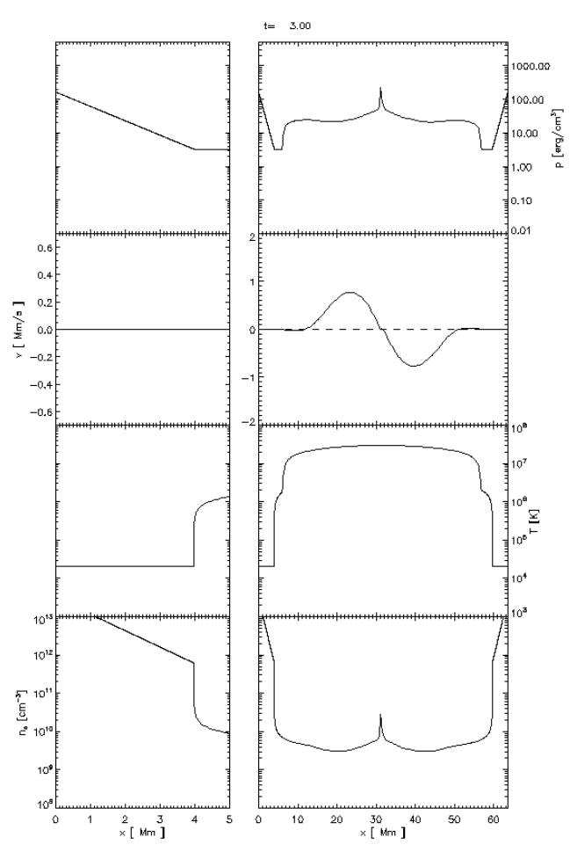
Gif of Pressure, Velocity, Temperature and Density of the Flux Tube.

Slide 11
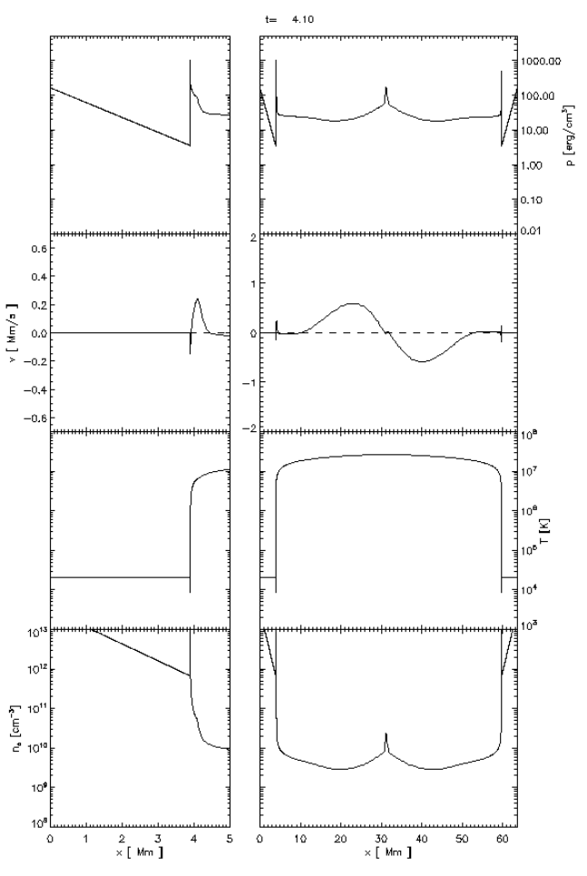
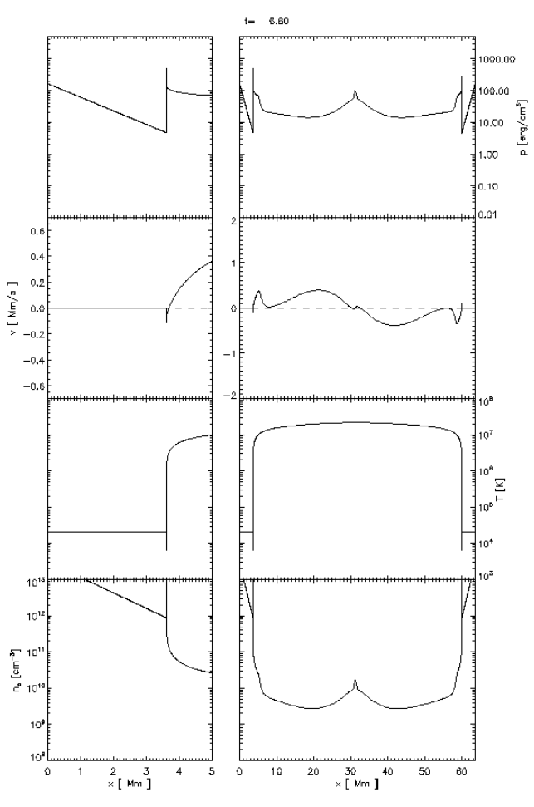
Gif of Pressure, Velocity, Temperature and Density of the Flux Tube.

Slide 12
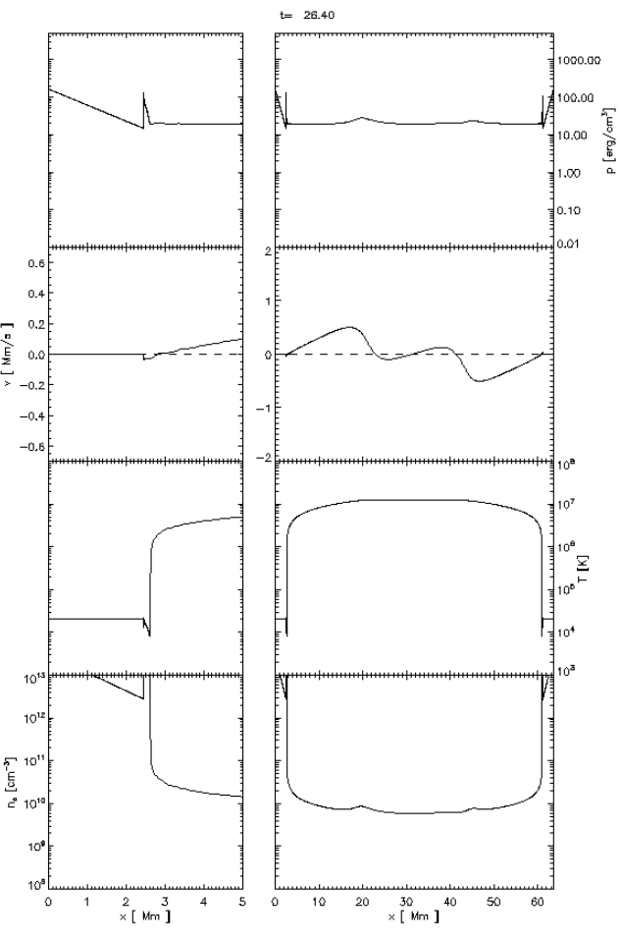
Gif of Pressure, Velocity, Temperature and Density of the Flux Tube.

