Slide 1
Hard X-Ray Footpoint Motion and Progressive Hardening in Solar Flares
Margot Robinson
Mentor: Dr. Angela DesJardins
MSU Solar Physics Summer REU, 2010

Slide 2
Outline
Theory
What is a Solar Flare?
RHESSI
Hard X-Ray Footpoints
Spectral Hardening
Project Goals
Methods and Data Analysis
Creating Lightcurves and Images
Imaging Example 1: SHS Flare
Imaging Example 2: SHH Flare
Centroid evolution
Velocity data
Conclusions
Correlation between SHH behavior and Footpoint Movement?

Slide 3
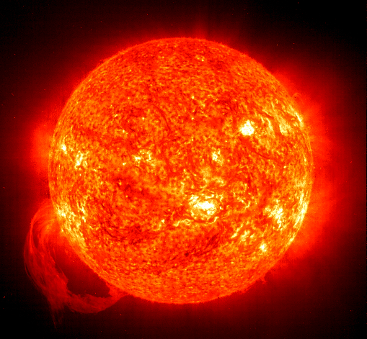
Theory: What is a solar flare?
An explosion in the Sun’s atmosphere caused by magnetic reconnection
Occur near sunspots
Concerns for Earth
Affect the Earth’s weather
Radiation due to SEP (solar energetic particles) is potentially hazardous for astronauts, spacecraft, and satellites
Potentially disruptive to Earth-based communications

Slide 4
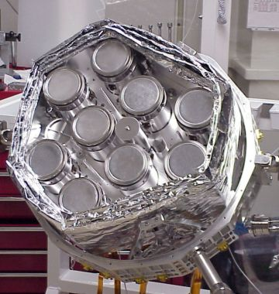
Theory: Reuven Ramaty High-Energy Solar Spectroscopic Imager (RHESSI)
Observes solar hard X-rays and gamma-rays from 3keV to 17MeV with a spatial resolution of 2.3 arcsec
Not a direct imager
Uses rotating modulation collimators similar to how a radio telescope works
Nine subcollimators, each with a photon detector at the back

Slide 5
Theory: Hard X-Ray Footpoints
Result of electrons being accelerated down along magnetic field lines
Abruptly halted by the dense chromosphere
As the flare progresses, the footpoints may spread out, migrate randomly, or remain relatively fixed
Causes behind and consequences of footpoint movement are mysterious, but possibly related to the acceleration mechanism active in the flare

Slide 6
Theory: What is spectral hardening?
Definition: When a spectra exhibits a decreased ratio of lower to higher energies
When non-thermal hard X-ray spectra become increasingly hard over time, is is known as progressive hardening, or SHH
SHS (Soft-Hard-Soft) behavior is observed more frequently
Knowing more about these HXR spectral trends will be one more clue in illuminating acceleration mechanisms in flares.
April 21, 2002 SHH Flare: Plots ratio of low to high energies

Slide 7
Theory: SHH Behavior and SEP Events on Earth
Grayson et al. (2009) show a statistically significant correlation between SHH behavior and solar energetic particle (SEP) events
Up until this point, we believed that SEP events originate with propagation of CME’s – this correlation supports the idea that SEP’s may originate at the sun.
Investigating the causes of SHH behavior is an important next step in predicting SEP events.

Slide 8
Project goals
Investigate any correlation between significant HXR footpoint migration and SHH behavior.
Image in hard X-rays the list of flares compiled in the Grayson et al. study using RHESSI data.
Determine the centroids of visible footpoints and track their movements and velocities.
Establish a standard for what constitutes significant footpoint motion.
Determine if there is any evidence for a correlation between significant HXR footpoint motion and SHH behavior.

Slide 9
Methods: Creating Lightcurves and Images
Image over highest energy with enough counts
Time intervals in multiples of 4 seconds, the time RHESSI takes to complete a full rotation
Roughly image over light curve peaks
Avoid attenuator shifts

Slide 10
Methods: Example 1, SHS Flare, June 9, 2003
35-100 keV Image
Steps:
RHESSI detectors 1-9 → results in 2.3 arcsec spatial resolution
CLEAN algorithm
Created contour plots displaying time evolution of footpoints
Calculated the centroid of footpoints at each time interval
From the centroids, calculate the velocity of the footpoints

Slide 11
Methods: Example 2, SHH Flare from April 21, 2002
35-100 keV Image
Hard X-Ray Footpoints and Thermal Loop Top

Slide 12
Methods: Centroid Evolution
SHS
SHH

Slide 13
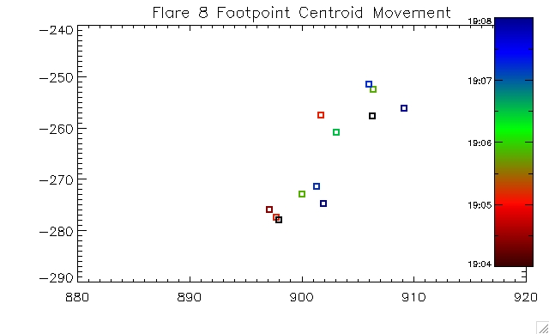
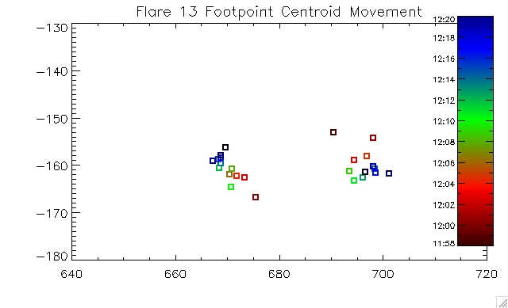
Continued…
SHS
SHH

Slide 14
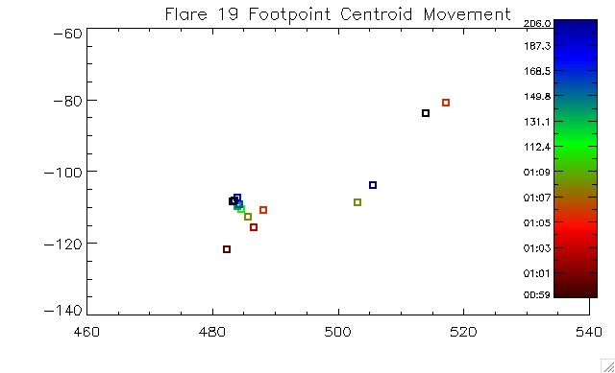
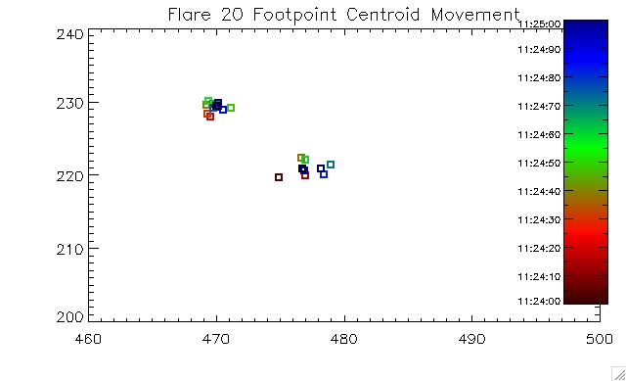
Continued…
SHH
SHS

Slide 15
Methods: Velocity data
This table shows the average velocity for each footpoint of each flare
Flare Date | SHH | FP #1 Velocity | FP #2 Velocity
Feb 25, 2002 | No | 212.39 | 87.93
Apr 21, 2002 | Yes | 88.52 | 61.66
Aug 3, 2002 | No | 217.63 | 92.89
Mar 18, 2003 | Yes | 26.37 | 18.44
May 29, 2003 | Yes | 226.23 | 30.12
Jun 9, 2003 | No | 167.27 | 342.55
Nb: Above velocities are in km/sec
Calculations are based on a 700 km per arcsec conversion.

Slide 16
Conclusions:
On average, the velocity of these SHS flare footpoints is 186.78 ±71 km/sec
On average, the velocity of these SHH flare footpoints is 75.22 ±55 km/sec.
Due to difficulty getting data from all flares imaged, we did not end up with many viable flares, which makes a conclusive statistical study difficult.
More work to be done: 17 more flares on the Grayson et al. list to be imaged, and a more exact system for converting arc seconds to kilometers at different locations on the Sun implemented.

Slide 17
Acknowledgements:
Angela DesJardins, Mentor
MSU Solar Physics group
Solar Physics REU group 2010
Sad it’s over…

