Slide 1
MSU Solar Physics REU Jennifer O’Hara
Heating of Flare Loops With Observationally Constrained Heating Functions
Advisors
Jiong Qiu, Wenjuan Liu

Slide 2
Contents
Background: Reconnection
Project summary
Method
Data Analysis
Conclusions

Slide 3
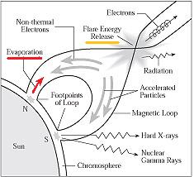
Magnetic Reconnection in Solar flares
Where oppositely directed field lines are brought in close proximity and reconnect
Become a lower energy state: -> energy release
Thermal and non-thermal electrons channelled down the loop ->emit hard and soft X rays
Heat flux along flux tubes heat Chromosphere -> UV
Heated plasma in Chromosphere can rise into the loop - Chromospheric evaporation
plasma cools and drains – Chromospheric condensation

Slide 4
Magnetic Reconnection
Reconnection continues, new loops form above old, higher in corona
Loops : 100’s of individual strands heated separately
Footpoints move apart
We can measure reconnection rate with
(Forbes)

Slide 5
Project Summary
Big picture: Understanding the relationship between reconnection and energy release.
What we know:
know flux: can measure reconnection
Know radiation (measured by GOES and AIA)
Want to know link :how this energy is released!
Specific Question:
Link is : HEATING FUNCTION
Guess that UV pixel observations reflect heating -> know times and place of heating.
Use model with heating function input to calculate radiation outputs and compare with GOES and AIA observations to see if our assumption is true.
Magnetic Reconnection
Heating Function
Radiation

Slide 6
Constructing a heating function
Model that each flare is made up of hundreds (thousands) of ind. Strands - each base is a pixel.
Formed and heated at different times.
Very bright U.V observations at feet of loops appear almost instantaneously
So can use U.V to deduce reconnection rate and can also calculate an individual heating function for each strand.

Slide 7
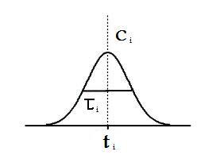
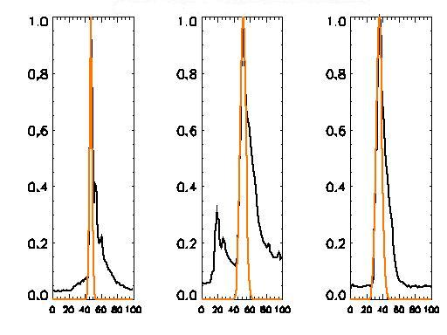
Constructing Heating Function cont’d
Each pixel has an individual UV light curve and we want individual heating function to model rise time for each.
Can use different shapes to model UV rise: Gaussian, Linear ect.
For our purposes we used Gaussian:
Observed UV
Heating Function
Comparison of Observed UV and Heat function
Time (minutes after 13.31 UT)

Slide 8
Transition region: Thin region between Chromospere and Corona, where most radiation is emitted.

Slide 9
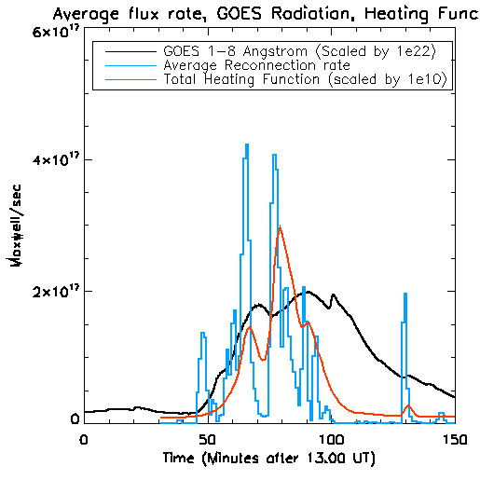
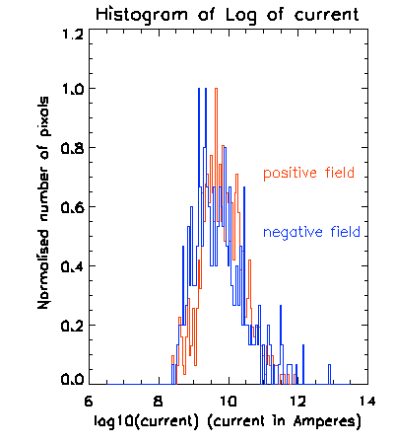
Resultant Heat Function
March 7th 2011, M1.7 class Flare, 13.45 UT
Theoretical current = energy / mag flux

Slide 10
EBTEL model
Models evolution of plasma in a single strand.
0D model : average T, n, P for each strand.
Equates the enthalpy flux with excess deficit of heat flux relative to transition region loss rate.
Q - volumetric heating rate
n - electron number density
T - Temperature P - Pressure
L - Length of strand
F0 – Fc Heat flux

Slide 11
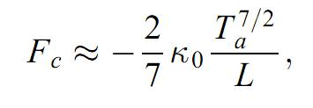
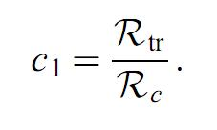
EBTEL model cont’d
Inputs: - initial temp, density and pressure
- scalar parameters c1, and total heating 𝛌
- Loop length (L): interpolated so increases for different strands
EBTEL: -Calculates initial Rc from equation above
-Use C1 to calculate Rtr .
- Sub into 3 diff eq.’s to find rate of change and new average n, P, T, then repeat
Output: - Average T,n,P at each time for each individual flux tube.
Use to make calculations and compare with observations

Slide 12
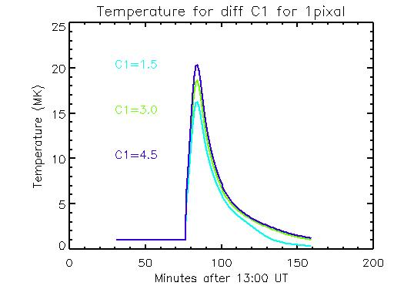
Single Flux Tube Analysis
Increased C1→ Greater total energy input
→ Greater Rtr to Rc ratio
→ After heating see less density: as less plasma as less evaporation
→ Less Rc : cools more slowly

Slide 13
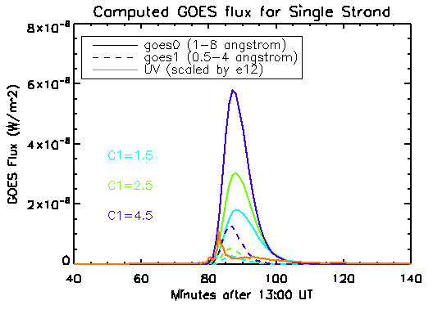
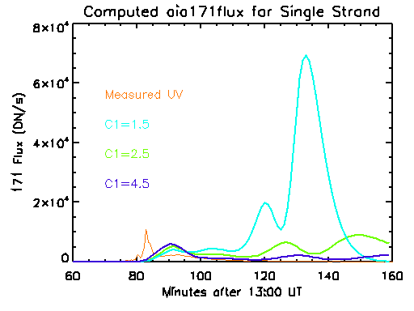
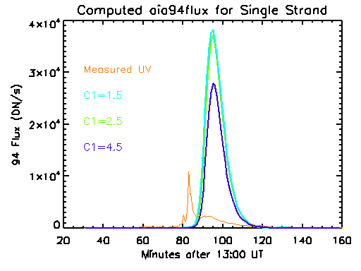
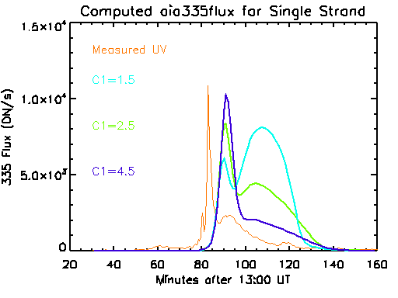
Single Flux Tube Analysis

Slide 14
Temperature and Density Distribution
982 flux tubes
Ranges are consistent with expected values
Use T and n for each flux tube to calculate expected radiation and
compare with obs.

Slide 15
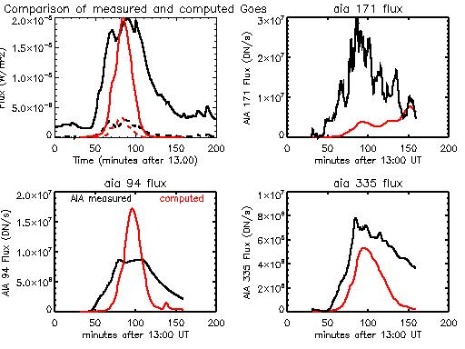
Comparison With Observed Data

Slide 16
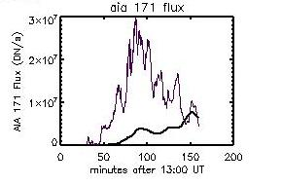
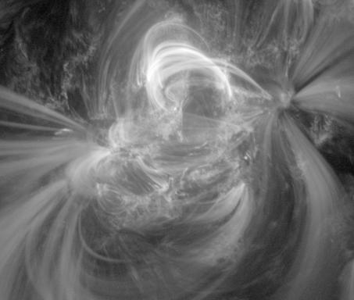
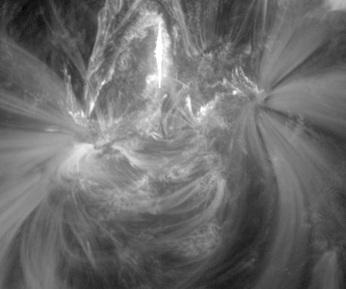
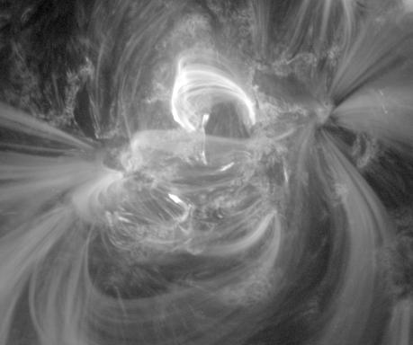
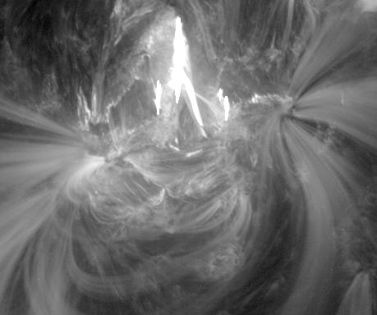
Observed Coronal structures that radiate at 171 Angstroms
Time: 15.35 UT
Time: 14.16 UT
Time: 15.10 UT
Time :14.30 UT

Slide 17
Conclusions
Calculated radiation using EBTEL fits reasonably well with observed values
Supports use of Individual strand Heating Function from UV obs.
Effect of C1 :
Some wavelengths more sensitive
Effect of Inaccurate Response functions
In the Future?
Physical model to determine how C1 should change

Slide 18
References
Klimchuk, A. J., Patsourakos, S., Cargill, P. J. 2008, ApJ, 682, 1351
Longcope, D., Des Jardins, A., Carranza-Fulmer, T., Qiu, J., 2010, Solar Physics, 267, 107
Acknowledgements
Jiong Qiu for her patience and guidance
MSU Physics faculty for their warm welcome
All the REU Students

