Slide 1
Simulating Shocks in Solar Flares
Daniel Gordon
Adviser: Dana Longcope

Slide 2
Introduction
Magnetic reconnection is a significant mechanism for phenomenon involving high energy release such as solar flares.
Post-reconnection field lines act like elastic bands under tension.
Aim to investigate case where magnetic reconnection occurs at two points simultaneously.

Slide 3
Method
Tube dynamics well approximated by thin flux tube equations.
Equations solved on 1D Lagrangian grid (1000 points) with head conduction, diffusion, viscosity.
My task was to design code to make the initial setup (right).
Typical scales: 60 Mm tube length, constant 60 G magnetic field, retraction observed up to 6.0s after reconnection event.

Slide 4
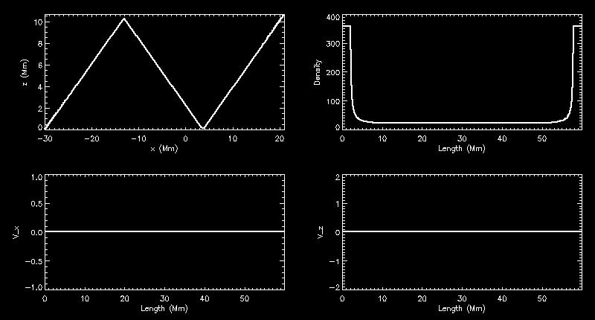
General Features & Evolution
Tube bend retracts at Alfven speed.
Tube length decreases with retraction causing plasma compression, density build-ups, due to supersonic flows either side of retracting regions which push plasma in to bends.
Interesting behaviour when flows collide.

Slide 5
Investigating the Density Drop-off
Interaction in v_x causes density evacuation at midpoint between bends.
Looking at the minimum density reached over 4.0s in the density/angle phase plane reveals a minimum.
Why this angle?

Slide 6
Deeper Investigation: Varying Temperature
T=1.0Mm
T=2.0Mm
T=1.0Mm gives rise to odd behaviour.
Minimal density achieved at 4.0s has relationship with temperature.
More work needed here to find this relationship more explicitly.
T=4.0Mm
T=5.0Mm

