Slide 1
Flux Tube Retraction Following Multiple Simultaneous Reconnection Events
Simulating Shocks in Solar Flares:
Daniel Gordon
Supervisor: Dana Longcope

Slide 2
Presentation Outline
Introduction
  Background
  The model
  Previous results (single reconnection event)
  The multiple reconnection case
Results
  Overview
  Similarities and differences between cases
  The differences in more detail
Summary & References

Slide 3
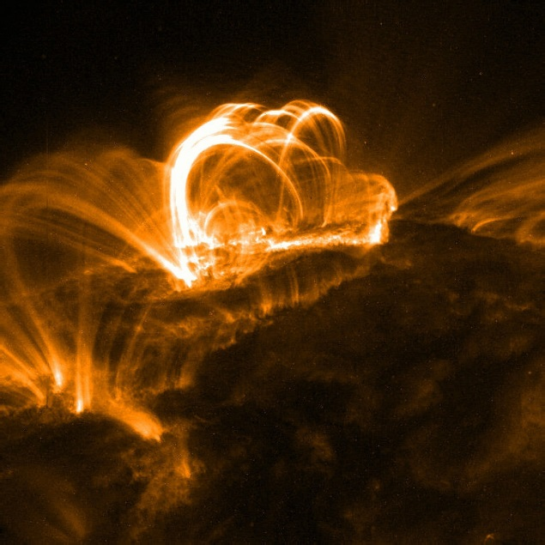
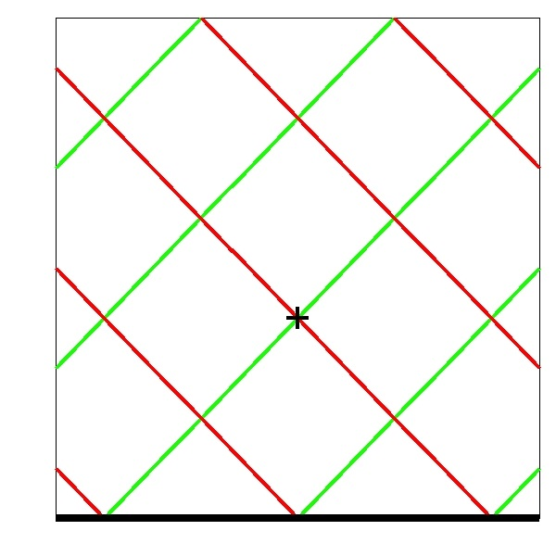
Introduction
Background
Reconnection a significant mechanism for phenomenon involving high energy release; solar flares, CME’s.
Post-reconnection field lines act like a string under tension. What happens to the plasma in the tube in terms of density, temperature, velocity, etc?

Slide 4
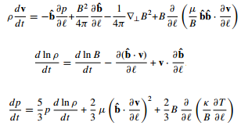
Introduction
The Model
Tube dynamics well approximated by Thin Flux Tube equations (for plasma beta << 1).
Solved on 1D Lagrangian grid of 1000 points.
Includes heat conduction, diffusion, viscosity (no gravity). B constant in this case.
Motion
Code: PREFT (Guidoni, Linton, Longcope)
Density Evolution
Energy Equation
& more.

Slide 5
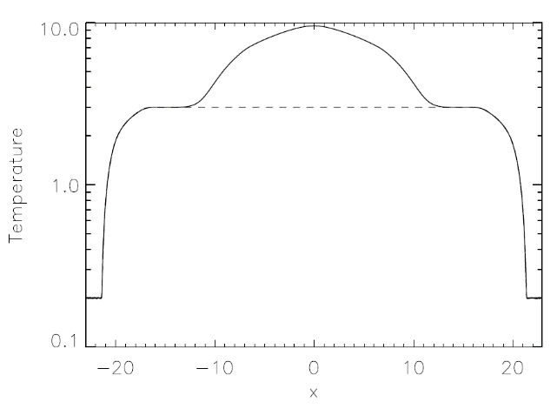
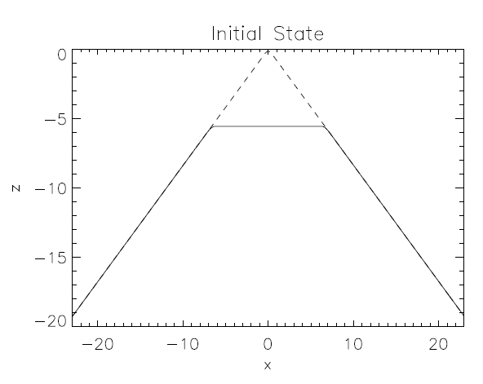
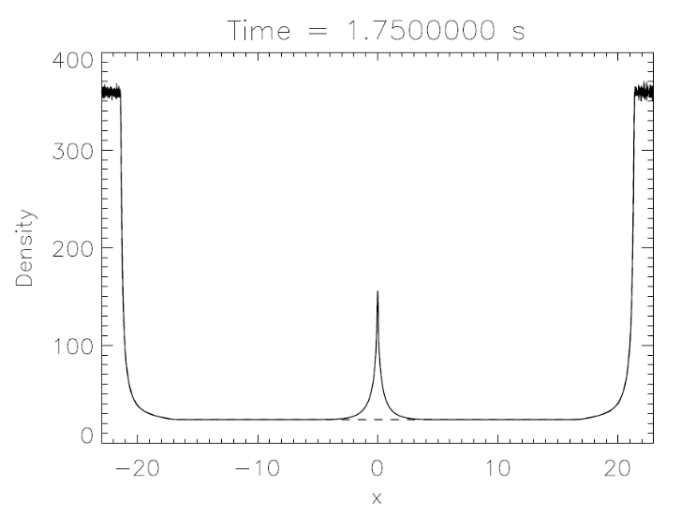
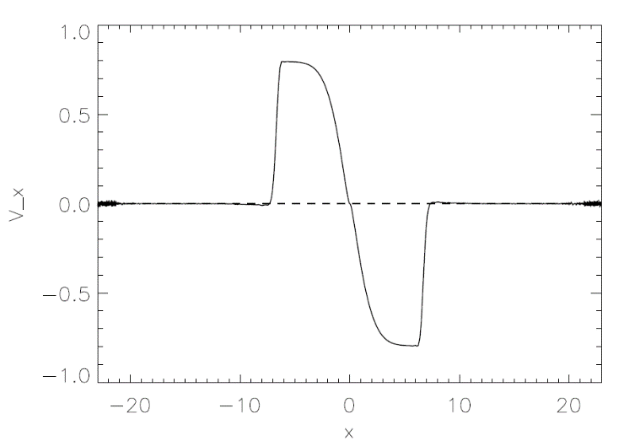
Introduction
Some Important Previous Results
Field line shortens from initial state. Rotational discontinuities (RD’s) – Alfven speed.
Plasma compression rate >> diffusion rate -> gas dynamic shocks (density build up). Field line shortens as it retracts.
High thermal conductivity
GDS’
RD’s
Notes:
RD: isentropic, no gas property change ie. change in density. GDS: abrupt change in gas property.

Slide 6
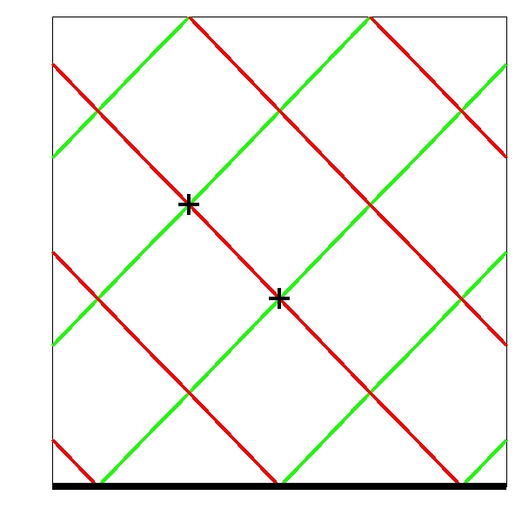
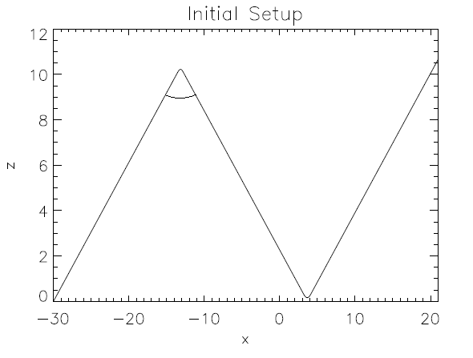
Introduction
The Multiple Reconnection Case
Multiple points of reconnection – separates in to three ‘sections’.
We consider the ‘new’ section.
How does it evolve in time?
Similarities and differences to single point case?

Slide 7
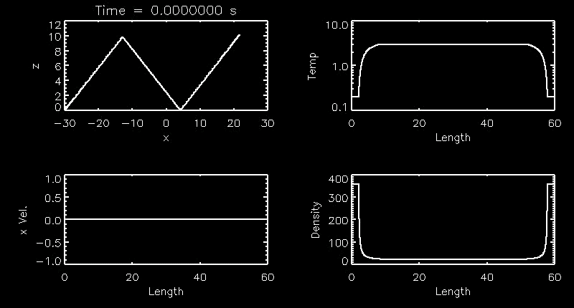
Results
Overview

Slide 8
Results
Differences to single reconnection case
Shocks collide at approx. 2.75s
V_x rarefaction wave => density drop-off
Field line curves at later times
Field lines cease shortening

Slide 9
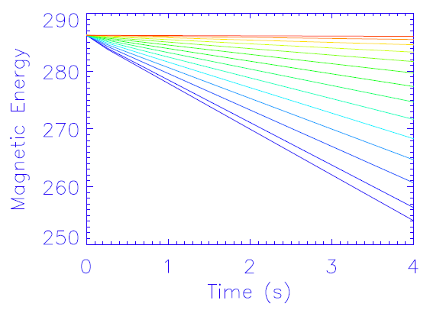
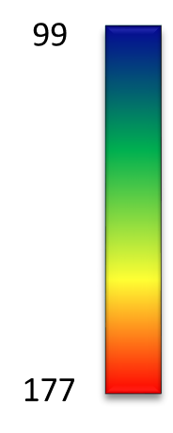
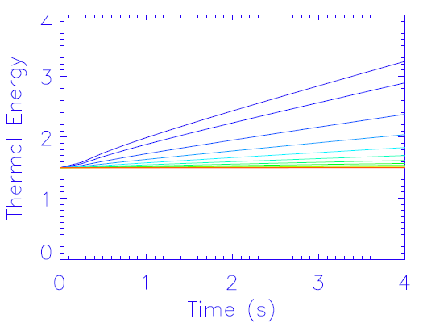
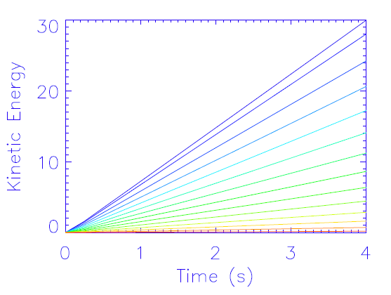
Results
Field line shortening: single reconnection case
Transfers magnetic -> kinetic energy, comparatively minimal energy lost to heat

Slide 10
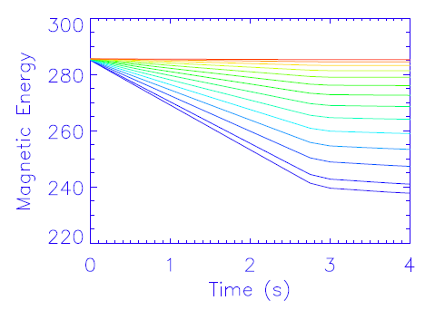
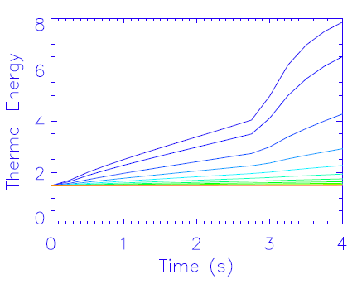
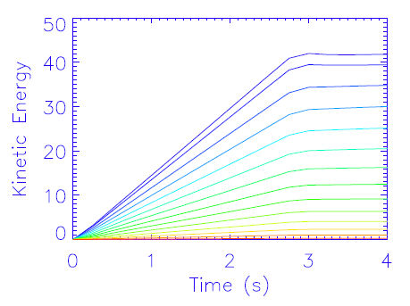
Results
Field line shortening: double reconnection case
After shocks interact: plateau reached, thermal conversion pronounced
Energy transfer rate doubled
99
177

Slide 11
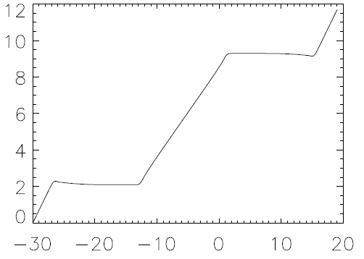
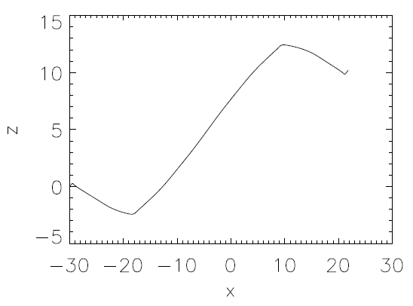
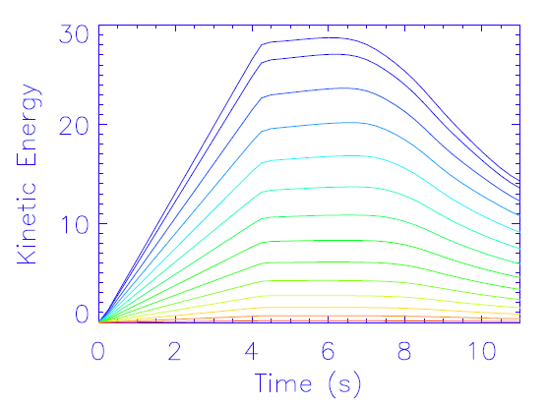
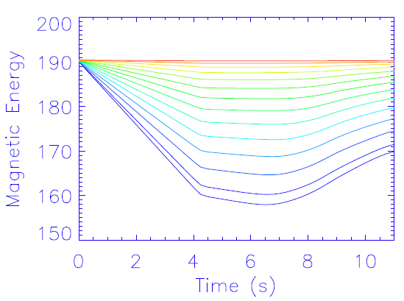
Results
Field line bending
From ~7s (left) tube begins to bend.
Right: 11.0s
z (Mm)
z (Mm)
x (Mm)
x (Mm)
As tube bends kinetic energy reconverted to magnetic

Slide 12
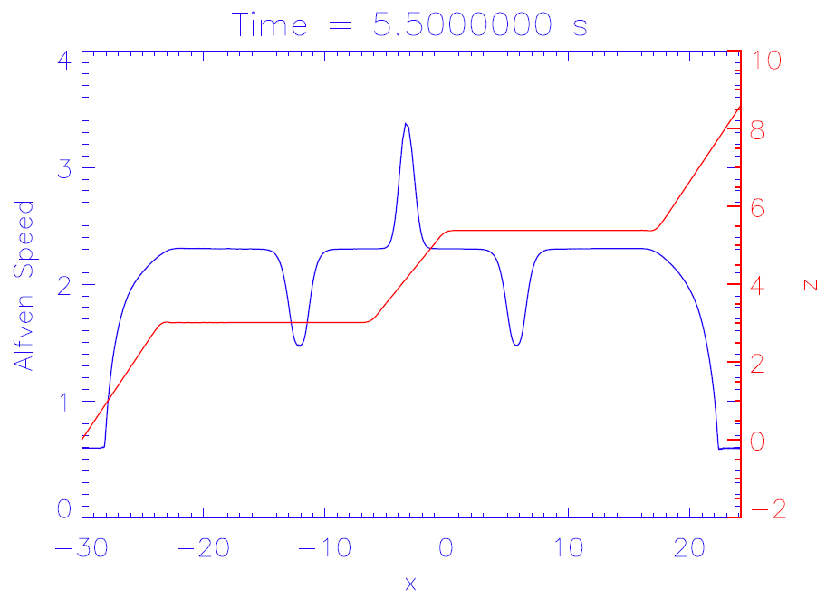
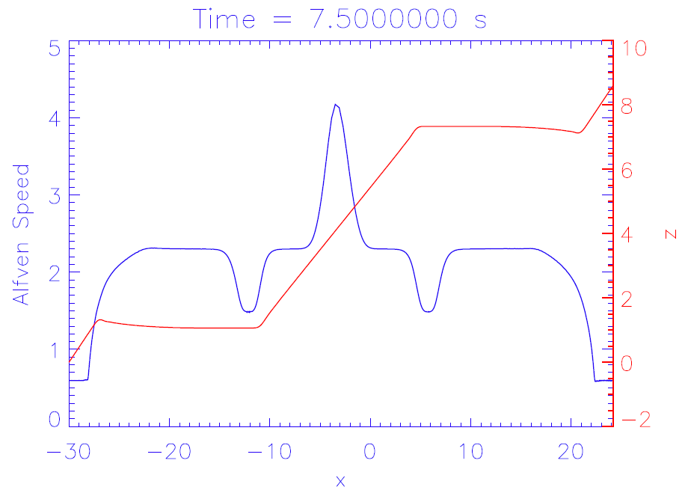
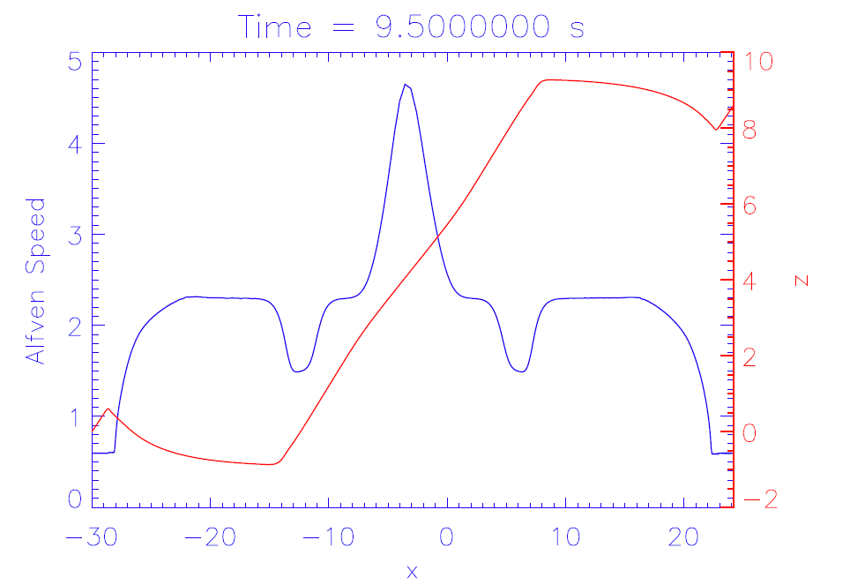
Results
Field line bending: explanation
Alfven speed influenced by the chromosphere.
Outer RD’s generally slow down, inner speed up, resulting in the observed bending.

Slide 13
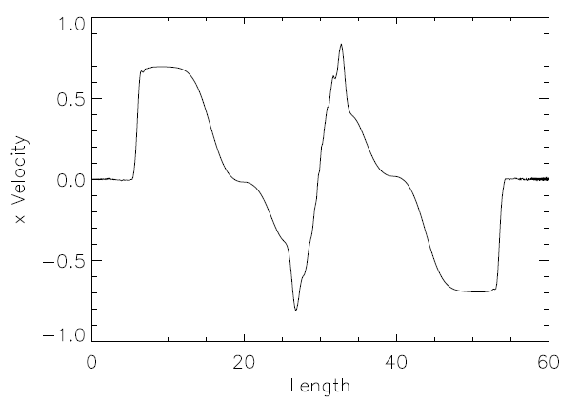

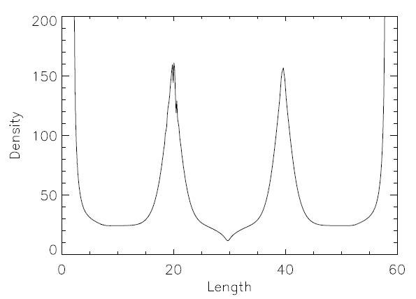
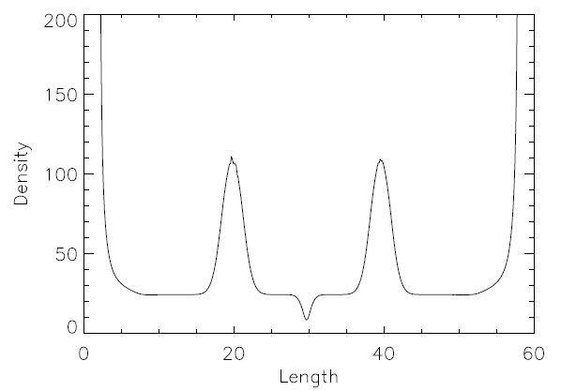
Results
Density drop-off
Angle: 105 deg
Angle: 120 deg
Rarefaction evacuates mass from tube centre.
Degree of density deficit is angle dependent; steeper rarefaction at 120 degrees.
t=4.0s

Slide 14
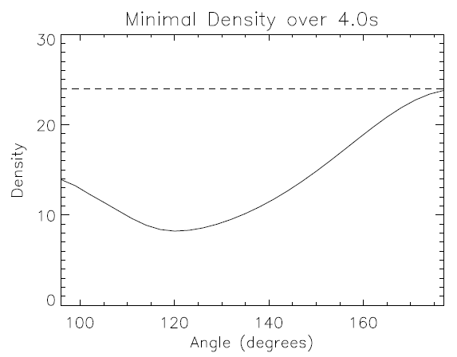
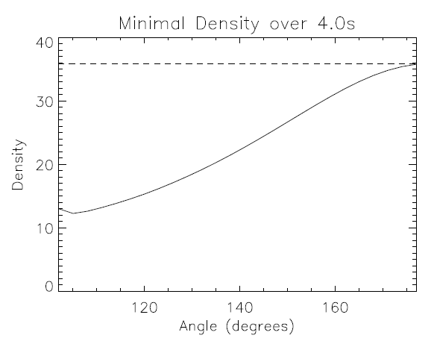
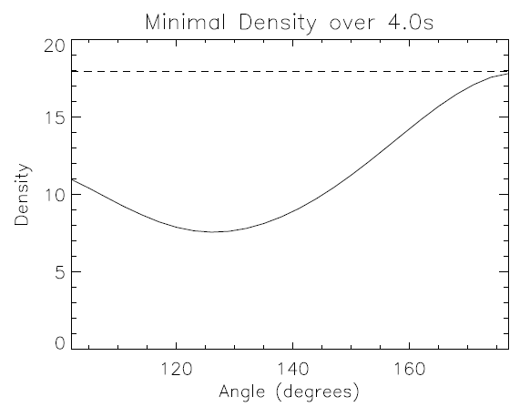
Results
Density drop-off
T=3MK
T=2MK
T=4MK
About 60% reduction near 120 deg. Why this angle?
Not ‘special’, angle varies with temperature. How?

Slide 15
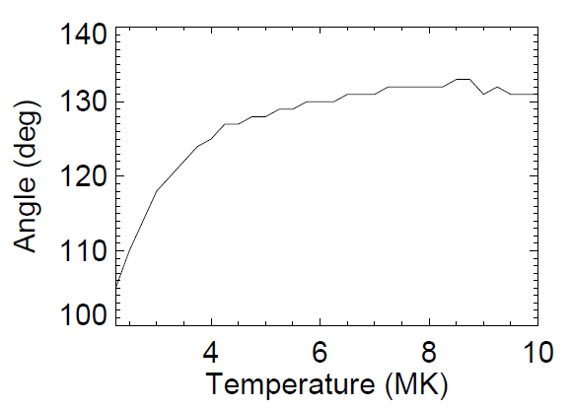
Results
Density drop-off
‘Minimum’ angle a function of temperature.
Initial steady rise with temp.
Seems to even off slightly above 130 degrees.

Slide 16
Summary
RD’s collide to produce interesting effects:
Tube shortening ceases at point of collision, as does conversion of energy (at least temporarily).
RD’s interact with (mainly) chromosphere but also GDS’ to cause tube bending; energy conversion continues but in reverse!
Rarefaction wave produced which evacuates mass from central portion of tube, decreasing density by more than 50% in some cases - easier to explain high energy particles?
Density removal not inversely proportional to angle

Slide 17
References
Linton, M. G., & Longcope, D. W. 2006, ApJ, 642, 1177
Longcope, D. W., Guidoni, S. E., & Linton, M. G. 2009, ApJ, 690, L18
Guidoni, S. W., & Londcope, D. W. 2010, ApJ, 718, 1476
Longcope, D. W., & Guidoni, S. E. 2011, ApJ, 740, 73
Priest, E.R, 1981, Solar Flare Magnetohydrodynamics (New York: Gordon and Breach Science Publishers)

Slide 18
Results
Field line shortening (find way of graphing length)

