Slide 1
MSU Solar Physics NSF REU Mid-Term Presentation
Student: Chace Carlson, Aerospace Engineering Senior at ERAU
Mentor: Dr. Dave Klumpar, Research Professor of Physics and Director, SSEL
Department: Space Science and Engineering Laboratory (SSEL)

Slide 2
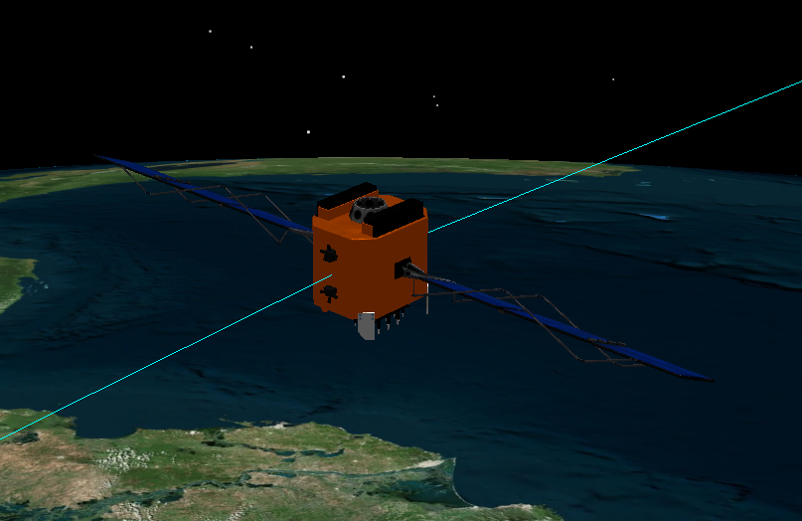
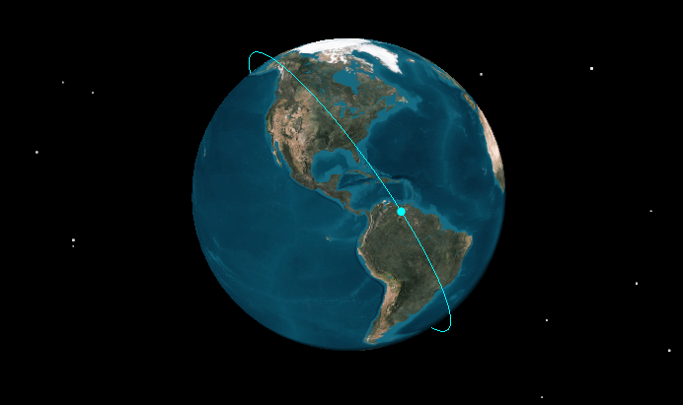
Specialty: Guidance, Navigation, and Control (GNC)
Attitude Determination and Control Systems (ADACS)
Trajectory Planning and Propagation Calculations

Slide 3
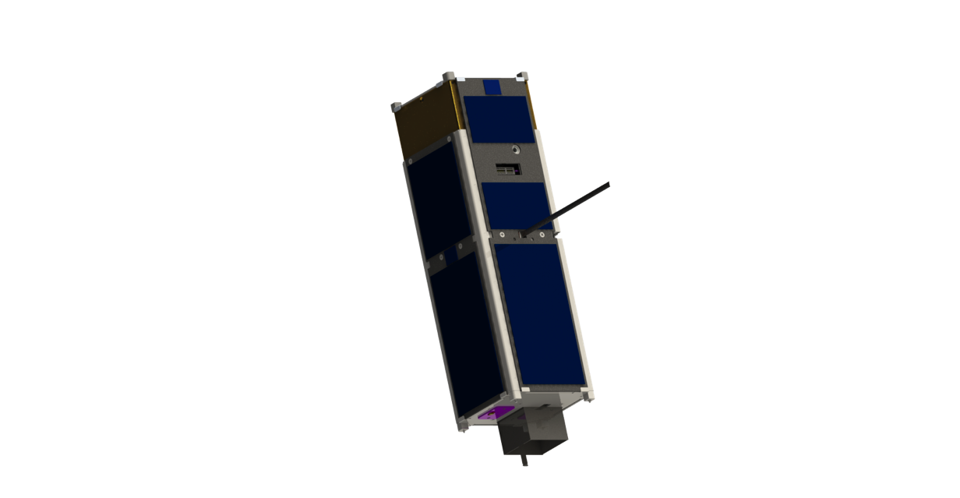
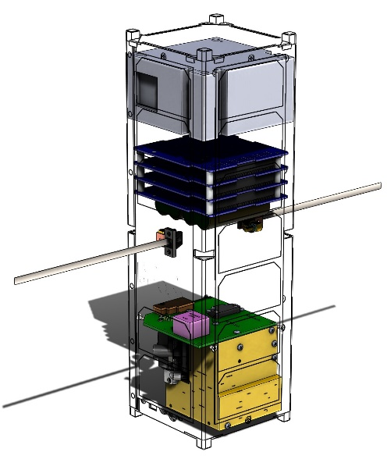
Mission: IT-SPINS
Ionospheric-Thermospheric Scanning Photometer for Ion-Neutral Studies
Size: 3U CubeSat
Launch: October 2017, NASA Educational Launch of Nanosatellites (ELaNA)
Payload: Stanford Research Institute International CTIP
Mission: To provide the first 2D tomographic imaging from a 3U research CubeSat. Also, it is MSU’s first CubeSat with an active ADACS system.
Orbit: Circular, 650 km altitude, 92° Inclination
Attitude: Spinning @ 2 rpm (about antenna)
Phase: Design

Slide 4
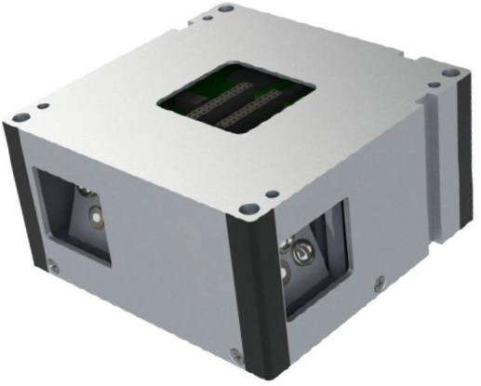
IT-SPINS: MAI-400
Maryland Aerospace Inc.
CubeSat ADACS Systems
Custom MAI-400
Size: ½ U
3 reaction wheels
3 axis magnetometer
2 IR EHS
3 electromagnets
ADACS Computer
Custom ACS Mode
Photos courtesy of Maryland Aerospace Inc.

Slide 5
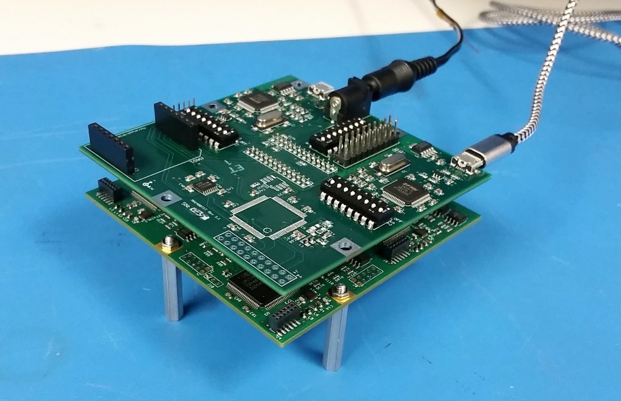
IT-SPINS: Test Board & ADACS Board
Firmware Flashing
Simulations
ESD precautions

Slide 6
IT-SPINS: Dynamic Simulator & Ground Station
Simulate day-to-day operations
Adjust/Test Different Initial Conditions

Slide 7
IT-SPINS: ADACS Telemetry Programming
Work w/software engineers
Integrate with SFC
Example ADACS Telemetry:
90 EB 11 B6 25 36 42 00 03 00 00 00 00 00 5C 01 00 00 F0 00 10 00 00 00 00 00 00 F0 0F 00 7C F8 80 00 ....

Slide 8
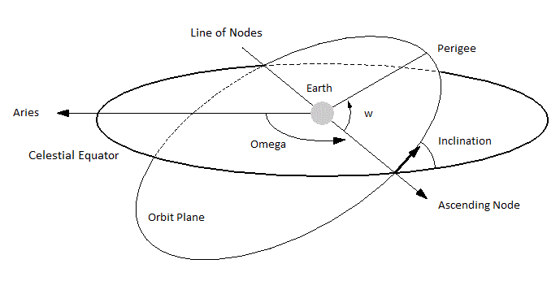
IT-SPINS: MLTAN to RAAN
MLTAN: Mean Local Time of Ascending Node (Sun Based)
RAAN: Right Ascension of the Ascending Node (Aries Based)
1st Eclipse: 10 Nov 2017
Duration: ~5 minutes
MLTAN (hours) | RAAN
1630 | 273°
1745 | 292°
1900 | 311°
Photo courtesy of sat.belastro.com

Slide 9
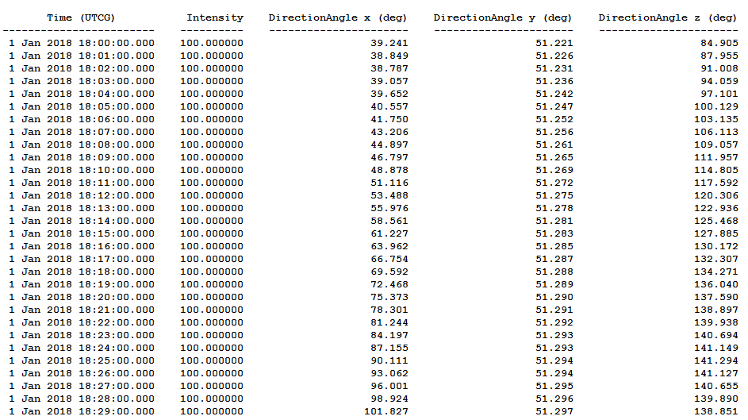
IT-SPINS: Sun Vector Calculations
Power Budget Month-by-Month

Slide 10
IT-SPINS: Sun Angle Calculations
$$θ=\cos^{−1}\left[\frac{(\overset{⃑}{v_{b}}×\overset{⃑}{r_{e/b}})∙\overset{⃑}{r_{s/b}} }{\left|\overset{⃑}{v_{b}}×\overset{⃑}{r_{e/b}}\right|∗\left|\overset{⃑}{r_{s/b}}\right|}\right]$$
$$\overset{⃑}{v_{b}}$$
$$\overset{⃑}{r_{e/b}}$$
$$\overset{⃑}{r_{s/b}}$$
Sun
$$\overset{⃑}{v_{b}}×\overset{⃑}{r_{e/b}}$$
$$θ$$
$$\overset{⃑}{r_{s/b}}$$
Earth

Slide 11
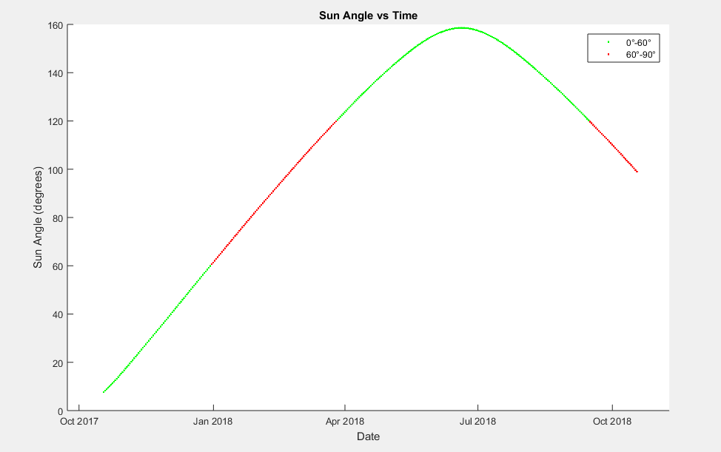
IT-SPINS: Sun Angle Calculations (continued)

Slide 12
Mission Concept 1
Size: 6U CubeSat
Launch: Unknown, Early 2018
Mission: Optical signatures of atmospheric gravity waves, traveling atmospheric disturbances, and traveling ionospheric disturbances against the limb far ultraviolet background
Orbit: r_{p}= 400-600 km, r_{a} = 500-600 km, i > 65°
Attitude: 2 modes: spinning @ 2 rpm or nadir pointing
Phase: Concept

Slide 13
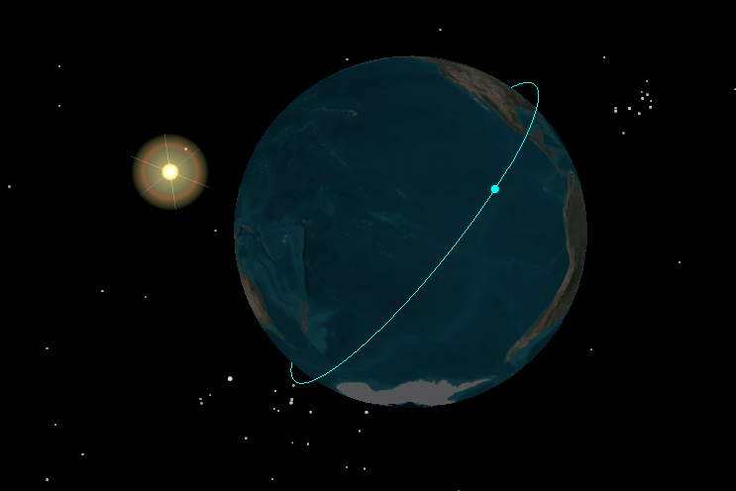
Mission Concept 1: Orbital Analysis
STK Simulations
Orbital Element | Effect on Sunlight: | Worst Case | Best Case | Correlation:
RAAN | medium | 135° | 0° | Sinusoidal
Inclination | large | 50° | 70° | Linear (higher is better)
AOP | small | 180° | 90° | Sinusoidal
Perigee | large | 400 km | 550 km | Linear (higher is better)
Apogee | large | 700 km | 900 km | Linear (higher is better)

Slide 14
Mission Concept 2
Size: 6U CubeSat
Launch: Unknown, Summer 2019
Mission: In-situ measurements of the O⁺ and H⁺ Temperatures and the electron temperature in the same volume
Orbit: r_{p}= 400-500 km, r_{a} > 800 km, i > 50°
Attitude: Ram facing
Phase: Concept

Slide 15
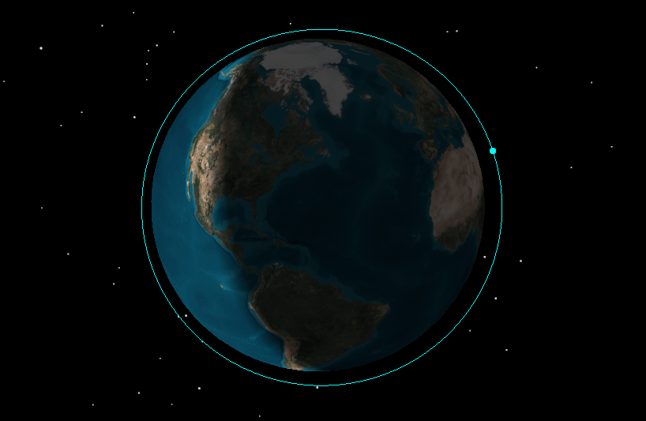
Mission Concept 2: Orbital Analysis
STK Simulations
Orbital Element | Effect on Sunlight: | Worst Case | Best Case | Correlation:
RAAN | medium | 225° | 90° | Sinusoidal
Inclination | large | 50° | 70° | Linear (higher is better)
AOP | small | 180° | 315° | Sinusoidal
Perigee | large | 400 km | 600 km | Linear (higher is better)
Apogee | large | 500 km | 600 km | Linear (higher is better)

Slide 16
Conclusion
IT-SPINS
Test Board & ADACS Board
Ground Station & Dynamic Simulator
ADACS Telemetry Programming
MLTAN to RAAN
Sun Vector Calculations
Sun Angle Calculations
Mission Concept 1
Orbital Analysis
Mission Concept 2
Orbital Analysis

Slide 17
Future Work
IT-SPINS MAI-400: day-to-day operations
Mission Concept 1: Power Budgets
Mission Concept 2: Power Budgets

Slide 18
Questions?

