Slide 1
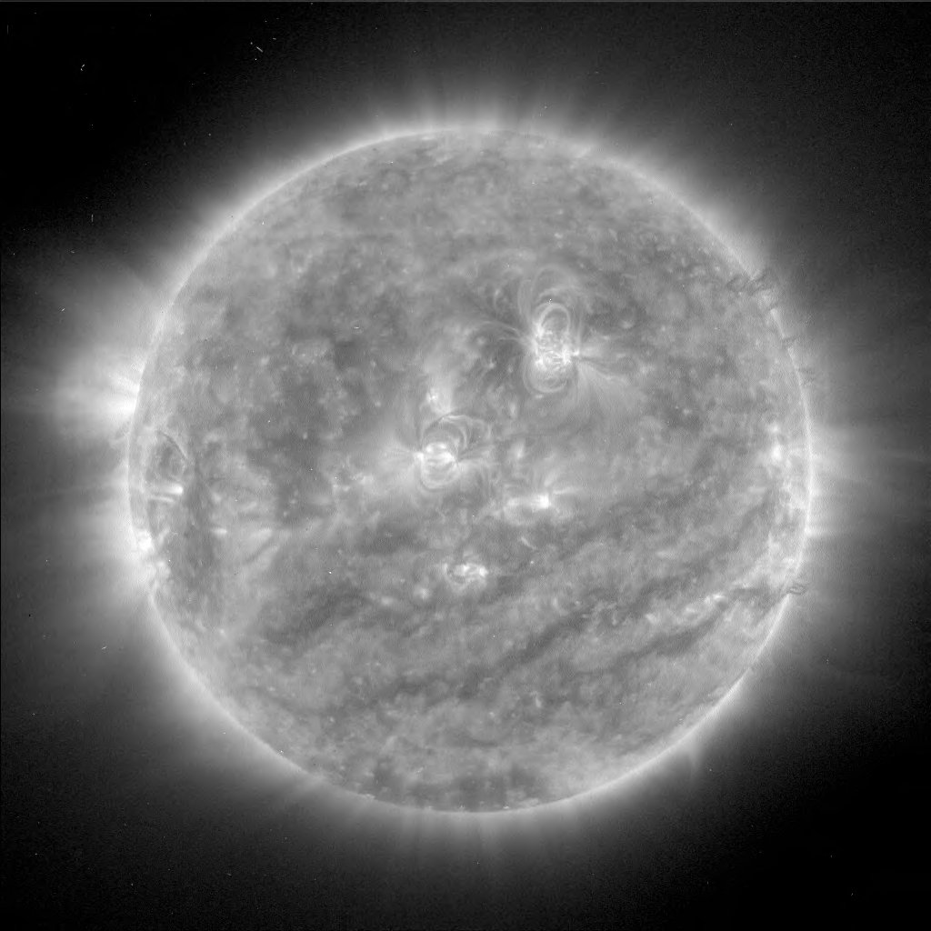
Synthesising Solar Flare Spectra
Callum Fairbairn
Advisor: Professor Dana Longcope
Callum Fairbairn |Spectral Synthesis

Slide 2
Compact X-Class Flare
Feb 26th 2004
Can models reproduce RHESSI observed spectra?
Aim:
Vary parameters – find spectral fit!
Callum Fairbairn |Spectral Synthesis

Slide 3
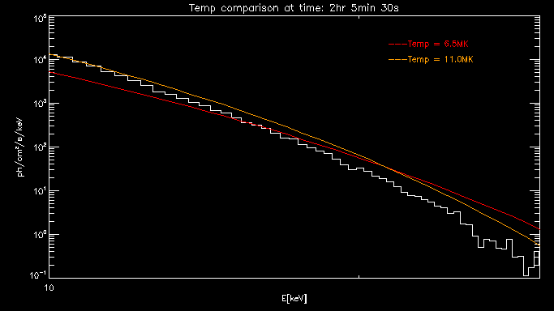
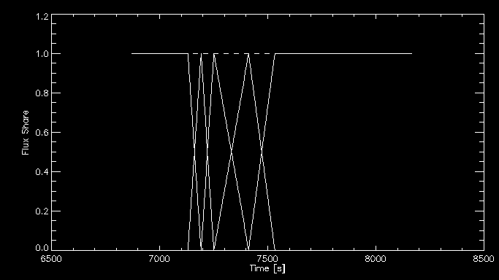
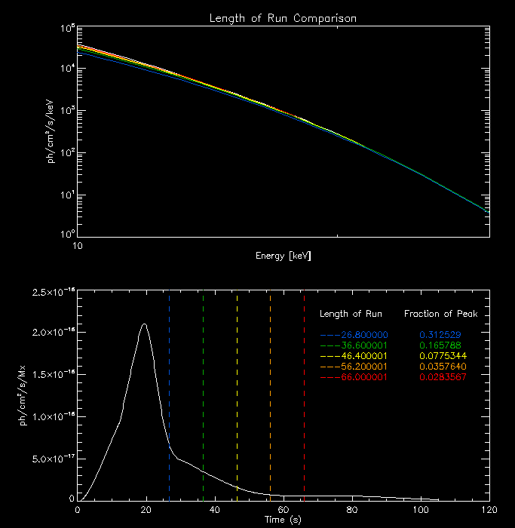
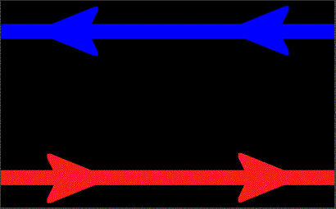
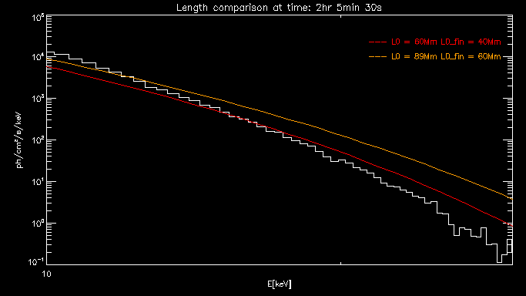
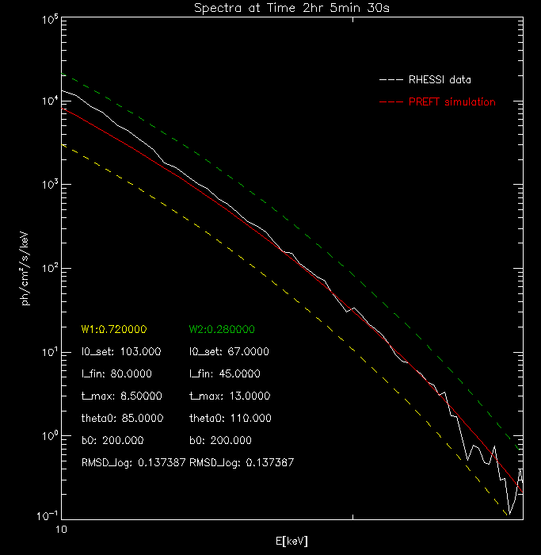
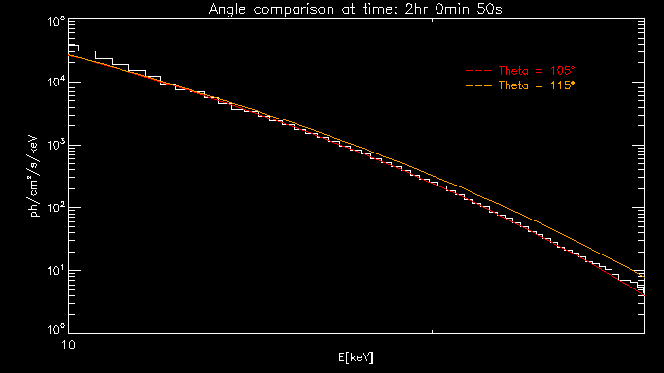
Background
Parameter Variation
Multi Convolution
Results and Theory
Callum Fairbairn |Spectral Synthesis

Slide 4
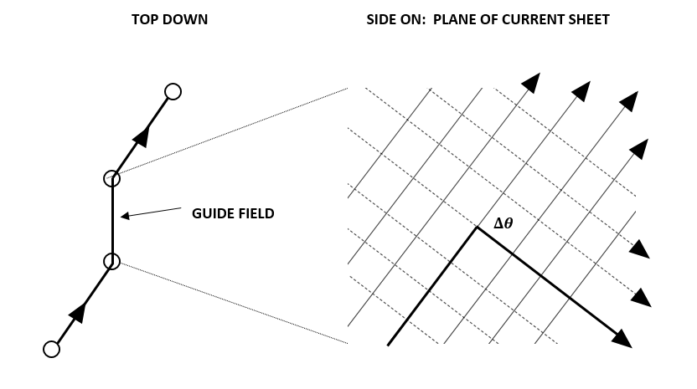
Magnetic Reconnection
Figure 1: Geometry of Magnetic Reconnection
Magnetic reconnection ⬄ non-ideal diffusion region.
Change field topology $⇒$ release of free energy.
General geometry incorporated via a ‘guide field’.
x
z
y
x
Callum Fairbairn |Spectral Synthesis

Slide 5
Post Reconnection Evolution of a Flux Tube
Energy Equation:
Adiabatic
Work
Thermal Conduction
Optically thin radiation
Viscous heating
Momentum Equation:
Surrounding magnetic pressure
Plasma pressure
Viscous forces
Tension
Gravity
Need to input initial conditions...
Callum Fairbairn |Spectral Synthesis

Slide 6
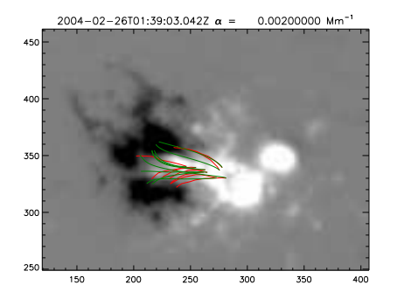
Initialisation
MDI magnetogram $⇒$LFFF Extrapolation.
Matching with TRACE loop observations $⇒$ $L_{f}$ and $B$.
Remaining parameters unconstrained:
$T_{apex}$
$L_{0}$
$∆θ$
My task to find which parameters work!
Figure 2: MDI observations with LFFF Fits overlaid (Longcope et al 2016)
Callum Fairbairn |Spectral Synthesis

Slide 7
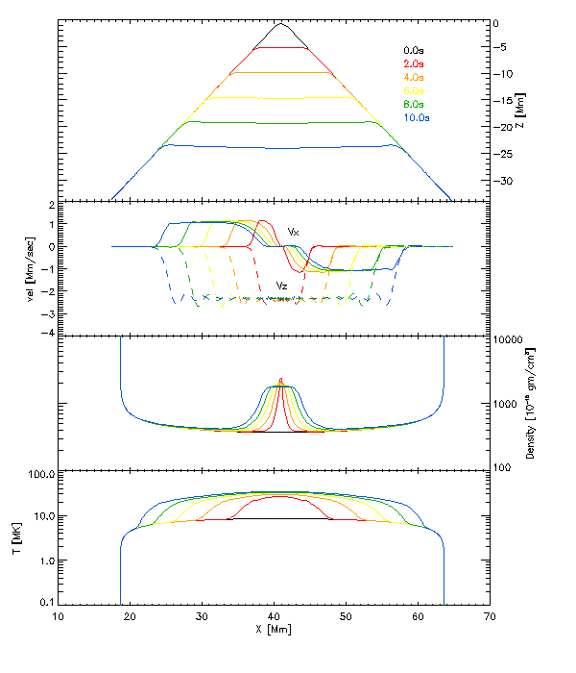
TFT Evolution
Tension force accelerates loop top.
RDs propagate downwards.
Plasma collision at loop top $⇒$ GDS.
Conduction fronts propagate ahead of bends.
Figure 3: Flux Tube Evolution
Callum Fairbairn |Spectral Synthesis

Slide 8
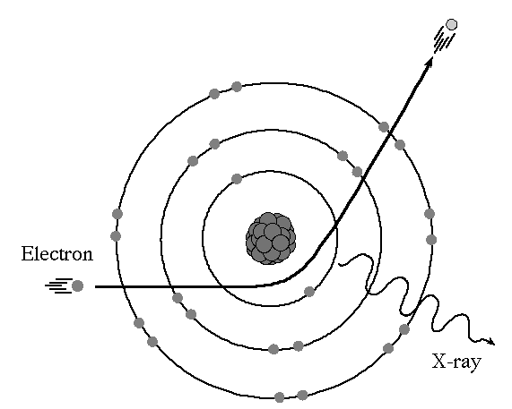
Spectral Synthesis
Viscous forces $⇒$ collisions $⇒$ Free-Free Interactions
Characterised by Spectral Response Function: $R[T(l,t)]$
Integrate over loop gives the light curve per flux:
Figure 4: Dipole Acceleration
Callum Fairbairn |Spectral Synthesis

Slide 9
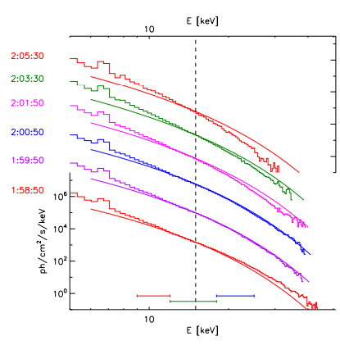
Spectral Synthesis
Convolve with flux transfer rate $\dot{φ}\left(s\right)$ $⇒$ net light curve:
How do results compare with observation?
Figure 5: Spectral comparison (Longcope et al 2016)
Callum Fairbairn |Spectral Synthesis

Slide 10
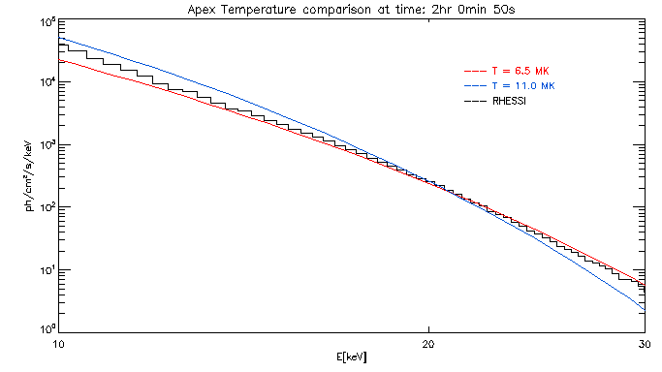
Parameter Variation
Apex Temperature:
$T_{apex}$ ↑ we observe a softening pivot.
RTV equilibrium $⇒$ $V_{a}$ ↓
Less violent collision at loop top.
Figure 6: Temperature Variation at 02:00:50
Callum Fairbairn |Spectral Synthesis

Slide 11
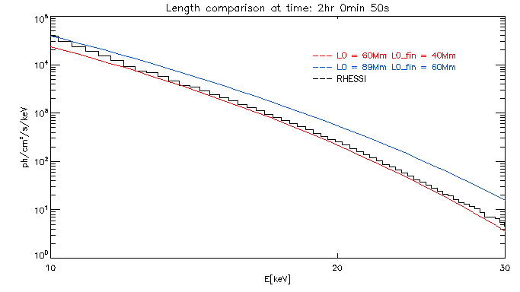
Parameter Variation
Retraction Length:
$ΔL$ ↑ we observe a hardening translation.
More magnetic free energy liberated.
Increased emission across spectra.
Figure 6: $ΔL$Variation at 02:00:50
Callum Fairbairn |Spectral Synthesis

Slide 12
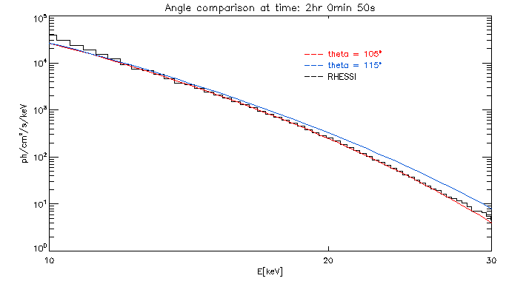
Parameter Variation
Angle:
$Δθ$ ↑ we observe a hardening pivot.
More rapid and efficient conversion of free energy.
Larger T and harder spectra.
Figure 7: $ΔL$Variation at 02:00:50
Callum Fairbairn |Spectral Synthesis

Slide 13
Parameter Fits
Parameter Fits at Different Times
Callum Fairbairn |Spectral Synthesis

Slide 14
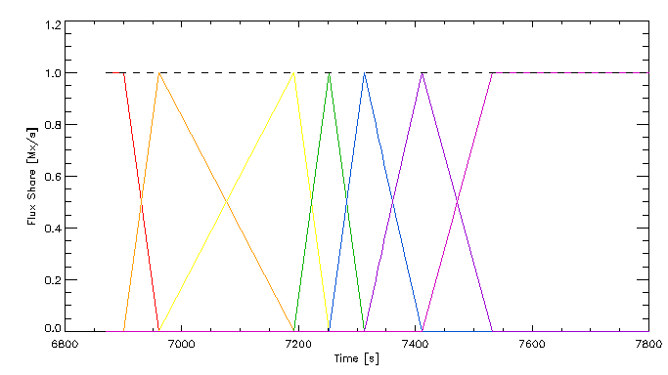
Multi Convolution Method
Trigger different loop retractions at different times.
Temporally staggered convolution.
Distribute flux transfer across different tubes.
$$I\left(t\right)=\sum_{i=1}^{7}{\int_{−∞}^{∞}{I_{0}^{\left(i\right)}(t−s){\dot{φ}}_{i}\left(s\right)ds }}$$
Figure 8: Flux Share
Callum Fairbairn |Spectral Synthesis

Slide 15
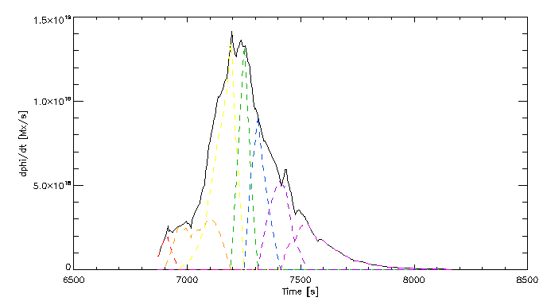
Multi Convolution Method
Trigger different loop retractions at different times.
Temporally staggered convolution.
Distribute flux transfer across different tubes.
$$I\left(t\right)=\sum_{i=1}^{7}{\int_{−∞}^{∞}{I_{0}^{\left(i\right)}(t−s){\dot{φ}}_{i}\left(s\right)ds }}$$
Figure 8: Flux Distribution ${\dot{φ}}_{i}(t)$
Callum Fairbairn |Spectral Synthesis

Slide 16
Results – Improved RHESSI and GOES
Callum Fairbairn |Spectral Synthesis

Slide 17
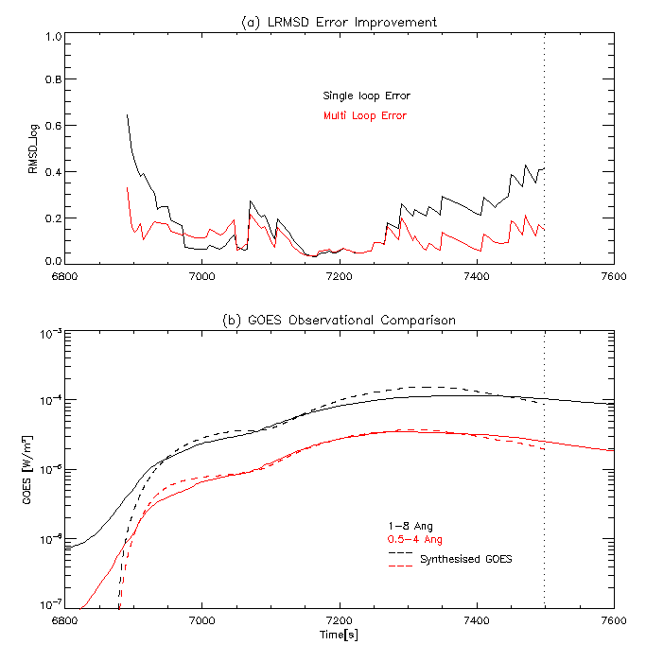
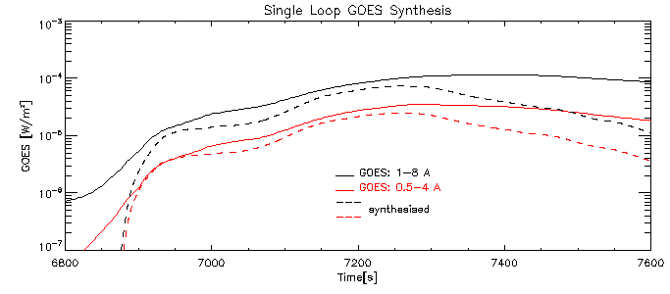
Results – Improved RHESSI and GOES
Figure 9: RHESSI and GOES Comparisons
Callum Fairbairn |Spectral Synthesis

Slide 18
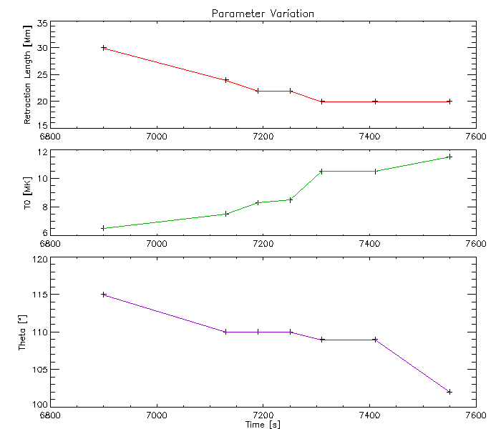
Results – Parameter Trends
Retraction length decreases.
Apex temperature increases.
Angle decreases.
Figure 10: Parameter Trends
Callum Fairbairn |Spectral Synthesis

Slide 19
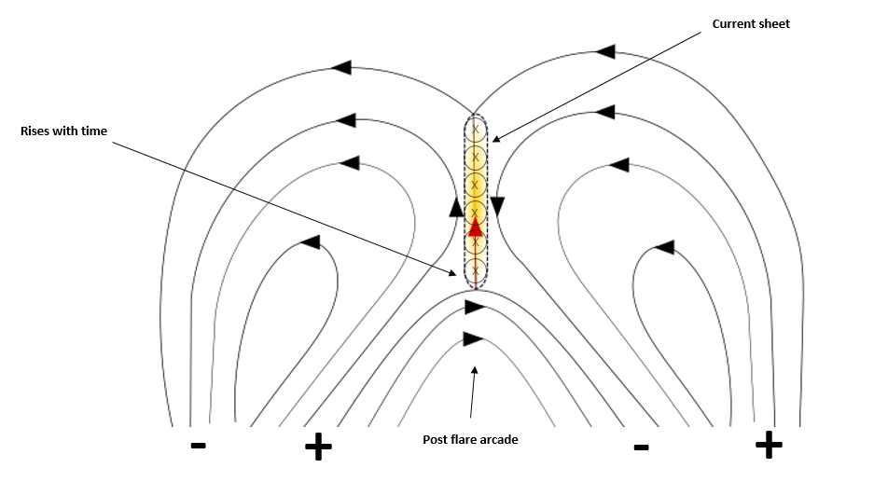
Theoretical Context?
Loops retract less as they collapse onto growing post flare arcade
Magnetic field strength decreasing or ribbon shearing may explain angle change.
Temperature strongest trend. Mechanism exists which drives $T_{apex}$ and $ρ$.
Figure 10: Non–Erupting flare setup
Callum Fairbairn |Spectral Synthesis

Slide 20
Conclusions and Looking to the Future
Multi Convolution method works – clearly improved fitting!
Parameter trends suggest enhancement in temperatures and densities.
Future: Incorporate further loops and investigate theoretical basis for parameter evolution.
Callum Fairbairn |Spectral Synthesis

Slide 21
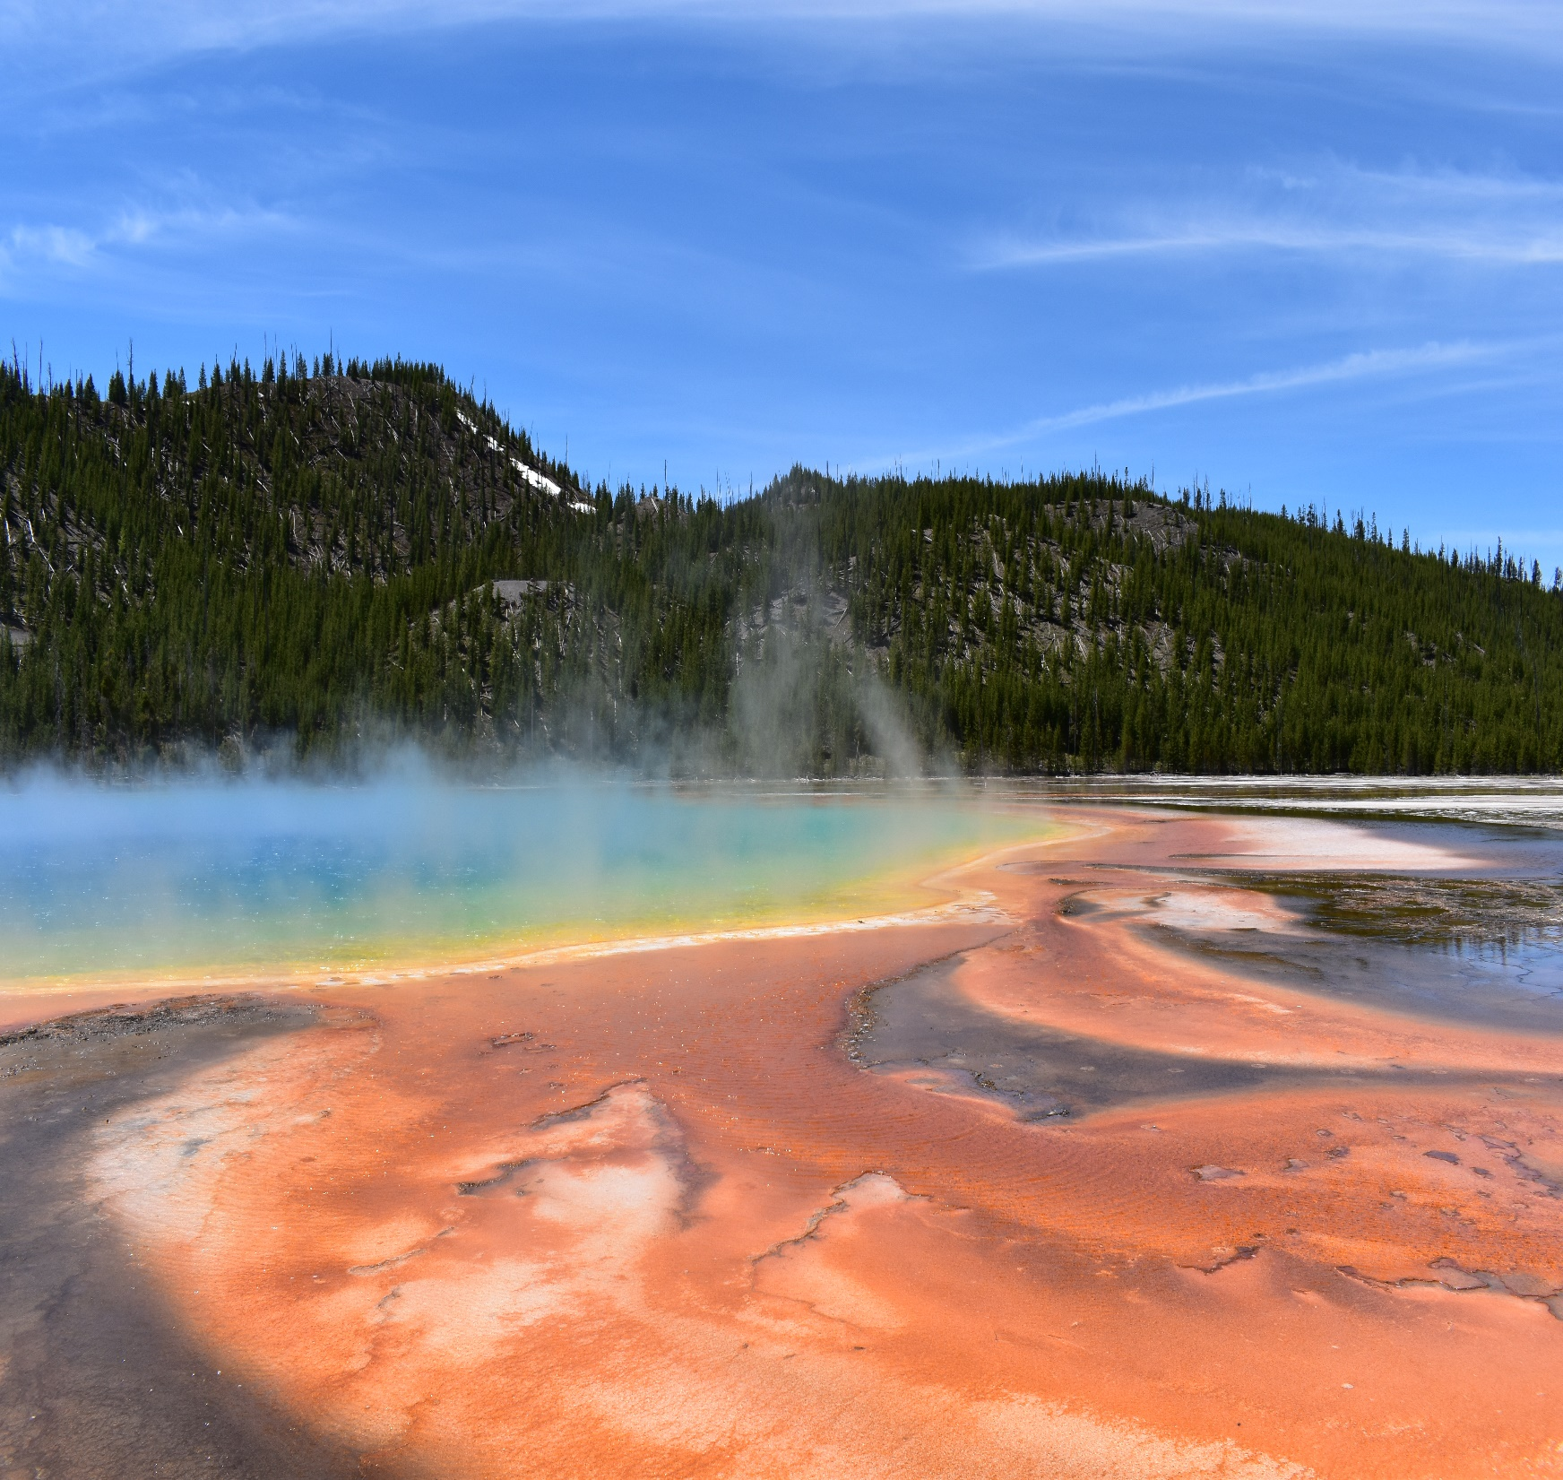
Thank you REU and Montana!
Questions…
Callum Fairbairn |Spectral Synthesis

Slide 22
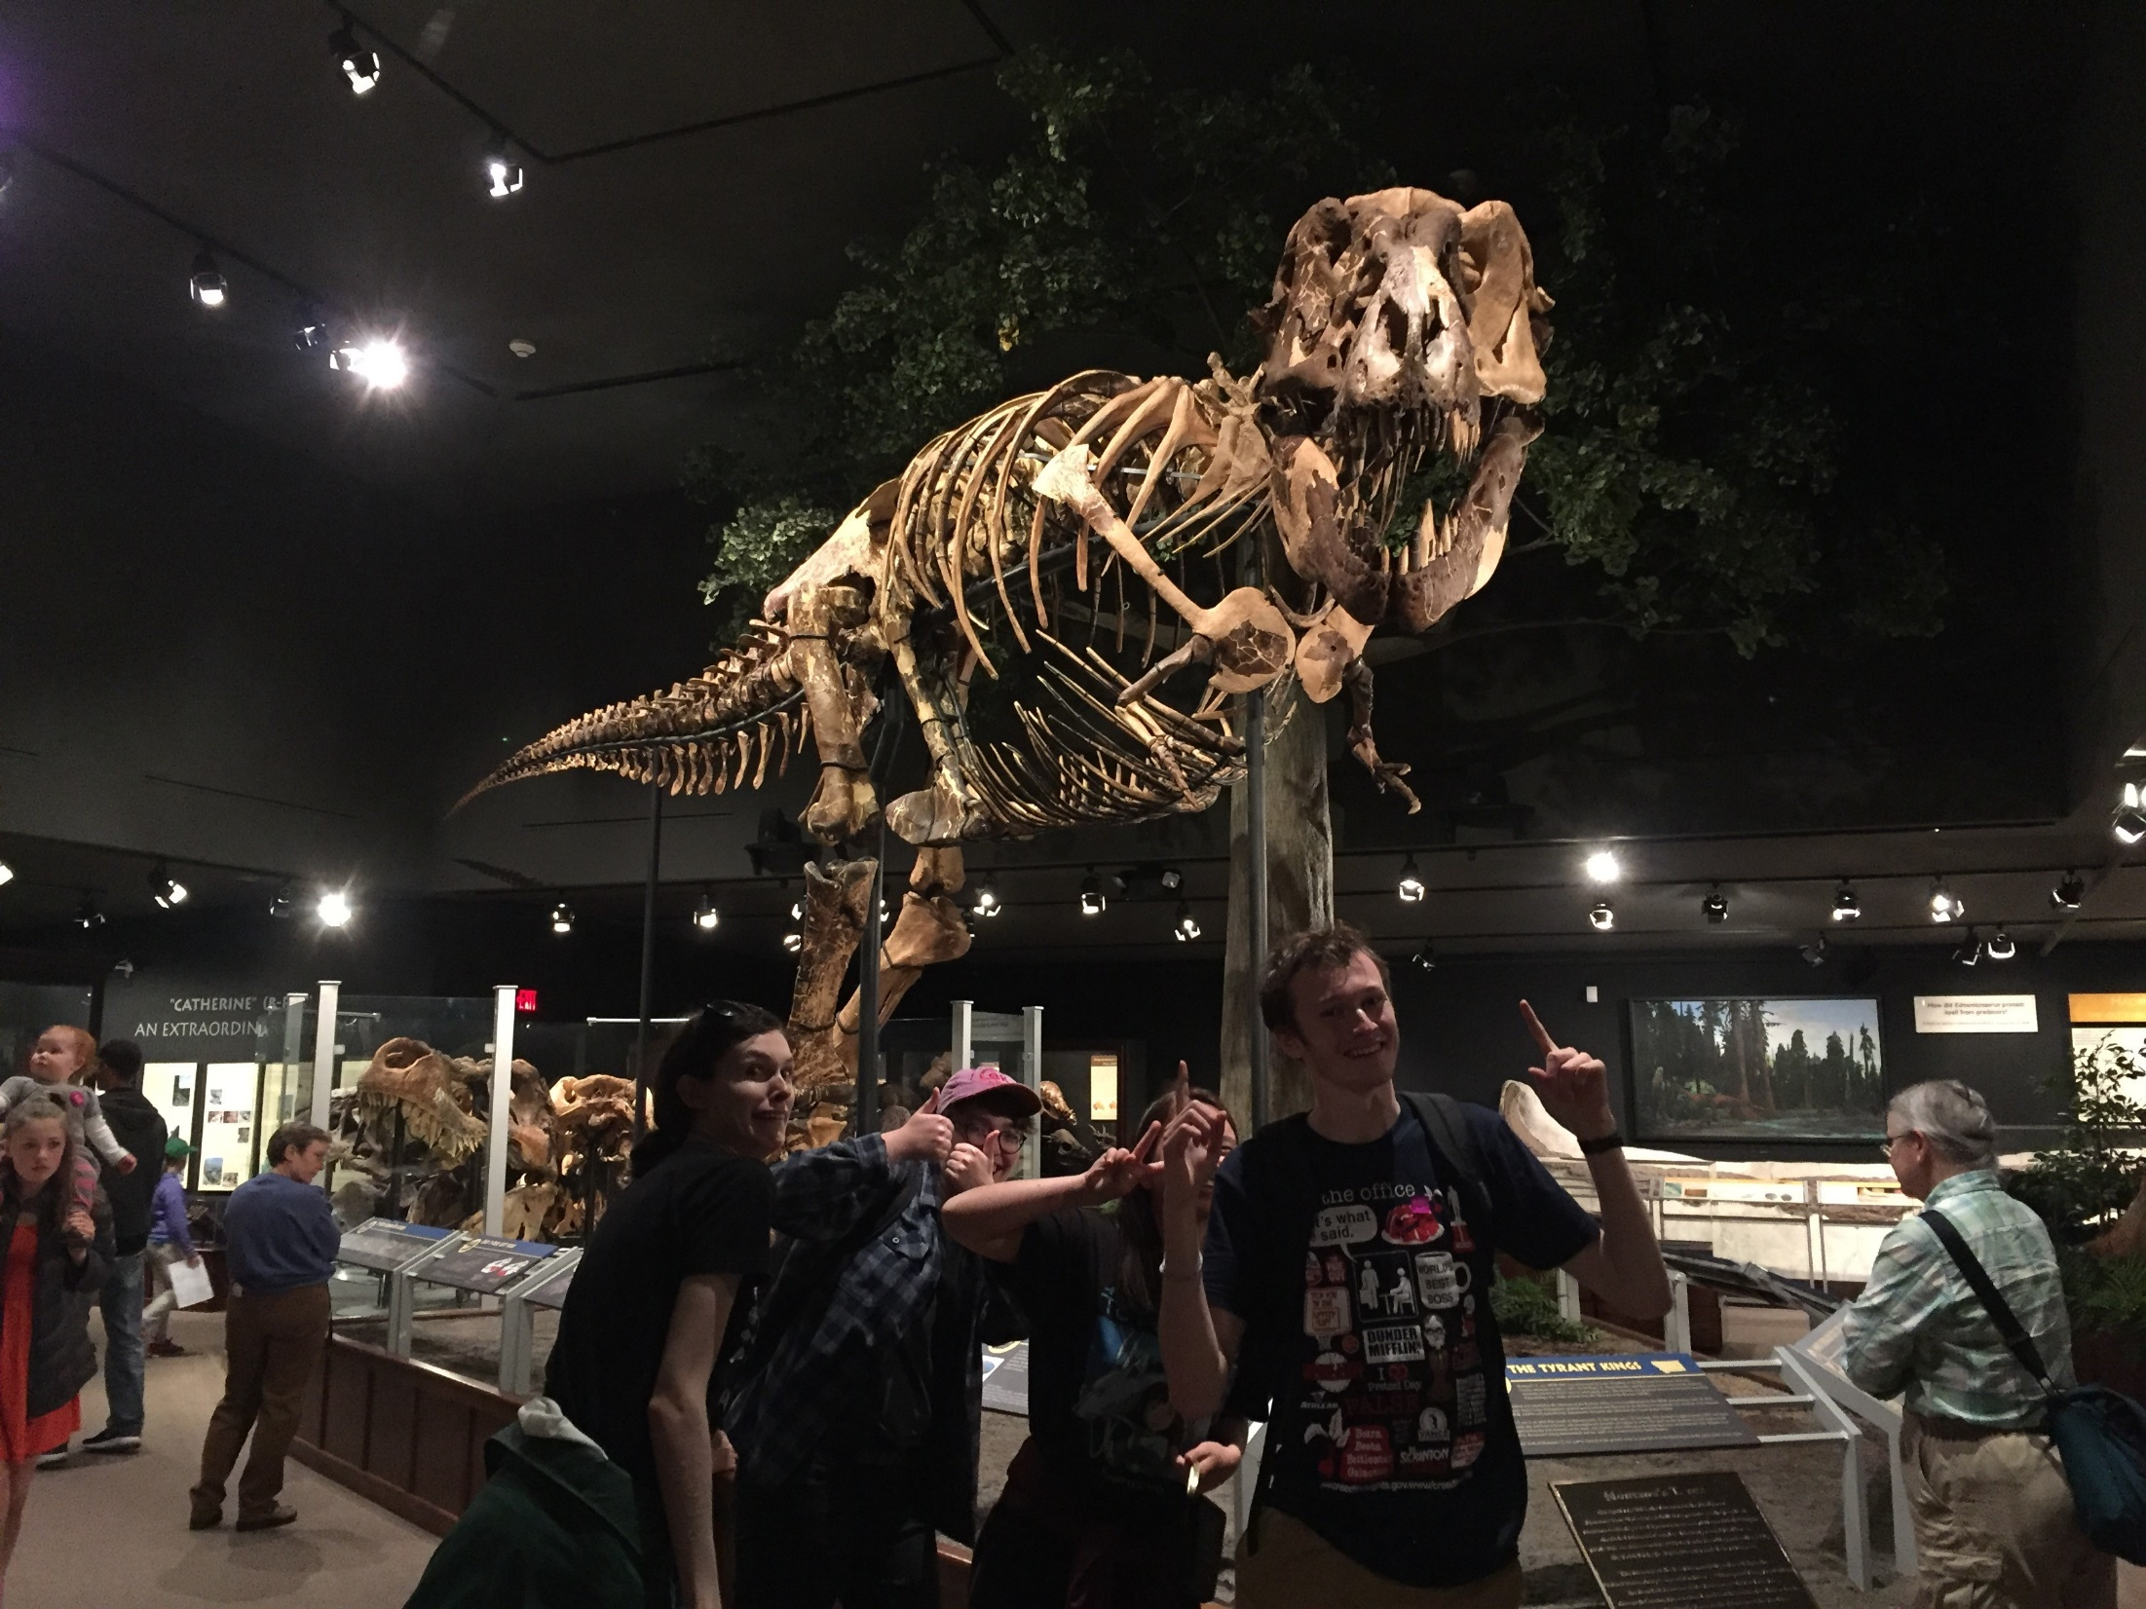
Thank you REU and Montana!
Questions…
Callum Fairbairn |Spectral Synthesis

Slide 23
Thank you REU and Montana!
Questions…
Callum Fairbairn |Spectral Synthesis

Slide 24
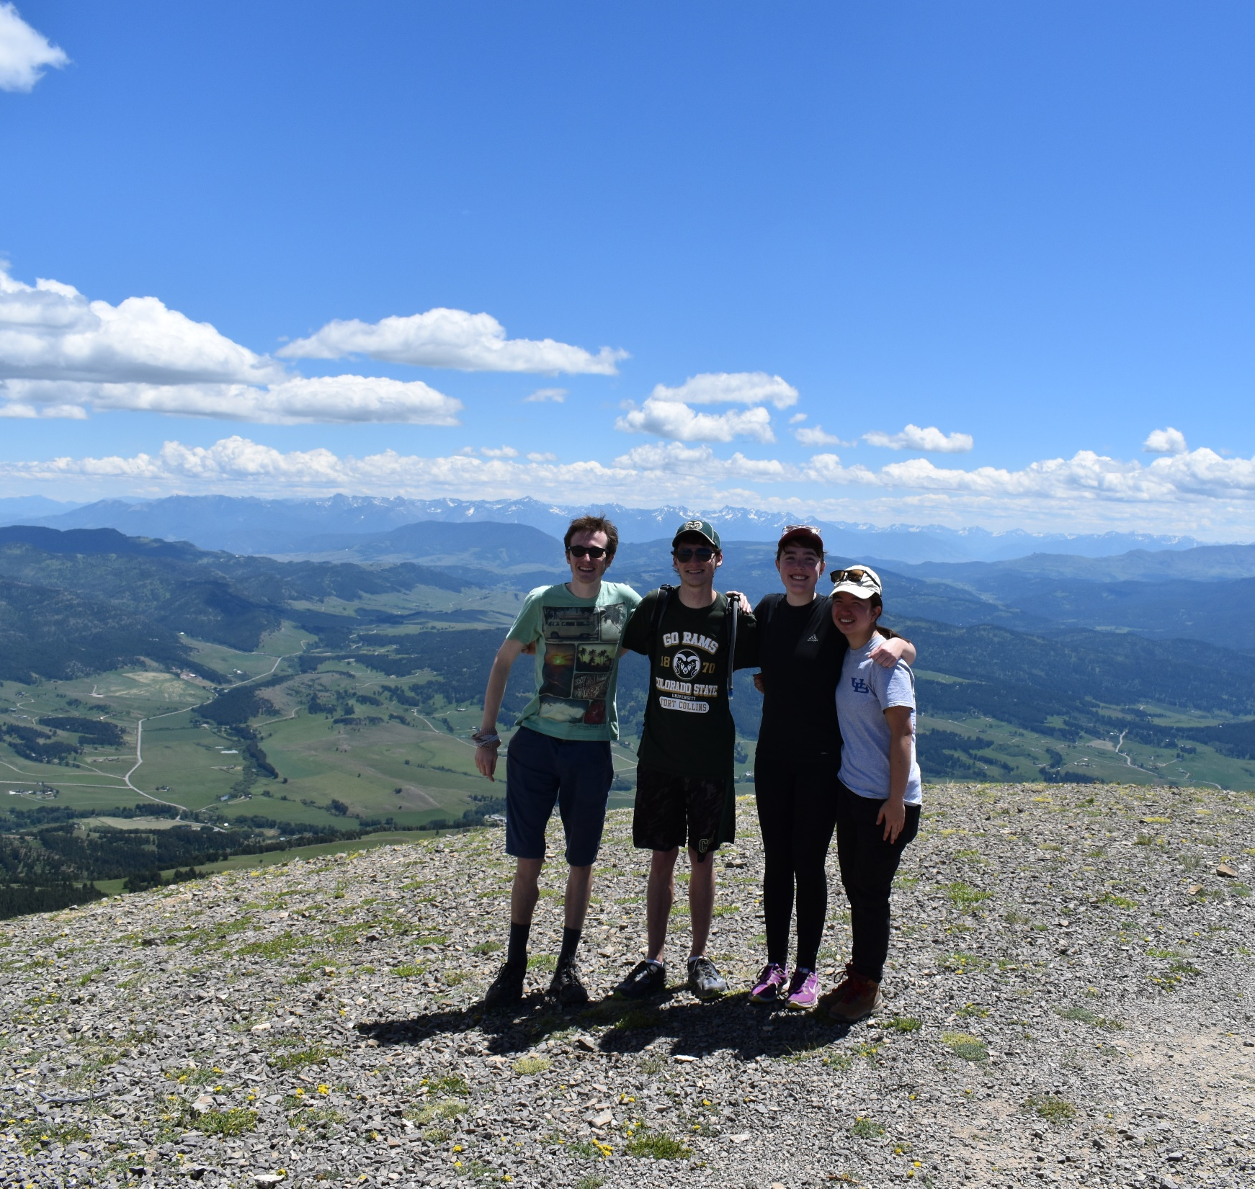
Thank you REU and Montana!
Questions…
Callum Fairbairn |Spectral Synthesis

Slide 25
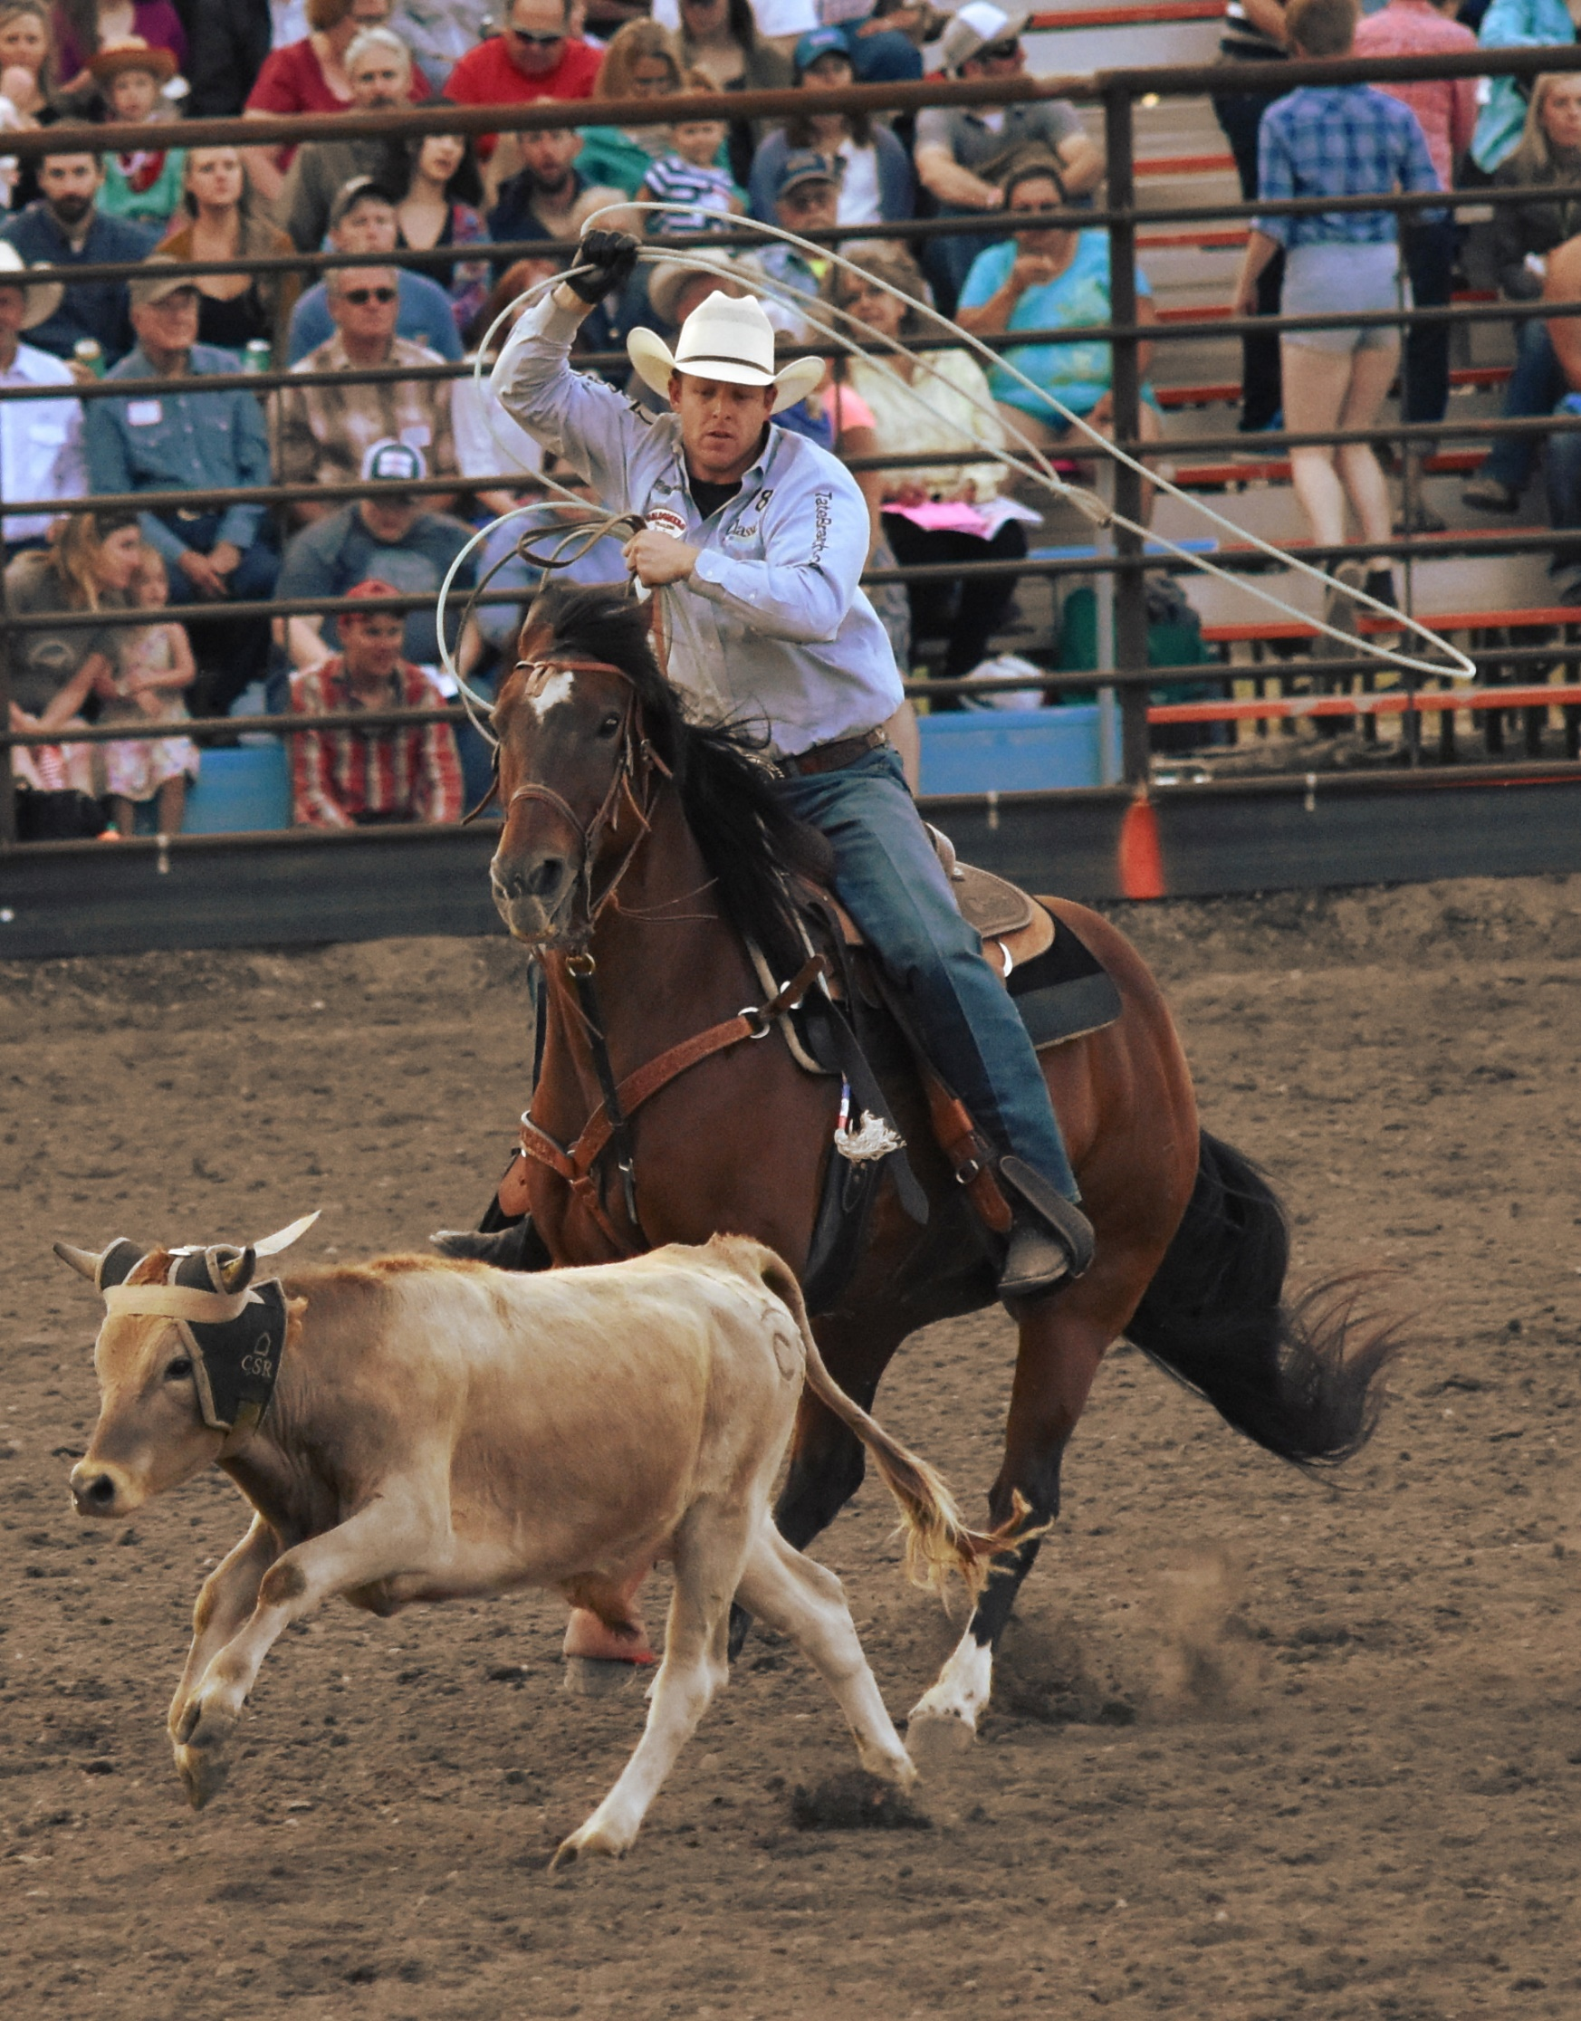
Thank you REU and Montana!
Questions…
Callum Fairbairn |Spectral Synthesis

Slide 26
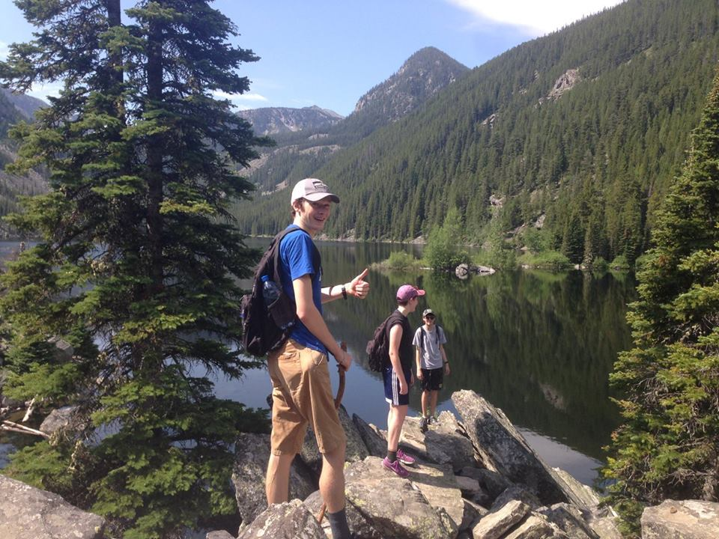
Thank you REU and Montana!
Questions…
Callum Fairbairn |Spectral Synthesis

Slide 27
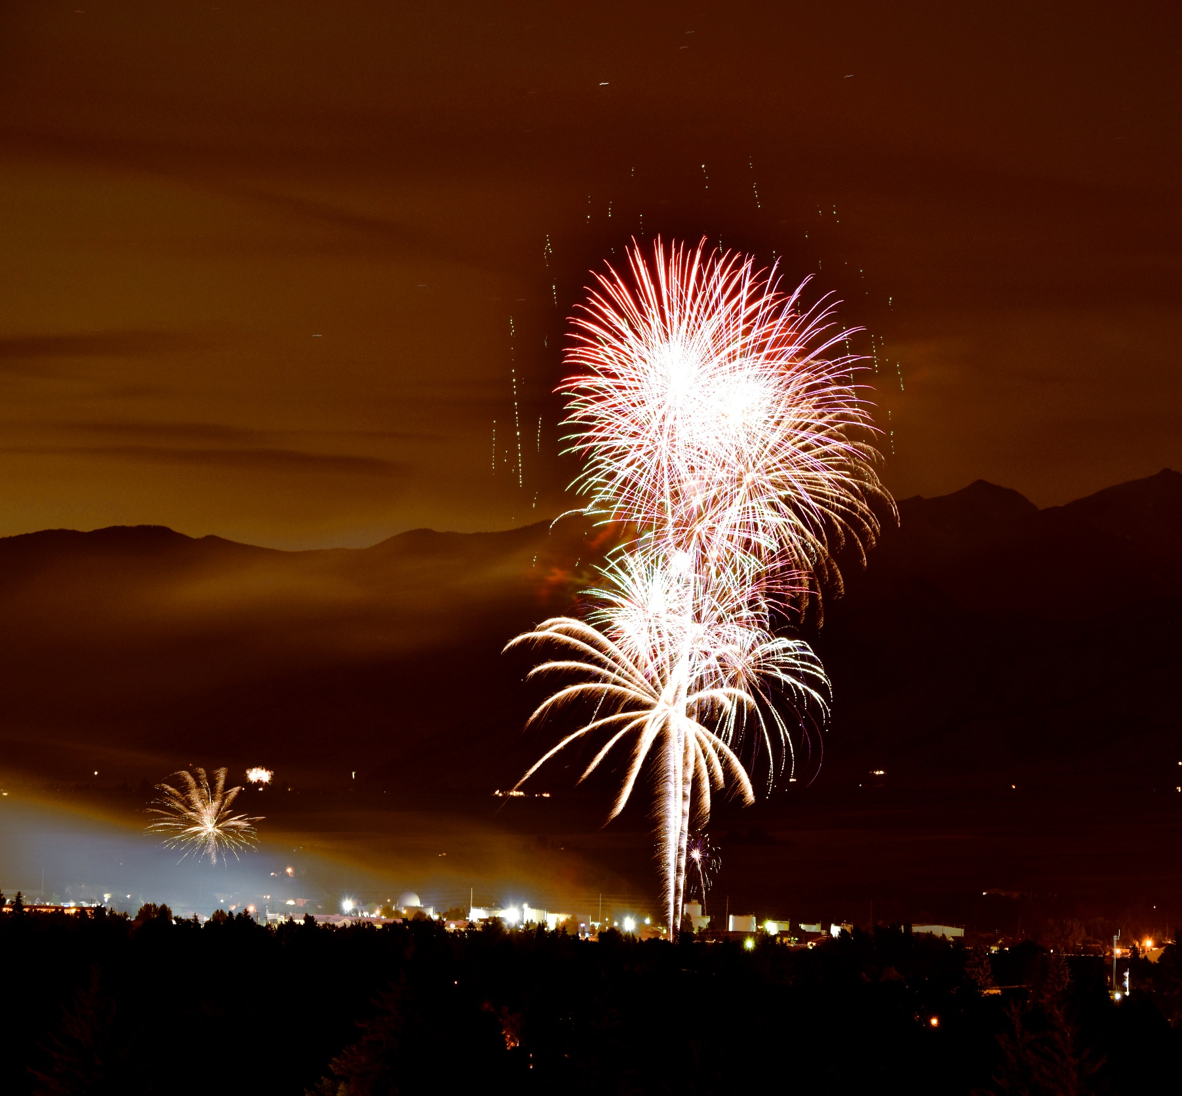
Thank you REU and Montana!
Questions…
Callum Fairbairn |Spectral Synthesis

