Slide 1
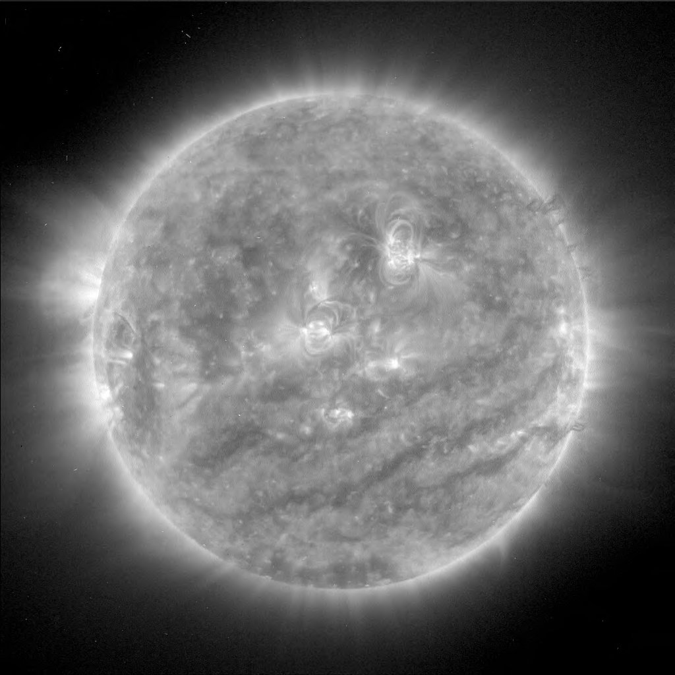
Synthesising Solar Flare Spectra
Callum Fairbairn
Advisor: Professor Dana Longcope
Callum Fairbairn |Spectral Synthesis

Slide 2
Compact X-Class Flare
Feb 26th 2004
Can models reproduce RHESSI observed spectra?
Aim:
Vary parameters – find spectral fit!
Callum Fairbairn |Spectral Synthesis

Slide 3
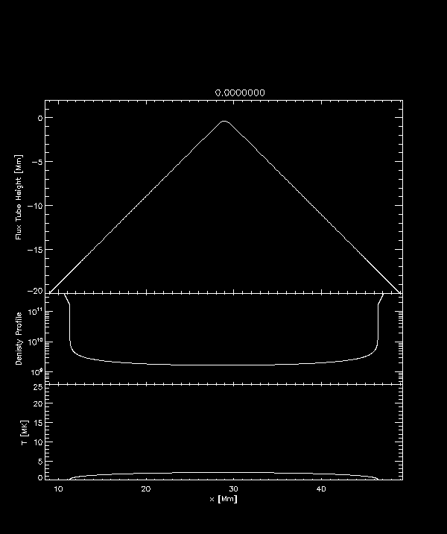
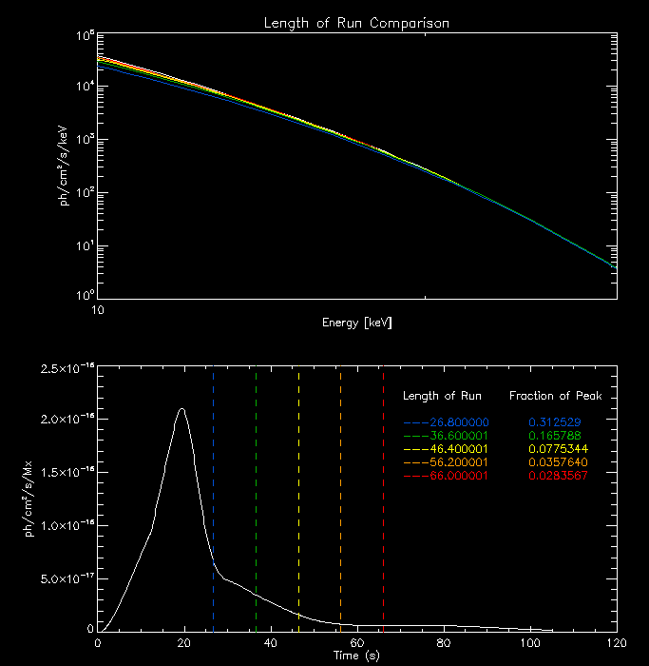
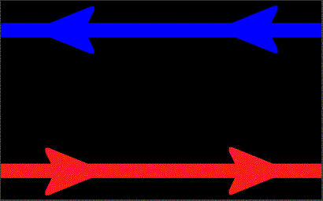
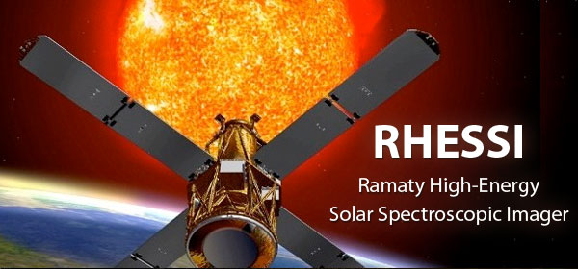
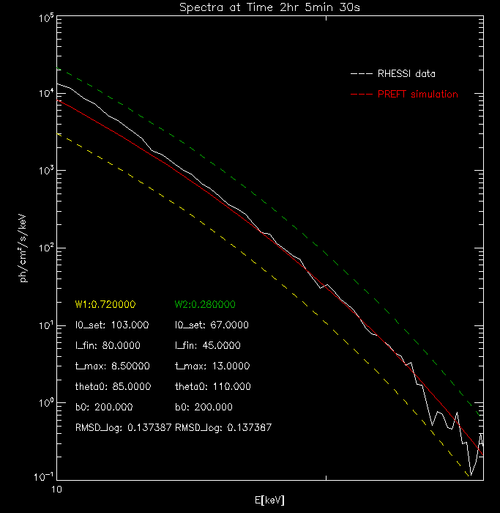
Background Theory
PREFT Model
Spectral Synthesis
Results and Future Work
Callum Fairbairn |Spectral Synthesis

Slide 4
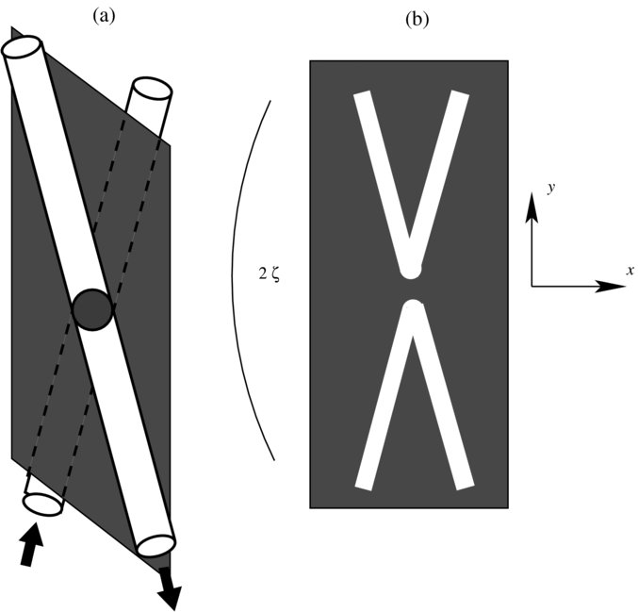
Magnetic Reconnection
Figure 1: Geometry of Magnetic Reconnection
Magnetic reconnection ⬄ non-ideal diffusion region.
Change field topology $⇒$ release of free energy.
General geometry incorporated via a ‘guide field’.
$$∆θ$$
Callum Fairbairn |Spectral Synthesis

Slide 5
Post Reconnection Evolution of a Flux Tube
1D Lagrangian model.
Follows post reconnection retraction.
Energy Equation:
Adiabatic
Work
Thermal Conduction
Optically thin radiation
Viscous heating
Momentum Equation:
Surrounding magnetic pressure
Plasma pressure
Viscous forces
Tension
Gravity
Callum Fairbairn |Spectral Synthesis

Slide 6
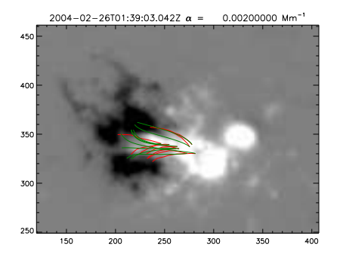
Initialisation of Run
MDI magnetogram $⇒$LFFF Extrapolation.
Matching with TRACE loop observations $⇒$ $L0_f$ and $B$.
Remaining parameters unconstrained:
$T0$
$L0$
$∆θ$
My task to find which parameters work!
Figure 2: MDI observations with LFFF Fits overlaid (Longcope et al 2016)
Callum Fairbairn |Spectral Synthesis

Slide 7
PREFT Physical Evolution
Tension force accelerates loop top.
RDs propagate downwards.
Plasma collision at loop top $⇒$ GDS.
Conduction fronts propagate ahead of bends.
Figure 3: Flux Tube Evolution
Callum Fairbairn |Spectral Synthesis

Slide 8
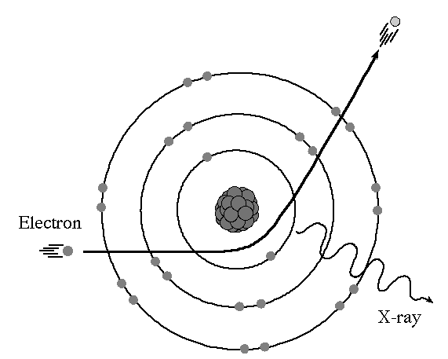
Spectral Synthesis – Theory
In thermal regime $⇒$ collisions.
Accelerating dipoles $⇒$ Free-Free interactions.
Integrating over Maxwellian velocity distribution $⇒$ Spectral Response Function: $R[T(l,t)]$
Integrate over loop gives the light curve per flux:
Figure 4: Dipole Acceleration
Callum Fairbairn |Spectral Synthesis

Slide 9
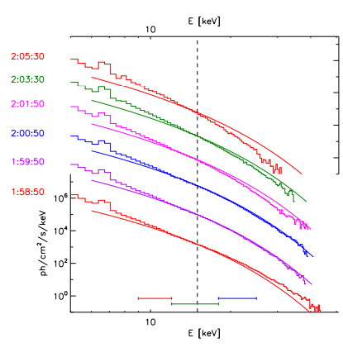
Spectral Synthesis – Theory
Convolve with flux transfer rate $\dot{φ}\left(s\right)$ $⇒$ net light curve:
Flare Ribbons
Invert convolution
How do results compare with observation?
$$\dot{φ}\left(s\right)$$
Figure 5: Spectral comparison (Longcope et al 2016)
Callum Fairbairn |Spectral Synthesis

Slide 10
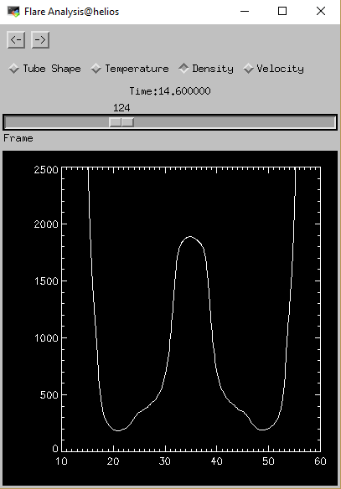
Weeks 1-2: A Matter of Trial and Error
Figure 6: Visualisation application
Early familiarisation with PREFT
Selection of tube runs – independently varying 3 free parameters.
19 runs performed $→$ effective comparisons.
Development of visualisation tools.
Callum Fairbairn |Spectral Synthesis

Slide 11
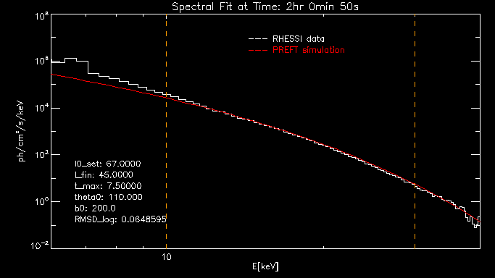
Week 3: Initial RHESSI Comparisons
--- RHESSI
--- PREFT
Framework synthesises spectra and compares with RHESSI
Logarithmic RMSE error measure
Recreate fit as featured in Longcope et al 2016
ph/cm²/s/keV
T
RMSD_log = 0.0649
10
E [keV]
30
Figure 7: Effective Fit at 02:00:50
Callum Fairbairn |Spectral Synthesis

Slide 12
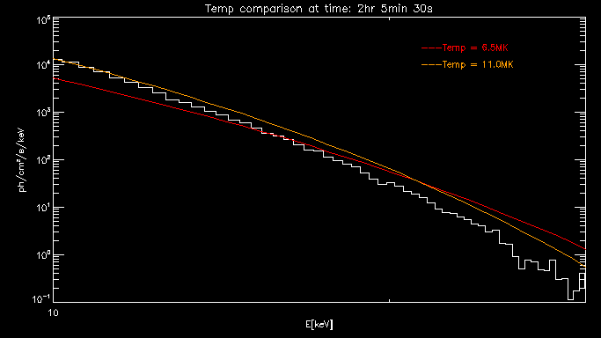
Week 4: Examine Broad Trends
$T$ related to $ρ$ through RTV initialisation
T ↑ $⇒$ $V_{a}$ ↓
Maximal temperatures at loop top ↓ $⇒$ softer spectra
Characteristic pivot behaviour.
--- T0 = 6.5MK
--- T0 = 11.0MK
ph/cm²/s/keV
E [keV]
Figure 8: Temperature Variation at 02:00:50
Callum Fairbairn |Spectral Synthesis

Slide 13
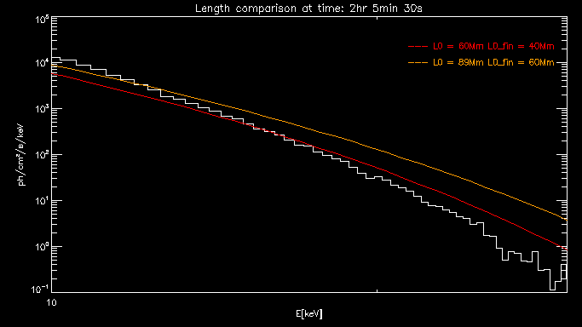
Week 4: Examine Broad Trends
Length retracted through increases
Free energy released ↑
Increase in emission across all bands
Use as a translational parameter
--- L0 = 60Mm L0_f = 40Mm
--- L0 = 89Mm L0_f = 60Mm
ph/cm²/s/keV
E [keV]
Figure 9: Length Variation
Callum Fairbairn |Spectral Synthesis

Slide 14
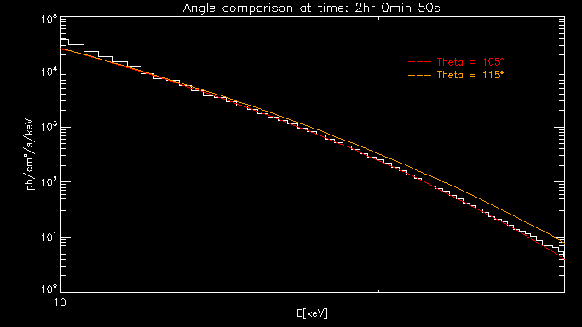
Week 4: Examine Broad Trends
$Δθ$ ↑ $⇒$ flux tube more bent.
More efficient conversion to horizontal velocity in loop top.
Max T ↑ .
Spectra becomes harder.
--- $Δθ$ = 105º
--- $Δθ$ = 115º
E [keV]
Figure 10: Angle Variation
Callum Fairbairn |Spectral Synthesis

Slide 15
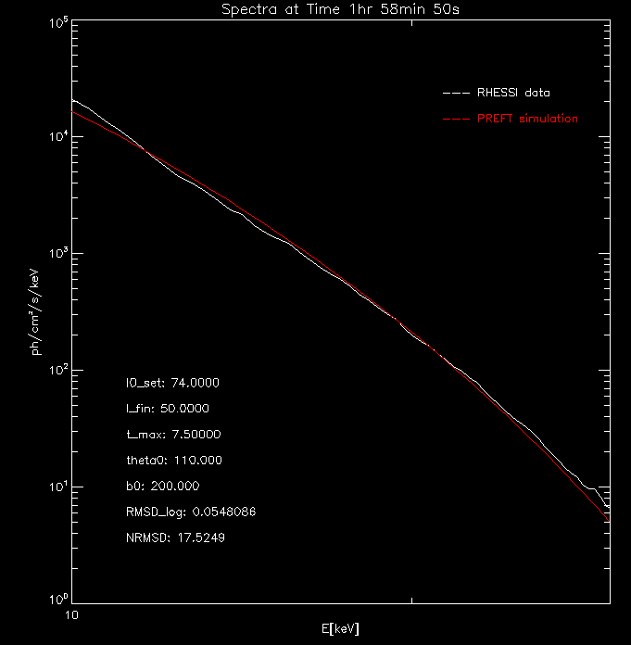
Week 5: Focused Runs
--- RHESSI
--- PREFT
$L0$: 74Mm
$L0_f$: 50Mm
$T0$: 7.5 Mm
$Δθ$ : 110º
$B0$: 200 G
RMSD_log: 0.0548
ph/cm²/s/keV
T
Increased length of retraction.
Achieves the slightly harder spectrum at earlier time.
E [keV]
Figure 11: Fit at 01:58:50
Callum Fairbairn |Spectral Synthesis

Slide 16
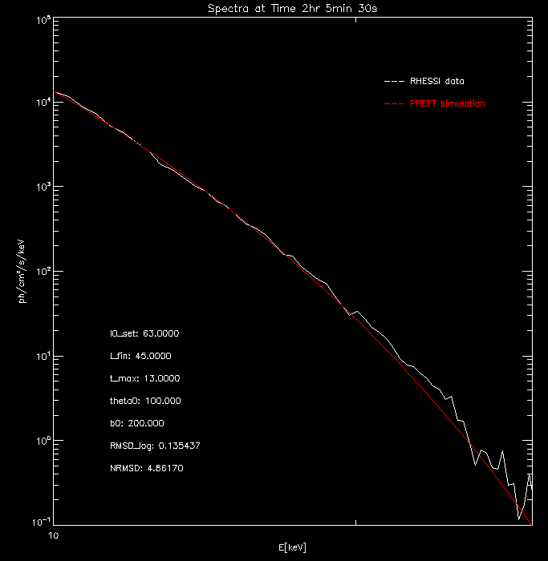
Week 6: Focused Runs
--- RHESSI
--- PREFT
$L0$: 63Mm
$L0_f$: 45Mm
$T0$: 13 Mm
$Δθ$ : 100º
$B0$: 200 G
RMSD_log: 0.135
ph/cm²/s/keV
Length of retraction ↓ $⇒$downwards translation
$Δθ$ ↓ $⇒$ fine tune hard end of spectrum
$T0$ ↑ $⇒$ softening pivot
E [keV]
Figure 12: Fit at 02:05:30
Callum Fairbairn |Spectral Synthesis

Slide 17
Week 6: Controversy?
Controversially high temperatures and densities required?
Some unknown mechanism exists to drive density enhancement over impulsive phase?
Callum Fairbairn |Spectral Synthesis

Slide 18
Next Steps
Figure 13: Time Staggered Flux Transfer Contributions
Trigger different loop retractions at different times.
Temporally staggered convolution.
Distribute flux transfer across different tubes.
$$\dot{φ}(t)$$
$$\dot{φ}\{(t)$$
$${\dot{φ}}_{1}(t)$$
$${\dot{φ}}_{2}(t)$$
$${\dot{φ}}_{3}(t)$$
$$I\left(t\right)=\sum_{1}^{5}{\int_{−∞}^{∞}{I_{o}^{\left(i\right)}\left(t−s\right){\dot{φ}}_{i}\left(s\right)ds}}$$
$$t$$
Callum Fairbairn |Spectral Synthesis

Slide 19
Questions…
Callum Fairbairn |Spectral Synthesis

