Slide 1
Microburst Imaging
Jessica Sydnor
Advisor: Dr. John Sample

Slide 2
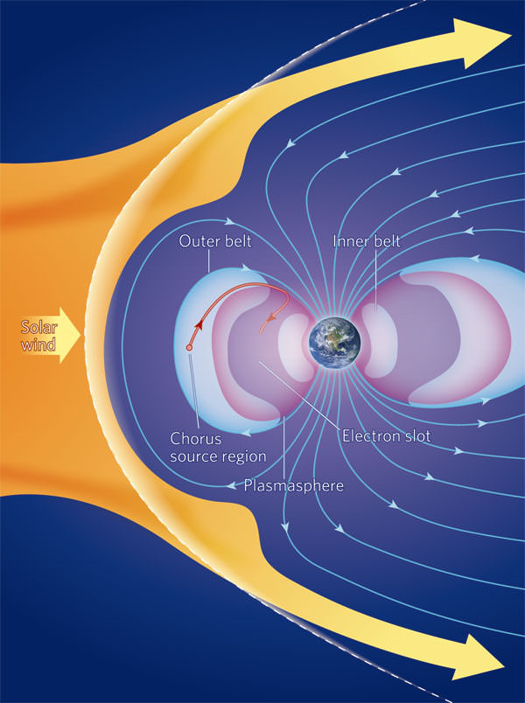
Radiation Belts
Solar wind becomes trapped in Earth’s magnetic field
Trapped particles protect the Earth
Gains and losses of particles occur
Want to determine the loss processes

Slide 3
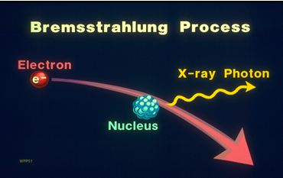
Microbursts
Possible loss process for the particles in the magnetosphere
Bursts of electrons hitting the ionosphere
Observe the x-rays the electrons create through bremsstrahlung radiation

Slide 4
Microbursts
Electrons interact with EM waves in the magnetic field
Waves change the pitch angle of the electrons
Electrons enter the loss cone

Slide 5
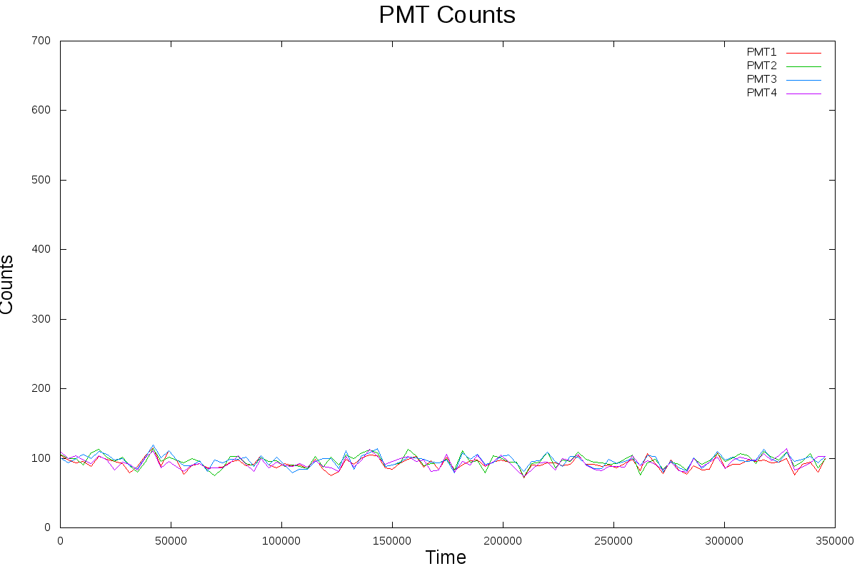
Quiet Time

Slide 6
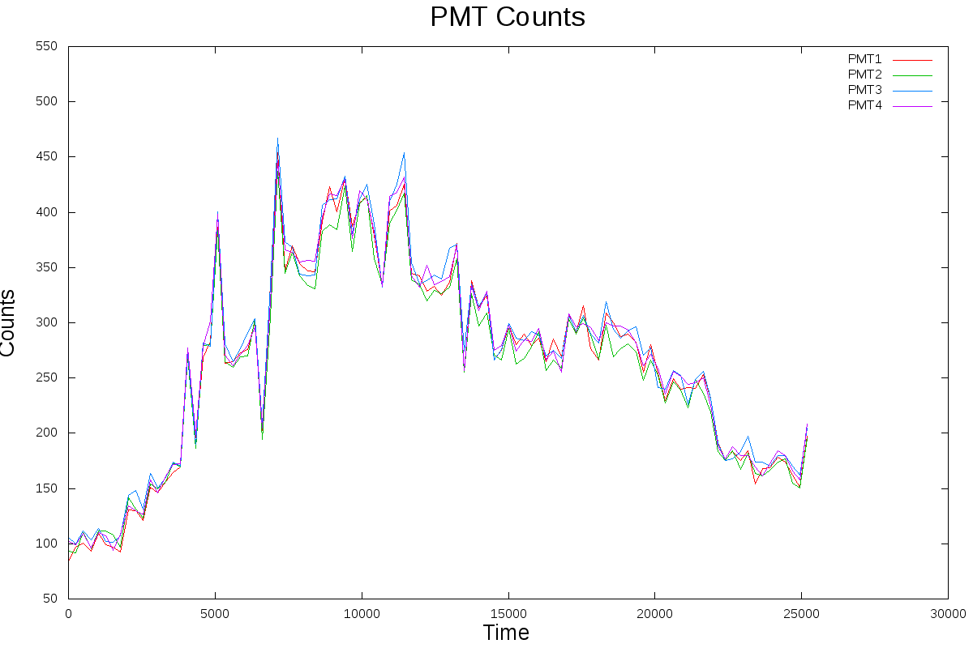
Active Time

Slide 7
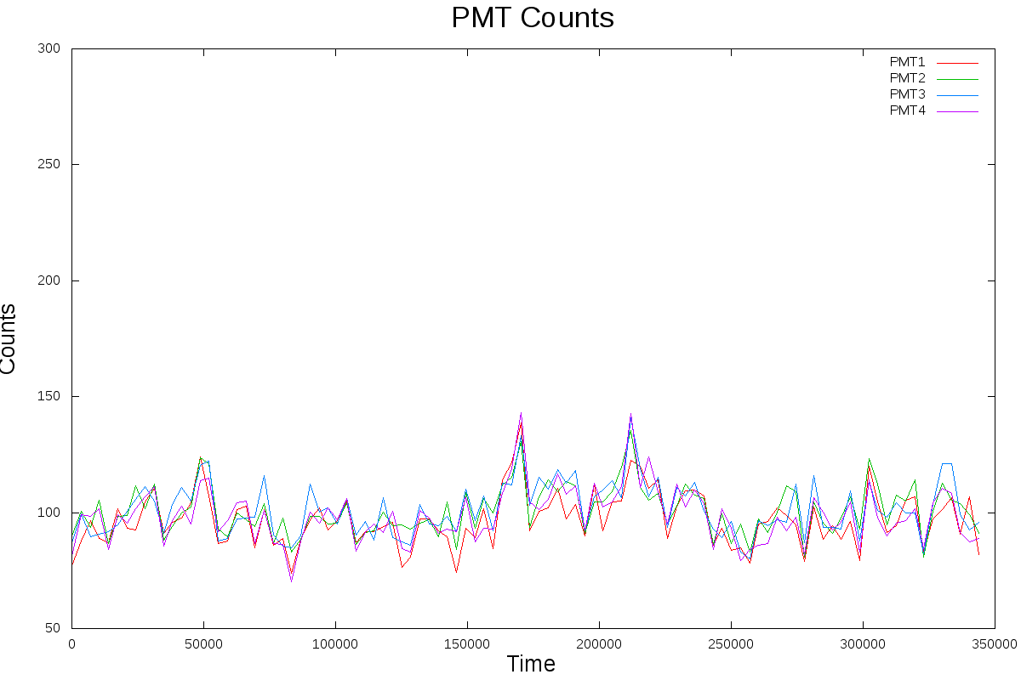
Microbursts

Slide 8
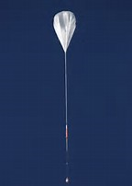
Why Imaging and Ballooning?
Understand spatial distribution of x-rays
Model back to radiation belts
Spacecraft move too fast
Balloons stay in one place, gaining longer exposure

Slide 9
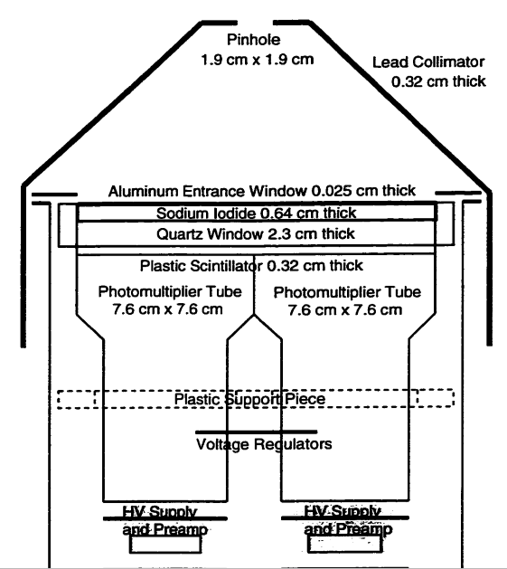
Instrumentation
Flew on a balloon payload at ~30-35km
Pinhole camera
4 4x4 pixelated PMTs
Recorded the energy and total counts seen by each PMT
Stored data in binary files

Slide 10
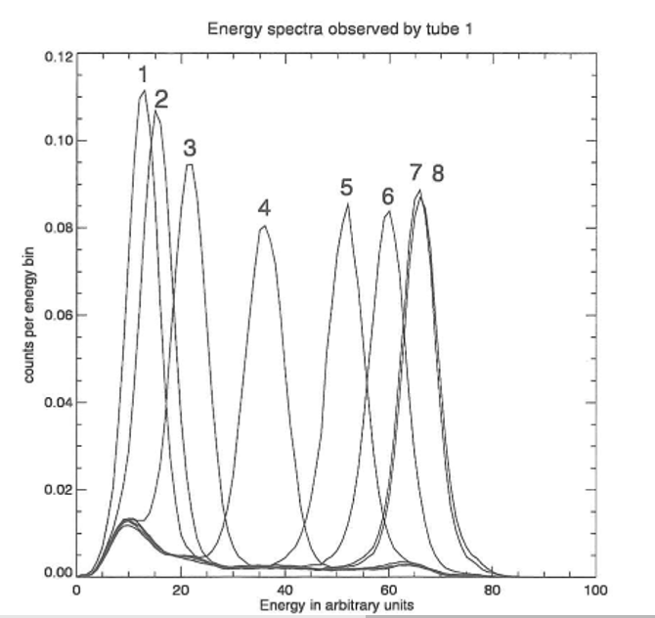
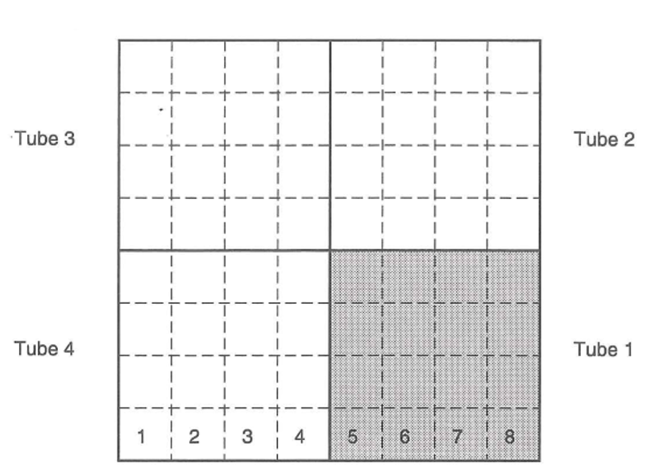
Look-Up Table

Slide 11
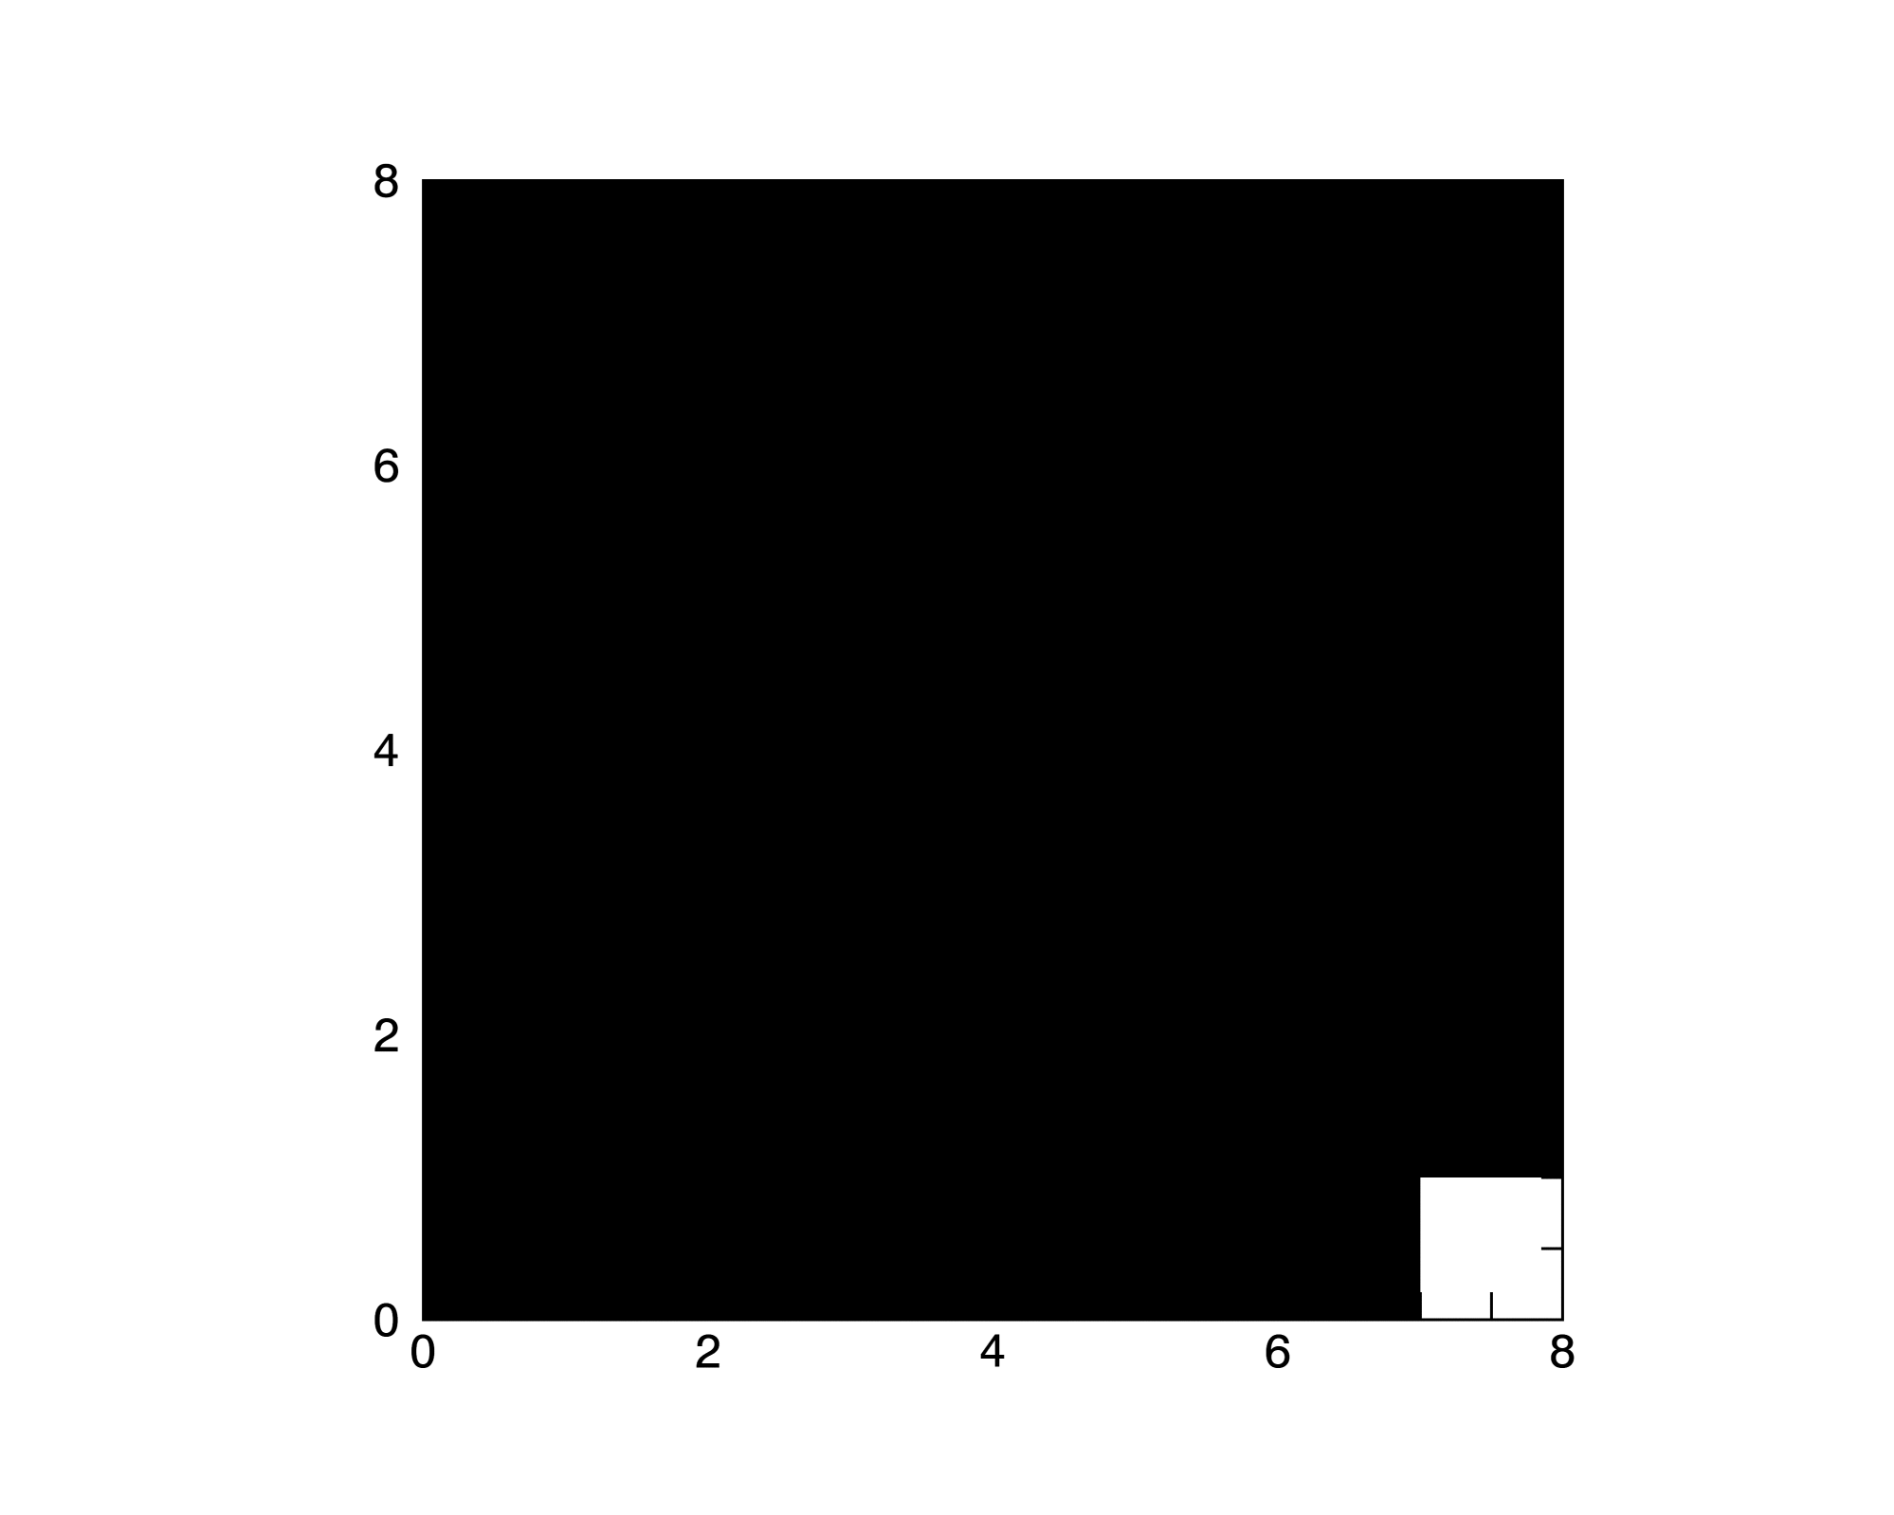
Look-up Table Implementation

Slide 12
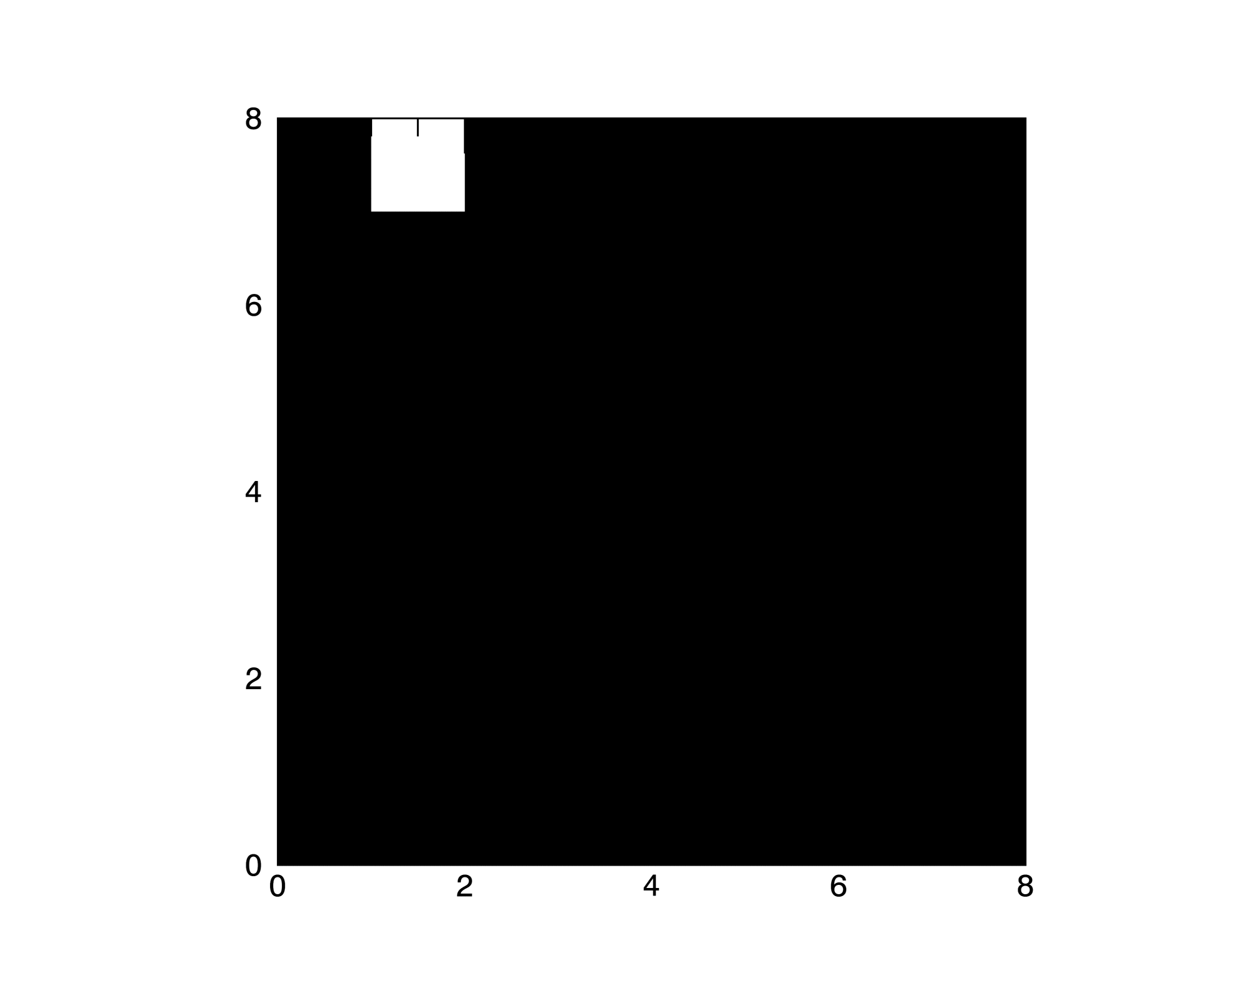
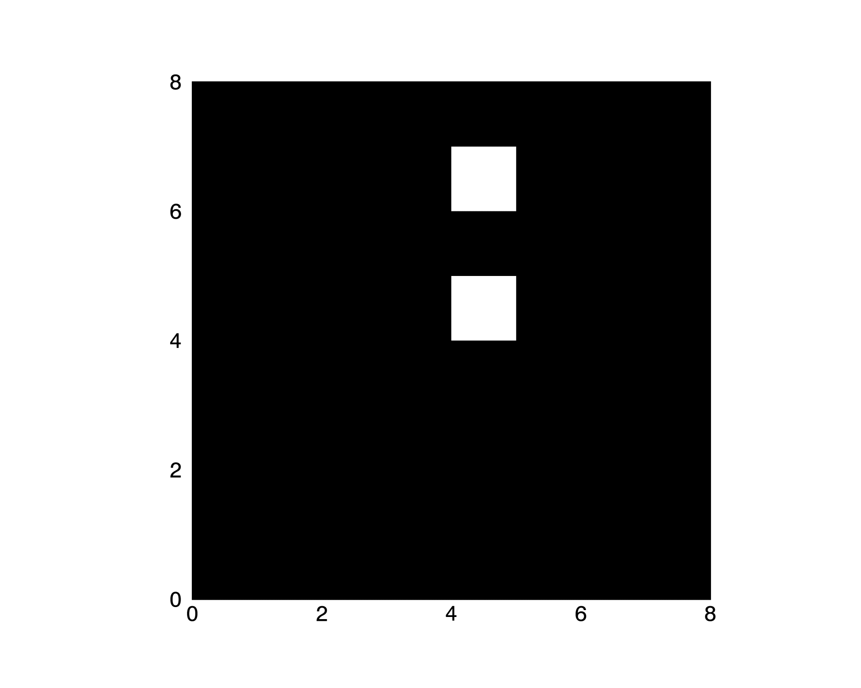
Payload Rotated – 90 and 180 Degrees

Slide 13
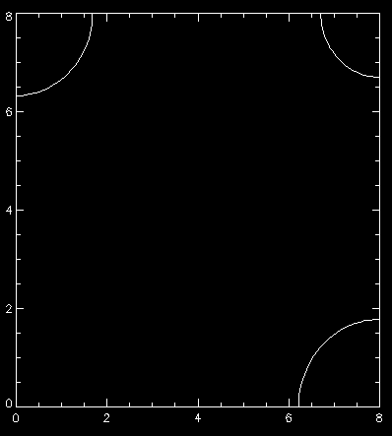
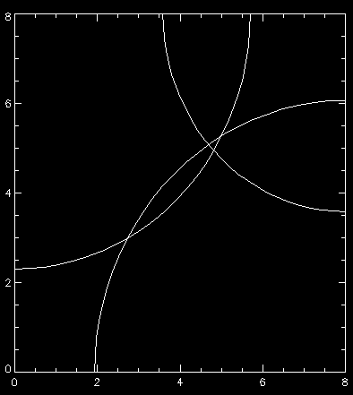
Triangulation

Slide 14
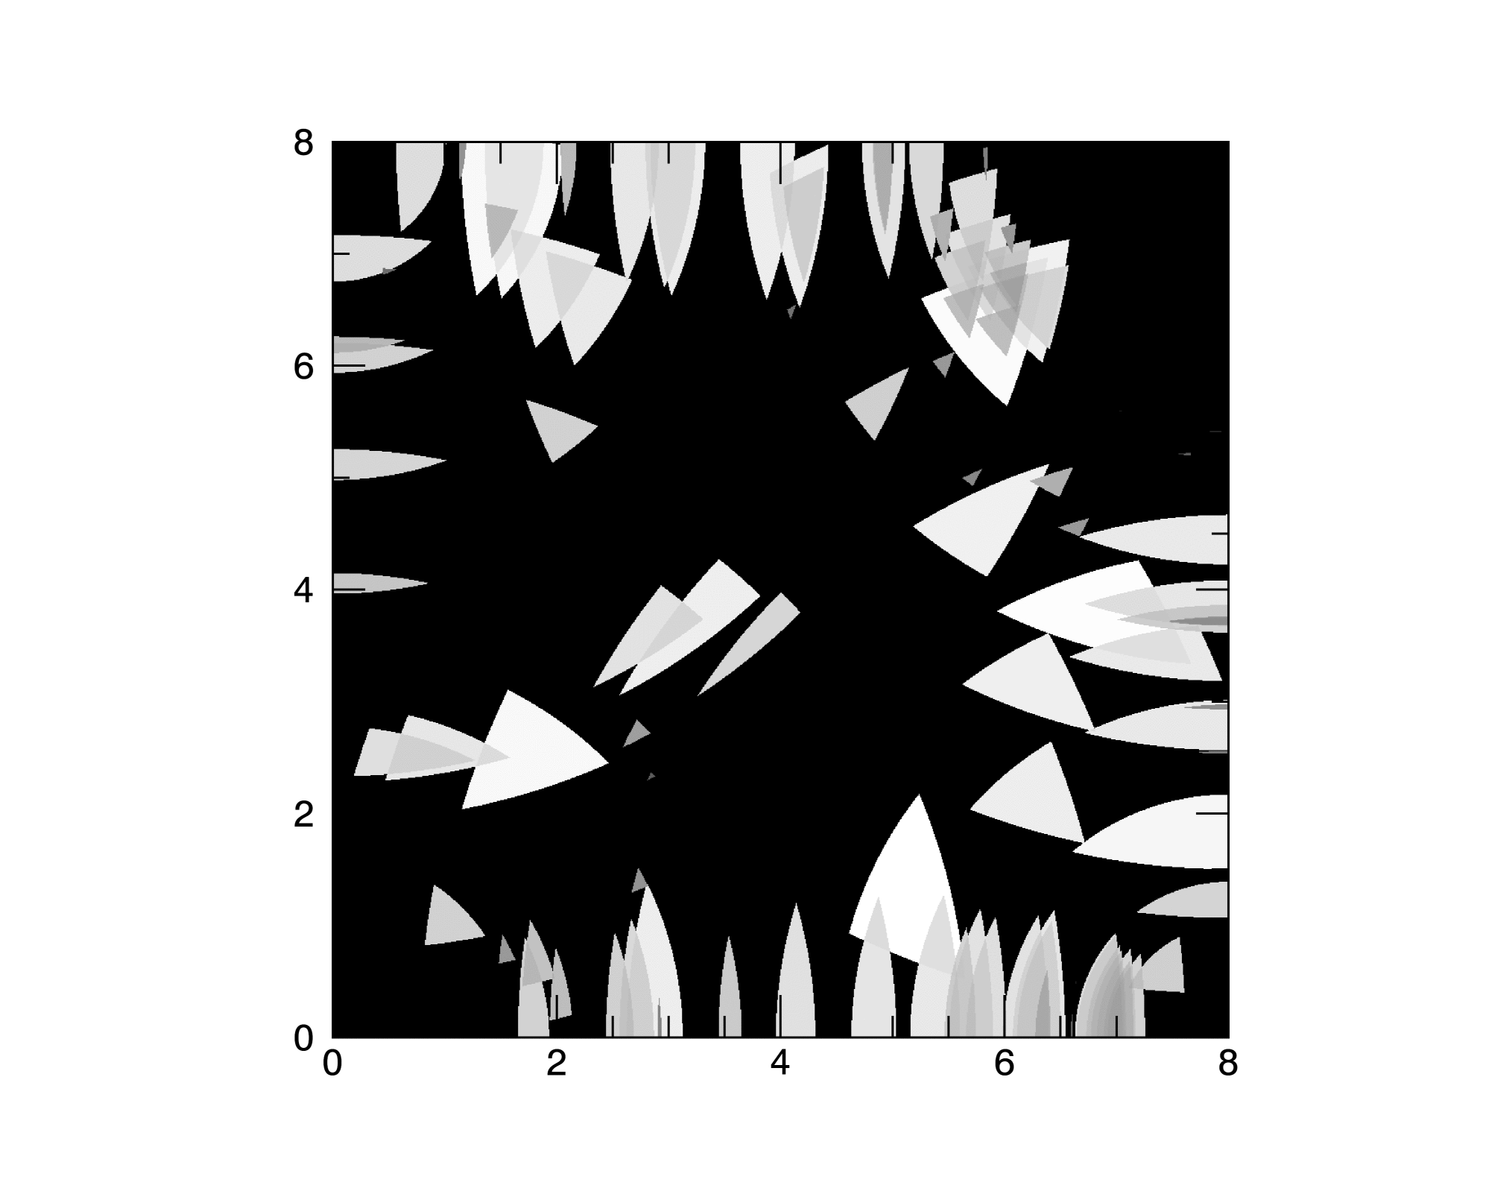
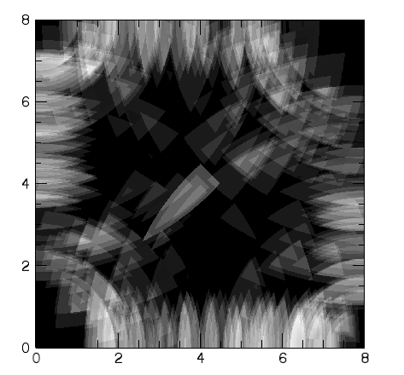
Triangulation Implementation

Slide 15
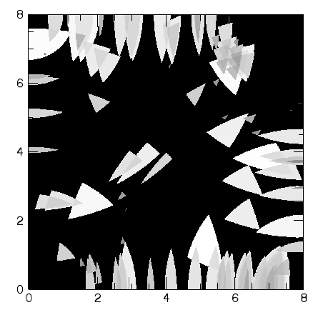
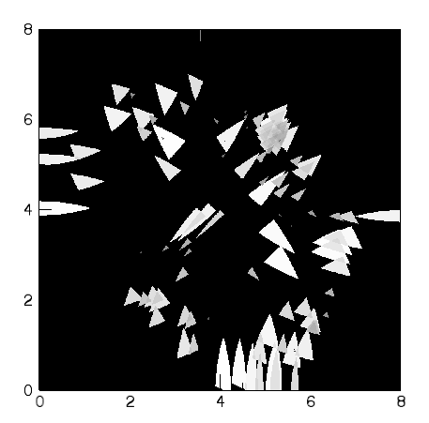
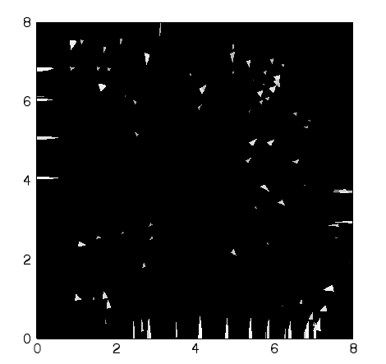
Linear, Logarithmic, and Square Root Scaling

Slide 16
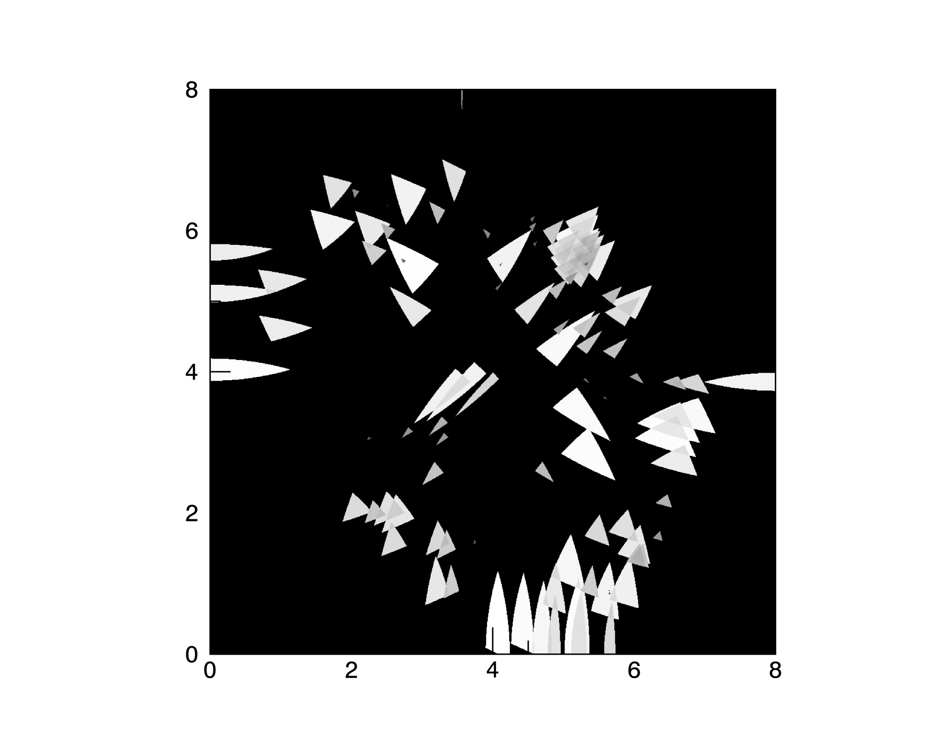
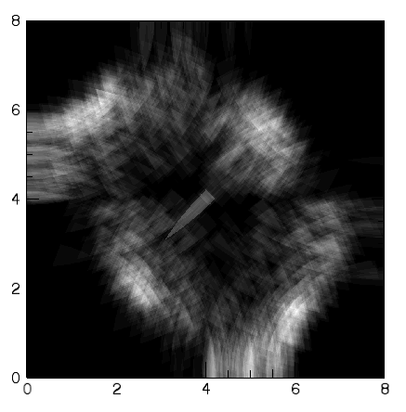
Square Root Scaling

Slide 17
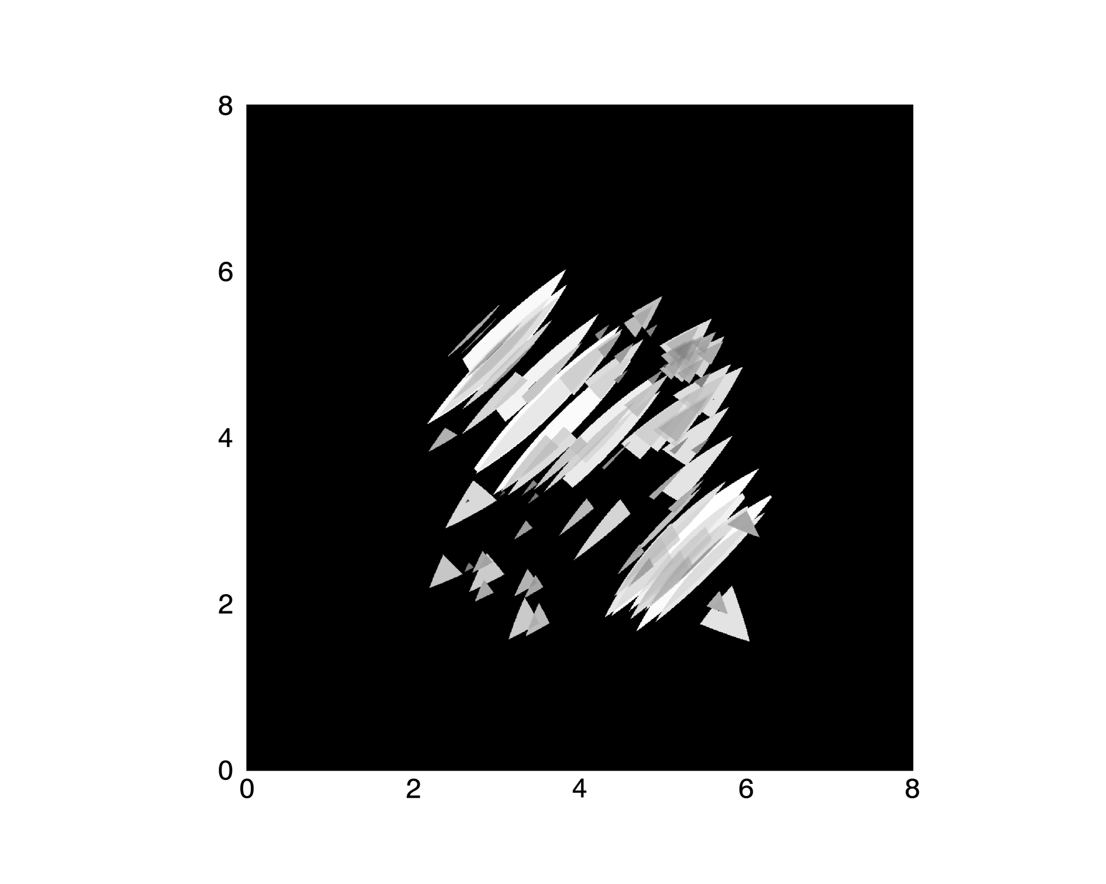
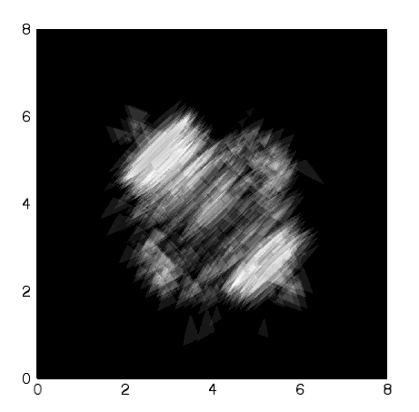
Triangulation Implementation Modified

Slide 18
Future Possibilities
Continued improvement of imaging methods
Further analysis of the data to understand oddities
De-spinning data

Slide 19
Acknowledgements
Thank you to Dr. Sample for all his guidance and help through out the summer
Thanks to Dr. Qiu and Dr. Longcope for organizing the REU program
Thank you to the NSF for supporting the MSU REU

Slide 21
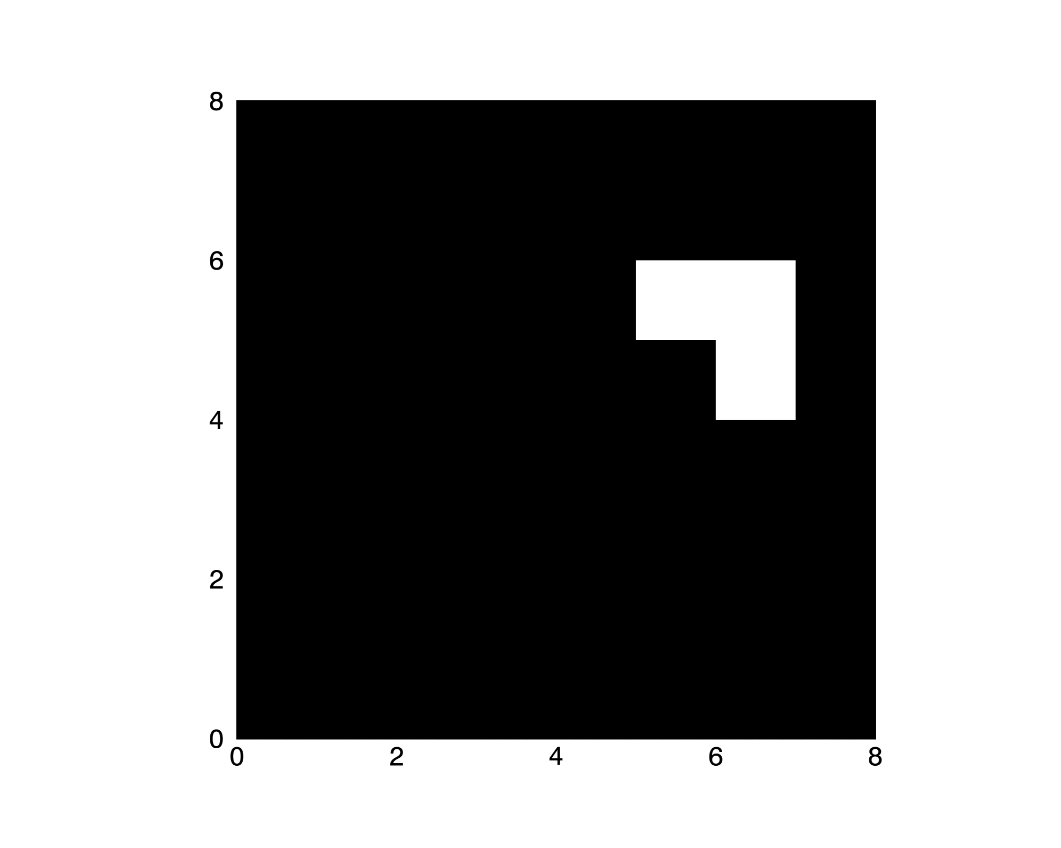
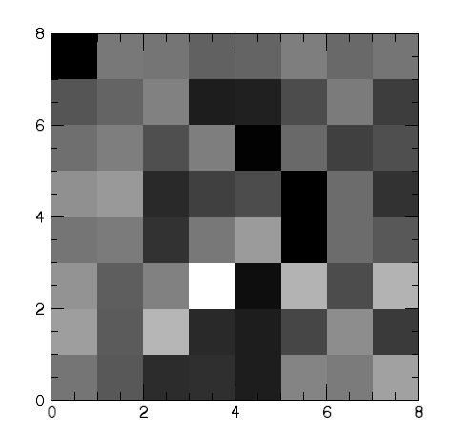
Relatively Quiet Time, 1000 frames
January 23rd Microburst

Slide 22
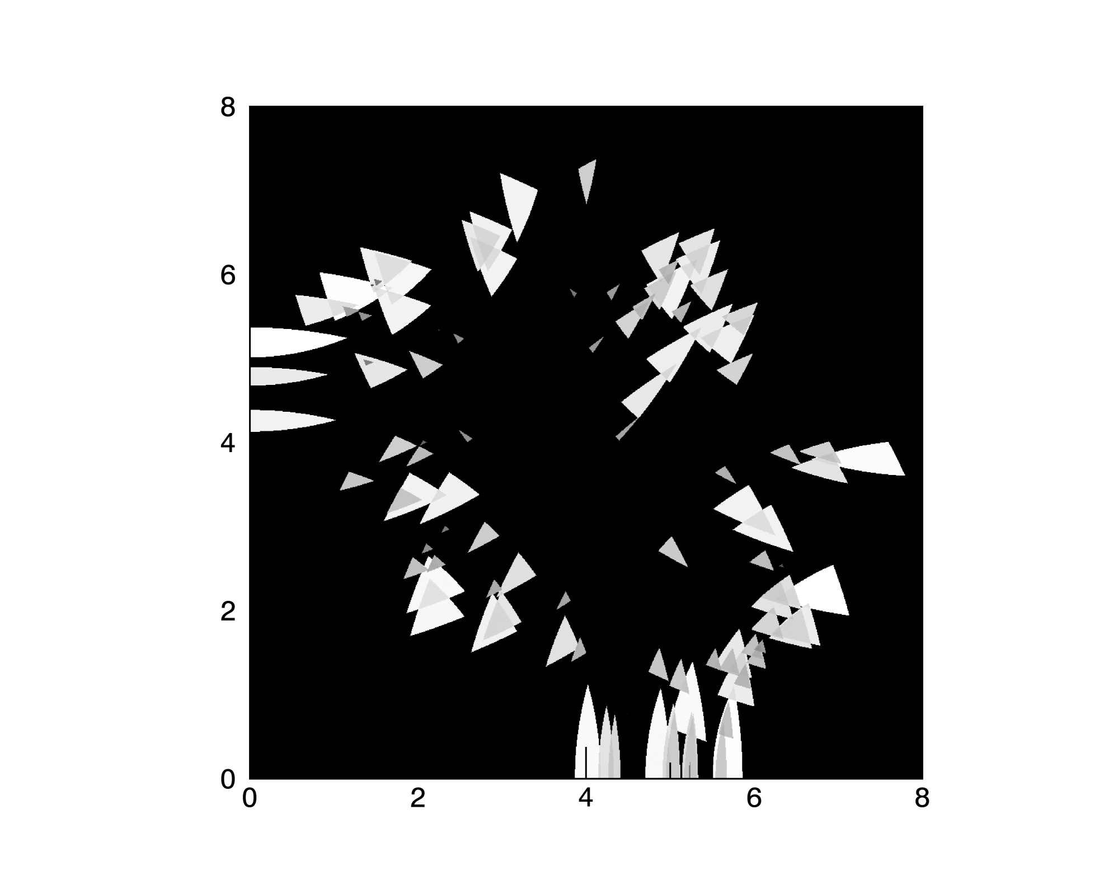
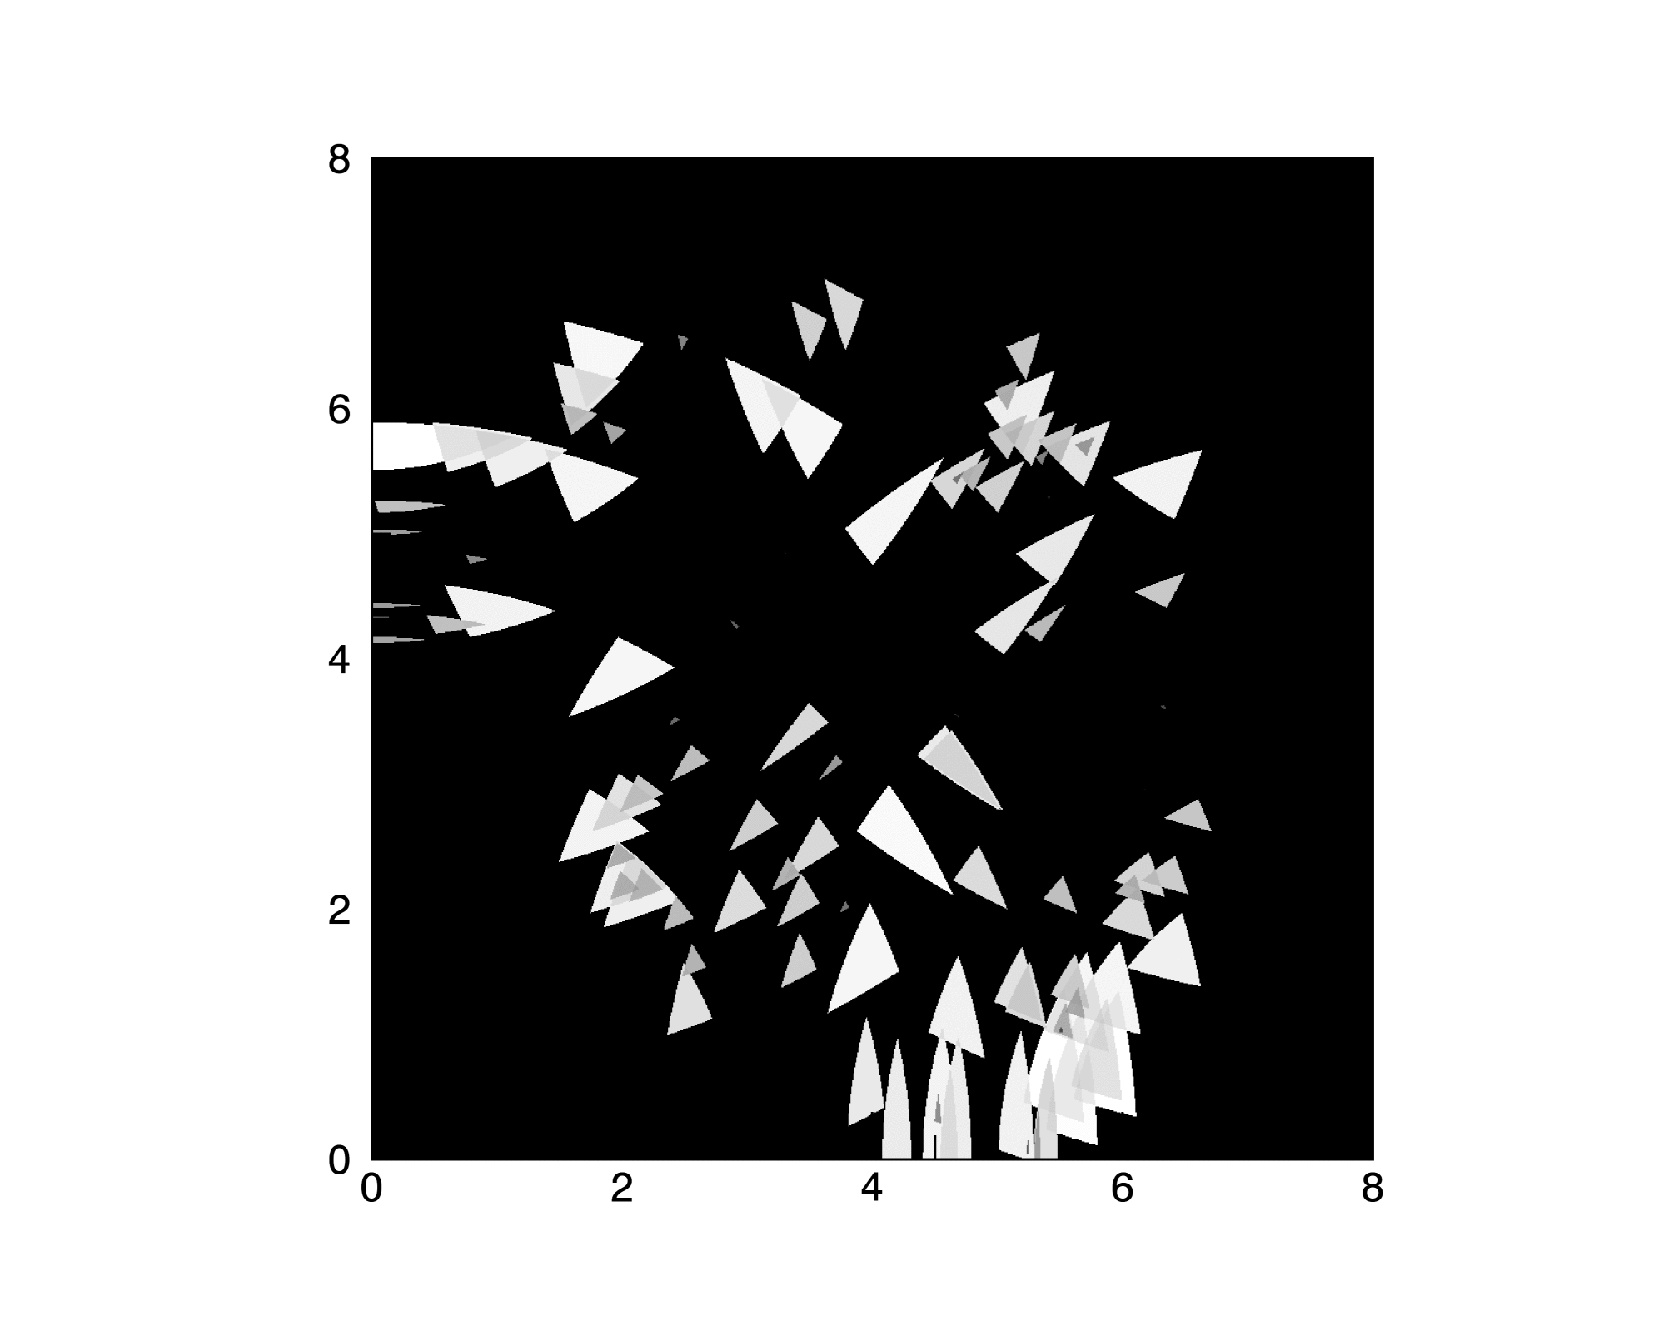
Payload Rotated – 90 and 180 Degrees

Slide 23
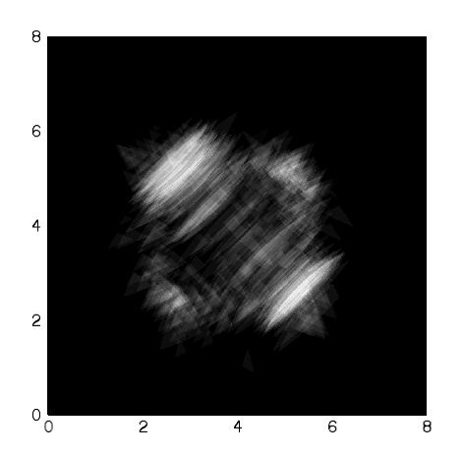
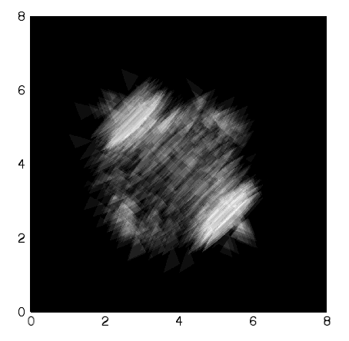
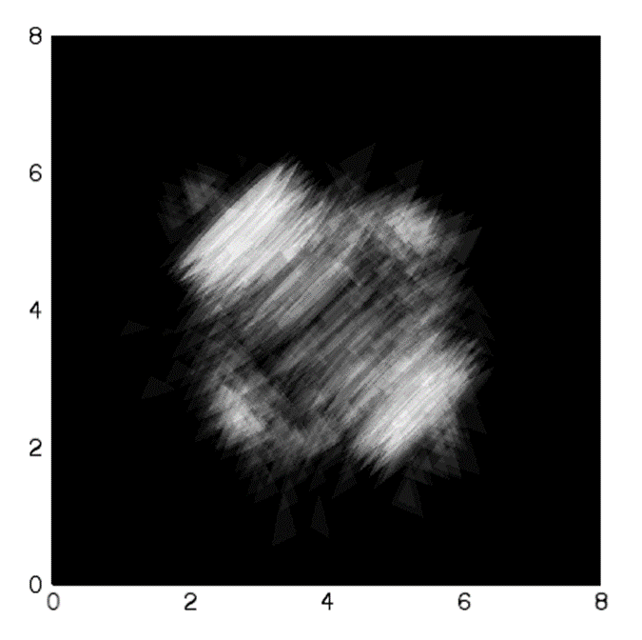
Before Microburst
During Microburst
During Active Time

