Slide 1
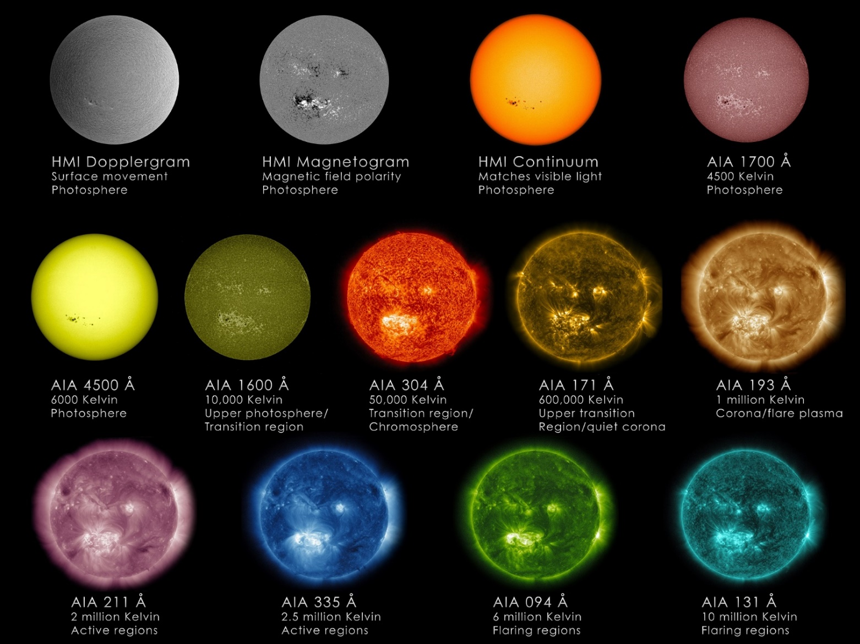
Flare Modelling in EUV using PREFT
Julia Quebral
Advisor: John Unverferth

Slide 2
Project Overview
Observation of flare loop
Modelling of flare loop
Simulation using PREFT

Slide 3
April 18, 2014 Flare

Slide 4
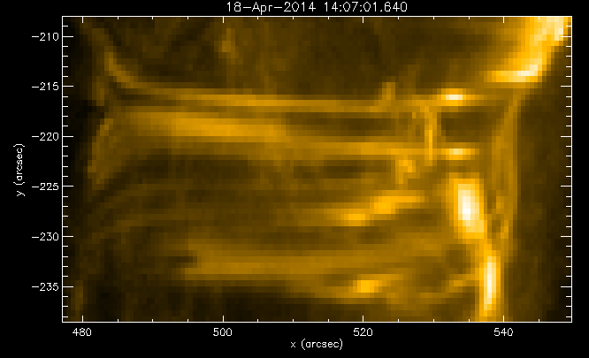
Flare Loop

Slide 5
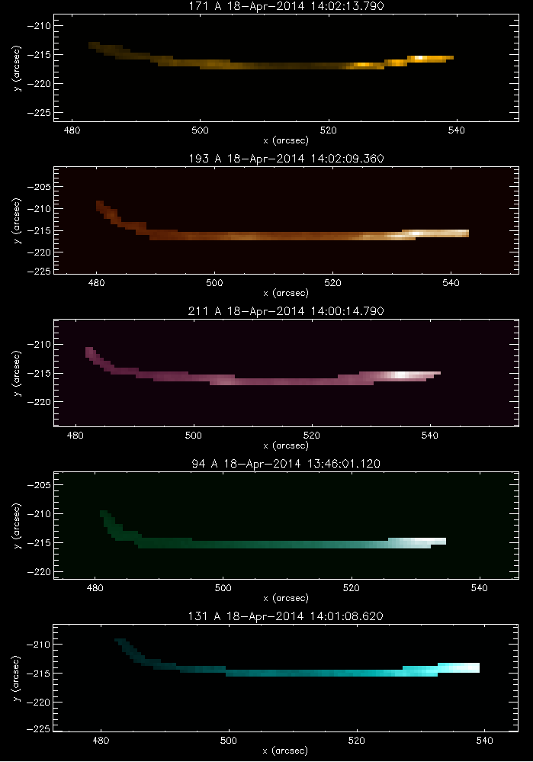

Slide 6
Stackplots

Slide 7
PREFT simulation
Thin flux tube model
Parameterized along length
Non-constant magnetic field

Slide 8
Notes:
Take out?

Slide 9
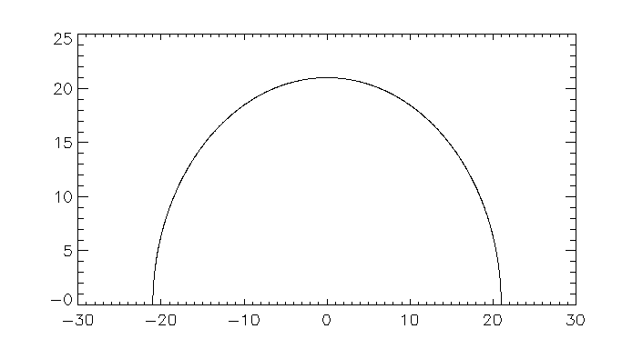
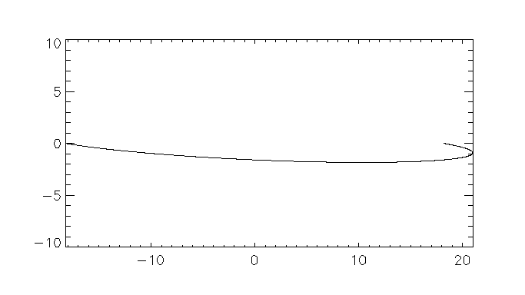
Synthetic EUV

Slide 10
Comparison

Slide 12
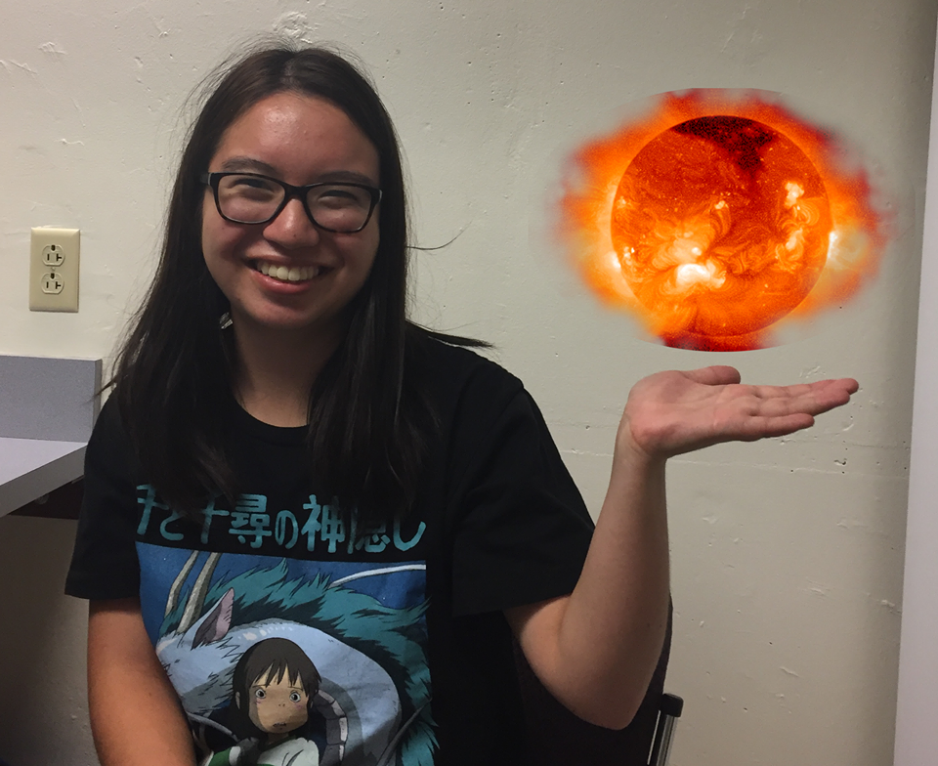
Thank you! Any questions?
(Photo courtesy of Callum Fairbairn)

