Slide 1
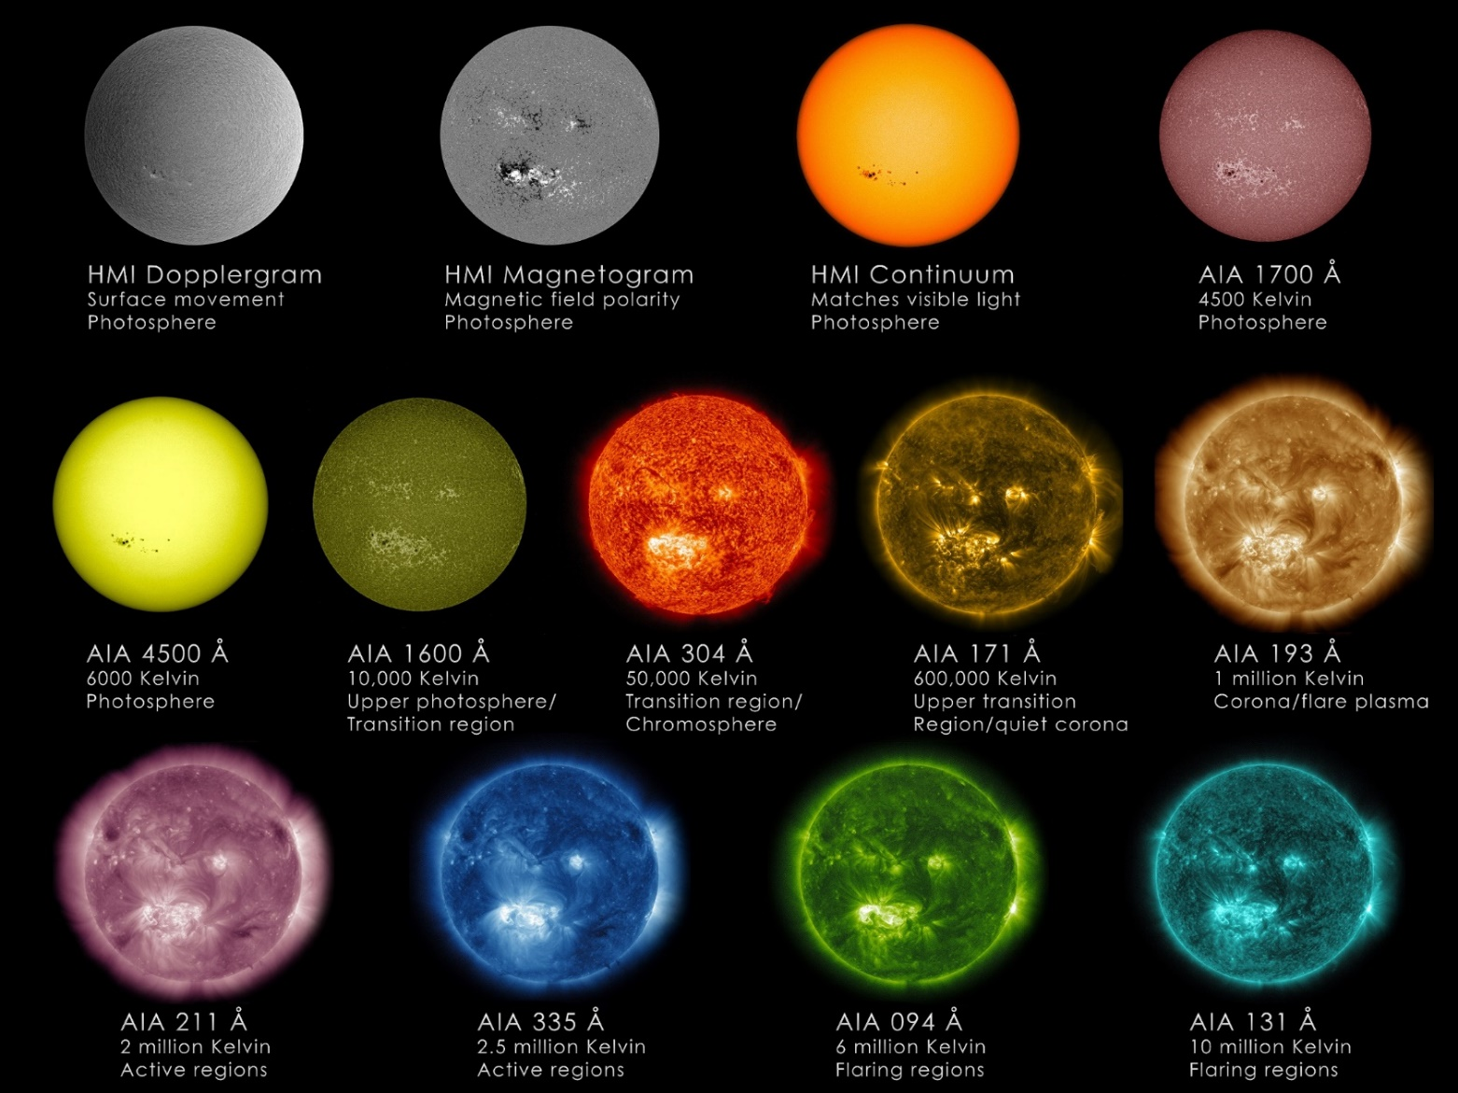
Flare Modelling in EUV using PREFT
Julia Quebral
Advisor: John Unverferth

Slide 2
Project Overview
Observation of flare loop
Modelling of flare loop
Simulation using PREFT

Slide 3
April 18, 2014 Flare

Slide 4
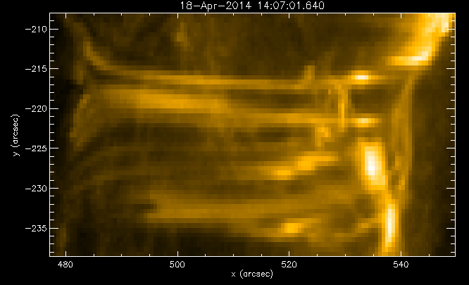
Flare Loop

Slide 5
Loop Mask

Slide 7
Field Line Tracing
Obtain magnetic field and length
Limits free parameters

Slide 8
PREFT simulation
Thin flux tube model
Parameterized along length
Non-constant magnetic field

Slide 9
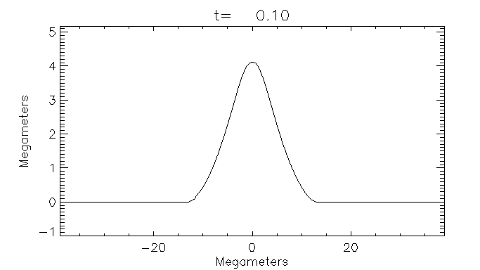
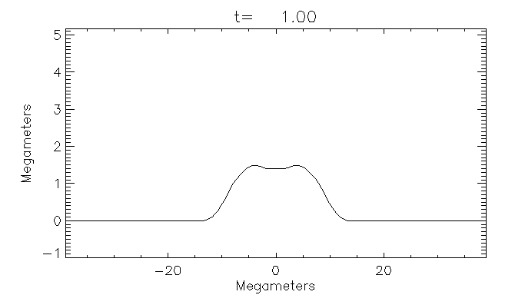
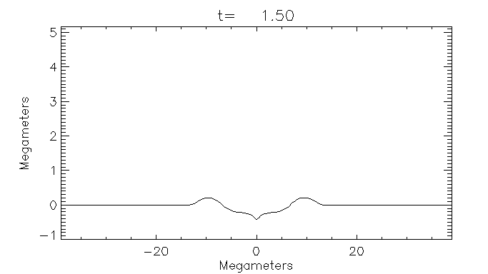
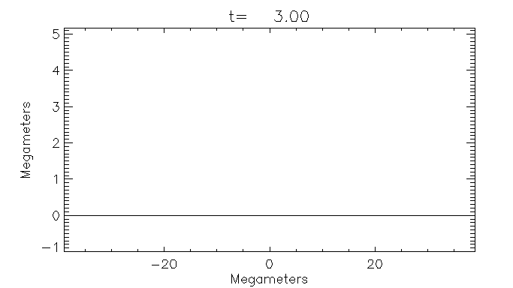

Slide 11
Synthetic EUV

Slide 12
Next steps
Finish magnetic field modelling
Match results of PREFT with observations
Consider non-equilibrium ionization effects

Slide 13
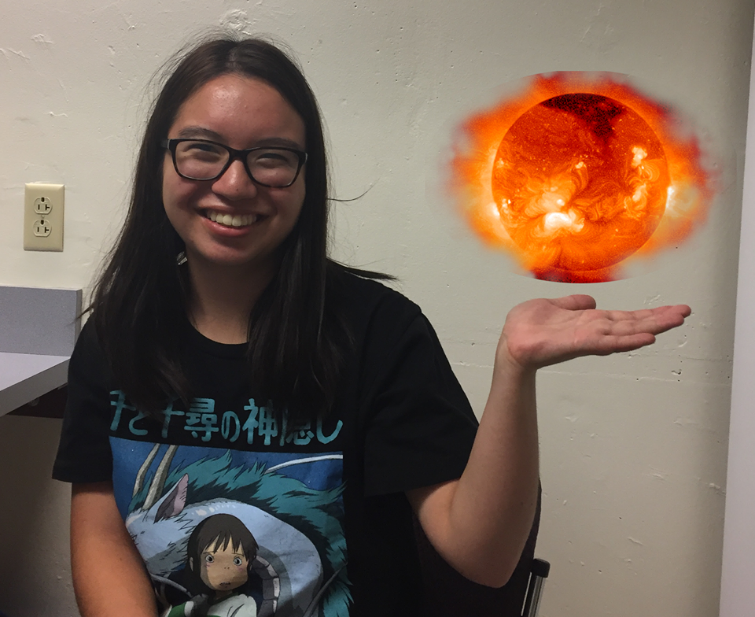
Thank you! Any questions?
(Photo courtesy of Callum Fairbairn)

