Slide 1
LAFTR
Scott Hunter
Montana State University
REU 2017

Slide 2
LAFTR – Light and Fast TGF Recorder
TGF – Terrestrial Gamma Flash
~ 1 Sv
Learn
Notes:
A TGF is a terrestrial gamma flash, which is a lightning strike which produces gamma radiation.
It can administer up to a Seivert (see-vert) of radiation in about 1 ms. A Seivert is a lifetime dose of natural radiation. Can cause radiation sickness or death!
So we want to learn about this relatively new phenomenon.

Slide 3
LAFTR - Outline
Background
Science goals
Instrumentation
My contribution
Notes:
Background on what a TGF is and where they are thought to come from.
Discuss science goals of LAFTR
Explain how the LAFTR payload will operate
Talk about what I contributed to the team

Slide 4
LAFTR - Background
TGF – Terrestrial Gamma Flash (Fishman et al., 1994)
10 – 15 km altitude
Similar to lightning distribution, but gaps
  Mid altitudes
  High altitude
  Inland regions
Notes:
What - TGF first discovered by Fishman et al. 1994
New field, high energy atmospheric physics (~ 20 years)
Gaps include Montana

Slide 5
LAFTR - Background
0.1 Sv in less than 1 ms (Bwyer et al., 2010)
More recent data claims up to 1 Sv!
Fortunately rare
Notes:
Why – 1 see-vert in under a millisecond! This is a full lifetime dose of radiation, all in a millisecond.
Rare – planes only get struck by lightning 1-2 times per year

Slide 6
LAFTR - Background
Occur during the ascent of a negative leader during intercloud lightning
Notes:
Gamma rays spread out into a cone shape via Compton scattering

Slide 7
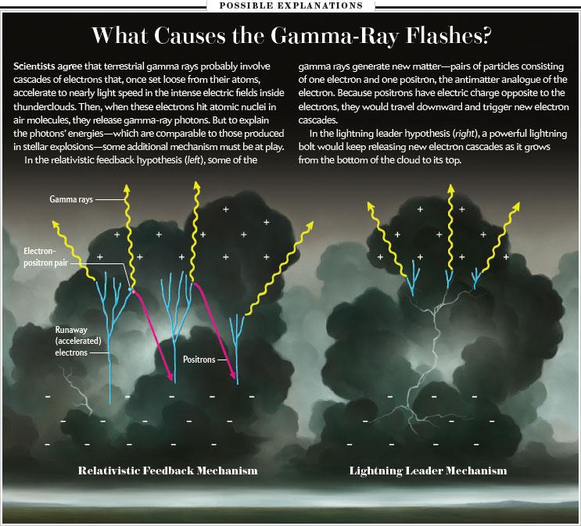
LAFTR - Background
Two mechanisms:
- Relativistic feedback - Lightning leader tip
From LAFTR CDR slides
Notes:
Cosmic rays are not enough to provide the scale recorded. Therefore: Two POSSIBLE mechanisms, both of which are present in regular lightning.

Slide 8
LAFTR - Background
Lightning Leader Tip
Create seed electrons
Strong local potential
Very little friction
TGF created by
  Weaker part of the leader tip
  Relativistic Runaway Electron Avalanche (RREA)
From LAFTR CDR slides
Notes:
Little friction b/c small distance

Slide 9
LAFTR - Background
Relativistic Feedback
Weaker local potential
Larger overall potential
Electrons must already
  be high enough in energy
  experience low enough friction
Pair production and Compton scattering produce an avalanche
Stops when potential had decreased
From LAFTR CDR slides

Slide 10
LAFTR - Background
Relativistic Feedback
Lightning Leader Tip
Glowy
Smooth time profile
Bursty
Energy continuum
From LAFTR CDR slides

Slide 11
LAFTR – Background
Previous observations:
Ground
Airplane
Balloon
Satellite
  ADELE
  Fermi
  RHESSI

Slide 12
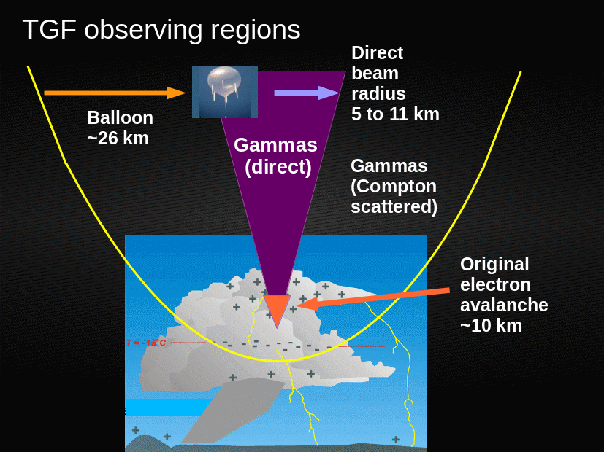
LAFTR – Science Goals
Light and Fast TGF Recorder
  Light, < 6 lbs.
  Fast, > 10 ns precision
  Time will distinguish between theories
Photo from LAFTR proposal
Notes:
Most importantly, time resolution

Slide 13
LAFTR – Science Goals
Balloon payload
  Flies at ~ 26 km vs. satellites at ~ 600 km
  TGFs at ~ 11 km
  Sensitivity goes as 1/r² resulting in a 3 order of magnitude increase in brightness of events
  This ignores atmospheric scattering present in data measured by satellites (LAFTR Proposal)
Notes:
Ignores scattering, so would be even better!
Would see if there are TGFs inland, near Montana

Slide 14
LAFTR – Science Goals
  Power law which follows dN/dC = C^{-λ} .
  λ = 2.3 ± 0.2 from Fermi and RHESSI (Østgaard et al., 2012)
    “If 1/1000 lightning flashes produce a TGF that can be seen from space, and if these power laws continue to lower luminosities, most lightning flashes should produce a small TGF at least 1% of the brightness of the smallest observable from orbit.” (LAFTR Proposal)
  Hope to measure lower energy TGFs than previously recorded
Notes:
N = # of TGF
C = Counts by satellite

Slide 15
LAFTR - Instrument
Scintillator
Shaper
SiPM
Sorter
FPGA
Arduino
Due
SD

Slide 16
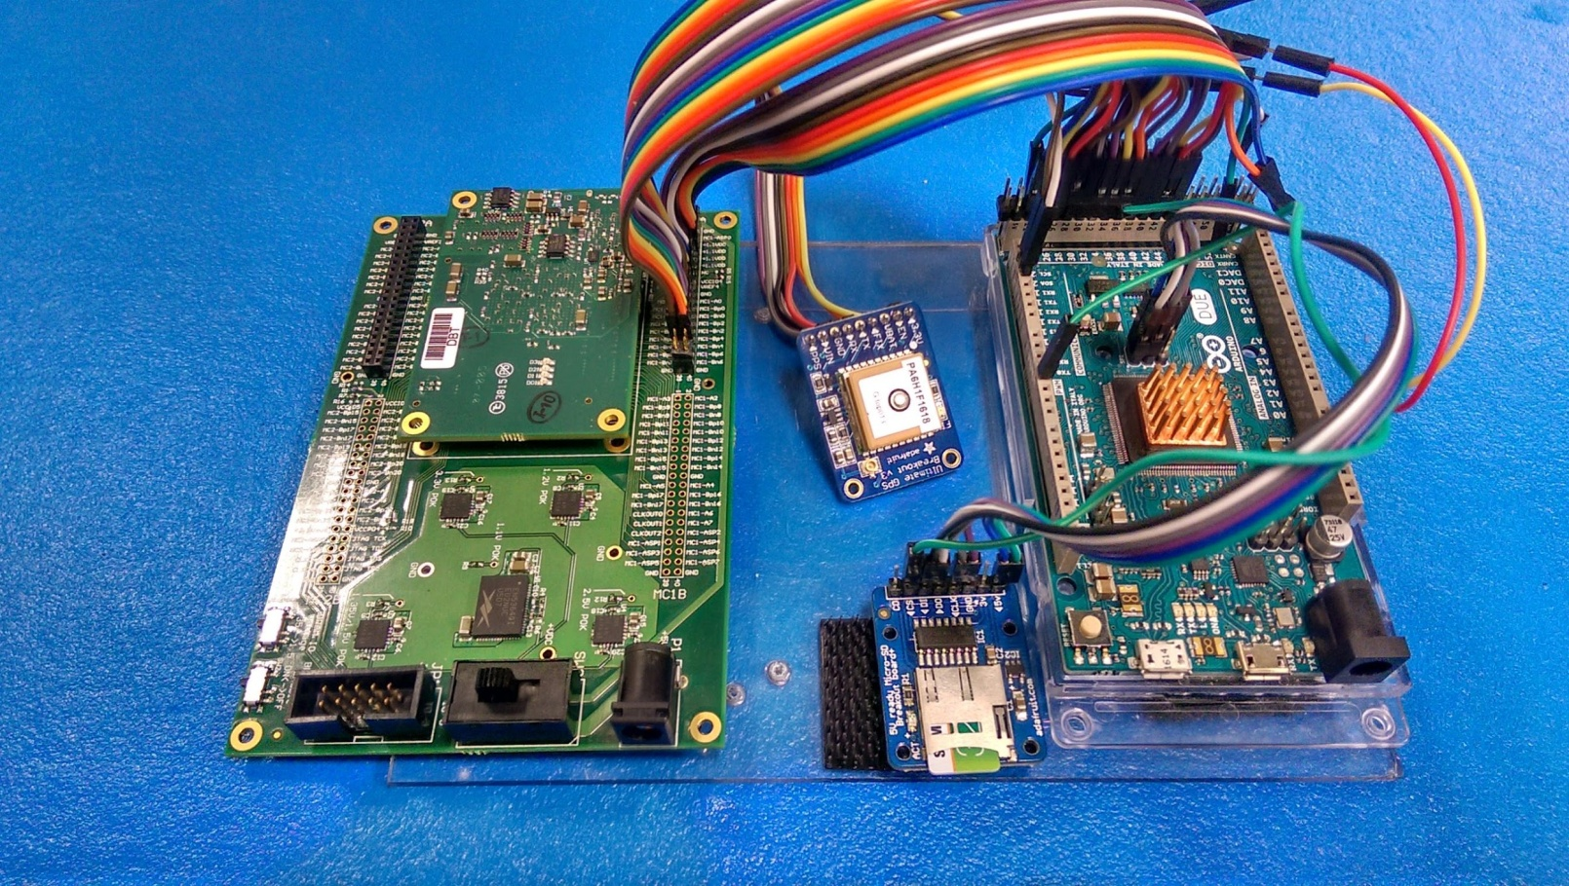
LAFTR - Instrument

Slide 17
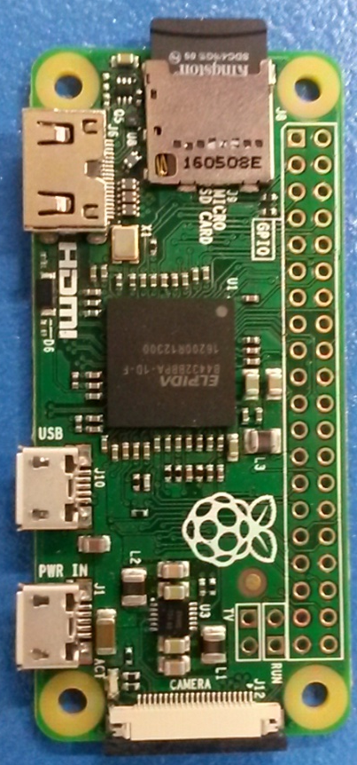
LAFTR – Proof of Concept
Enter Raspberry Pi 0
Bottleneck in Arduino

Slide 18
LAFTR – Proof of Concept
Arduino Due
Raspberry Pi 0
More GPIO
84 MHz processor
96 kB RAM
Must SPI to SD card
69 – 95 mA draw
Smaller
1 GHz processor
512 MB RAM
On board SD card
100 – 200 mA draw
Notes:
Proves to be a viable option

Slide 19
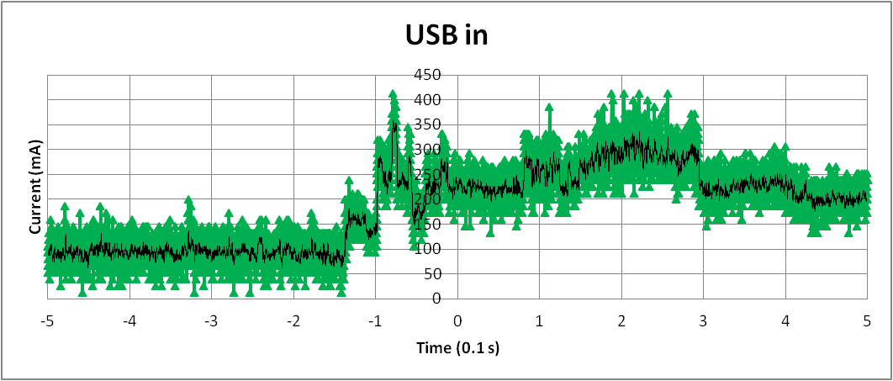
Current Draw

Slide 20
kWord Timing

Slide 22
References
LAFTR Proposal
LAFTR CDR Slides
http://www.lightningsafety.noaa.gov/science/science_initiation_stepped_leader.htm
Papers cited in the slides

Slide 23
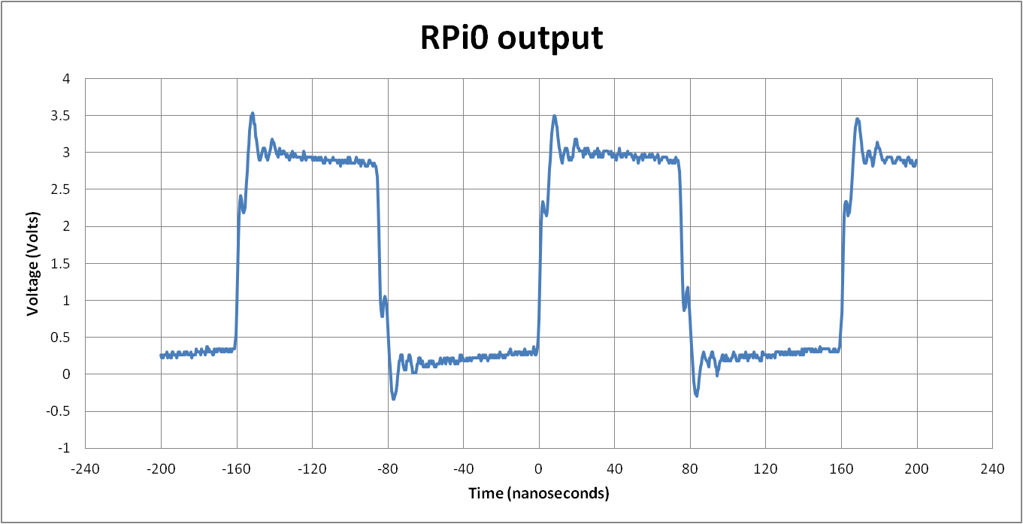
Digital Output

Slide 24
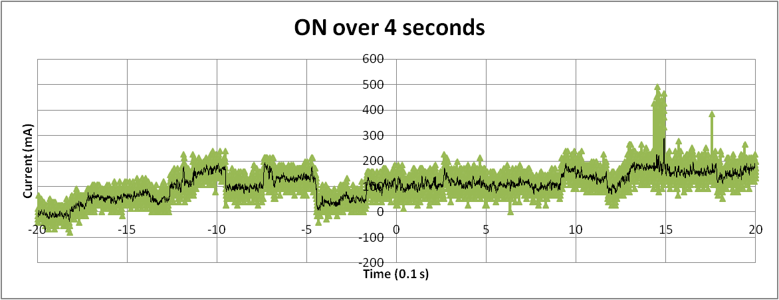
Current Draw

Slide 25
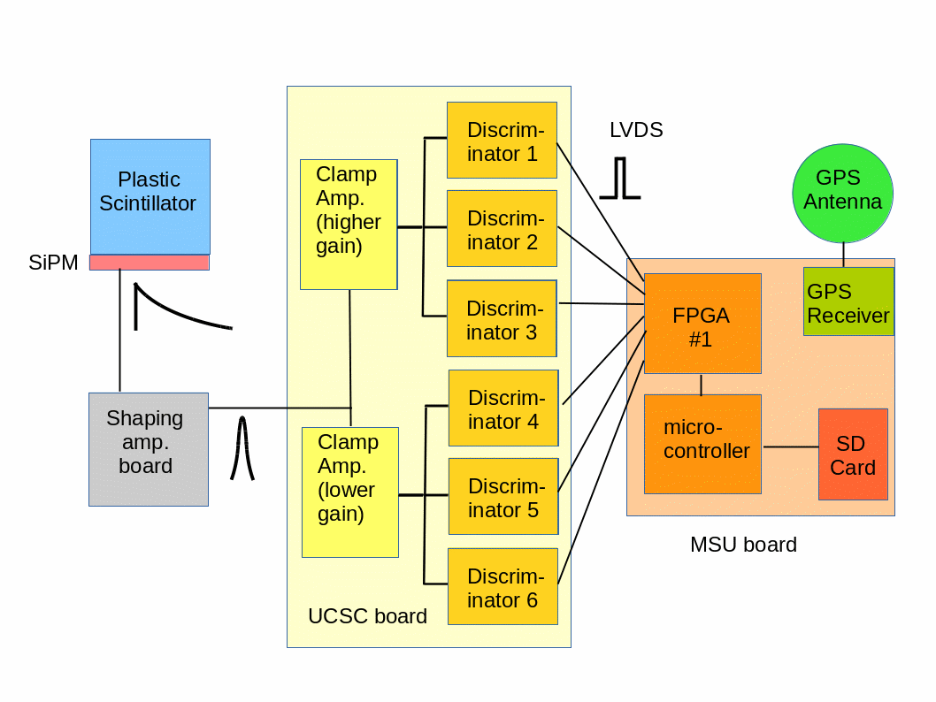
Block Diagram

