Slide 1
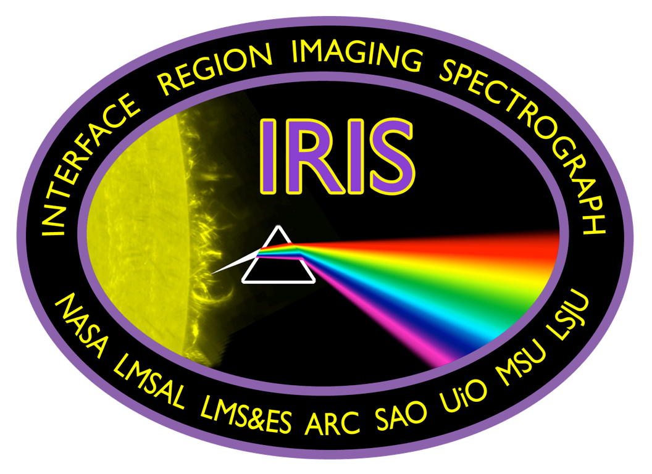
What is H₂ doing in the Chromosphere?
Sarah A. Jaeggli
Montana State University
with P. Judge, F. Delgado, H. Uitenbroek, and the IRIS Team

Slide 2
Background

Slide 3
Importance
Large quantities of molecular gas may exist in cool pockets of the photosphere
change the gas equation of state
provide an energy reservoir
decrease the number density

Slide 4
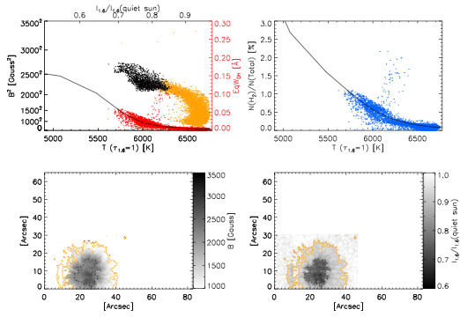
NOAA 11101, 2010-08-29
Jaeggli 2011, PhDT
Jaeggli, Lin, & Uitenbroek 2012, ApJ
H₂ Fraction
Magnetic Field
Intensity

Slide 5
Direct detection
Not so easy
In the Infrared
H₂ has ro-vibrational transitions with long timescales, highly forbidden in the solar atmosphere
In the Ultraviolet
Lyman and Werner bands of H₂
in absorption (rare for the Sun)
in emission

Slide 6
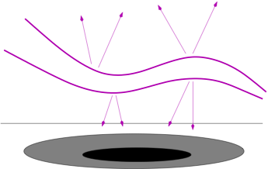
H₂ fluorescence
Transitions of the H₂ Lyman (1300-1800 Å) and Werner (1000-1200 Å) bands excited by nearby strong lines:
Ly α (1216 Å)
C II (1335 Å), C IV (1551 Å)
O IV (1401 Å), O V (1371 Å), O VI (1032 Å)
Si IV (1394 Å)
bright line
2
γ
3
1
4

Slide 7
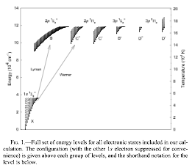
H₂ fluorescence
Shaw (2005) fig.1

Slide 8
Contributions to H₂ fluorescence
Molecular abundance
temperature, pressure
Chromospheric radiation field
intensity, velocity, width of exciting emission lines
Opacity
mostly from ionization continua of Si I, C I

Slide 9
Consequences
Fluorescing H₂ must be in the low chromosphere
opacity increases rapidly with depth
density decreases rapidly with height and H₂ formation is a 3-body process
We might expect H₂ emission over sunspots…
cool temps, high abundance, low opacity, chromospheric activity

Slide 10
Line Identifications

Slide 11
Previous IDs
Krishna Swamy (1975)
predicted, but current instruments had insufficient resolution
Jordan (1977,1978), Bartoe (1979)
First identifications in the solar atmosphere with HRTS
Sandlin (1986)
HRTS and Skylab ATM
Curdt (1999,2004)
SUMER, no new identifications (they actually left a few out)

Slide 12
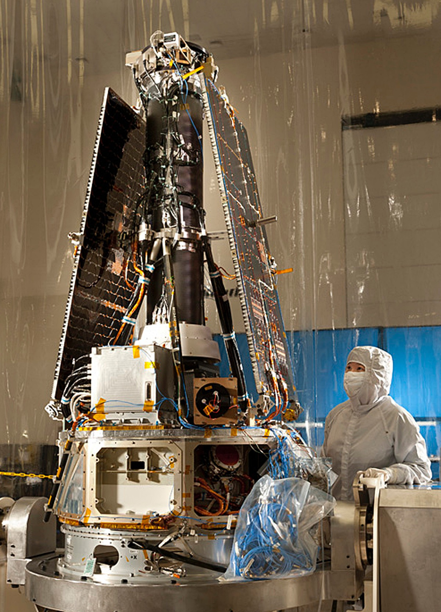
Now there’s IRIS
Interface Region Imaging Spectrograph
0.33”-0.4” resolution
Nyquist limited spectral resolution 26-53 mÅ
1-30 sec cadence
1332-1356 Å (C II, Fe XXI), 1389-1407 Å (Si IV, O IV), 2783-2834 Å (Mg II)
4 channel context imager
175”x175” FOV

Slide 13
1330 Å C II
30,000 K
1400 Å Si IV
65,000 K
2796 Å Mg II core
15,000 K
2832 Å Mg II wing
6,000 K

Slide 14
1332-1356 Å
1389-1407 Å
2783-2834 Å

Slide 15
Previously observed lines in the IRIS range
IRIS FUV short
Wavelength, Branch (J), v', v'', Exciting Species, Source, Comments
1333.48 R0 0 4 Si IV Bartoe79 in flare and sunspot spectra
1333.80 R1 0 4 Si IV, Si IV Bartoe79 in flare and sunspot spectra, blended with S I
1337.47 R3 0 4 ... Bartoe79 in light bridge
1338.57 P2 0 4 Si IV Bartoe79 in flare and sunspot spectra, not O IV
1340.79 R4 0 4 O IV Bartoe79 in light bridge, flare, and sunspot spectra
1342.26 P3 0 4 Si IV, Si IV Bartoe79 in flare and sunspot spectra, blended with Ni II
1342.88 P7 1 4 O IV Jordan78 weak
1345.05 R0 2 5 ... Bartoe79 in flare
1345.09 R5 0 4 O IV Bartoe79 in light bridge, flare, and sunspot spectra
1346.91 P4 0 4 OIV Bartoe79 in light bridge
1352.51 P5 0 4 OIV Bartoe79 in light bridge, flare, and sunspot spectra
1356.49 R7 0 4 ... Bartoe79 in light bridge
1358.01 P4 2 5 ... Bartoe79 in flare
IRIS FUV long
Wavelength, Branch (J), v', v'', Exciting Species, Source, Comments
1393.47 P10 0 4 C II Jordan78 blended
1395.20 R2 0 5 C II, O IV Bartoe79 in flare
1396.22 P1 0 5 ... Bartoe79 in flare and sunspot spectra, blended w/ Fe II
1397.42 R3 0 5 ... Bartoe79 in flare and sunspot spectra, blended w/ Fe II?
1398.96 P2 0 5 Si IV Bartoe79 in flare and sunspot spectra
1403.98 P11 0 4 O V Bartoe79 in light bridge, flare, and sunspot spectra

Slide 16
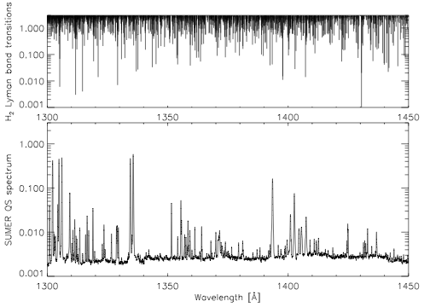
All possible lines
~10 lines/Å

Slide 17
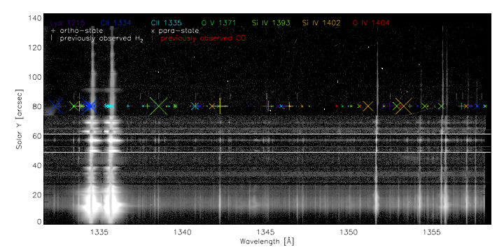
FUV 1
umbra
sunspot
“microflares”
non-local illumination
absorption during flare
C flare loop w/ strong continuum

Slide 18
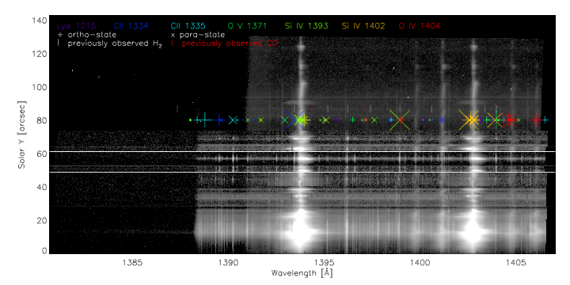
FUV 2
umbra
sunspot
“microflares”
non-local illumination
absorption during flare
C flare loop w/ strong continuum

Slide 19
Making sense of H₂ observations

Slide 20
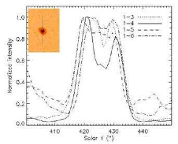
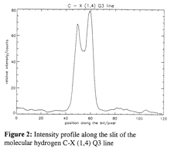
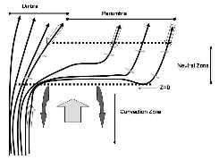
Observations with SUMER
From 18 March 1999 sunspot "reference spectrum”:
Schuhle (1999)—confirmed branching ratios from common upper levels
Kuhn (2006)—inferred the existence of a diffusion-driven neutral wind

Slide 21
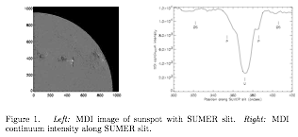
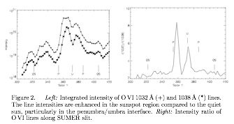
figures from Labrosse et al. (2007)

Slide 22
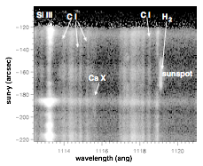
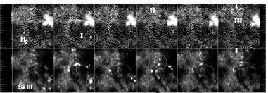
Observations with SUMER
Innes (2008)—excitation of H₂ 1119.1 Å by micro-flares, coincident with x-rays
Innes (2008) fig.1
Innes (2008) fig.1 & 2
Notes:
O VI is 2 orders of magnitude brighter above sunspots

Slide 23
Observations with IRIS

Slide 29
Learning from observations
H₂ emission depends very strongly on radiation input
H₂ may respond to non-local radiation field, esp. during large flares
H₂ is everywhere in the low chromosphere (but there might not be very much)
H₂ velocities are photospheric in magnitude (but motion does not correlate well)

Slide 30
Modeling and synthesis

Slide 31
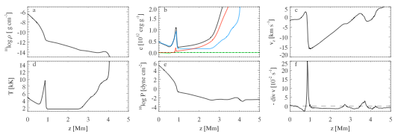
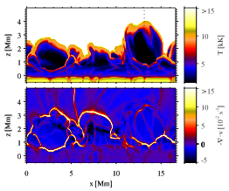
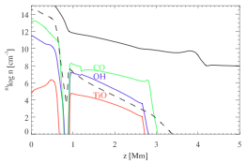
Simulating molecules in a dynamic chromosphere
non-magnetic chromosphere
NLTE Hydrogen
non-equilibrium Hydrogen ionization and H₂ formation
plots from Leenaarts et al. (2011)

Slide 32
Synthesis of H₂ with the RH code
RH = Rybicki-Hummer Radiative Transfer and Chemical Equilibrium code by Han Uitenbroek
does not treat H₂ in non-LTE or consider radiative dissociation (and it might not be necessary)
thus a kluge by Phil Judge:
use RH to solve for the detailed opacity
input a radiation field (scaled SUMER spectrum)
calculate H₂ intensity layer by layer

Slide 33
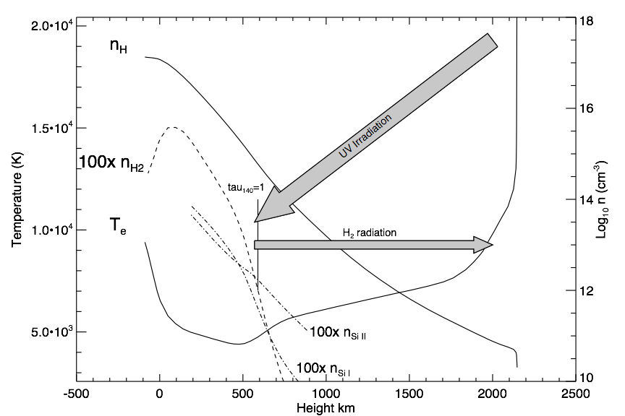
H₂ florescence revisited

Slide 34
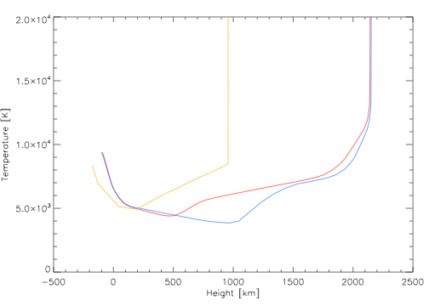
Synthesis of H₂ with the RH code
COX
VALC
F2
Lines are synthesized for three atmospheric models
Arbitrarily scale radiation to simulate flaring conditions ( x 100)

Slide 35
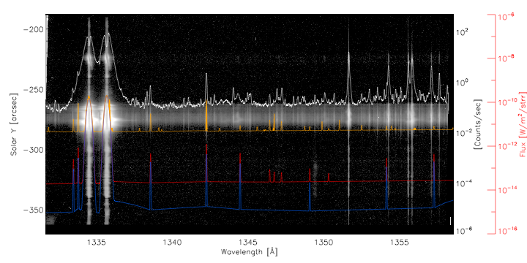
COX
VALC
F2

Slide 36
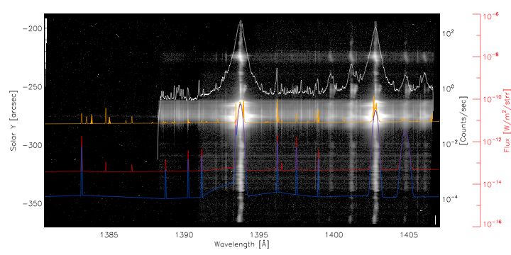
COX
VALC
F2

Slide 37
Closing remarks and future plans
H₂ emission is a delicate balance between input radiation, opacity, and abundance
Observations of H₂ seem dominated by radiation field, opacity effects are obvious in some observations
Modeling is required to untangle the abundance (might not be possible)
We may be able to select an atmospheric model which best describes the observations and determine the extent of a cool or non-magnetic chromosphere (à la Carlsson & Stein (1995))
Notes:
point 1: H2 emission (strength) may only be weakly dependent on abundance
point 2: IRIS data might not tell us about H2 in sunspots, but it might be part of the cool chromospheric component

Slide 38
Thanks!
The work of S. Jaeggli and F. Delgado was funded by NASA’s IRIS grant subcontracted from LMSAL to MSU.
Thanks to the NSO for helping to support this visit.

