Slide 1
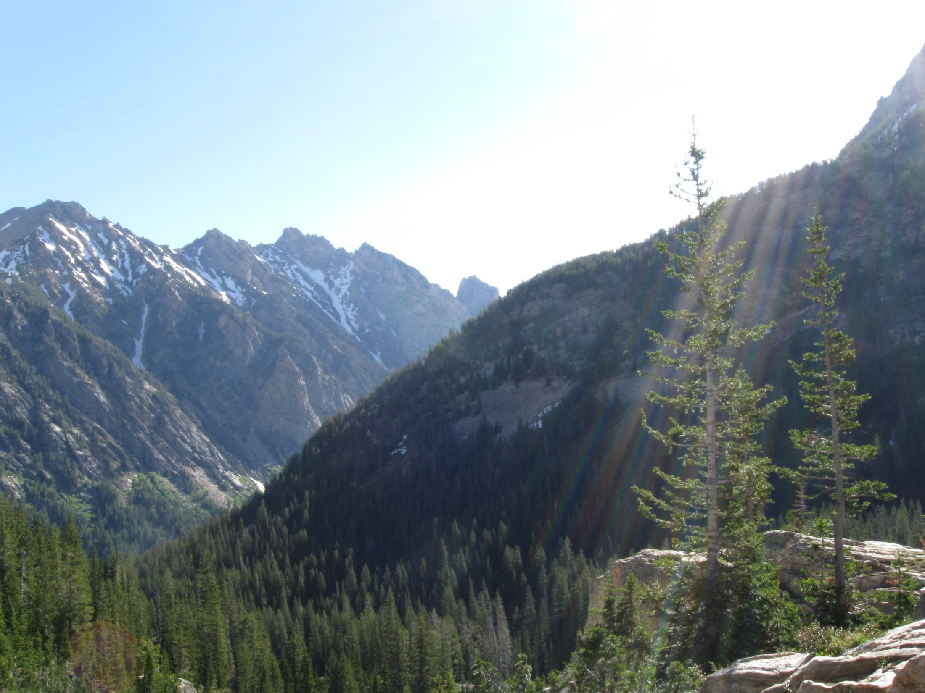
Concealed Ejecta: The Search for a Unarmed Flare
Cameron Martus
Solar Physics REU 2010
Montana State University
Mentors Dana Longcope & Angela Des Jardins

Slide 2

Introducing Flare Spectra
Two hard x-ray sources:
  Thermal emission consists of thermal electrons producing a relatively soft spectrum that falls off quickly at higher energies
  Thick-target emission produces a much harder spectrum, resulting from high-energy electrons colliding suddenly with very dense material
Magnetic reconnection occurs in the top of the flaring loop
Particles are energized at the reconnection site

Slide 3
Introducing Flare Spectra
If reconnection site is dense enough for frequent collisions, its temperature increases and thermal emission is produced
If a CME occurs, particles are removed from the reconnection site, decreasing the density
Electrons can then escape and are sent at very high-energies down the loop to its footpoints where they encounter dense plasma and produce non-thermal emission

Slide 4
Introducing Flare Spectra
To better understand thermal processes within a flare, Longcope et. al analyzed an X-class flare with no CME on 26 Feb 2004 and found that its spectra fit best to two thermal models, rather than a thermal + non-thermal model
My project was to find a second case of a two-thermal flare

Slide 5

A Promising Trail
An X 1.3 flare at 01:43 16 July 2004 was chosen for this analysis – based on the Wang and Zhang paper stating that it was not associated with a CME
Analysis plan:
  Fit to several spectral models
  Produce RHESSI images to pinpoint the locations of the emission in different energy bands, and augment by overlaying onto TRACE images to determine location within the loops
Learning to execute these tasks took about three weeks, when I was ready to start producing results

Slide 6
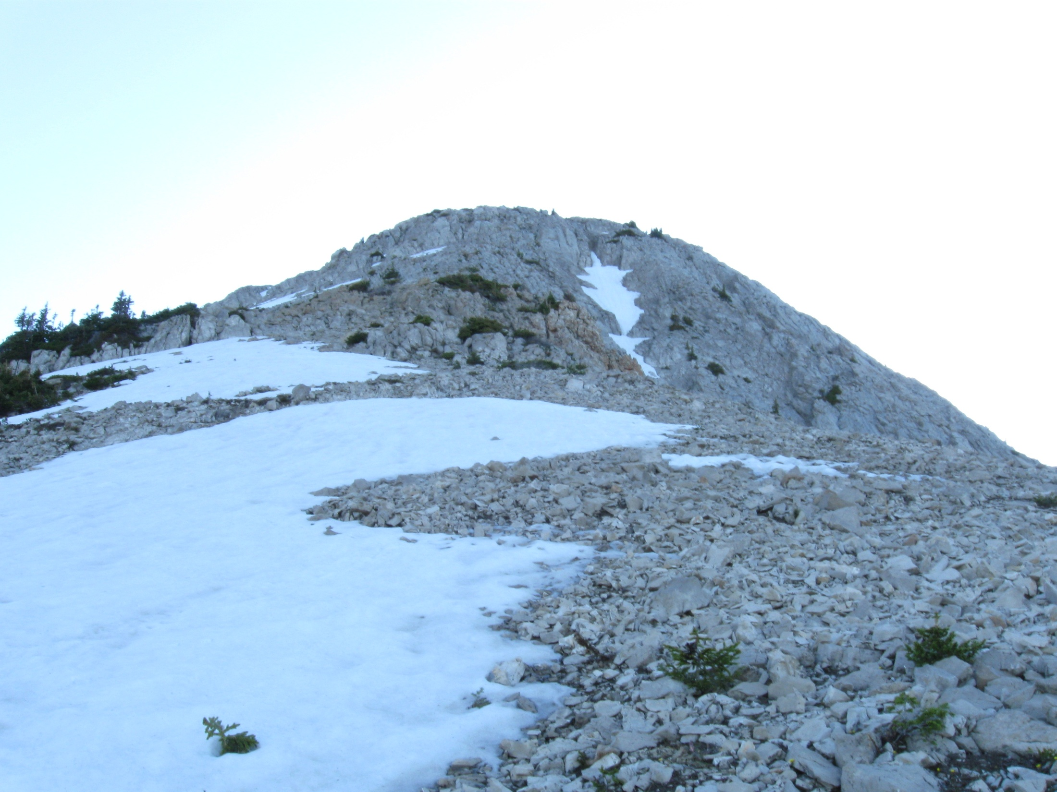
Impassable!
Unfortunately, the reconnecting loops in the flare of interest were too small to resolve for the purposes of magnetic modeling, so even though the structure of the flare was quite interesting, it had to be abandoned
When we began searching for a new CMEless flare, it became evident that this flare indeed WAS associated with a CME!

Slide 7
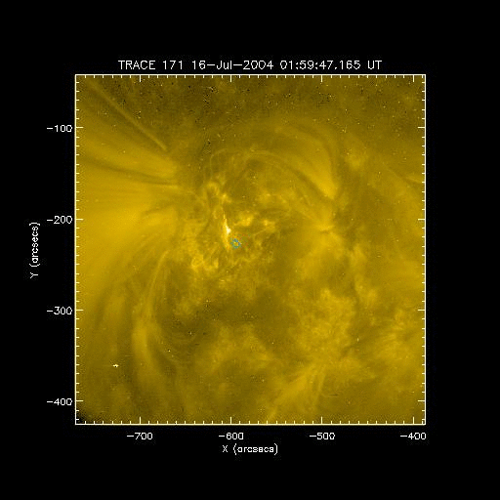
Impassable!

Slide 8
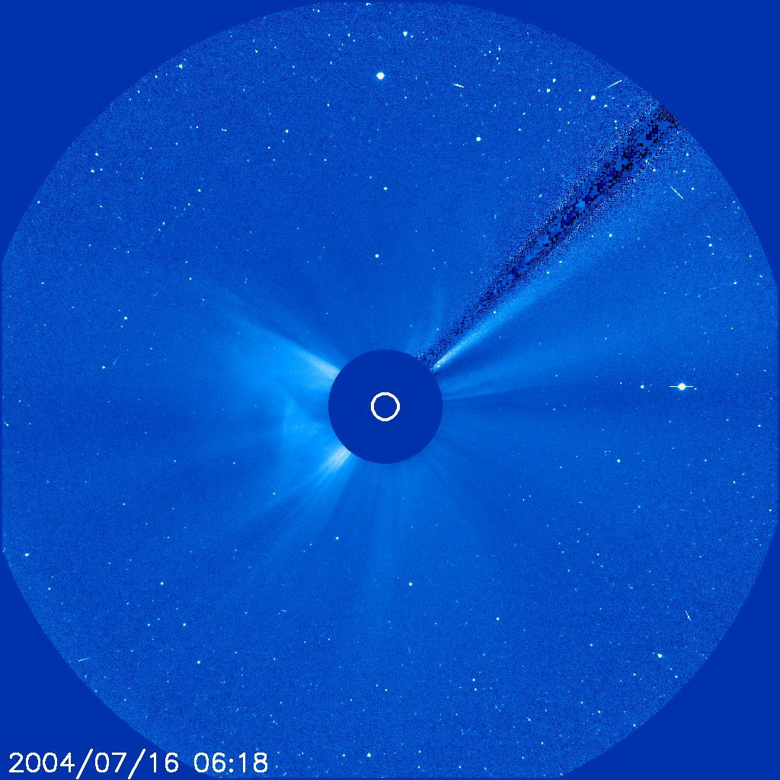
Route-finding
Dr. Longcope chose the flares for both his prior study and the current one based on Wang and Zhang’s list of X-class flares not associated with a CME
Using the GOES flare catalog and the LASCO CME catalog, flares were determined as “CMEless” if a CME did not originate within a 1 hour window centered on the flare
CMEs are observed in LASCO when they have at least reached 2.5 solar radii, so extrapolations based on trajectory must be used to determine time of origin

Slide 9
Route-finding
There are three faults with the flare-selection criteria:
  Some CMEs are not in the catalog
  Extrapolation may be incorrect near solar surface
  CME may not come within 1 hour around flare start but still be associated if the flare is very long
Once qualifying flares are found, most do not have RHESSI data available

Slide 10
Route-finding
Of all the flares in the Wang and Zhang list, only the two already studied had RHESSI data
Thus we determined to look for M-class flares, using the same selection criteria
Some X-class flares were found that were not in the Wang and Zhang list
Most had no RHESSI data; those that did had no TRACE data, except one

Slide 11
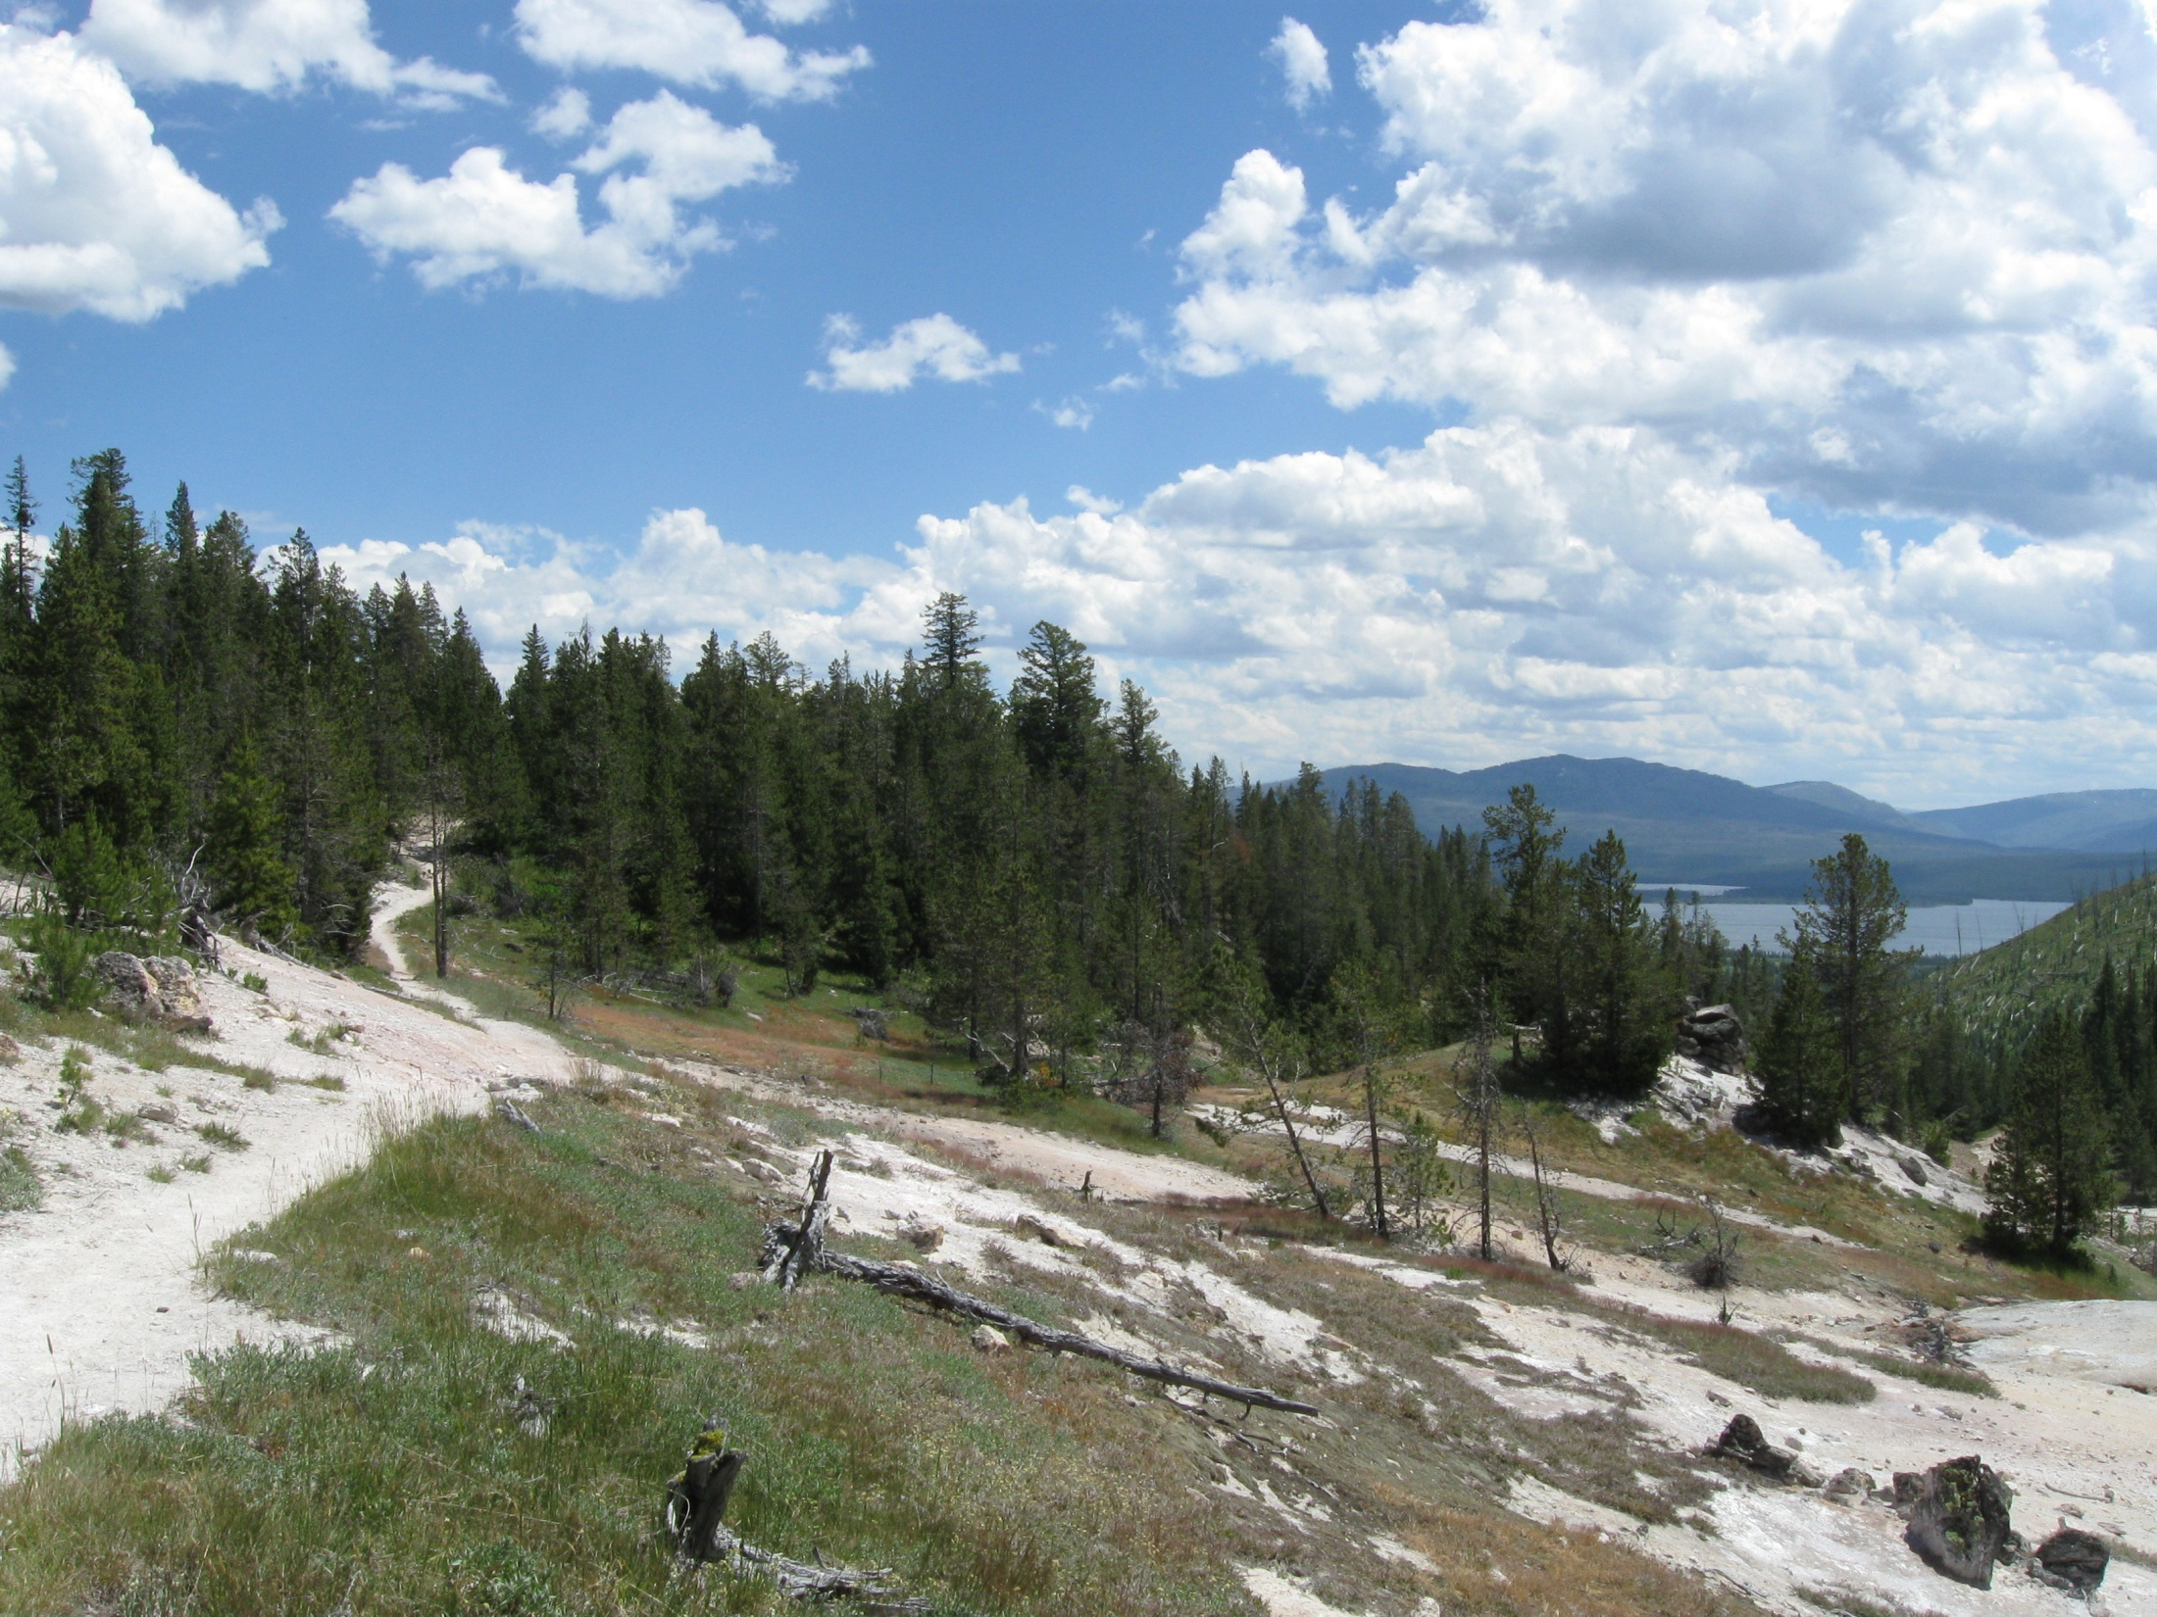
The Analysis Proceeds
The flare we selected, an X 1.0 flare on 13 Aug 2004, had a CME extrapolated to about 45 minutes after the end of the flare
Nevertheless, we proceeded on to analyze the flare
Making the images and fitting the spectra turned out to be very difficult, as the RHESSI software presented no end of problems

Slide 12
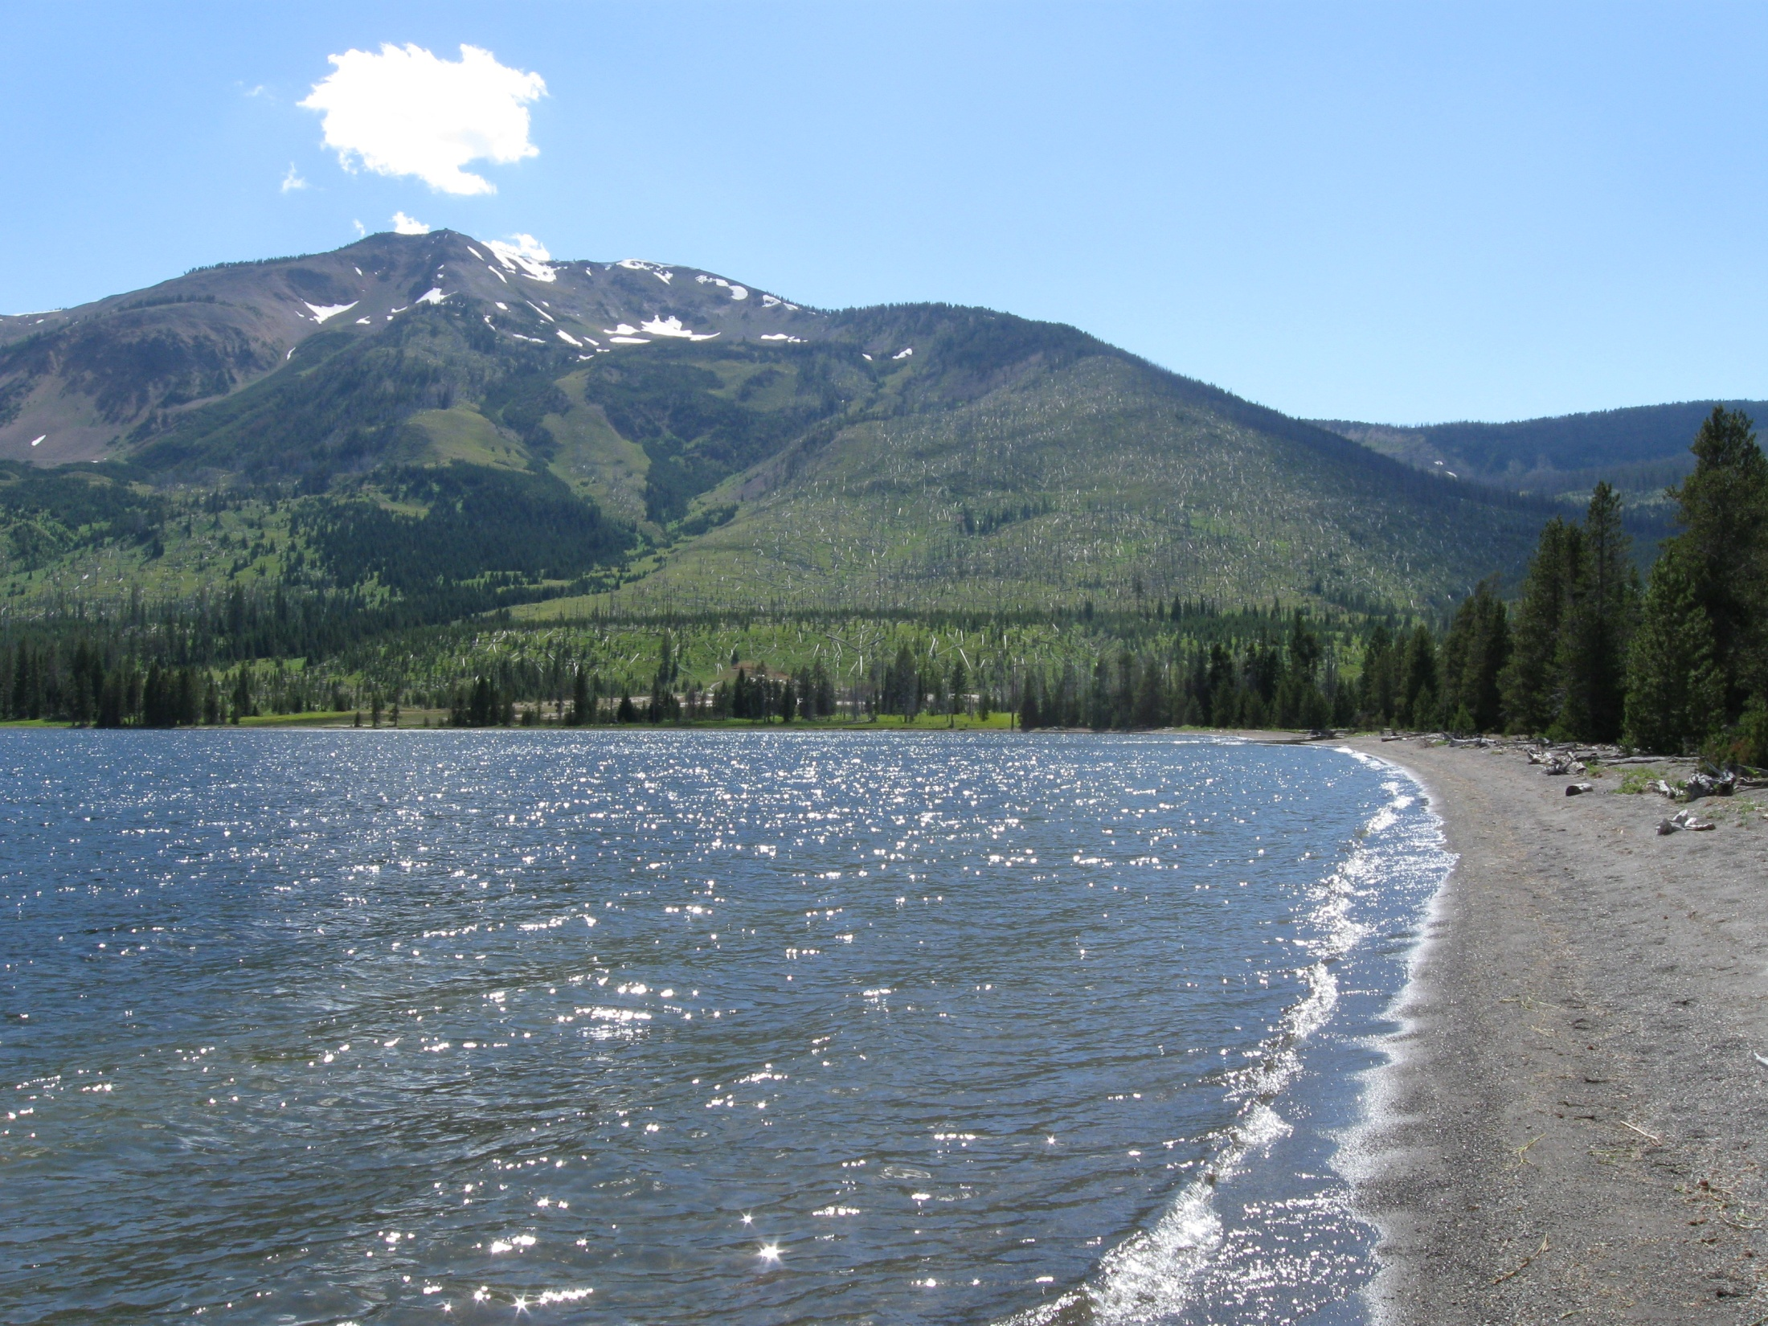
Results
The spectra of this flare clearly fit best to the thermal + thick-target model, rather than the two-thermal model
RHESSI contours overlaid onto TRACE images show emission in all energy bands –6-12 keV, 12-25 keV, and 35-100 keV – to be centered at the same place: the footpoint
There is only one bright spot, as opposed to the normal two seen in footpoint emission

Slide 13
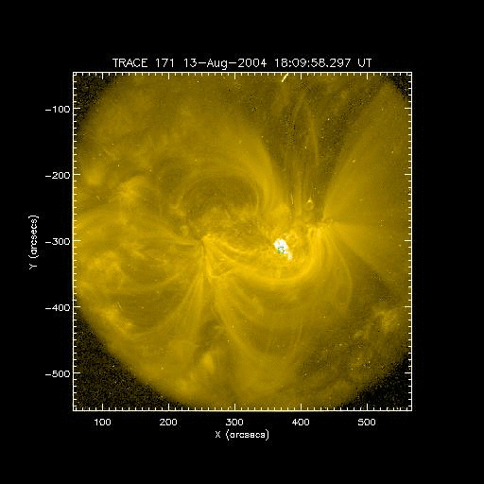
Results

Slide 14
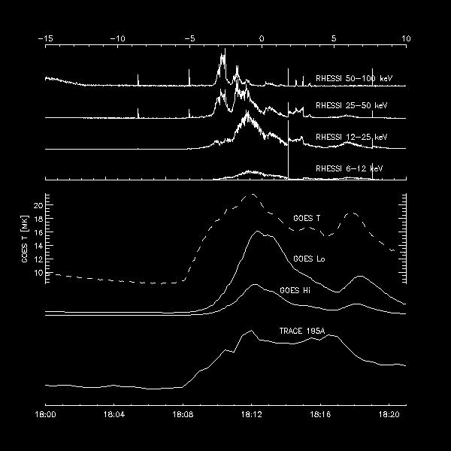
Results

Slide 15
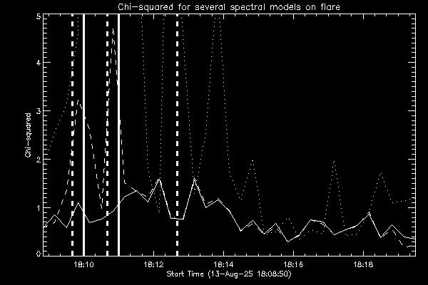
Results

Slide 16
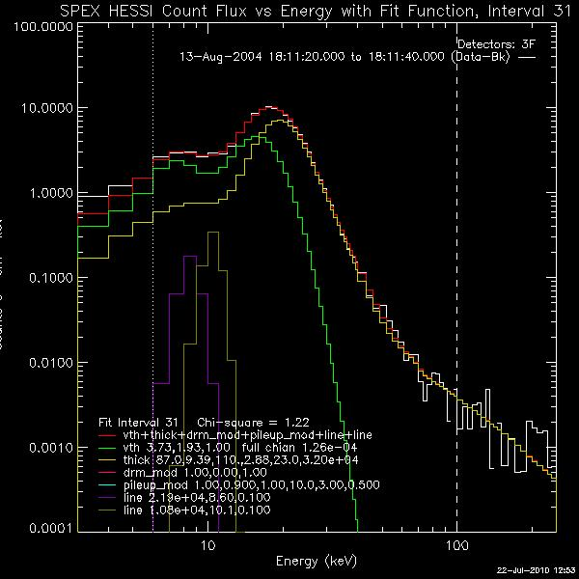
Results

Slide 17
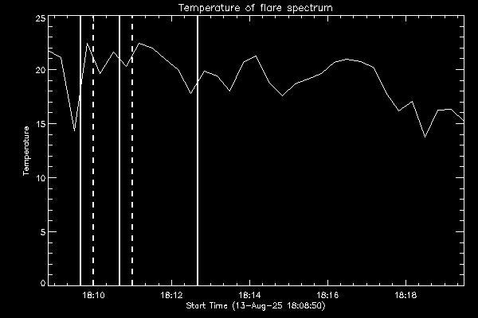
Results

Slide 18
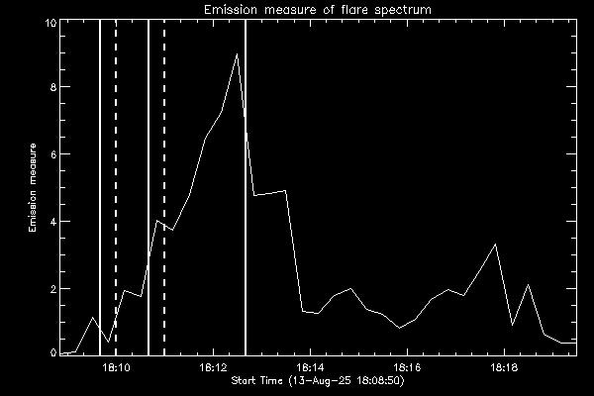
Results

Slide 19
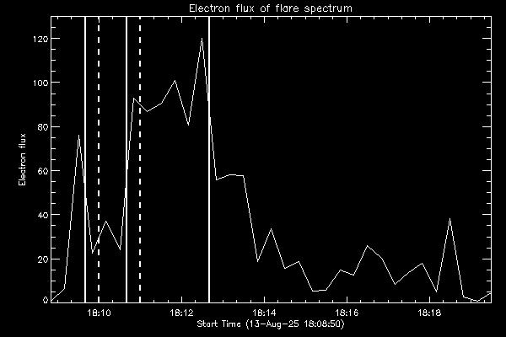
Results

Slide 20
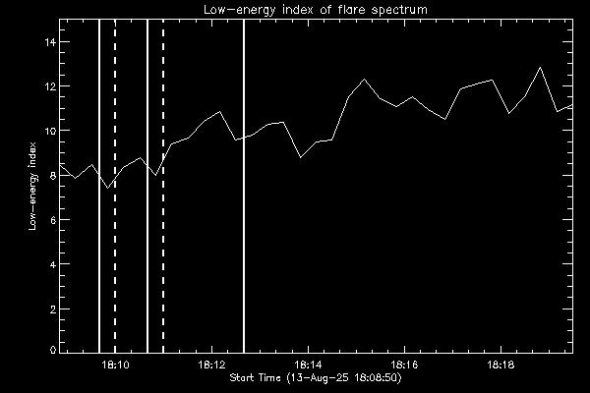
Results

Slide 21
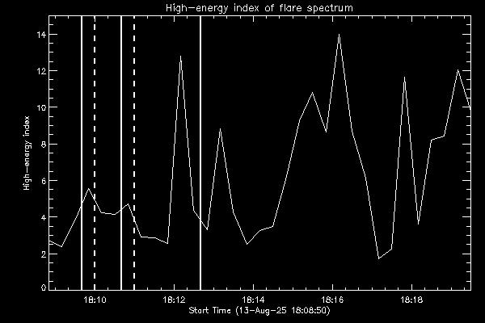
Results

Slide 22
Results
Apparently the flare had such low densities in the reconnection site that electrons escaped to create non-thermal emission
Thermal emission was produced by heating of the footpoint plasma during the electron bombardment
Perhaps the flare was associated with the CME!

Slide 23
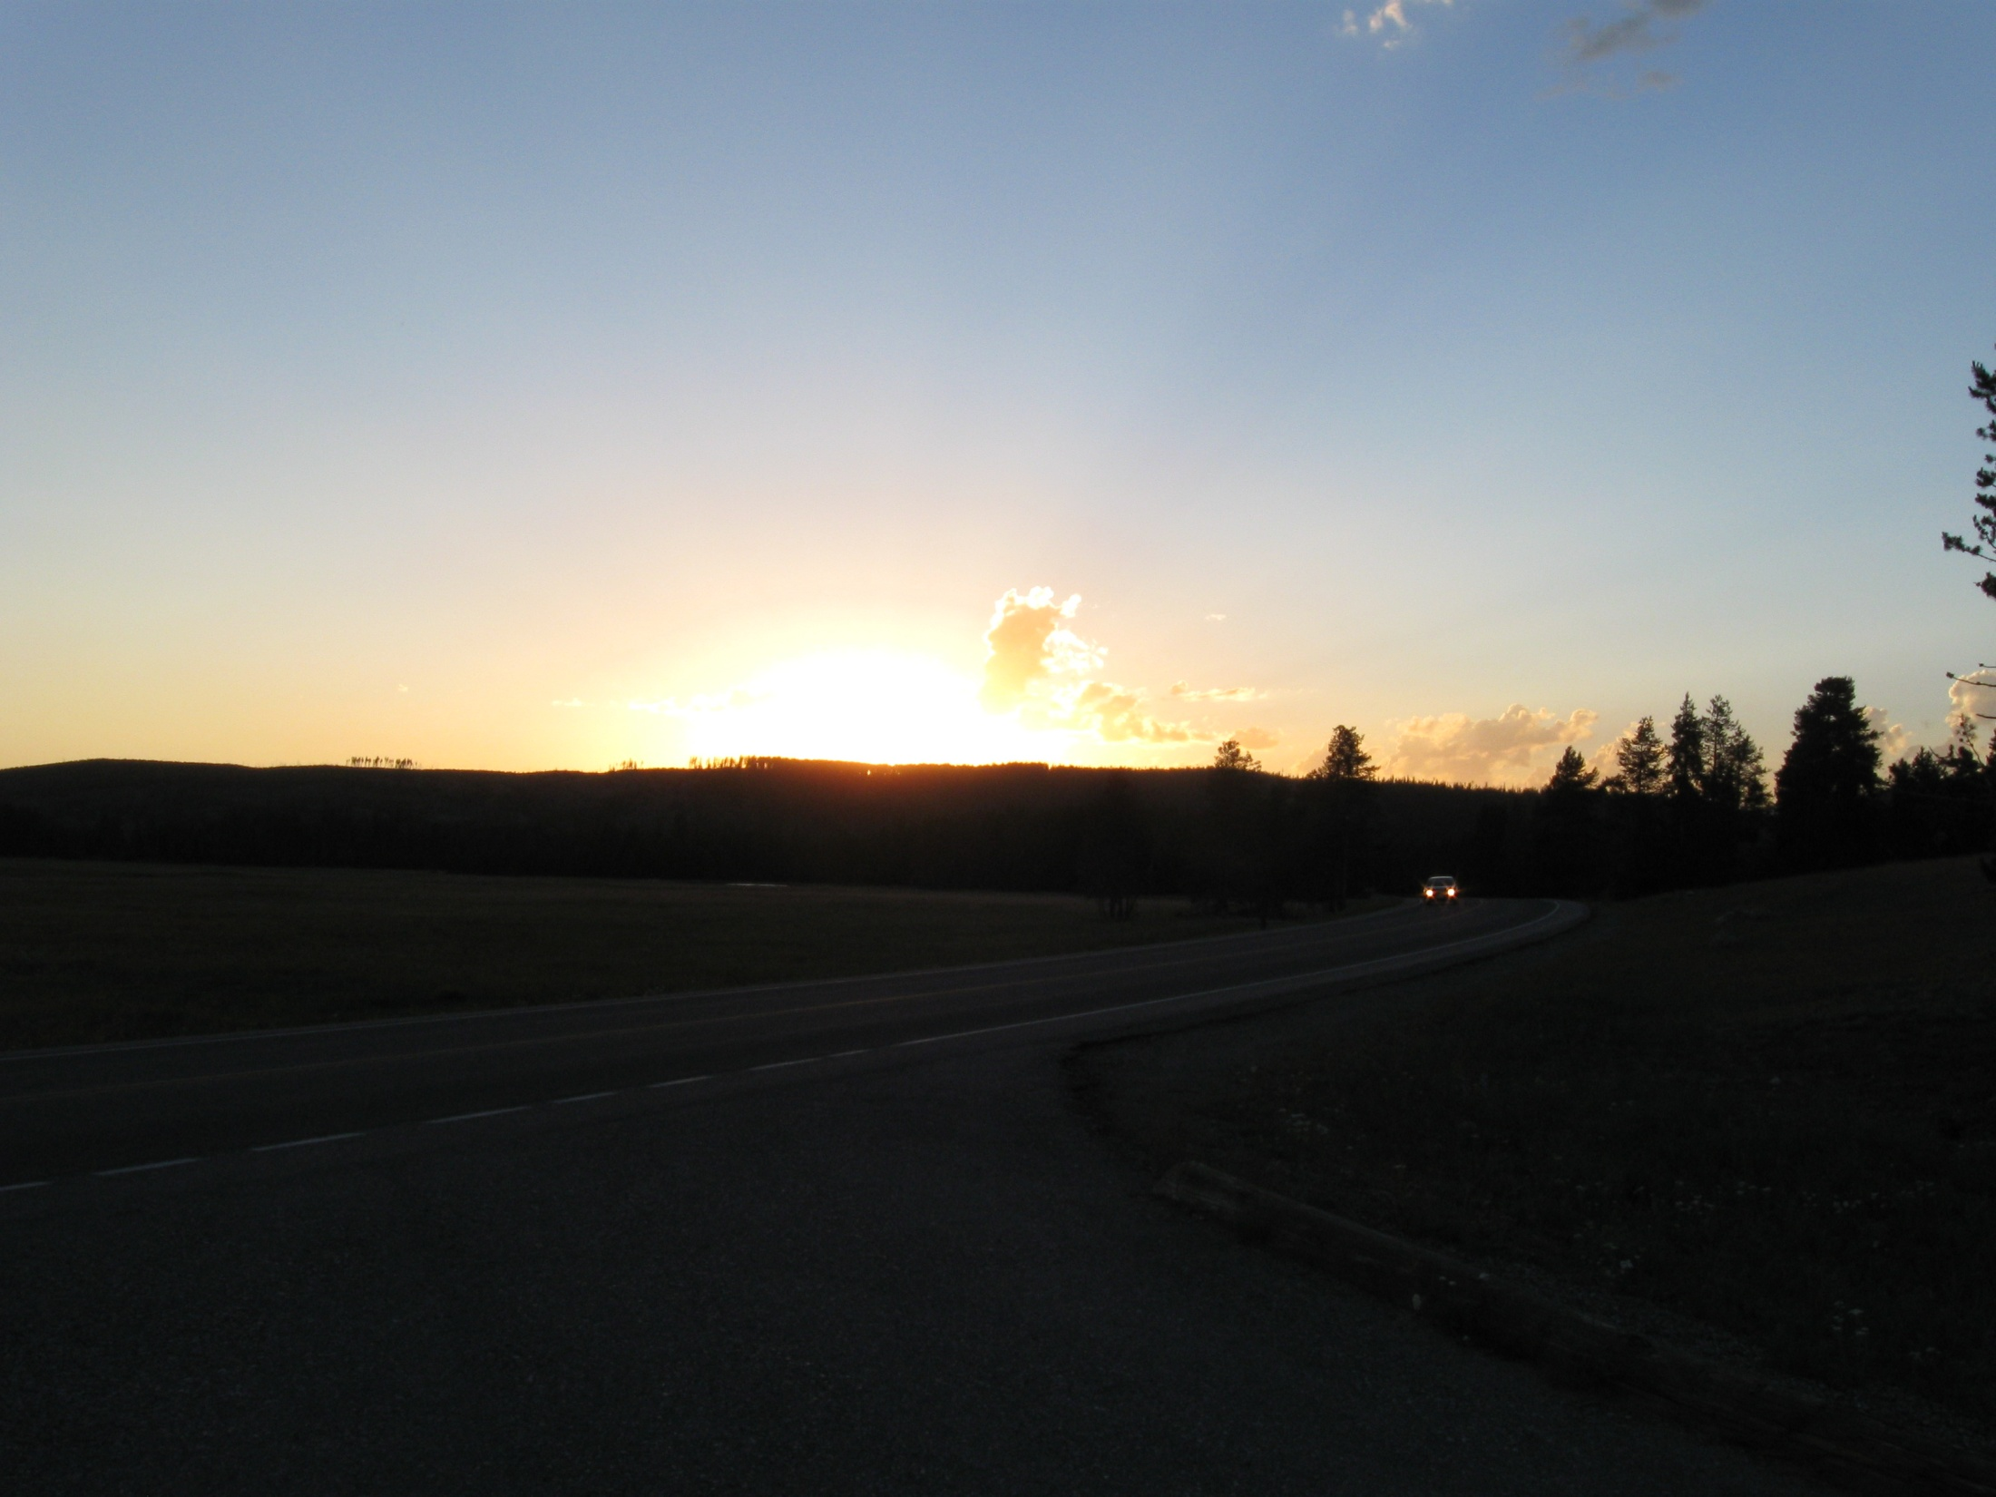
The End

