Slide 1
Controlling Intersatellite Separation Rate of Two P-Pod Ejected CubeSats
Nathan Roskoff
MSU Solar Physics REU
Space Science and Engineering Laboratory

Slide 2
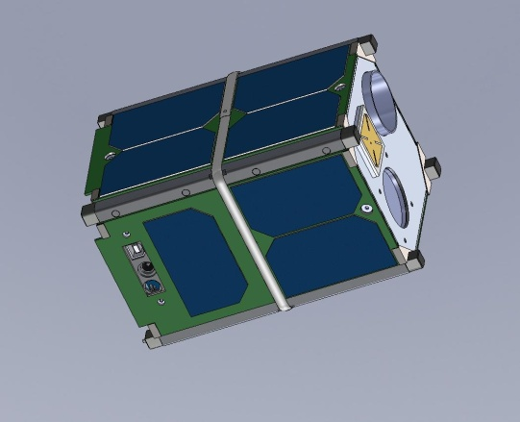
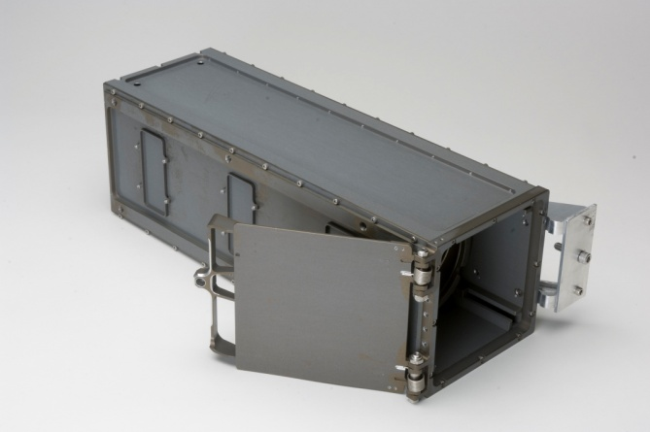
Abstract
Create a method that will separate two CubeSats ejected from a P-Pod at a controlled rate
Past strategies have consisted of getting as far away as quickly as possible
Must create a new method
FIREBIRD (CubeSat)
P-Pod

Slide 3
FIREBIRD Mission Requirements
Focused Investigations of Relativistic Electron Burst Intensity, Range and Dynamics
The FIREBIRD mission shall have a primary mission duration of 120 days post commissioning.
The FIREBIRD mission shall take two, physically separate, point measurements of relativistic electron microbursts over a variety of separation distances between 1.5 km and 150 km with an accuracy of +/- 250 meters.
Set to launch late 2011 or early 2012.

Slide 4
Desirables
Constraints
Separate satellites at a controlled rate:
0.7 < x < 1.4 cm/s
Use a mechanical system
Finite space available
No power available
Must be functional after long durations of heavy vibration
Must work in the vacuum of space
Must be extremely reliable
Must be functional after a minimum static storage time of two months

Slide 5
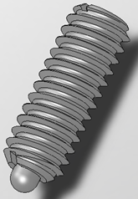
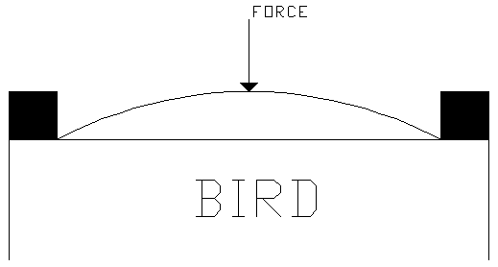
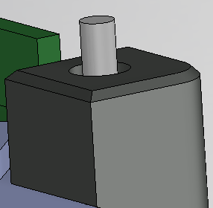
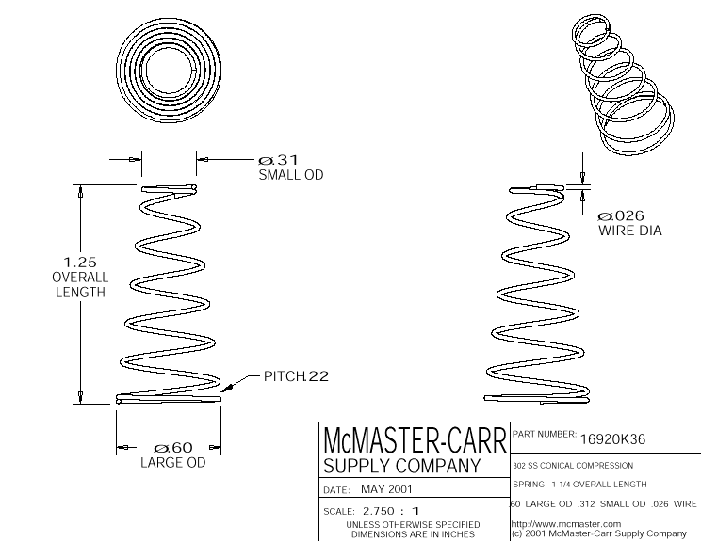
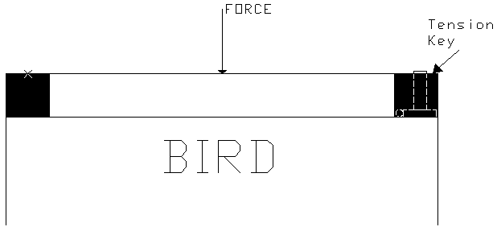
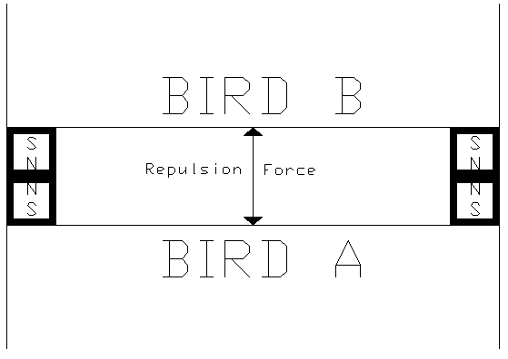
Overview of Design Alternatives
Premade Spring Plunger*
Custom Spring Plunger*
Leaf Spring*
Multi-Separation Switch
Conical Spring
Tension String Box**
Magnetic Repulsion
*2 per assembly
**4 per assembly

Slide 6
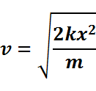
Analytical Evaluation
Basic energy balance approach
expected separation speed
Results tabulated: separation_analytical_testing.xls

Slide 7
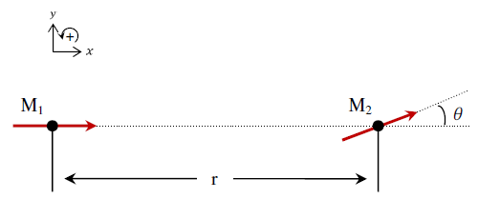
Effect of Attitude Stabilization Magnets on Separation System
Same analysis can be used to predict separation speeds resulting from two opposed bar magnets.

Slide 8
Solution Method
1 and 2 were then simultaneously solved , from differential form, with MatLab’s ode45 solver
Separation/attraction velocities calculated for all combinations of initial conditions and plotted
The velocity needed to escape the effects of the magnets was also calculated and plotted
(1)
REQUIRED INITIAL CONDITIONS
initial separation distance
initial rotation
(2)

Slide 9
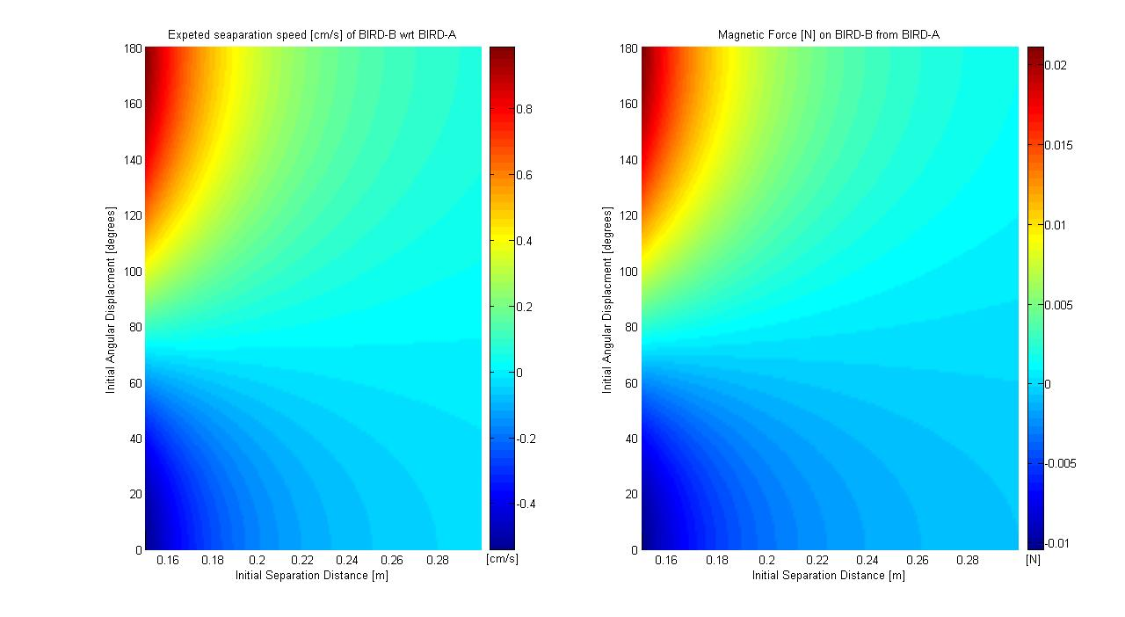
Results

Slide 10
Physical Testing
Air Track Testing
Environmental Error Evaluation
Repetition
Time
Thermal Vacuum
Multi-Dimensional
Vomit Comet
To be done after force analysis completed.

Slide 11
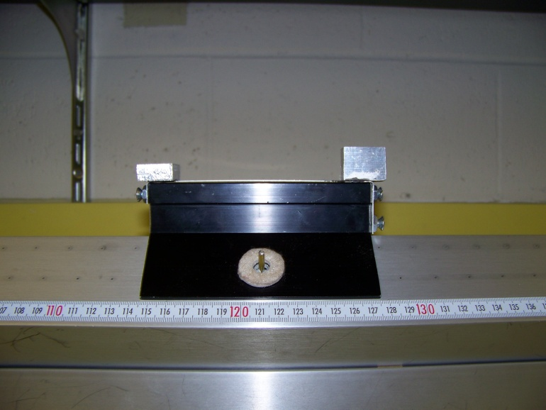
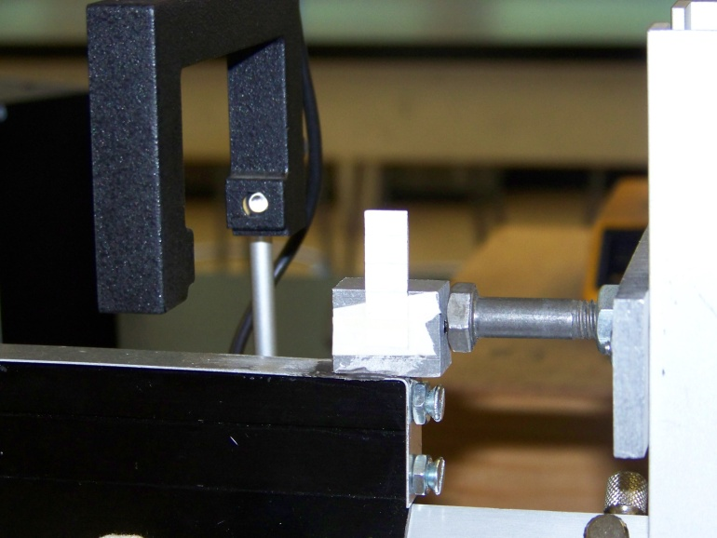
Air Track Testing
Assemblies tested on a 1-D air track
Photo-gate used to collect velocity data
Velocity data will be statistically analyzed
Points outside of 1 standard deviation will be considered flawed data and disregarded
AIR TRACK
PHOTO-GATE

Slide 12
Air Track Results
Data displayed from physical testing of McMaster SP # 8499A52.
This specific spring plunger will not suffice!

Slide 13
Environmental Error Evaluation
Repetition
High number of repetitions will be performed with a constant force
Accuracy and reliability
Time
Will mimic static P-Pod loading (≥ 1 month)
Force degradation
Temperature
Mechanisms chilled to space-like temperature
Affects of output force

Slide 14
Multi-Dimension Evaluation
Full-scale model of FIREBIRD to be tested
2-D Air Table
2-D Long String Dangling Test (if no air-table)
Opportunity to calibrate mechanisms that use more than one component

Slide 15
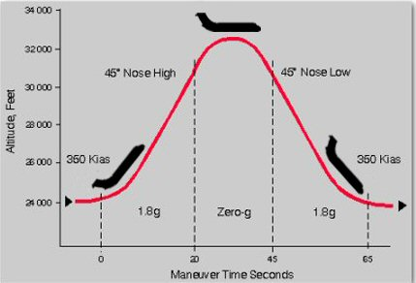
Vomit Comet
Test system performance in a zero-gravity environment while still on Earth
An opportunity to perform this experiment on the Vomit Comet has arisen! The flight is scheduled for the summer of 2011.
Letter of Intent by:
September 22nd, 2010
Proposals by:
October 27th, 2010

Slide 16
Road to Completion
First physical testing must continue until a viable option is found.
Custom spring plunger…………………………. started
Leaf spring………………………………………….. started
Conical spring…………………………………….. not begun
Multi-separation switch………………………. not begun
Once all physical tests passed & system finalized
Incorporate into the FIREBIRD units
Physically test system on the units

Slide 17
Acknowledgements
David Klumpar- advisor
Tom J. Rose- research partner
FIREBIRD team
Jerry DiMarco- physics lab tech
Norm Williams- machine shop tech
MSU Solar Physics Group
Solar REU colleague’s

