Slide 1
Motivation
Carbon Sequestration is the process of trapping CO₂ underground in order to prevent its release into the atmosphere to reduce our impact on the climate.
One important factor in the effectiveness of sequestration is the formation of hydrates.
Hydrates are water molecules that have formed solid structures around other compounds, in our case CO₂, and can both help and hinder our efforts.
This research examined calcite, a common mineral found in reservoirs used in sequestration, and its effects on the formation of hydrates.

Slide 2
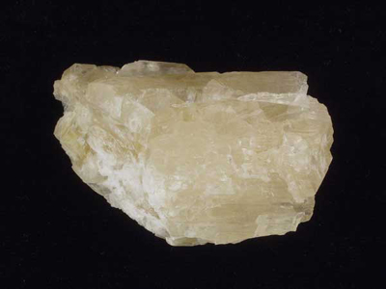
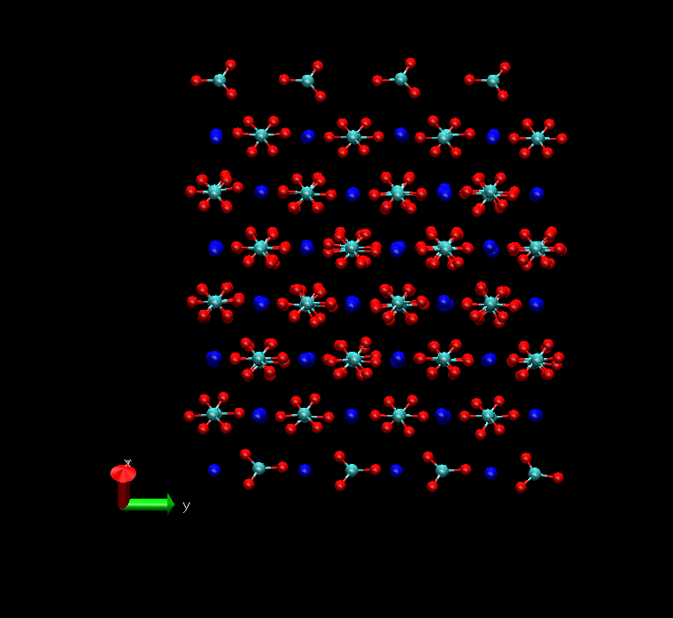
Calcite- CaCO₃
Viewed in Visual Molecular Dynamics
Bureau of Economic Geology

Slide 3
Goals
Create a working calcite model to be used in current and future simulations
Examine water/CO₂/calcite interface
Perform thermodynamic integration to calculate the favorability of water deposition on calcite
Determine the affect of calcite on hydrate formation

Slide 4
Simulation Setup
Our first task was to create a working model for the calcite crystal to be used in our simulations.
We acquired data on the calcite lattice structure from the American Mineralogist Crystal Structure Database and used CrystalMaker for Windows version 2.2.3 to create the crystal.
We then transferred our calcite to Visual Molecular Dynamics, where we wrote code to cleave the crystal to the correct size and align it in space.
The water and carbon dioxide molecules had already been created.

Slide 5
Simulations
Our first simulations were run to decide between various parameters based on experimental values.
We then ran simulations of calcite and water at different temperatures to test for physicality, observe the adsorption of water on the surface of calcite, and gather data for thermodynamic integration.
Finally, we ran a simulation of calcite, water, and CO₂ to determine the favorability of hydrate formation.
We ran all simulation using MDynamics 4.3 and we also fixed the calcium ions in space in order to keep the calcite crystalline at high temperatures.

Slide 6
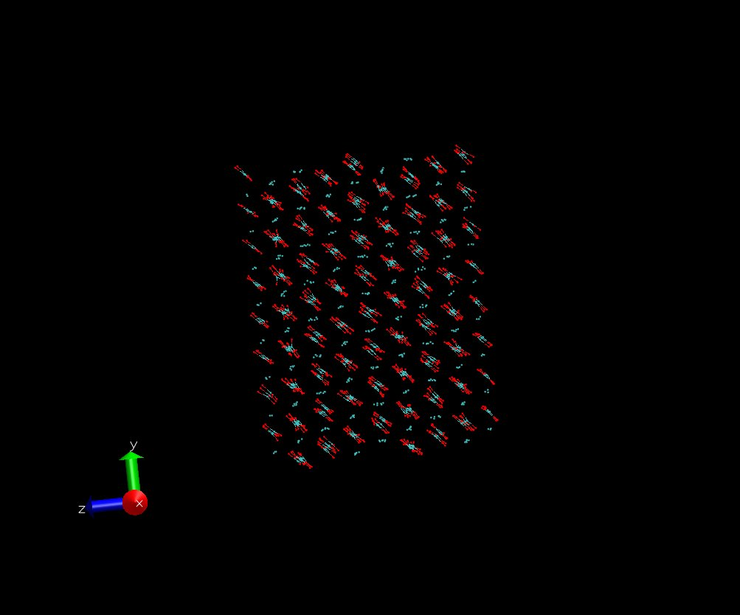
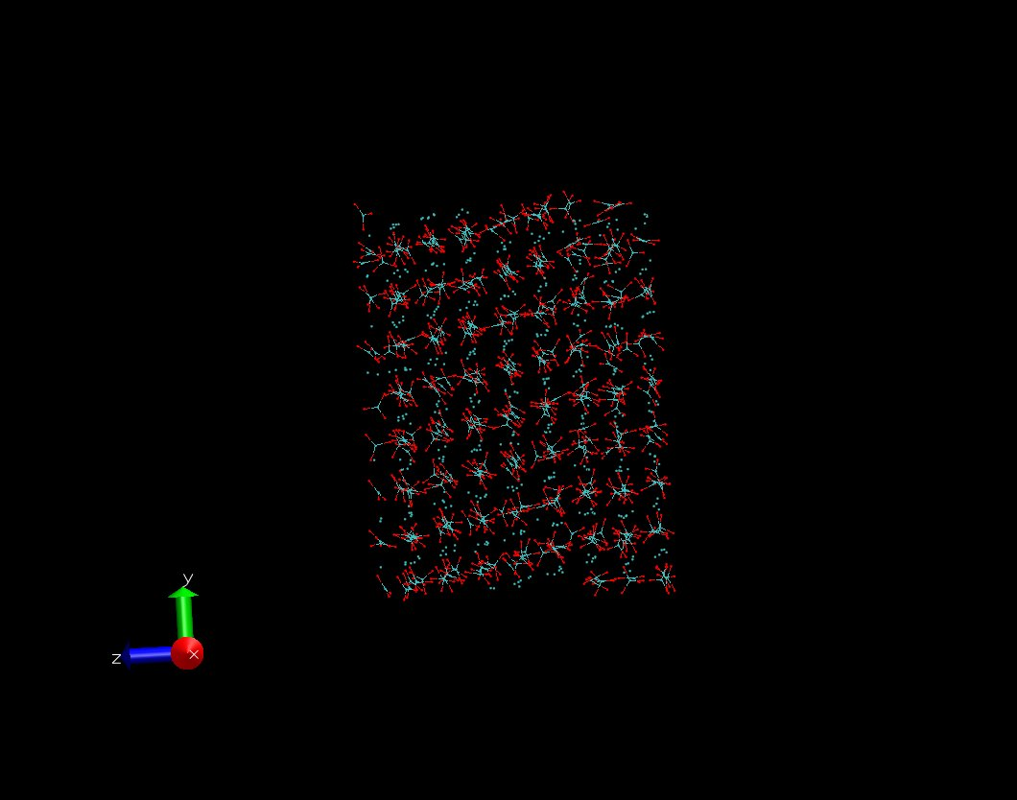
Formal Charges Calculated Quantum Chemical Charges
We ran several simulations of our calcite model to decide between using formal, whole integer charges for the calcite or quantum chemical charges. The formal charges outperformed the calculations.

Slide 7
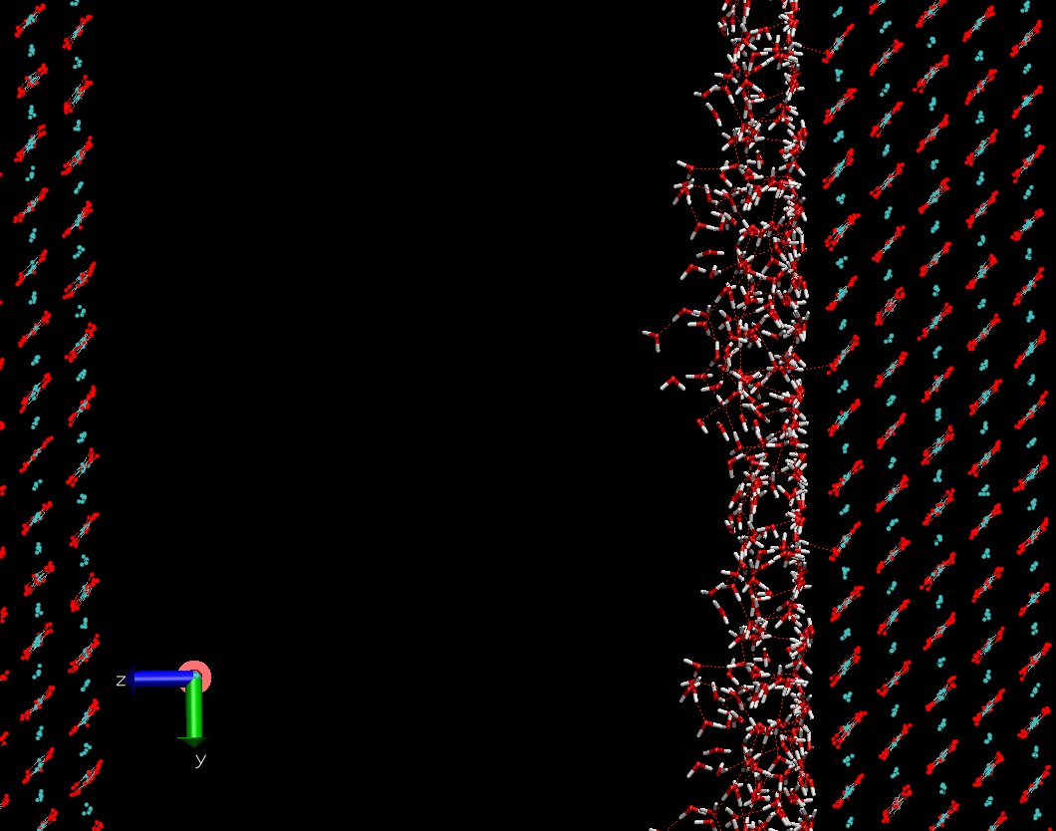
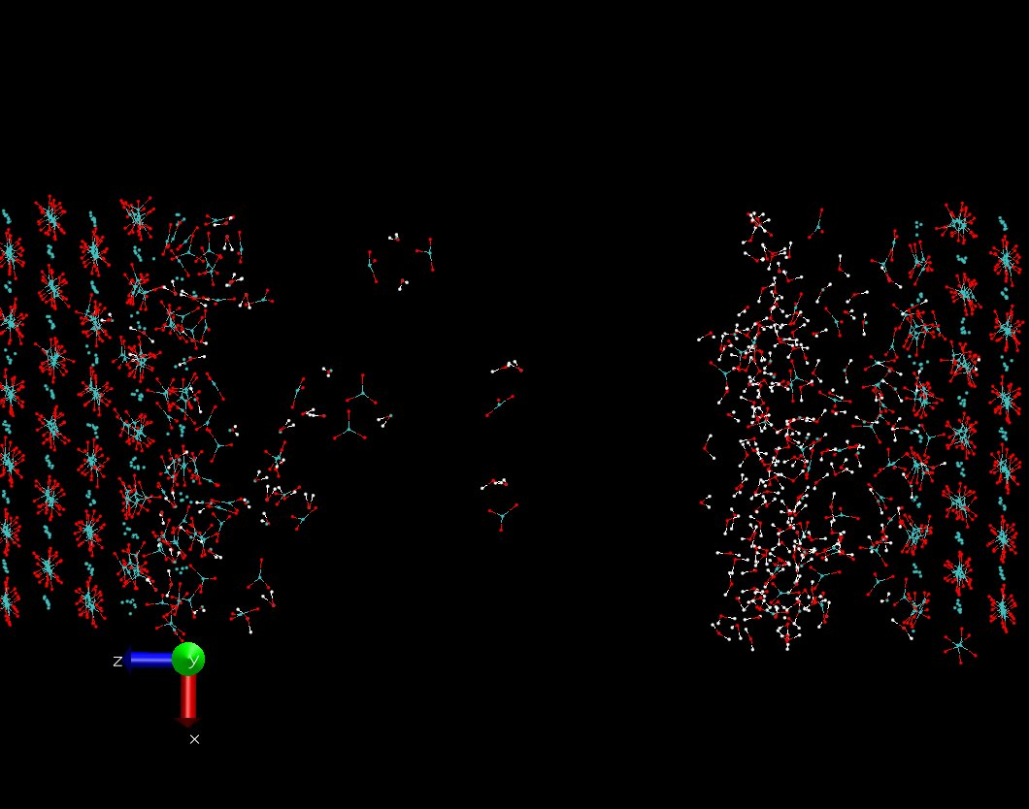
Lennard-Jones Potential Buckingham Potential
We also tested several interaction potentials for the water molecules, with the Lennard-Jones Potential the clear winner.

Slide 8
The water formed two adsorbed layers on the calcite surface.
This indicates the favorable interaction of water with calcite.
The next iterate of the periodic boundary conditions is shown.
Calcite and Water at 277K

Slide 9
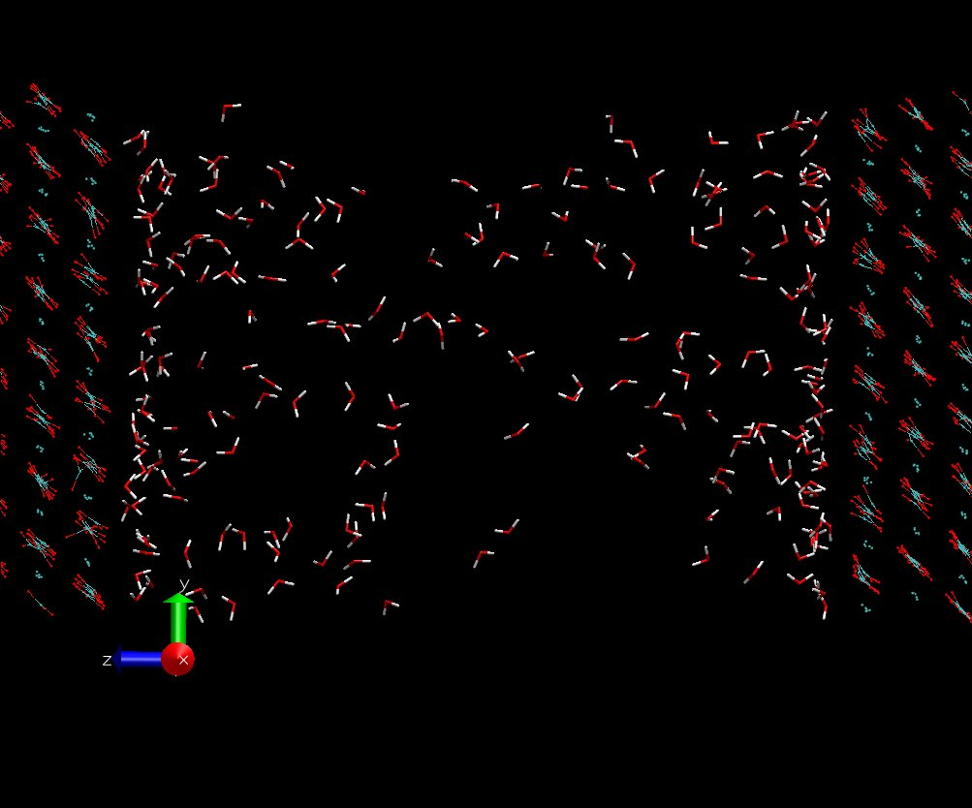
As we increased the temperature, the water was able to overcome the calcite’s potential and enter the vacuum between the iterated crystal.
Another layer was formed on the opposite face.
Calcite and Water at 815K

Slide 10
Thermodynamic Integration
Thermodynamic integration is used to compute differences in free energy and to compare the favorability of different states.
Our data completely contradicted the simulation’s behavior, predicting that adsorbed layers are more favorable at high Kelvin.
We discarded numerical data from our research as the rest of the simulations performed admirably in comparison to experimental values.
Temperature of System | Total Interaction Energy of H₂O
277.00 | 37.5022
298.00 | 29.1840
314.96 | 29.0926
338.02 | 25.4361
364.72 | 20.6614
396.00 | 23.4051
433.15 | 20.8314
477.99 | 17.8821
533.19 | 20.9066
602.80 | 15.6512
693.32 | 7.8038
815.82 | -0.7636
990.90 | -6.4642
1261.67 | -8.6686
1736.06 | -7.9698
2780.14 | -5.8181

Slide 11
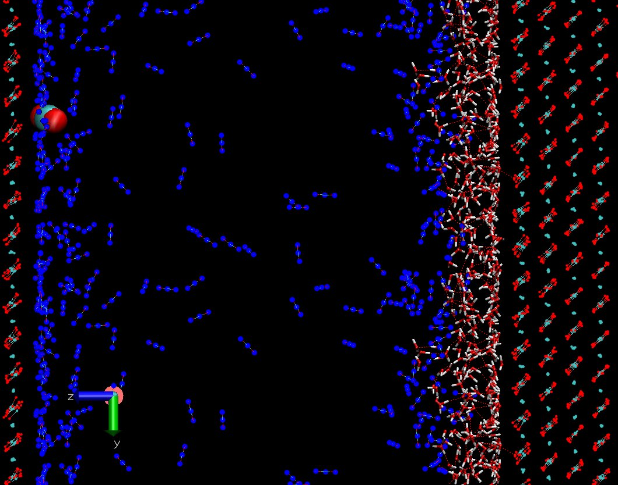
Water, Calcite, and CO₂ at 277K
The CO₂ (in blue) had sufficiently strong interaction with calcite to cross the vacuum and form adsorbed layers on the opposite face but not enough to displace the water.

Slide 12
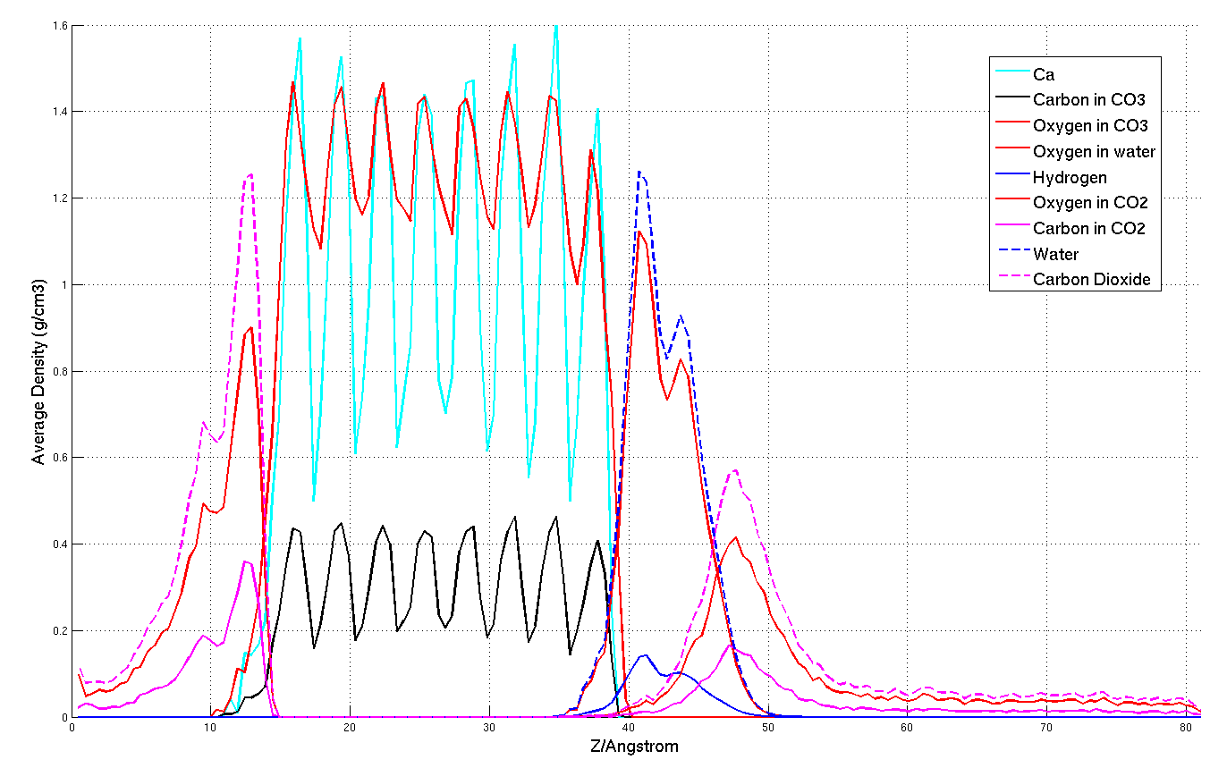
This graph shows the densities of each species in the water, CO₂, and calcite simulation.

Slide 13
Conclusion
The structure of the adsorbed layers of water would interfere with the formation of hydrates along the surface of calcite.
However, further away from the calcite, the intermixing of water and CO₂ occurs with greater mobility of particles (lack of structure) for increased favorability of hydrate formation.
With this knowledge we can more accurately predict when hydrates will form, aiding us in determining whether hydrates will help us (effectively trapping the CO₂) or hinder us (blocking the flow to reservoirs).

Slide 14
Acknowledgements
This material is based upon work supported by the National Science Foundation under Grant
No. 0651674.
I would like to thank Dr. Tatiana Kuznetsova, Dr. Bjorn Kvamme and Bjornar Jensen, my mentors at the University of Bergen, Norway.
I would also like to thank Dr. Steve Holmgren, Scarlet Reierson, and the rest of USP for presenting me with the opportunity to participate in this research.

