Slide 1
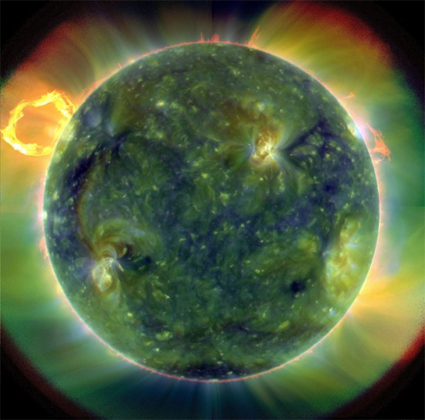
X-Ray Observation and Analysis of a M1.7 Class Flare
Courtney Peck
Advisors: Jiong Qiu and Wenjuan Liu

Slide 2
Project Outline
Overview of Solar Flares
Solar Flare Model
Observing Solar Flares
RHESSI Observation
Analyzing Lightcurve Data
Monitoring Footpoints and Loop-top
Calculating Spectra
EBTEL/CHIANTI Predictions
Comparing Theory and Observations

Slide 3
Solar Flare Basics
Large release of magnetic energy at an active region causing radiation
Emission ranges from radio to gamma rays
Classified by soft x-ray flux:
B, C, M, X
Two groups:
small, compact
large, two ribbon

Slide 4
Solar Flare Model
Magnetic field emerges from solar surface and forms active region
As field emerges, reconnection occurs and releases energy
Loop heating -> Thermal radiation
Particle acceleration -> Bremsstrahlung radiation
Subsequent field lines go through reconnection giving illusion of moving footpoints and growing loops
(Forbes)

Slide 5
Viewing Solar Flares
Monitoring Loops and Footpoints
UV and EUV
Thermal radiation -> loop and footpoint heating
X-Ray: Soft and Hard
Soft X-ray: 3-20keV
Thermal radiation -> loop-top heating
Hard X-ray: >10keV
Non-thermal radiation-> Bremsstrahlung radiation at footpoints

Slide 6
RHESSI X-Ray Observations
Bridges footpoint and loop-top observations using HXR and SXR
Shows evolution of top and bottom of flare
HXR
Highest energy band commonly observed in flare
Observes footpoints
First peak in lightcurve of flare event
SXR
Lower energy than HXR
Observes loop-top radiation
Gradual rise of lightcurve to flare maximum

Slide 7
Flare to be Studied
March 7th, 2011
M1.7 flare in active region 11166
Use RHESSI Software to construct an understanding of flare
Lightcurve
Image
Footpoint movement
Loop-top evolution
Spectra

Slide 8
Using RHESSI Lightcurve
Lightcurve
Time history of SXR and HXR
Decide how to make images
Peaks
Attenuators
Footpoints
First high-energy peak
Loop-tops
Slowly rising lower energy peaks

Slide 9
Where are the footpoints?

Slide 10
… Apparently Not Here
All high energy HXR (>25keV) particles indicated in lightcurve were a result of different flare
Other flare region not recognized by other flare catalogs
Complicates analysis a bit
Nothing Here

Slide 11
Solution
Correcting the Lightcurves
Make images from both flaring regions
Use RHESSI to compute flux in each region
Make computer program to determine ratio of the flux in each region to total flux
Multiply original lightcurve by ratio to get lightcurve for our region
Image Loop-top Evolution
Footpoints not seen in this flare
Calculate Theoretical Spectra
Can no longer use RHESSI software to calculate spectra
Use EBTEL/CHIANTI to calculate theoretical spectra and lightcurve
Compare theoretical lightcurve to actual lightcurves to confirm spectra

Slide 12
Correcting Lightcurve for Extra Flare

Slide 13
Correcting Lightcurve for Extra Flare

Slide 14
Correcting Lightcurve for Extra Flare
All non-thermal radiation not in our flare!

Slide 15
Monitoring loop-top Evolution
All energy associated with loop-tops not footpoints as shown by lightcurve correction. Flare is therefore a thermal flare.

Slide 16
Comparing New Lightcurve with Theory
EBTEL
Use actual UV data to best fit to EBTEL model
Find best-fit parameters for EBTEL
Considered thermal flare -> Fortunately
Find density and temperate parameters for loops
CHIANTI
Atomic database
Uses EBTEL parameters to calculate differential emission measure (DEM)
Amount of plasma emitting radiation at a given temperature range
Plot predicted lightcurve and spectra for RHESSI energy ranges

Slide 17
Actual vs. Theoretical

Slide 18
Actual vs. Theoretical

Slide 19
Actual vs. Theoretical

Slide 20
Actual vs. Theoretical

Slide 21
Actual vs. Theoretical

Slide 22
Actual vs. Theoretical

Slide 23
Conclusions
Predicted lightcurves for RHESSI closely correlated to actual lightcurves after correcting for extra flare
First time RHESSI lightcurves predicted with EBTEL DEM and CHIANTI
EBTEL/CHIANTI used DEM which better predicted the changing temperature across loops than isothermal models used by RHESSI
Isothermal model assumes constant temperature and density across all loops -> not often true
Better model for spectra than RHESSI spectra due to extra flare and strong correlation of lightcurves

