Slide 1
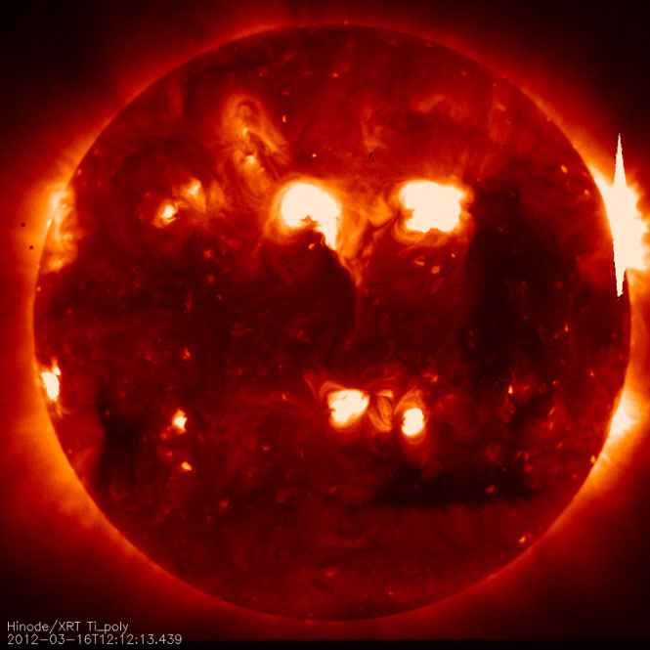
Probing Magnetic Reconnection with Active Region Transient Brightenings
Martin Donachie
Advisors: Adam Kobelski & Roger Scott

Slide 2
Outline
Background
ARTBs: What are they?
An overview of typical characteristics
Preparing the data
Searching for ARTBs
Plotting light curves
Numerical modeling
Conclusions

Slide 3
ARTBs: What are they?
Short-lived X-ray brightenings
Caused by magnetic reconnection
First observed in 1983
Based on data from images from SXT Japanese scientists identified a clear set of events that they called ARTBs (1992)
Combining SXT data with simultaneous observations of hard X-rays and radio led to the conclusion that ARTBs are most likely scaled down flares

Slide 4
Properties
Sudden brightenings of magnetic loops
Energy released: 10²⁵-10²⁹ ergs (c.f. flares: ~10³² ergs)
Hard X-ray fluxes ~10⁻³ < regular flares
Frequency: 1-40 events per hour in active regions (c.f. a few flares per day for active Sun; < 1 per week for quiet Sun)
Timescale: a few, to tens of minutes

Slide 5
Why study them?
To better understand the mechanisms behind magnetic reconnection
Occur at lower energies than flares, BUT, far more frequently
They can be treated statistically
Since they occur on a smaller scale a number of simplifying assumptions can be made
Easier to describe with current numerical models
Notes:
Ultimate goal is to better understand the mechanisms behind magnetic reconnection.
Looking at previous slide can see that they occur at lower energies, however…

Slide 6
The Data
XRT data from Hinode
Active region 11112
Aluminium-on-mesh filter
Start time: 11-10-2011 0:09
End time: 16-10-2011 23:48
‘xrt_prep’ already run
Cleans up data: removes dark currents, cosmic ray hits, hot pixels etc.
Original data set parsed into multiple smaller sets
~60 new sets, 30 mins – several hours
Average cadence ~ 80-180 seconds
Notes:
Say why we had to split into smaller arrays: computing time etc.
Wrote some code that kept running total of elapsed time, and when greater than 30 mins and a sufficient gap presented itself the data was separated.

Slide 7
Searching for ARTBs
Use ‘find_artb.pro’
Calculates the running mean and standard deviation of the background
Searches for pixels 5σ above noise level
When such a pixel is found:
Program flags it
Looks at adjacent pixels to determine whether they are connected to same event
Traces out an abstract, 3D, shape which is one ARTB region
When no more connected pixels are found, starts searching for new ARTB region

Slide 8
Searching for ARTBs
Result: new array, elements = -1, except where ARTB regions lie
Use a binary count to track where each region lies : a=2^{n}-1 (n is ARTB #)
To extract information from a particular region:
Enter chosen value of ‘n’
Divide whole array by ‘a’
ARTB region lies where array = 1
When two regions overlap – slightly more complex

Slide 10
Light Curves
‘find_artb.pro’ effectively creates a mask for each ARTB region
Combining each mask with original data:
Can plot light curves for each ARTB
First: select ARTB via method on previous slide
Sum region along Z direction
Gives total area covered by chosen region
Multiply resultant area with original data along entire image stack
Get X-ray data for that ARTB alone

Slide 11
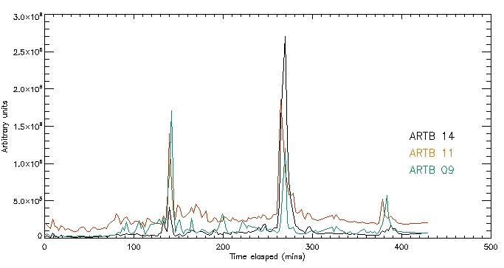
Light Curves

Slide 12
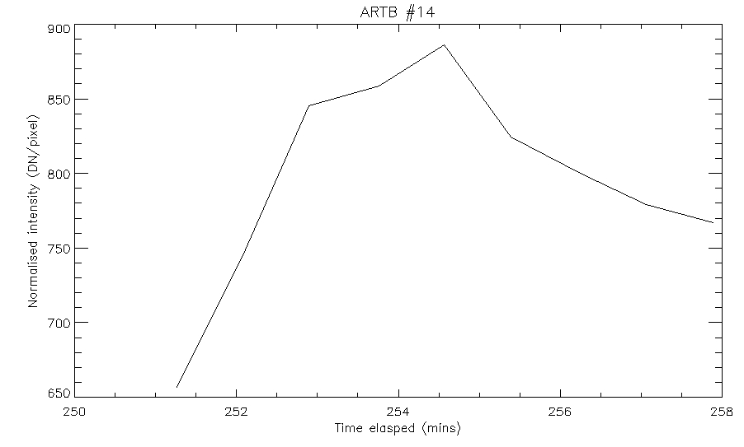
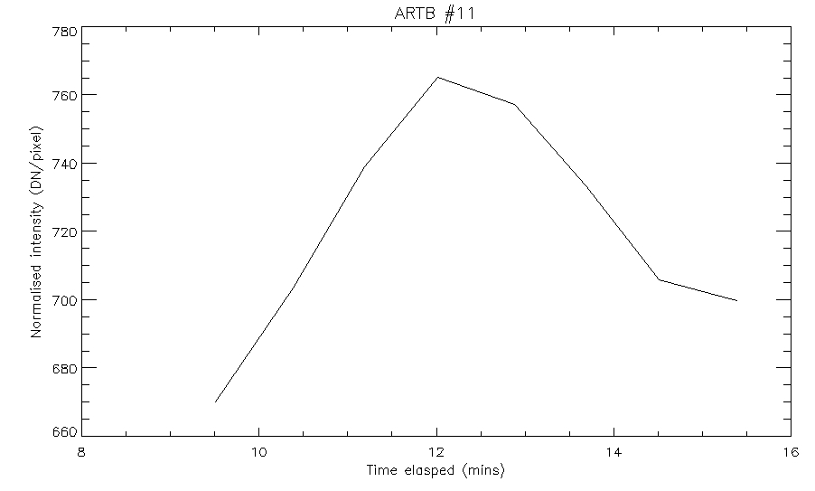
Notes:
Have to isolate light curves in tim

Slide 13
Next Steps
Improving light curve code
Counting problem
Bounding problem
Modeling
Feed information from light curves into the numerical model

Slide 14
Modeling
Enthalpy-based thermal evolution of loops (EBTEL) model
‘0D’: only one value of temperature, pressure and density at any given time
Excellent agreement with more sophisticated models
Uses 4 orders of magnitude less computing time
Model ARTBs as bundles of unresolved strands evolving independently
Fit multiple parameters to EBTEL model in order to match observed data

Slide 15
Input Parameters
Peak heating (ergs cm⁻³ s⁻¹)
Heat pulse width (s)
Strand length (cm)
Strand delay (s)
The length of time between strand n firing, and strand n+1
No. of strands

Slide 16
Input Parameters
Inferred from flare loop data
Scaled down to provide initial search values
Code uses an amoeba to search parameter space
Changes shape to find best fit
Set size of steps for each parameter
Bigger steps: faster computation but may skip over best fit values
Smaller steps: slower but better chance of finding fit values

Slide 17
Input Parameters
 | Peak heating (ergs cm⁻³ s⁻¹) | Heat pulse width (s) | Strand length (cm) | Strand delay (s) | No. strands
Input | 0.340 | 100 | 7x10⁸ | 5 | 100
Scale range | 10 | 10 | 1x10⁷ | 1 | 5
Best fit | 0.322 | 117.843 | 7.109x10⁸ | 9.614 | 107.768
Example: Sub-set 14, ARTB #1

Slide 18
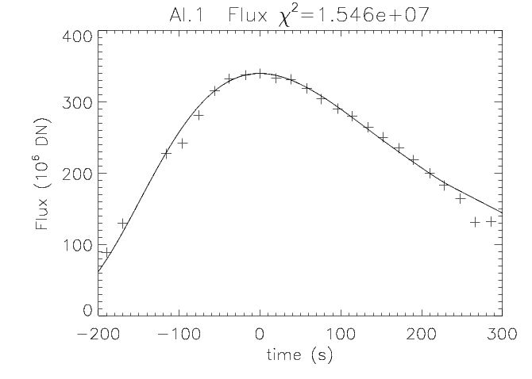

Slide 19
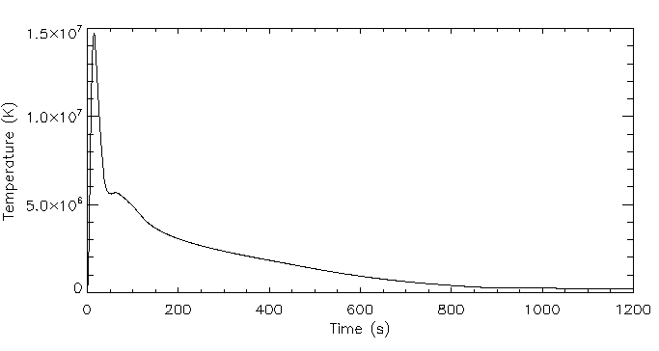
Emission Weighted Average Temperature

Slide 20
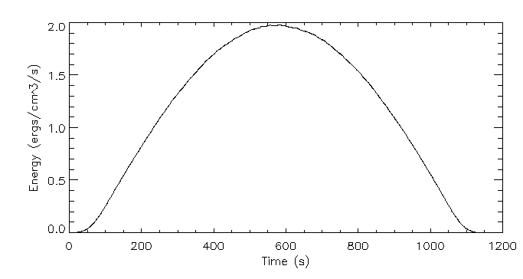
Energy over time

Slide 21
Problems Encountered
Initial goal was to gather enough data points to treat statistically
Not enough quality data to get good fits
Most ARTBs too short to gather sufficient data points
Need higher cadence data and/or longer events

Slide 22
Conclusions
Detection method is effective
Current amoeba model for searching parameter space is too sensitive to initial guesses
Need a more robust way of finding best fit parameters

