Slide 1
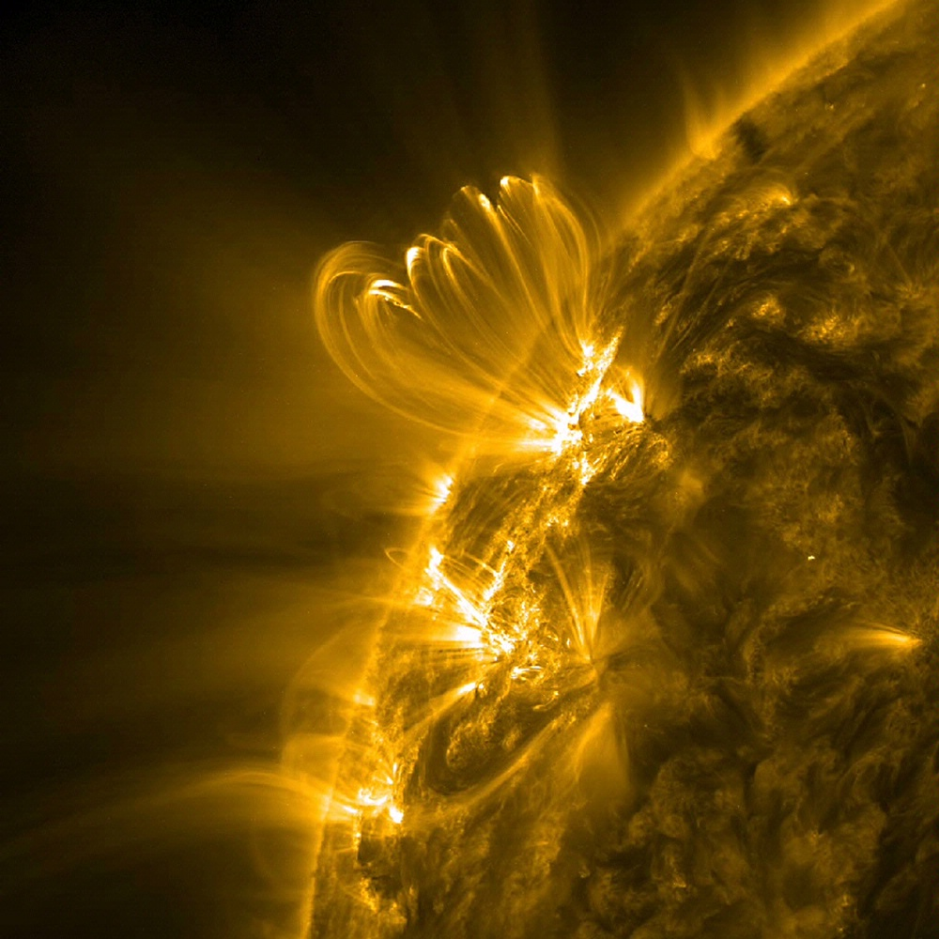
Inferring Energy Release in Solar Flares
Ben Williams
Advisors: Jiong Qiu and Angela Des Jardins
Montana State University Solar Physics REU

Slide 2
Outline
Background
Method
EBTEL Model
Results
Flare
Short vs. Long Loops
Ebtel Output
DEM
Energy Released
Conclusion

Slide 3
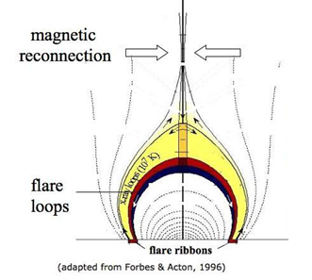
Flares
release of energy
magnetic field lines reconnecting
lower energy state
heats the chromosphere and corona
structures form e.g. coronal flare loops, bright footpoints
use satellite imagery and data to calculate energy release in each loop, $Q$

Slide 4
Basic EBTEL Model 0D Enthalpy Based Thermal Evolution of Loops
$$\frac{\text{d}\overline{n}}{\text{d}t}=−\frac{c_{2}}{5c_{3}kL\overline{T}}\left(F_{0}+L_{t}\right)$$
$$\frac{\text{d}\overline{P}}{\text{d}t}≈\frac{2}{3}\left(\overline{Q}−\frac{1}{L}\left(R_{c}+L_{t}\right)\right)$$
where $R_{c}={\overline{n}}^{2}LΛ\left(\overline{T}\right)$, $L_{t}=c_{5}\overline{P}$
$Q$: volumetric heating rate
$L$: half loop length
$F_{0}$: thermal conduction flux
$R_{c}$: coronal radiation rate
$L_{t}$: energy loss rate through transition region
Notes:
0D – no variation in variables over spatial coordinates

Slide 5
EBTEL
Highly simplified – 0D
two free parameters - $c_{0}$ and $c_{1}$
$c_{0}$ determines heating rates $Q$ and is scaled to footpoint emission
$c_{1}$ determines $L_{t}$
adjust these to find a good fit
Notes:
L_t: energy loss rate through the transition region

Slide 6
EBTEL
cannot track each individual loop
model one loop per pixel
independent
spatial average over all loops
$Q$ is the input
input an good approximation from observational data

Slide 7
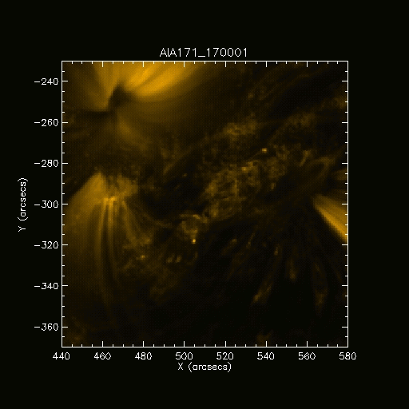
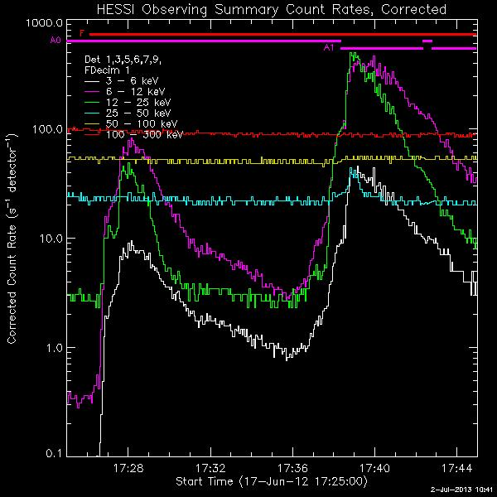
The Flare 17th June 2012 1700 – 1800 UTC
Notes:
Date/time
30 Mm, 92 Mm, 147 Mm
C- Class
No high energy particle emission

Slide 8
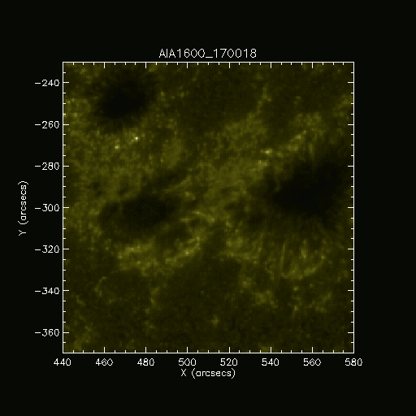
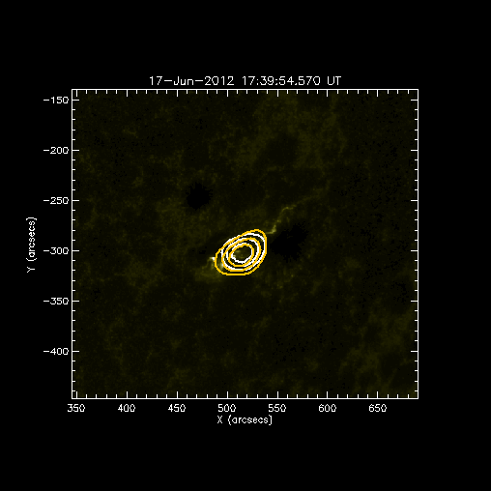
The Flare 17th June 2012 1700 – 1800 UTC
Notes:
Use 1600 for ebtel model - 2838 loops – use footpoints
80/60/40% - Rhessi data
Rhessi plot shows it is a loop top source so equations are valis

Slide 9
At Higher Resolution
Two different flares both with different loop lengths

Slide 10
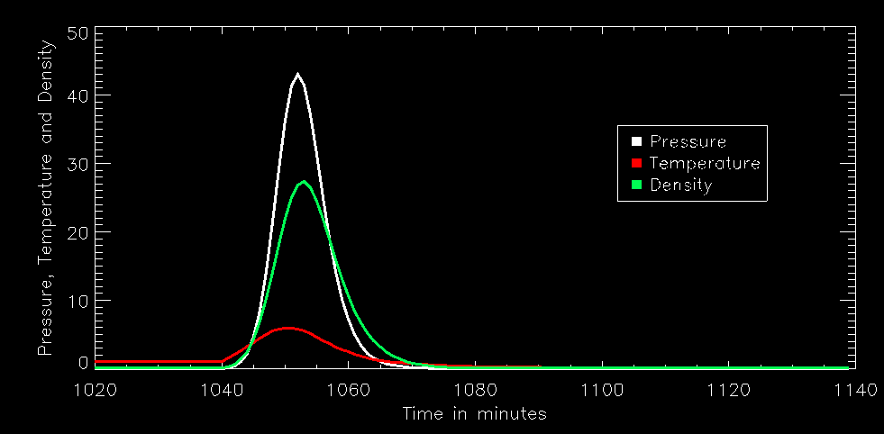
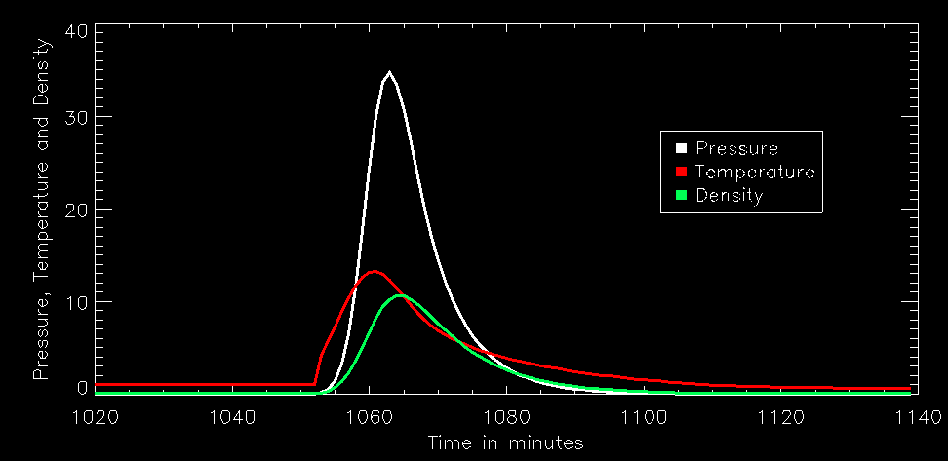
Short vs. Long Loops
Shorter loop:
$92 \text{Mm}$
Longer Loop:
$147 \text{Mm}$
Shorter loops decay faster than longer loops
Agrees with decay being proportional to
$$\frac{1}{L^{2}}$$
Density changes always lags behind temperature changes
Shorter Loop
Longer Loop
Notes:
Temperature increases => increase in heat conduction downwards => Flow upwards => increase in density
Temperature in MK
Density in ${10}^{9}$ ${\text{cm}}^{−3}$

Slide 11
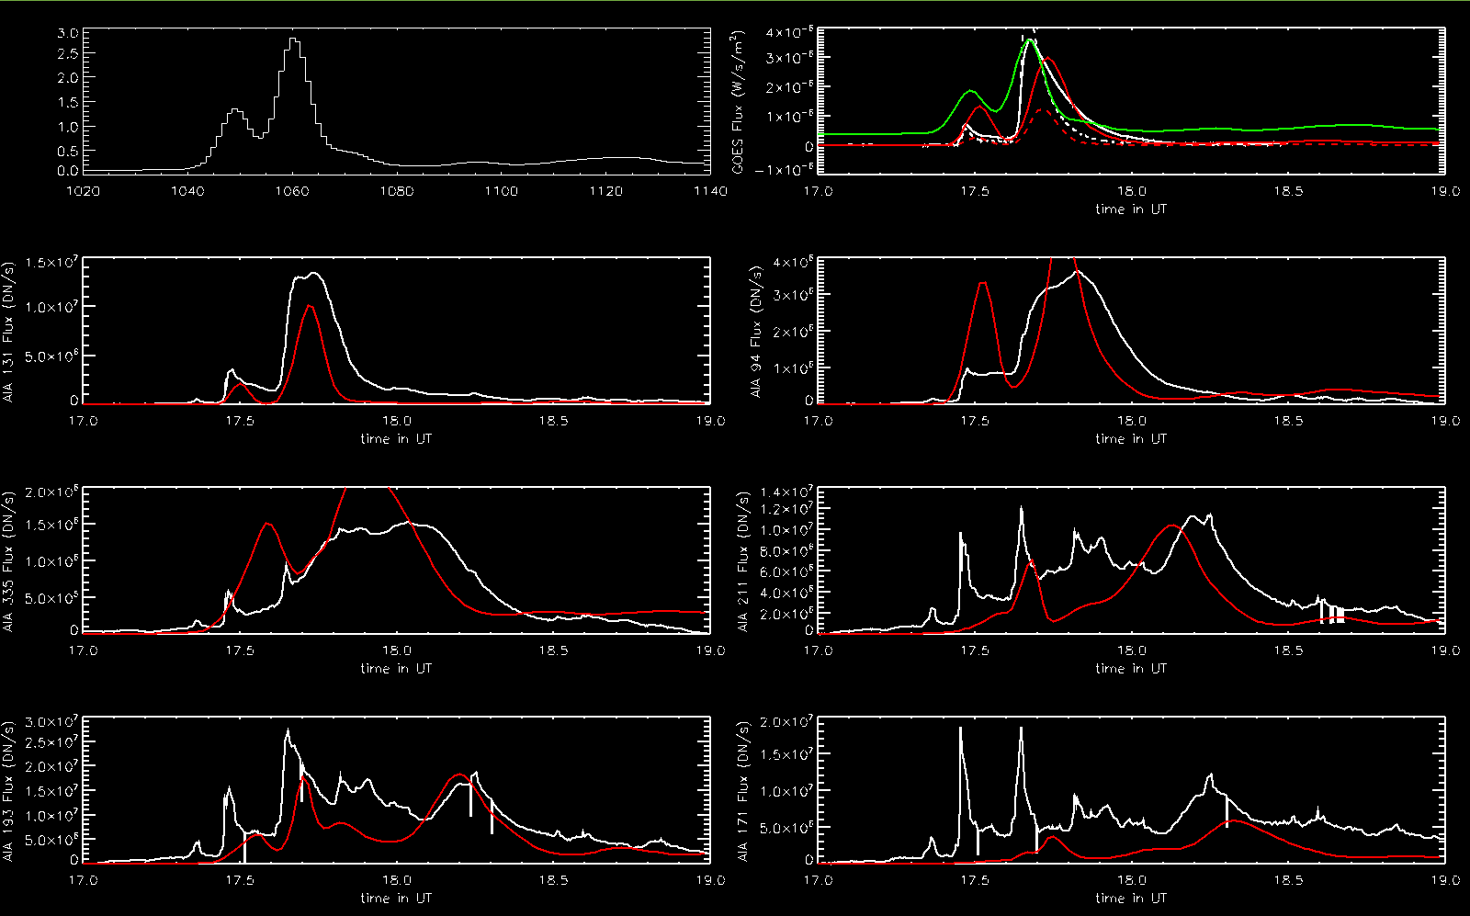
EBTEL Output
Heating Function
GOES
AIA 131
AIA 94
AIA 335
AIA 211
AIA 193
AIA 171
Red – EBTEL output White – Observations
Notes:
Ordered temperatures
Altered Ebtel model to have different parameters for each loop length
Use gaussians to model the heating function - one for each flare

Slide 12
DEM Differential Emission Measure: $ε=n^{2}\frac{dV}{dT}$
GOES/RHESSI temperature evolution
$$\log_{10}{T}$$
Highest DEMs are red – ${10}^{42} {\text{cm}}^{−3} {\text{K}}^{−1}$
Lowest DEMs are black – ${10}^{38} {\text{cm}}^{−3} {\text{K}}^{−1}$
Minutes after 1700 UTC
Distribution of amount of plasma as a function of temperature
RHESSI/GOES and DEM are co-temporal suggesting good fit
RHESSI/GOES higher perhaps due to their isothermal assumption (cannot be true for many loops)
In future, use DEM to calculate RHESSI spectrum ⇒ temperatures
Notes:
DEM calculated from EBTEL data
Correlates well suggesting modelled and observed trends are similar
Graph from 1MK to 30MK => corona
Max/Min temperatures by colours
Rhessi 7-30
GOES 7-15/16
Rhessi/Goes temperatures correlate well with DEM plot

Slide 13
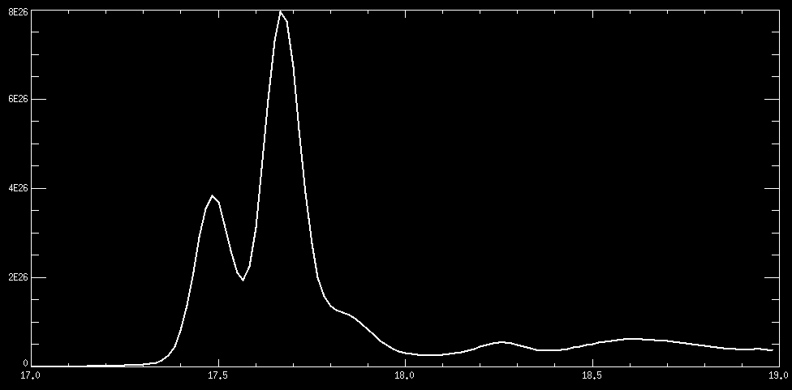
Energy Released
Energy Release Rate ($\text{erg} s^{−1})$
Hours starting 1700 UTC
Total energy released: $Q=9.3×{10}^{29} \text{erg}$
Notes:
C class flare – valid energy release for this type of flare

Slide 14
Conclusion
EBTEL works remarkably well considering its simplicity
Works much quicker than more complex models
Final $Q$ is valid for a C-Class flare
Notes:
EBTEL – 1 min
More complex models – 1D Loop heating model 20 mins for one loop

