Slide 1
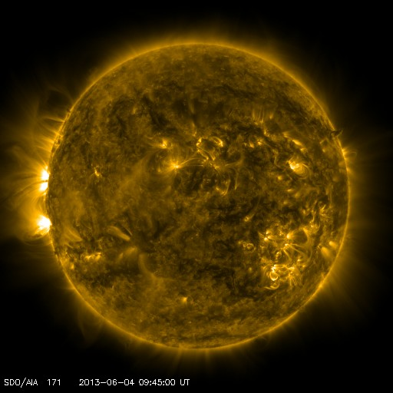
Global Structure of the Solar Corona
Roberto J. Pérez (UPRM)
Charles Kankelborg (MSU)
Sarah Jaeggli (MSU)

Slide 2
Abstract
The AIA instrument on the Solar Dynamics Observatory obtains images of the sun in seven different extreme ultraviolet wavebands. Each filter produces images with distinctive appearance that is apparent to experienced observers. Subjective descriptions abound in the literature and in conference presentations, as do qualitative explanations of the physical reasons for these differences. We seek a quantitative description of the image properties, with the aim of understanding what the general image properties indicate about the temperature structure of the corona. Our preliminary results, obtained at multiple heliocentric angles above and below the limb, show that some channels consistently present a high or low intensity contrast which we attribute to the differing temperature, density and filling factor of the structures imaged. We also investigate the power spectra characteristic of each waveband.

Slide 3
Main Question
Why are images produced by different EUV (Extreme ultraviolet) filters so different? Can these differences be caused by physical parameters or could it be that different filters image specific solar structures?

Slide 4
Possible Explanations
Some papers present qualitative explanations
Instrument Scattering, Resonance Scattering and contamination of photons in the passbands has been suggested but they have been proven wrong.
“Filling-Factor Model” – Piling up of structures along the line of sight

Slide 5
Data
SDO (Solar Dynamics Observatory) (NASA)
- AIA (Atmospheric Image Assembly)
We consider seven different EUV (Extreme Ultraviolet) wavebands.
94 Angstroms
131 Angstroms
171 Angstroms
193 Angstroms
211 Angstroms
304 Angstroms
335 Angstroms

Slide 6
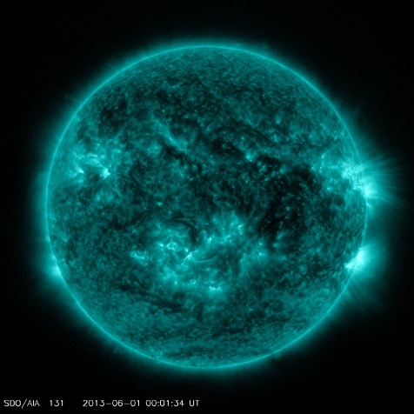
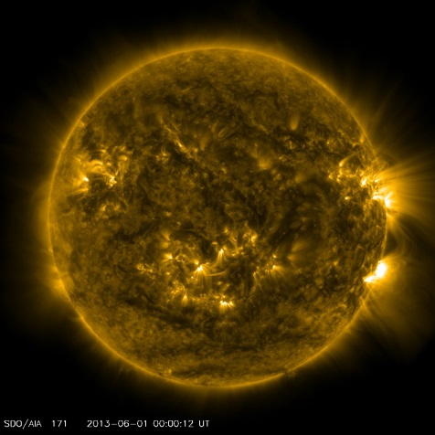
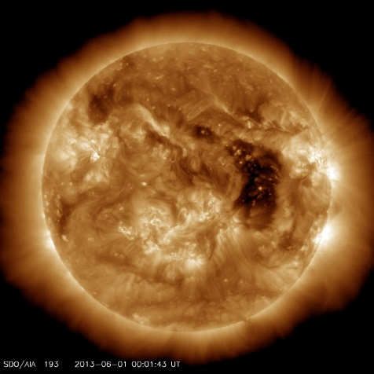
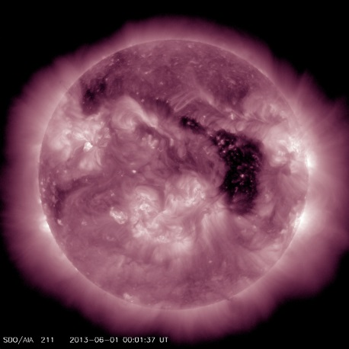
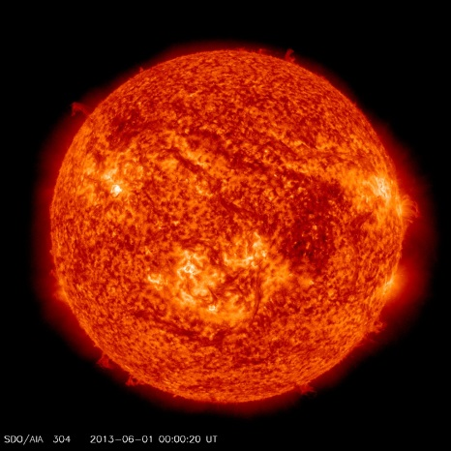
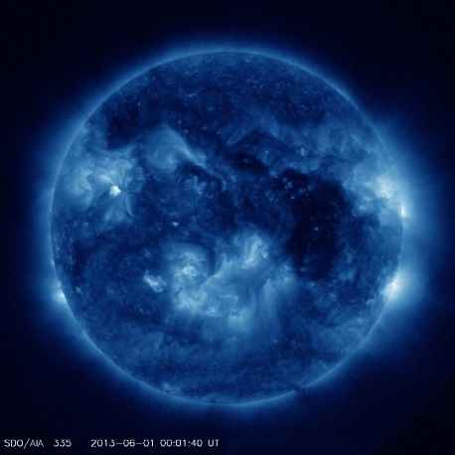
Data

Slide 7
Approach
Extract intensity arrays corresponding to different heliocentric annular regions.
2^14 elements
Divide the arrays by their median value (For means of comparison)
Compare these arrays using different techniques

Slide 8
Histograms
The histograms presented here were created by taking the average of histograms corresponding to twelve consecutive Carrington rotations of the sun (roughly).
The frequency axis is log-scaled

Slide 9
200-205 pixels

Slide 10
500-505 pixels

Slide 11
1000-1005 pixels

Slide 12
1500-1505 pixels

Slide 13
1620-1625 pixels

Slide 14
1700-1705 pixels

Slide 15
1800-1805

Slide 16
Observations
High frequency of low intensity pixels in the 335 and 94 wavebands
Relatively similar structure among wavebands
Seemingly erratic behavior far above the solar limb.

Slide 17
Contrast
We define contrast as the difference between the 75th percentile intensity value and the 25th percentile value.

Slide 18
200-205 pixels

Slide 19
500-505 pixels

Slide 20
1000-1005 pixels

Slide 21
1500-1505 pixels

Slide 22
1620-1625 pixels

Slide 23
1700-1705 pixels

Slide 24
1800-1805 pixels

Slide 25
Observations
94, 335, and 211 consistently have the higher contrast in all annular regions.
This does not support our initial hypothesis that the images that look less “fuzzier” to our eyes (ie. 304) should have the higher contrast.
The 304 waveband consistently presents a low contrast.
The plots from annular regions below the limb look different from the ones above the limb. Imaging of different ionic species could be an explanation for this.

Slide 26
Contrast vs. Characteristic Temperature
It is possible to deduce a characteristic temperature for each waveband.
This does not mean that everything imaged in that waveband is at that specific temperature but it provides a nice approximation.
Some ions are only imaged in specific solar activities (ie. Flares). For our purposes we use the most stable temperature that corresponds to each waveband.

Slide 27
200-205 pixels

Slide 28
500-505 pixels

Slide 29
1000-1005 pixels

Slide 30
1500-1505 pixels

Slide 31
1620-1625 pixels

Slide 32
1700-1705 pixels

Slide 33
Observations
For annular regions below the limb we can observe a light correlation between characteristic temperature and contrast.
Annular regions above the solar limb show no correlation at all.
It is important to note that the waveband that has the lowest characteristic temperature almost always has the lowest contrast below the limb while the waveband that has the highest characteristic temperature almost always presents the highest contrast below the limb.
304 is dominated by Si XI (Log(6.2)=6.2) above the limb.

Slide 34
Discrete Fourier Transforms
These plots consist of the average of Fourier transform plots corresponding to twelve consecutive Carrington rotations of the sun.
The intensity component axis is log scaled
The frequency axis is presented as log(frequency)
The frequency axis goes to the Nyquist frequency

Slide 35
200-205 pixels

Slide 36
500-505 pixels

Slide 37
1000-1005 pixels

Slide 38
1500-1505 pixels

Slide 39
1620-1625 pixels

Slide 40
1700-1705 pixels

Slide 41
1800-1805 pixels

Slide 42
Observations
Linear behavior below the limbs (small bumps noticeable in the 94, 304 and 131 wavebands.
Bumps become more noticeable above the limbs
Could the bumps be of solar origin?
Mean Signal (335-94-131-304) : Bump height (94-335-131-304) (Highest to lowest)
Period of some solar structures:
Sunspots: ~33 arcsecs
Granules: ~1.4-2.0 arcsecs (frequency range: (-1.7) – (-0.15))
Supergranules: ~49 arcsecs
Coronal Holes: ~974-1252 arcsecs
Active Region Loops: ~14 arcsecs
Spicules: ~.7 arcsecs

Slide 43
Overall Results
The characteristic temperature of a specific waveband seems to have an effect on the contrast observed.
The temperature of the imaged structure of each waveband appears to directly affect the contrast or ‘fuzziness” that our eyes perceive.
It is possible that some temporary solar structures are affecting the overall consistency of the results (This needs further proof)
The bumps on the Fourier transform plots seem to be of solar origin. Granular and supergranular scales look relevant.
Hotter wavebands present bumps (Coronal heating problem?)

Slide 44
Further Work
Construction of a coronal model
- Densities of the solar structures imaged
- Temperature map of the plasma imaged by the different
wavebands
Find the origin of the bumps on the Fourier transform plots.

Slide 45
References
The Transparency of Solar Coronal Active Regions (Brickhouse & Shmelz, 2005)
Warm And Fuzzy: Temperature and Density Analysis of an Fe XV EUV Imaging Spectrometer Loop (Shmelz et al., 2011)
Are Coronal Loops Isothermal or Multithermal? (Shmelz et al., 2009)
SDO/AIA Response to Coronal Hole, Quiet Sun, Active Region and Flare Plasma (O’Dwyer et al. , 2010)

