Slide 1
Detection and Tracking of Active Regions to Investigate the Solar Cycle
Michael DeLuca
Adviser: Dr. Andrés Muñoz-Jaramillo
Notes:
Image credit: http://apod.nasa.gov/apod/image/9701/bluesun_soho_big.jpg

Slide 2
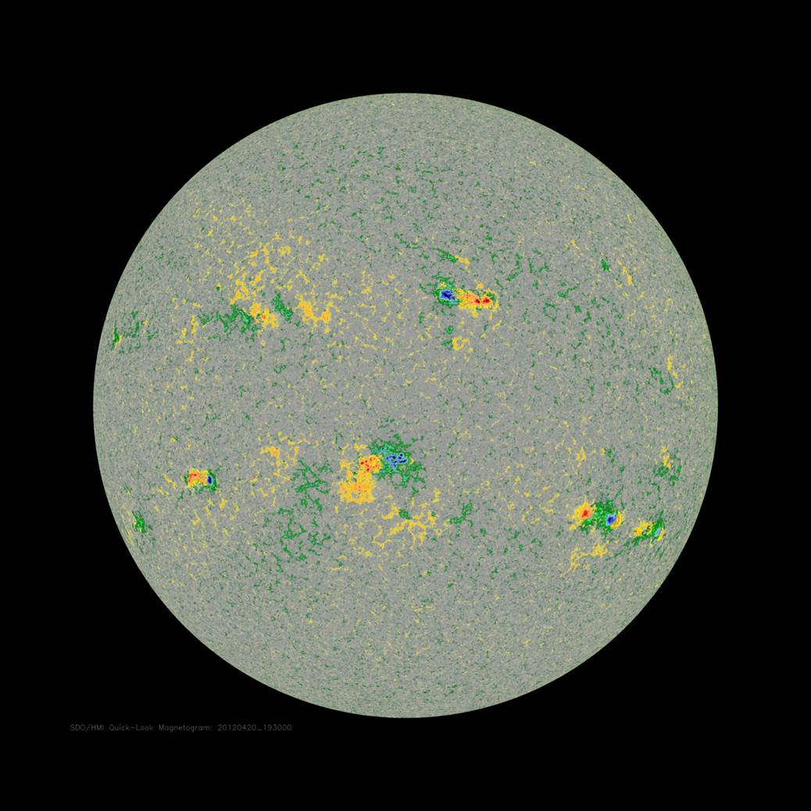
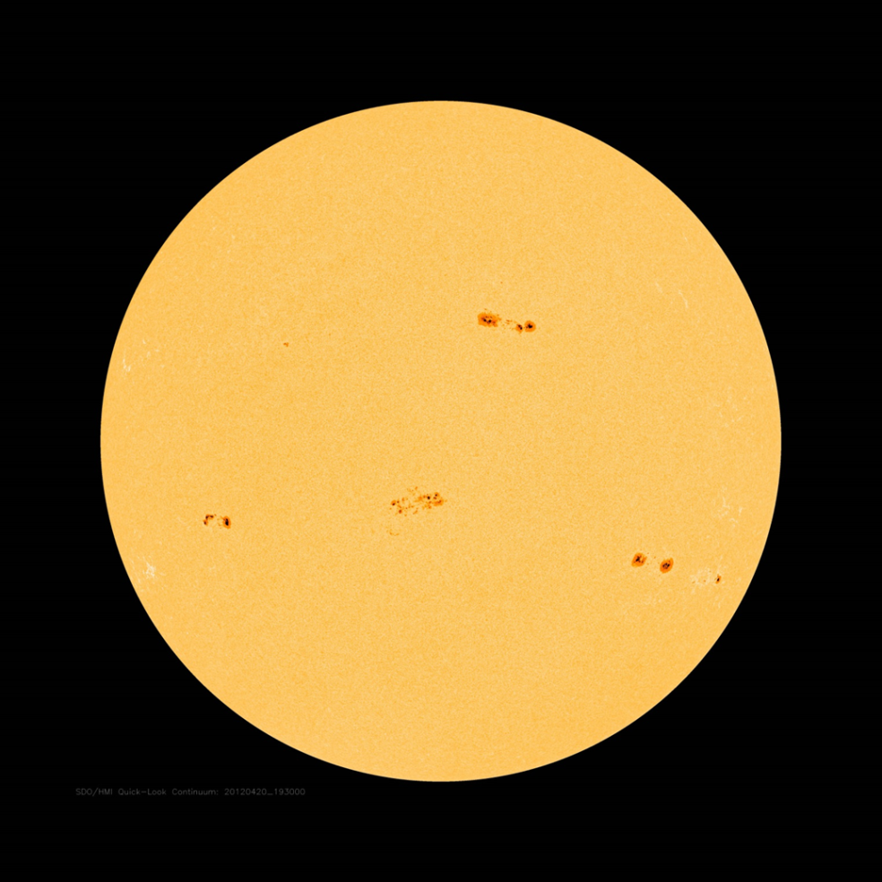
Active Regions
Magnetic fields emerge from the Sun
Pairs of positive and negative magnetic field
Cause sunspots
Active region properties
Notes:
“The number and properties of the active regions follow an 11 year cycle.”
Magnetic fields emerge from the Sun
Flares/CME’s can occur in active regions
Cause sunspots – disrupt heat flow creating a cooler region (the sunspot)
Image credit: http://www.nature.com/nclimate/journal/v1/n2/fig_tab/nclimate1096_F1.html

Slide 3
Solar Cycle
11-year cycle of solar activity, 22-years total
Notes:
“The solar cycle has implications for life here on Earth”
11-year cycle of solar activity; 22-years total
Image credit: http://www.nasa.gov/images/content/144051main_ButterflyDiagramLG.jpg

Slide 4
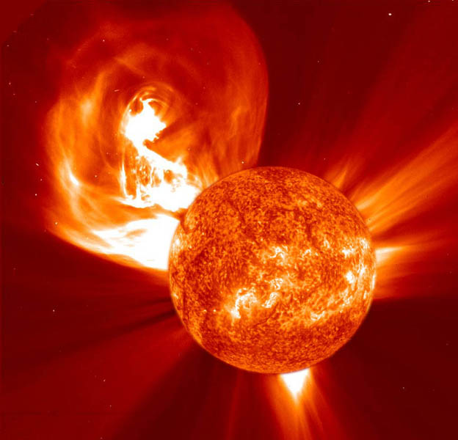
Effects of the Solar Cycle
Heats upper atmosphere of Earth
Increased/Decreased number of solar flares and coronal mass ejections
Possible effect on climate
Notes:
“Due to the importance of the solar cycle spacecraft have been launched to learn more about it.”
Affects upper atmosphere of Earth – drag on satellites
Increased number of solar flares and CME’s – particles can damage instruments in space, endanger astronauts
Possible effect on climate
Image credit: http://soho.nascom.nasa.gov/bestofsoho/images/large/CME_EIT_C2_2002_prev.jpg

Slide 5
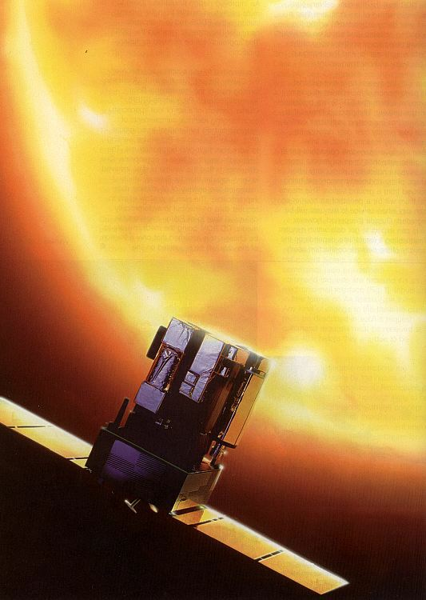
SOHO/MDI Mission
Launched in 1995 to study the interior of the Sun, the Sun’s atmosphere, and the solar wind
Michelson Doppler Imager takes multiple daily magnetograms
Notes:
“These magnetograms are the data that I am working with this summer.”
Solar and Heliospheric Observatory
Nearly lost spacecraft in 1998
Located at Lagrange Point L1 – pointed at Sun 24/7 (Earth can’t get in the way!)
Image credit: http://nssdc.gsfc.nasa.gov/image/spacecraft/soho.jpg

Slide 6
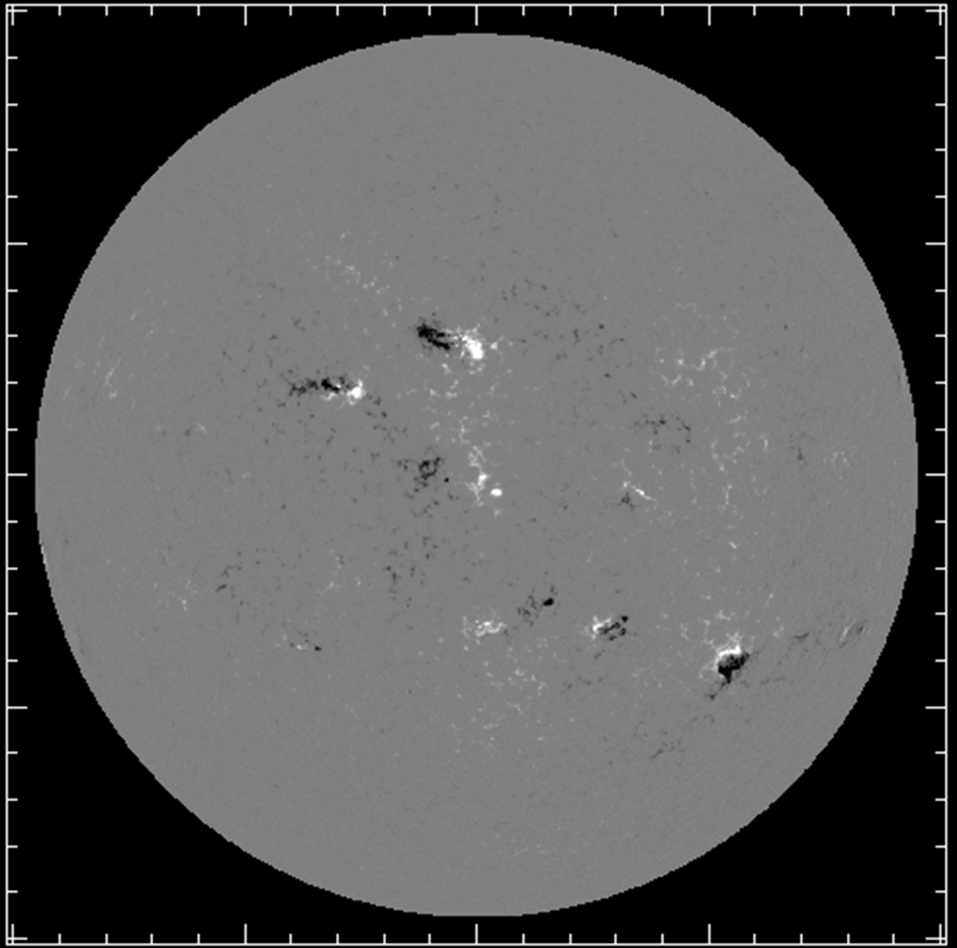
Data
MDI data from 1996 to 2011
Black regions indicate a negative magnetic field
White regions indicate a positive magnetic field
Notes:
“We want to study the properties of these active regions.”
Go into some detail again about AR properties visible in this image (leading polarity, inclination, location)
Magnetogram from 2001-08-05

Slide 7
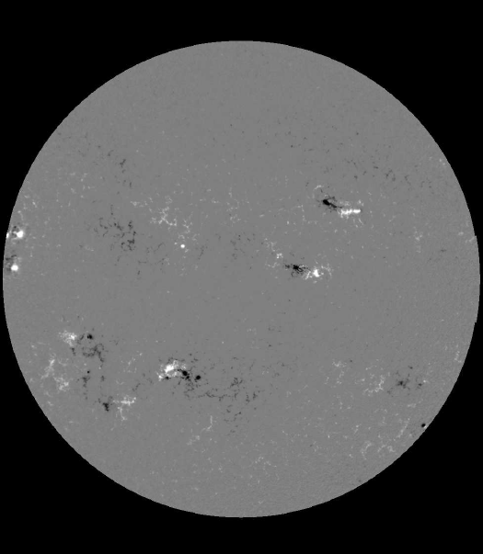
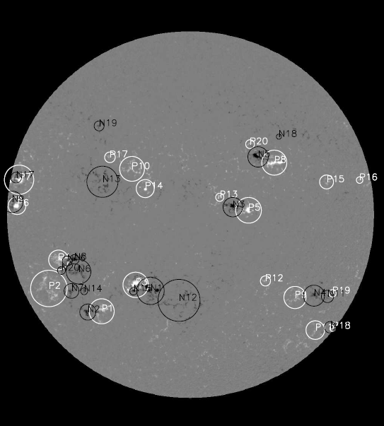
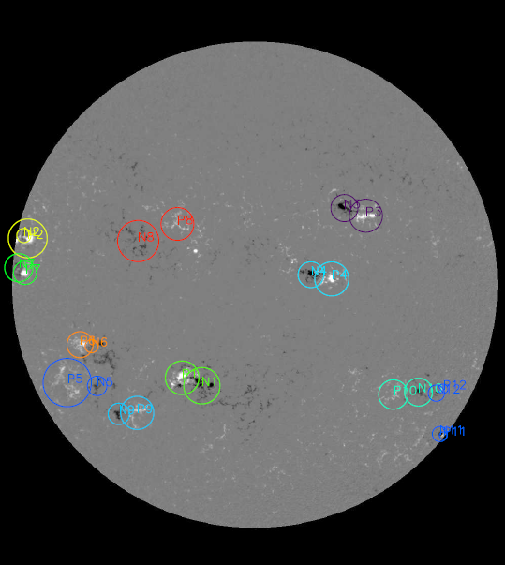
Automatic Detection of Active Regions
BARD code = Bipolar Active Region Detection
Detection of positive and negative regions separately.
Aggregation into active regions based on size, flux and distance.
Tracking of active region across magnetograms.
Notes:
“However, automatic detection is not perfect.”

Slide 8
Human vs. Computer
Humans have evolved to be very good at finding patterns but can be subjective
Computers are not as good at recognizing patterns but are more consistent and objective
Notes:
“The computer can make mistakes that are obvious to a human.”
Microsoft clipart

Slide 9
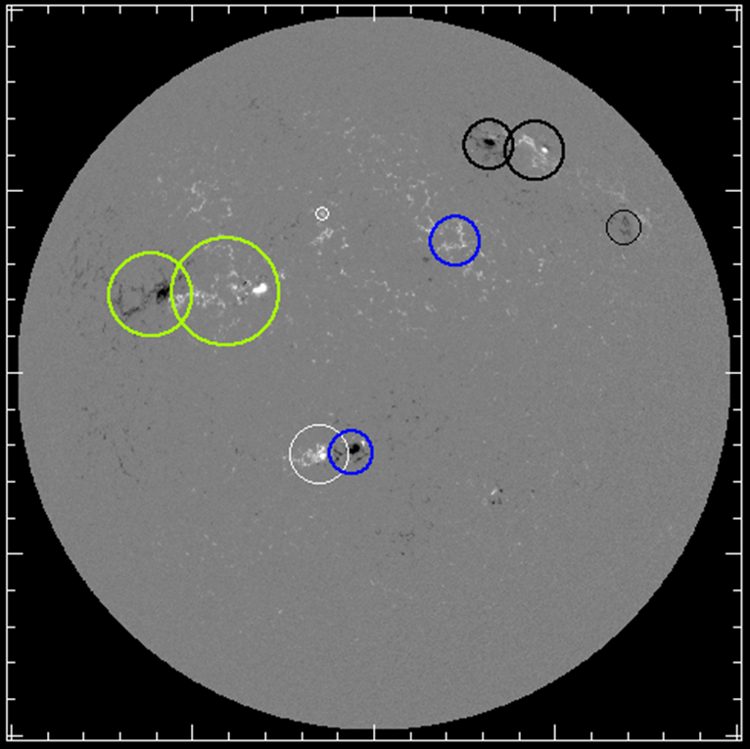
Computer Mistake
Notes:
“A human needs to come in here to fix the problem.”
Previous project had a human perform all detections, but when things got busy the small things were lost

Slide 10
Project
Combine the pattern-finding skills of a human with the consistency of a computer
Computer detects positive/negative regions and performs initial pairing and tracking
Human reviews results and makes corrections
Ultimate Goal: Create a database of active regions for the study of the solar cycle
Notes:
“Before we began to create this database, we prepared the code to do as much of the work as possible.”

Slide 11
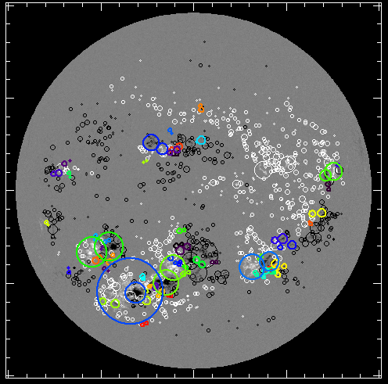
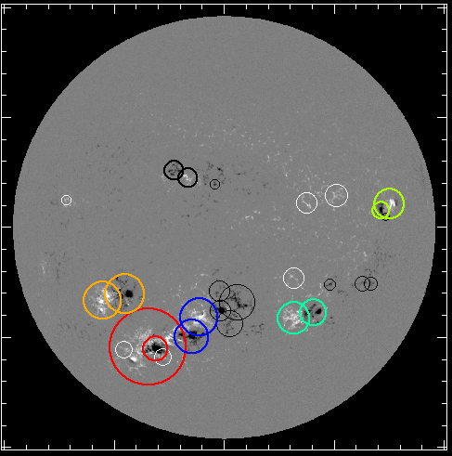
Parameter Search
Optimize the computer’s ability to detect, track, and pair active regions
eros_size = 3.0
eros_size = 9.0
Notes:
“We had hundreds of possible parameter combinations.”

Slide 12
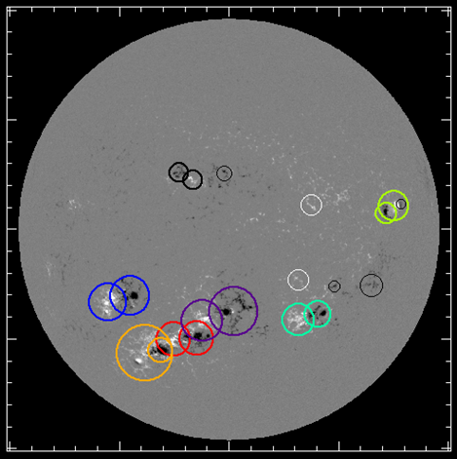
Parameter Search
Hundreds of parameter combinations
Parameters to optimize:
Kernel threshold
Erosion size
Region threshold
Distance limit
Overlap limit
Best Combination
Notes:
“With the code optimized, we had to develop a way for a human to make any necessary corrections.”
ker_th = upper limit on pixel threshold when detecting PNR kernels
(code performs detections multiple times using values between ker_th and ker_th2)
ar_th = pixel threshold when growing regions
eros_size = minimum size for region to remain (eroded and then grown back)
dis_lim = distance at which PNR’s are independent
ovr_lim = overlap at which PNR’s are merged

Slide 13
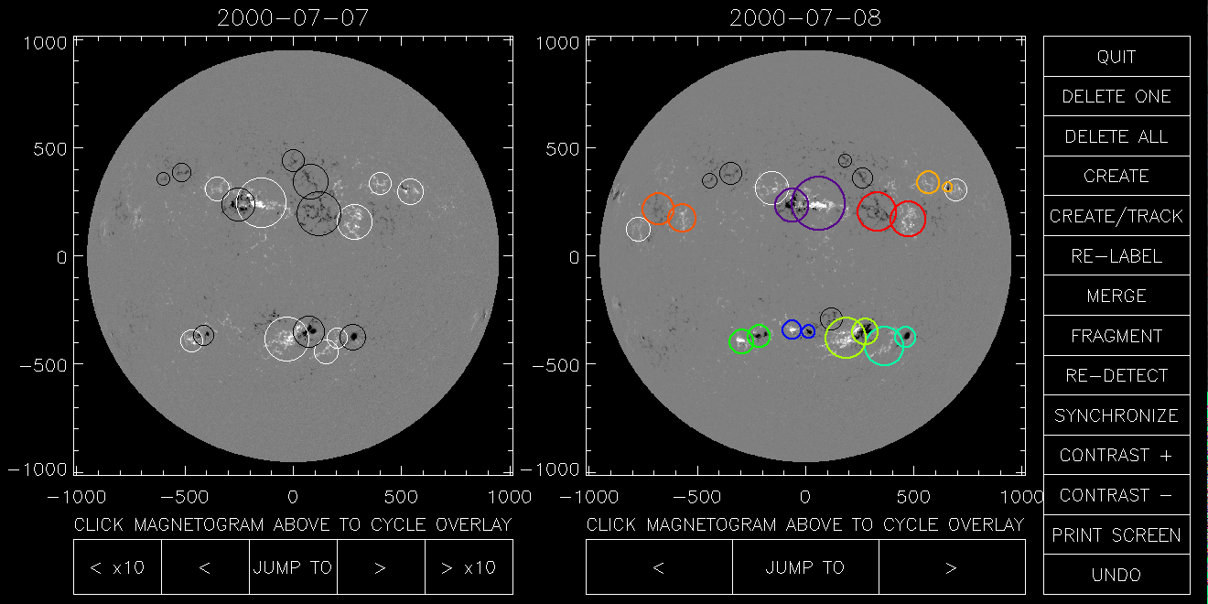
Developing the Interface
Coded functionality to allow human intervention
Notes:
“This interface allowed me to correct the error we saw earlier.”

Slide 14
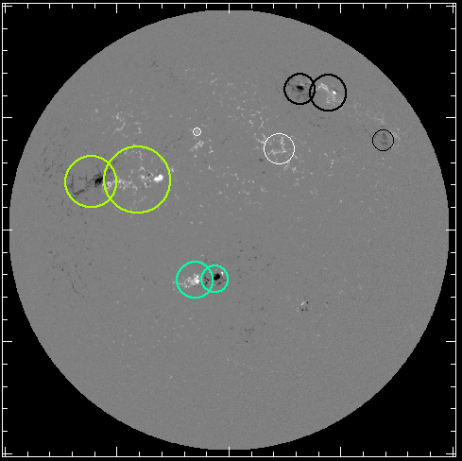
Corrected Mistake
Notes:
“With the code ready we then began to start detections.”

Slide 15
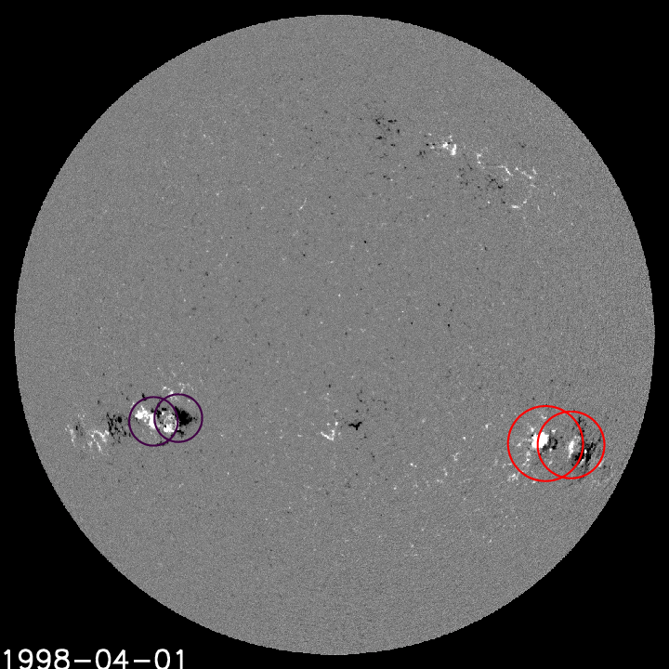
Active Region Detections
Notes:
“I have been working on these detections since last week.”

Slide 16
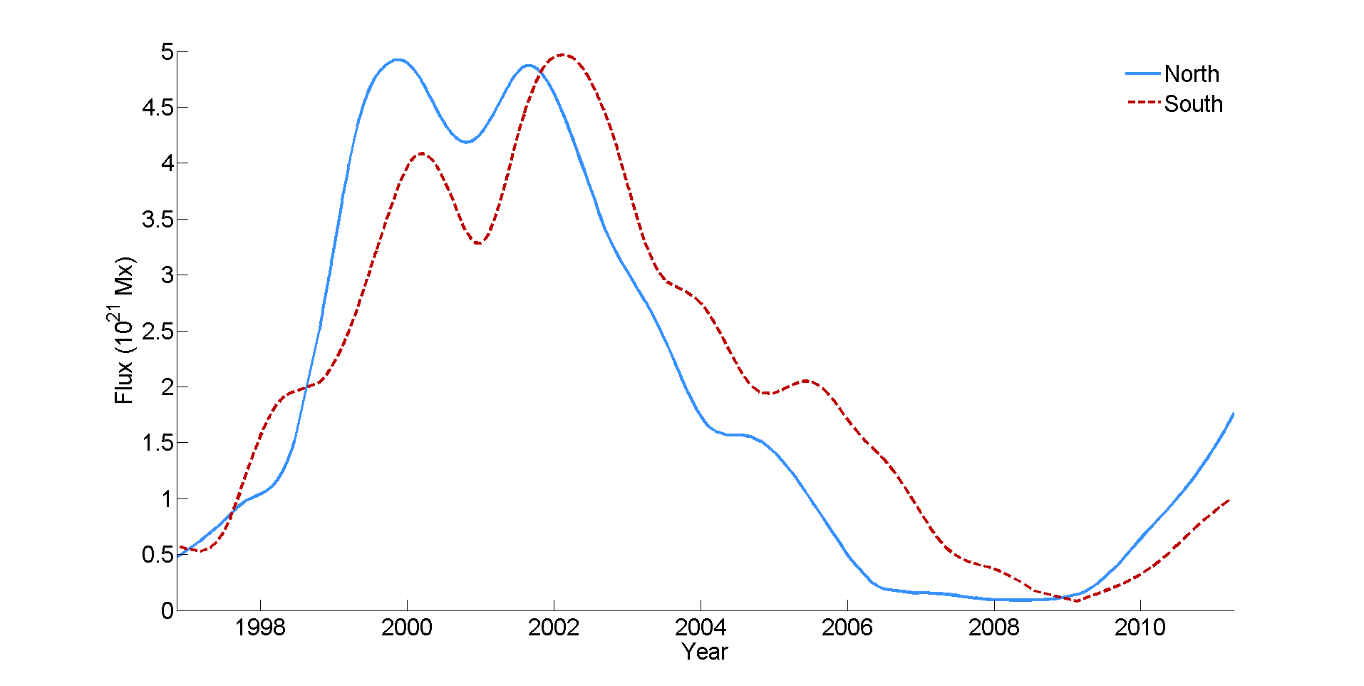
Project Status
Mission goes from 1996 to 2011
Completed detections from 1996 to 2000
Current Position
Notes:
“Any questions?”
Total AR flux calculated with the database that Dana and his student did last summer. This has been smoothed (24-mo Gaussian filter) to show the long-term evolution.

Slide 17
QUESTIONS?
Notes:
Image credit: apod.nasa.gov

Slide 18
Sources
Cambridge Encyclopedia of the Sun
“The Solar Cycle” by David M. Hathaway
Images:
http://apod.nasa.gov/apod/image/9701/bluesun_soho_big.jpg
http://www.nature.com/nclimate/journal/v1/n2/fig_tab/nclimate1096_F1.html
http://www.nasa.gov/images/content/144051main_ButterflyDiagramLG.jpg
http://soho.nascom.nasa.gov/bestofsoho/images/large/CME_EIT_C2_2002_prev.jpg
Microsoft Clipart
http://nssdc.gsfc.nasa.gov/image/spacecraft/soho.jpg

