Slide 1
Optical Instruments for Solar Eclipse Measurements Advisor: Dr. Joe Shaw
LOGAN
cARPENTER

Slide 2
Project Assignments
Spectropolarimeter
Jon and Logan
Aurora Detector
Kendra and Logan
Solar radiometer
Everyone and Logan

Slide 3
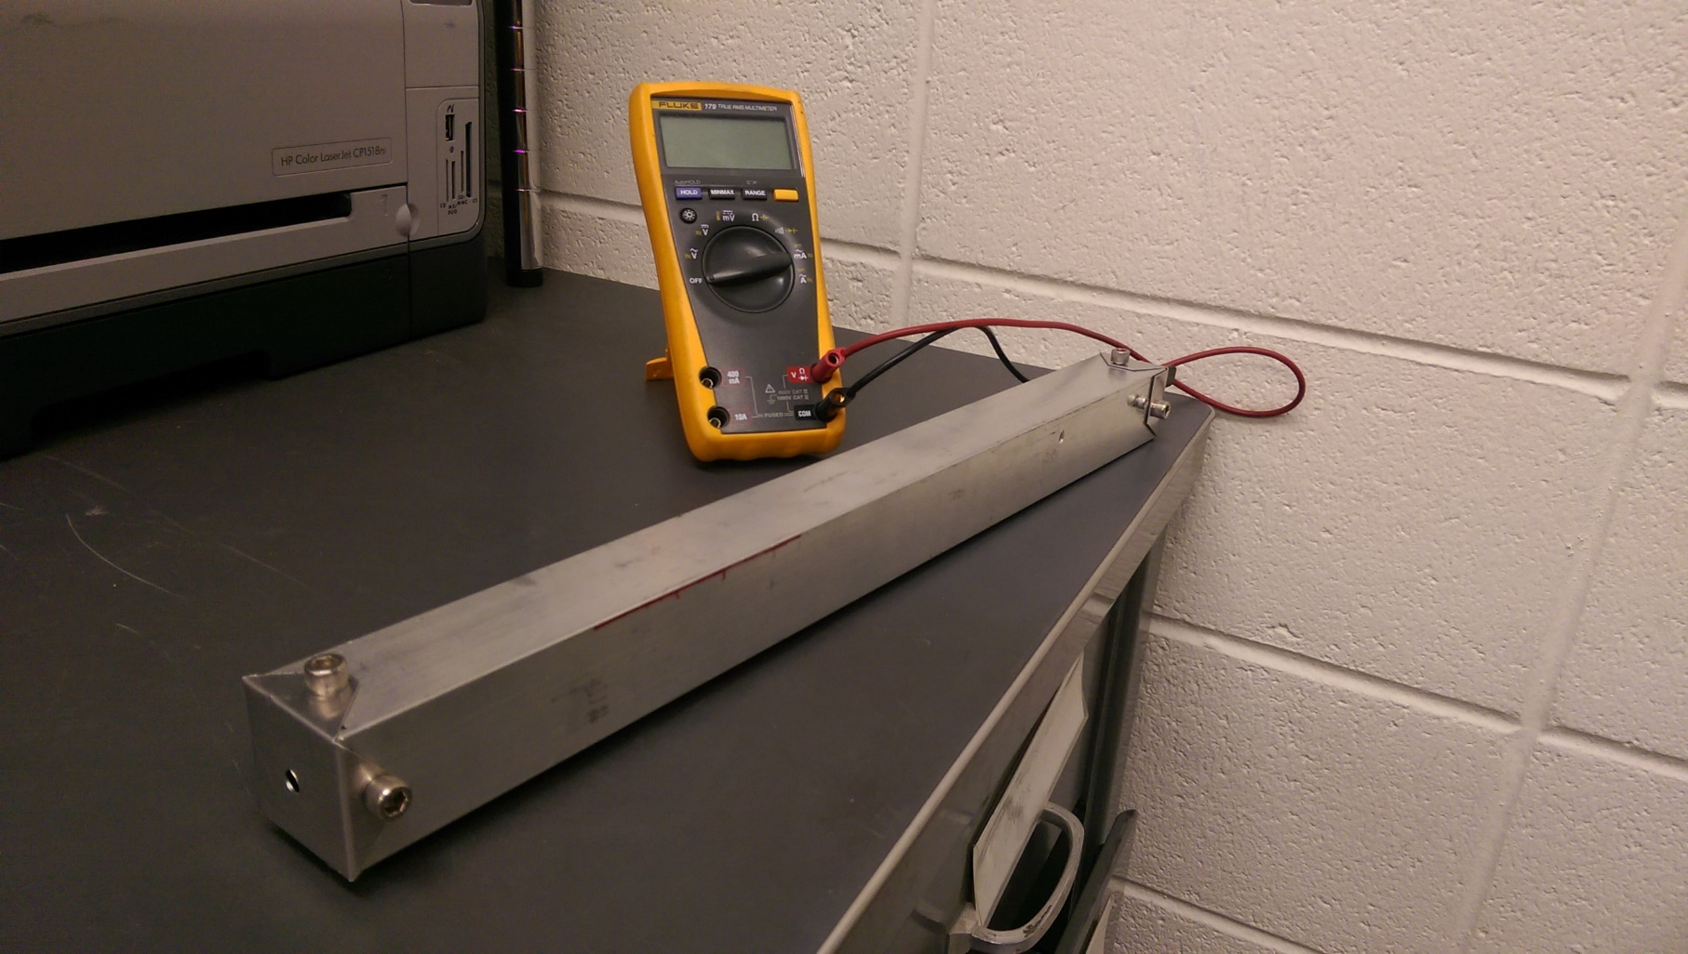
My mid-term report focus
Measuring the atmospheric optical depth with a Solar Radiometer

Slide 4
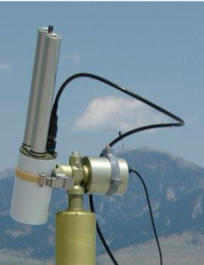
Why would we want to make a Solar Radiometer?
Become familiar with taking data from the instrument. *
Experience calibrating instruments.
Further understanding of atmospheric optics.
Practice for the solar eclipse in 2017mEASURING POLARIZATION OF SKYLIGHT. Interpreting the polarization requires knowing the aerosol optical depth. Before and after eclipse.
* Photo by Joe Shaw
Notes:
-Experience.
-Getting our feet wet in the atmospheric optics world.

Slide 5
How the solar radiometers work
Earth
* $1366 \frac{W}{m^{2}}$
* Number taken from http://www.britannica.com/topic/solar-constant
Notes:
-Light waves propagate
-Solar irradiance at earth

Slide 6
How the solar radiometers work
Atmospheric extinction.
Greater optical depth means greater extinction.
Notes:
-Extinction = absorption + scattering
-Ex of scattering is Rayleigh scattering (blue sky)
-ex of absorption is water vapor (most effective green house gas)
-Higher latitudes means more extinction because of greater optical depth.

Slide 7
Understanding optical depth
Optical depth = $τ = \int^{∞}{σ\left(z\right)N\left(z\right)dz}$
σ = absorption, scattering, or extinction cross section $[m^{2}]$
$N=$gas molecule or particle density $[m^{−3}]$
$z=$distance along the optical path $[m]$
Notes:
-sigma describes the property of a gas or aerosol to cause extinction.
-N = density
-path
-unit less number that describes the extinction of the light along that particular path
-in order to know the optical depth we need to know the air mass.

Slide 8
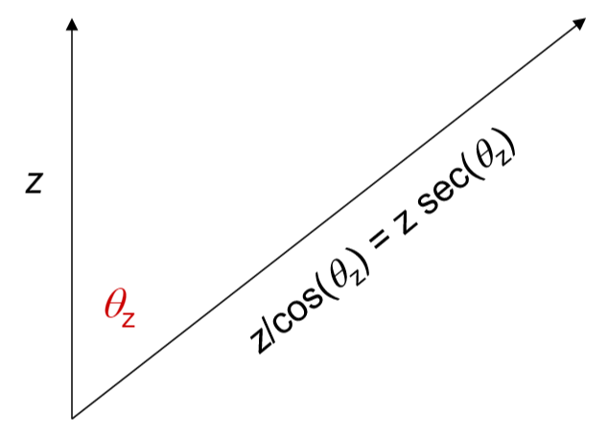
Understanding Air Mass
Air Mass
Air mass at zenith is 1
Air mass at the horizon is $∞$
Calibration is taking several measurements in varying air masses.
*
* Gratitude to Joe Shaw for the above figure
Notes:
-Path with witch light has to pass to reach the observer.
-Angle relative to the zenith

Slide 9
Using optical depth to find spectral irradiance
$$E\left(λ\right)=E_{0}\left(λ\right)e^{−τ(λ)∗sec\left(θ_{z}\right)} \left[\frac{W}{m^{2} nm}\right]$$
Notes:
-Irradiance at the point of the observer corresponds to the irradiance outside the atmospheric in a decaying exponential equation.
-do example with E=700 and E_o = 1366

Slide 10
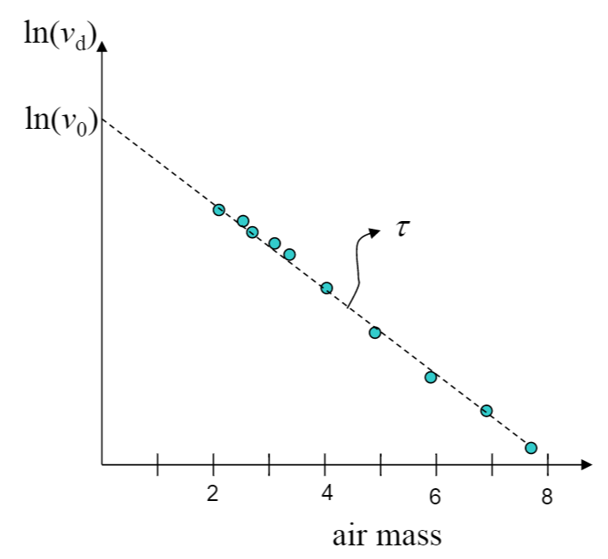
Calibrating the radiometer by plotting voltages
The solar irradiance correlates to the detector’s voltage
$E ∝ v_{d} ∴ v_{d}= v_{0}e^{−τ\sec\left(θ_{z}\right)}$
$\ln\left(v_{d}\right)=\ln\left(v_{0}\right)−τ\sec\left(θ_{z}\right)$
$\ln\left(v_{0}\right) ∝ E_{0}$
$τ = optcal depth$
$\sec\left(θ_{z}\right) = air mass$
*
* Gracias to Joe Shaw for the figure
Notes:
-it is a linear equation of a line
-the y intercept is the exo-atmospheric irradiance
-the slope is the optical depth.

Slide 11
Brief Explanation of LEDs
Conduction Band
N-type
Valence Band
P-type
Notes:
-Semiconductor (Gallium Nitride)
-Electroluminescence
-Band Gap determines color

Slide 12
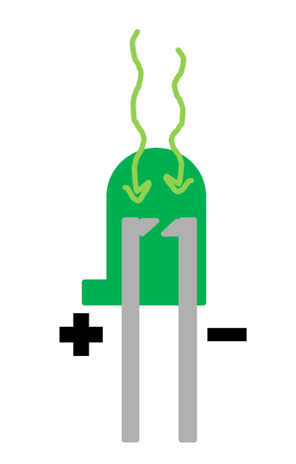
How LSDs work
Light. Sucking. Diode.
Notes:
-Electron excited into Conduction zone
-Of no Effect unless charge is running through
-The injection current doesn’t reach the threshold to emit light

Slide 13
Solar Radiometer in a nutshell
Reading from voltmeter
Reading from voltmeter
Notes:
We hook up a source and are then able to measure the output.

Slide 14
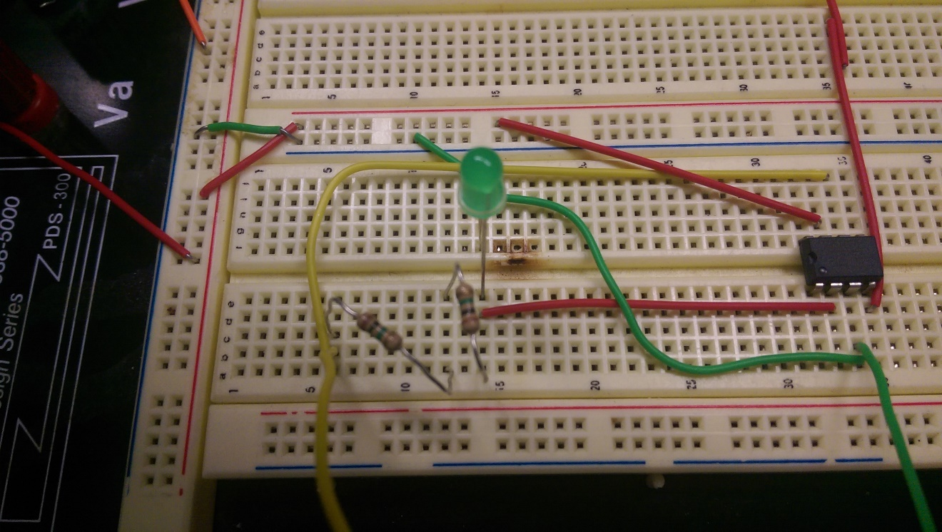
Radiometer circuit set up
Circuit diagram created by Forrest M. Mims III http://haze.concord.org/spworks.html

Slide 15
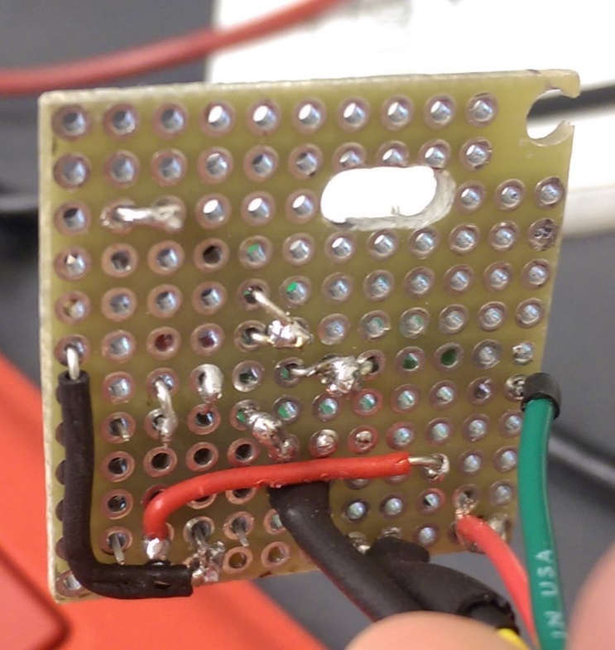
Building and testing the circuit
Difficulty level: 3
Difficulty for Logan: 5.4
(difficulty scale is logarithmic)
The trouble turned out not to be a wire connection, as I thought, but this little guy here.

Slide 16
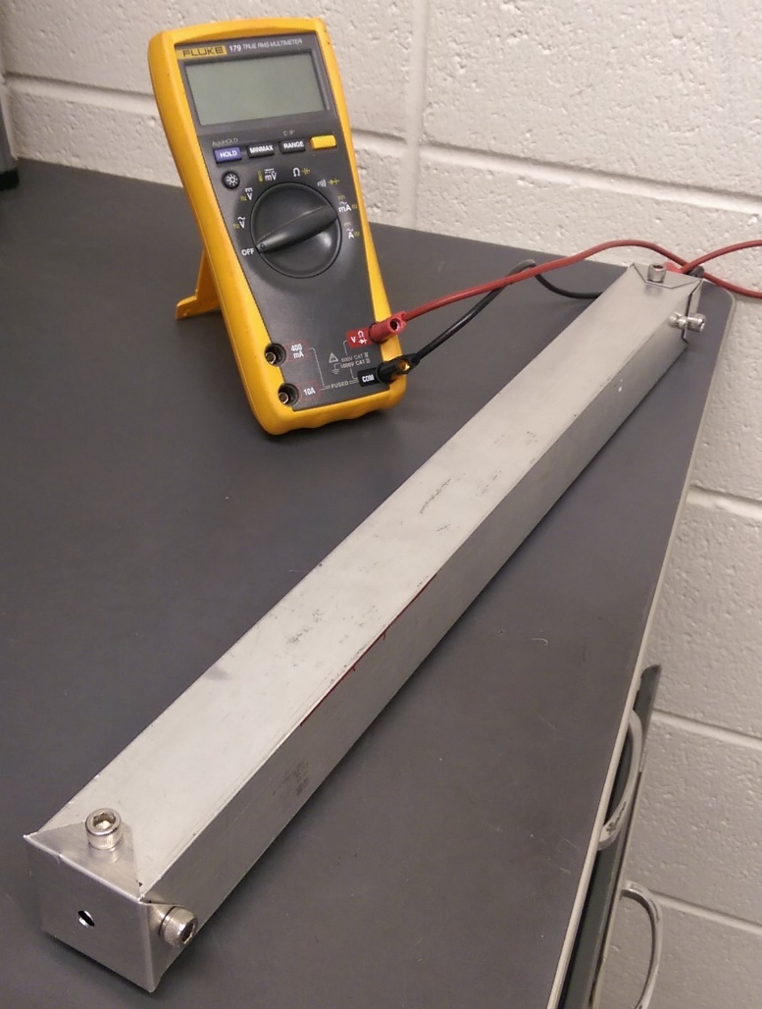
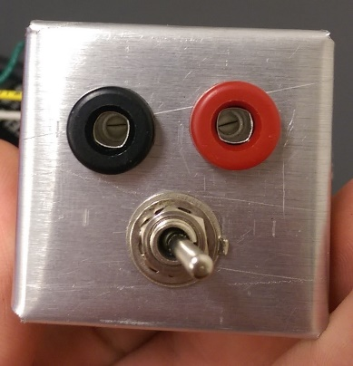
Making the casing to hold the radiometer
Battery and circuit board holder
Control switch
Final product

Slide 17
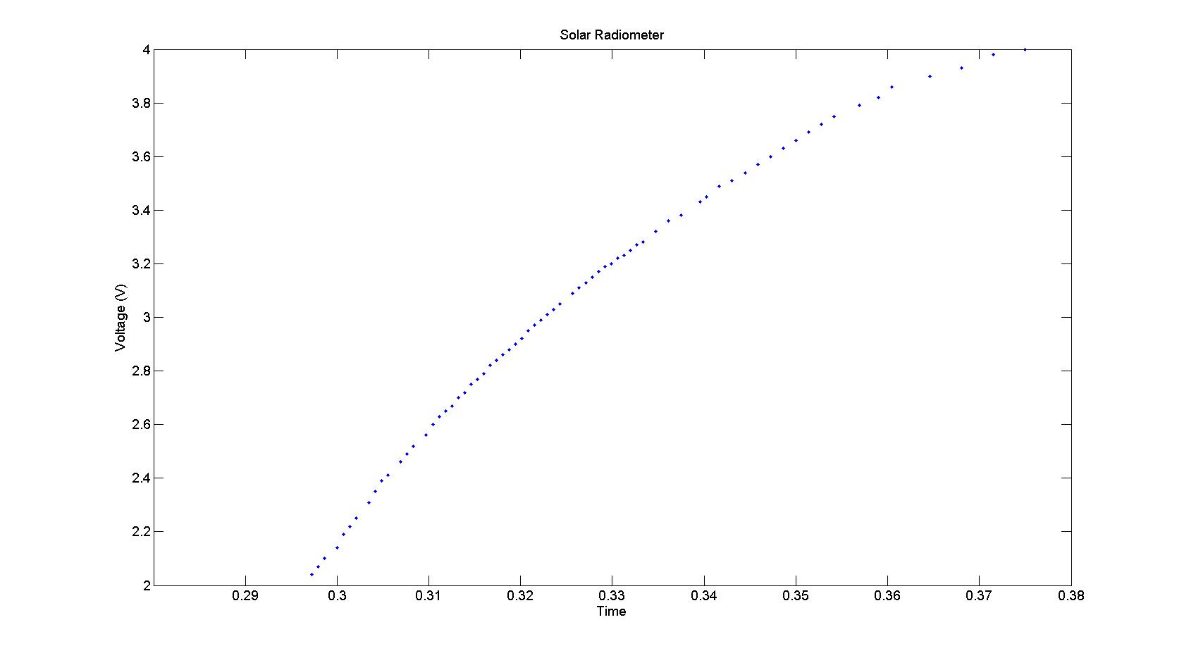
Taking Readings
Pic of Voltage vs Time

Slide 18
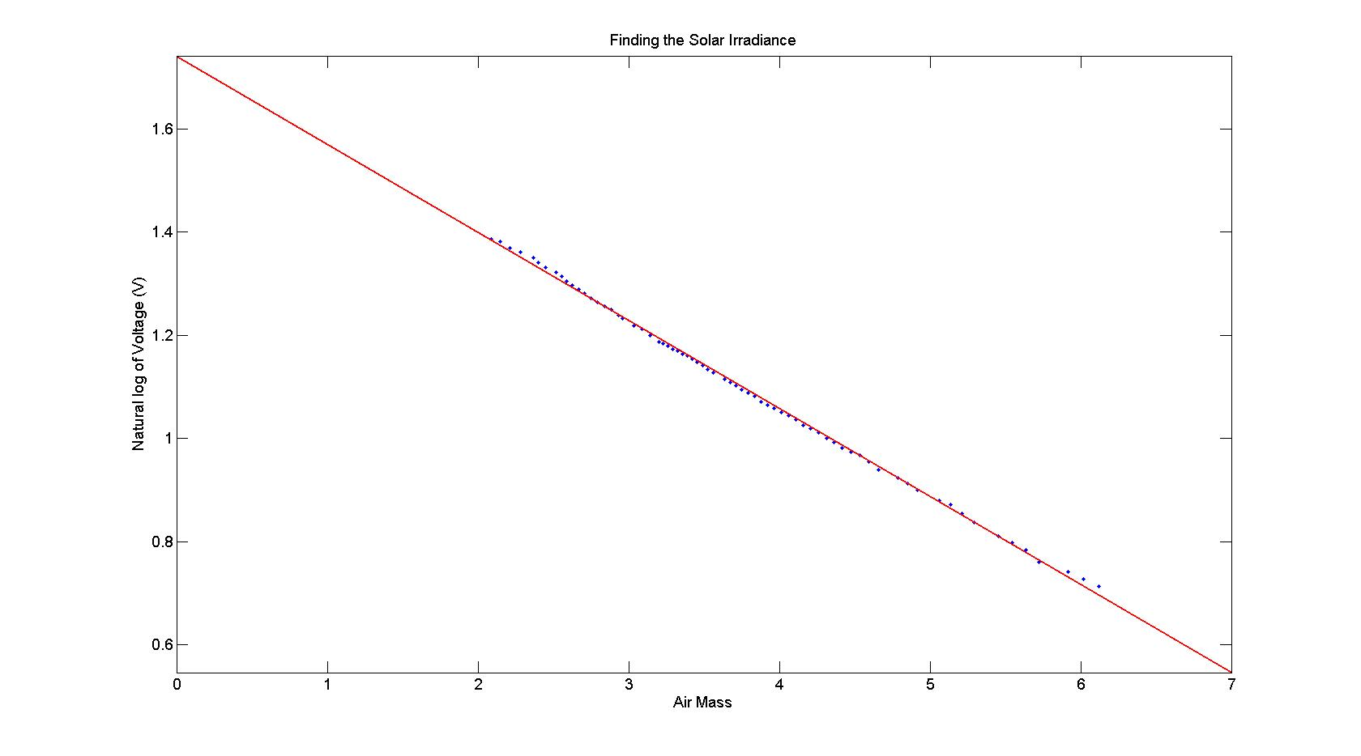
Calibration
Picture of log(voltage) vs air mass

Slide 19
Calculating the Optical Depth
$$\frac{y_{1}−y_{2}}{x_{1}−x_{2}}= τ$$
$\frac{1.74−.05462}{0−7}= −0.170543$ = optical depth
$e^{y_{1}}$ $=$exo-atmospheric reading
$e^{1.74}= 5.697 V$

Slide 20
Future Work
Calculate the spectral irradiance for the wavelengths of the LED.
Calculate different optical depths.

Slide 21
Acknowledgements
Thanks to Joe Shaw for teaching us about atmospheric optics and helping through the whole process.
Thanks is also due to Joe’s grad students, Dave and Paul, who helped us on a day to day basis.

Slide 22
Questions? 質問? Preguntas? 问题? Perguntas? الأسئلة?

