Slide 1
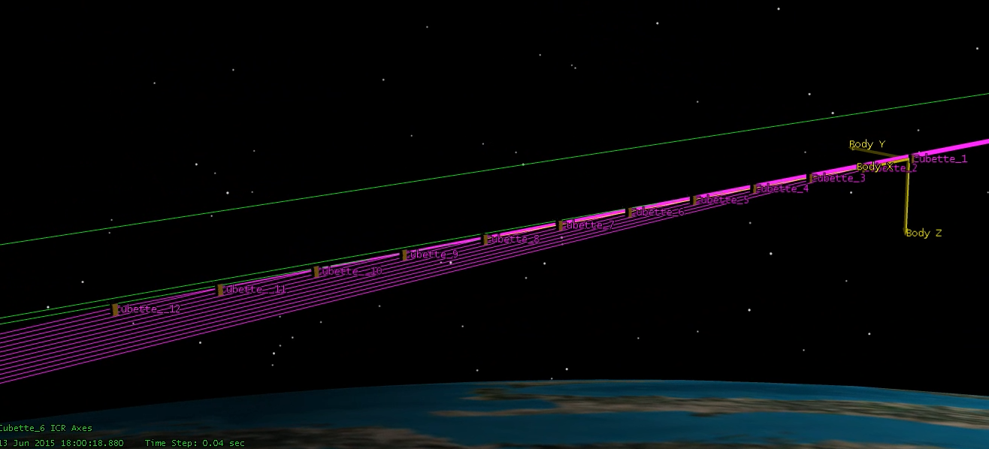
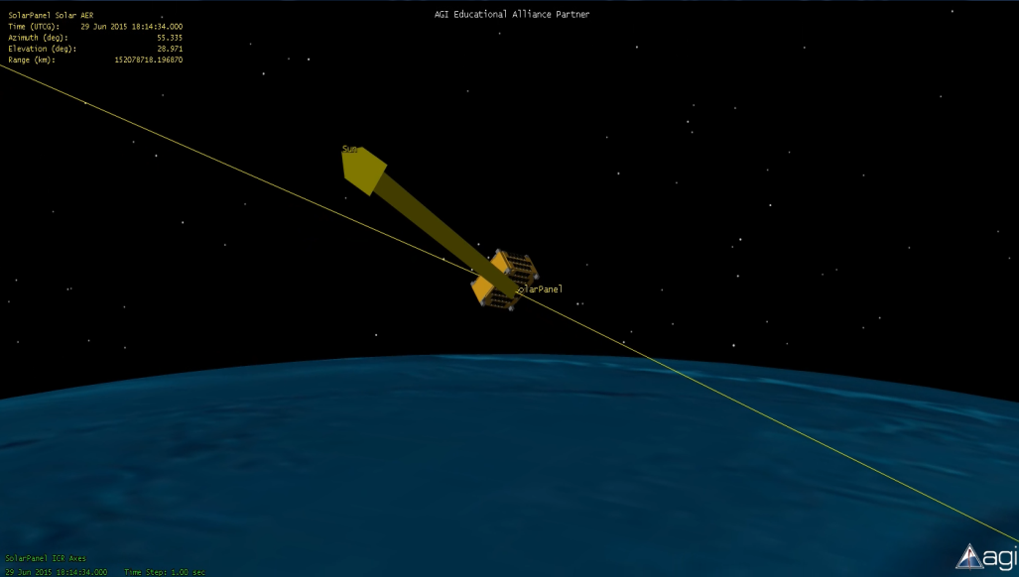
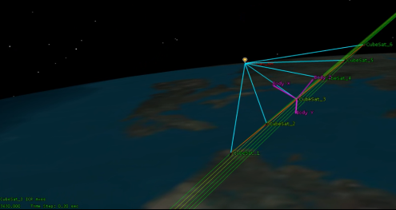
Space Weather and Radiation Multi-point Magnetometry (SWaRMM): Cube Satellite Mission Design Study
Tyler Croteau
MSU Solar Physics REU: SSEL
Mentor: Dr. Klumpar

Slide 2
Outline
Introduction to CubeSats
Mission Focus
Mission Science
Mission Concept Characterization
Orbit analysis
Structure
Budget Estimates
Command and Data Handling
Attitude Determination and Control
Outcomes

Slide 3
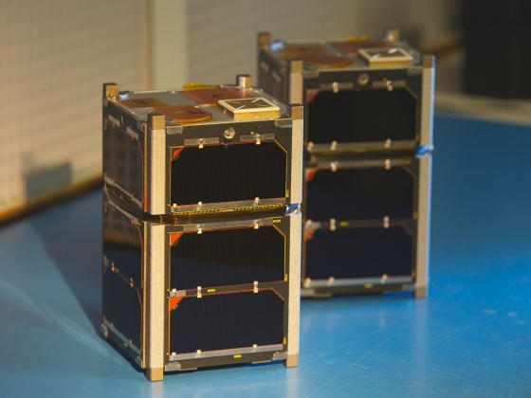
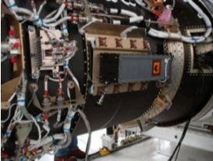
CubeSat Introduction
Class of Nanosatellite
1U: (10x10x10 cm)
2U: (20x10x10 cm)
3U: (30x10x10 cm)
Deploy from P-POD
Low Earth Orbit (LEO)
Science and space
weather applications
MSU’s FIREBIRD 3 and 4
P-POD Mounted to Minotaur Launch Vehicle

Slide 4
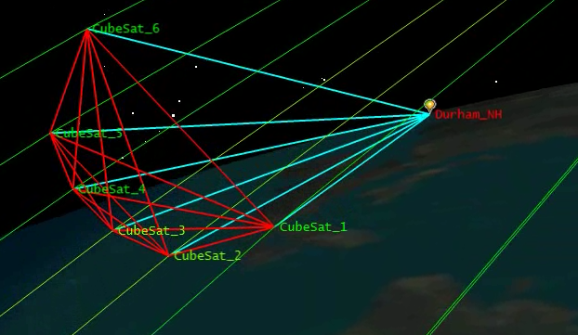
SWaRMM Mission
Primary Objective: Conduct space weather science that requires multipoint measurements
Electromagnetic Ion Cyclotron (EMIC) waves at high latitude
Boom deployed mini fluxgate magnetometer
Secondary Objective: Demonstrate the capabilities of a swarm of 0.5U CubeSats
Uncommon
Low Cost
Low Power

Slide 5
EMIC Waves
Magnetosphere
Plasma instabilities
Energy from anisotropic protons (0.1-5 Hz)
transferred from particles to waves when gyrofrequency matches Doppler shifted wave frequency
Amplification based on time of propagation through finite growth region
Multipoint measurements
Reduction in density of magnetic field in propagation region
Off-equator local minimum magnetic field regions not yet been extensively studied

Slide 6
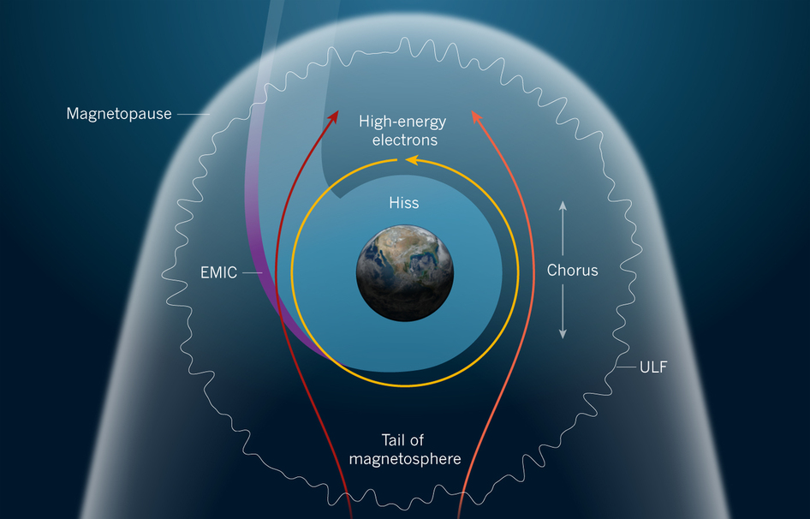

Slide 7
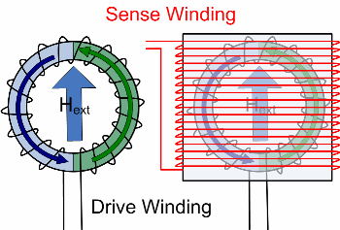
Fluxgate Magnetometer
2 half cores of ring with 2 coil windings
Current flows through windings
No External field
Cores saturate at same
time
External Field
Core fields do not cancel
and induce voltage
Notes:
1 half core generates field in same direction as the external field while the other generates in the opposite

Slide 8
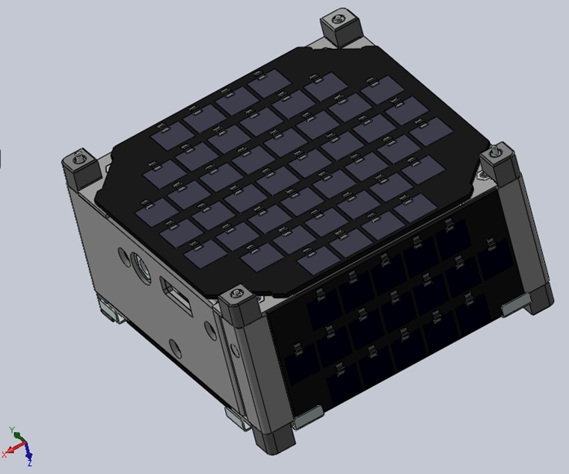
Structure
0.5U Size (5x10x10 cm)
650 grams per CubeSat
6 units in one PPOD
Utilize MSU Flight Heritage
FIREBIRD 3 and 4
ICE
(1x1 cm) Solar Cells
0.5U SolidWorks Rendering

Slide 9
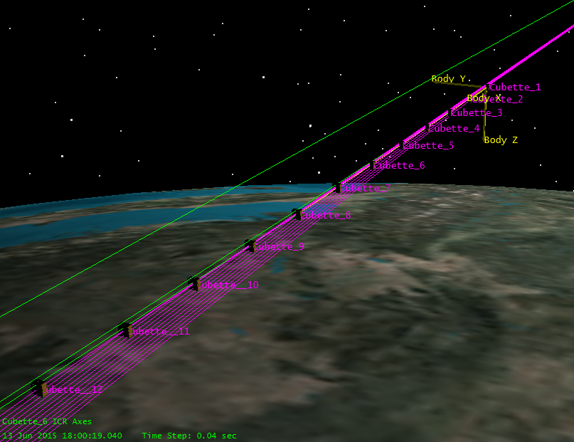
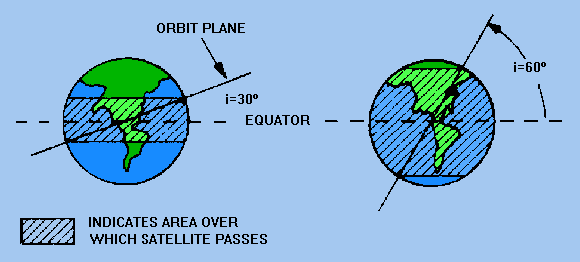
Swarm Design and Orbit Analysis
String Of Pearls
Slow Separation
Linear Orbit dynamics
allows passively
stable formation flying
Constraints
6-12 0.5U CubeSats
400-600 km circular LEO
High latitude
inclination 60-80 deg
STK 12 Sat Deployment
Orbit Inclination

Slide 10
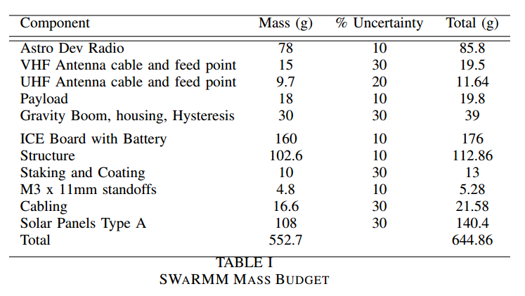
Mass Budget
Must be < 650g/CubeSat
Scaled from FIREBIRD flight heritage
5.14g reserve with worst case uncertainties

Slide 11
Electrical Power System (EPS)
Primary: Space rated Photovoltaics
Secondary: Lithium Ion
3.3V regulated power
Direct energy transfer from solar cells
94.6 min Orbital Period
Assume 0.65 sunlit orbit fraction = 61.5 min sunlight/orbit

Slide 12
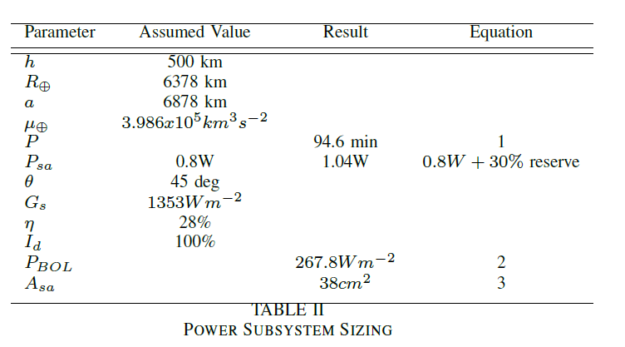
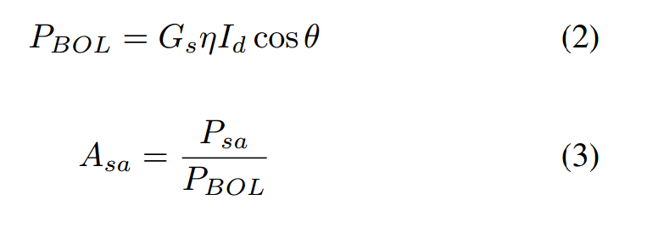
EPS Sizing
Need 1.04W average solar array power

Slide 13
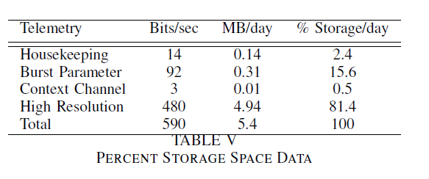
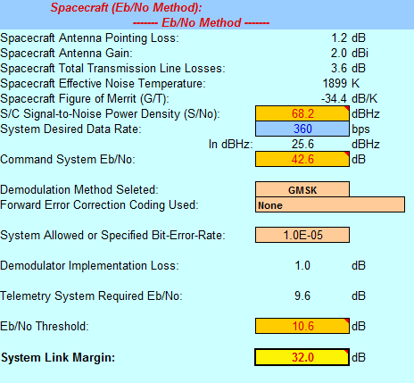
Command and Data Handleing (C&DH)
5Hz EMIC waves
10Hz sample rate
3 axis magnetometer:
16 bits per axis
Given 4GB of NAND-Flash
740 days without overwriting
data
Link Design
Feasibility of a radio link:
FIREBIRD flight heritage

Slide 14
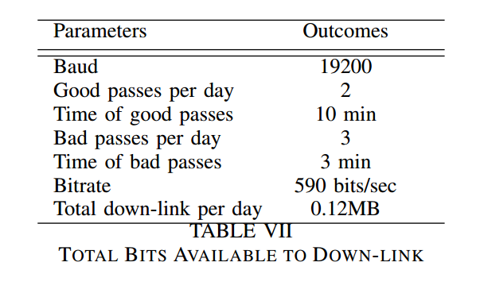
Downlink
Collect around 2%
total data per day
per CubeSat
Consider two ground
stations
Campaign Mode
Down-link Low-res data for event spikes before High-res

Slide 15
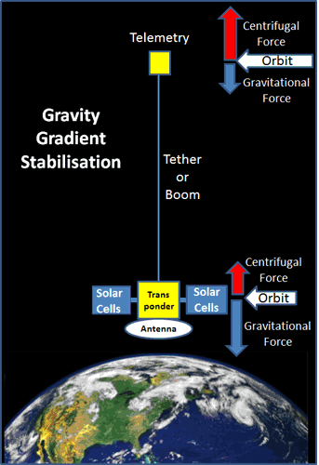
Attitude Determination and Control (ADCS)
Investigate gravity gradient
Tip mass on deployed boom
Nadir pointing aligned
with max moment of inertia
Hysteresis rods
Dampen gyration

Slide 16
Conclusions
6 CubeSat 0.5U Constellation: Feasible
Investigate Further
EPS and solar panel alternatives
ADCS gravity gradient options

Slide 17
Acknowledgments
Dave Klumpar - Advisor
Keith Mashburn – SSEL Systems Engineer
Kevin Zack – SSEL Grad Student
Matthew Handley – SSEL Grad Student
All of the SSEL team
References
[1]Maria de Soria-Santacruz, Electromagnetic Ion Cyclotron (EMIC) Waves for Radiation Belt Remediation Applications, Space Propulsion Laboratory, MIT, 2015.
[2] Wiley, Observing the Birkeland currents, ScienceDaily. ScienceDaily, 6 October 2014.
[3] Wertz, J.R., and Larson, W.J., Space Mission Anaylsis and Design, 3rd ed., Microcosm, El Segundo, CA, 1999, pp. 353-518.
[4] Electdom Matandirotya, and Robert R. Van Zyl, Evaluation of a Commercial-Off-the- Shelf Fluxgate Magnetometer for CubeSat Space Magnetometry, JoSS, Vol.2, No.1, pp. 133-146.
[5]Erich Bender, An Analysis of Stabilizing 3U CubeSats Using Gravity Gradient Techniques, California Polytechnic State University, San Luis Obispo, 2011, pp. 1-24.
[6] David T. Gerhardt, Passive Magnetic Attitude Control for CubeSat Spacecraft, University of Colorado, Boulder, CO, 24th Annual AIAA/USU SSC10.

Slide 18
Questions

