Slide 1
Space Engineering Mission Design: CubeSat Swarm
Tyler Croteau
MSU Solar Physics REU: SSEL
Mentor: Dr. Klumpar

Slide 2
Outline
Introduction to CubeSats
Mission Focus
Introduction to Mission and Design Process
Mission Concept Characterization
Orbit analysis
Budget Estimates
Link design
Communication Architecture
Timeline

Slide 3
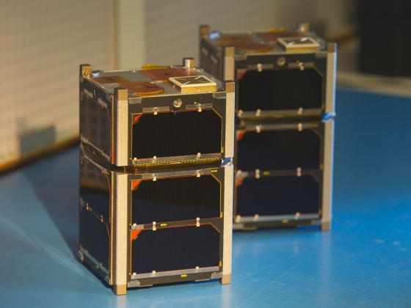
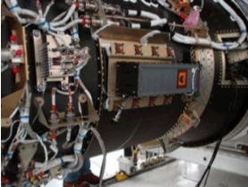
CubeSat Introduction
Class of Nanosatellite
1U: (10x10x10 cm)
2U: (20x10x10 cm)
3U: (30x10x10 cm)
Deploy from P-POD
Low Earth Orbit (LEO)
Science and space
weather applications
MSU’s FIREBIRD 3 and 4
P-POD Mounted to Minotaur Launch Vehicle

Slide 4
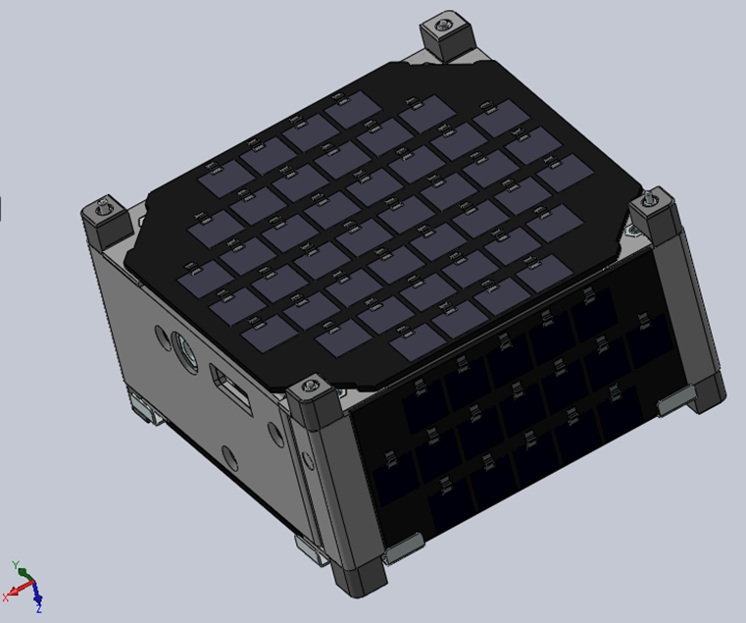
The Mission: CubeSat Swarm
Primary Objective: Conduct space weather science that requires multipoint measurements
Electromagnetic Ion Cyclotron (EMIC) waves at high latitude
Boom deployed magnetometer
Secondary Objective: Demonstrate the capabilities of a swarm of 0.5U CubeSats
Uncommon
Low Cost
Low Power
0.5U SolidWorks Rendering

Slide 5
Introduction to Mission Design
Define Objectives
Preliminary Estimates
Functional: Orbit, Power
Operational: Data, Link, Communication architecture
Constraints: Costs
Characterization and Alternatives
Trade Studies
Produce Budgets
Select Design for Proposal

Slide 6
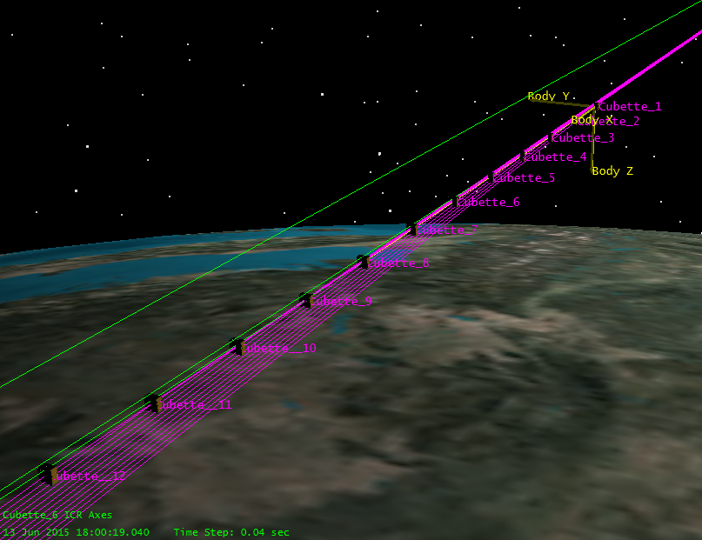
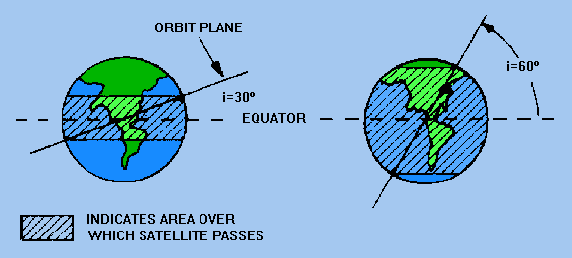
Swarm Design and Orbit Analysis
String Of Pearls
Slow Separation
Linear Orbit dynamics
allows passively
stable formation flying
Constraints
6-12 0.5U CubeSats
400-600 km circular LEO
High latitude
inclination 60-80 deg
STK 12 Sat Deployment
Orbit Inclination

Slide 7
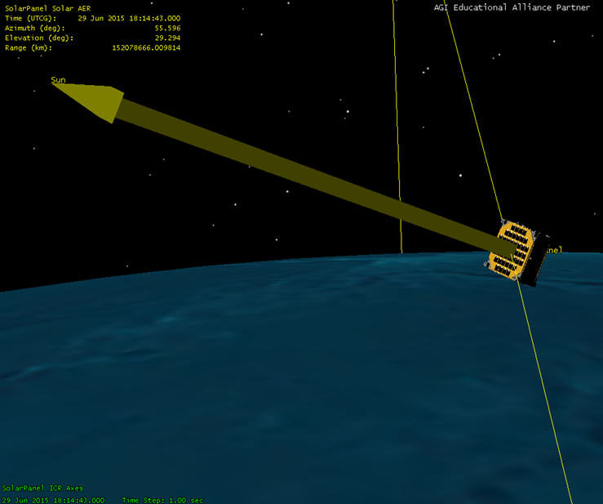
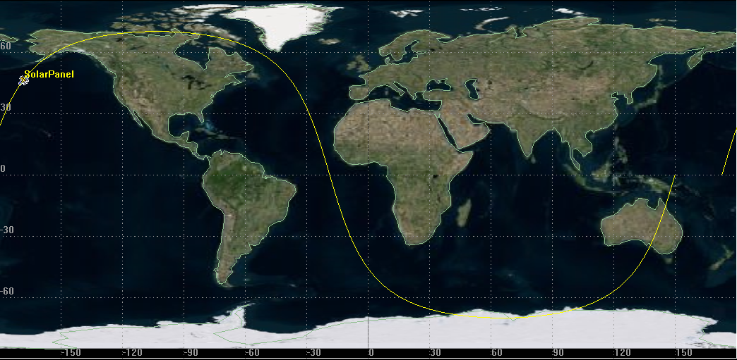

Slide 8
Preliminary Budgets
Assumptions
0.5W payload
Fluxgate Magnetometer
10 Hz sample rate
Range of EMIC events
12 bit measurements
Want 30 measurements/sec
=360 bits/sec

Slide 9
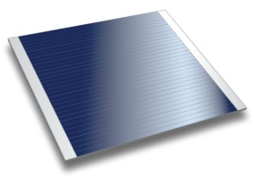
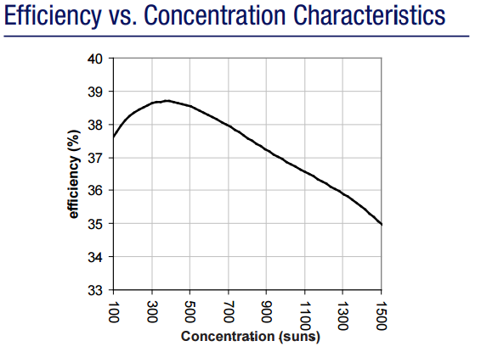
Power Budget
Orbit Average Power (OAP) – Average Power Used
In general OAP = 60% *(Power from one panel)
1x1cm cells at 37% efficiency
1361W/m^2*(0.37)*(0.0044m^2) = 2.2W
1361W/m^2*(0.37)*(0.0017m^2) = 0.85W
SolAero CTJ Cell
CTJ Photovoltaic Cell Characteristics
STK Solar Panel Tool Model

Slide 10
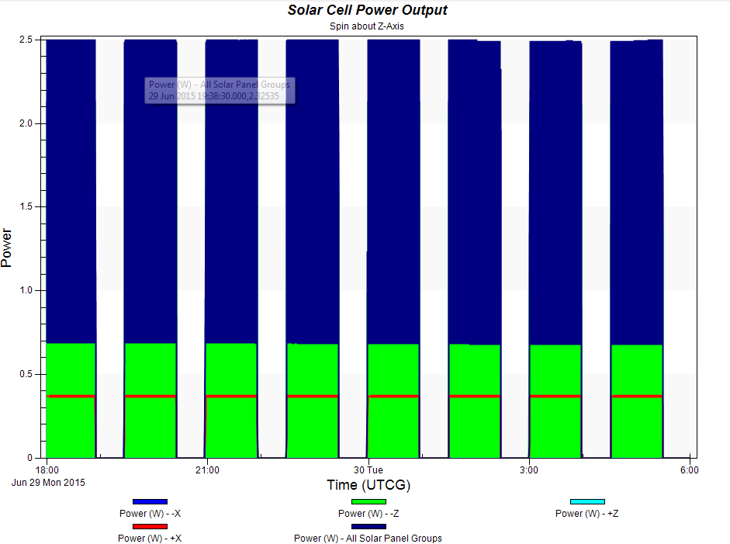
Comparison to STK:
%60 of 2.2W – 0.7 W = 600 mW
%60 of 0.85W – 0.4W = 100 mW
Estimated Budget:
2.5W – 0.5W = +2W

Slide 11
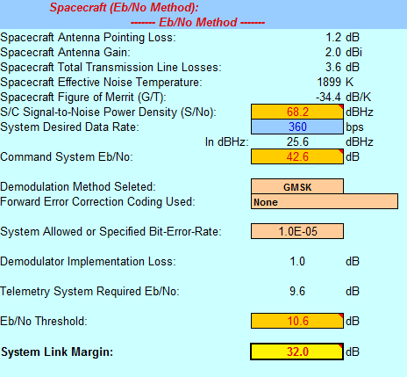
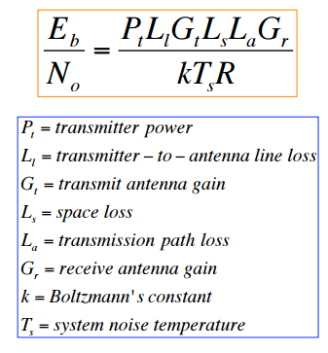
Link Design
Determine feasibility of a radio link
Relationship between data rate, antennae size, propagation path length, transmitter power
Defined by Link Budget:

Slide 12
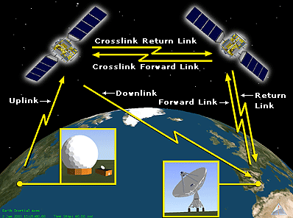
Communications Architecture
Individual ground station relays Vs. Crosslink communications
Trade Studies:
Link distance
Vs. Link bandwidth
Frequency
Vs. Number of contacts
Short range wireless
Vs. Long range crosslinks
Prefer individual autonomous satellites

Slide 13
Timeline
Mission Focus
Orbit Analysis
Budget Characterization
Power
Link
Data
Telemetry
Mass
Trade Studies
Proposal
Complete
In Progress
Not Started

Slide 14
Acknowledgments
Dave Klumpar - Advisor
Keith Mashburn – SSEL Systems Engineer
Kevin Zack – SSEL Grad Student
Matthew Handley – SSEL Grad Student

Slide 15
Questions

Slide 16
Bonus Slides

Slide 17
EMIC Waves
Magnetosphere
Plasma instabilities
Energy from anisotropic protons (0.1-5 Hz)
transferred from particles to waves when gyrofrequency matches Doppler shifted wave frequency
Amplification based on time of propagation through finite growth region
Multipoint measurements
Reduction in density of magnetic field in propagation region
Off-equator local minimum magnetic field regions not yet been extensively studied

Slide 18
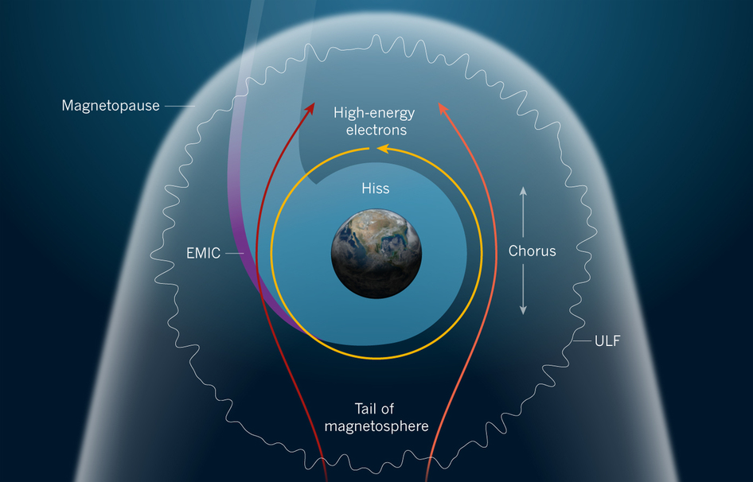

Slide 19
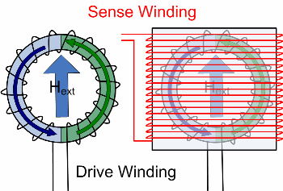
Fluxgate Magnetometer
2 half cores of ring with 2 coil windings
Current flows through windings
1 half core generates field in same direction as the external field while the other generates in the opposite
No External field
Cores saturate at same
time
External Field
Core fields do not cancel
and induce voltage

