Slide 1
FIREBIRD Science Overview
Marcello Ruffolo
Nathan Hyatt
Jordan Maxwell
2 August 2013
FIREBIRD Science

Slide 2
FIREBIRD
Focused Investigations of Relativistic Electron Burst Intensity, Range, and Dynamics
1.5-unit cube-satellite mission investigating relativistic electron microbursts
Two low-earth-orbiting satellites studying radiation belt dynamics

Slide 3
Fundamental Concepts
Radiation Belts
L-Shell
Electron Microbursts
Whistler-Mode Chorus
Radiation Belt Electrons
Loss Cone
Gyro-Resonant Interaction

Slide 4
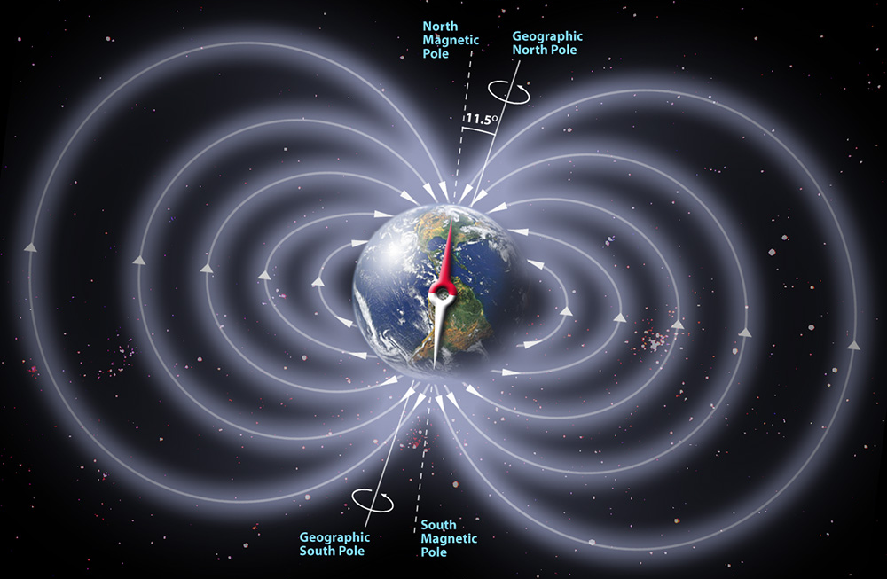
L-Shell
Magnetic field strength calculated using L-shell, location, and time

Slide 5
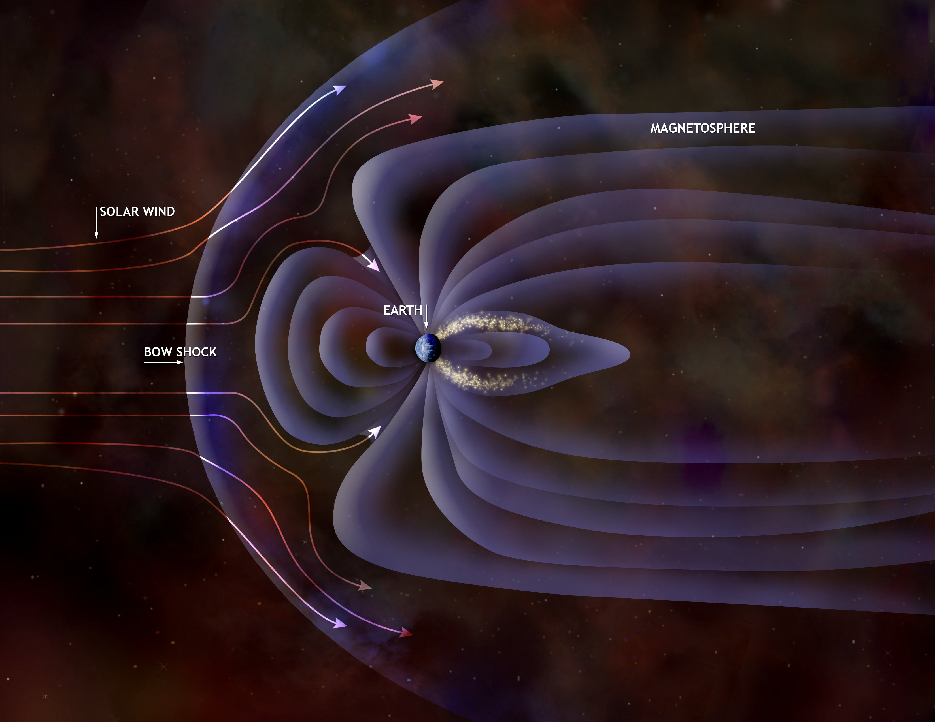
L-Shell

Slide 6
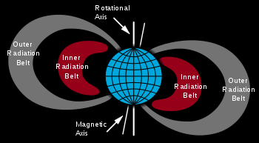
Radiation Belts
Bands of charged particles trapped in Earth’s magnetic fields
Inner belt from L=1.5 to L=2
Outer belt from L=4 to L=6

Slide 7
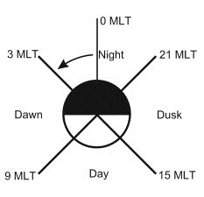
Magnetic Local Time
Measurement of time with axis about the magnetic pole

Slide 8
Electron Microbursts
Localized region of precipitating electrons
Lost from the Van Allen radiation belts and precipitate down onto the ionosphere (upper atmosphere)
Occur on a short timescale (~0.2s)
Observed predominantly from L=4 to L=6 in the morning sector (3MLT to 9MLT)
Believed to be correlated to chorus waves generated in the near equatorial region

Slide 9
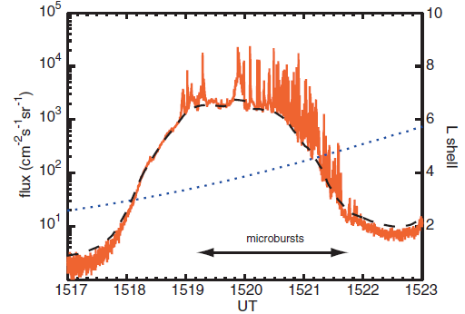
Electron Microbursts
May occur in trains ranging from 10s to several hours with ~0.5s spacing between bursts
Black-dashed line: Estimate of locally-trapped population
Blue-dotted line: Position in L-Shell
Orange spikes: Relativistic Microburst events

Slide 10
Whistler-Mode Chorus
Bursts of very-low frequency (VLF) electromagnetic emissions
Propagate within plasma in radiation belts
Frequencies range from hundreds of Hz to several kHz
Timescale of ~1s, but may occur in trains
Train timescales match those of microbursts
Right-hand polarized (RHP) waves

Slide 11
Whistler-Mode Chorus

Slide 12
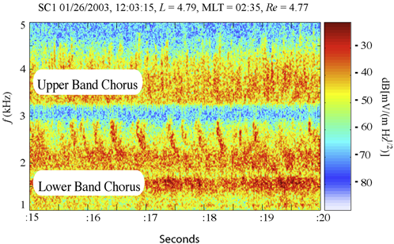
Whistler-Mode Chorus
Chorus appears in two bands
Upper-Band Chorus
Lower-Band Chorus
Correlation with energy bands of microbursts
Bell et al 2009

Slide 13
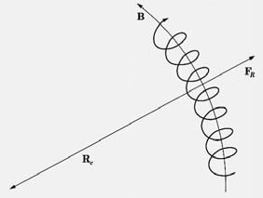
Radiation Belt Electrons
Electrons have right-hand cyclotron motion about field lines
Cyclotron frequency:
Electrons >1 MeV are relativistic:

Slide 14
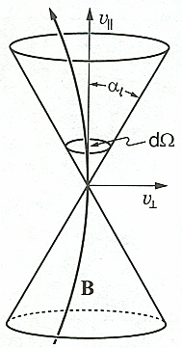
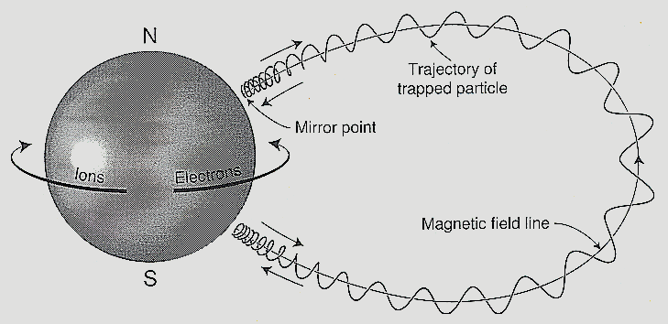
Loss Cone
Shape in velocity space
Represents probability that electrons will precipitate off the magnetic field lines
Dimensions determined by angle between velocity and magnetic field lines (pitch angle)
Condition for a loss cone:
Where is measured on a specific
L-shell
Pitch angle:

Slide 15
Gyro-Resonant Interaction
Interaction between radiation-belt electrons and whistler-mode chorus waves
Conditions for interaction
Wave frequency equals electron gyro-resonant frequency
Wave frequency less than electron cyclotron frequency
Requires that wave and electron be travelling toward each other, so that Doppler-shift can allow for comparable frequencies
Wave and electron must be similarly polarized
Whistler-mode chorus and electron cyclotron both RHP

Slide 16
Gyro-Resonant Interaction
Gyro-resonant interaction scatters electron pitch angles
Some electrons have low enough pitch angles to enter loss cone and precipitate into ionosphere
This precipitation is an electron microburst
Most accepted theory

Slide 17
FIREBIRD Mission
The FIREBIRD mission consists of two satellites operating simultaneously to answer the following:
What is the spatial scale size of an individual microburst?
What is the energy dependence of an individual microburst?
How much total electron loss from the radiation belts do microburst's produce globally?

Slide 18
Spatial Scale Size
Multi-point measurement required to determine spatial scale size
FIREBIRD payloads separate at ~8 cm/s
Current orbital scenarios estimate payloads will exceed 150 km (a landmark value mentioned in the FIREBIRD proposal) after about 2.5 months
GPS coordinates resolved with science data will provide estimates of spatial scale size

Slide 19
Energy Dependence
Lower energy bursts (tens to hundreds of keV) can resonate at the equator with whistler-mode chorus waves
Higher energy bursts typically occur between 60º- 66º latitude
Energy of microburst's correlated with chorus bands.

Slide 20
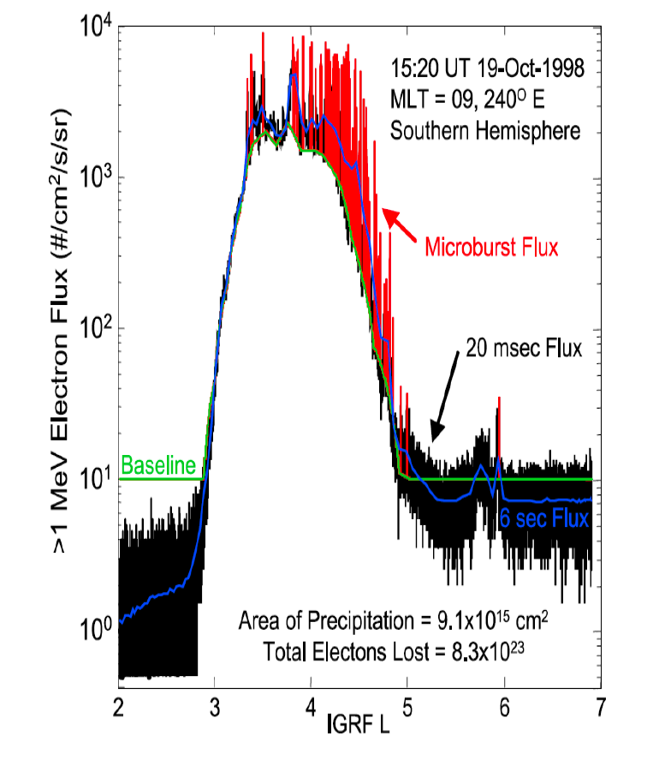
Global Electron Loss
Use data from RBSP and BARREL to complement FIREBIRD
Microbursts are believed to be a primary loss mechanism of radiation-belt electrons

Slide 21
Global Electron Loss
Remove charged particles from the radiation belts
Various mechanisms
Microbursts
General precipitation
Other less prevalent mechanisms (account for small percentage of loss)

Slide 22
Why do we care?
Fill in gaps in understanding of radiation-belt phenomena
Strengthening correlation between EMBs and whistler-mode chorus
Enhancing conclusions drawn by past and present satellite missions by providing missing information
Educational opportunity for students involved

Slide 23
Questions?

