Slide 1
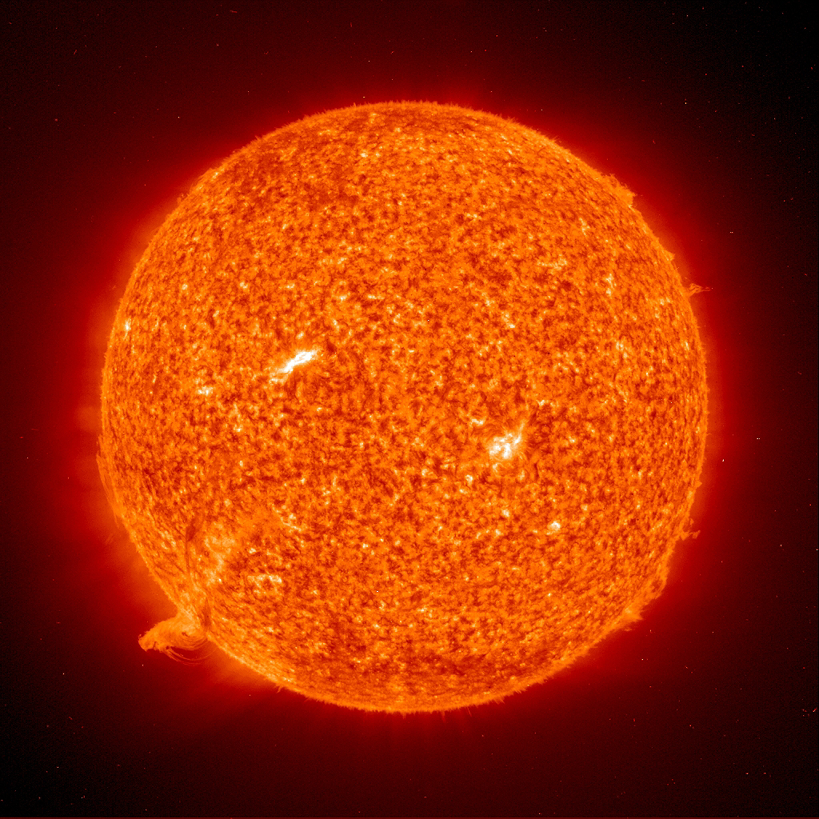
Explosive Events in the Quiet Sun
Extreme Ultraviolet Imaging Spectroscopy
Instrumentation and Observations

Slide 2
Abstract
Transition Region Explosive Event (EE) is the name for large spectroscopic velocities observed in extreme ultraviolet emission lines formed between 50,000K and 500,000K in the solar atmosphere. Thought to be powered by magnetic reconnection, they may contribute to the mass and energy balance of the hot solar corona. Understanding of these transient events is hampered by lack of rapid, high resolution combined spatial and spectral measurements. We present EE observations and analysis from the Multi-Order Solar EUV Spectrograph (MOSES) that open the door for true high speed imaging spectroscopy in the solar transition region.

Slide 3
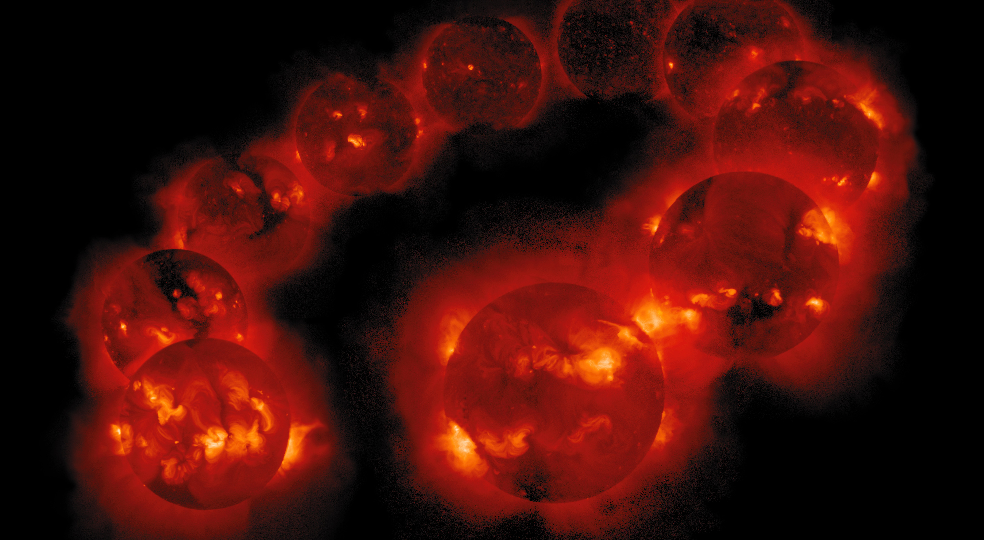
The coronal heating problem
Dissipation of magnetic energy
Active Sun
  Active Regions
Quiet Sun
  ??
Notes:
X-ray (HOT!) emission
Solar Cycle 11 year peak to peak

Slide 4
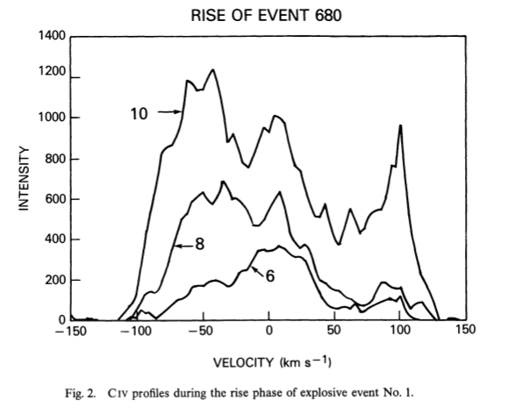
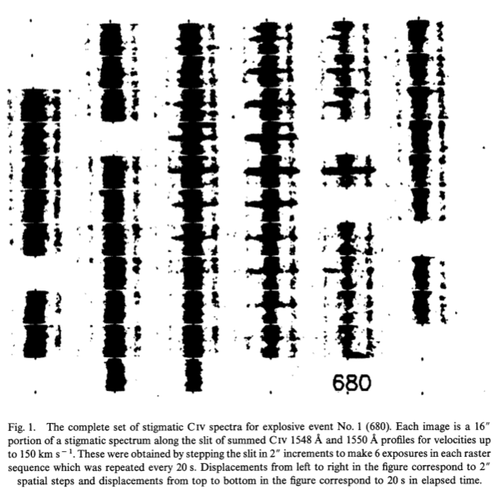
High Resolution Telescope and Spectrograph Observations
Small explosions at the base of the corona
Supersonic spectroscopic velocities
Average Properties:
  100 km/s
  2” (1500 km)
  60 s lifetimes
  600 s⁻¹ birthrate
Dere 1989
CIV λ1550
logT = 10⁵
Notes:
At log T = 10^5,

Slide 5
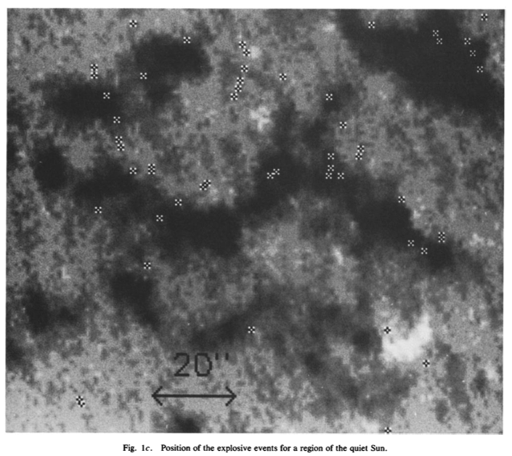
HRTS Observations
HRTS EEs lie on the boundary of the quiet
sun magnetic network
Dere 1991
Associated with changes in photospheric magnetic flux
Likely powered by magnetic reconnection
Notes:
The picture here is

Slide 6
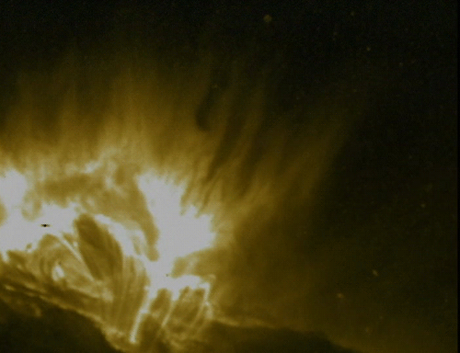
Magnetic Reconnection
Converts magnetic energy to plasma mechanical energy
A little hard to see in
the corona…
NASA/Goddard Space Flight Center
Scientific Visualization Studio - TRACE
Tom Bridgman
Notes:
Reconnection often associated with flares in active regions…
Terrible line of sight problems looking at dark things in a bright oprically thin medium…

Slide 7
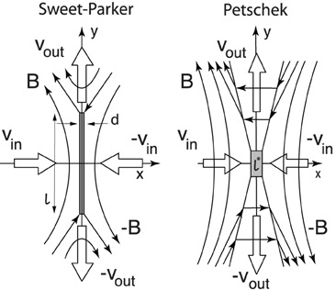
EE’s and reconnection
If EE’s are observational signatures of reconnection they have tremendous diagnostic value:
Density 10x greater in
TR, EM 100x greater.
EE’s extremely common
Parker 1957
Petschek 1964
Notes:
Rudolf A. Treumann^{1,2*} and Wolfgang Baumjohann³
Front. Phys., 31 December 2013
https://doi.org/10.3389/fphy.2013.00031

Slide 8
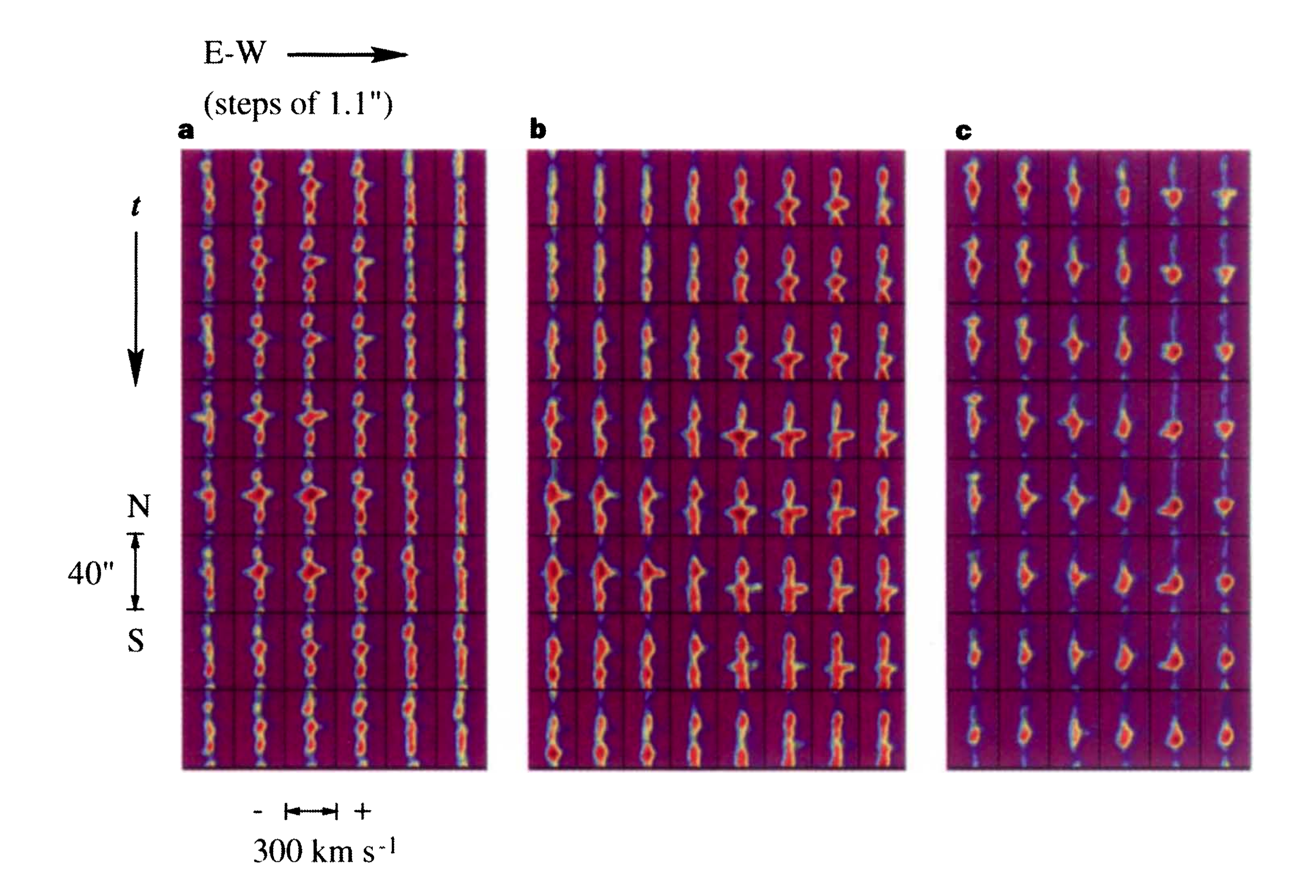
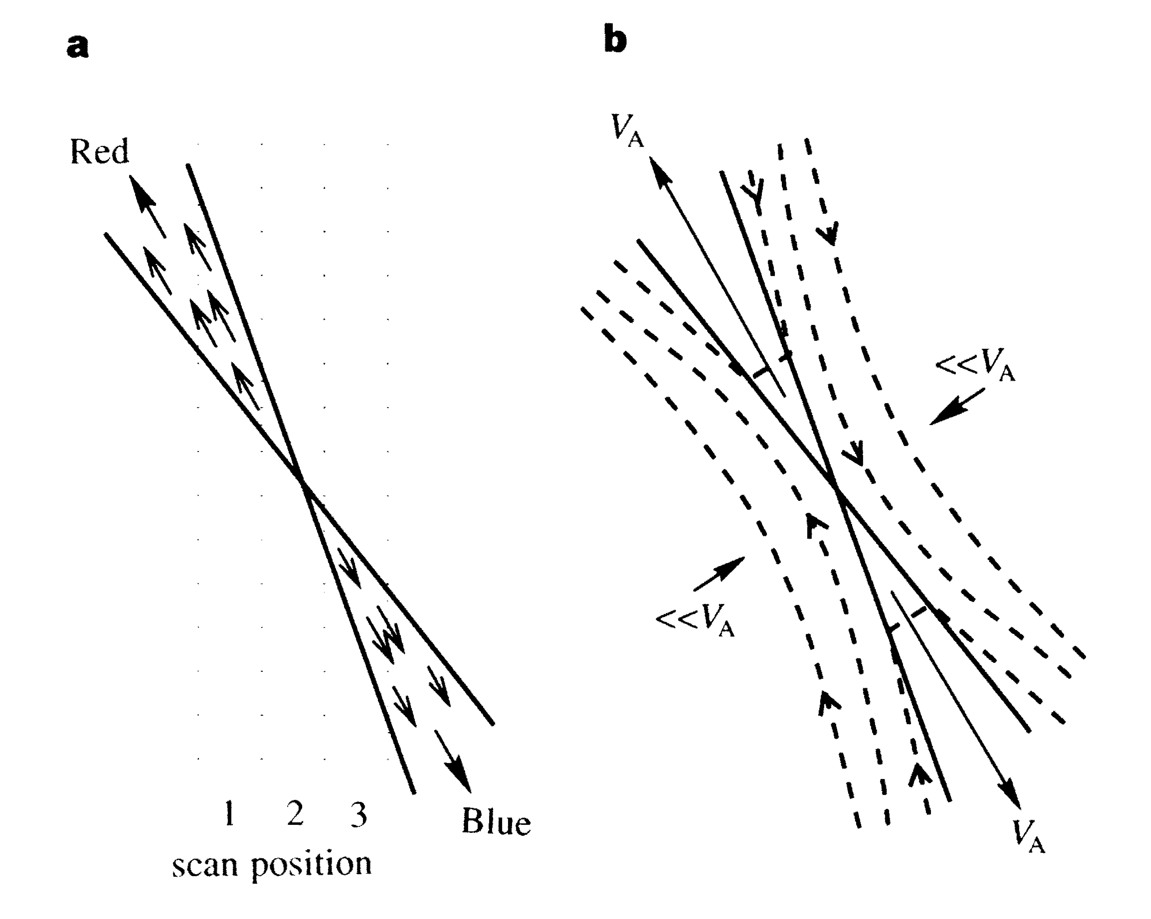
EE emission traces reconnecting field
Innes et. al. 1997
Notes:
The significance here is that authors assert that the plasma shows the field lines. Thus ee’s are direct observations of reconnecting field.
>Innes 1997 – Yes! Sort of…
>Slightly different than flares and BP’s – weak mixed polarity fields rather than bipolar fields.

Slide 9
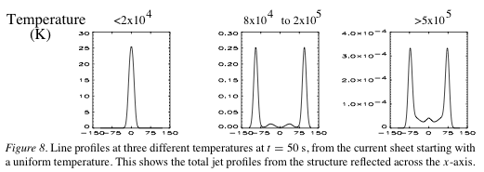
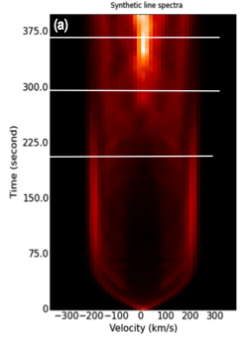
EE Reconnection Models
Innes and Toth 1999
  Petschek
  Bi Directional Jets,
  no core
Innes et al 2015
  Plasmoid instability
  Core dominates after initial
  period of bi directional jets
Notes:
Add points, or add another slide, regarding the fact that some line profiles show core brightening, and some do not.

Slide 10
Commentary on EE Observations
Ees are short lived. Problems with observation:
Although the results indicate a possible connection between
explosive events and intensity fluctuations in TRACE , we cannot
state that there is a one-to-one correspondence between the two
phenomena. Because of the poor time resolution of the SUMER
spectral scans, we were unable to follow an event from beginning
to end. For instance, the event shown in Figure 1 was imaged
by SUMER at the middle of the TRACE intensity fluctuation
(see Fig. 3a ). We have no way of knowing what the SUMER
spectrum would look like at the beginning of the event or whether
there was an explosive event that preceded the TRACE
brightening. Winebarger 2002
At the moment, the debate is still open as to where the primary energy in-put site is and can probably only be resolved by high resolution simultaneous spectroscopic imaging from the chromosphere to the corona. Innes n Teriaca 2012
Notes:
FIX THIS SLIDE UP!!

Slide 11
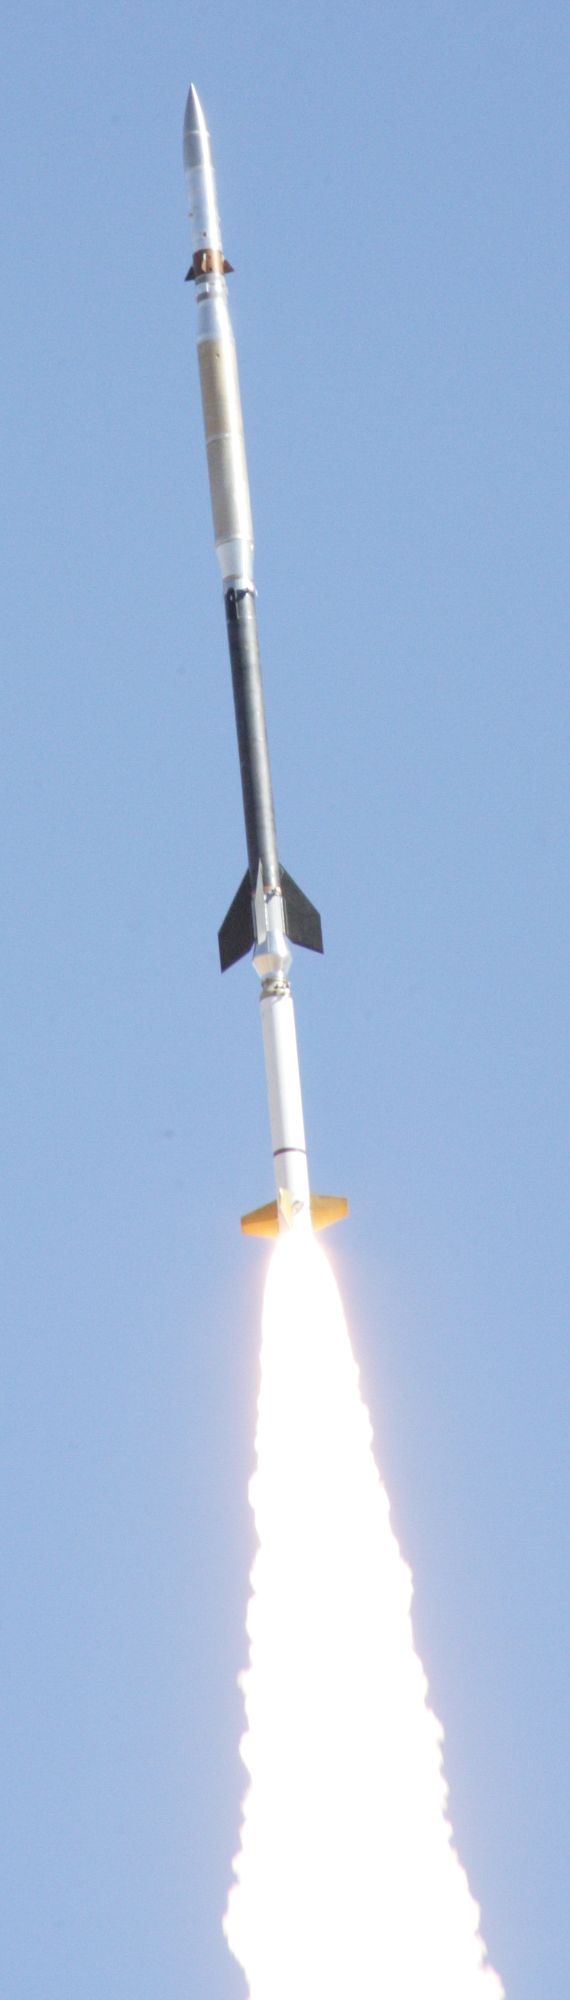
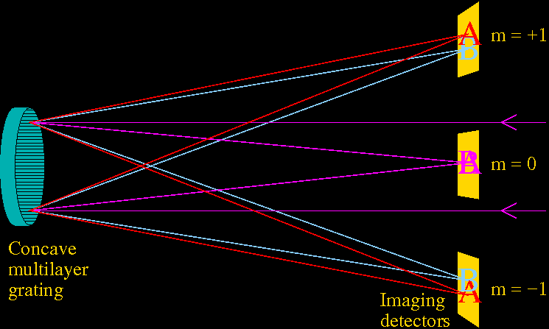
Multi-Order Solar EUV Spectrograph
(MOSES)
Imaging spectrograph designed to measure spectra in a single snapshot over a wide FOV
Notes:
1.) Sounding Rocket Mission
2.) m=0 is total intensity at all wavelengths, gives spatial location of emission.
3.) dispersed images show counts at location which depends on WHERE the emission came from, and the WAVELENGTH of the emission.
4.) Objects appearing at a different location in the dispersed orders relative to zero indicates off line center emission.
5.) Multilayer ideally restricts the passband to a single spectral line ➔ emission observed off line center is due to doppler shifts.

Slide 12
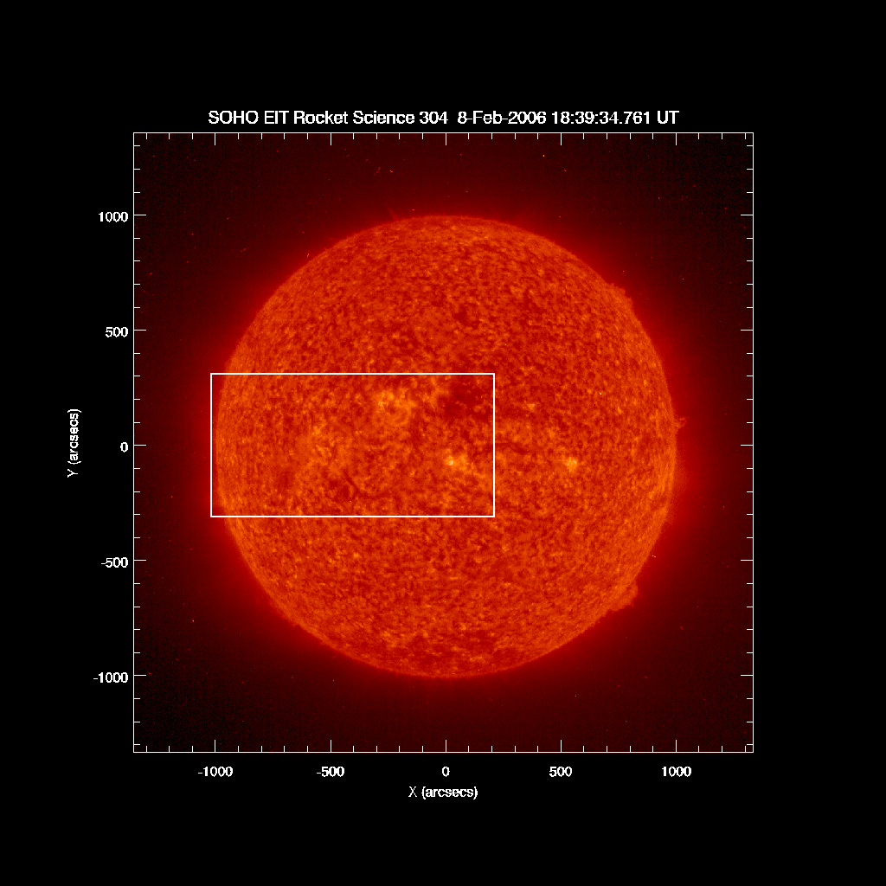
MOSES-I
February 8 2006
10’ x 20’
0.59” pixels
30 km/s/pix
Dispersion along x
30.4 nm

Slide 13
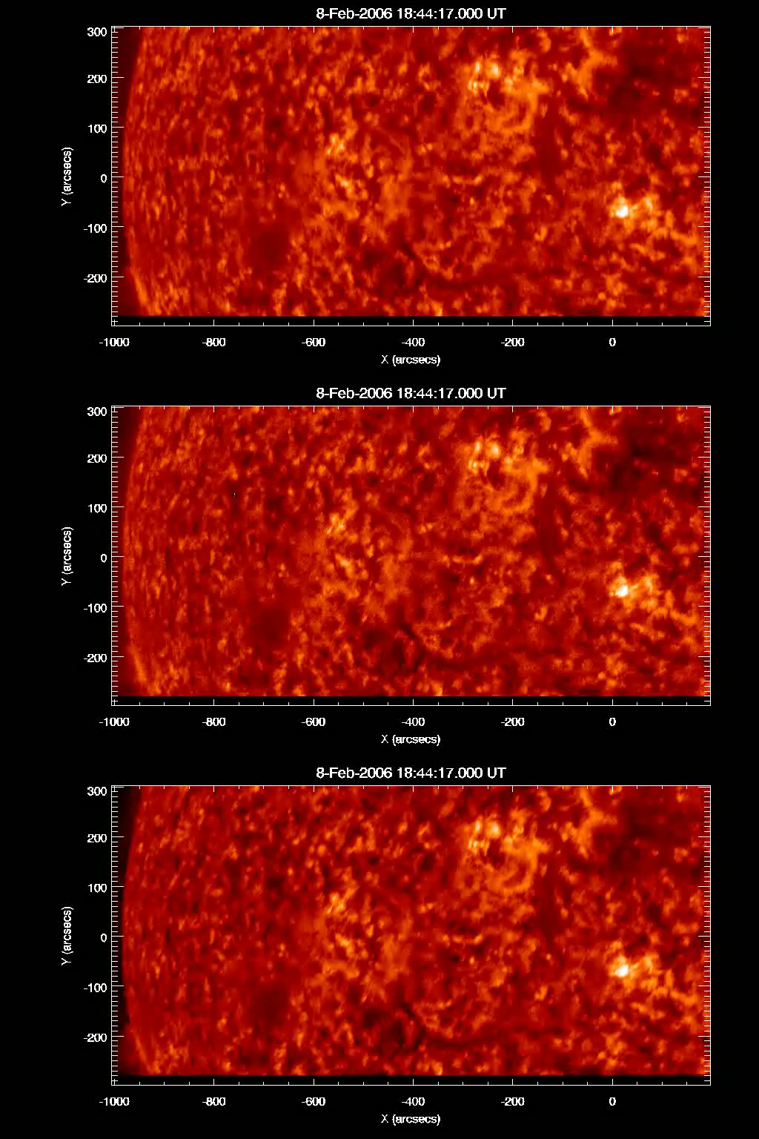
27 Exposures from 0.25-24 s
  Avg. cadence is
  ~ 10 s
m = +1
m = 0
Data Reduction
Dark Subtraction
Flatfield
Coregistration
m = -1
Notes:
0.)Change this movie: color scheme? Apple Universal?
0’.)These imges are log scaled. Black regions are missing data.
1.) Coregistration of the dispersed images to the m=0 image ensures that line center emission appears in the same pixel in each image.
2.) Now we go looking for compact sources with disparity between dispersed and non dispersed intensities.

Slide 14
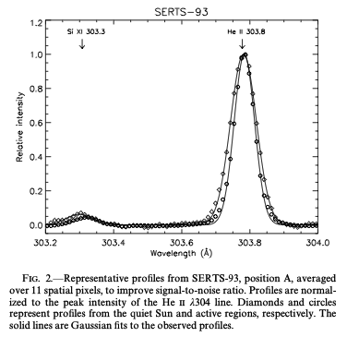
He II λ304 Spectral Line
log T = 4.9
v_{T} = 13 km/s
(1 sigma)
Andretta et. al.
2000
Notes:
He II anomalous intensity

Slide 15
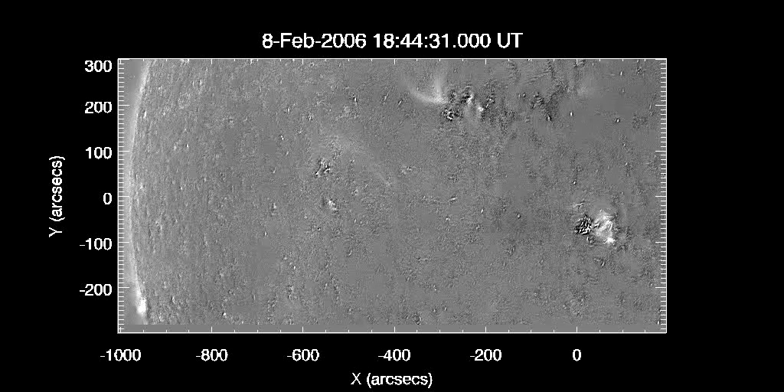
Difference Images

Slide 16
Wavelet Transform
Coarse Scales
Medium scales
Fine scales

Slide 17
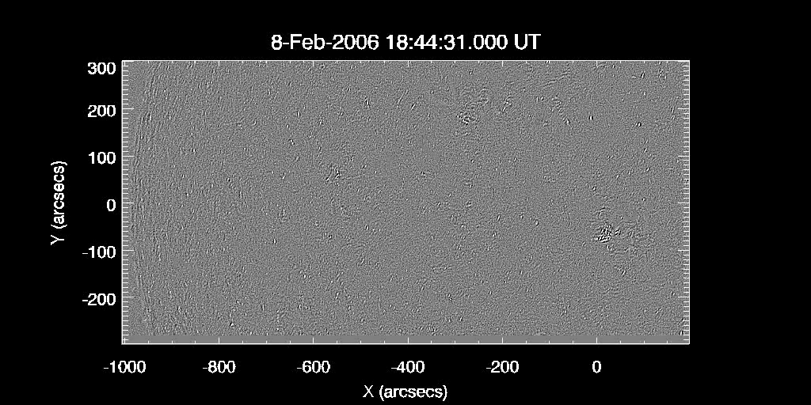
Small Scale Difference Images

Slide 18
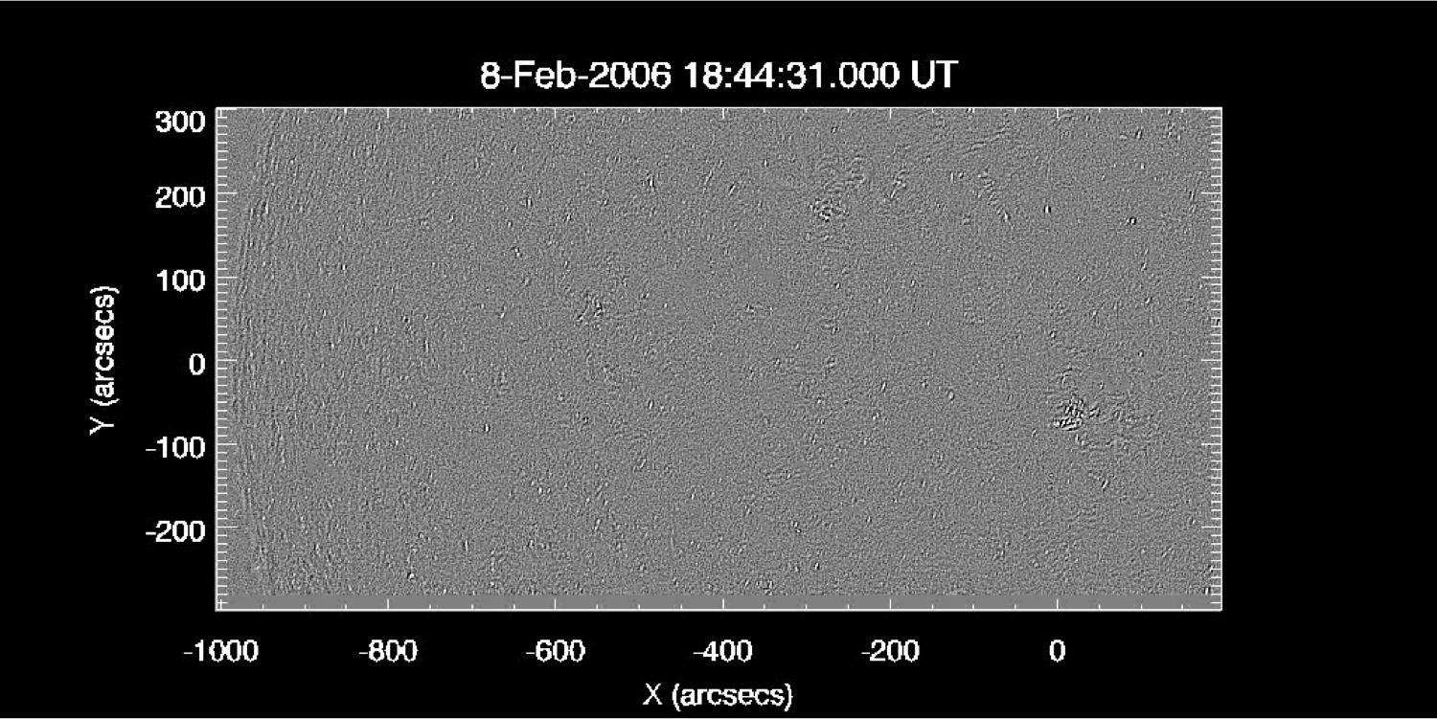
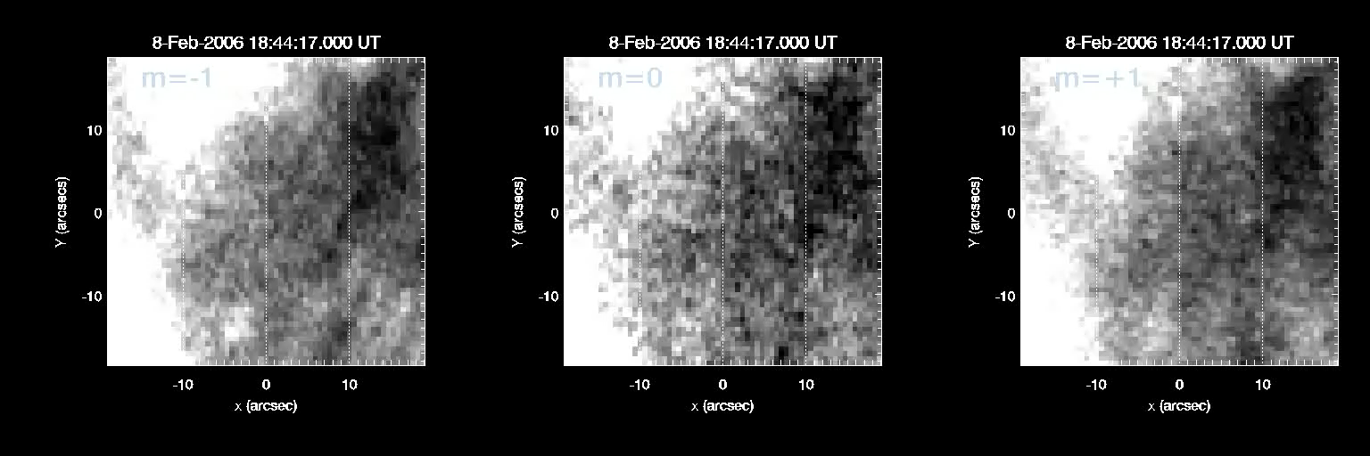

Slide 19
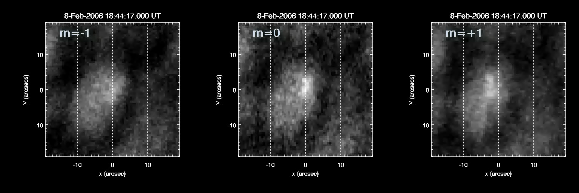

Slide 20
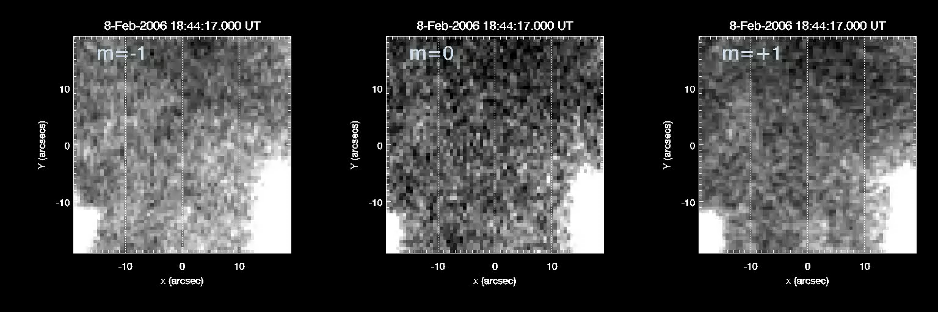

Slide 21
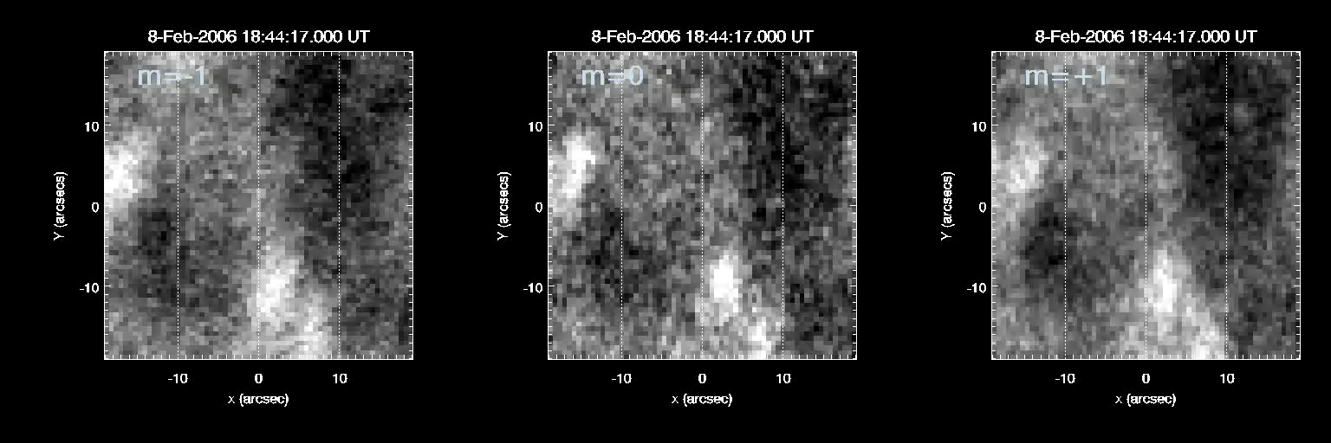

Slide 22
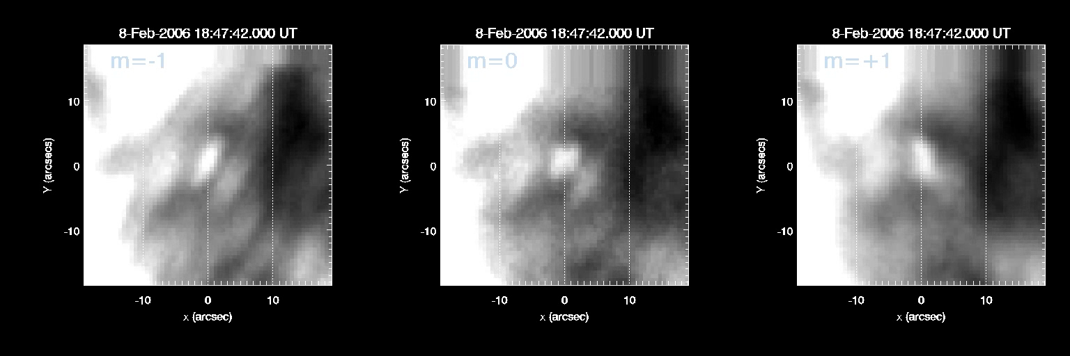
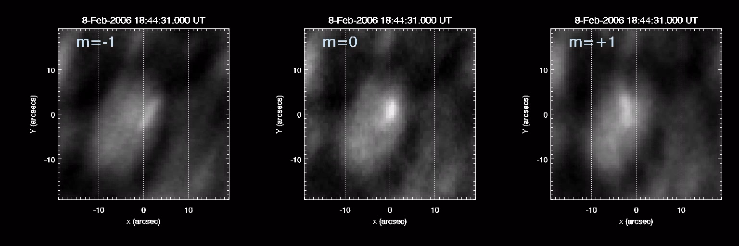
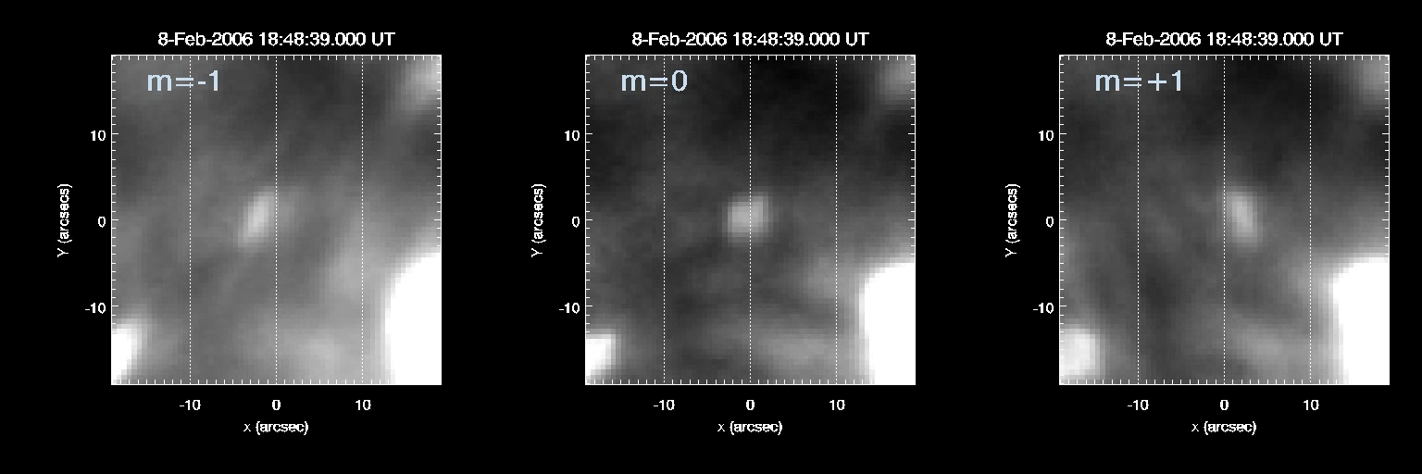
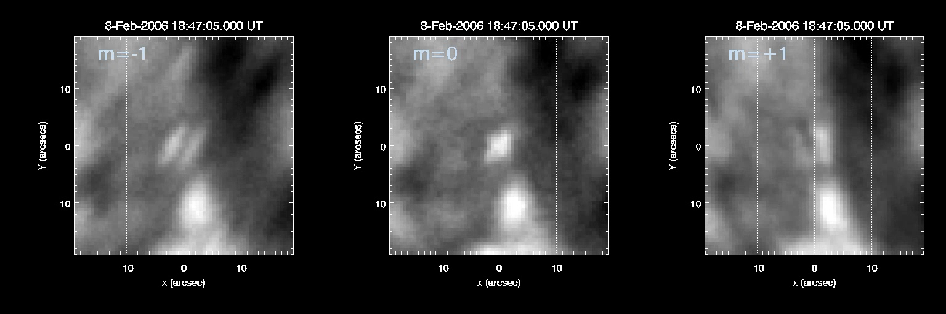
Raw Data

Slide 23
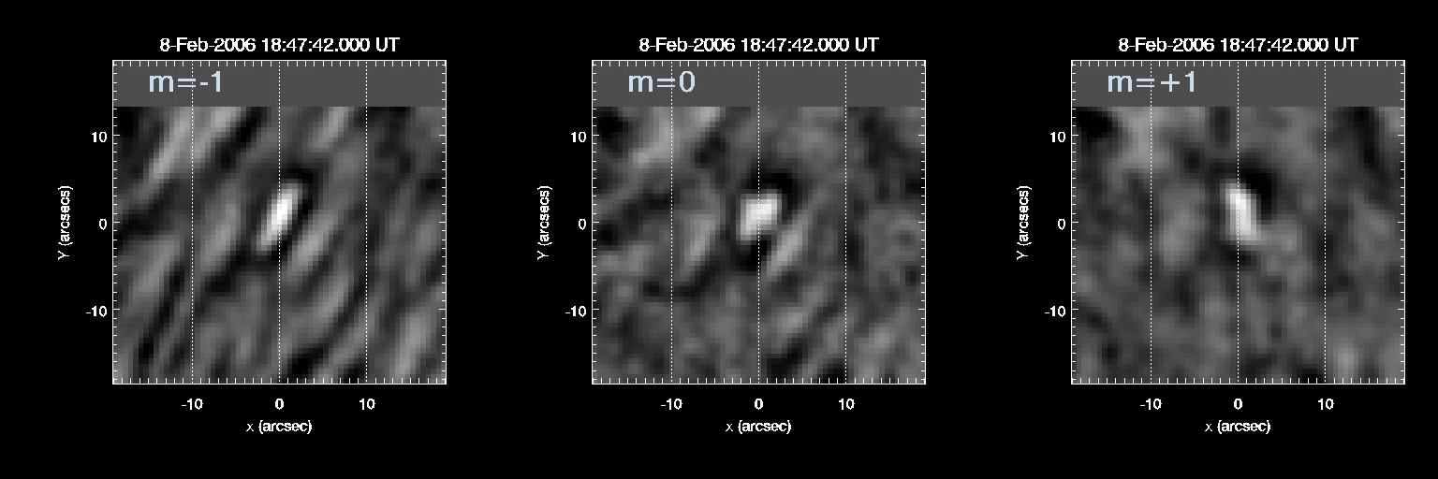
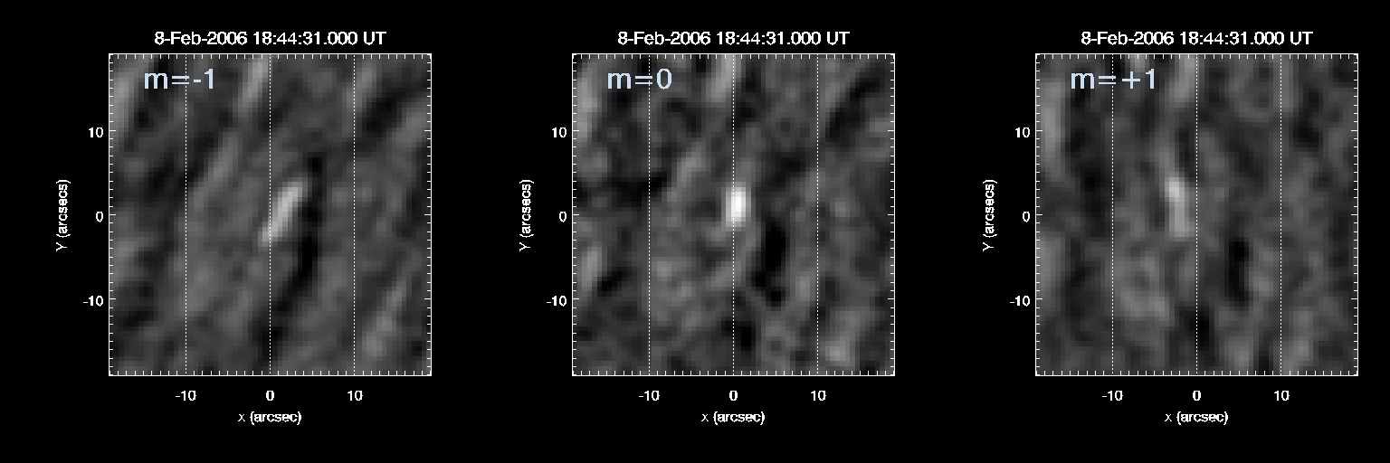
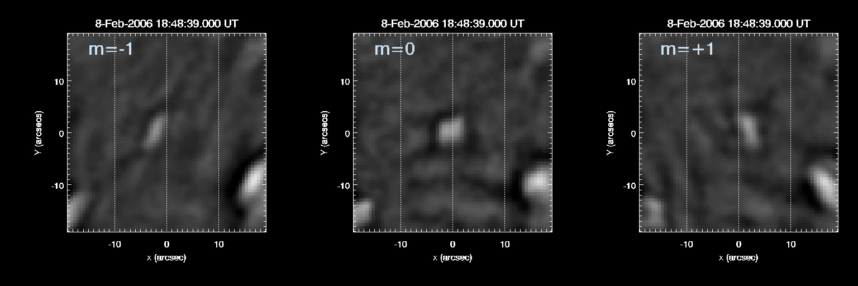
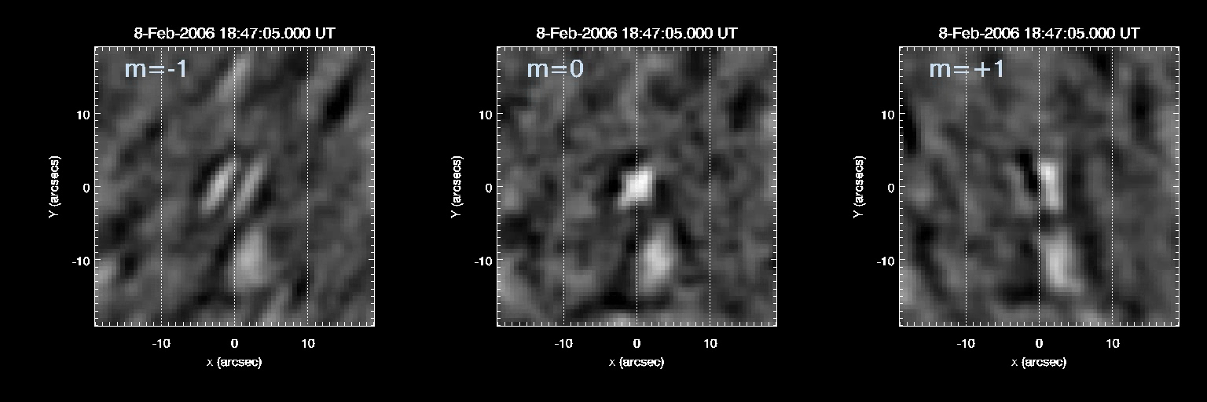
Wavelet Transform
Small Scales

Slide 24
No Doppler Shift
Red Shift Only
Shifts 3-4 pixels
≈ 100 km/s
No Line Core
Blue Shift Only?
Bi Directional Shifts

Slide 25
Point Spread Functions
Notes:
Wavelet Transform
Show PSFS, brief method of reconstruction:
reconstructs psfs, respects the noise

Slide 26
PSF Reconstruction
Notes:
The key here is that only a small subset of wavelet coefficients is sufficient to explain the intensity distribution corresponding to the EE. In the inversions then only these coefficients should contribute.
Make this a movie, instead?
Show all psfs?
Show psf profiles, angular/spectral resolution? – YES!

Slide 27
PSF Estimates

Slide 28
Notes:
Forward model is fairly convincing.
How about the inverse problem?

Slide 29
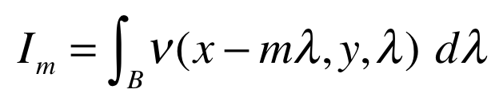
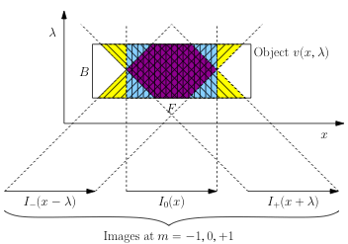
Inversions
MOSES imaging equation:
MOSES images are projections of the
solar spectral radiance ν(x,y,λ)
The inverse problem of
reconstruction from projection
data is called tomography
MOSES is a three projection
tomographic imager
Fox et al 2010
Notes:
ν(x,y,λ) is the solar spectral radiance
Tomography – same as cat scan

Slide 30
Inversion method: (S)MART
λ
Guess
x
Project through Guess to simulate Data
Divide data by projection
Back project to form Correction
Multiply Guess by Correction^{1/3}
Iterate to convergence
Notes:
1.) MOSES is a few projection tomography problem.
2.) Tomographic inversion is automated, treats all objects in the same way, allows estimation of a spectra for each space pixel.
3.) MART is standard reconstruction technique – solution is always positive and missing data is easier to deal with that using, say, fourier backprojection.
4.) Reconstruction artifacts are inevitable. Reconstructing data filtered to contain only the object scales of interest seems to reduce artifacts ➔ inversion applied to high pass filtered data.
5.) PSF deconvolution applied prior to filtering.

Slide 31
Inversion Results

Slide 32
Inversion Results

Slide 33
Inversion Results
Averaged
Line Profile

Slide 34
Inversion Results
Averaged
Line Profile
Slice through
reconstructed
radiance

Slide 35
MART + Partial Reconstruction
Only a handful of wavelet coefficients
describe the explosive event
Notes:
Also tacked on a deconvolution… another slide for this?

Slide 36
Partial Reconstruction

Slide 37
Inversion Results 2
MART + Partial Reconstruction + Deconvolution

Slide 38
Inversion Results 2

Slide 39
Inversion Results 2

Slide 40
Inversion Results 2

Slide 42
Evolution
No acceleration phase
No sky plane motion
No core brightening

Slide 43
Spatial Distribution
combined
Notes:
Small events
Line wing dominated – Petschek
Need to clean this shit up
Similar morphology. Hmmm….

Slide 44
Conclusions EEs
EE’s common in He ii 304
Line wing dominated. This suggest the plasmoid instability is not occurring – why? State more clearly that we can conclude something about reconnection, (not coronal heating. )
Sky plane motion often not observed – how?
Motion is jets – not rotational
Need rough statistics: How many red, blue, bi directional, coronal hole vs qs, network locations, speeds, how many with core brightening.

Slide 45
Conclusions MOSES
Excellent tool for explosive event observations, with or without inversions
We can invert the data to obtain line profiles
Imaging Spectroscopy is a reality. When ESIS comes out, everyone will want some.

