Slide 2
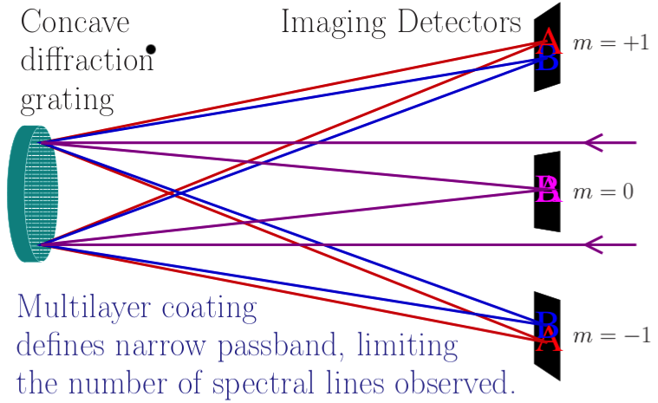
MOSES INSTRUMENT
Notes:
Imaging Spectrograph. Explain.˜

Slide 3
MOSES INSTRUMENT
Slide with movie simulations of point response of MOSES with simulated spectrum.

Slide 4
DATA
Add eit moses image without white box, on a 5 second timer, this shows the coregistration for a moment before the next image with the white box showing moses data kicks in.

Slide 5
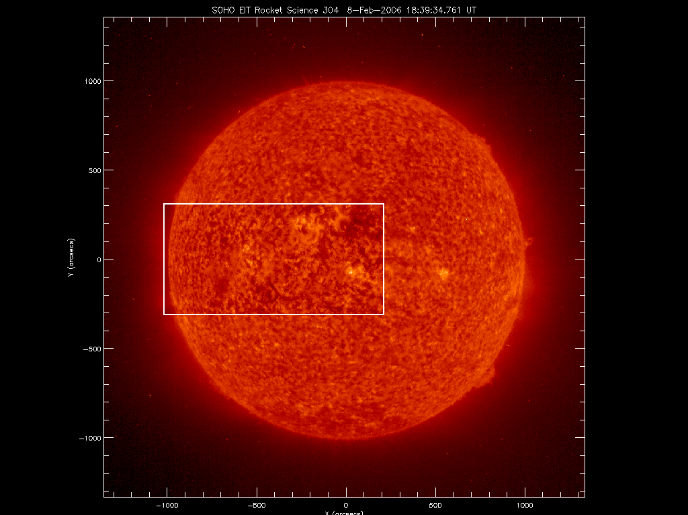

Slide 6
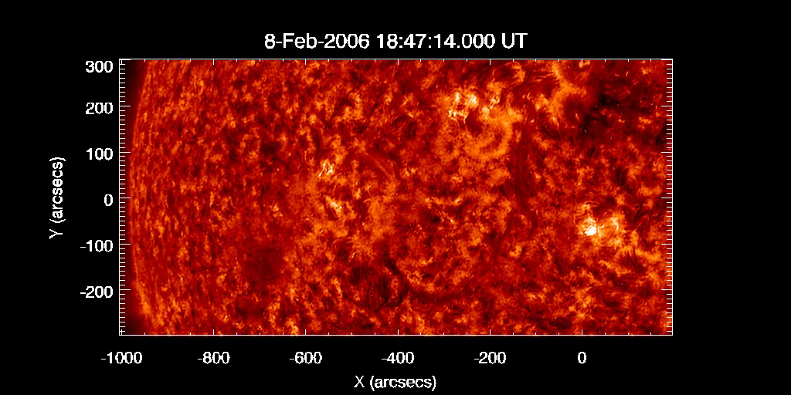
DATA

Slide 7
DATA

Slide 8
Data Processing
Dark subtract
Flatfield
Coregistration
PSF Deconvolution
Inversion

Slide 9
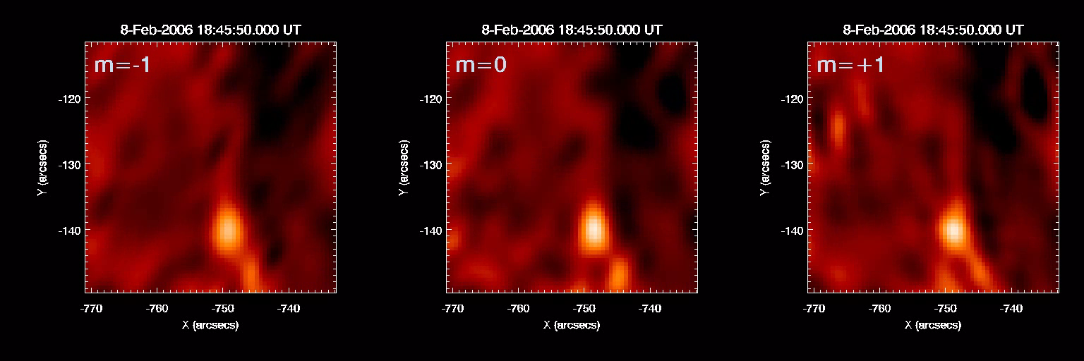
Notes:
Do I want to include a copy of the instrument schematic in this frame?

Slide 10
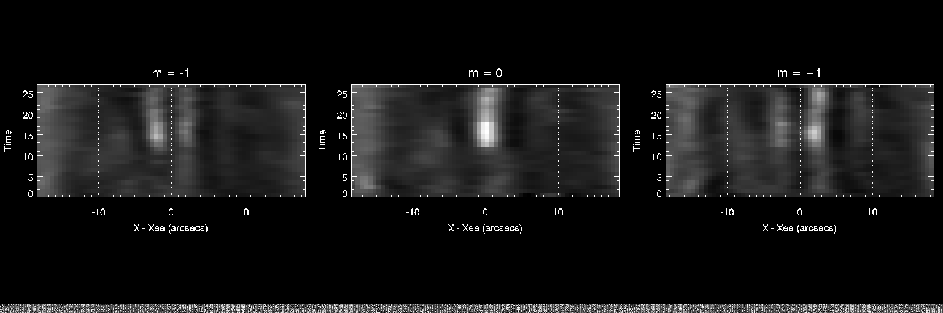

Slide 11
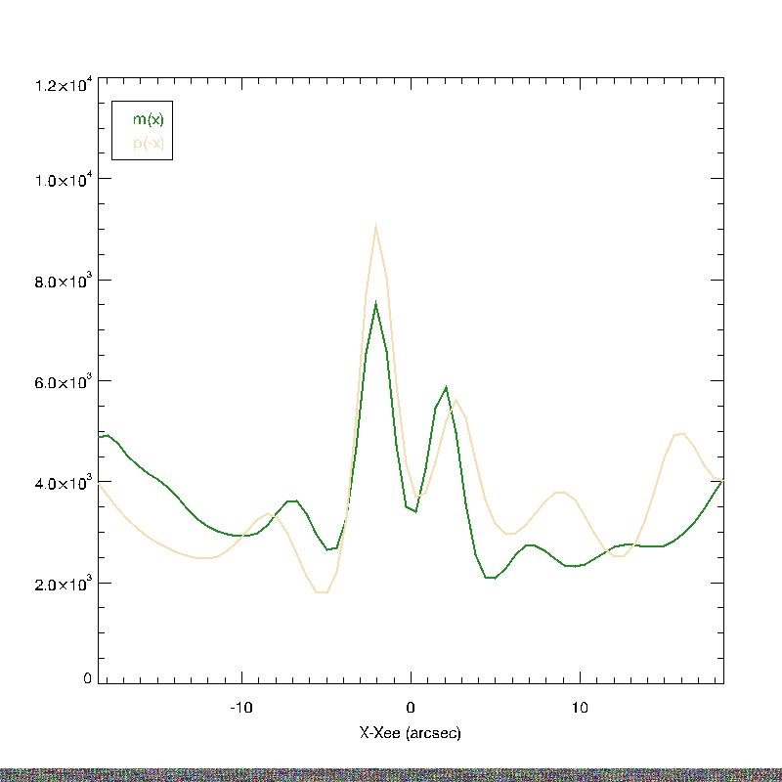

Slide 12
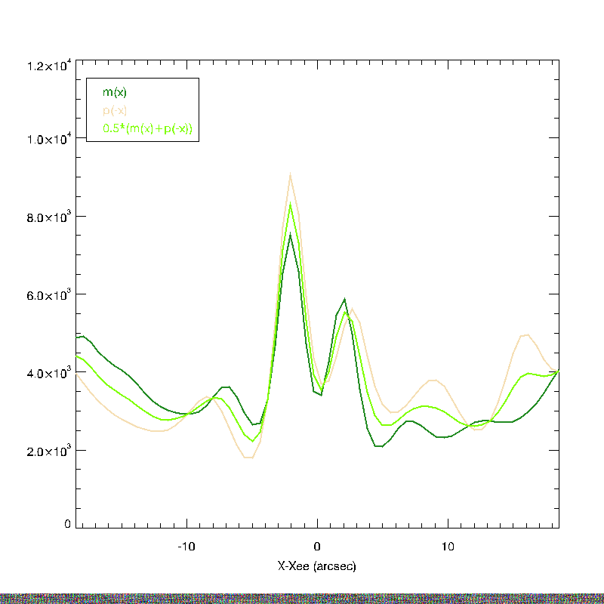

Slide 13
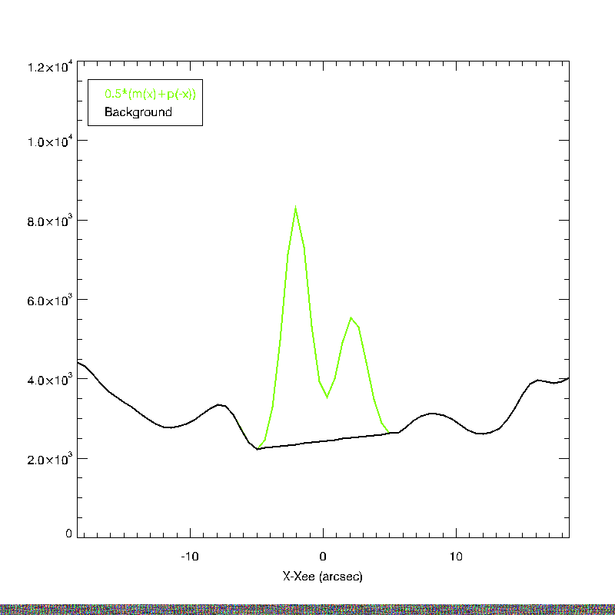

Slide 14
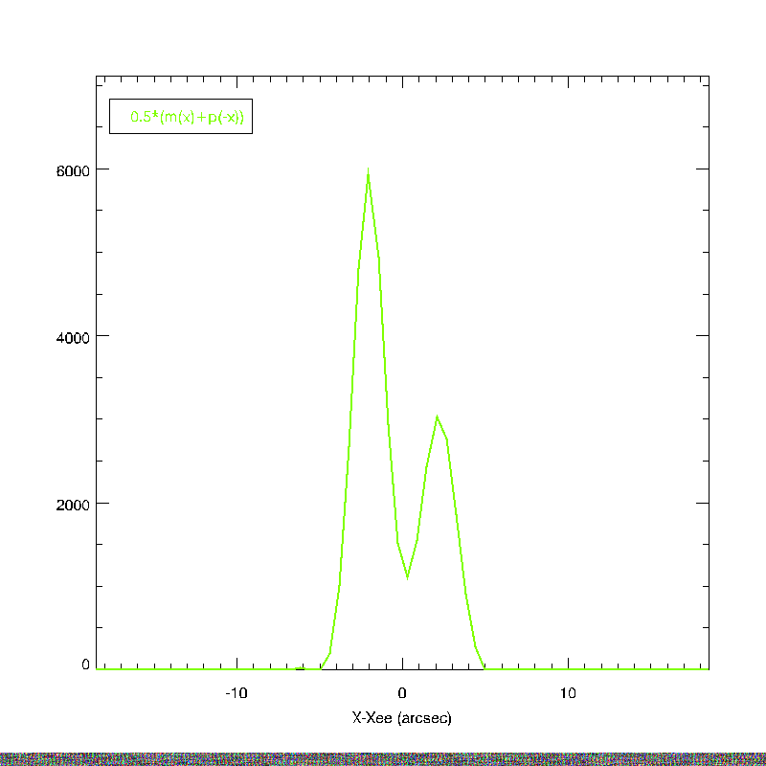

Slide 15
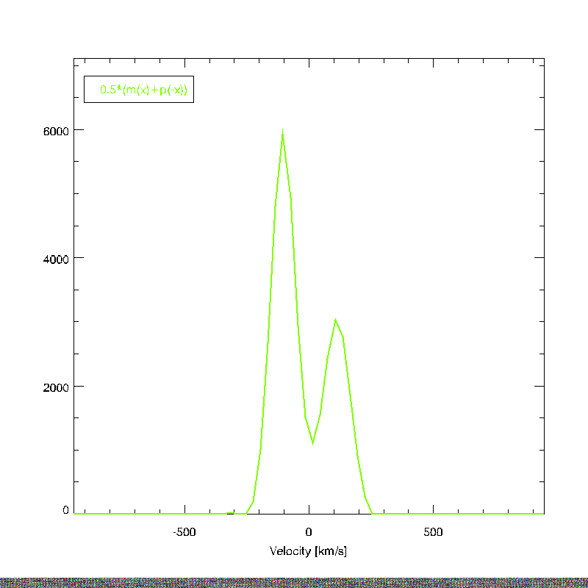

Slide 16
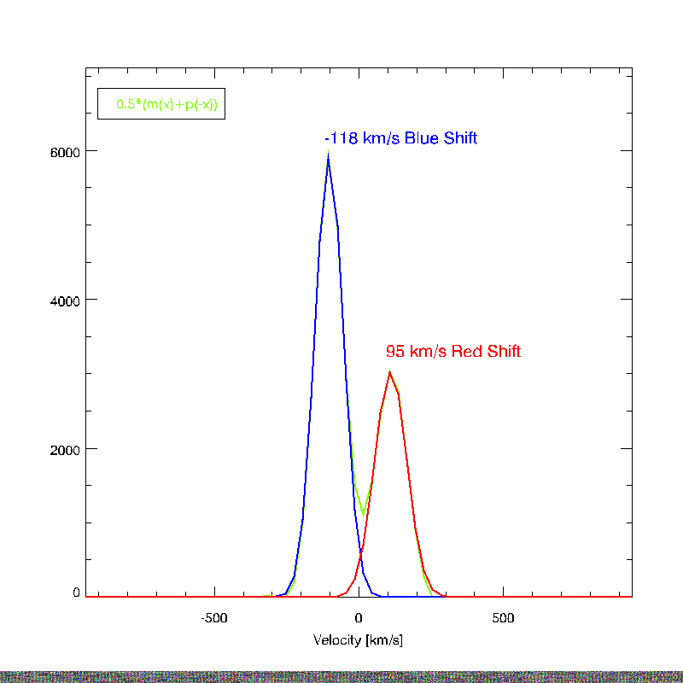

Slide 17
Simple estimate of the doppler shifts involved come from centroiding the components seen in the intensity data ➔ Plot of intensity profiles.
This event can be seen to meet the observational criteria of an explosive event.
Any centroid method will require some sort of background model.

Slide 18
INVERSIONS

Slide 19
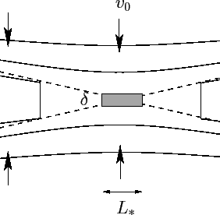
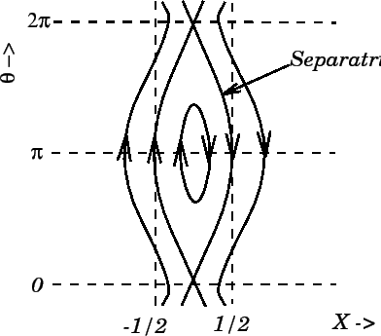
Reconnection Cartoons
Petschek
Plasmoid Instability

Slide 20
Need Slide with Spectra “predicted” from cartoon models.
Reference innes and guo for plasmoid spectra? Refernece for petschek assumed spectra?

Slide 21
SECTIONS I NEED
What should the reconnection models look like to MOSES?
Can I distinguish the models, and what is the success rate for detection for various signal to noise of event?

