Slide 1
Transition Region Explosive Events in He II 304Å:
Observation and Analysis
Thomas Rust, Charles Kankelborg
Montana State University Physics
thomas.rust1@montana.edu

Slide 2
Abstract
We present examples of transition region explosive events observed in the He II 304Å ?spectral line with the Multi Order Solar EUV Spectrograph (MOSES). With small (<5000 km) spatial scale and large non-thermal (100-150 km/s) velocities these events satisfy the observational signatures of transition region explosive events. Derived line profiles show distinct blue and red velocity components with very little broadening of either component. We observe little to no emission from low velocity plasma, making the plasmoid instability reconnection model unlikely as the plasma acceleration mechanism for these events. Rather, the single speed, bi-directional jet characteristics suggested by these data are consistent with acceleration via Petschek reconnection. Observations were made during the first sounding rocket flight of MOSES in 2006. MOSES forms images in 3 orders of a concave diffraction grating. Multilayer coatings largely restrict the passband to the He II 303.8Å ?and Si XI 303.3Å ?spectral lines. The angular field of view is about 8.5'x17', or about 20% of the solar disk. These images constitute projections of the volume I(x,y,λ), the intensity as a function of sky plane position and wavelength. Spectral line profiles are recovered via tomographic inversion of these projections. Inversion is carried out using a multiplicative algebraic reconstruction technique.

Slide 3
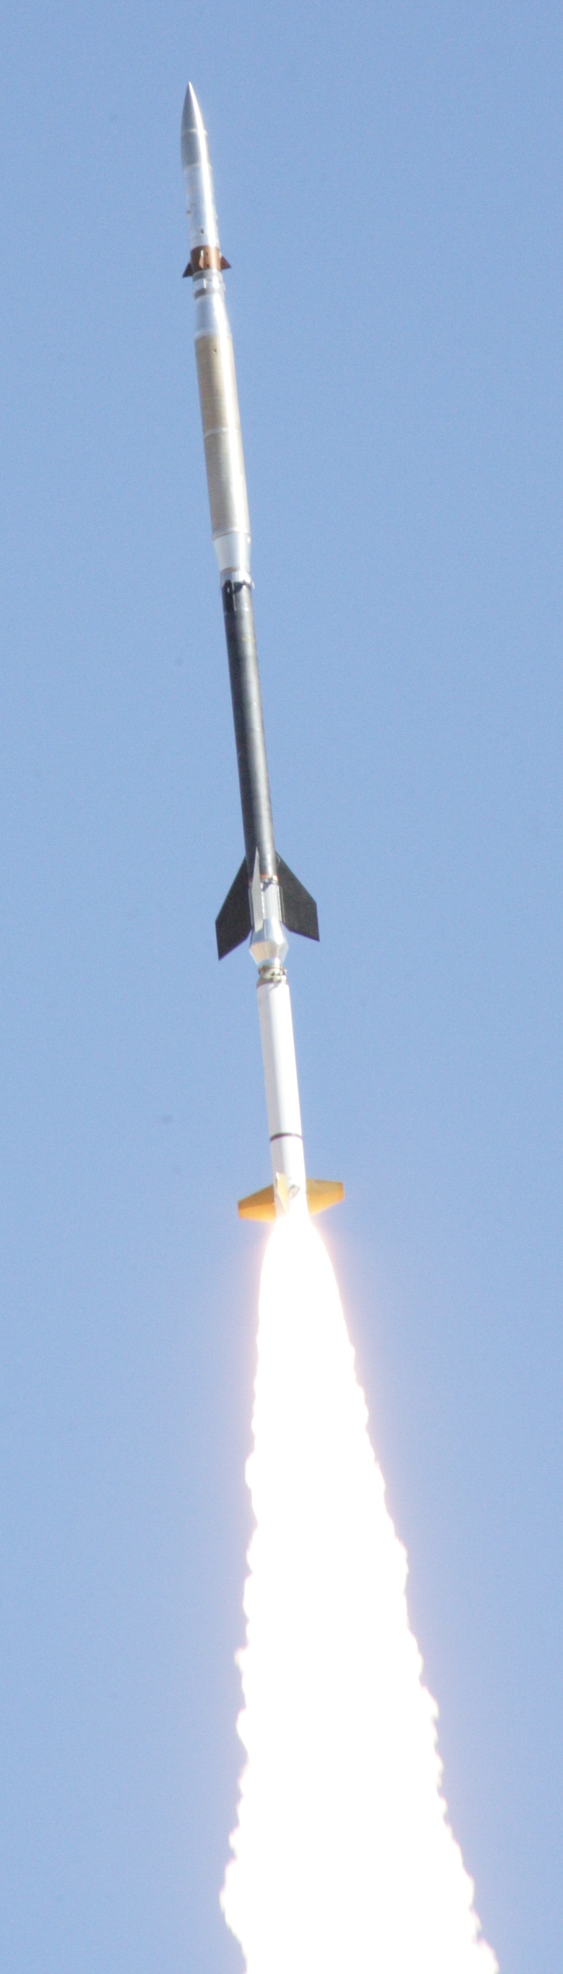
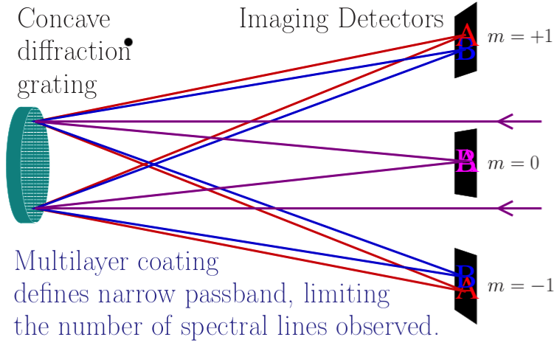
Multi-Order Solar EUV Spectrograph
(MOSES)
Imaging spectrograph designed to measure spectra in a single snapshot over a wide FOV

Slide 4
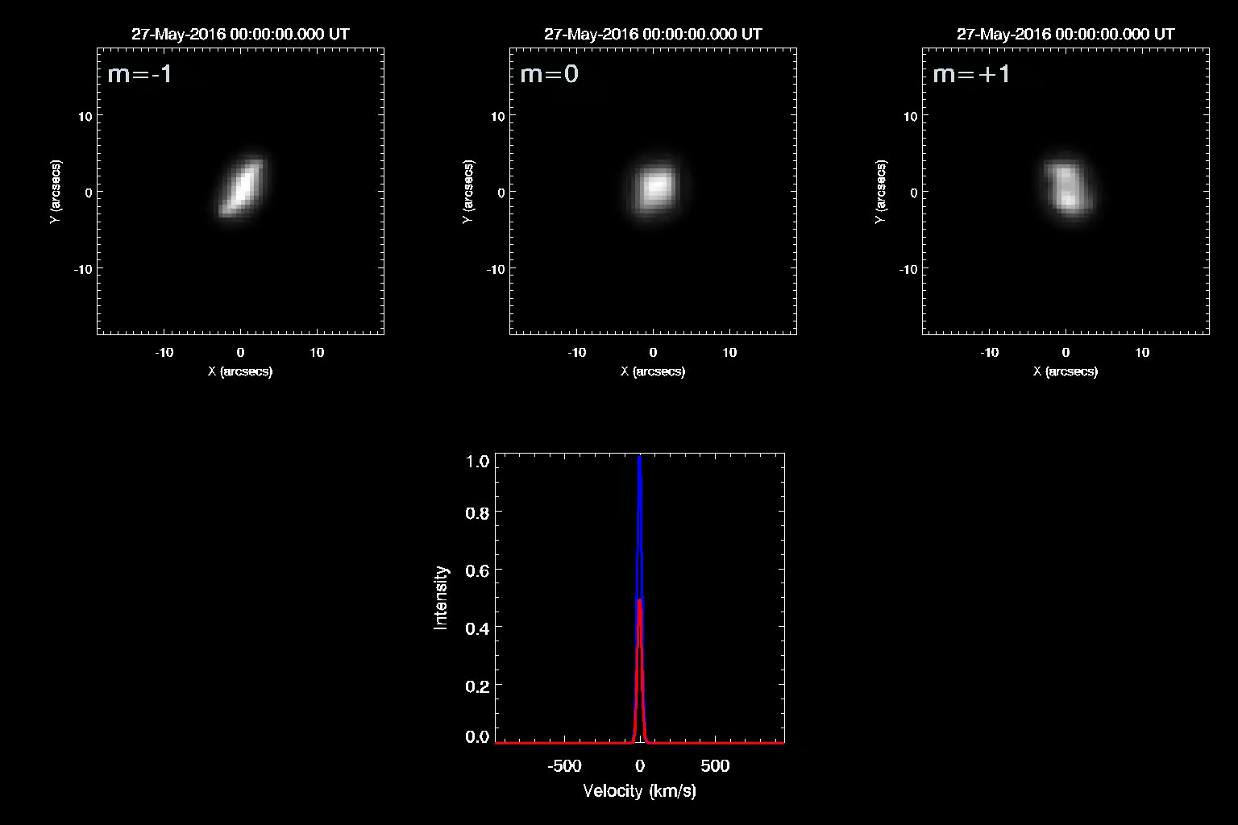
Upper panels show how MOSES sees isolated compact HeII emission with velocity spectrum on right.
Dispersion is
30 km/s/pixel
PSFs estimated
from data
Notes:
Note that under the assumption that the only spectral line is HeII, all emission observed away from line center is due to line of sight motion.
The m=+-1 dispersion direction profiles the line profile convolved with the psf. If shifts are big enough, or broadening is wide enough, I should be able to get a good estimate of the shifts or broadening. Note that one directional jets should be measureable at small shifts, as the oversampled psfs are easy to centroid.

Slide 5
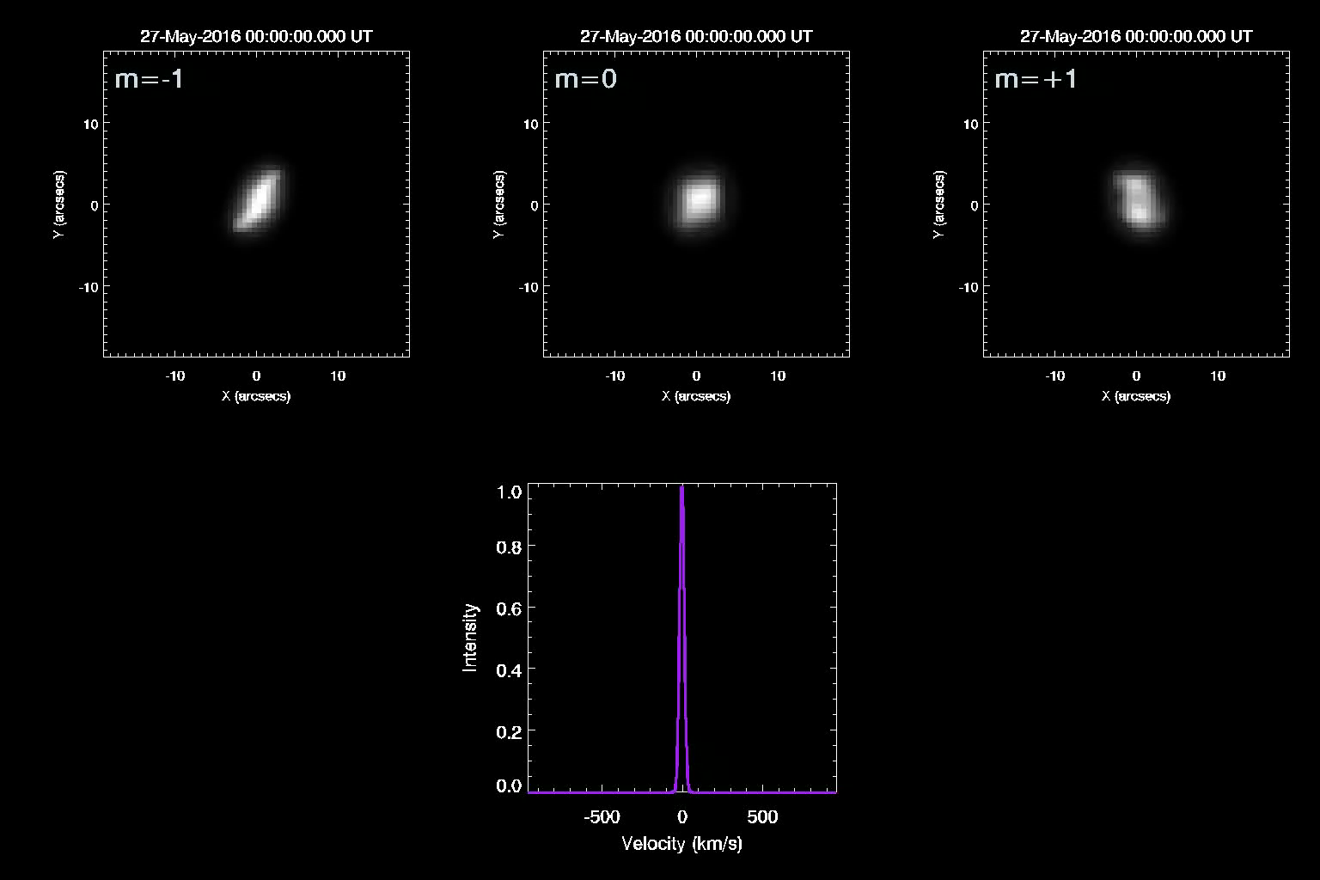
Upper panels show how MOSES sees isolated compact HeII emission with velocity spectrum on right.
Dispersion is
30 km/s/pixel
PSFs estimated
from data

Slide 6
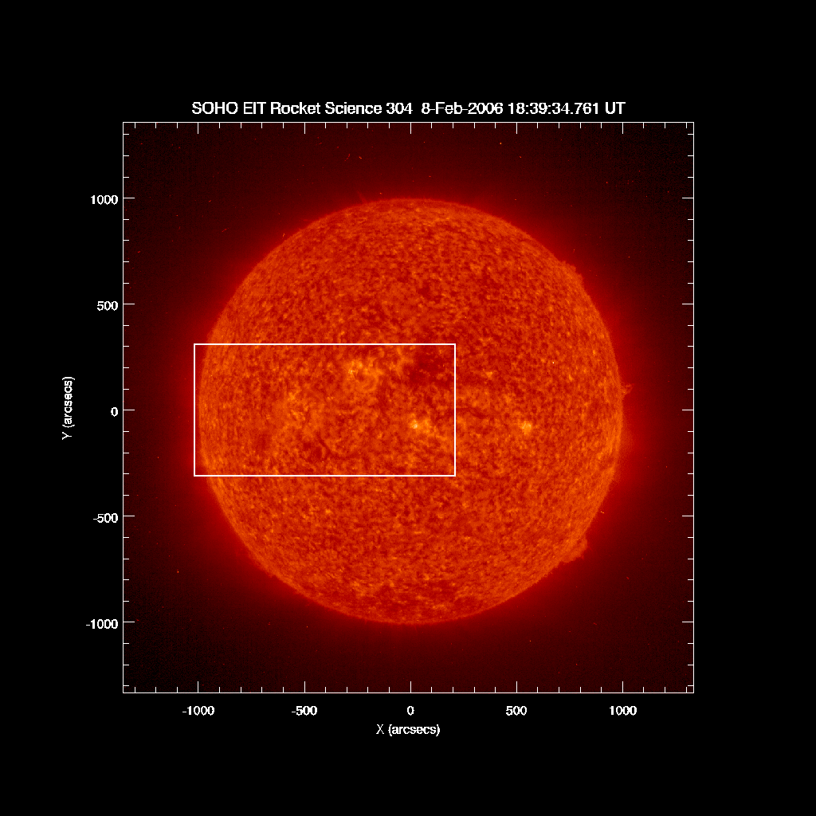
MOSES-I
February 8 2006
8.5’ x 17’
0.57” pixels
30 km/s/pix
30.4 nm (see
Parker P2.04)

Slide 7
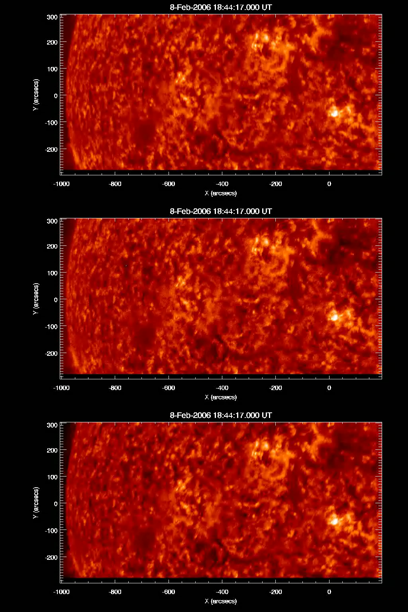
27 Exposures from 0.25-24 s
  Average cadence is
  10 s
m = +1
m = 0
Data Reduction
Dark Subtraction
Flatfield
Coregistration
m = -1

Slide 8
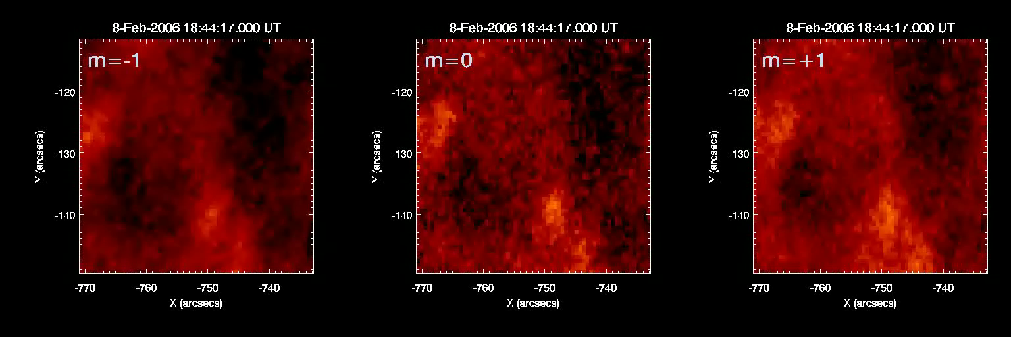

Slide 9
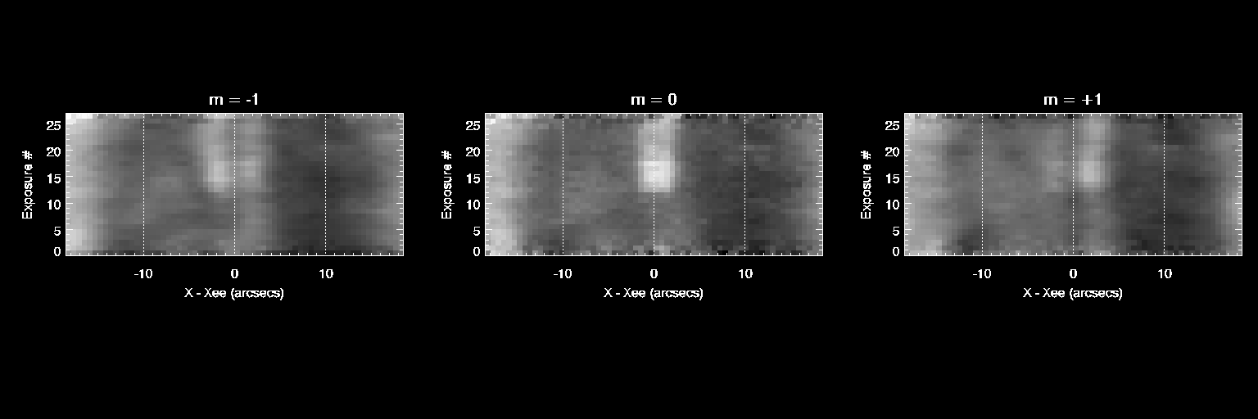
Stack plots of intensity profiles vs. time. x is the dispersion direction, centered on the event.

Slide 10
Stack plots of intensity profiles vs. time. x is the dispersion direction, centered on the event.

Slide 11
Stack plots of intensity profiles vs. time. x is the dispersion direction, centered on the event.

Slide 12
Deconvolve PSF from image data

Slide 13
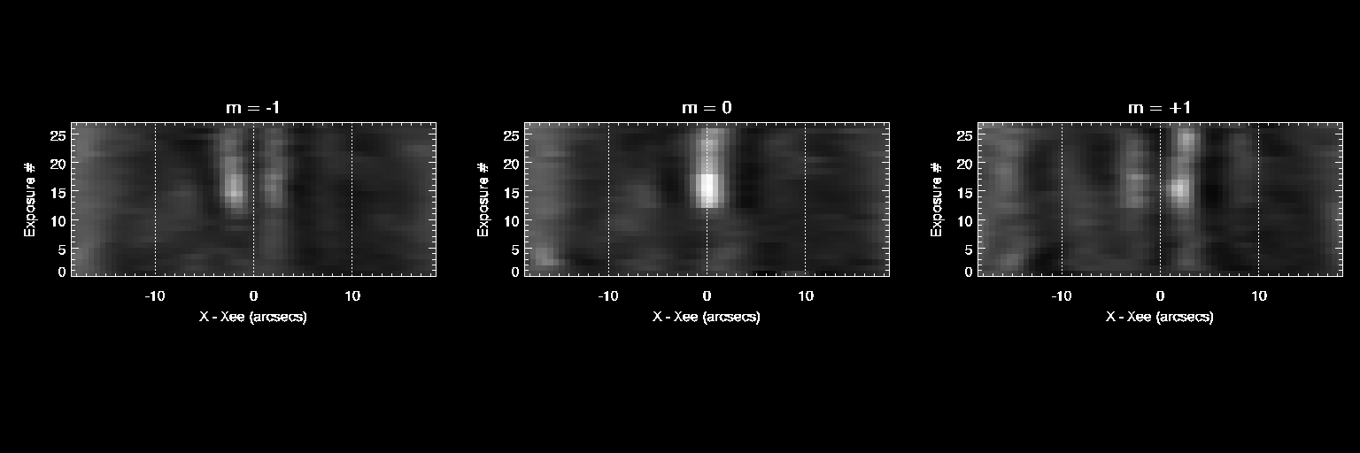
Deconvolve PSF from image data

Slide 14
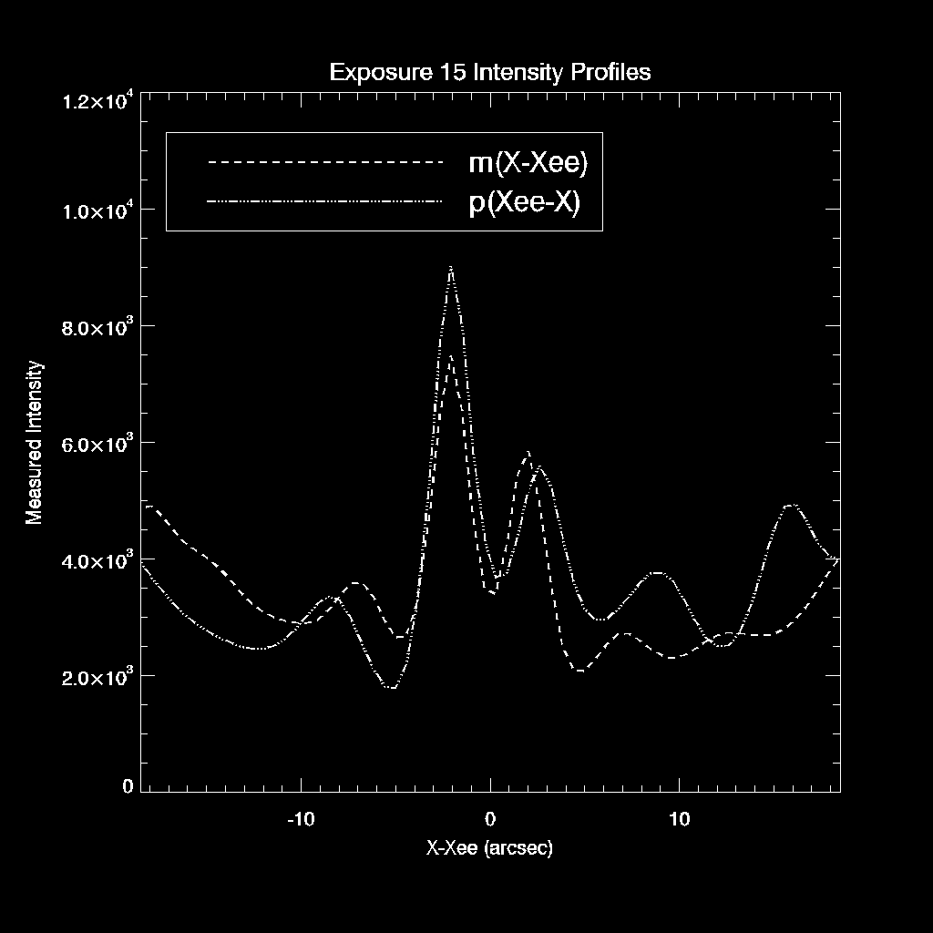

Slide 15
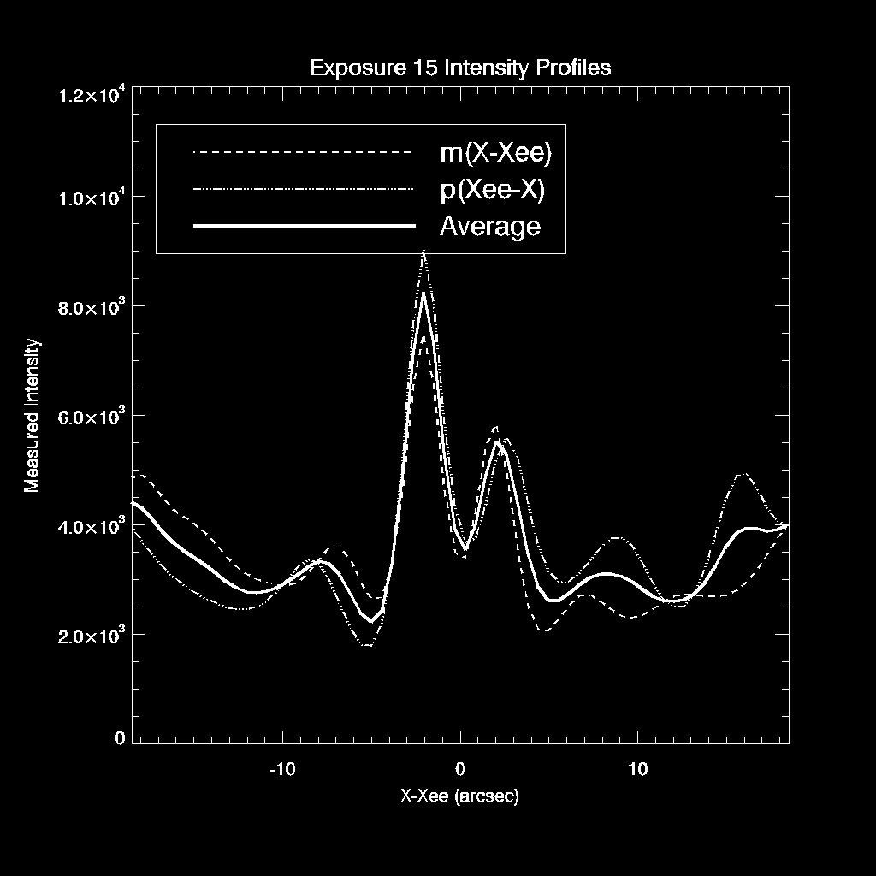

Slide 16
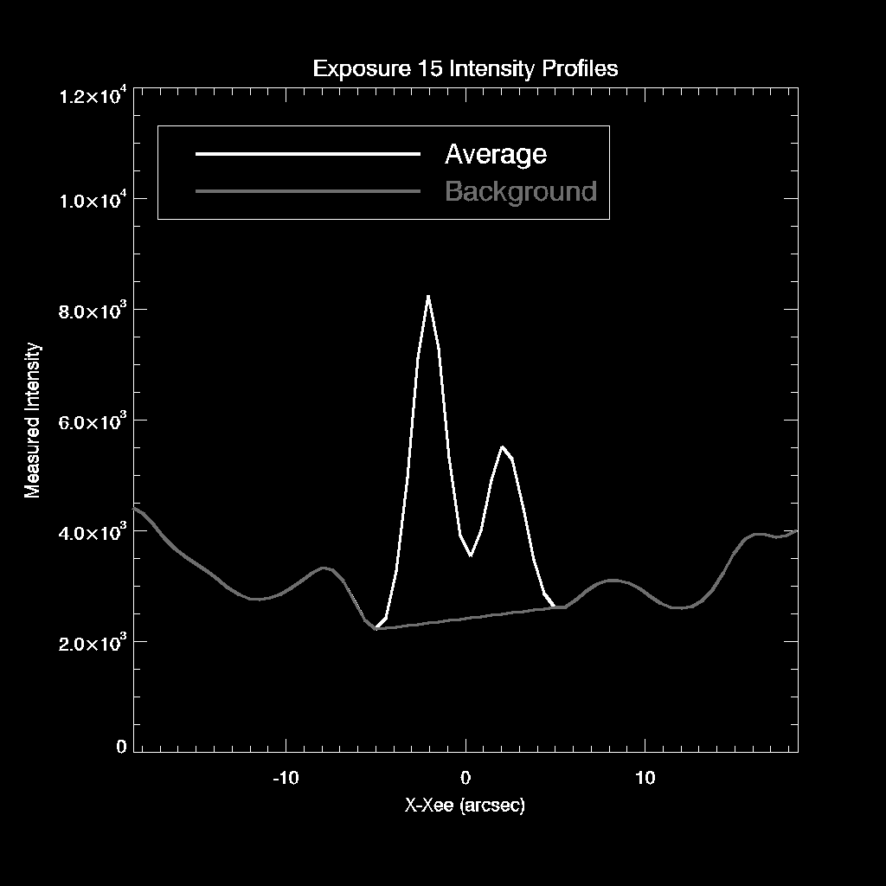

Slide 17
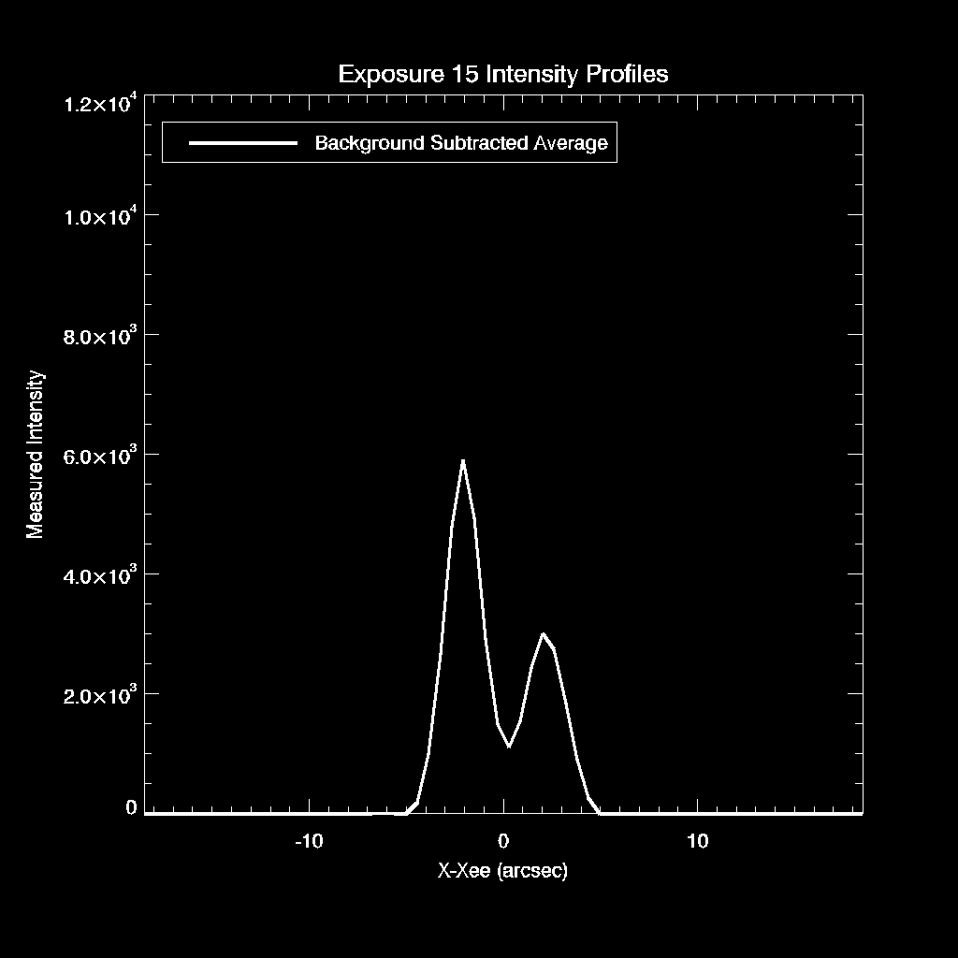

Slide 18
0.57”/pixel
30 km/s/pixel

Slide 19
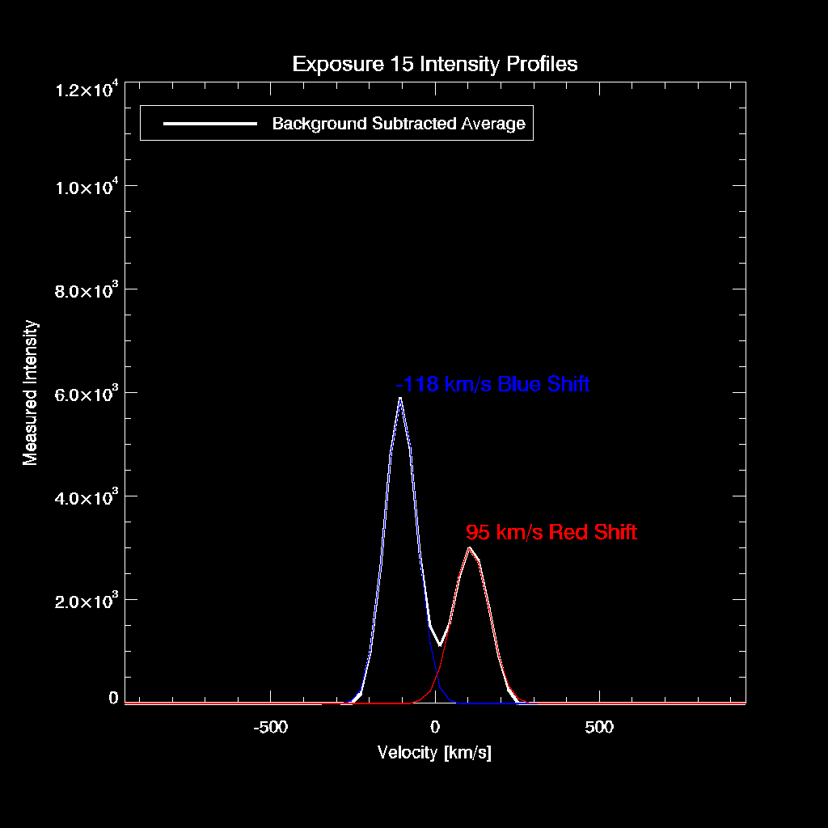

Slide 20
Inversion: MART
Guess
Project through Guess to simulate Data
Divide data by projection
Back project to form Correction
Multiply Guess by Correction^{1/3}
Iterate to convergence

Slide 23
Explosive events should meet the qualifications for compactness and strong shifts and/or broadening.
Often reported in slit spectra (e.g., Bruekner and Bartoe 1983, Dere et. al. 1989, Innes et. al. 1997)
Strong but complicated event observed in MOSES data, reported by Fox et. al.
Can we find more?

Slide 24
For a compact object, the intensity profile in the dispersion direction in the m=-1 image is the spectrum S(L) of the object, convolved with the m=-1 PSF profile.
The intensity profile in the m=+1 image is the mirror image S(-L)
Compact objects act as their own slit.
If a shift is strong enough, or broadening is wide enough, we should be able to get a good estimate of the spectrum of compact objects despite the PSFS.

Slide 25
Data Processing
Dark subtract
Flatfield
Coregistration
PSF Deconvolution (Later?)
Inversion (Later?)

Slide 26
Simple estimate of the doppler shifts involved come from centroiding the components seen in the intensity data ➔ Plot of intensity profiles.
This event can be seen to meet the observational criteria of an explosive event.
Any centroid method will require some sort of background model.

Slide 27
INVERSIONS
I(x,y) = int{O(x+mL,y,L),dL}
For d function object, i.e., O = d(x,y)*f(L),
I(x,y) = f(x/m) , m ne 0
total(f) , m = 0

Slide 28
Inversions
Need to talk about high pass filtering.
Need simulations of plaid, i.e., inversions with and without backgrouds.

Slide 29
Need multiple examples of EE’s
Here…
Here…
And here.

Slide 30
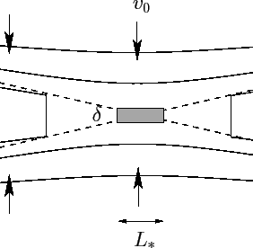
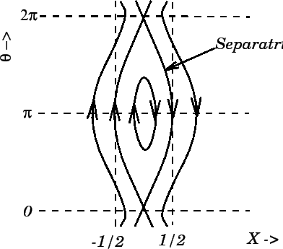
Reconnection Cartoons
Petschek
Plasmoid Instability
Innes 1997 also has a nice petschek cartoon.

Slide 31
Discussion
I have numerous EE’s in the data.
I think I can tell the difference between wide broadenings and strong shifts… and this seems like strong shifts.
The observed lack of low velocity plasma leads me to picture bi directional jets as predicted by fast sweet parker, e.g., petschek, not plasmoid.
Why do I not see the broad type events of HRTS and IRIS?
Are these two jet events different than broad events, or are they different parts of the elephant?

Slide 32
SECTIONS I NEED
What should the reconnection models look like to MOSES?
Can I distinguish the models, and what is the success rate for detection for various signal to noise of event?
Reference innes and guo for plasmoid spectra? Refernece for petschek assumed spectra?

Slide 33
TO DO
All plots need a little polish.

