Slide 1
Transition Region Explosive Events in He II 304Å:
Observation and Analysis
Thomas Rust, Charles Kankelborg
Montana State University Physics
thomas.rust1@montana.edu

Slide 2
Abstract
We present examples of transition region explosive events observed in the He II 304Å ?spectral line with the Multi Order Solar EUV Spectrograph (MOSES). With small (<5000 km) spatial scale and large non-thermal (100-150 km/s) velocities these events satisfy the observational signatures of transition region explosive events. Derived line profiles show distinct blue and red velocity components with very little broadening of either component. We observe little to no emission from low velocity plasma, making the
plasmoid instability reconnection model unlikely as the plasma acceleration mechanism for these events. Rather, the single speed, bi-directional jet characteristics suggested by these data are consistent with acceleration via Petschek reconnection. Observations were made during the first sounding rocket flight of MOSES in 2006. MOSES forms images in 3 orders of a concave diffraction grating. Multilayer coatings largely restrict the passband to the He II 303.8Å ?and Si XI 303.3Å ?spectral lines. The angular field of view is about 8.5'x17', or about 20% of the solar disk. These images constitute projections of the volume I(x,y,λ), the intensity as a function of sky plane position and wavelength. Spectral line profiles are recovered via tomographic inversion of these projections. Inversion is carried out using a multiplicative algebraic reconstruction technique.

Slide 3
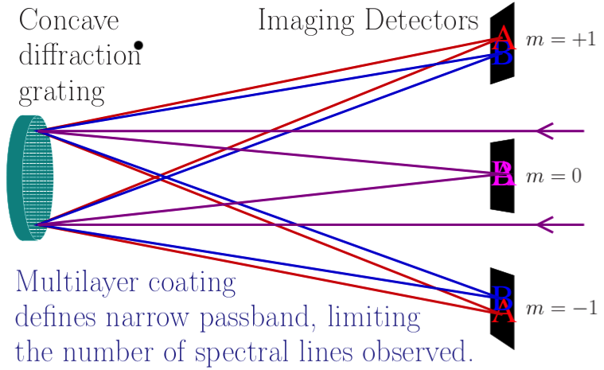
MOSES Spectrograph
Notes:
Imaging Spectrograph. Explain:
MOSES spectrograph using a concave diffraction grating to form images in three spectral orders.
*The m=0 order is non dispersed, and is a typical 304 multilayer solar image (e.g., EIT). This image provides the reference intensity and spatial coordinates image. It shows where things are emitting (at any wavelength), and how bright they are.
*In the outboard order images, observed intensity is a function of *where* the emission came from AND the *wavelength* at which it is emitting. Spatial coordinates remain the same in all images (after coregistration for ccd position tolerances and pointing drift). Emission at line center is imaged to the same coordinates in all images (assumes no net shift over the FOV). Emission that is blue of center is moved solar +x in the m=+1 order, and solar –x in the m=-1 order. Emission red of line center is shifted spatially –x in the m=+1 order and solar +x in the the m=-1 order.
Another way to put it is that the intensity observed in the mth order is the image formed by convolving the m=0 image with the spectral profile P(x,y,m*(L-L0)) of the emission at that location.
Each image is of course then convolved with the point spread function for that order.

Slide 4
Goal of MOSES spectrograph is to get spectral information over a wide FOV in a single snapshot.
Lets start simple: compact objects.

Slide 5
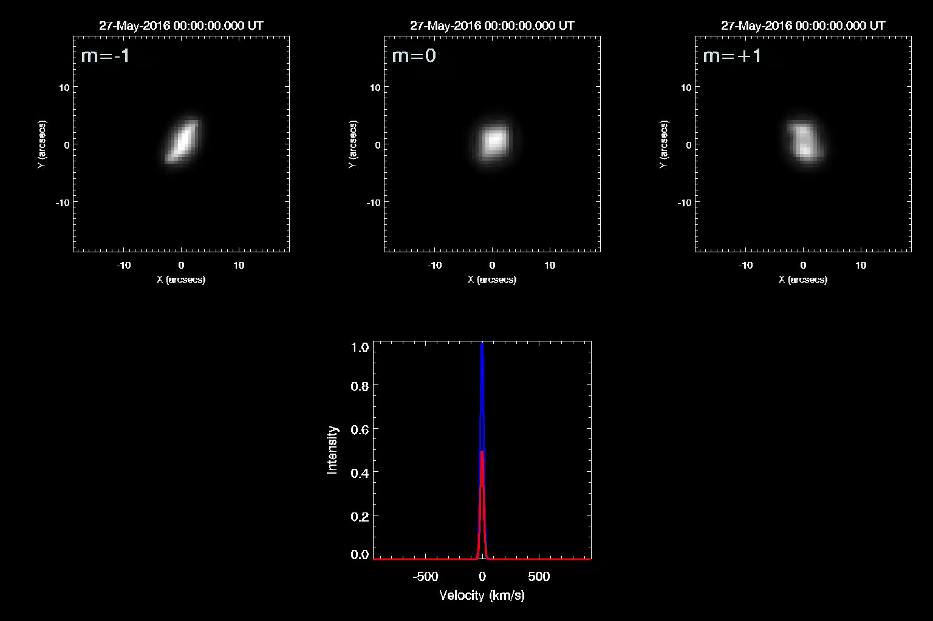
MOSES INSTRUMENT

Slide 6
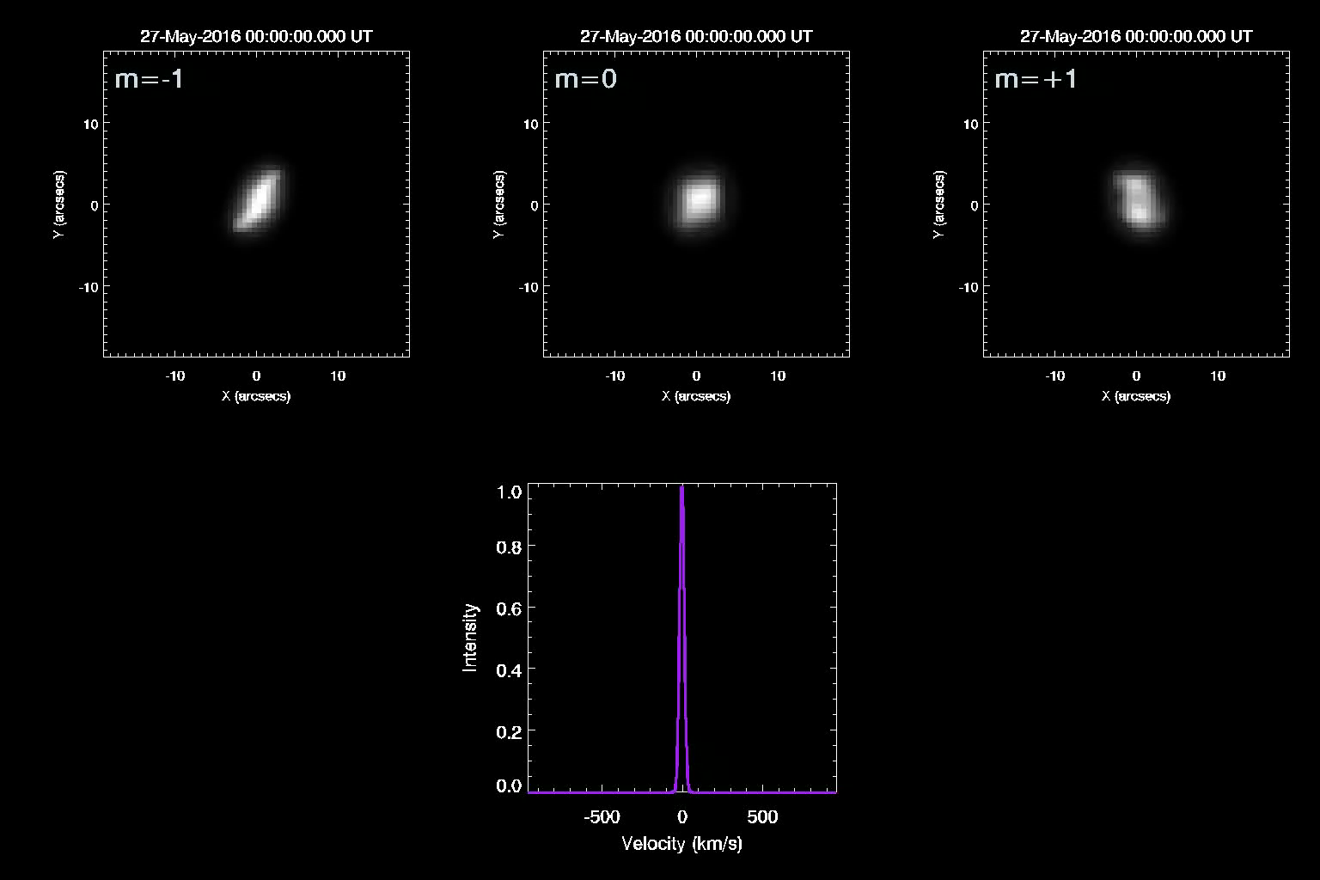
MOSES INSTRUMENT

Slide 7
For a compact object, the intensity profile in the dispersion direction in the m=-1 image is the spectrum S(L) of the object, convolved with the m=-1 PSF profile.
The intensity profile in the m=+1 image is the mirror image S(-L)
Compact objects act as their own slit.
If a shift is strong enough, or broadening is wide enough, we should be able to get a good estimate of the spectrum of compact objects despite the PSFS.

Slide 8
Explosive events should meet the qualifications for compactness and strong shifts and/or broadening.
Often reported in slit spectra (e.g., Bruekner and Bartoe 1983, Dere et. al. 1989, Innes et. al. 1997)
Strong but complicated event observed in MOSES data, reported by Fox et. al.
Can we find more?

Slide 9
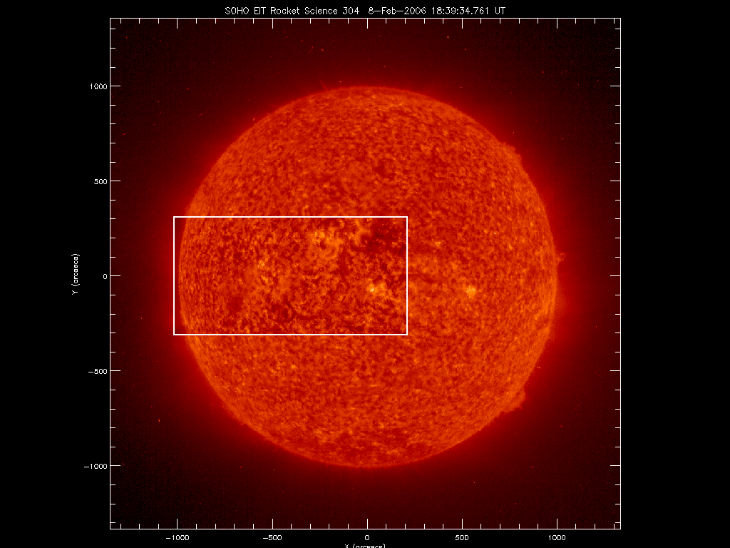

Slide 10
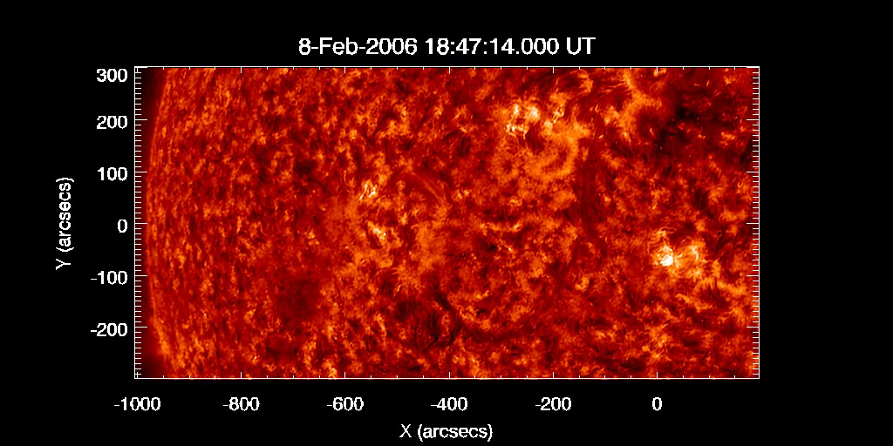
DATA

Slide 11
DATA
Need descriptive data on MOSES instrument:
  FOV
  Arcsec/pixel
  Dispersion
  Cadence
  Multilayer, and spectral content. Just HeII 304 as far as I’m concerned, but point to Jake Parkers poster.
  Put this stuff on the EIT inset slide?

Slide 12
Data Processing
Dark subtract
Flatfield
Coregistration
PSF Deconvolution (Later?)
Inversion (Later?)

Slide 13
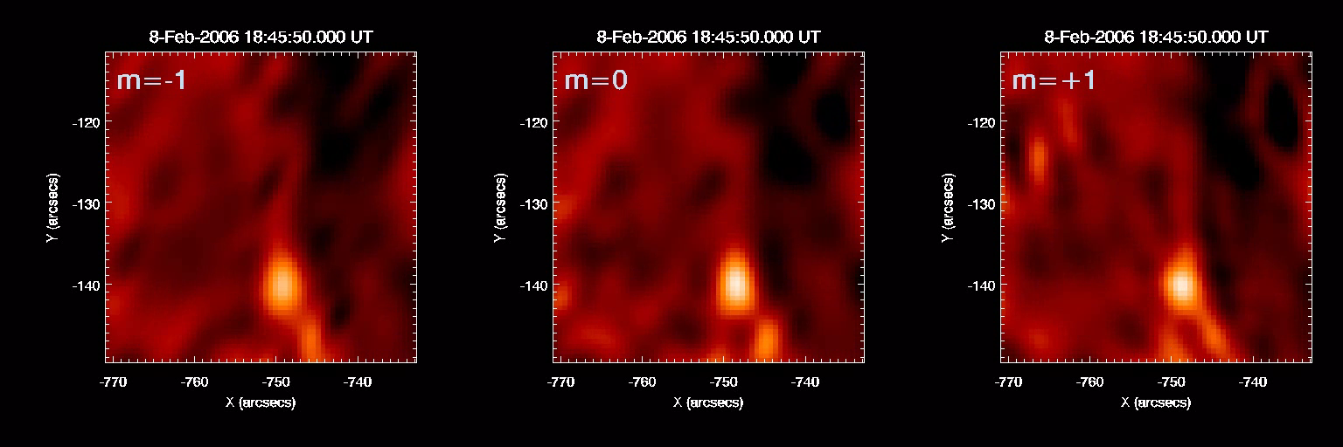
Need to add another row to this plot, showing profiles through
The object.
Notes:
Do I want to include a copy of the instrument schematic in this frame?

Slide 14
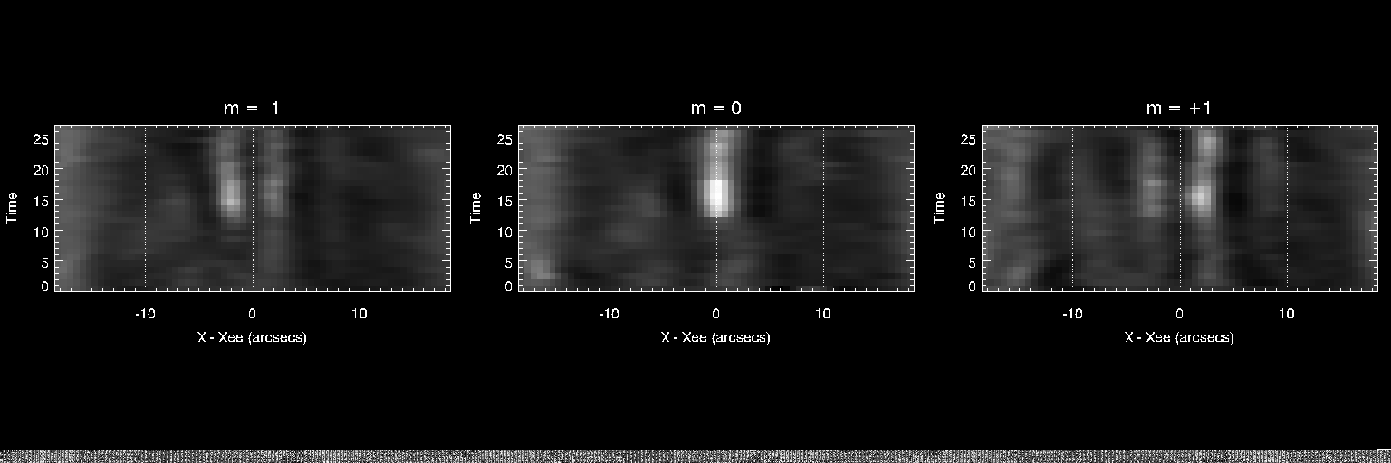
Need to set the y axis on these plots with the true time, or at least elapsed time
In seconds.

Slide 15
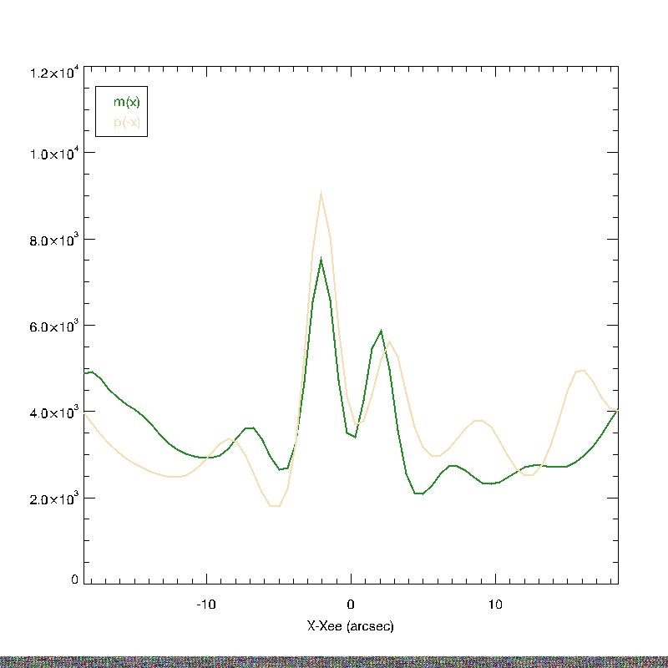
I might want to make
These plots on a black background.
Also, use linestyles instead of these
awful colors to defferentiate the
Two orders

Slide 16
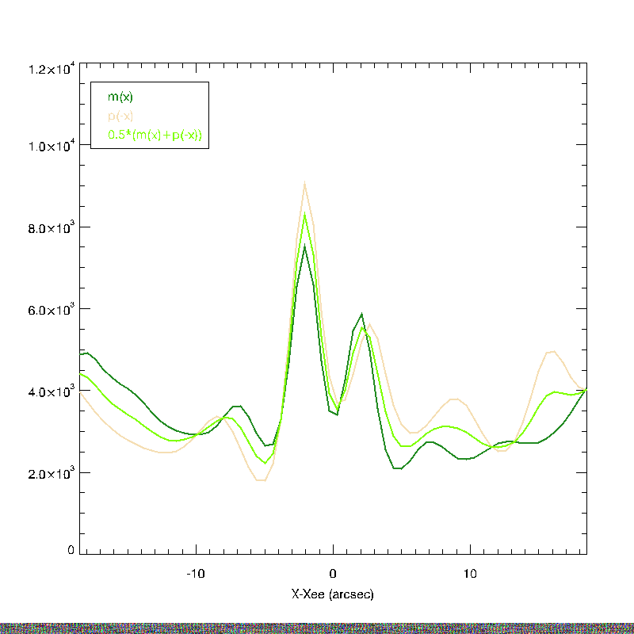

Slide 17
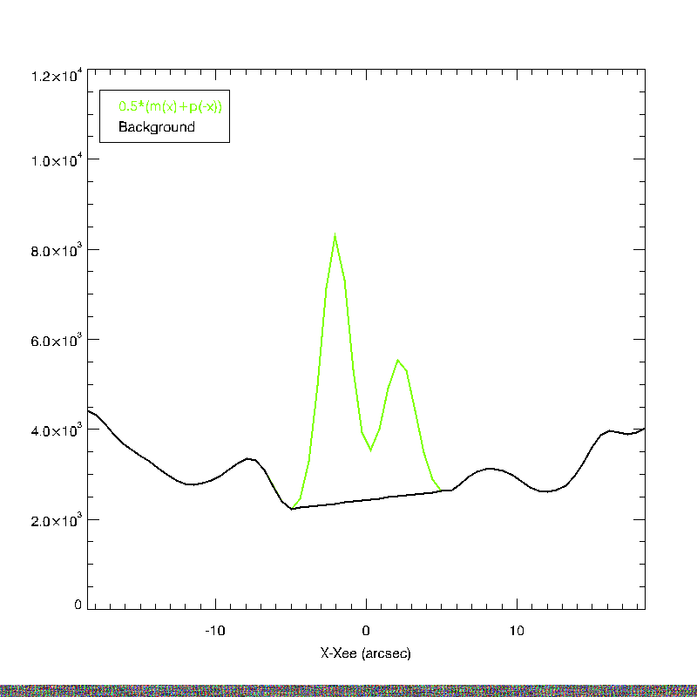

Slide 18
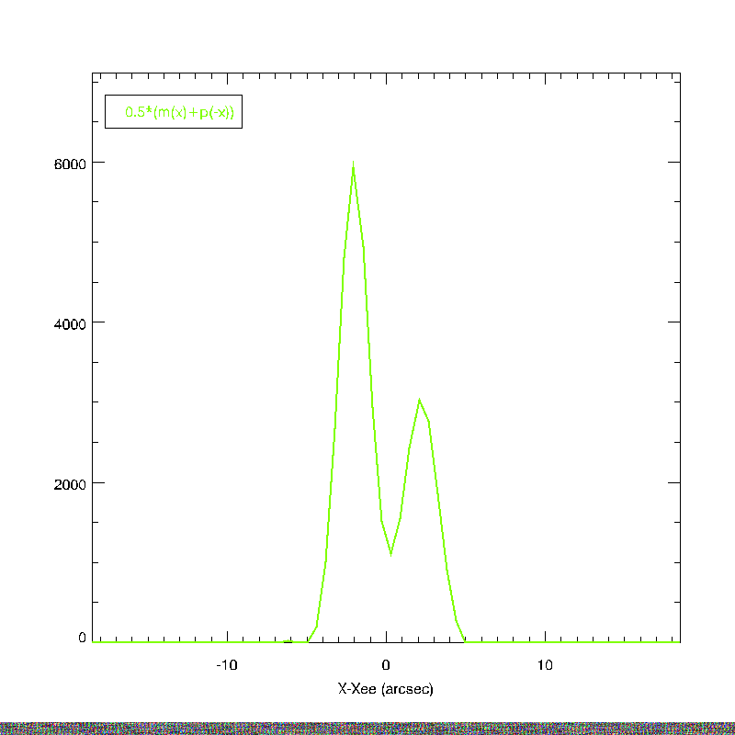

Slide 19
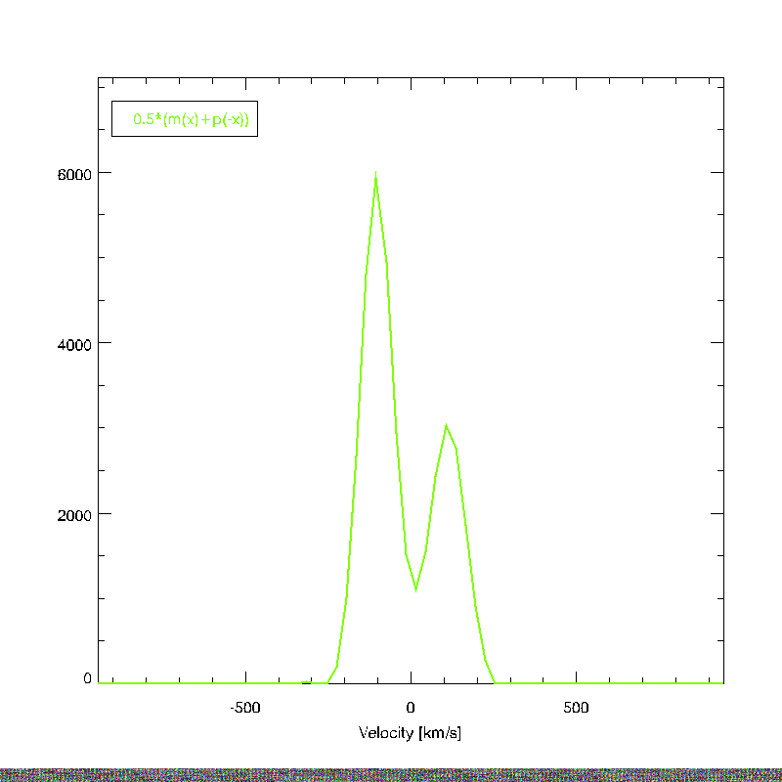

Slide 20
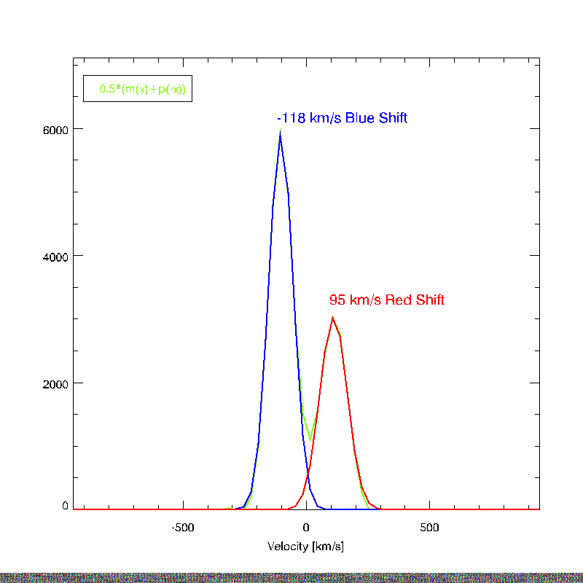

Slide 21
Simple estimate of the doppler shifts involved come from centroiding the components seen in the intensity data ➔ Plot of intensity profiles.
This event can be seen to meet the observational criteria of an explosive event.
Any centroid method will require some sort of background model.

Slide 22
INVERSIONS
I(x,y) = int{O(x+mL,y,L),dL}
For d function object, i.e., O = d(x,y)*f(L),
I(x,y) = f(x/m) , m ne 0
total(f) , m = 0

Slide 23
Inversions

Slide 24
Inversions
Need to talk about high pass filtering.
Need simulations of plaid, i.e., inversions with and without backgrouds.

Slide 25
Need multiple examples of EE’s
Here…
Here…
And here.

Slide 26
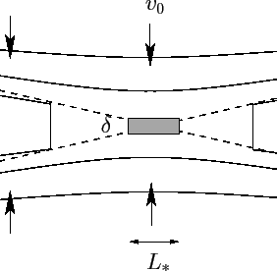
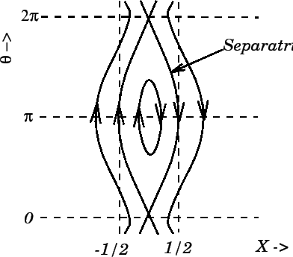
Reconnection Cartoons
Petschek
Plasmoid Instability
Innes 1997 also has a nice petschek cartoon.

Slide 27
Discussion
I have numerous EE’s in the data.
I think I can tell the difference between wide broadenings and strong shifts… and this seems like strong shifts.
The observed lack of low velocity plasma leads me to picture bi directional jets as predicted by fast sweet parker, e.g., petschek, not plasmoid.
Why do I not see the broad type events of HRTS and IRIS?
Are these two jet events different than broad events, or are they different parts of the elephant?

Slide 28
SECTIONS I NEED
What should the reconnection models look like to MOSES?
Can I distinguish the models, and what is the success rate for detection for various signal to noise of event?
Reference innes and guo for plasmoid spectra? Refernece for petschek assumed spectra?

Slide 29
TO DO
All plots need a little polish.

