Slide 1
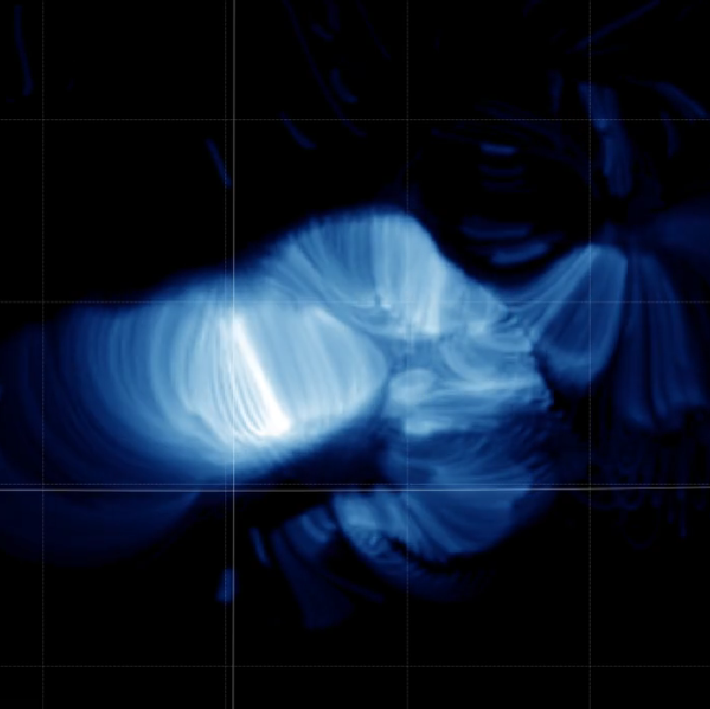
Energy Release Process in the 2021 October 28 X1.0 Flare
BROCK PARKER
CHUNMING ZHU
JIONG QIU
DANA LONGCOPE

Slide 2
OVERVIEW
01
02
03
04
BACKGROUND
PREVIOUS WORK
Solar flares, SDO, EBTEL
Magnetic Extrapolation, UFC, Two-phase Heating
CURRENT WORK
EXTENSION
Python SynthesizAR, Importing loop EBTEL results
Loop distributions

Slide 3
01
BACKGROUND

Slide 4
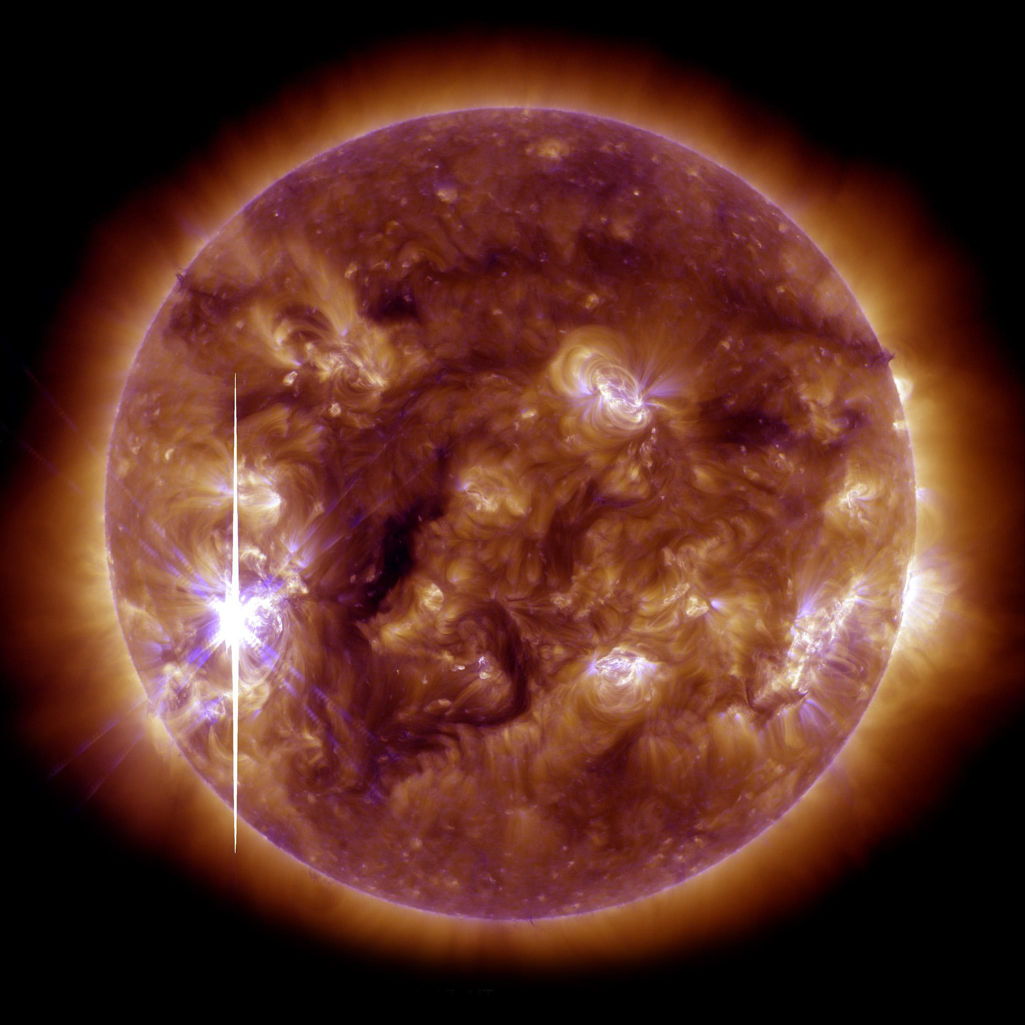
SOLAR FLARES
Intense eruption of electromagnetic radiation from the sun’s atmosphere.
Image Credit: SDO AIA

Slide 5
SDO - Solar Dynamics Observatory
HMI
1600 Å
304 Å
Magnetic Field in the Photosphere
Upper Photosphere and Transition Region, 10,000 K
Transition Region and Chromosphere, 50,000 K
171 Å
193 Å
131 Å
Upper Transition Region and Corona,
600,000 K
Corona,
1,000,000 K
Flaring Regions,
10,000,000 K
Image Credit: https://www.nasa.gov/mission_pages/sdo/how-sdo-sees-the-sun

Slide 6
EBTEL - Enthalpy Based Time Evolution of Loops
EQUILIBRIUM
ENTHAPLY
Energy balance between coronal heating and losses by radiation and thermal conduction.
Equate enthalpy flux of plasma with change in heat flux relative to radiation loss rate in the transition region.
(Klimchuk et al., 2008)

Slide 7
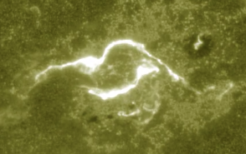
UFC
UV Footprint Calorimeter Method, assuming the heating of the loops is proportional to the brightness of loop feet.
(Qiu et al., 2012)

Slide 8
02
PREVIOUS WORK

Slide 9
PROCESS
LIGHTCURVES
EBTEL
IMAGES
Flare lightcurves for each different SDO EUV wavelength.
Run 0D simulations of the loops and generate synthetic lightcurves.
Load simulations and generate animations using SynthesizAR.

Slide 10
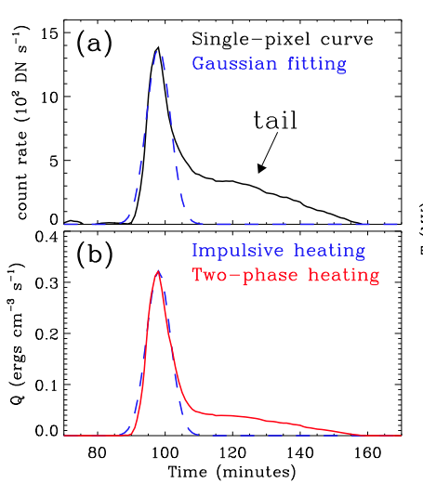
Two-Phase Heating
(Qiu & Longcope, 2016, Zhu et al., 2018)

Slide 11
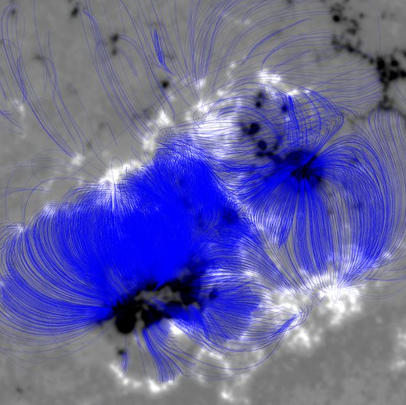
Magnetic Extrapolation
Simulating magnetic field loops from HMI data.

Slide 12
03
CURRENT WORK
Notes:
Using all of this, where are we so far

Slide 13
20211028 X1.0
OUR FLARE

Slide 14
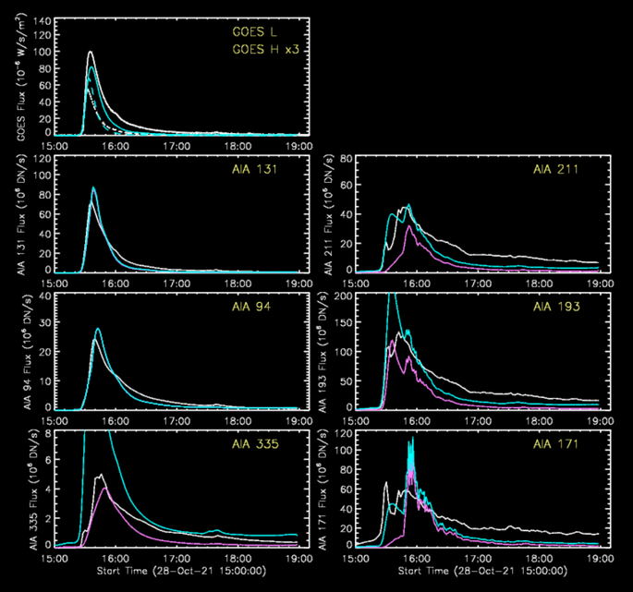
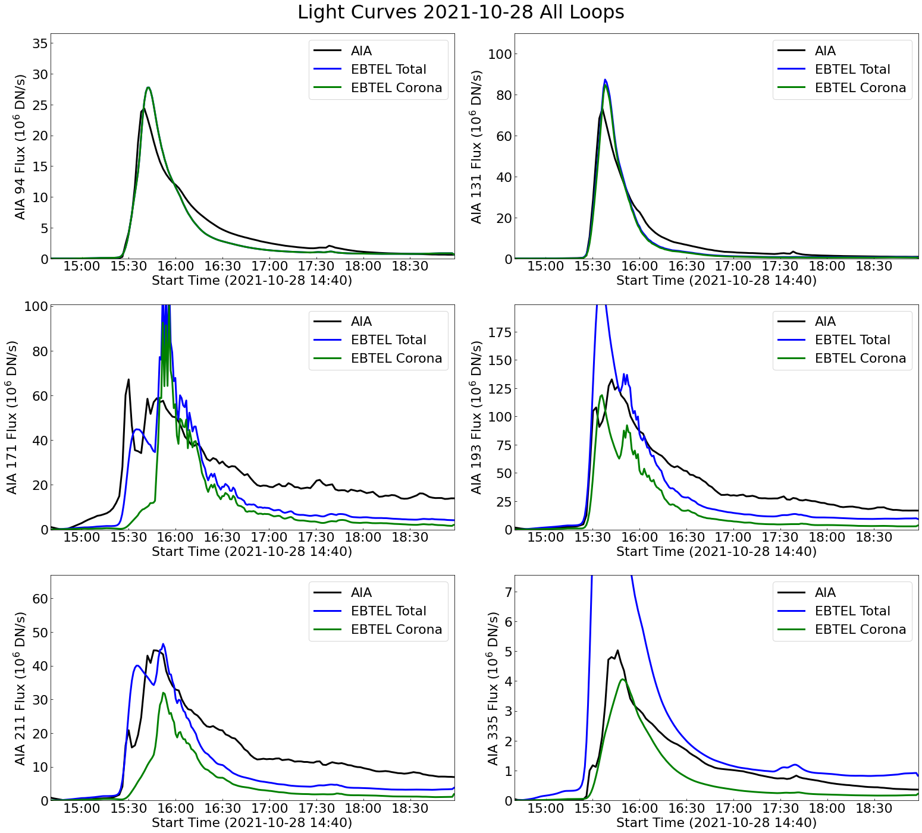
LIGHT CURVES
Light curves of the entire flaring region from observational data compared with synthetic emissions.

Slide 15
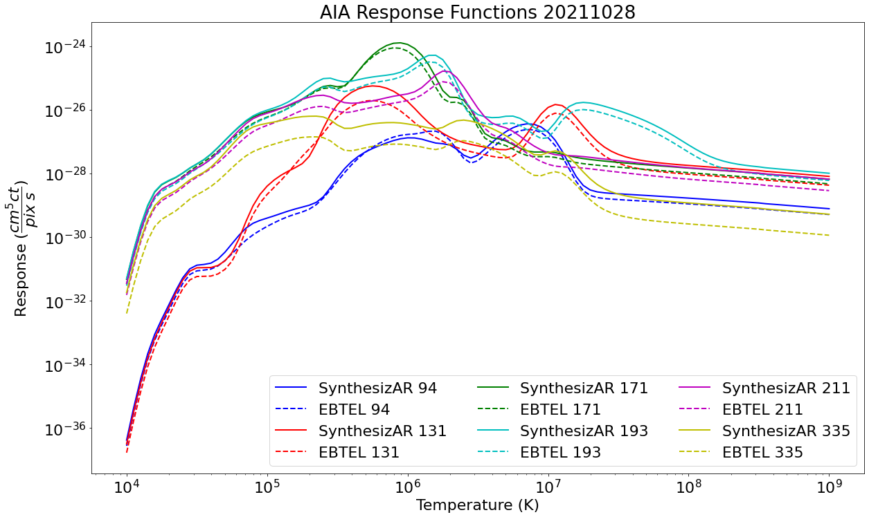
SynthesizAR
$$p_{c}=\int{dhK_{c}(T_{e}){n_{e}}^{2}}$$
(Boerner et al., 2012)
.(Barnes et al., 2019)

Slide 16
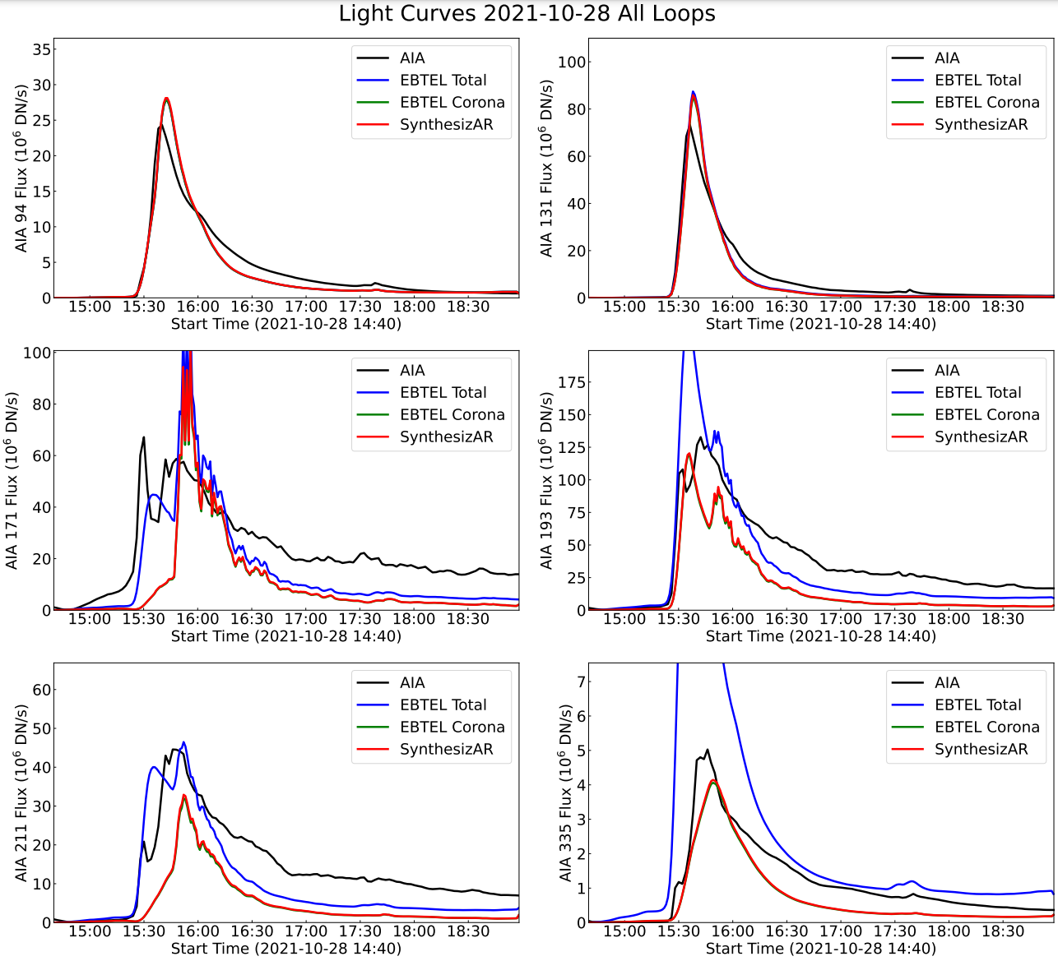
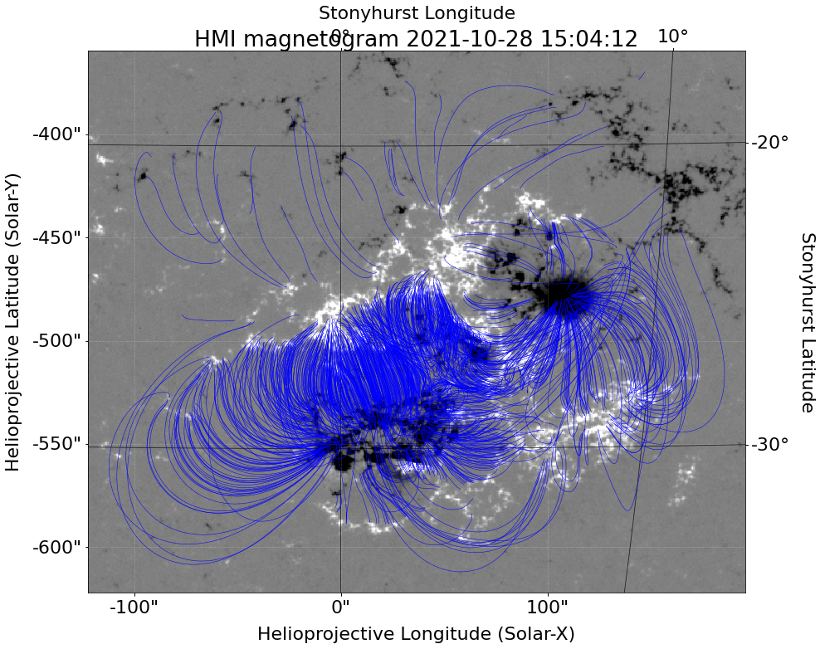
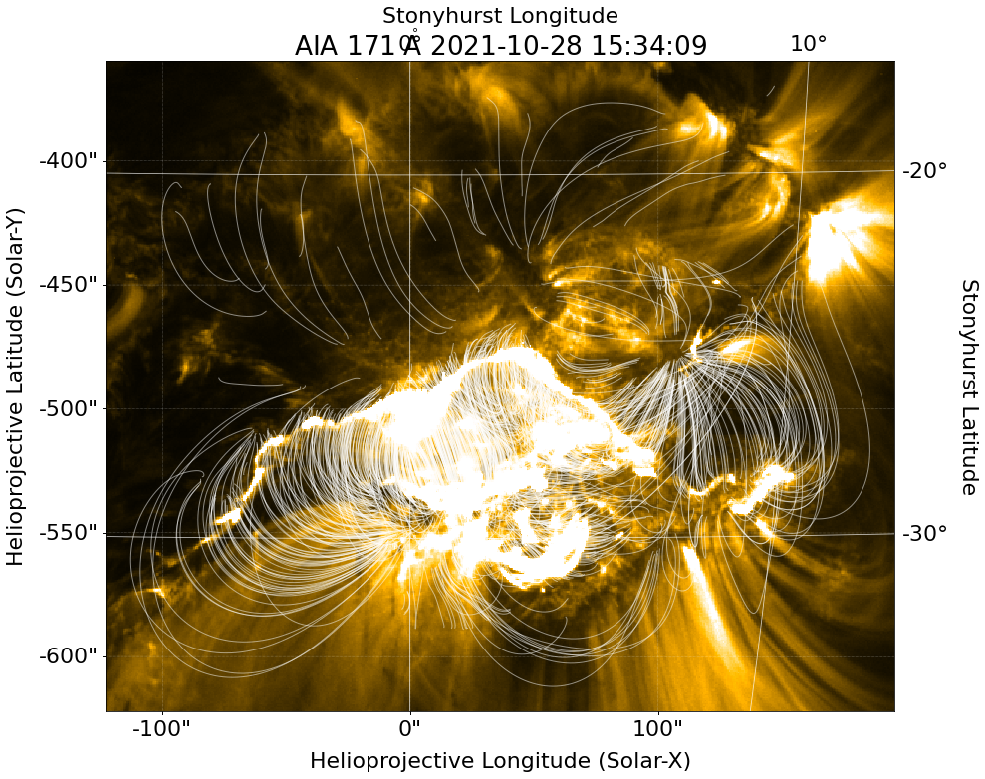
IMPORTING LOOPS
EBTEL and Coordinates. Uniform temperature and density.

Slide 17
ANIMATIONS

Slide 18
04
EXTENSIONS

Slide 19
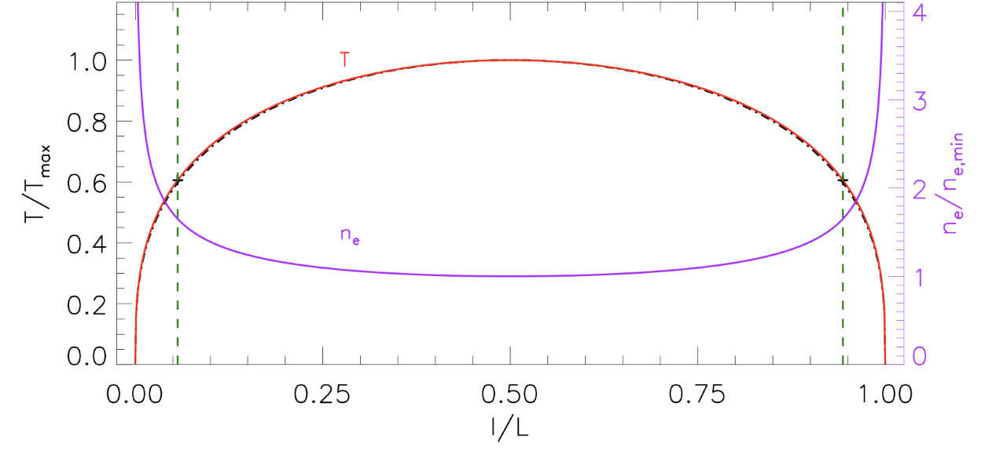
RTV distributions for temperature and density.
$$T\left(s\right)=1.29\left\langle T\right\rangle {(1−{(s/L)}^{2})}^{1/3}$$
$$n\left(s\right)=0.77\left\langle n\right\rangle {(1−{(s/L)}^{2})}^{{−1}/3}$$
LOOP DISTRIBUTIONS
(Rosner et al. 1978; Credit: Dana Longcope)

Slide 20
LOOP DISTRIBUTIONS
Footpoint brightness

Slide 21
ANIMATIONS

Slide 22
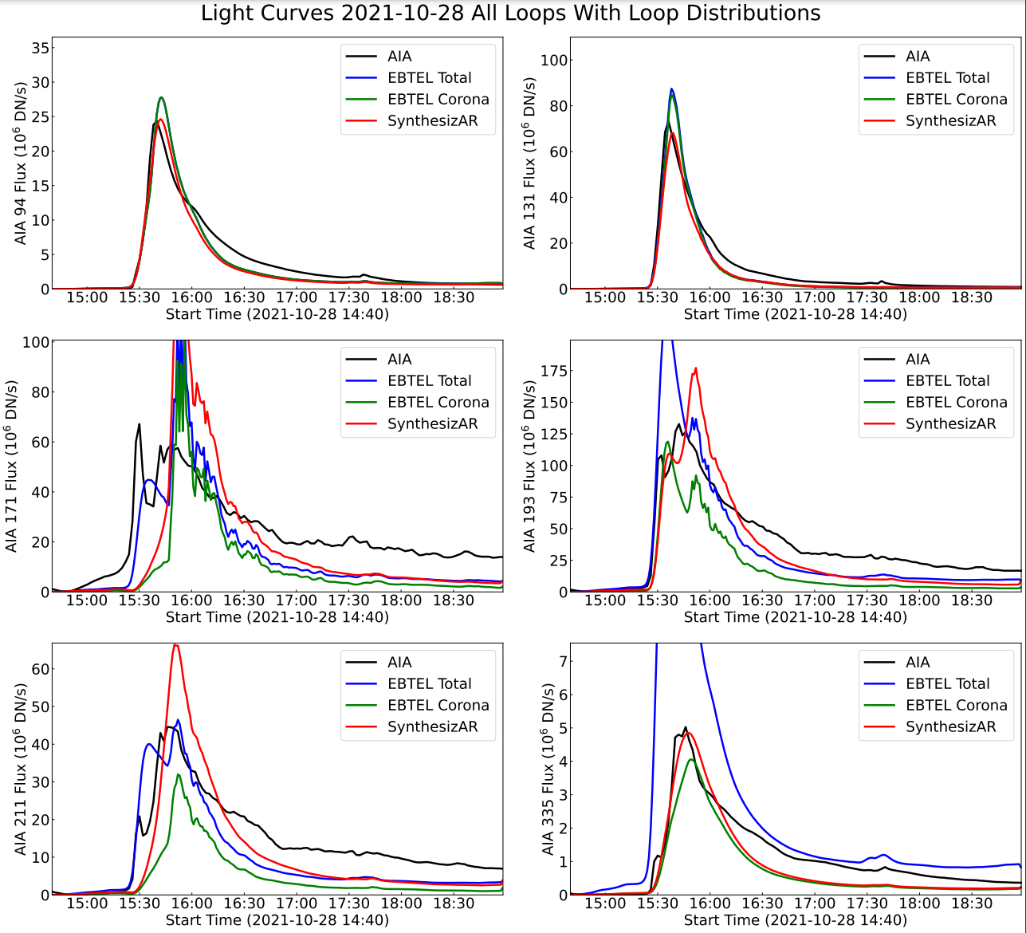
LIGHTCURVES

Slide 23
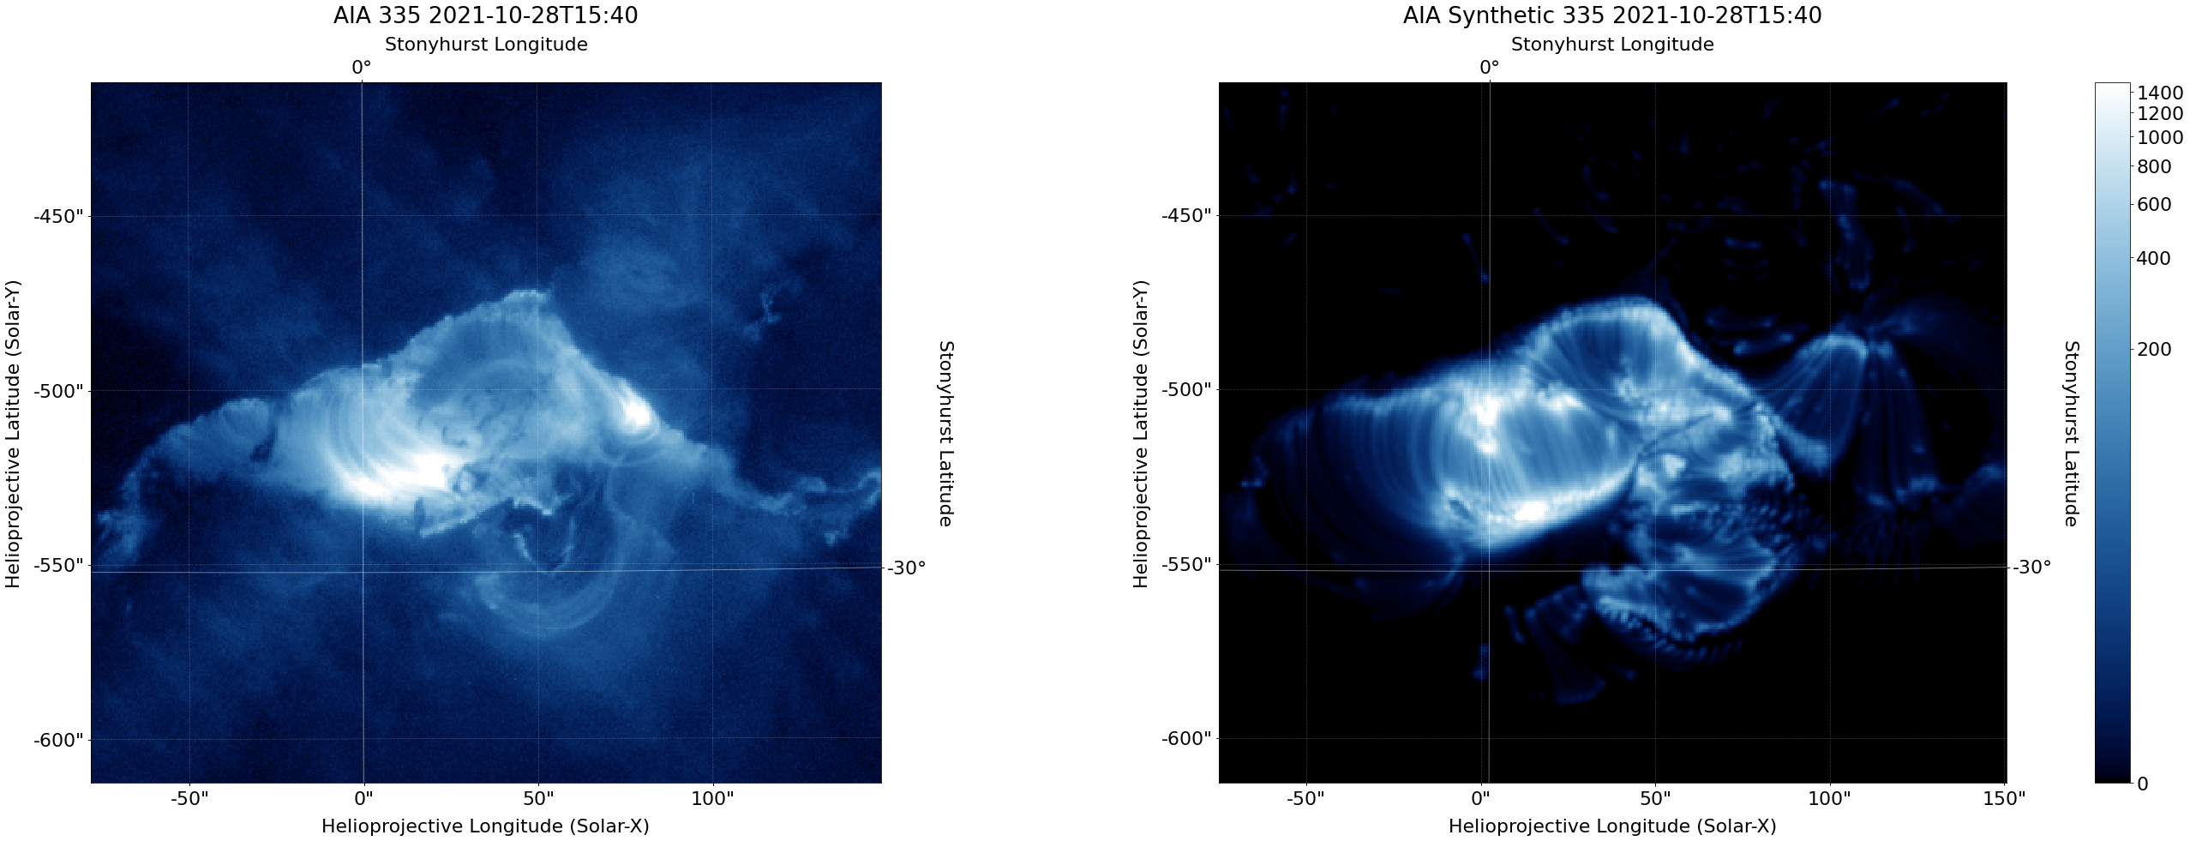
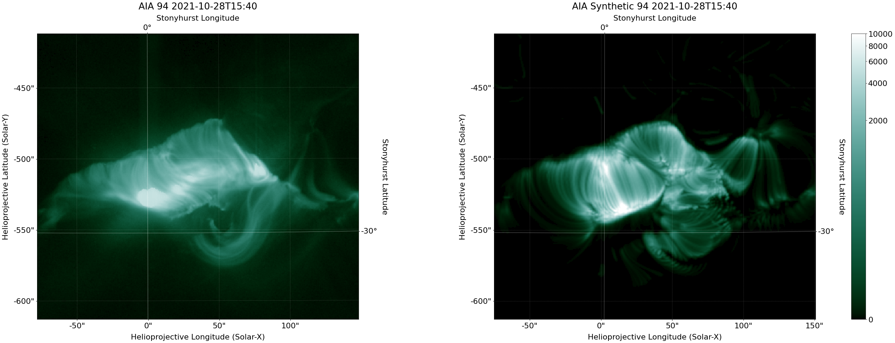
COMPARISON
Comparing synthetic images to actual data.

Slide 24
BIBLIOGRAPHICAL REFERENCES
J. A. Klimchuk, et al. 2008, ApJ, 682, 1351.
Highly Efficient Modeling of Dynamic Coronal Loops
Jiong Qiu, et al. 2012, ApJ, 752, 124.
Heating of Flare Loops with Observationally Constrained Heating Functions (UFC or UV Footprint Calorimeter Method)
Jiong Qiu and Longcope, Dana 2016, ApJ, 820, 14.
Long Duration Flare Emission: Impulsive Heating or Gradual Heating?
Chunming Zhu, et al. 2018, ApJ, 856, 27.
Two-Phase Heating in Flaring Loops
W. T. Barnes, et al. 2019, ApJ, 880, 56.
Understanding Heating in Active Region Cores through Machine Learning. I. Numerical Modeling and Predicted Observables
R. Rosner, et al. 1978, ApJ, 220, 634.
Initial Calibration of the Atmospheric Imaging Assembly (AIA) on the Solar Dynamics Observatory (SDO)
Paul Boerner, et al. 2012, Solar Physics 275, 41.
Dynamics of the quiescent solar corona

Slide 25
THANKS!
Do you have any questions?
bparke13@uwyo.edu
https://solar.physics.montana.edu/home/www/reu/2022/bparker/index.html
Advisor: Dr. Chunming Zhu

