Slide 1
SYNTHETICALLY OBSERVING EBTEL MODELED SOLAR FLARES
BY BROCK PARKER
Notes:
Discussing my project, synthetically observing ebtel modeled flare loops
We will get to what ebtel is and what we mean by synthetic

Slide 2
OVERVIEW
01
02
03
04
BACKGROUND
PREVIOUS WORK
Solar flares, SDO, EBTEL
Magnetic Extrapolation, UFC, Two-phase Heating
CURRENT WORK
FUTURE
Python SynthesizAR, Importing loops
Importing Results, Modifications
Notes:
Quick overview
What is needed to understand everything that has been done
What has been previously done and what we are building on
What we are actually doing
What we plan to do next

Slide 3
01
BACKGROUND
Notes:
Start with some background

Slide 4
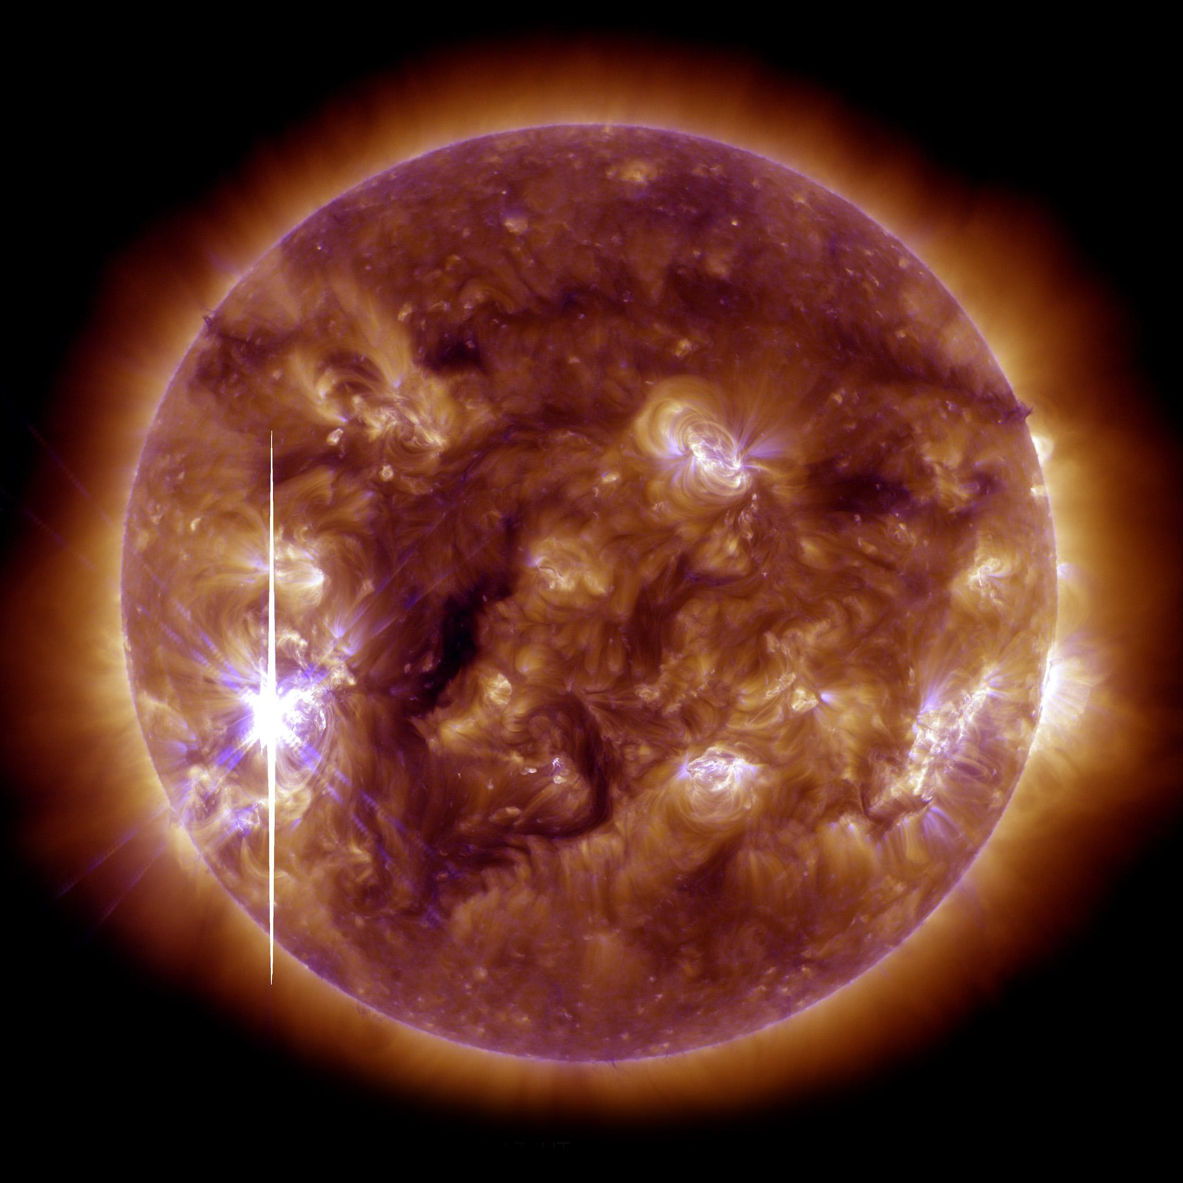
SOLAR FLARES
Intense eruption of electromagnetic radiation from the sun’s atmosphere.
Image Credit: SDO AIA
Notes:
Working with solar flares, very much beating a dead horse
Review is always nice - intense eruption of electromagnetic radiation from the sun’s atmosphere
Energy comes from magnetic field reconnection - loops come together to a more energy stable state and release the free energy, energy difference between the states

Slide 5
SDO - Solar Dynamics Observatory
HMI
1600 Å
304 Å
Magnetic Field in the Photosphere
Upper Photosphere and Transition Region, 10,000 K
Transition Region and Chromosphere, 50,000 K
171 Å
193 Å
131 Å
Upper Transition Region and Corona,
600,000 K
Corona,
1,000,000 K
Flaring Regions,
10,000,000 K
Image Credit: https://www.nasa.gov/mission_pages/sdo/how-sdo-sees-the-sun
Notes:
Working with data from SDO, both HMI and AIA
HMI gives magnetic field strength in all 3 directions
AIA observes at different wavelengths - each wavelength probes a different emission line, hence a temperature
Different temp also means different region of the sun’s atmosphere, small selection here

Slide 6
EBTEL - Enthalpy Based Time Evolution of Loops
EQUILIBRIUM
ENTHAPLY
Energy balance between coronal heating and losses by radiation and thermal conduction.
Equate enthalpy flux of plasma with change in heat flux relative to radiation loss rate in the transition region.
(Klimchuk et al., 2008)
Notes:
Enthalpy based time evolution of loops, two equations, need not know all the terms, just note that they are averaged, not over time but over space - will come back to
Based on equilibrium balance between energy gained by coronal heating and energy lost through radiation and thermal conduction
Enthalpy - total heat content, energy plus volume times pressure
Equating the change in total heat content to the change in the radiation loss rate - not just loss rate

Slide 7
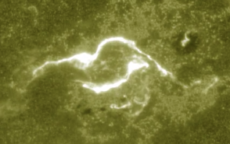
UFC
UV Footprint Calorimeter Method. The brightness of loop feet is proportional to the heating of the loops.
(Qiu et al., 2012)
Notes:
UV footprint calorimeter method
Intensity of the feet of the loops is proportional to the heating of the loops/energy, developed by Jiong
Each pixel in the image is treated as a footpoint for a half loop, use 1600 as it looks near the bottom of the loops

Slide 8
02
PREVIOUS WORK
Notes:
Using that, what has been done

Slide 9
PROCESS
LIGHTCURVES
PIXELS
EBTEL
Flare lightcurves for each different SDO EUV wavelength.
Identification of flaring pixels in the 1600 flaring ribbons.
Run 0D simulations of the loops and generate synthetic lightcurves.
Notes:
Overview of the process that is used to get synthetic loop parameters and lightcurves

Slide 10
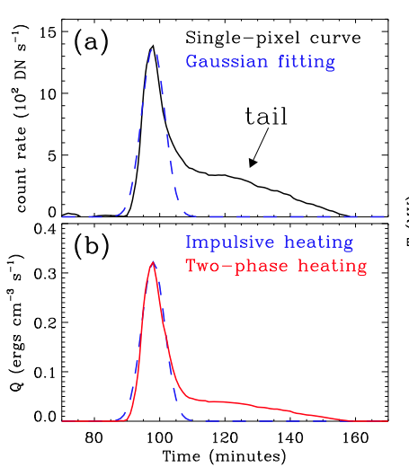
Two-Phase Heating
(Qiu & Longcope, 2016, Zhu et al., 2018)
Notes:
Twophase heating
Initially just one impulsive phase in blue, but flares have residual tail intensity not accounted for
Model impulsive with a gaussian, model tail as simply a factor of the tail itself, two different lambda factors

Slide 11
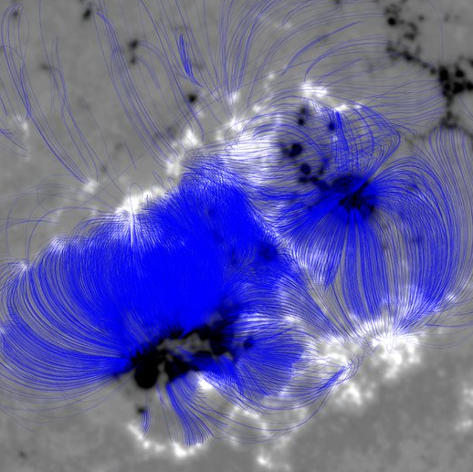
Magnetic Extrapolation
Simulating magnetic field loops from HMI data.
Notes:
Also need to see where these loops are
Talked about during seminars, can use magnetic field boundary conditions, with a lot of assumptions, plus Maxwell’s equations to get magnetic field lines
Loops (specifically the emitting particles) are charged plasma, meaning they follow field lines, can assume

Slide 12
03
CURRENT WORK
Notes:
Using all of this, where are we so far

Slide 13
20211028 X1.0
OUR FLARE
Notes:
This is the flare we are observing in different wavelengths
Couldn’t get movies to load

Slide 14
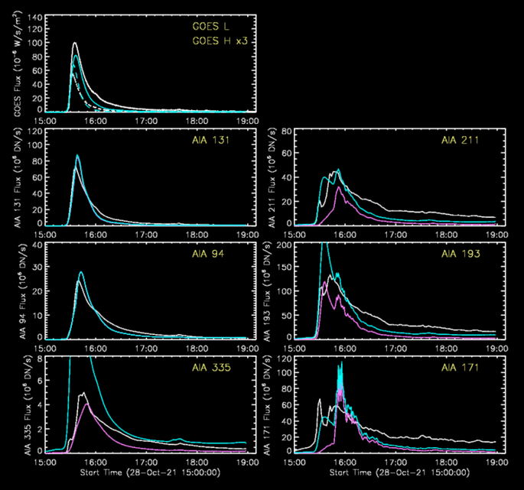
LIGHT CURVES
Light curves of the entire flaring region from observational data compared with synthetic.
Notes:
First, generate white actual light curves
Plug into pipeline discussed earlier to get blue and pink light curves - blue is total, pink is coronal, the two that are only blue have the same blue and pink, all coronal
Ideally they would all match, but this is the best we have so far
Also generates graphs of pressure, density, and temperature over time for each loop - these are total combined, we work with individual pixels

Slide 15
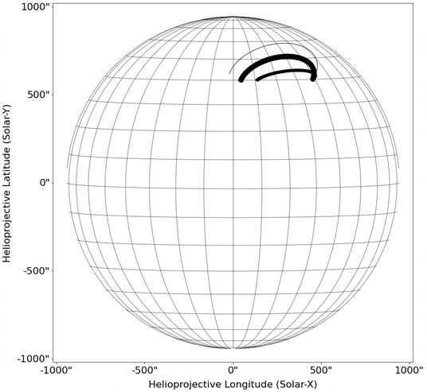
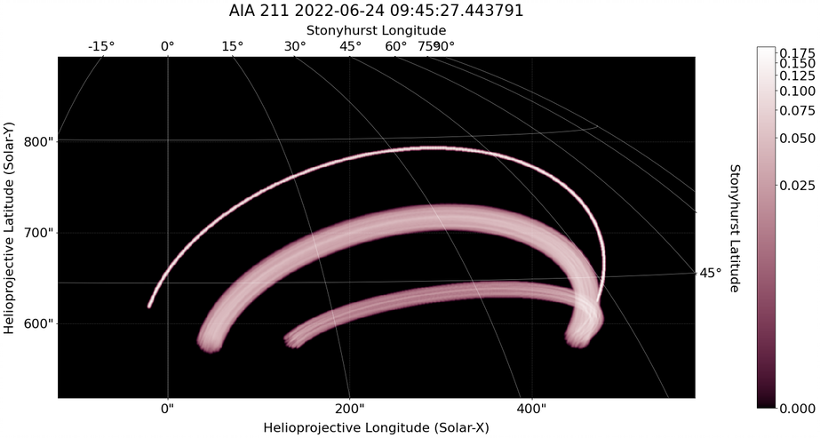
SynthesizAR
(Barnes et al., 2019)
Notes:
Move to python package synthesizAR developed by WT barnes
Allows generation of fake loops, and then passing them to a fake AIA camera to see what it would see
These loops are just made and placed by hand, and combined by hand - we have 14000, need to generalize

Slide 16
RANDOM LOOPS
Modification to Python standards plus adaptation to arbitrary numbers of loops.
Notes:
Generalized code to take arbitrary loops, here are 100 random loops with random heating
Also made it follow python standards - now can use our data

Slide 17
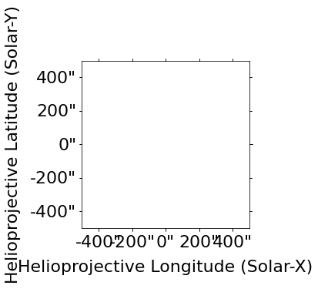
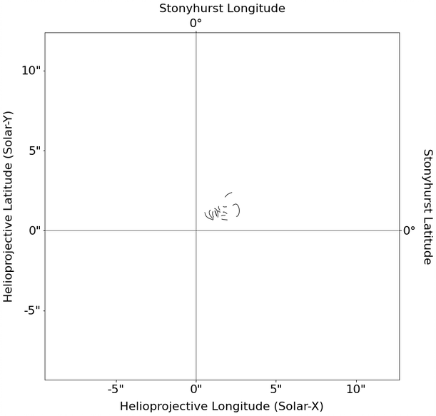
IMPORTING LOOPS
Modifying loop coordinates to be processed by SynthesizAR.
Notes:
First had to actually get extrapolated loops into synthesizAR coordinates - kinda hard
Eventually got something, but wrong size

Slide 18
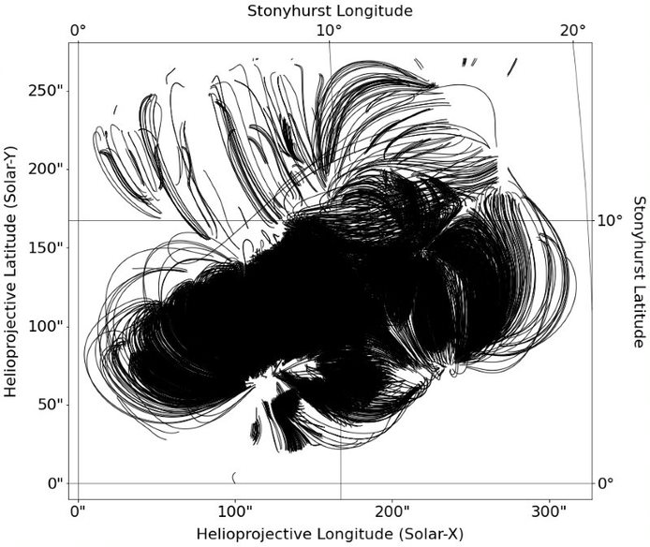
IMPORTING LOOPS
Modifying loop coordinates to be processed by SynthesizAR.
Notes:
Finally got them. This is all 14 thousand, size is correct, however placement is not - will come back to

Slide 19
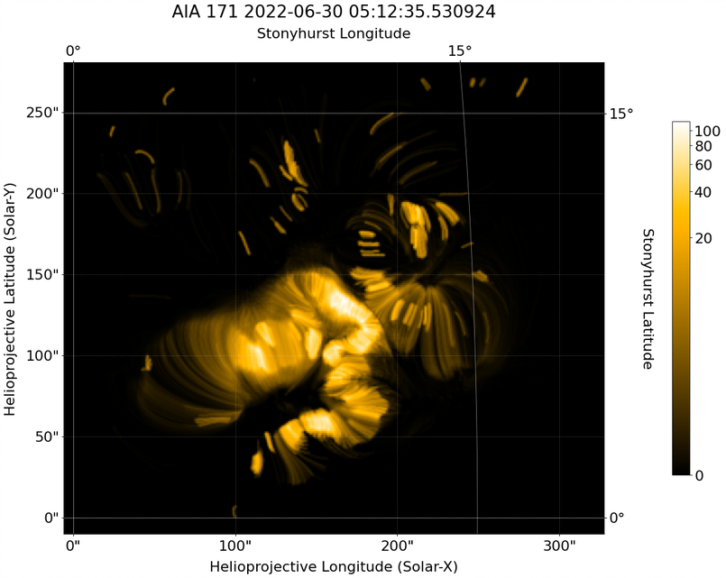
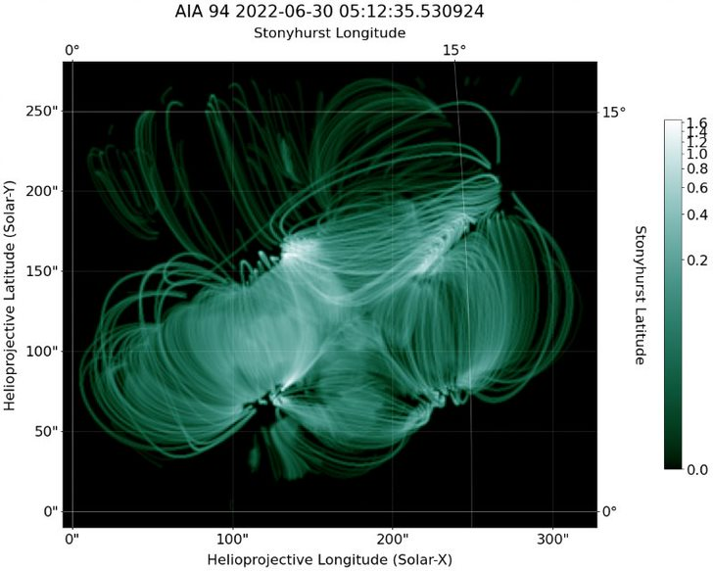
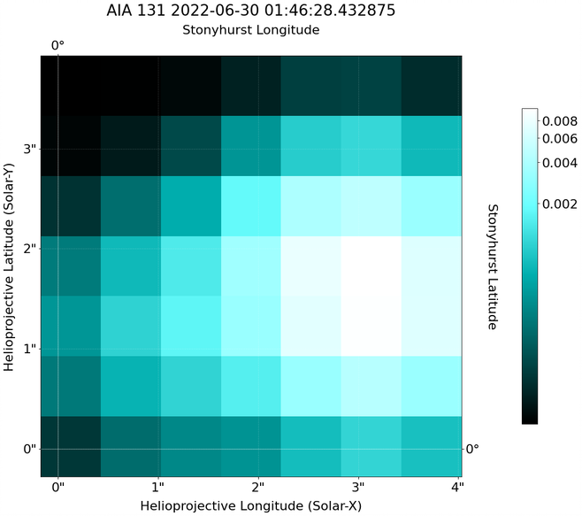
SYNTHETIC LOOPS
Notes:
Now to observe them with “AIA”
Again kinda hard, eventually got it
Each loop has the same constant heat flux, however because of different sizes and locations the resulting equilibrium is different, giving these nice differences

Slide 20
04
FUTURE WORK
Notes:
What next?

Slide 21
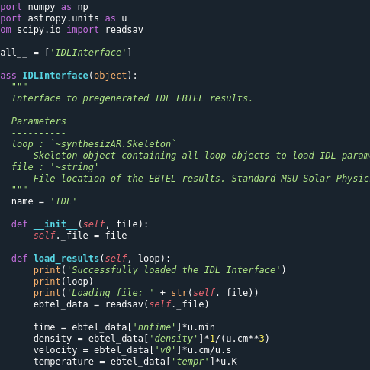
NEXT STEPS
COORDINATES
EBTEL
Accurately import loop coordinates in Stonyhurst frame.
Read in EBTEL results for each loop.
TIME
COMPARE
Iterate synthetic observations over actual time evolution.
Compare synthetic images to actual data.
Notes:
Distribution along flare loops

Slide 22
BIBLIOGRAPHICAL REFERENCES
J. A. Klimchuk, et al. 2008, ApJ, 682, 1351.
Highly Efficient Modeling of Dynamic Coronal Loops
Jiong Qiu, et al. 2012, ApJ, 752, 124.
Heating of Flare Loops with Observationally Constrained Heating Functions (UFC or UV Footprint Calorimeter Method)
Jiong Qiu and Longcope, Dana 2016, ApJ, 820, 14.
Long Duration Flare Emission: Impulsive Heating or Gradual Heating?
Chunming Zhu, et al. 2018, ApJ, 856, 27.
Two-Phase Heating in Flaring Loops
W. T. Barnes, et al. 2019, ApJ, 880, 56.
Understanding Heating in Active Region Cores through Machine Learning. I. Numerical Modeling and Predicted Observables

Slide 23
THANKS!
Do you have any questions?
bparke13@uwyo.edu
https://solar.physics.montana.edu/home/www/reu/2022/bparker/index.html
Advisor: Dr. Chunming Zhu

