Slide 1
SYNTHETICALLY OBSERVING EBTEL MODELED SOLAR FLARES:
Week 8 Update
BY BROCK PARKER

Slide 2
PROCESS
LIGHTCURVES
EBTEL
VIDEOS
Flare lightcurves for each different SDO EUV wavelength.
Run 0D simulations of the loops and generate synthetic lightcurves.
Load simulations and generate animations using SynthesizAR.

Slide 3
EBTEL - Enthalpy Based Time Evolution of Loops
EQUILIBRIUM
ENTHAPLY
Energy balance between coronal heating and losses by radiation and thermal conduction.
Equate enthalpy flux of plasma with change in heat flux relative to radiation loss rate in the transition region.
(Klimchuk et al., 2008)

Slide 4
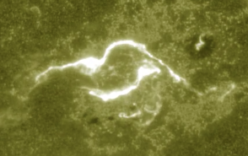
UFC
UV Footprint Calorimeter Method. The brightness of loop feet is proportional to the heating of the loops.
(Qiu et al., 2012)

Slide 5
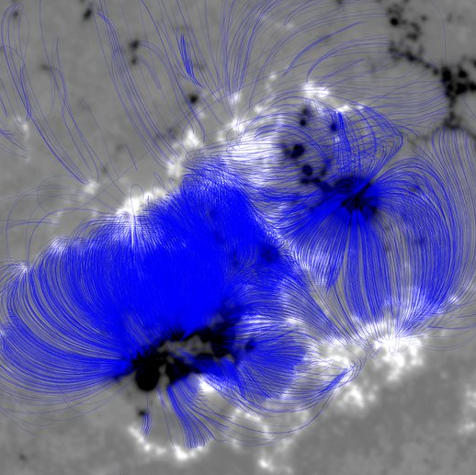
Magnetic Extrapolation
Simulating magnetic field loops from HMI data.

Slide 6
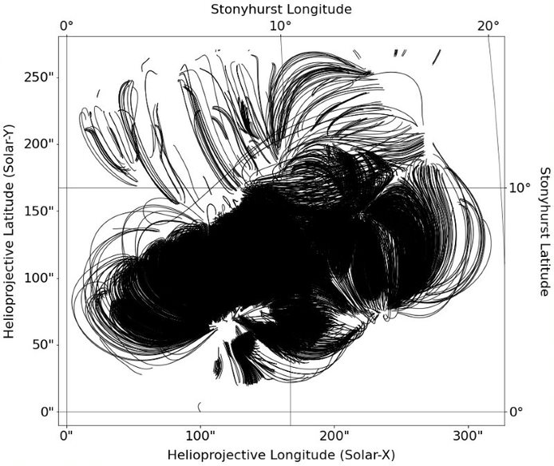
IMPORTING LOOPS
Modifying loop coordinates to be processed by SynthesizAR.

Slide 7
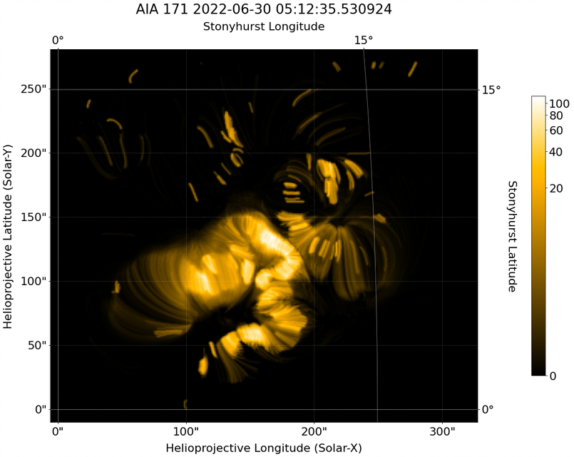
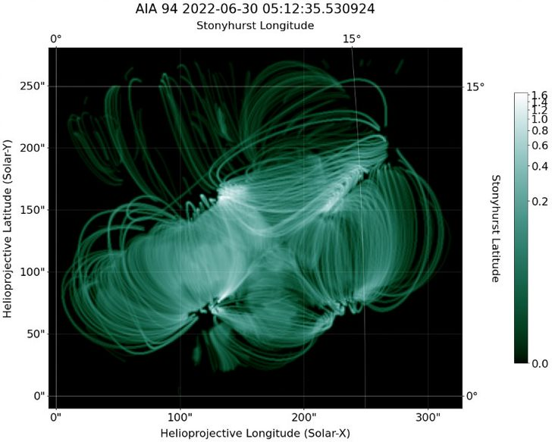
SYNTHETIC LOOPS

Slide 8
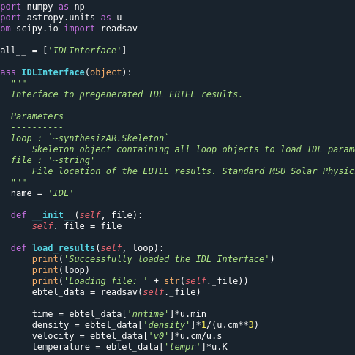
PREVIOUSLY
COORDINATES
EBTEL
Accurately import loop coordinates in Stonyhurst frame.
Read in EBTEL results for each loop.
TIME
COMPARE
Iterate synthetic observations over actual time evolution.
Compare synthetic images to actual data.
Notes:
Distribution along flare loops

Slide 9
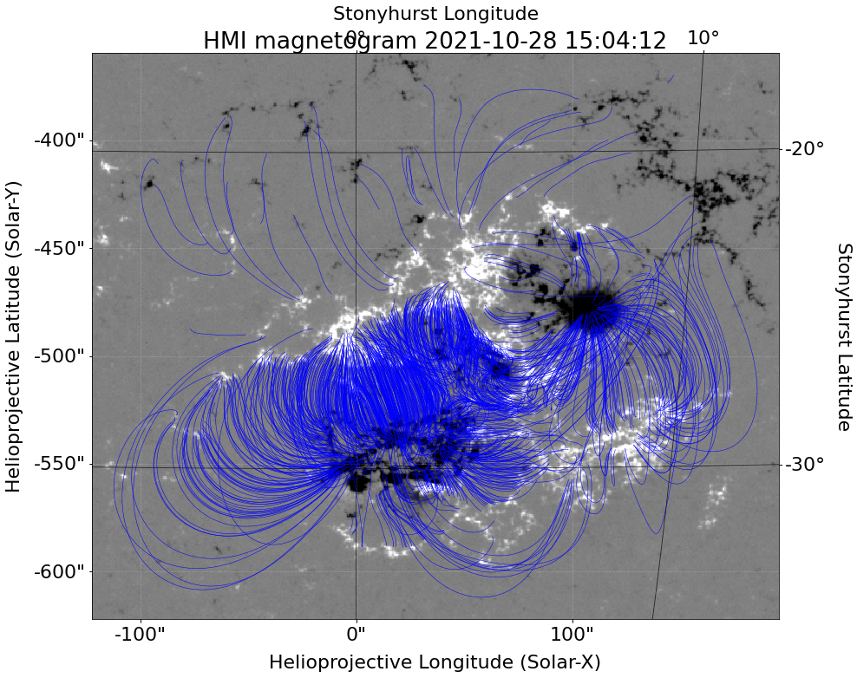
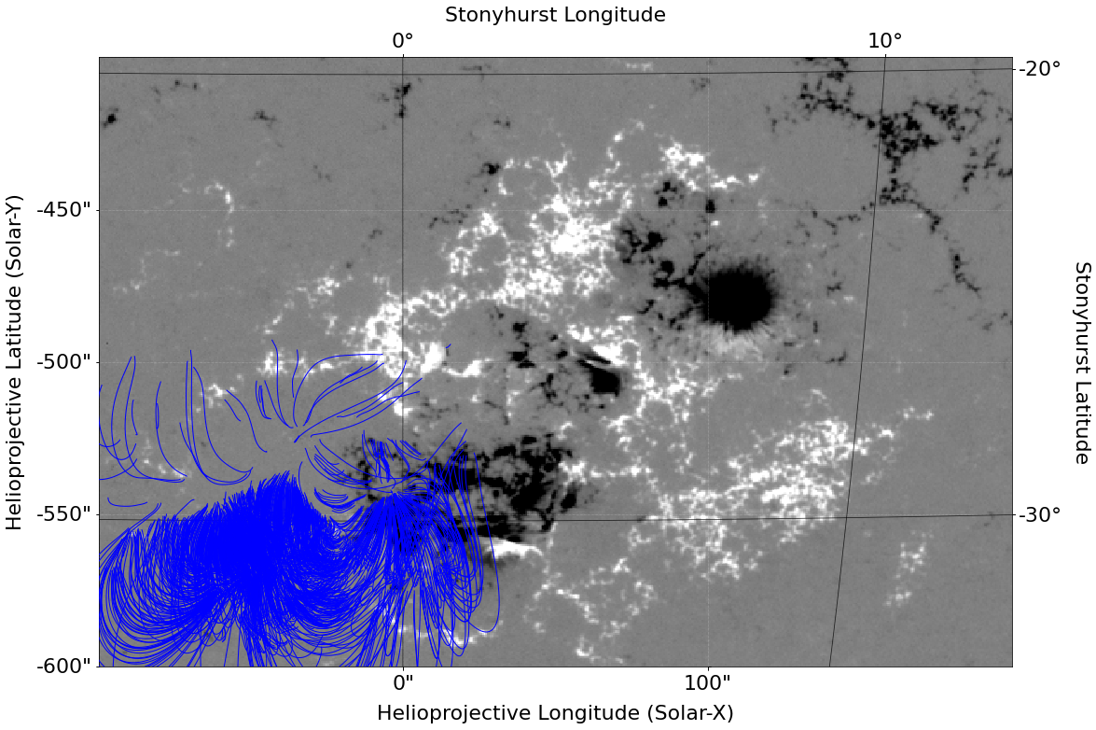
CORRECT COORDINATES
BEFORE
AFTER
(Klimchuk et al., 2008)

Slide 10
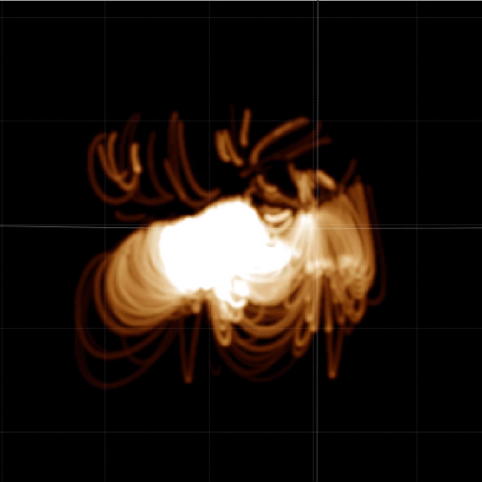
EBTEL RESULTS

Slide 11
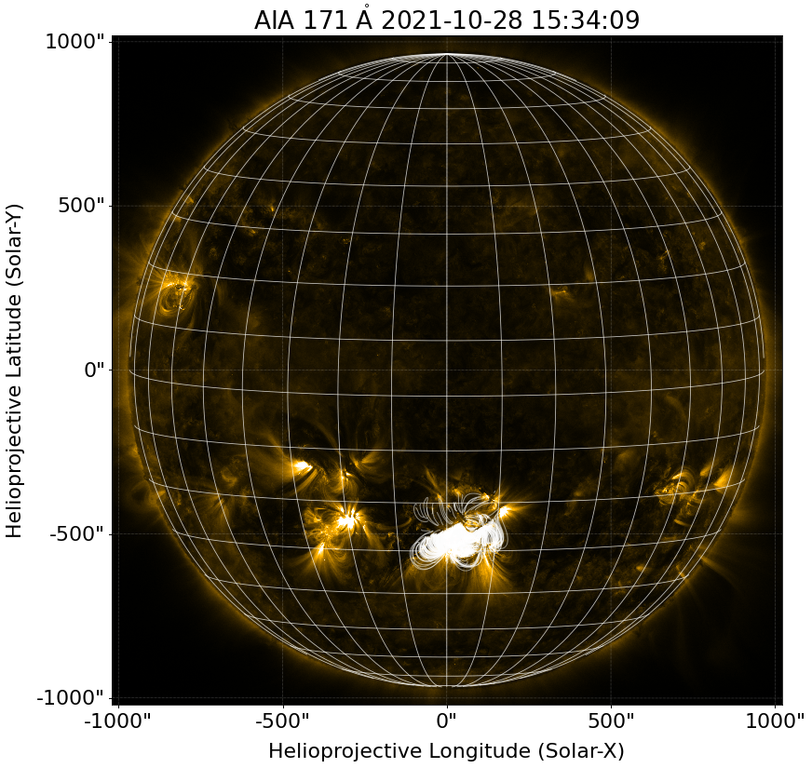
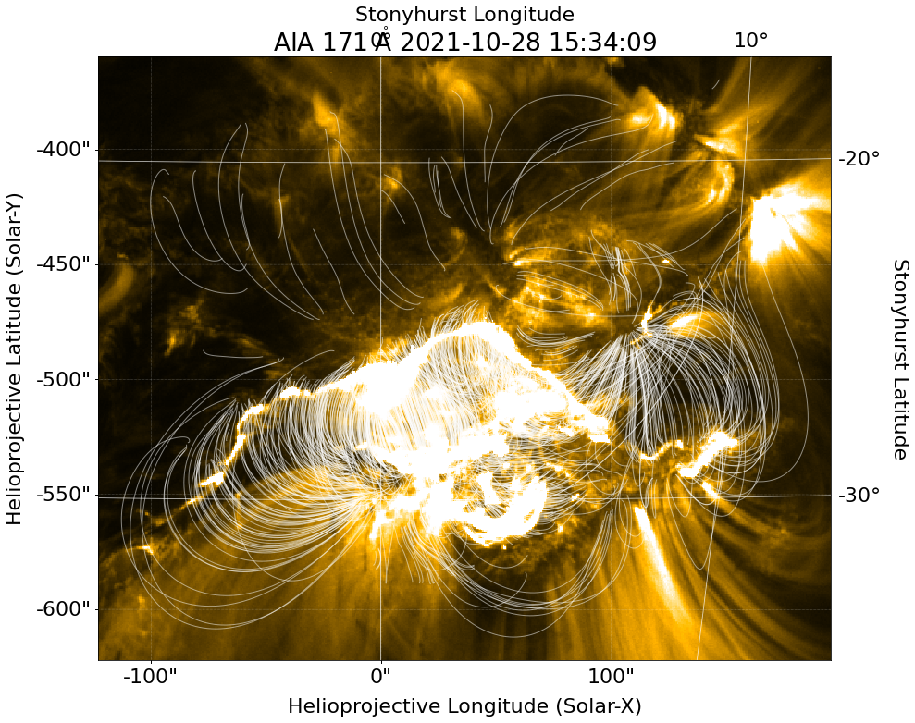
PLOTTING

Slide 12
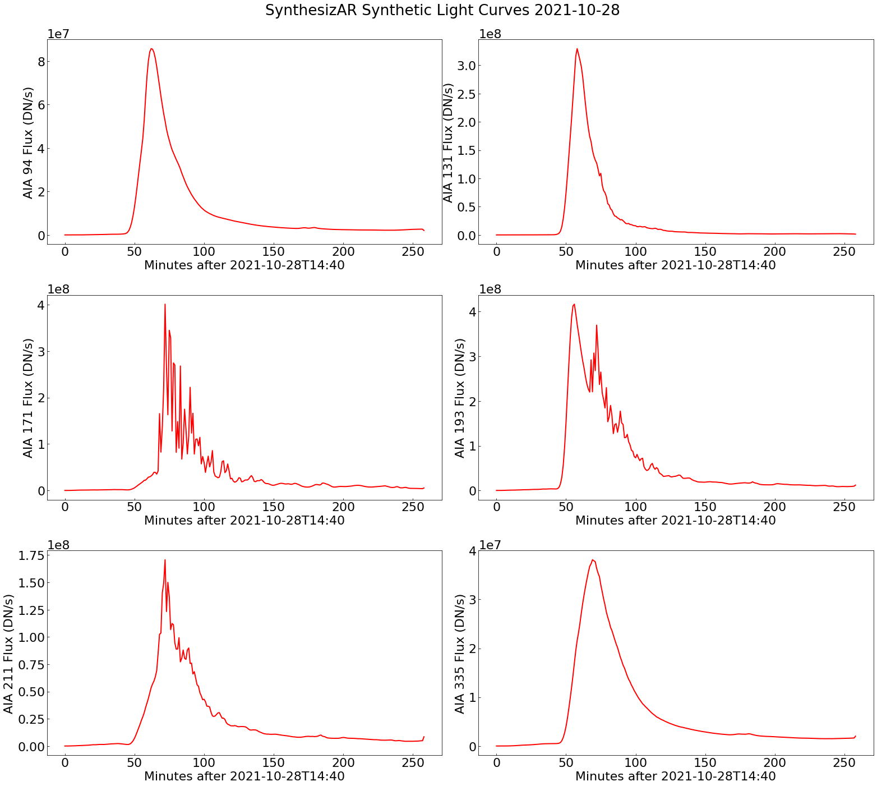
LIGHT CURVES

Slide 13
ANIMATIONS
94
131
https://solar.physics.montana.edu/home/www/reu/2022/bparker/files/aia_94_full.mp4
https://solar.physics.montana.edu/home/www/reu/2022/bparker/files/aia_131_full.mp4
171
211
https://solar.physics.montana.edu/home/www/reu/2022/bparker/files/aia_171_full.mp4
https://solar.physics.montana.edu/home/www/reu/2022/bparker/files/aia_211_full.mp4
Notes:
Distribution along flare loops

Slide 14
BIBLIOGRAPHICAL REFERENCES
J. A. Klimchuk, et al. 2008, ApJ, 682, 1351.
Highly Efficient Modeling of Dynamic Coronal Loops
Jiong Qiu, et al. 2012, ApJ, 752, 124.
Heating of Flare Loops with Observationally Constrained Heating Functions (UFC or UV Footprint Calorimeter Method)
Jiong Qiu and Longcope, Dana 2016, ApJ, 820, 14.
Long Duration Flare Emission: Impulsive Heating or Gradual Heating?
Chunming Zhu, et al. 2018, ApJ, 856, 27.
Two-Phase Heating in Flaring Loops
W. T. Barnes, et al. 2019, ApJ, 880, 56.
Understanding Heating in Active Region Cores through Machine Learning. I. Numerical Modeling and Predicted Observables

